Slide 1
World Book Day Scavenger Hunt
P3 had to hunt for the different items from our traditional tales unit. We found red shoes, 3 bowls and a tin of beans along with lots of other things. Unfortunately the birds helped themselves to our bread from Hansel and Gretal!

Slide 2
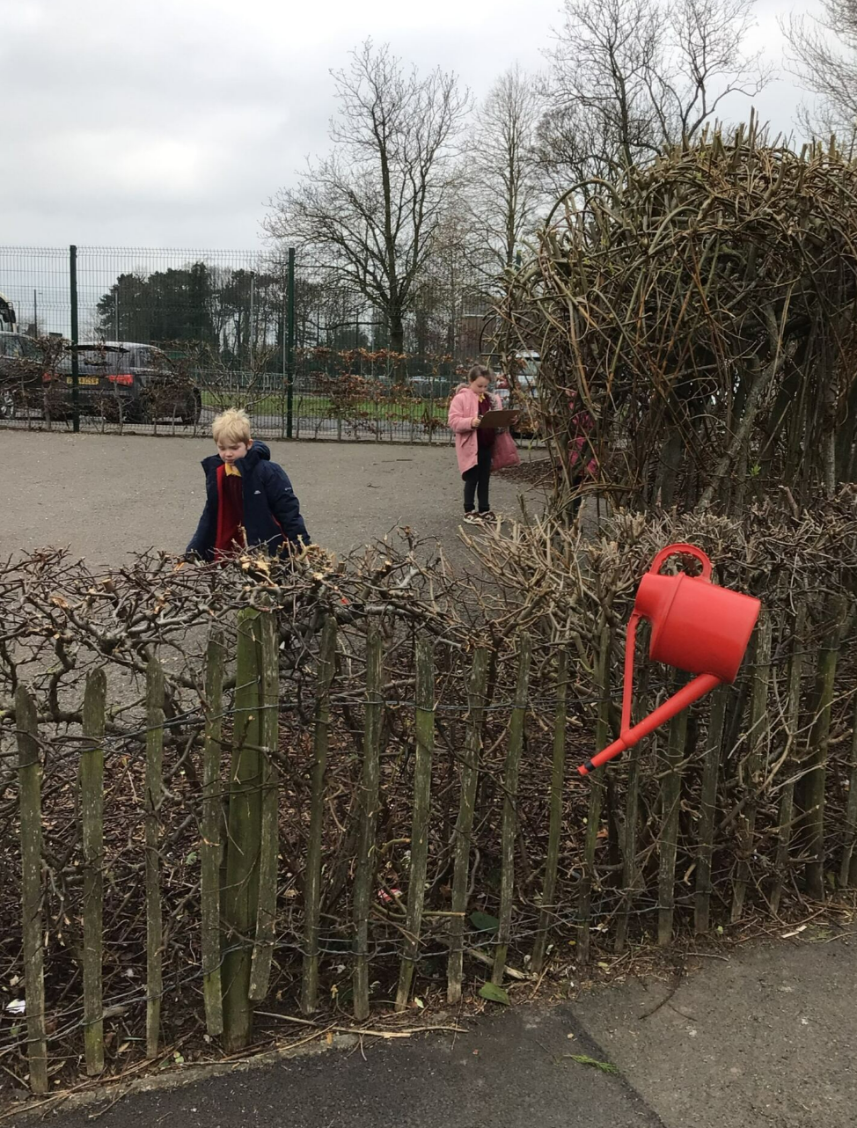
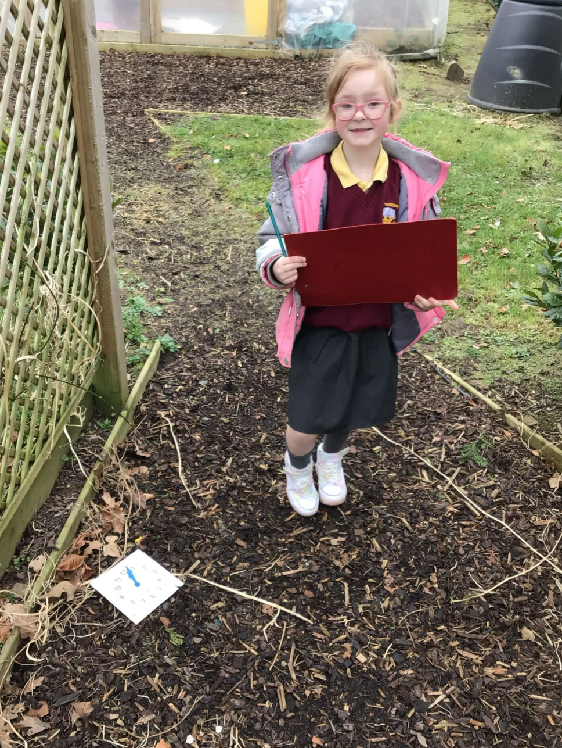

Slide 3
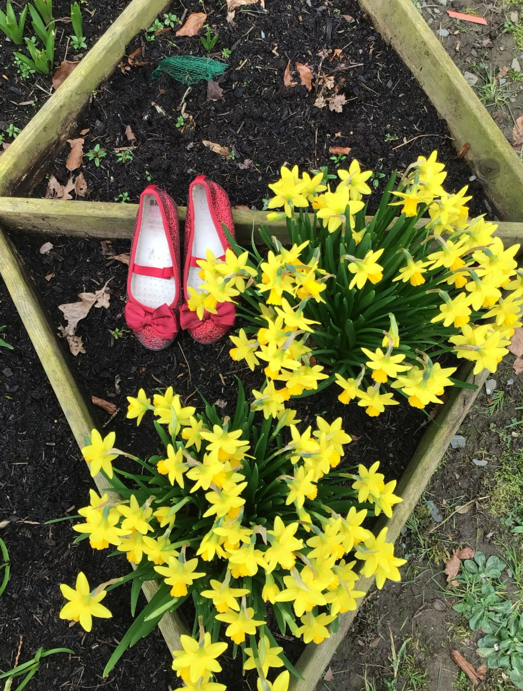
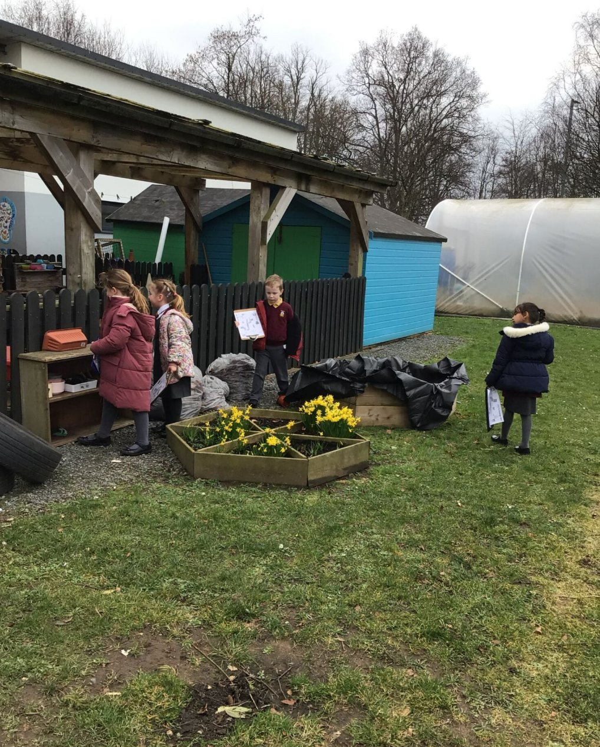

Slide 4
