Slide 1

Tiny Treasures!
P3 and P4 searched for tiny treasures. We looked at these and discussed them with our buddy. Then we used them to play a memory game. It was tricky but great fun!

Slide 2
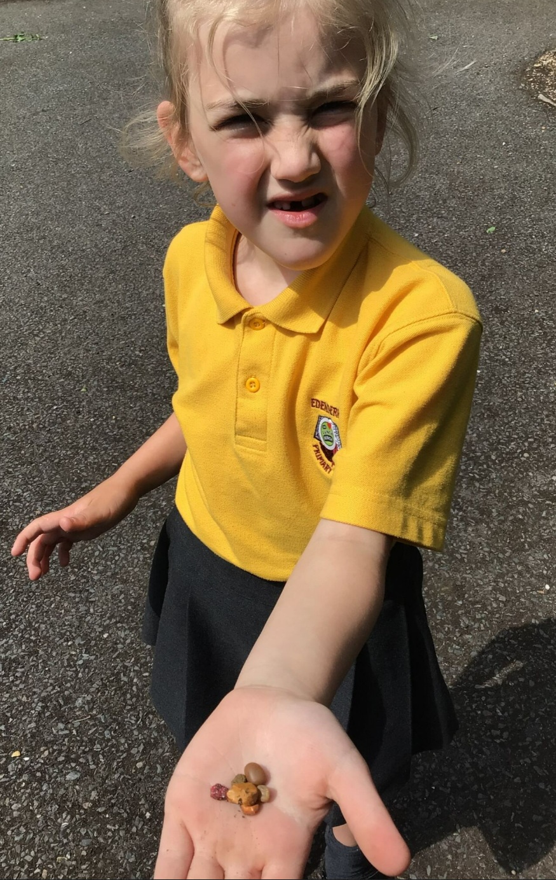
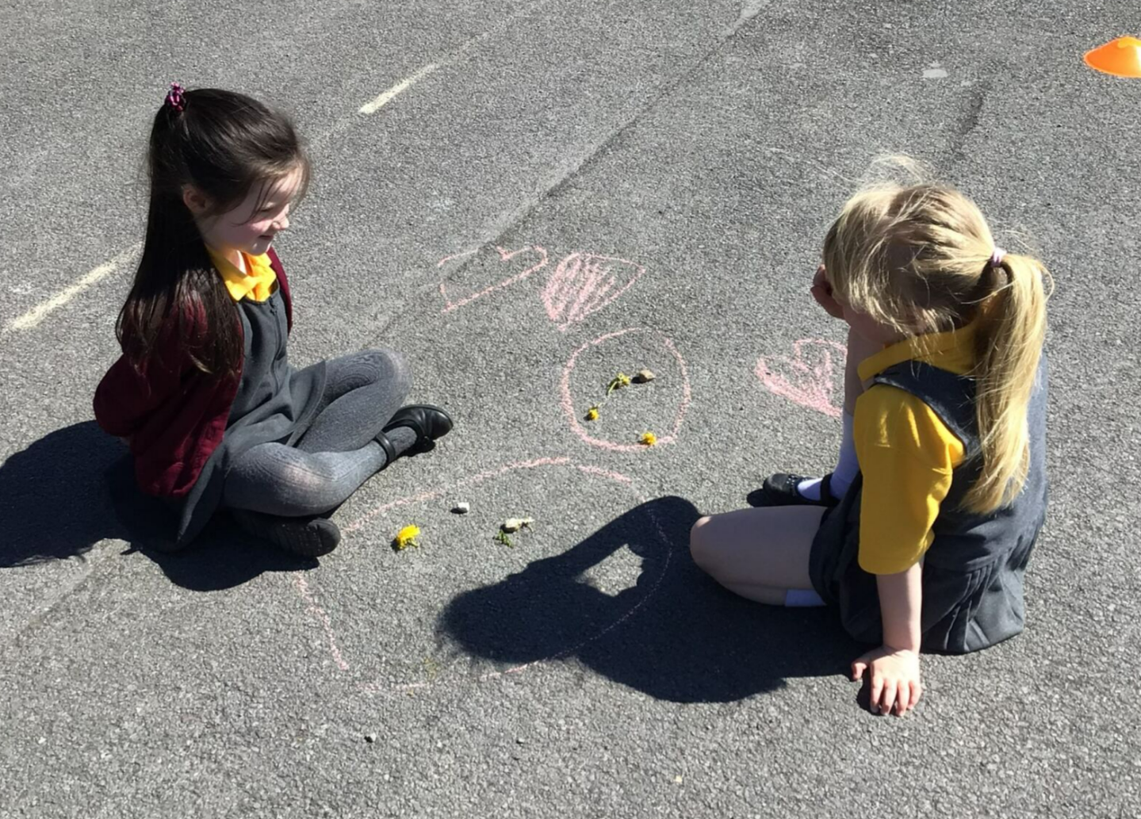

Slide 3
