Slide 1
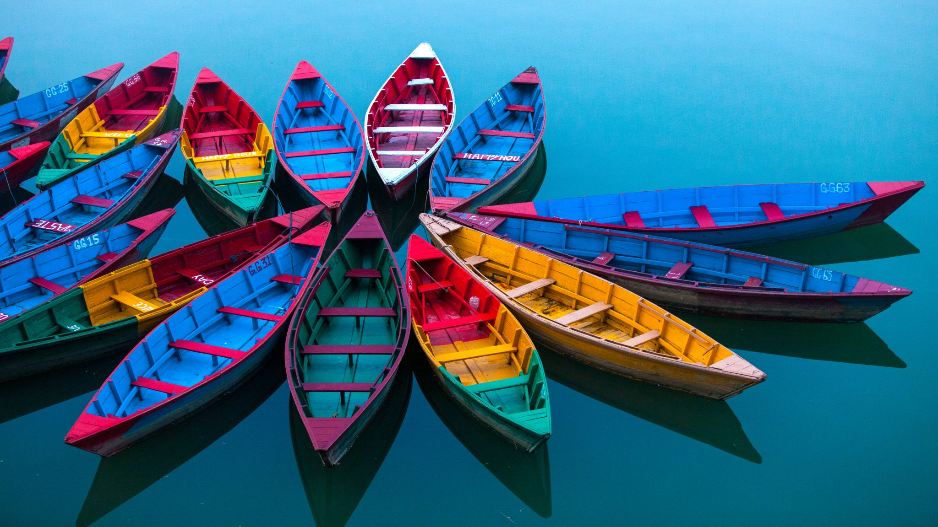
Leaf Boats
Linked to The Lighthouse Keeper’s Lunch – make a boat that will float

Slide 2
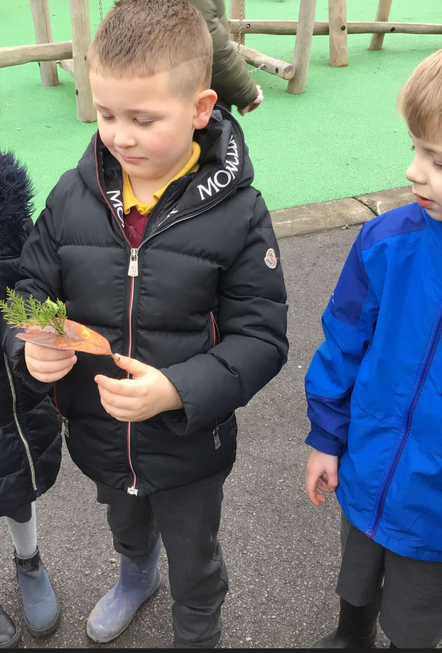

Slide 3
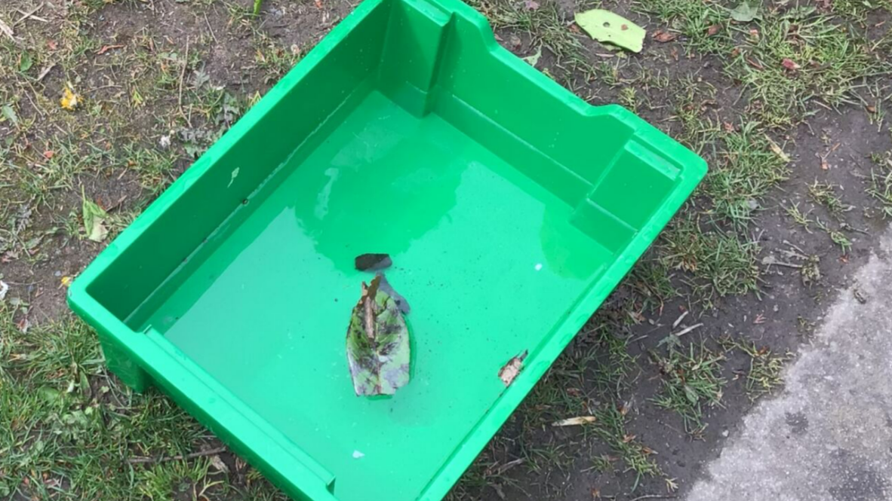

Slide 4


