Slide 1
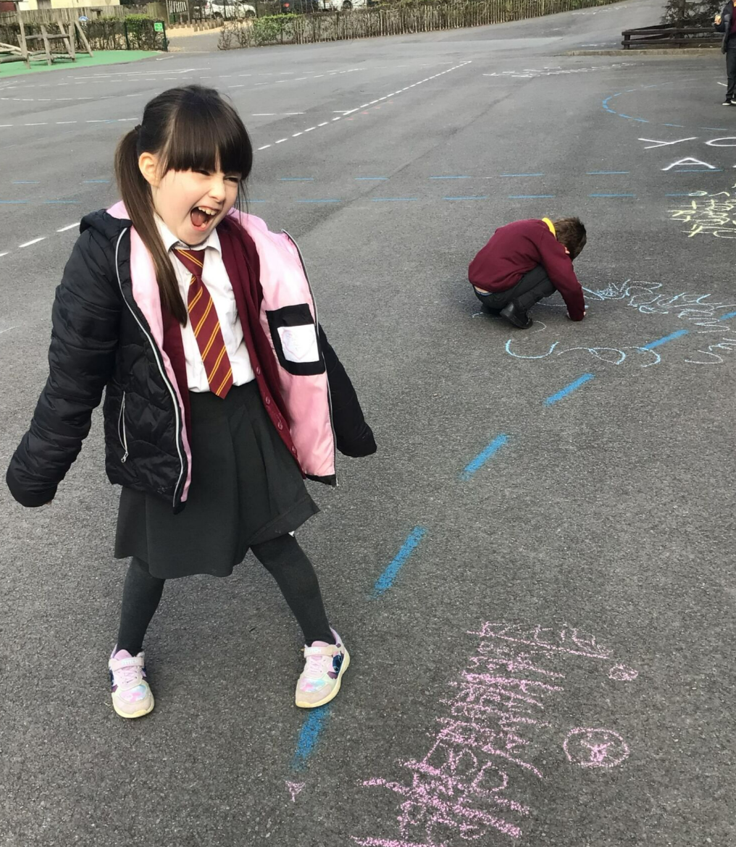
When spelling tests inside are too overwhelming…..we take it outside!

