Slide 1
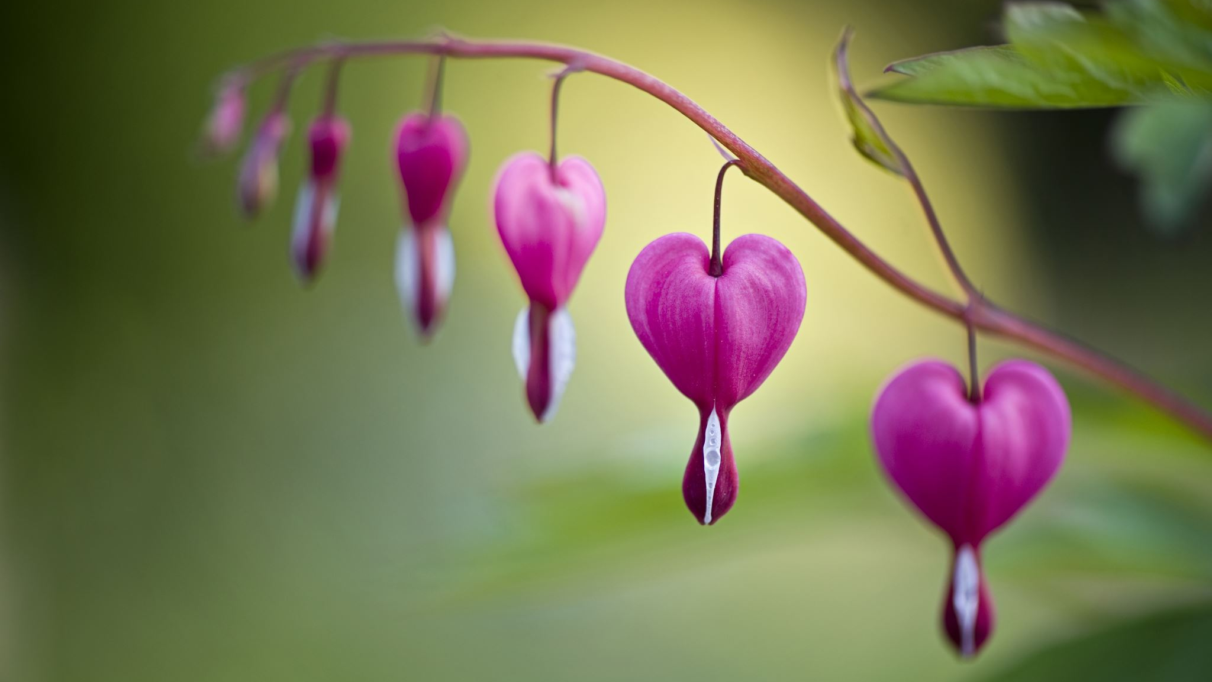
Valentines Day Clay Hearts and Nature Hearts – A Full Day Outdoors

Slide 2
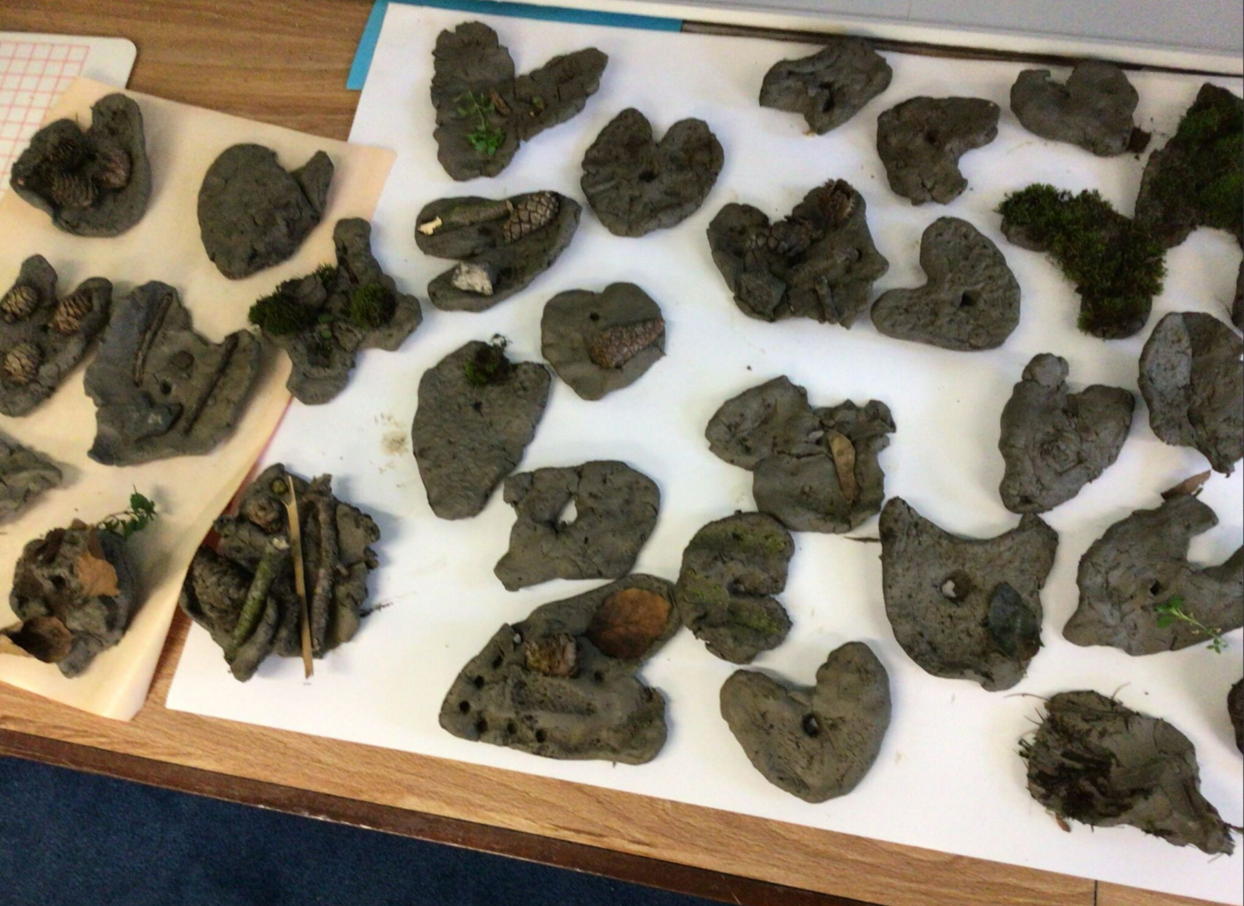

Slide 3
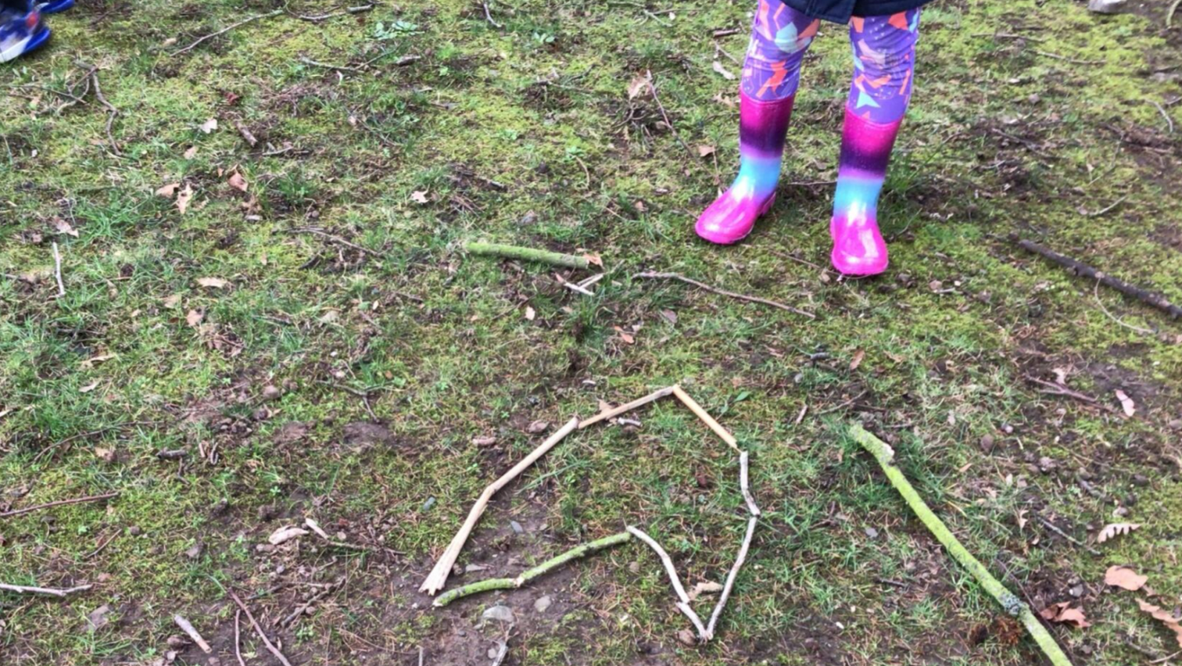

Slide 4
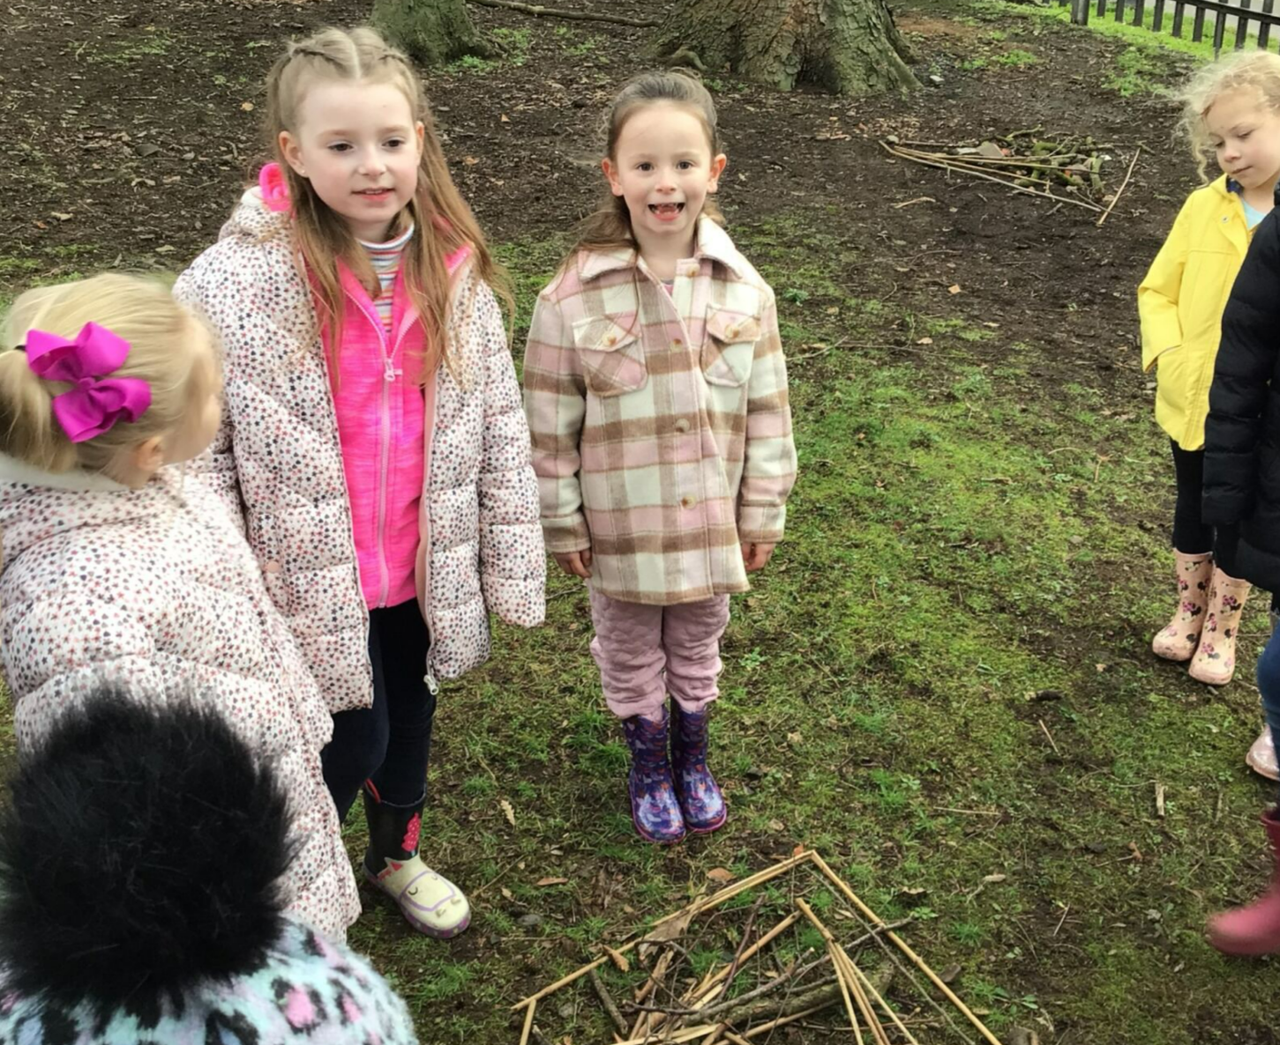

Slide 5
