Slide 1
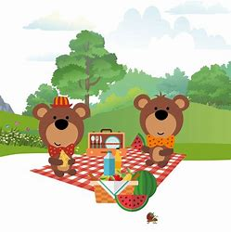
Forest School St. Trea’s PS Teddy Bear’s Picnic 8th May

Slide 2
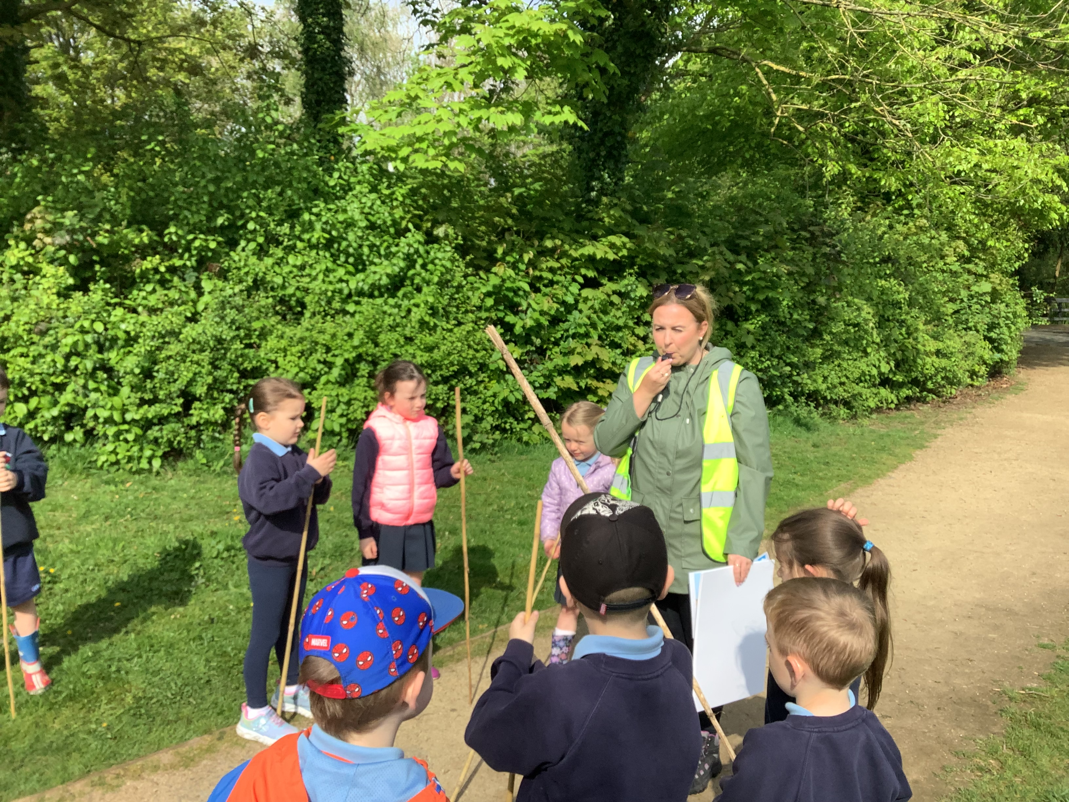
RULES
We went over our Forest School rules:
1 whistle: freeze like a tree
2 whistles: back to base
3rd rule: have fun and learn.

Slide 3
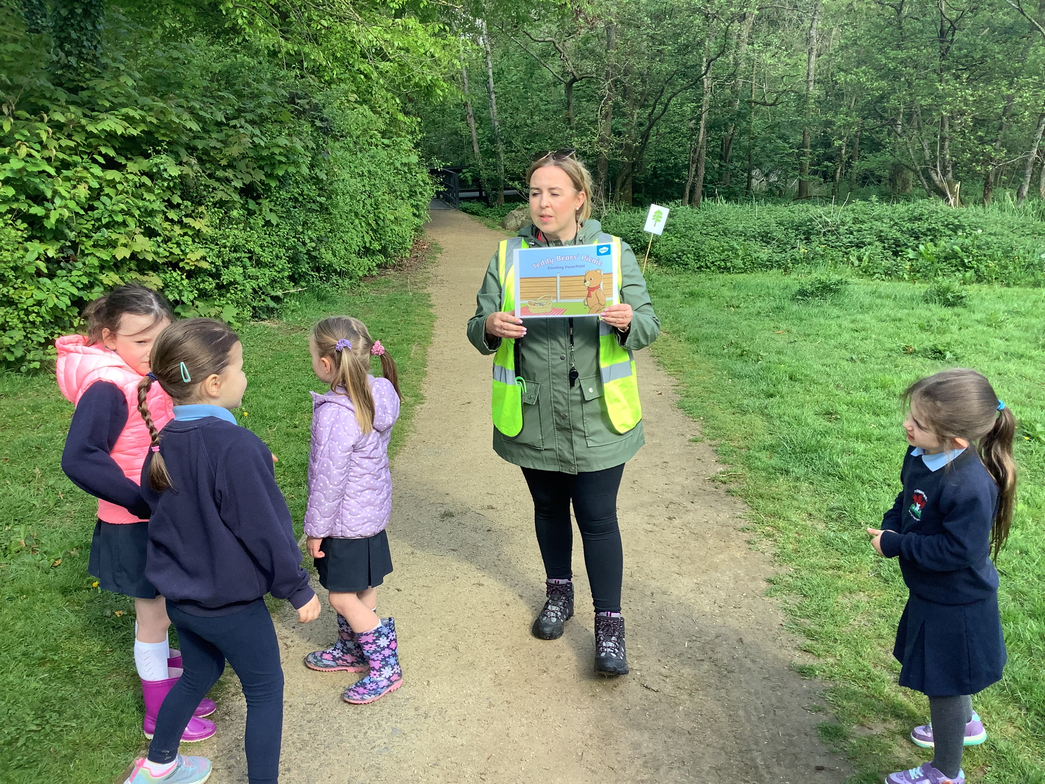
RULES We put up boundaries around the area we were using.

Slide 4
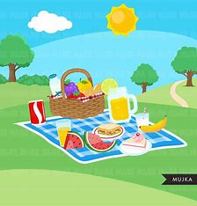
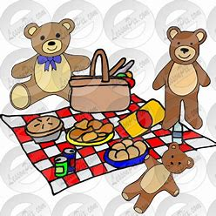
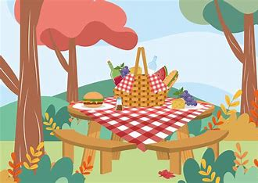
Teddy Bear’s Picnic
We discussed all the different things we would need for a nice picnic.
We talked about various picnic foods.

Slide 5
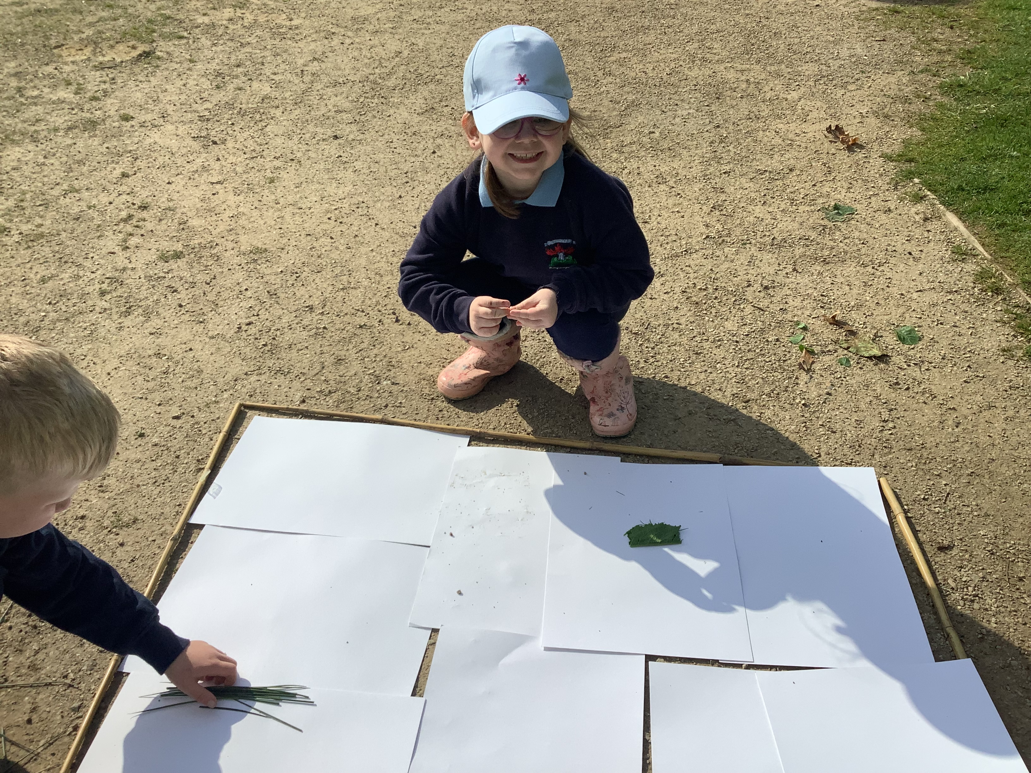
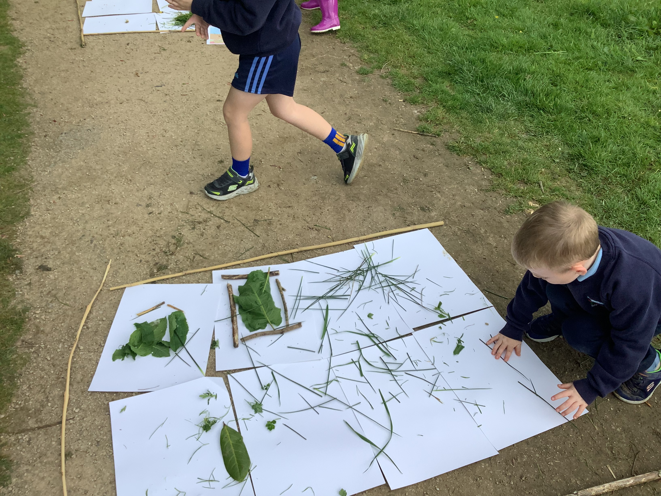
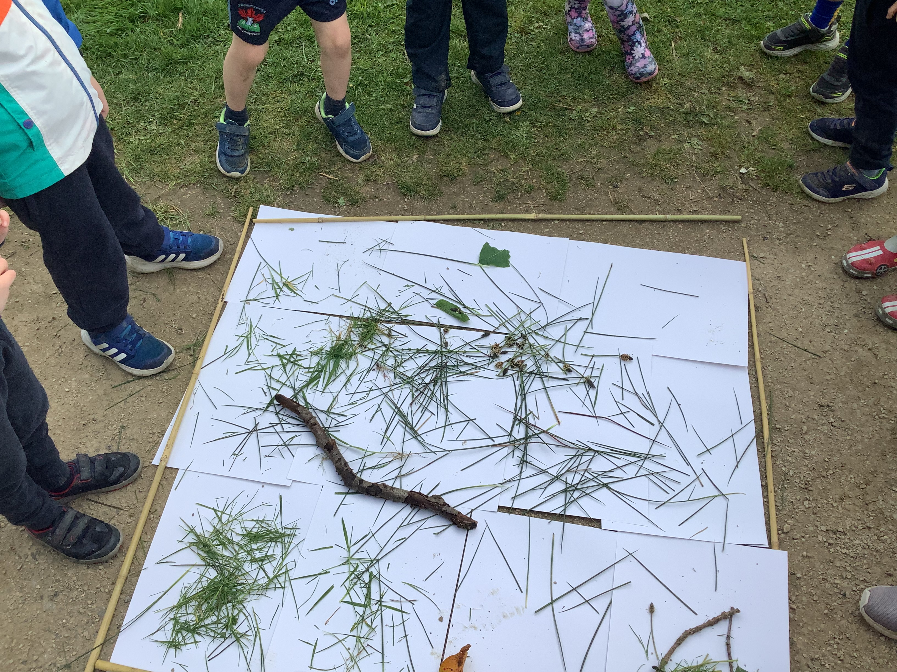
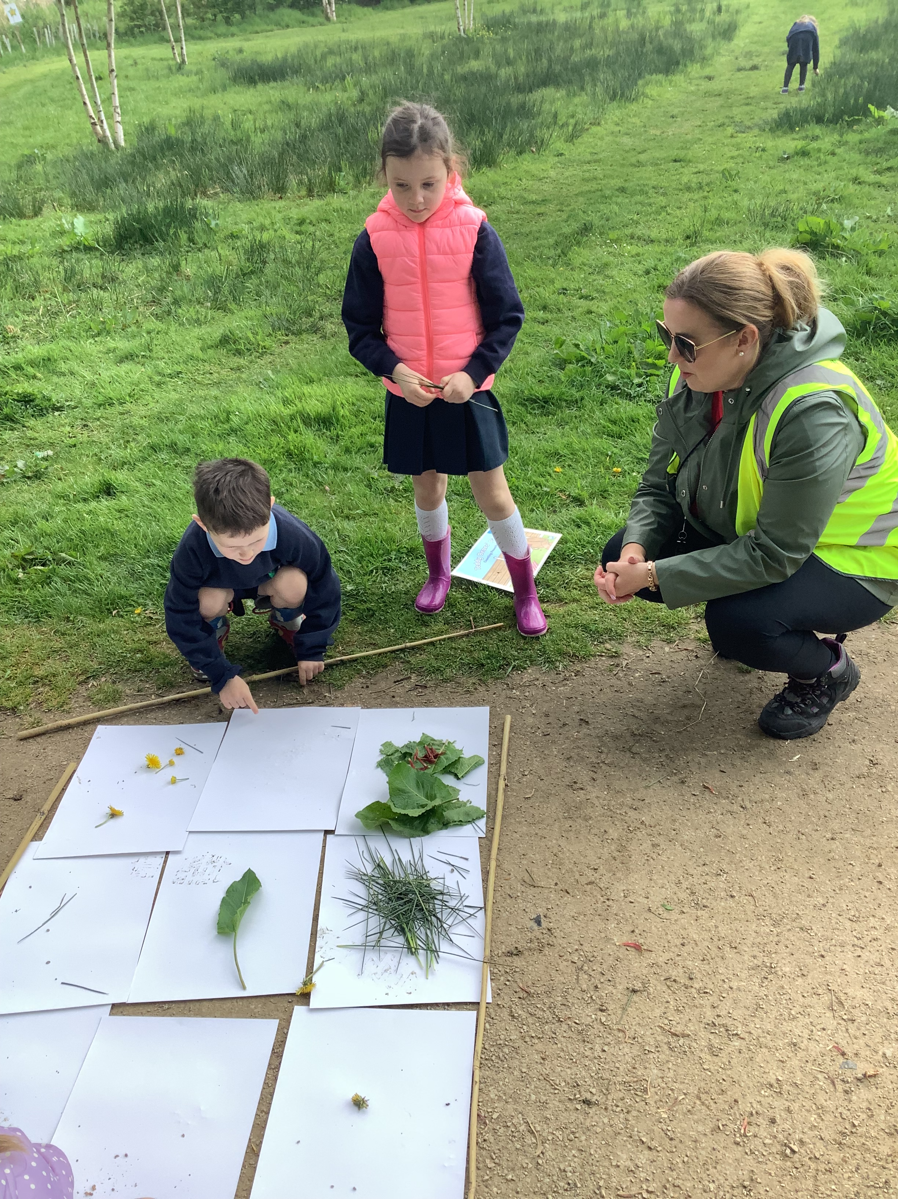
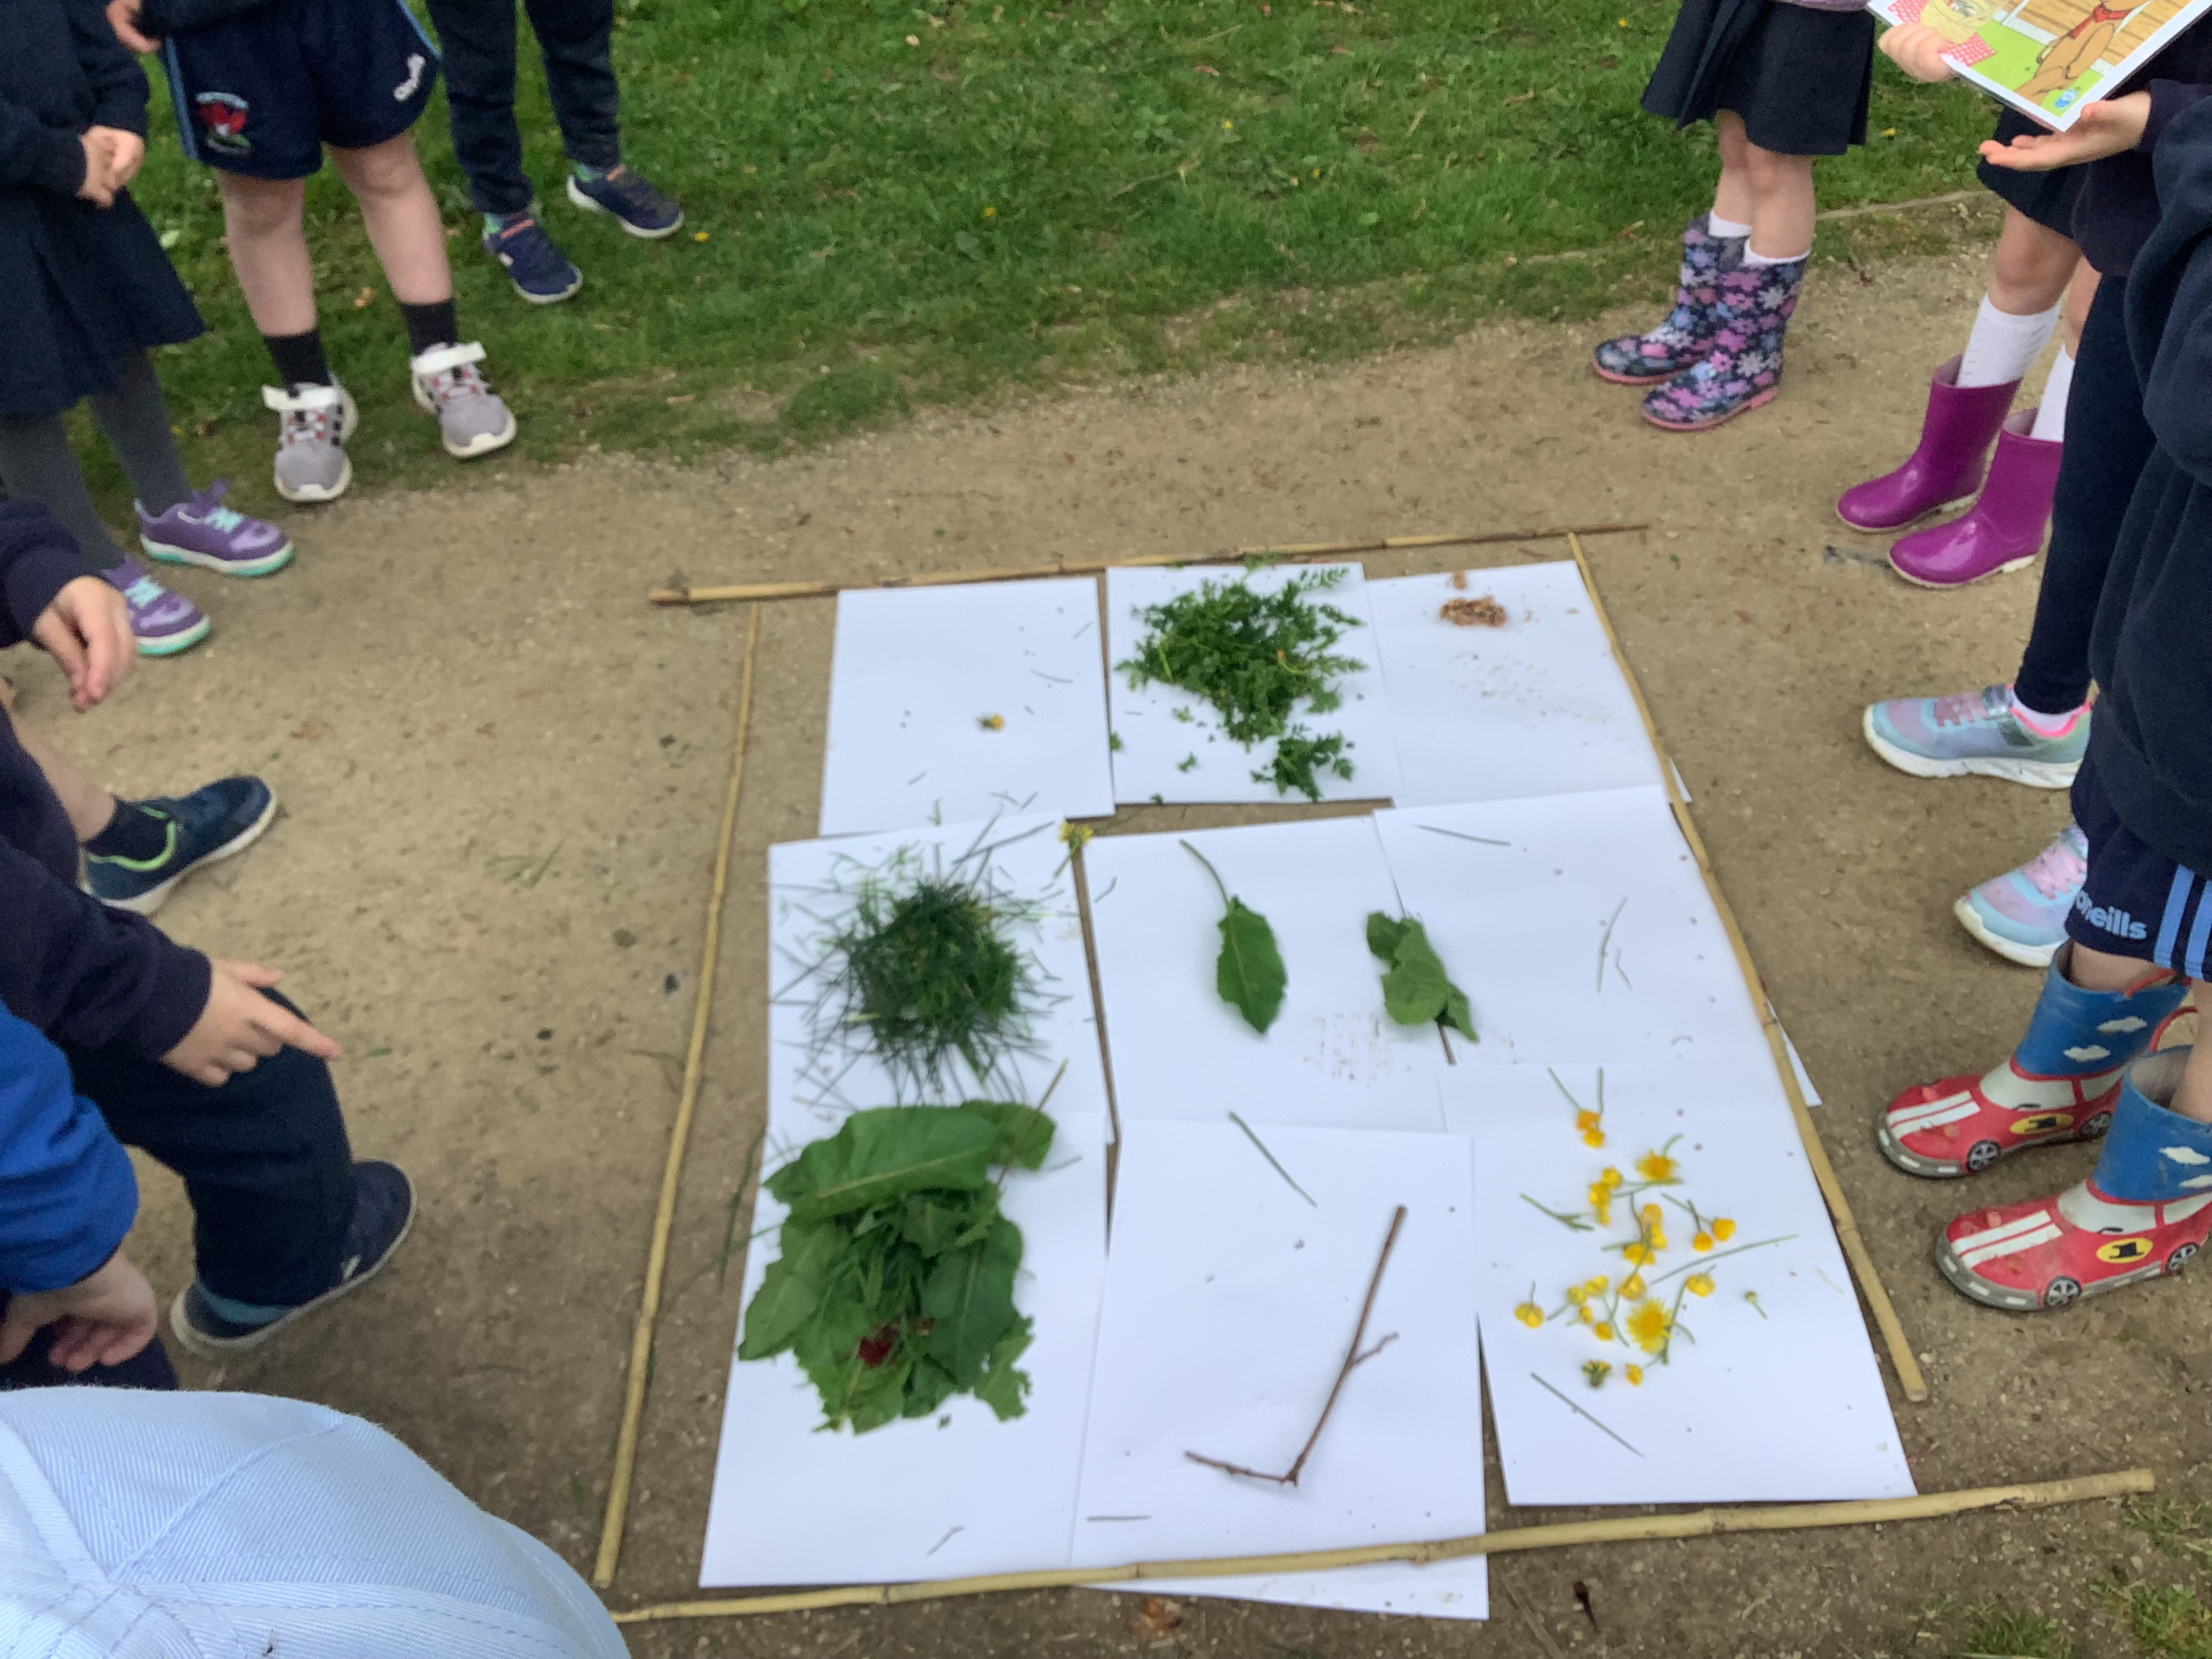
Teddy Bear’s Picnic
We started to build our own versions of the perfect Teddy Bear’s Picnic.
We represented lots of different picnic items with natural materials, such as, picnic blankets, baskets, benches and various picnic foods.

Slide 6
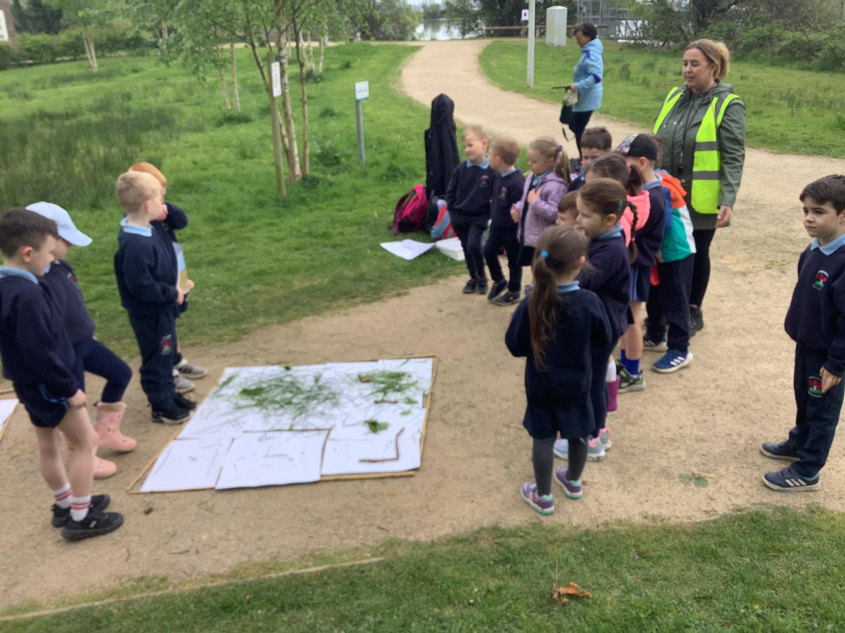
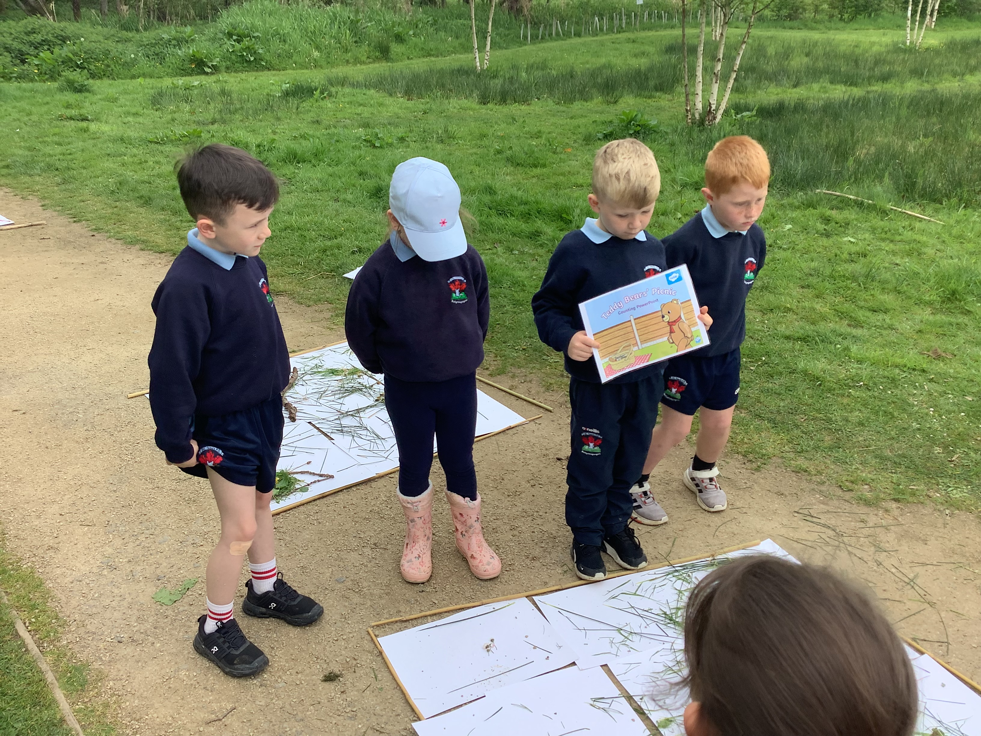
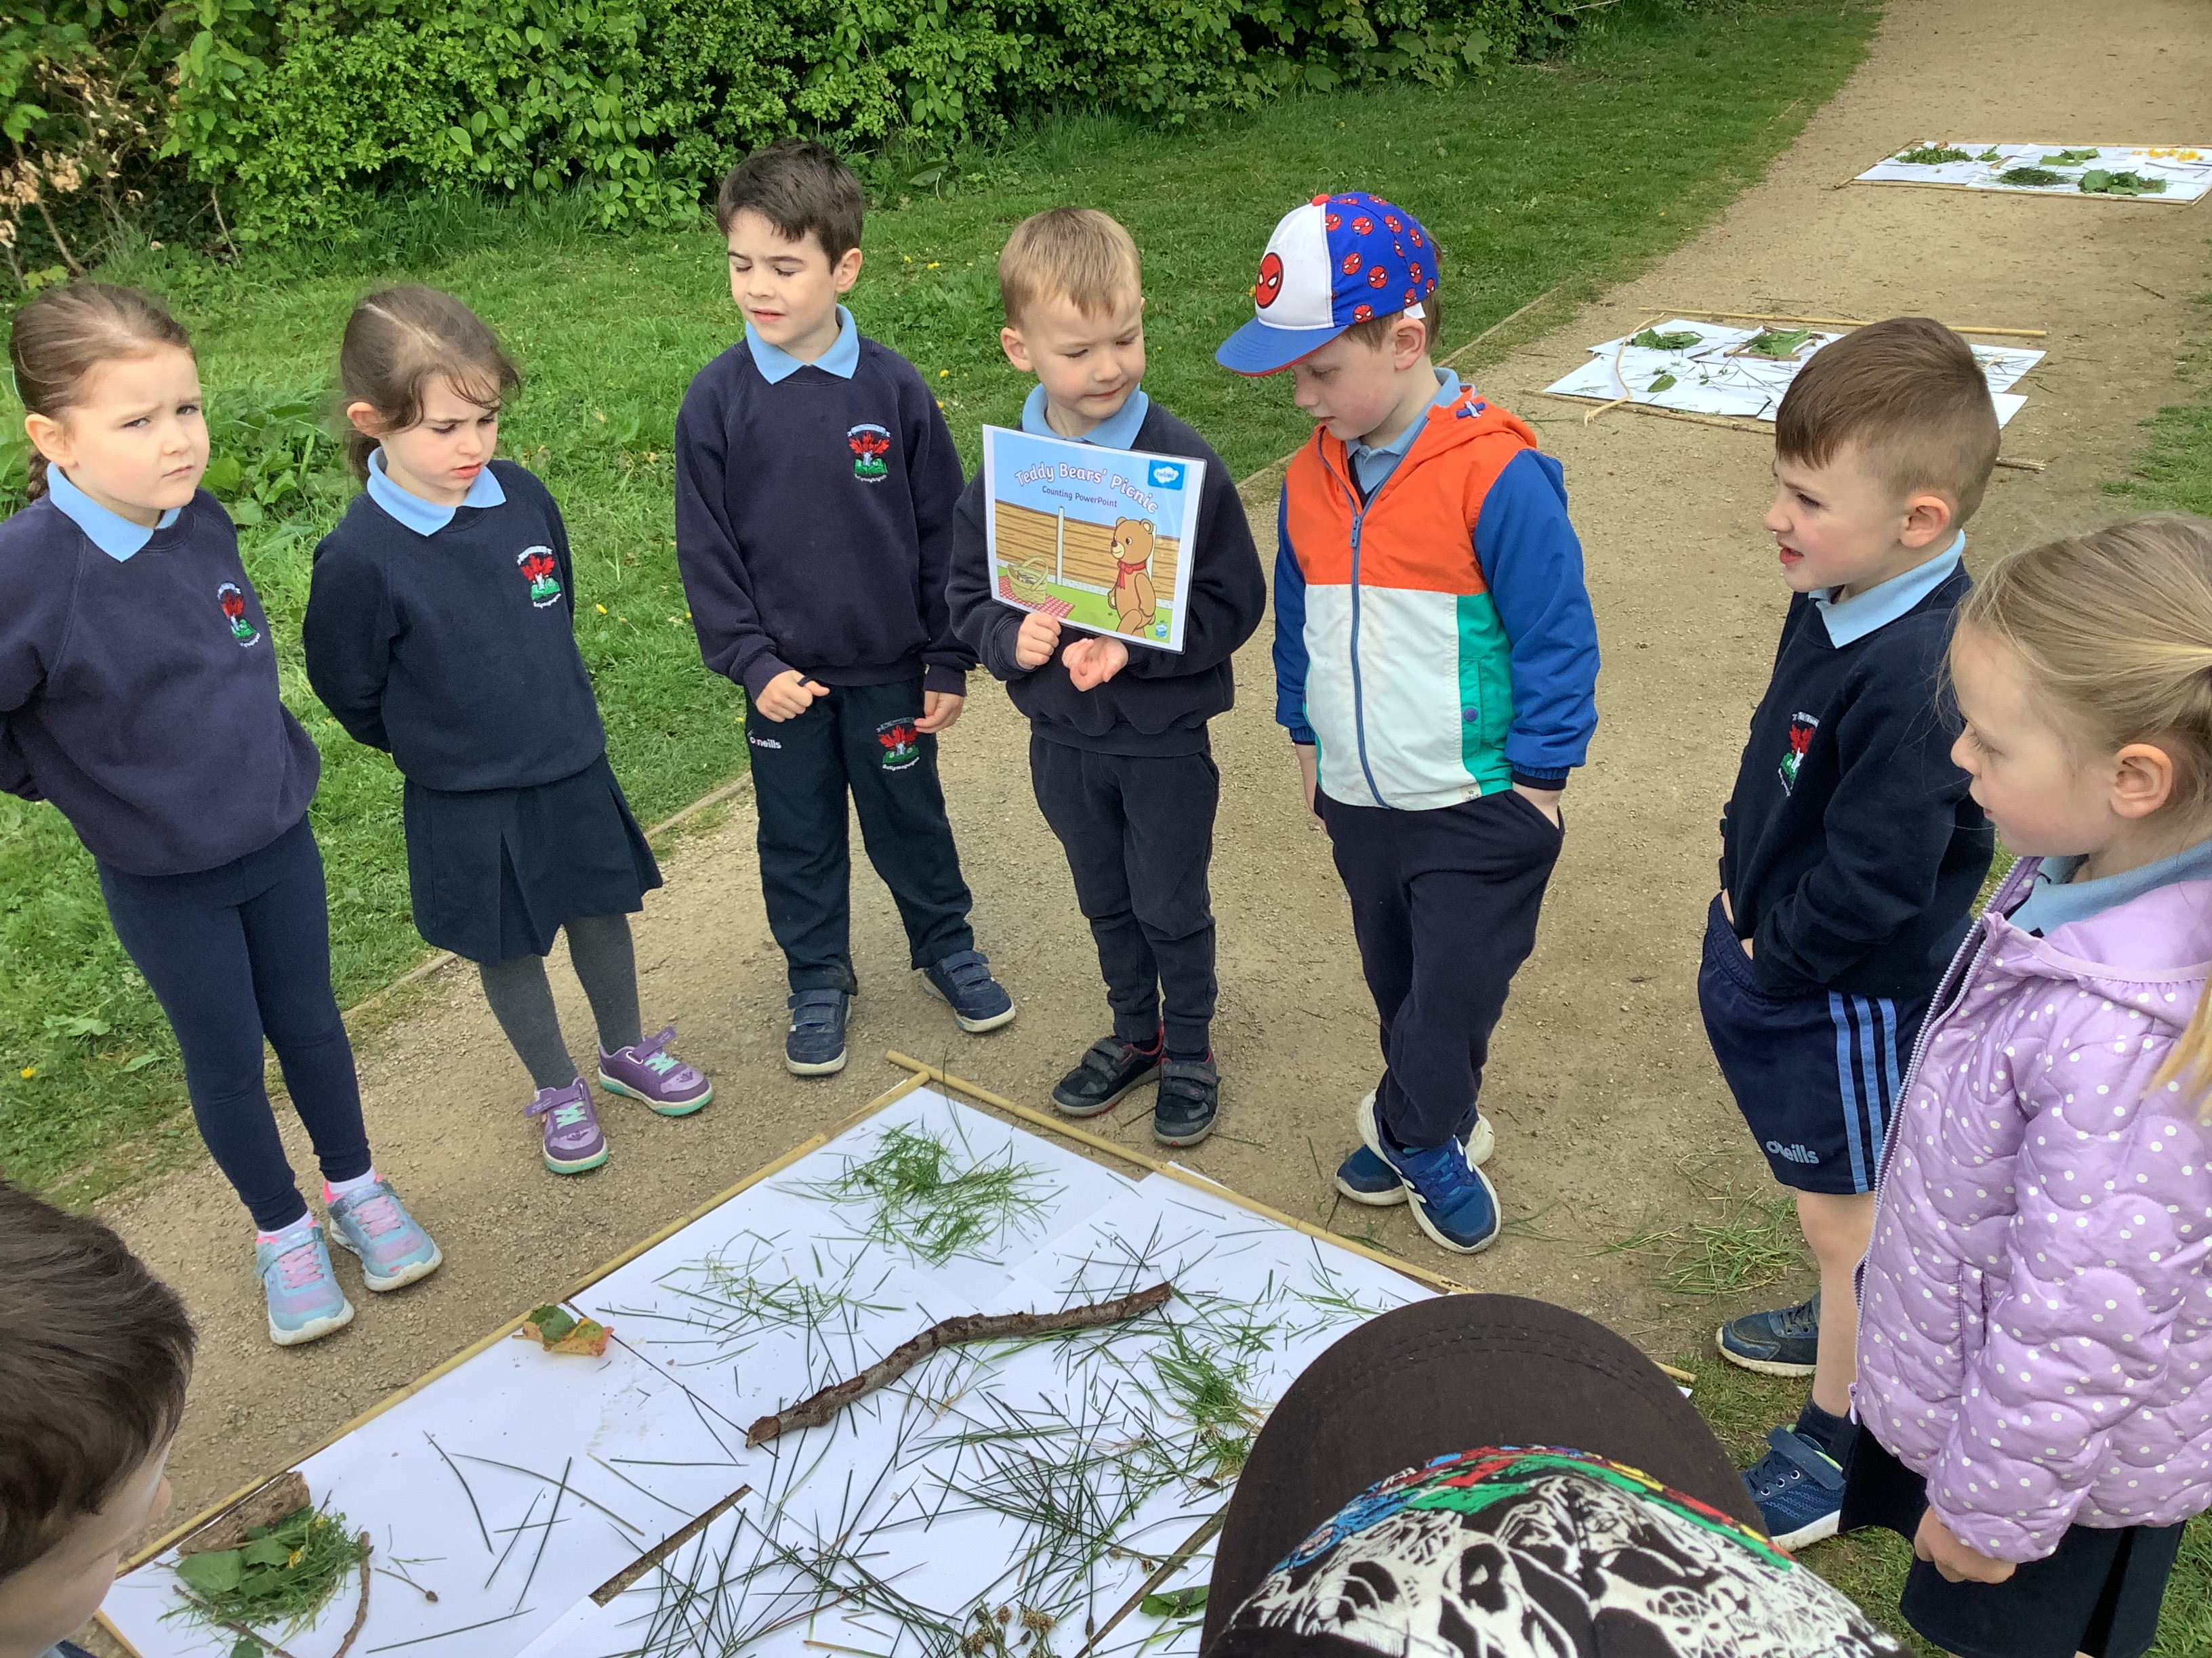
Teddy Bear’s Picnic
We worked in teams, and we discussed our creations at the end of our lesson.

Slide 7
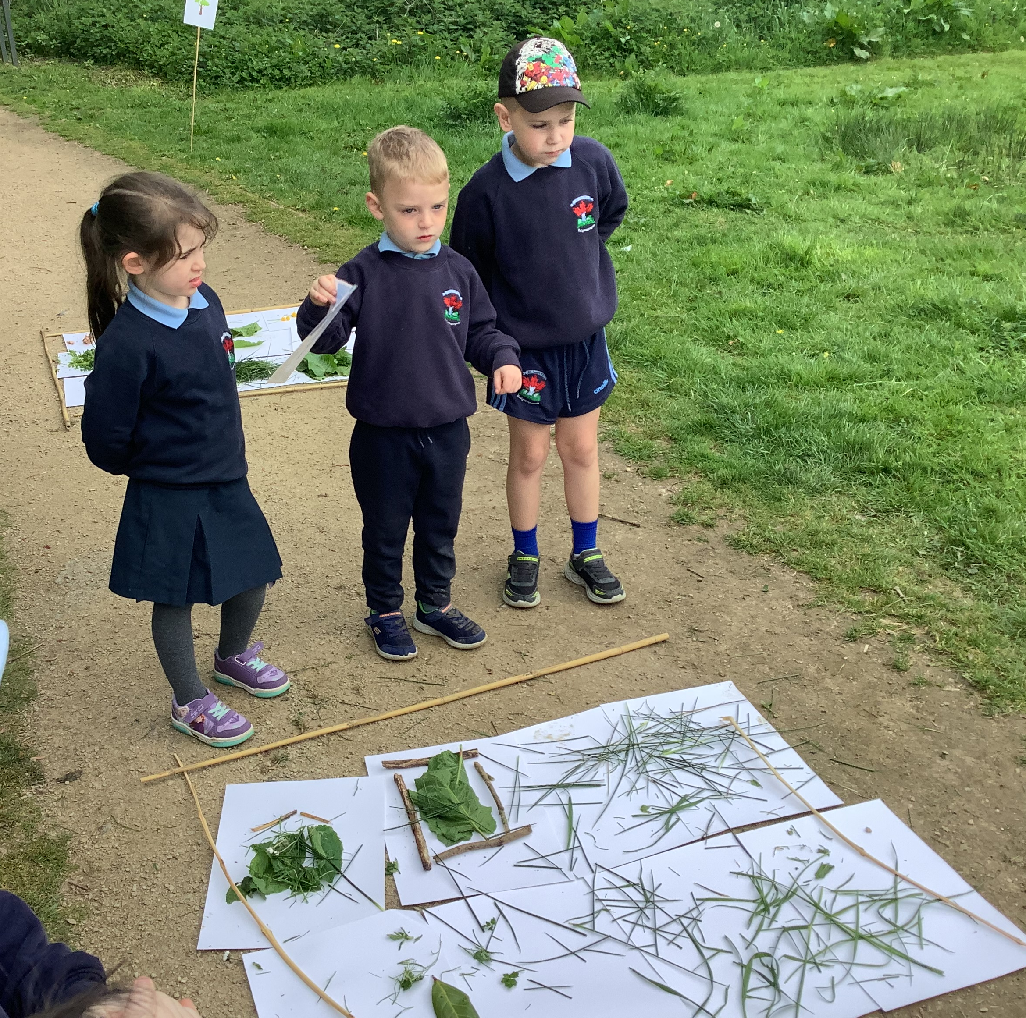
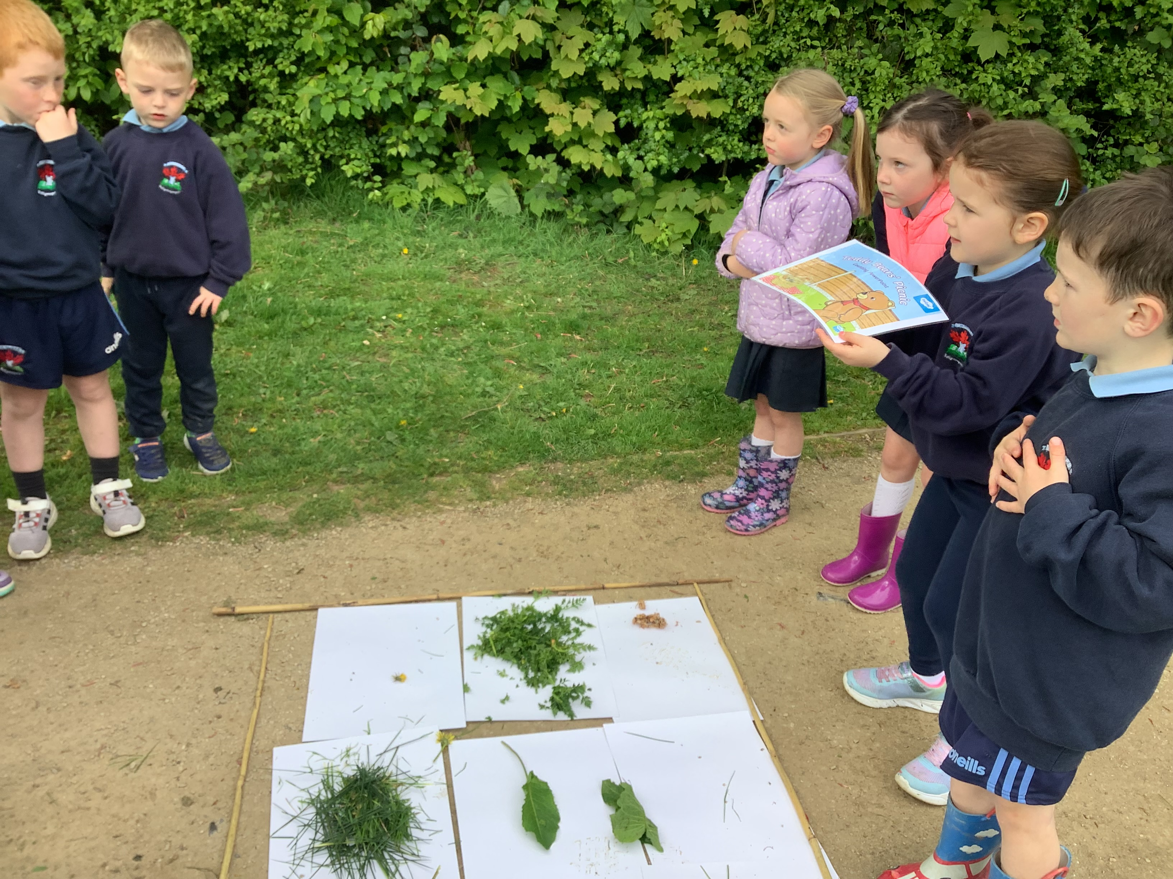
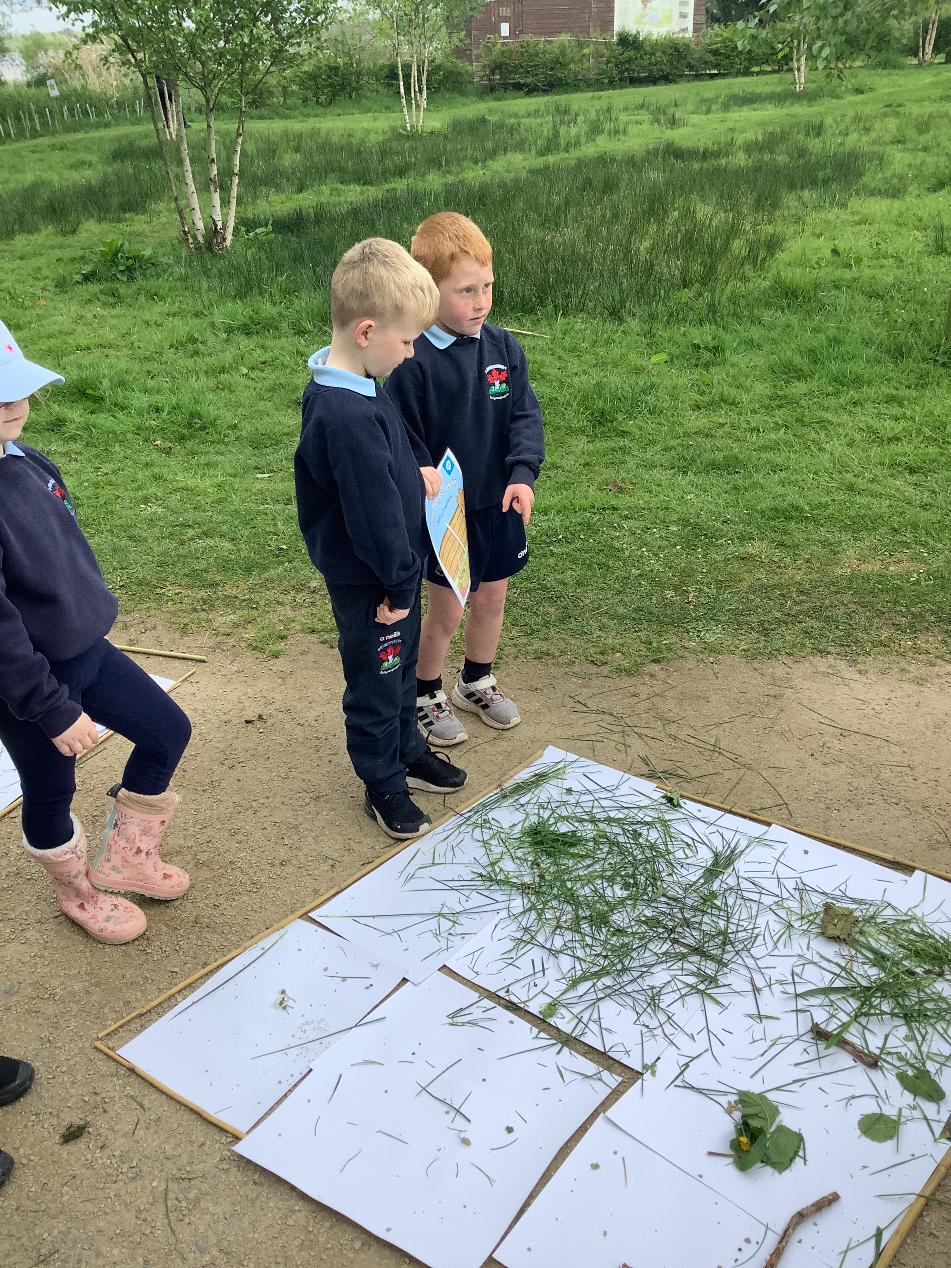
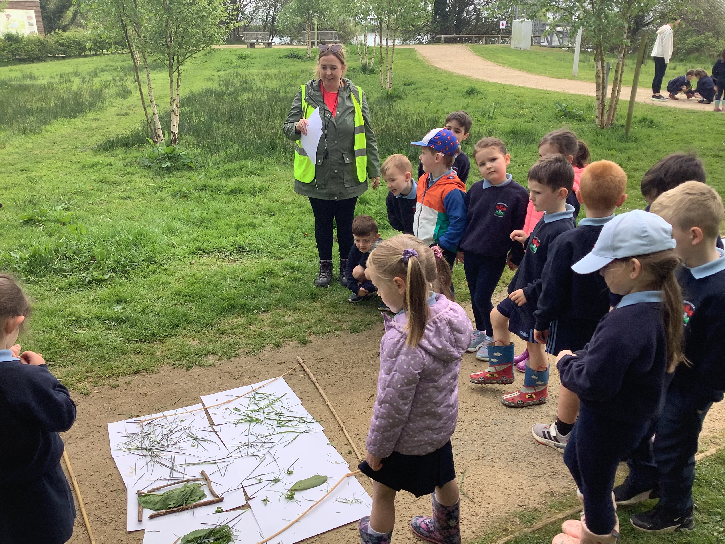
We were so excited to share what we created!

Slide 8
LEAVE NO TRACE
We collected the boundaries and tidied the resources to leave the place as we found it.

Slide 9
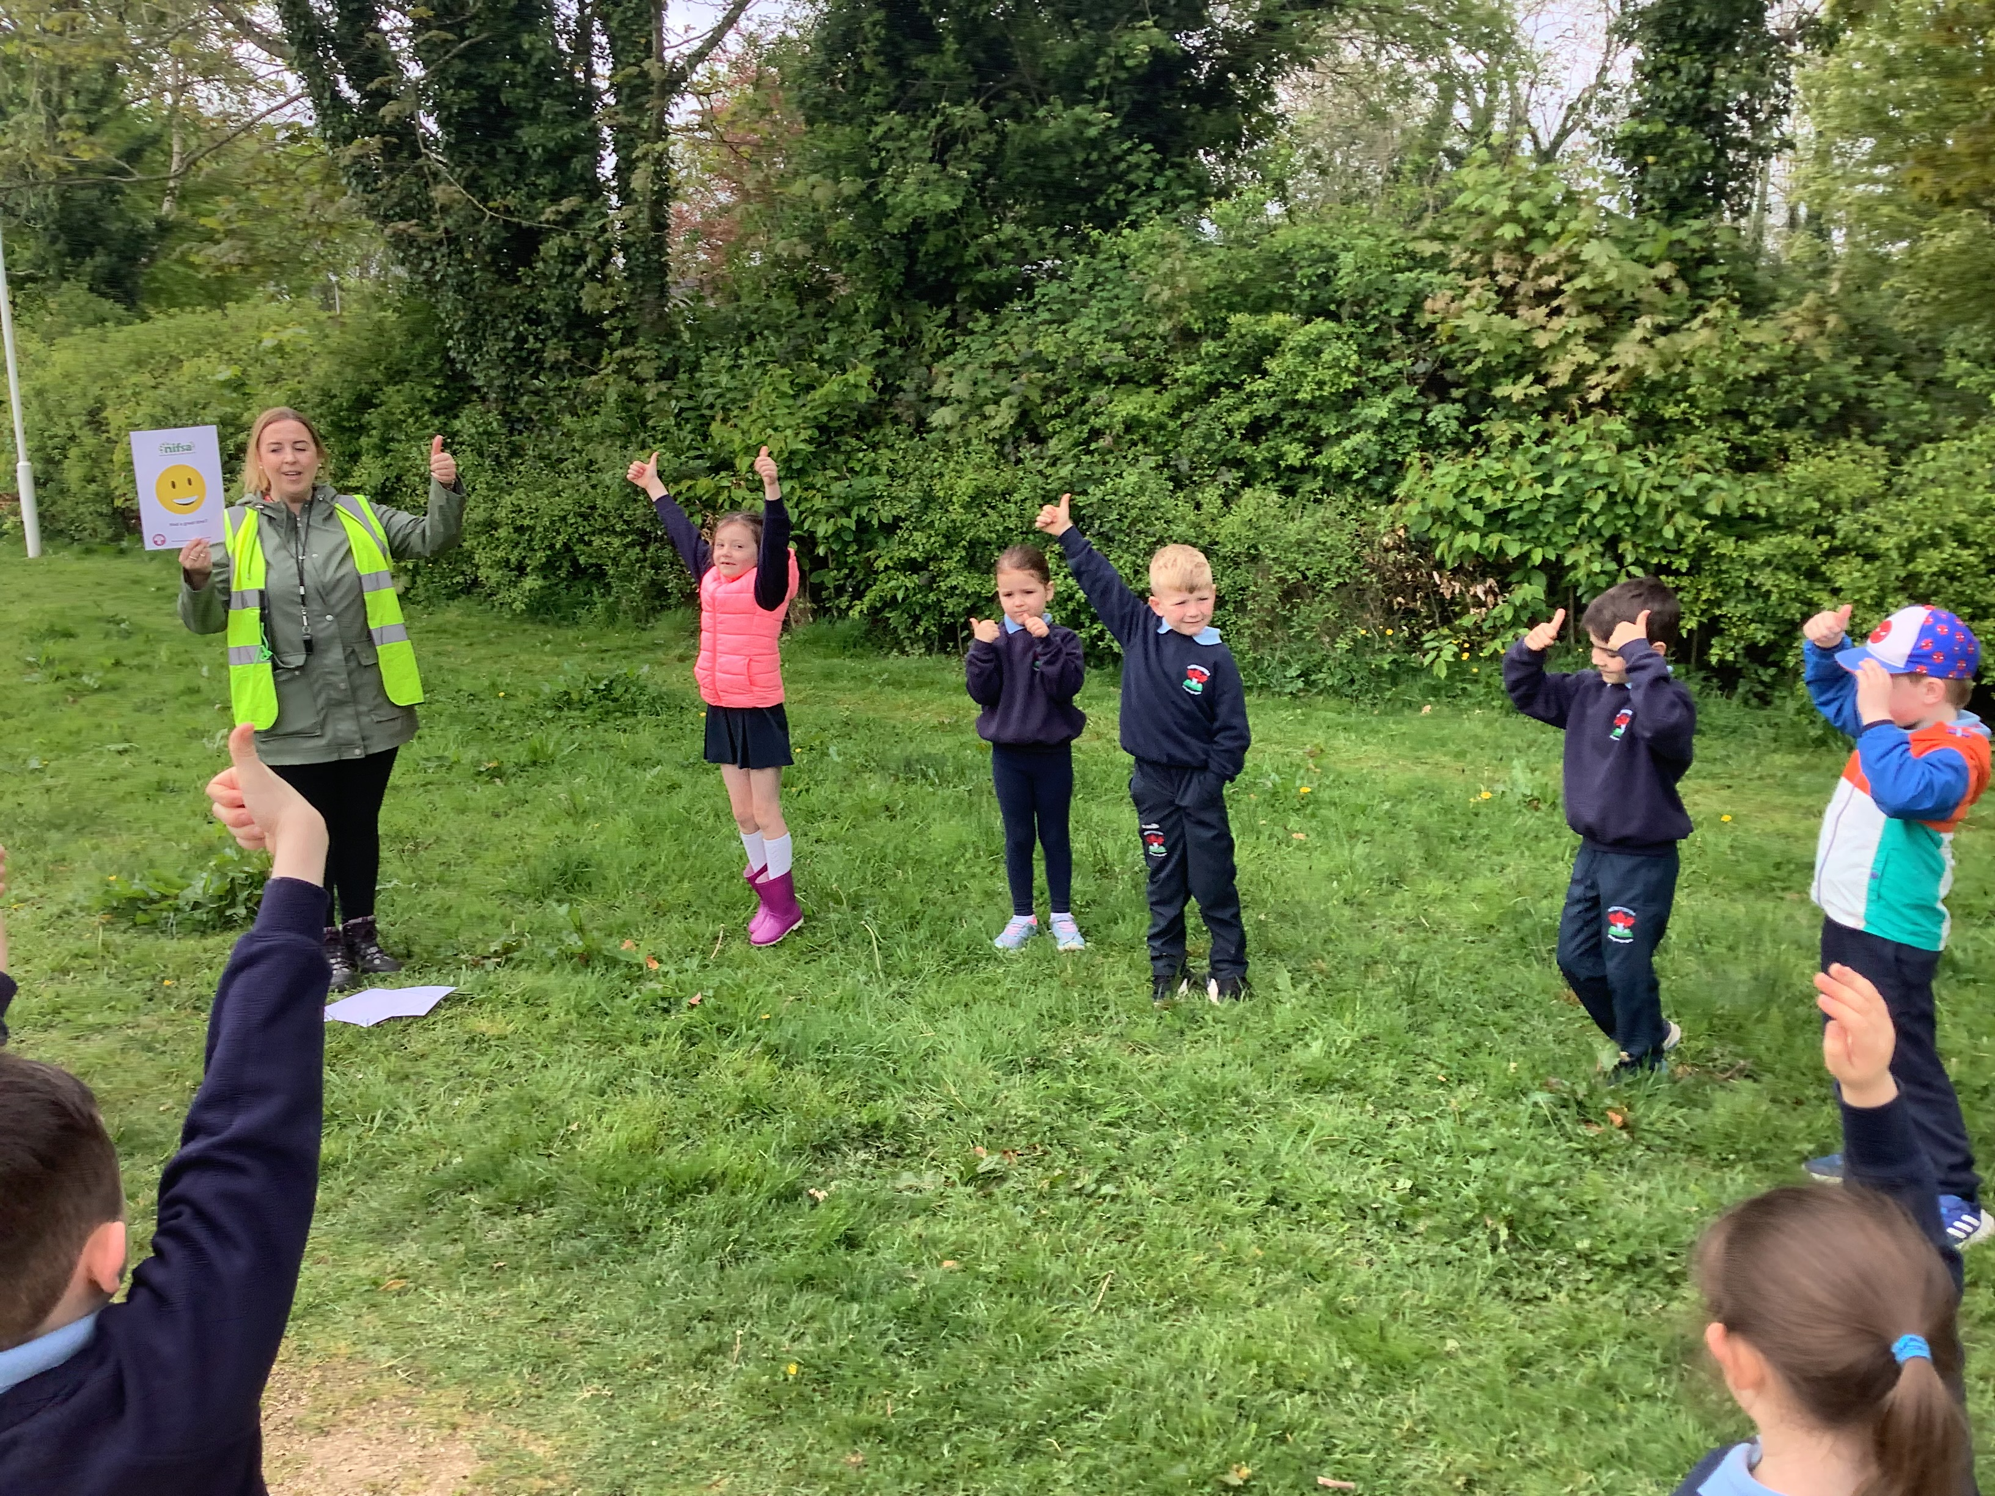
DID YOU ENJOY IT?
We gave feed back on what we thought of our lesson today.
We loved it!

