Slide 1
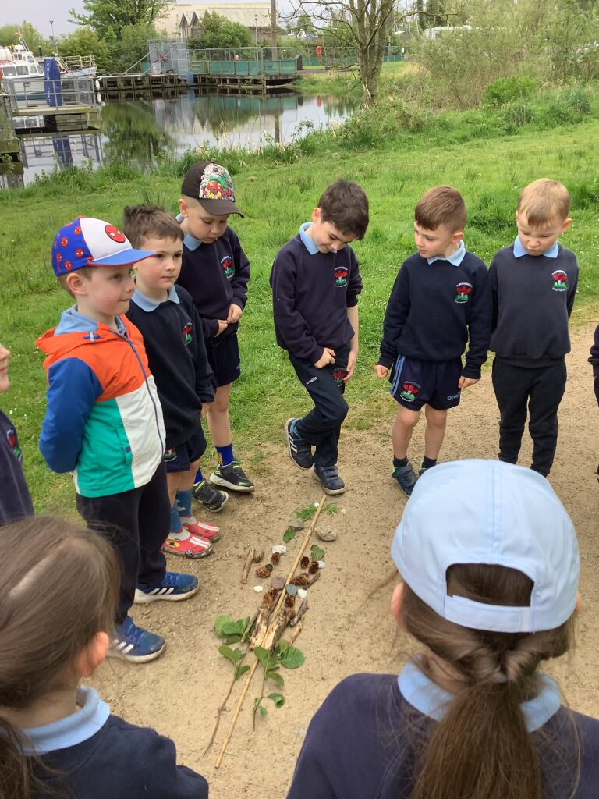
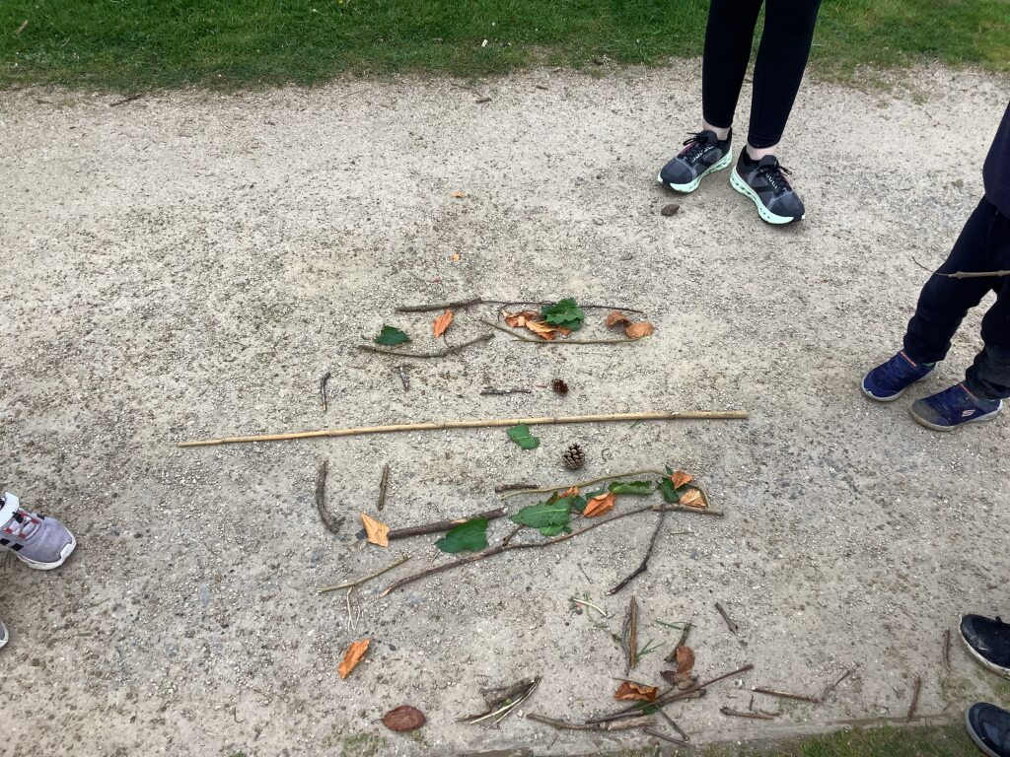
St Trea’s P.S
Our Forest Schools Diary 28th March 2025
Symmetry

Slide 2
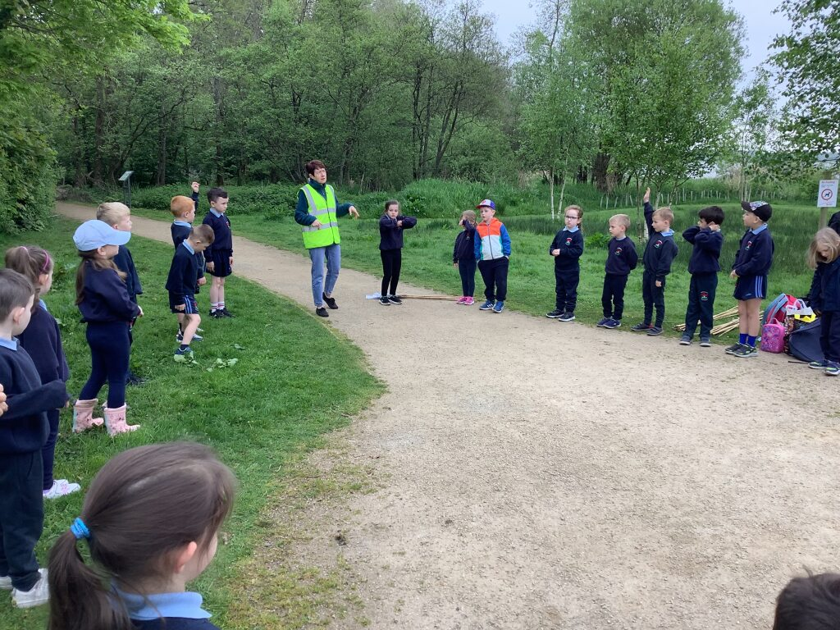
RULES
First we went over the rules:
One whistle – freeze.
Two whistles – return to base.
Have Fun!

Slide 3


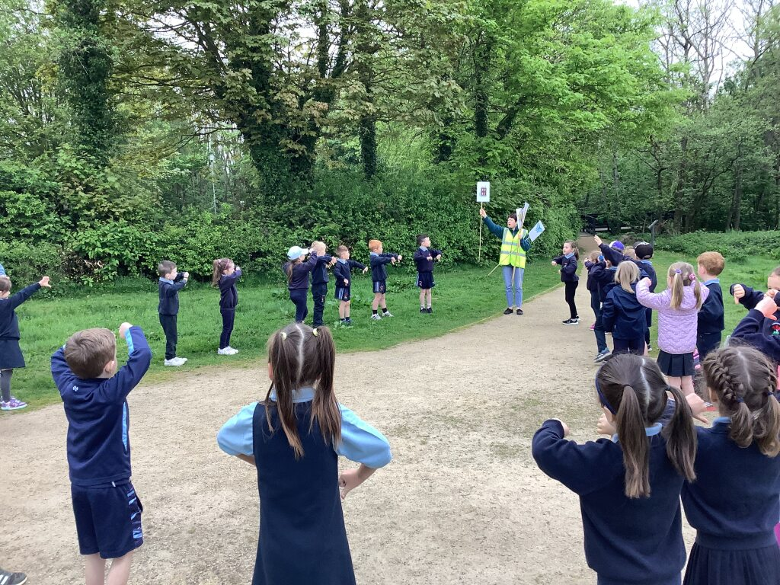
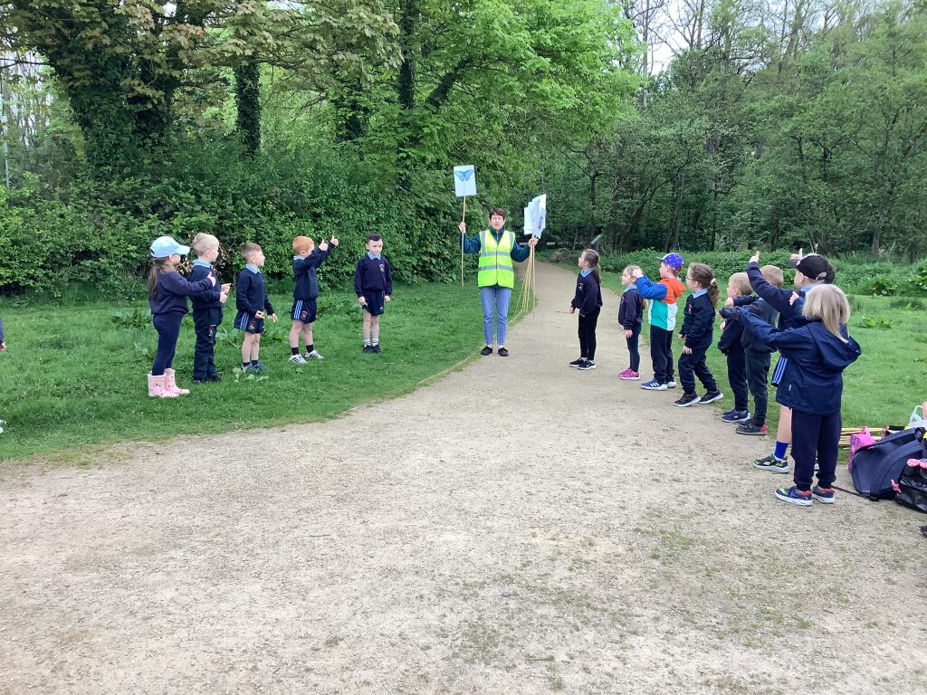
symmetrical or not symmetrical
We looked at some pictures to see if they were symmetrical or not symmetrical.

Slide 4
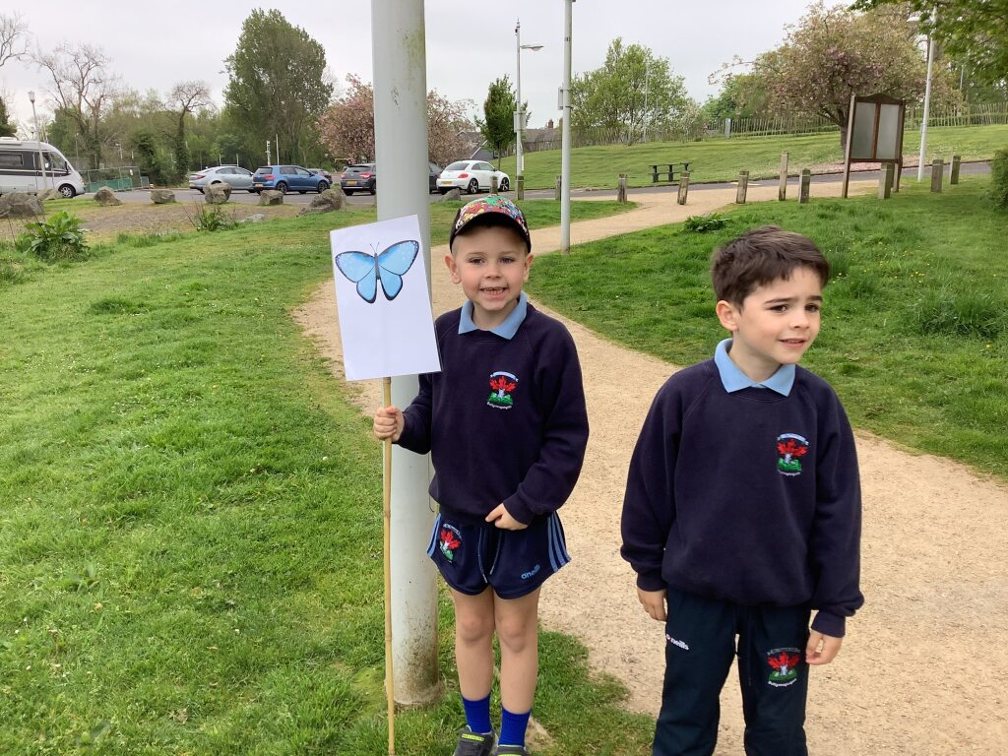
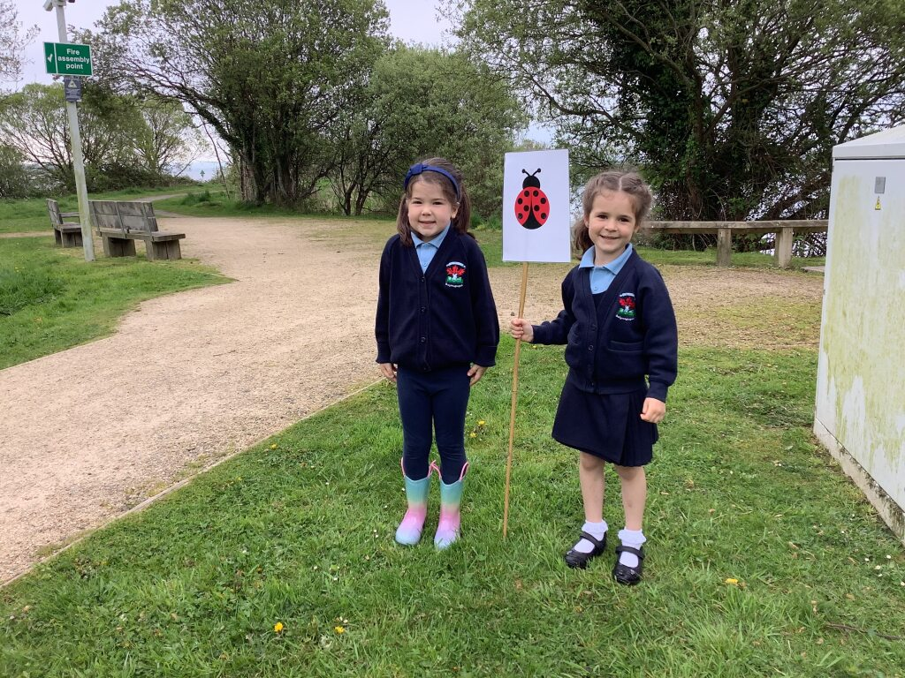
RULES
We put up boundaries around the area we were working in.

Slide 5
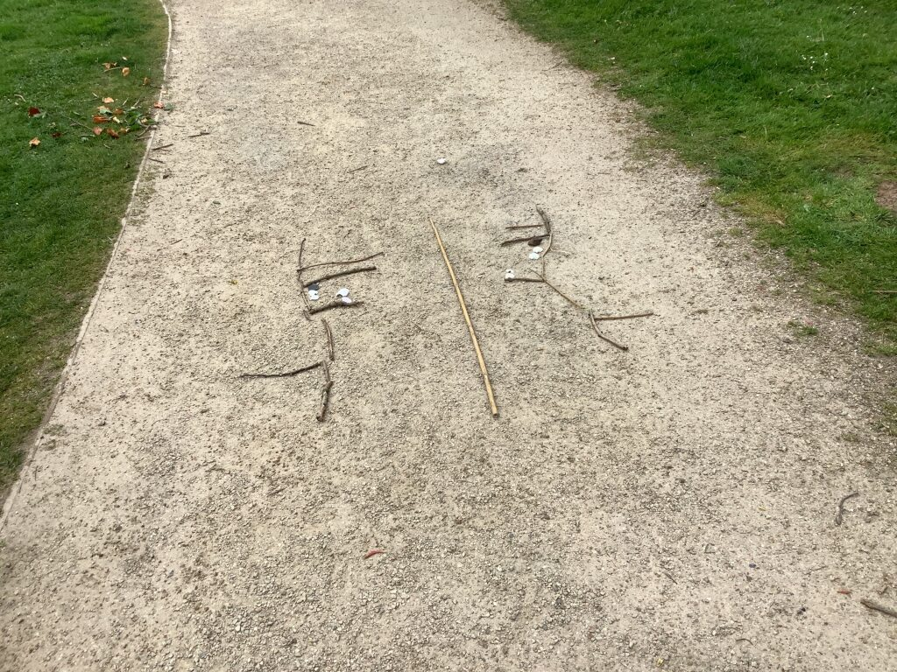
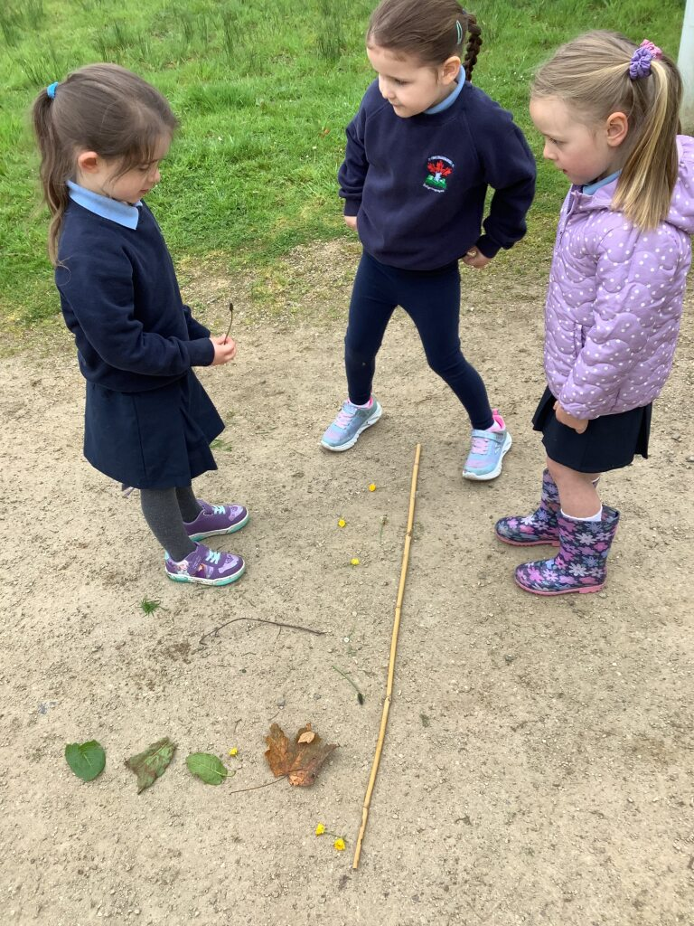
Symmetry activity
We worked in groups to make symmetrical pictures.

Slide 6
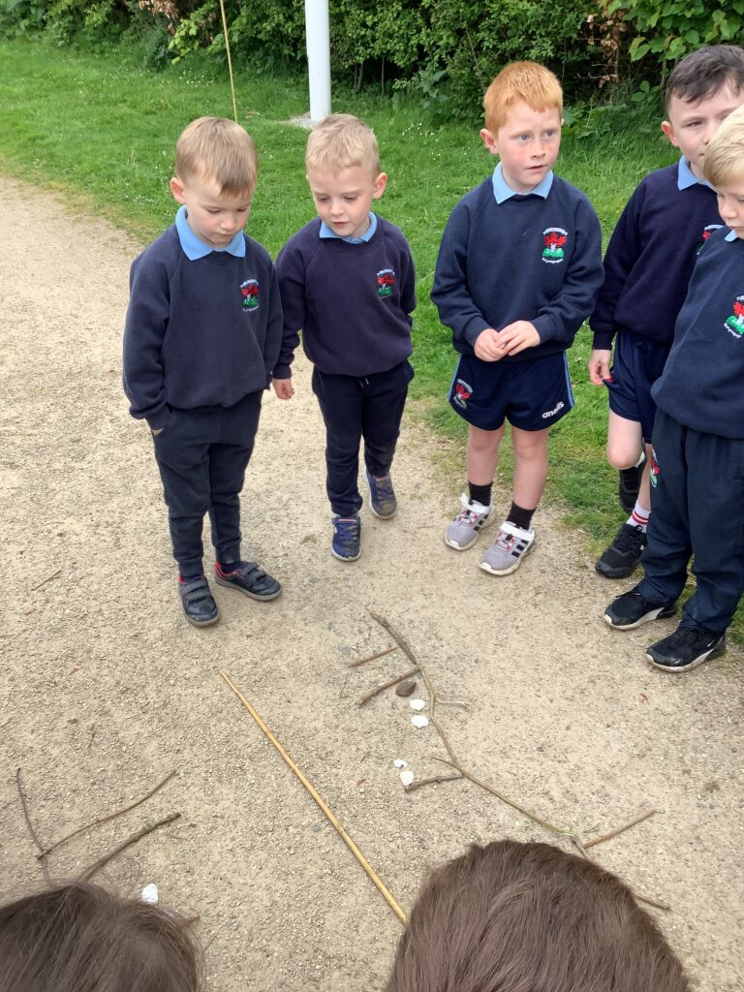
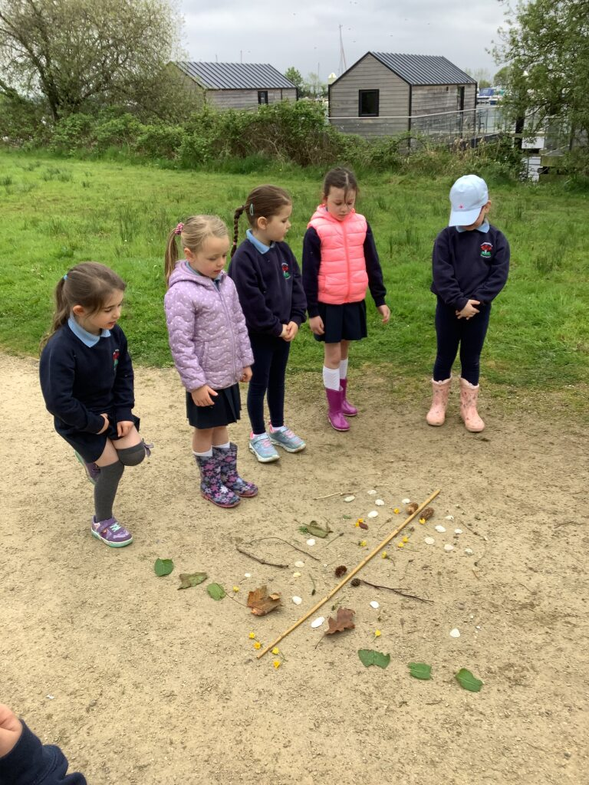
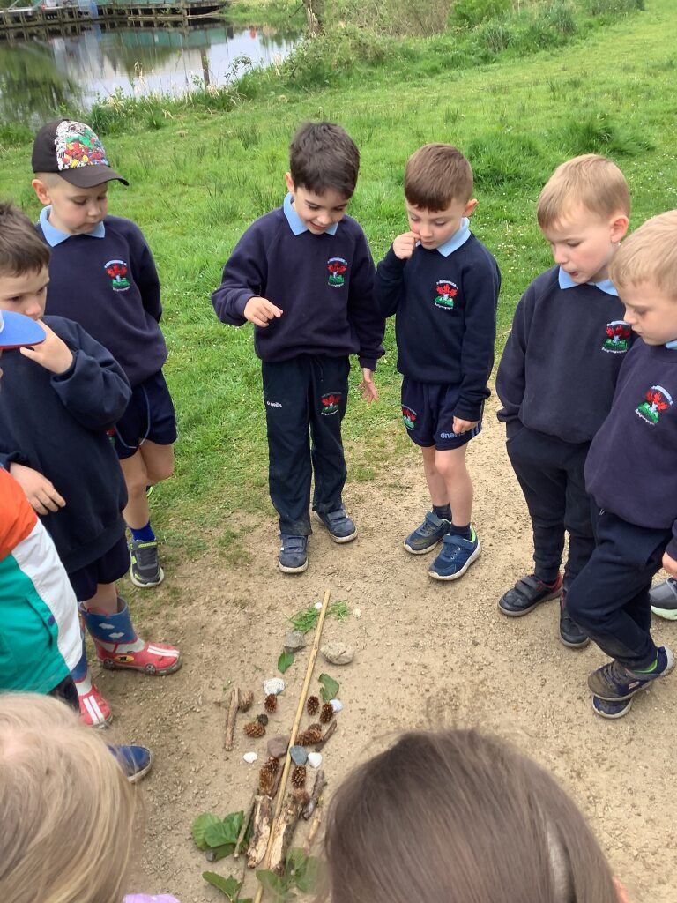
Report Back
The children talked about the pictures that they had made.

Slide 7
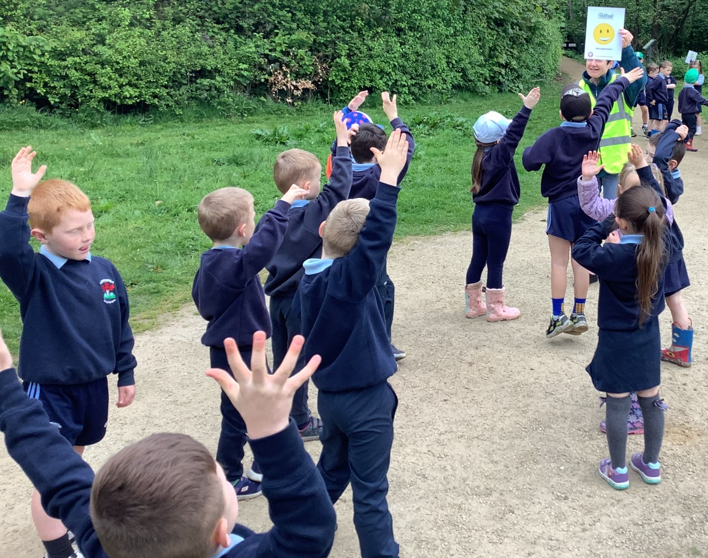
Did you enjoy the lesson?
Everyone enjoyed the lesson on symmetry.

Slide 8
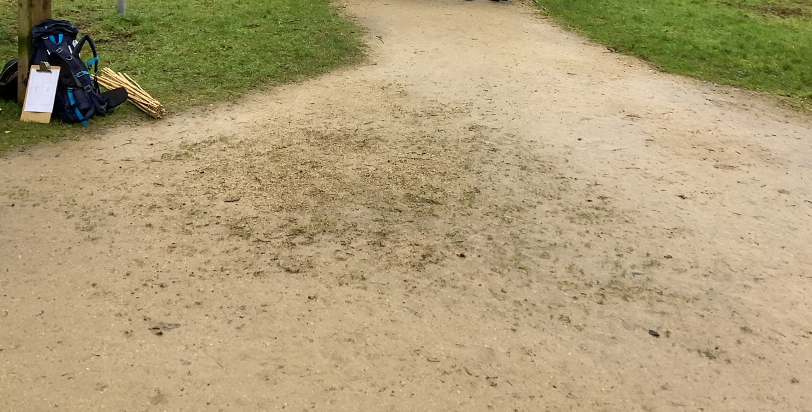
Leave no trace.
We made sure to tidy up when we had finished.

