Slide 1
Word Problems
Outdoor group work

Slide 2
WALT: solve word problems in groups.

Slide 3



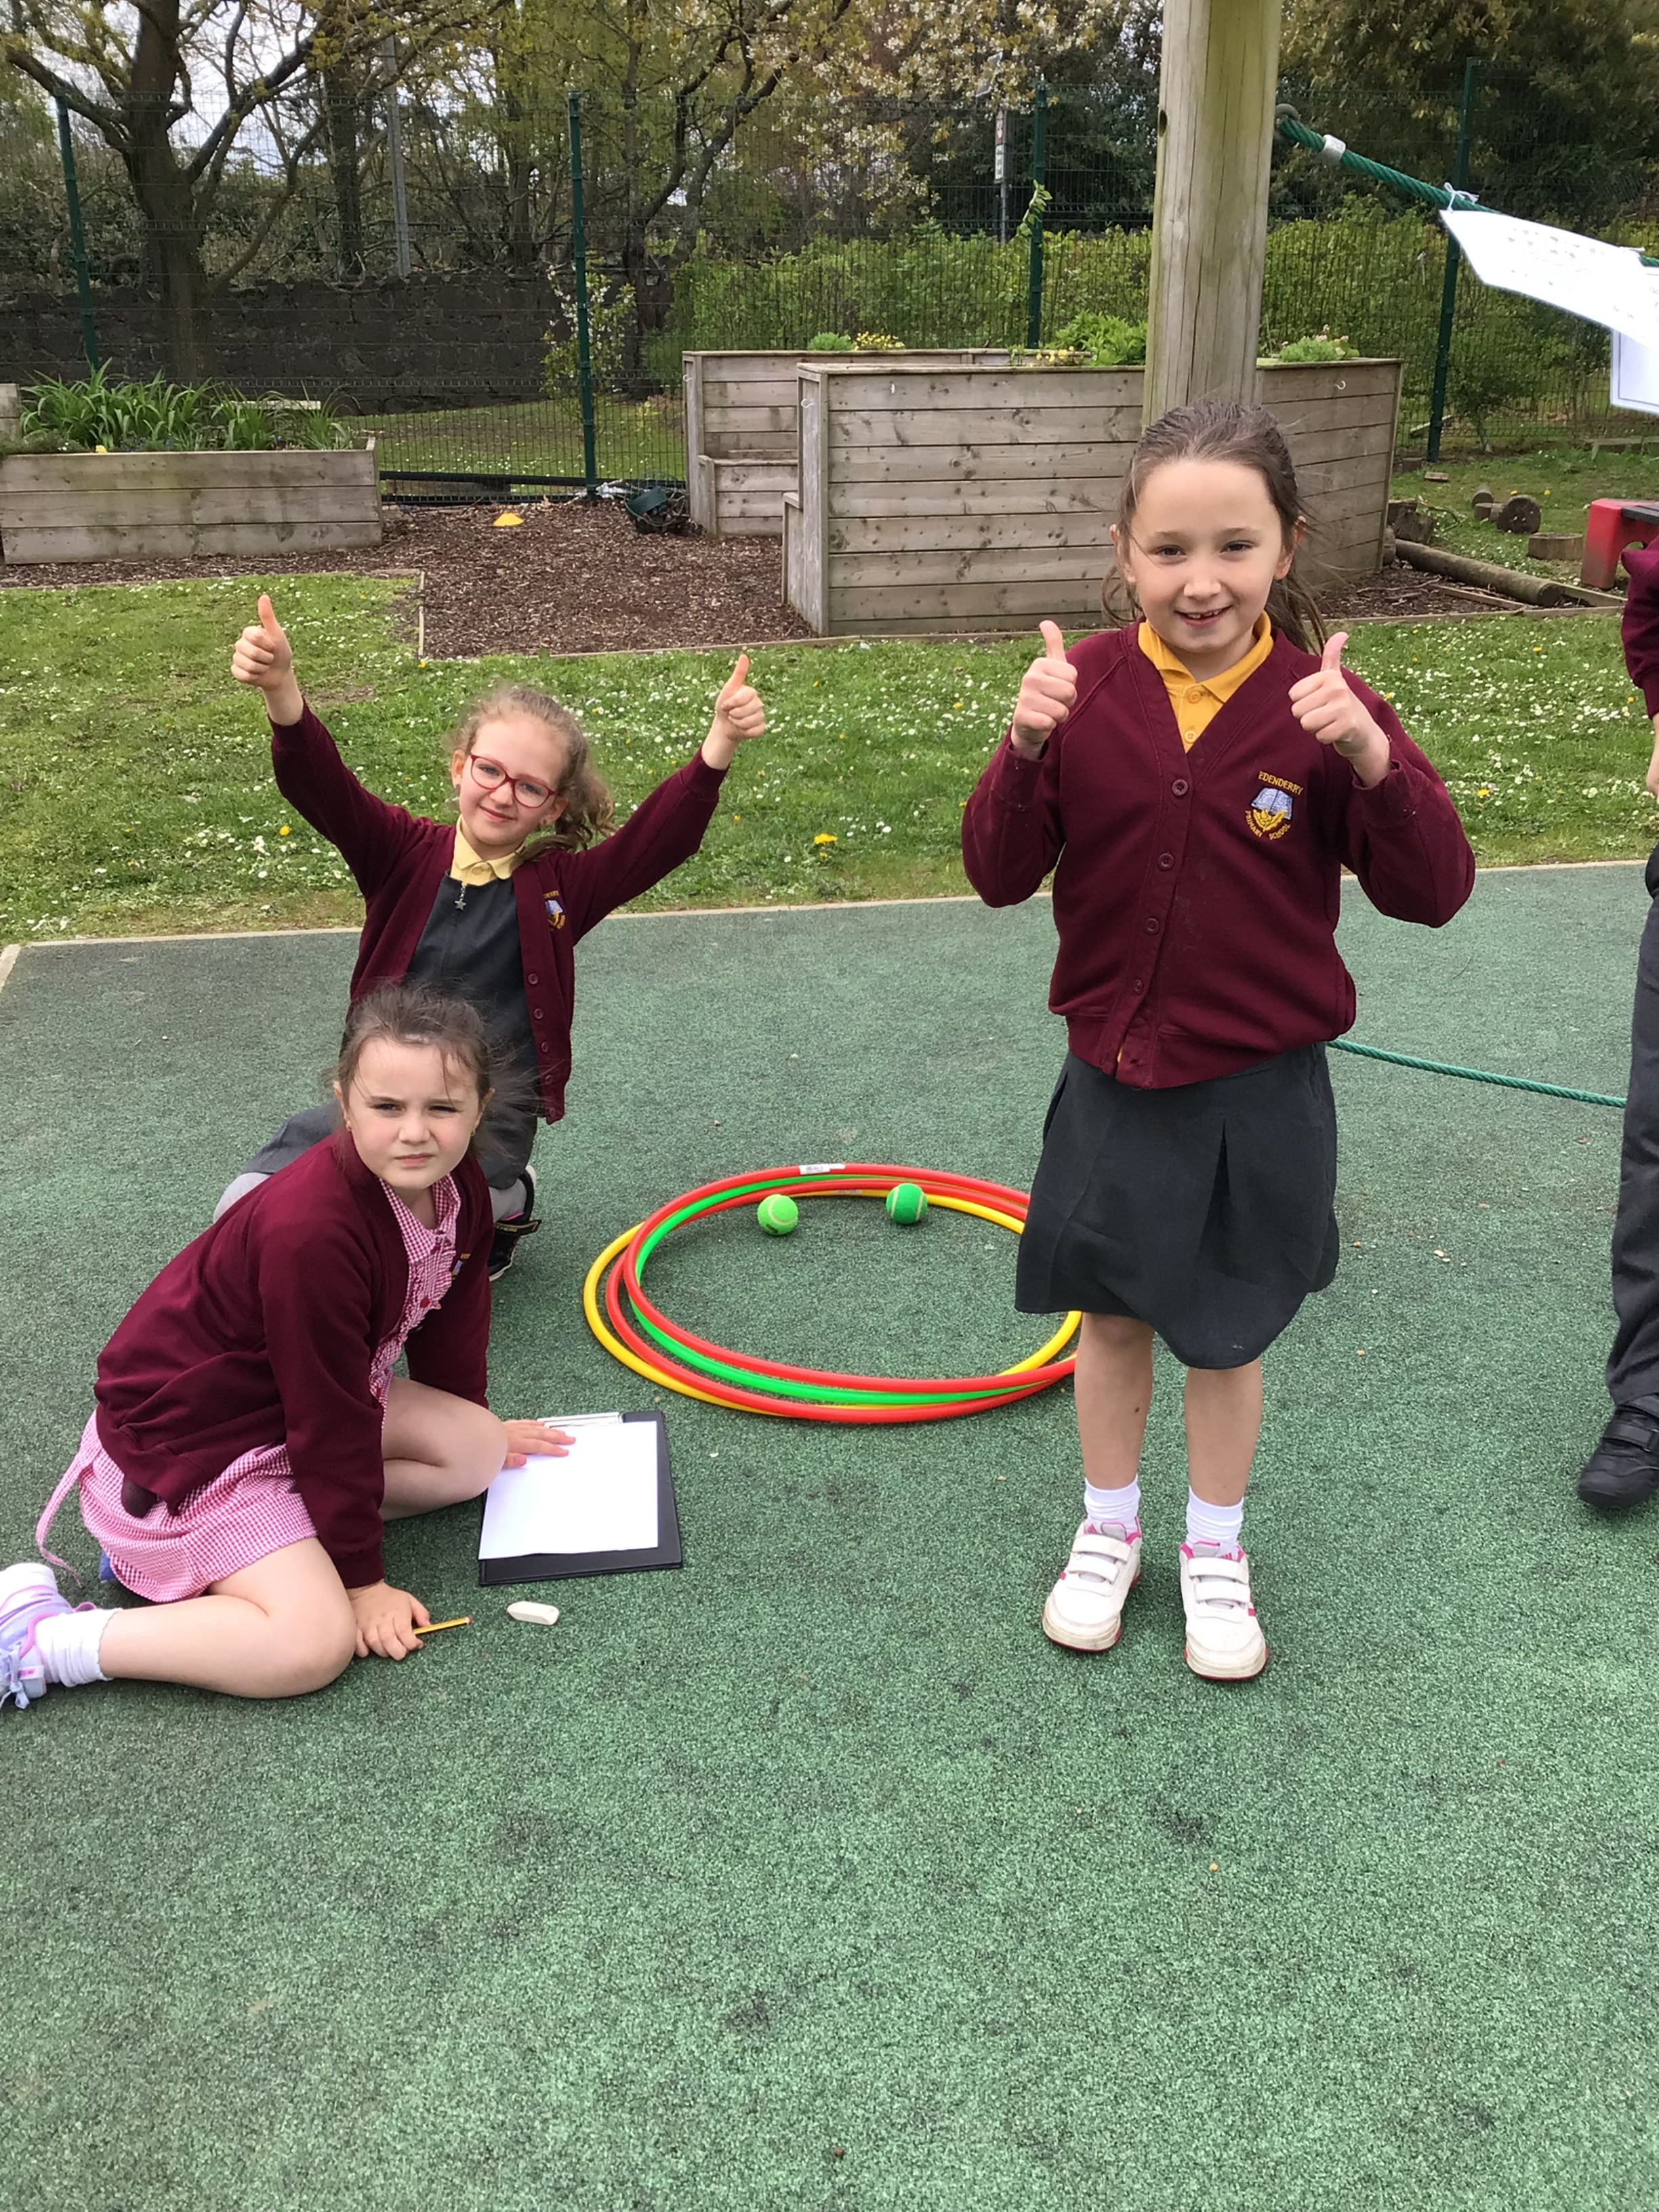


Mixed ability groups. Encourage children to use the space on the page to select mathematical language and answer sums and then select correct multiple-choice answer on answer sheet.
Teacher and classroom assistant circulate and take photographs of pupils completing the activity.

Slide 4

5 questions – 4 multiple choice answers!
Find the Key mathematical word.
Solve the problem.
Select the correct answer.
Is it; A B C or D?
Record your letter.
Extension: Can you and your group make a word problem with the objects at each station?

Slide 5
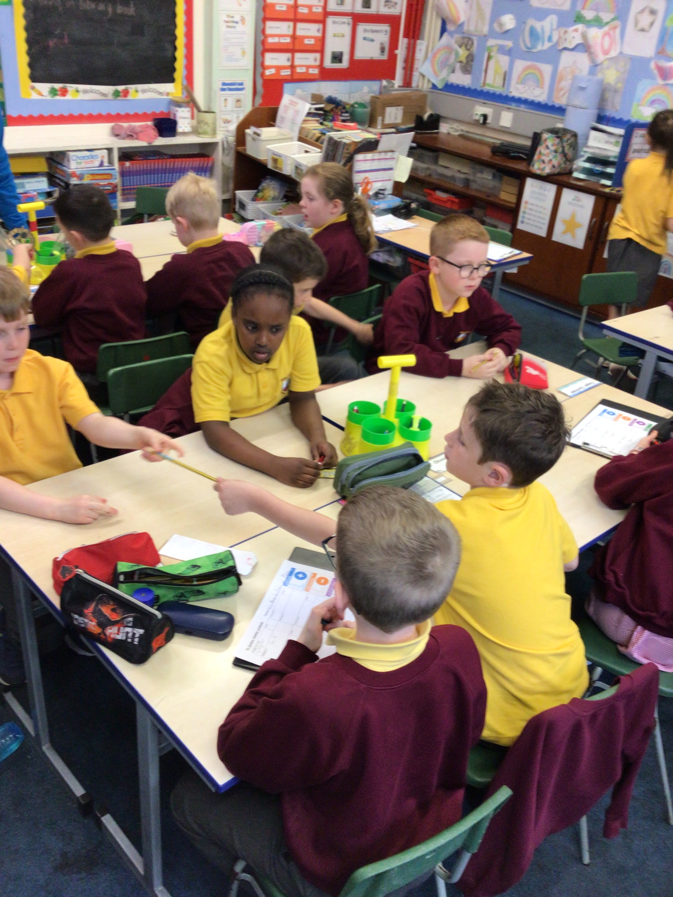
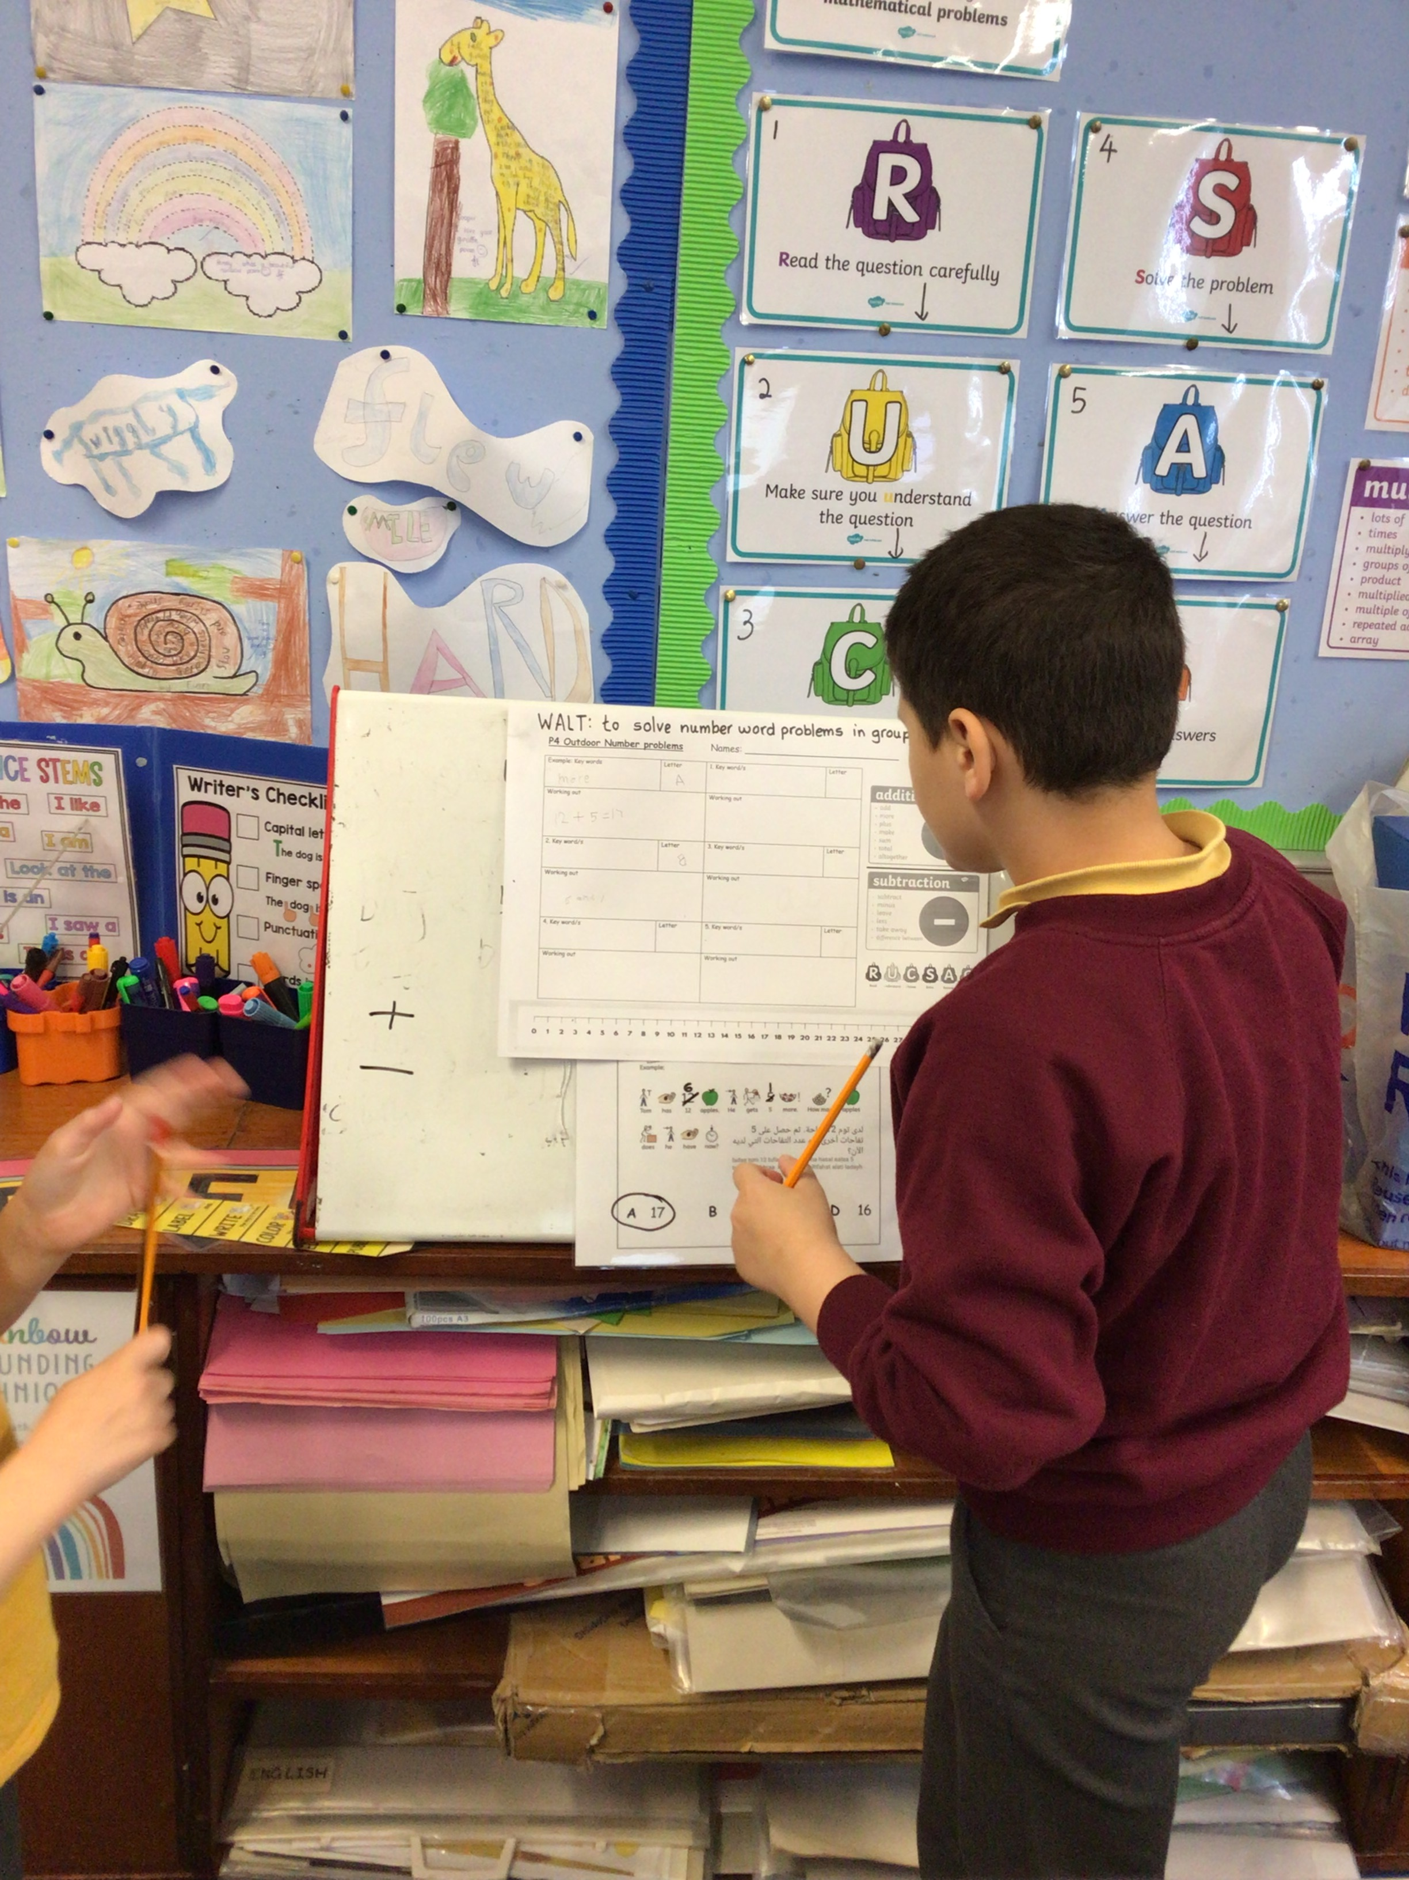
Lots of excitement and discussion! Getting ready, understanding the instructions before we head outside!

Slide 6
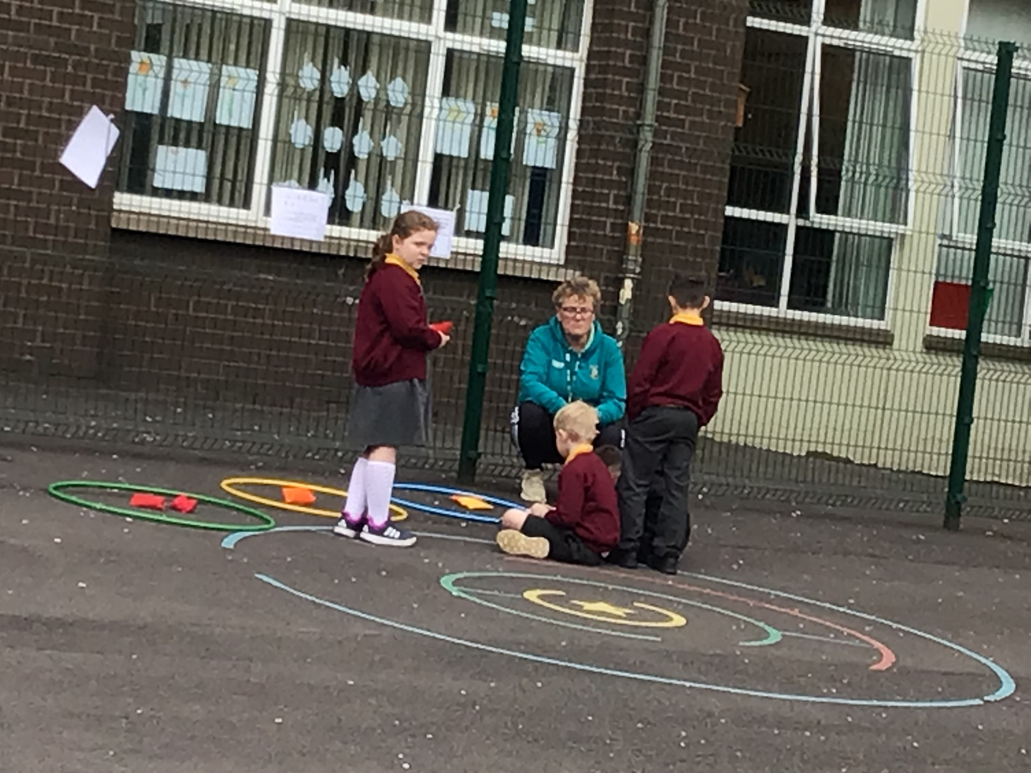
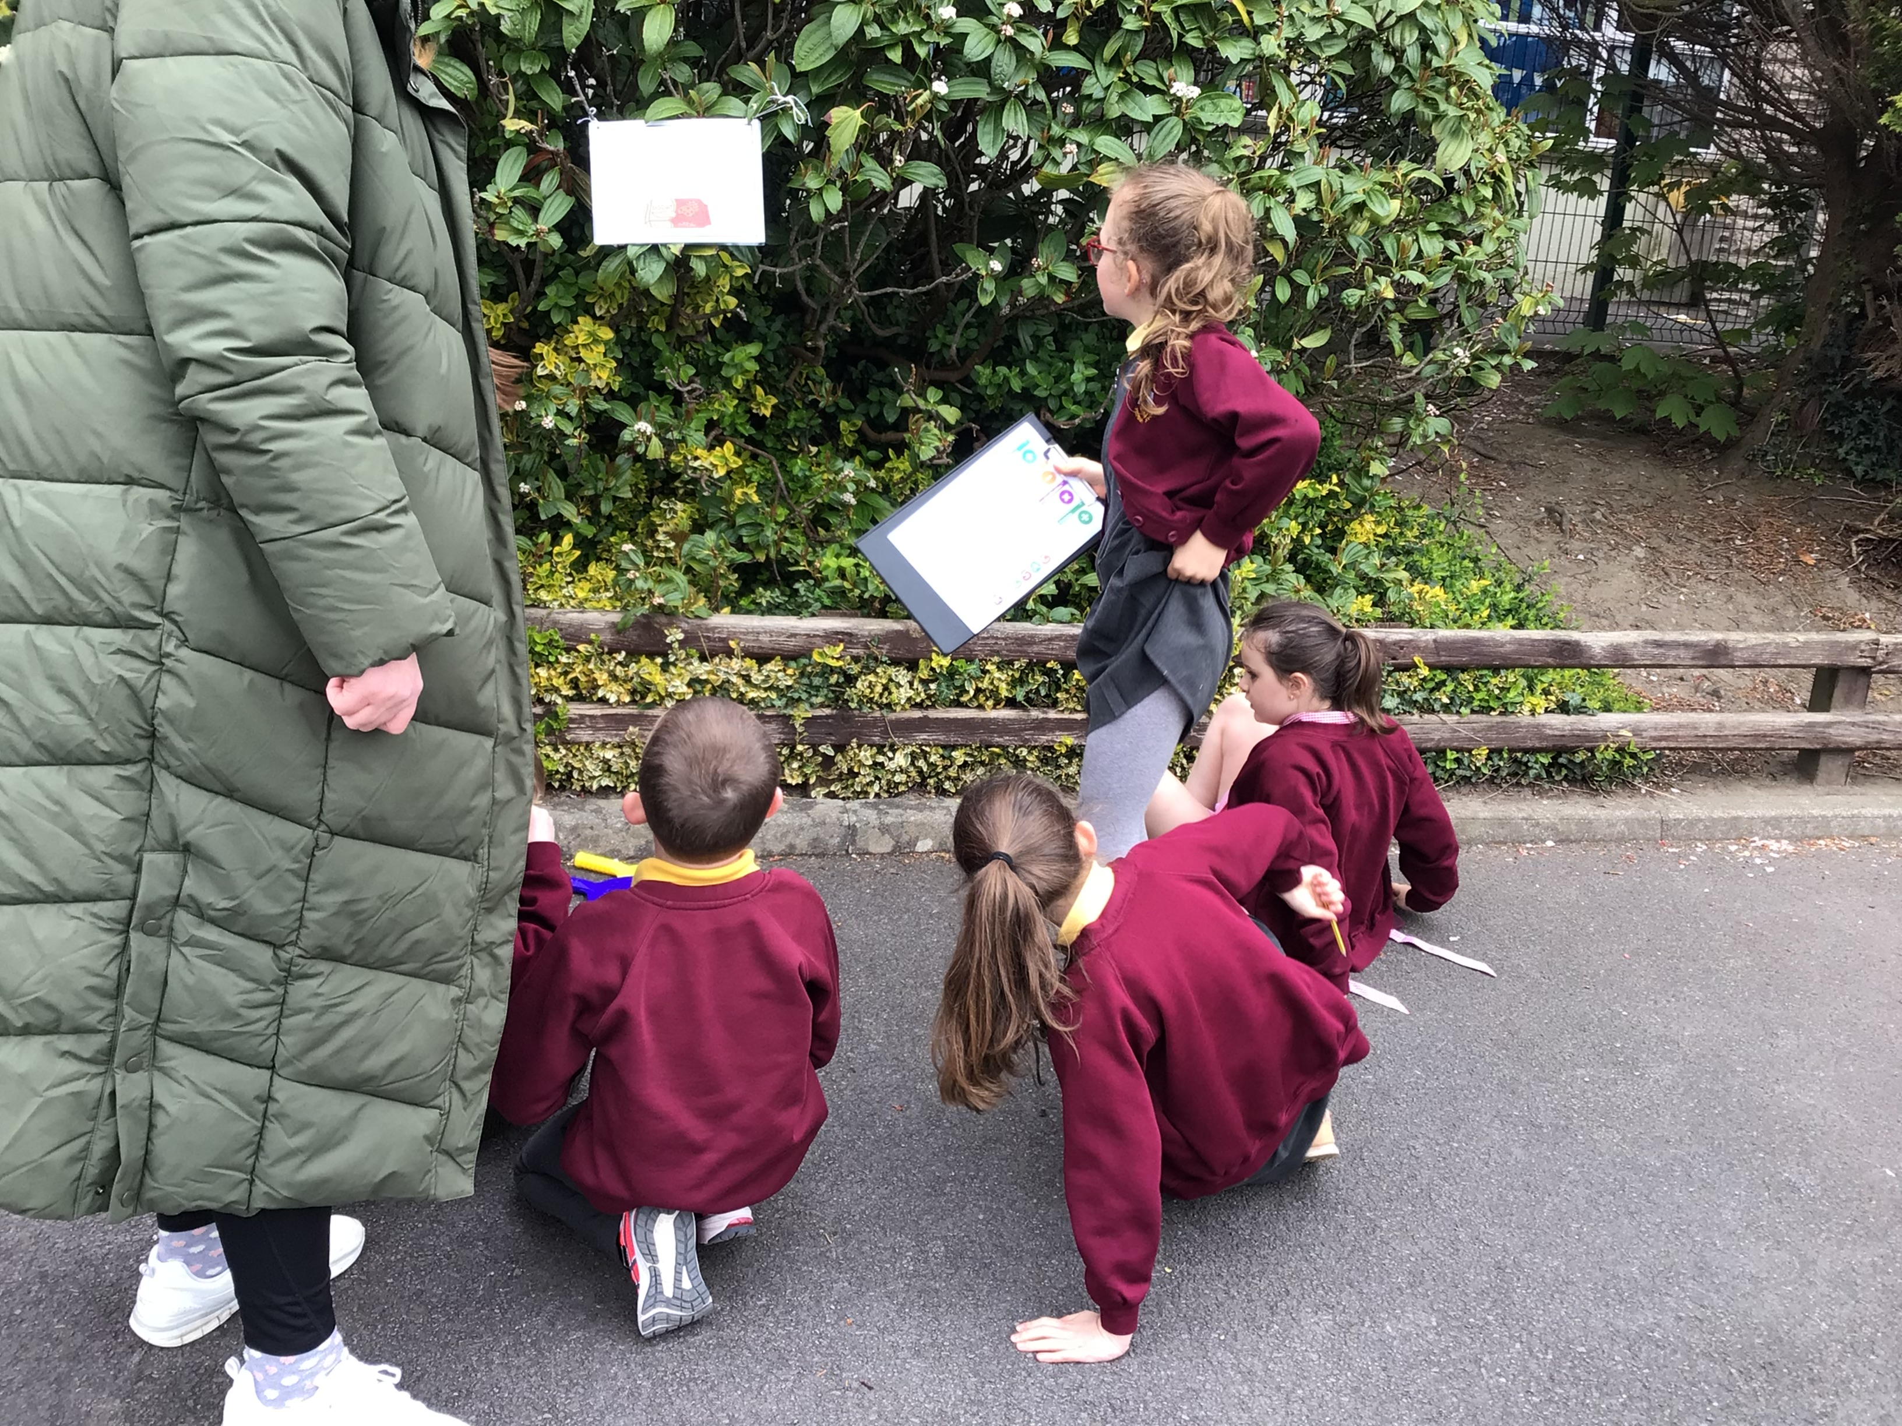
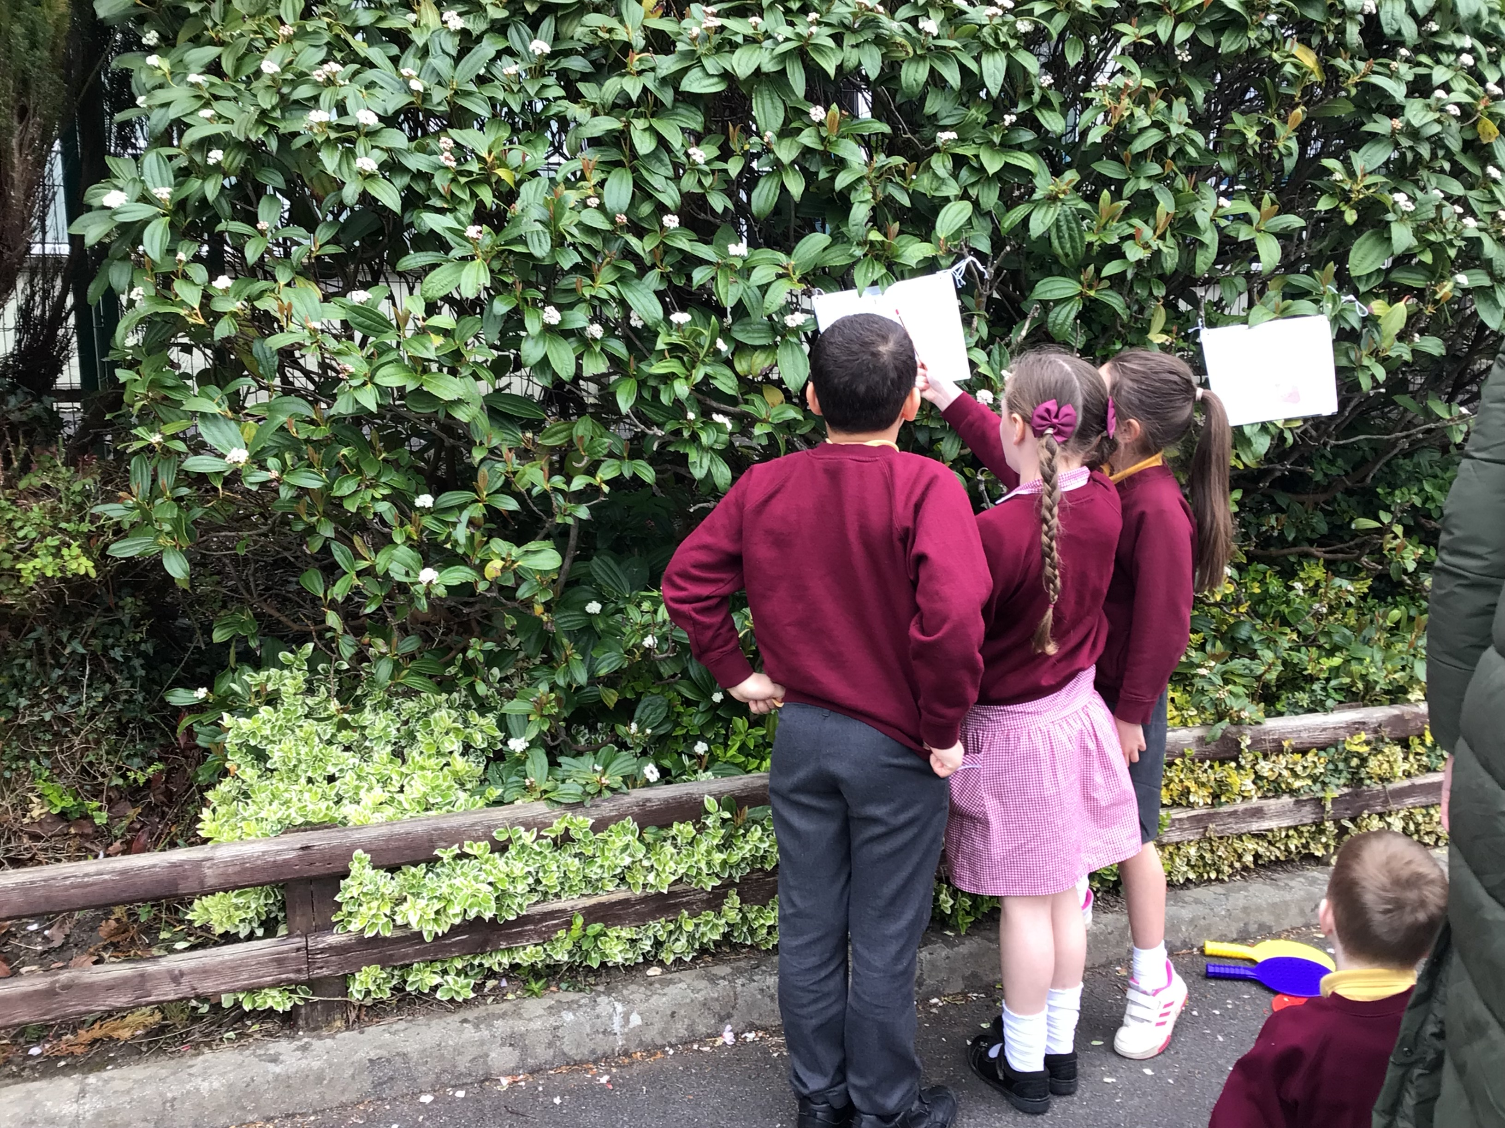
Outside and ready to go!.

Slide 7
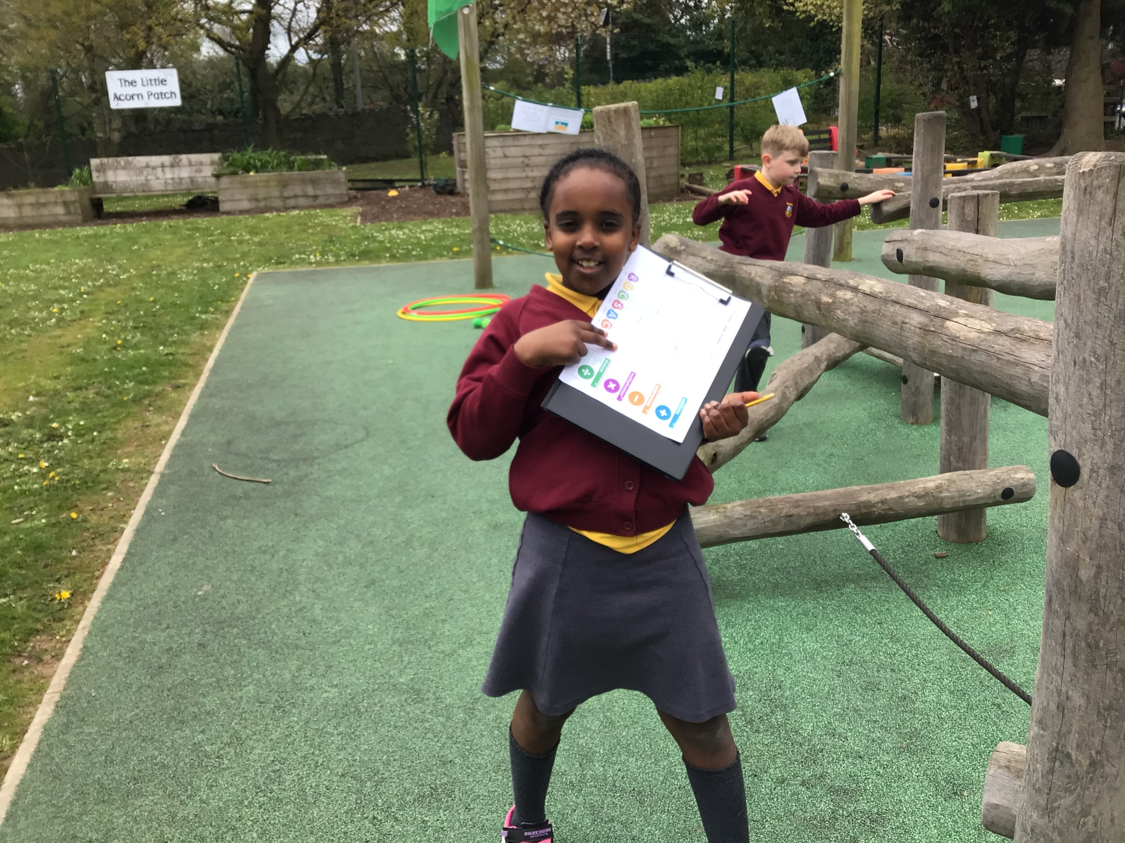
Solving and creating word problems.

Slide 8
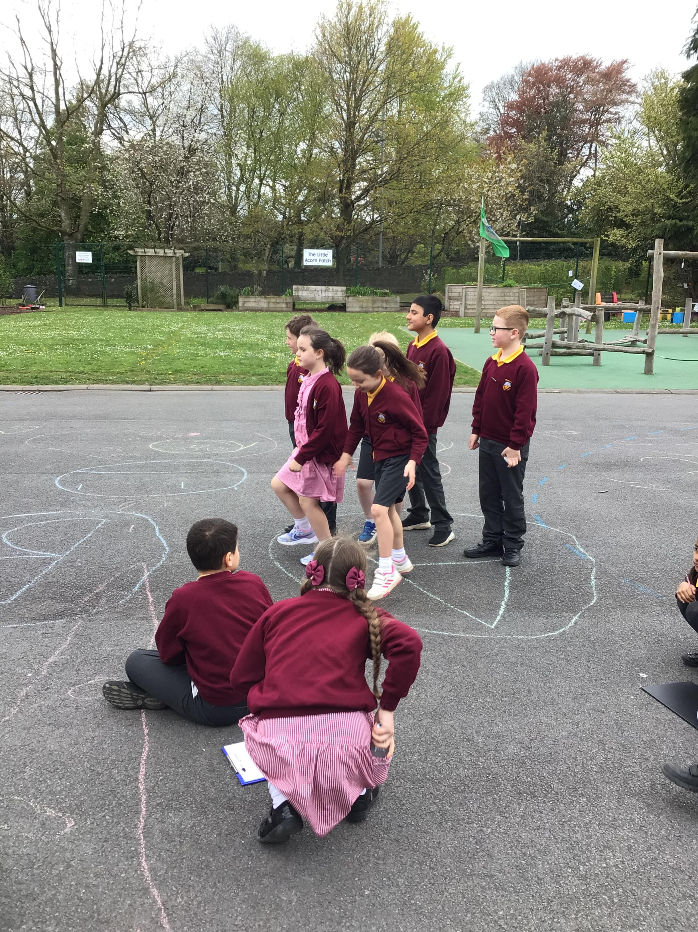
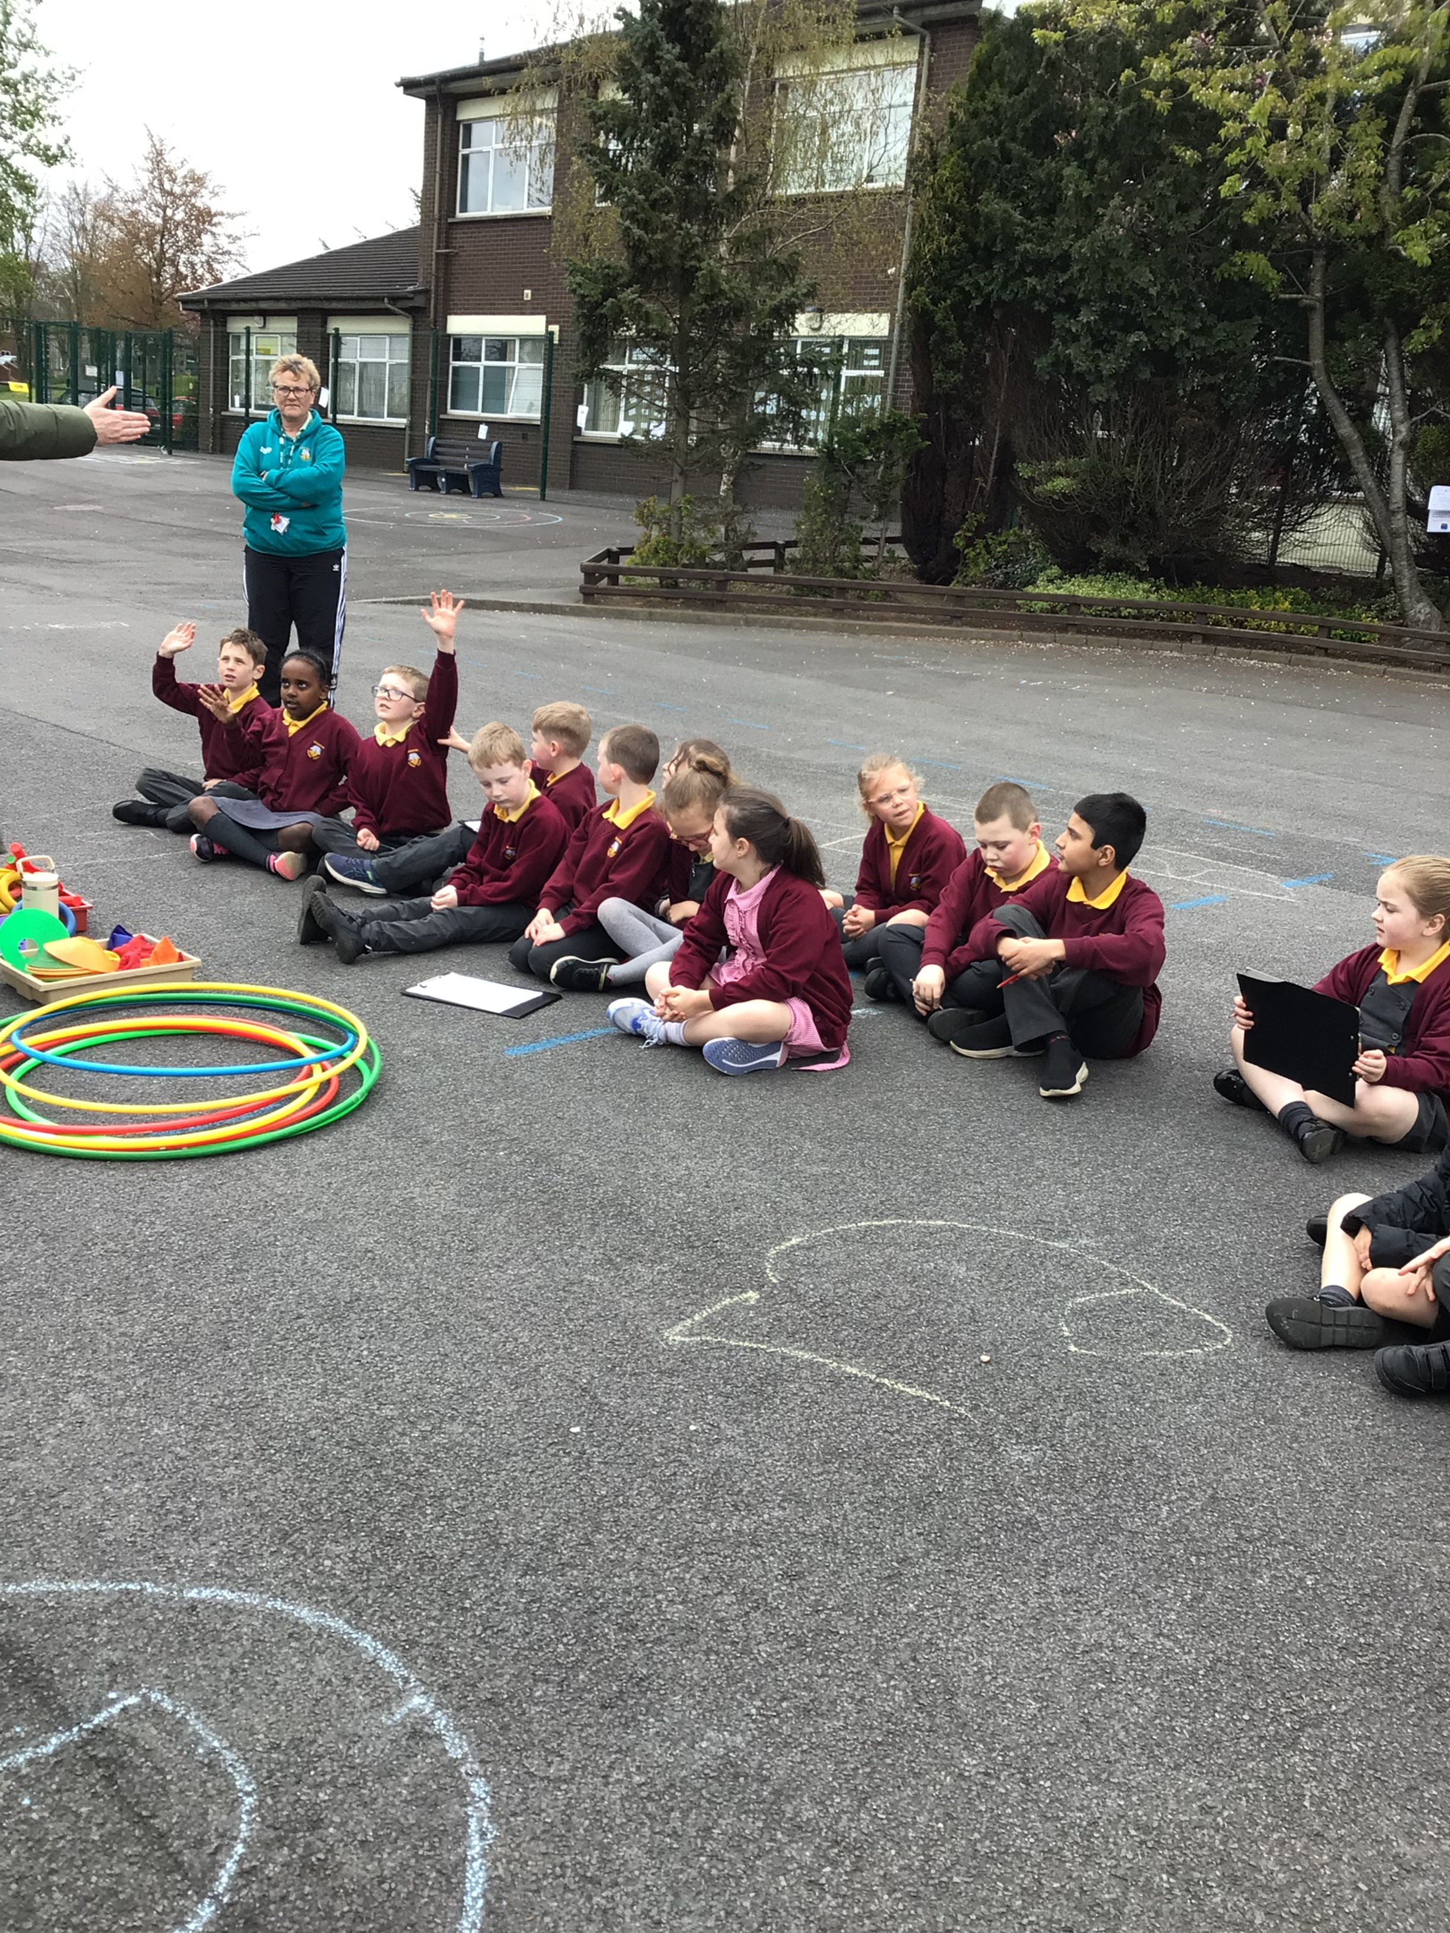
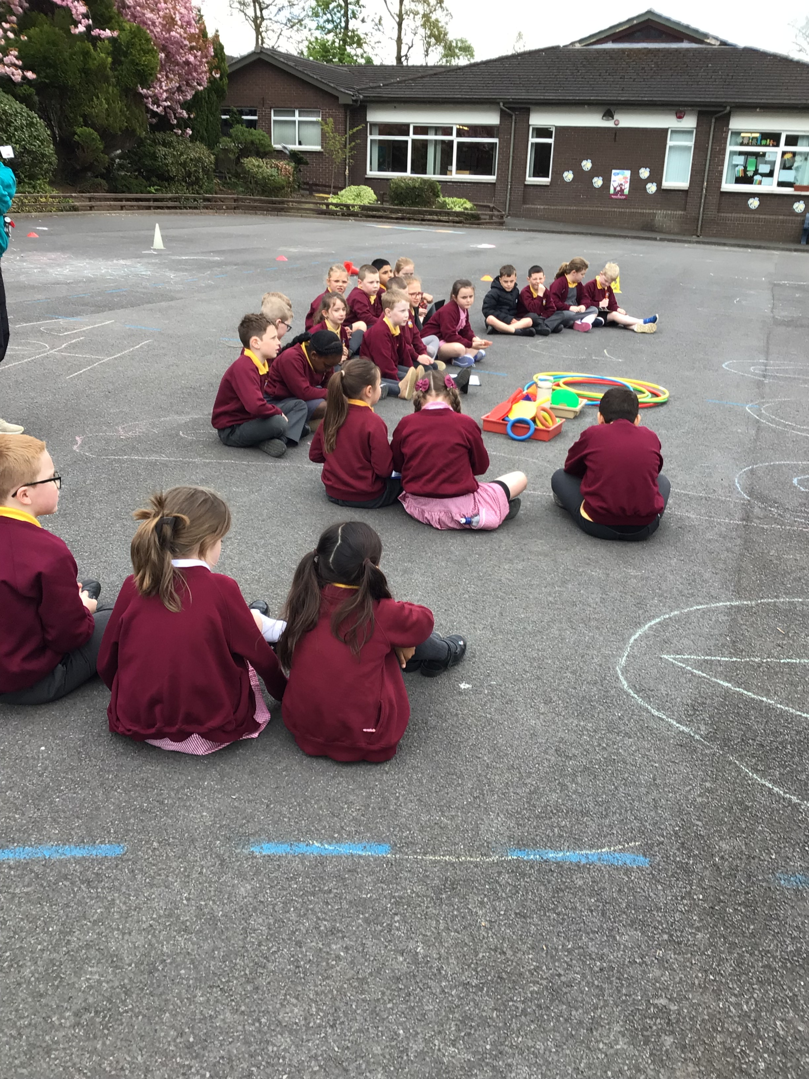
Lets see if we guessed the answer correctly by stepping in the correct letter written in chalk.

Slide 9
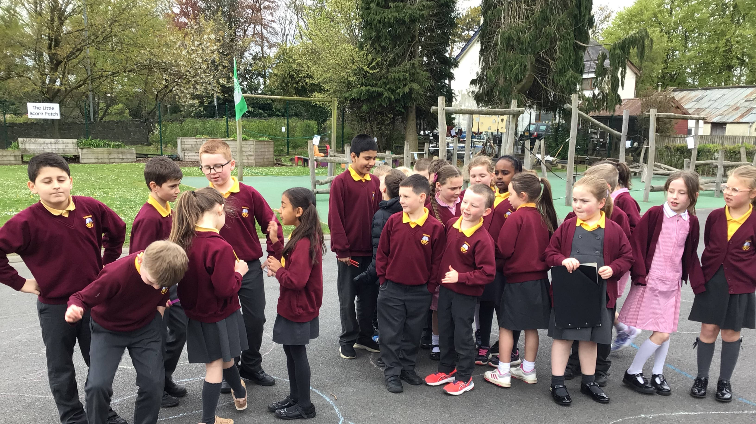
It was great fun!

Slide 10
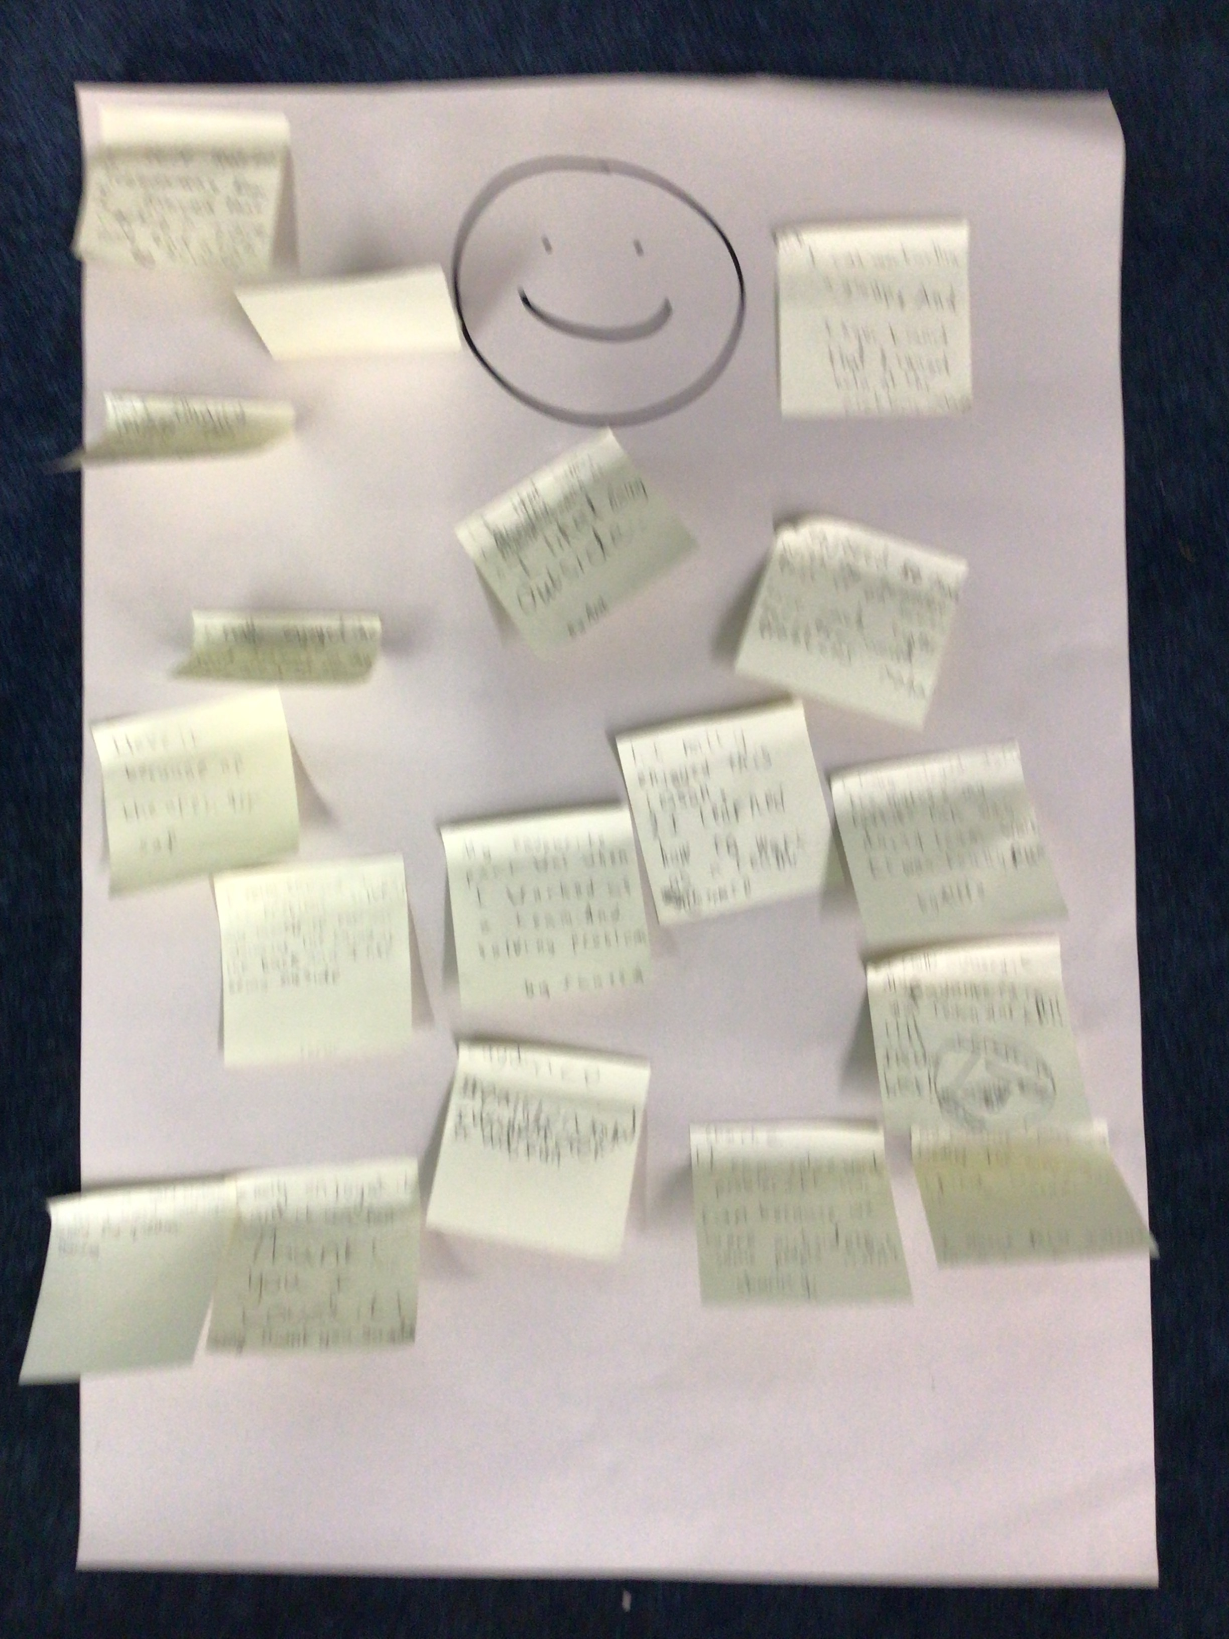
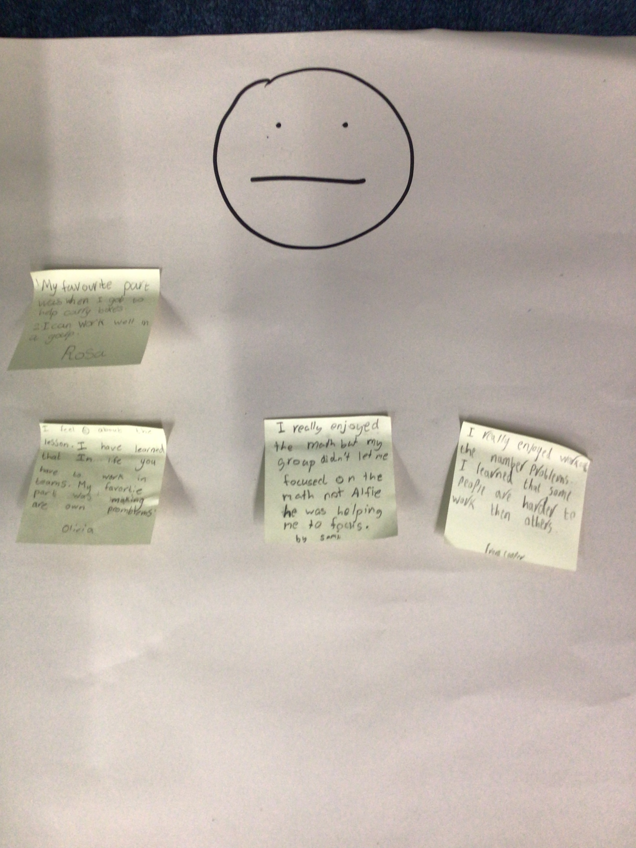
Self-evaluation about the lesson.

