Slide 1
Outdoor Stories and Mindfulness with our Forest School Buddies.
P3 and P4 – mindful activities and a number of games

Slide 2
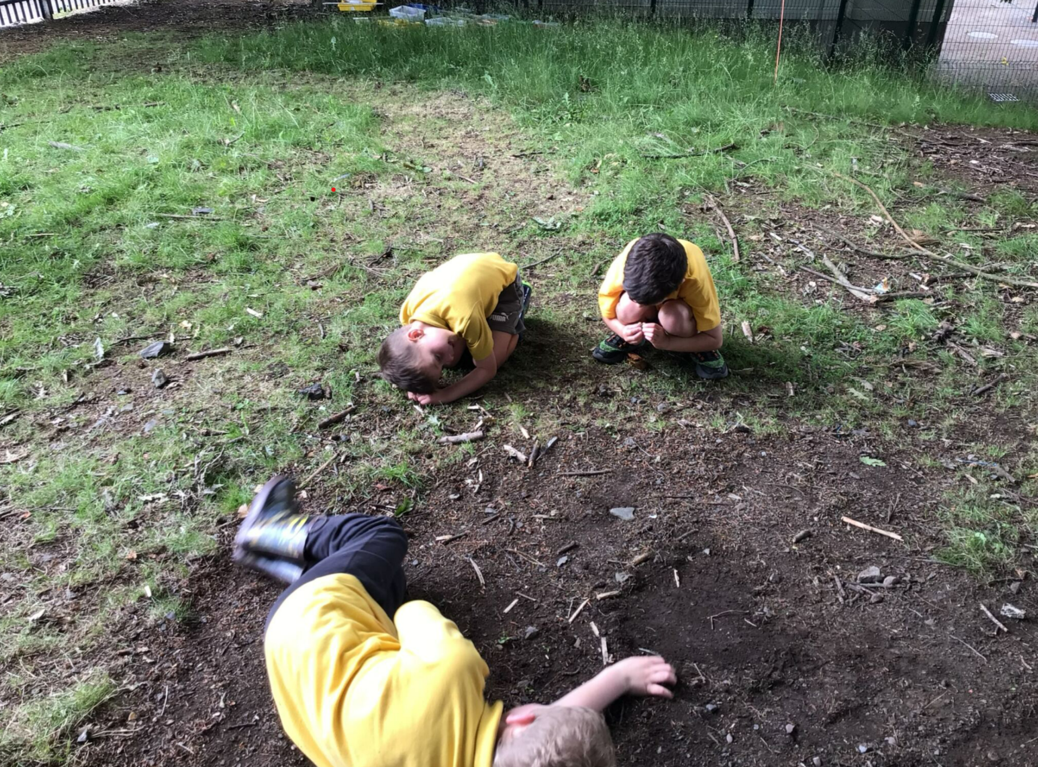

Slide 3
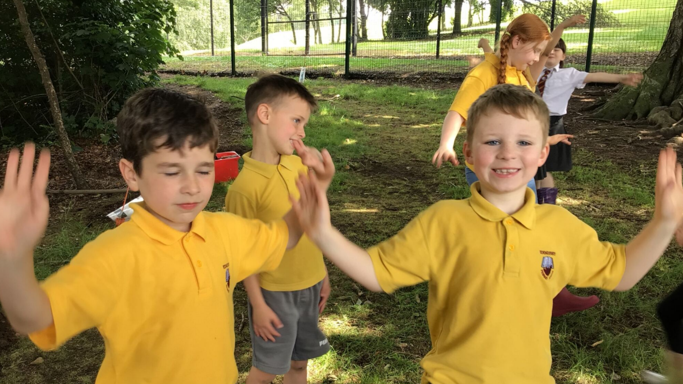

Slide 4
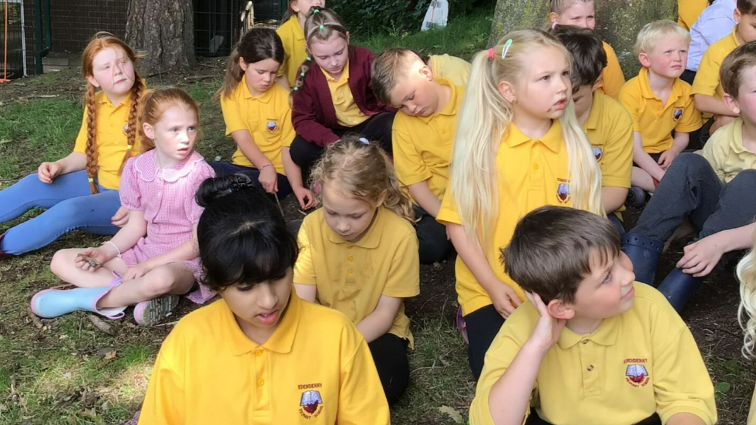

Slide 5
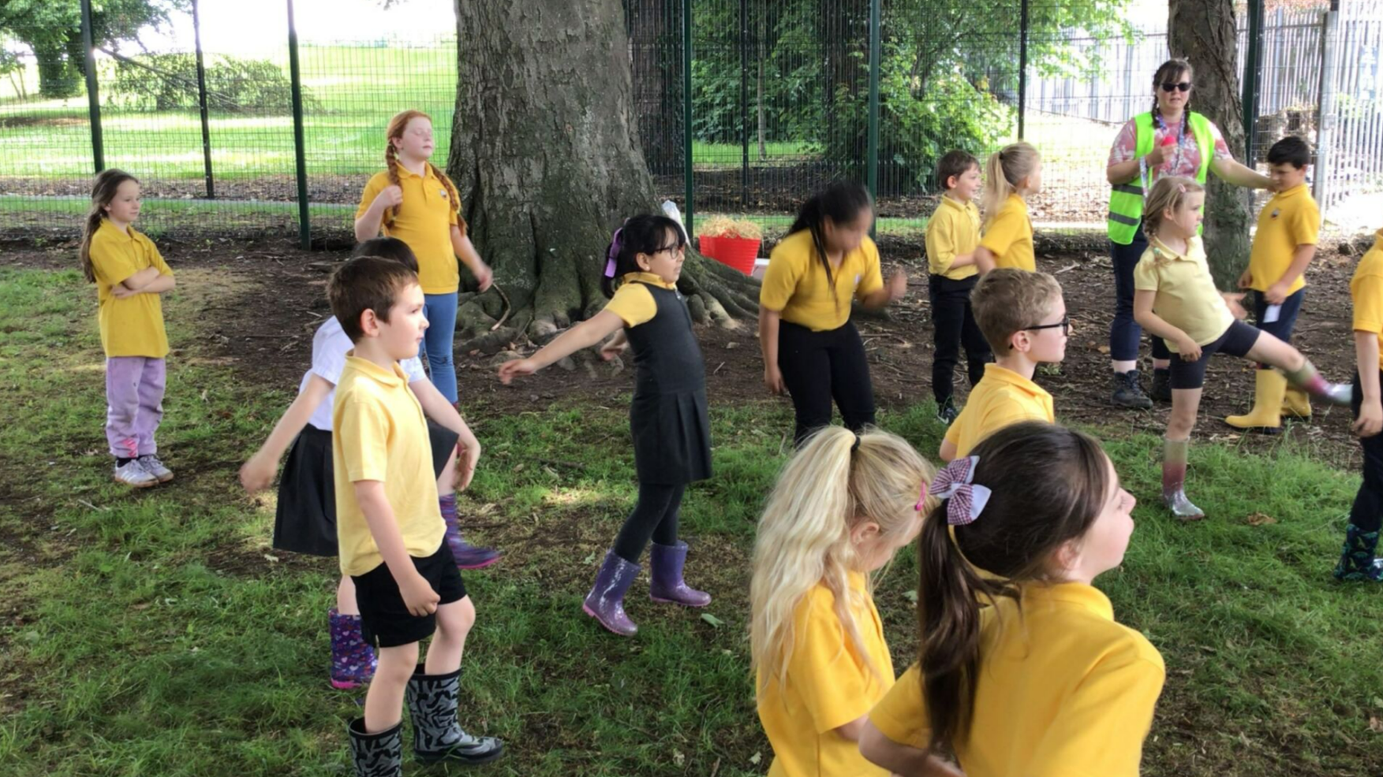

Slide 6
