Slide 1
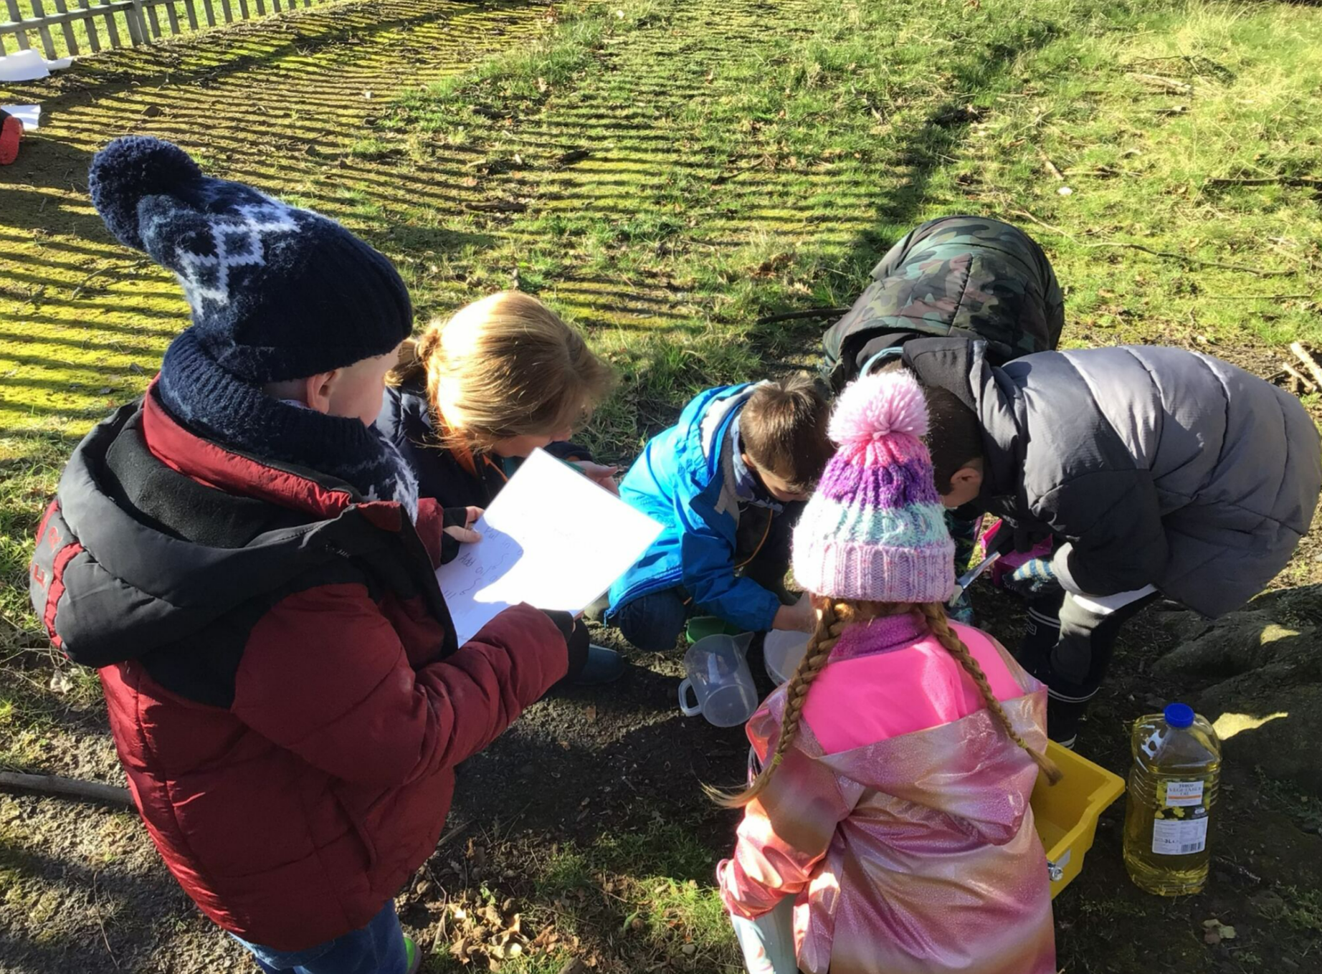
Outdoor Learning Day 2025
What a great time we had linking our Julia Donaldson stories to our free outdoor play session. We could build a house for a mouse, paint with natures paintbrushes, make a stick man, make our own Gruffalo crumble, make owl ice cream or use our own imagination in our outdoor learning space. P3 loved this!

Slide 2
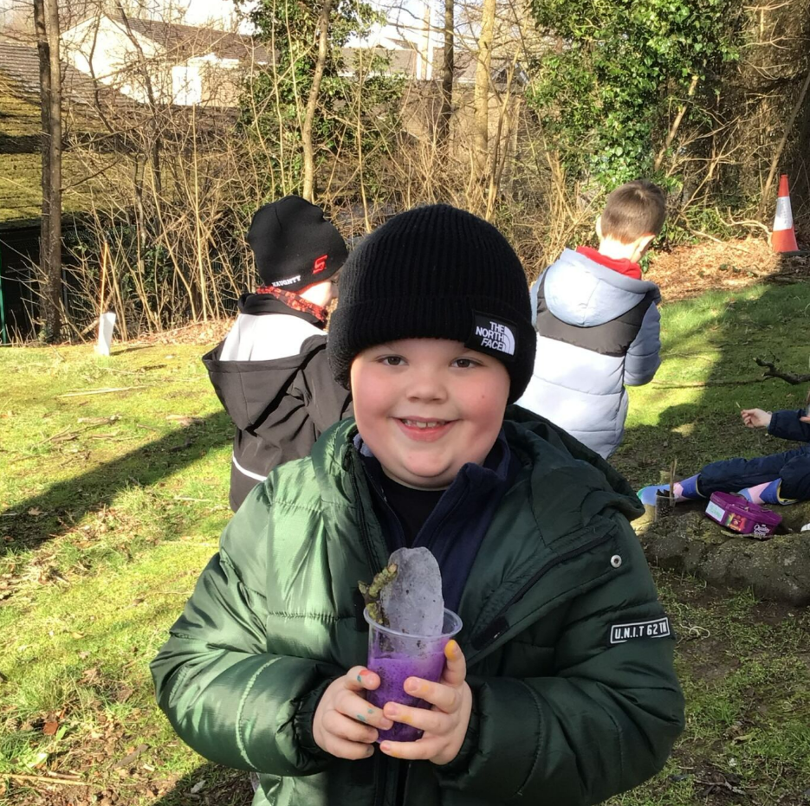
Owl Icecream
We used some magic powder to make our ice cream foam up!
Vinegar mixed with food coloring added to ice and natures sprinkles. Children then added baking powder and whoooosh!

Slide 3
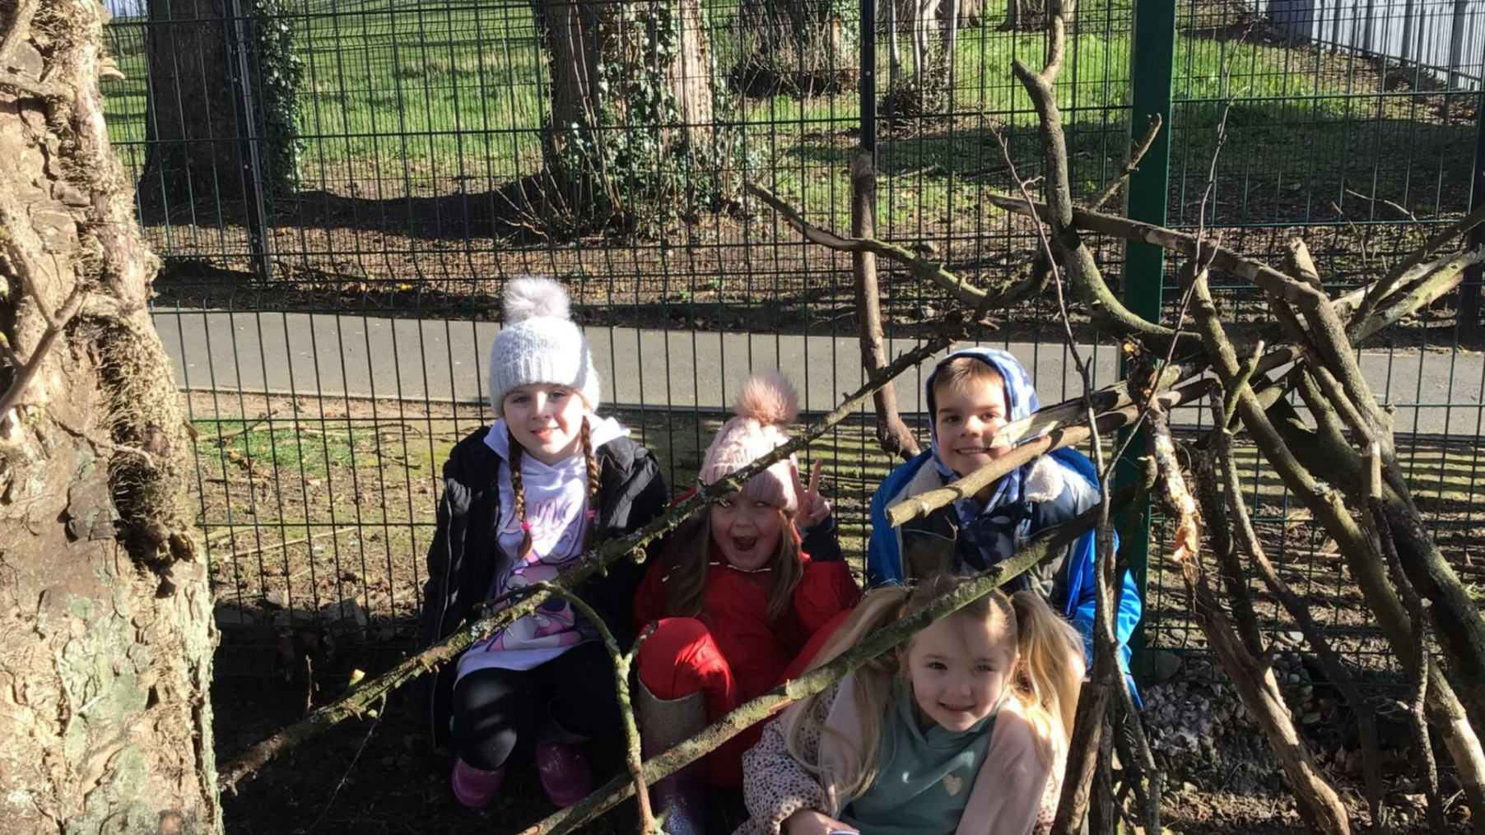

Slide 4
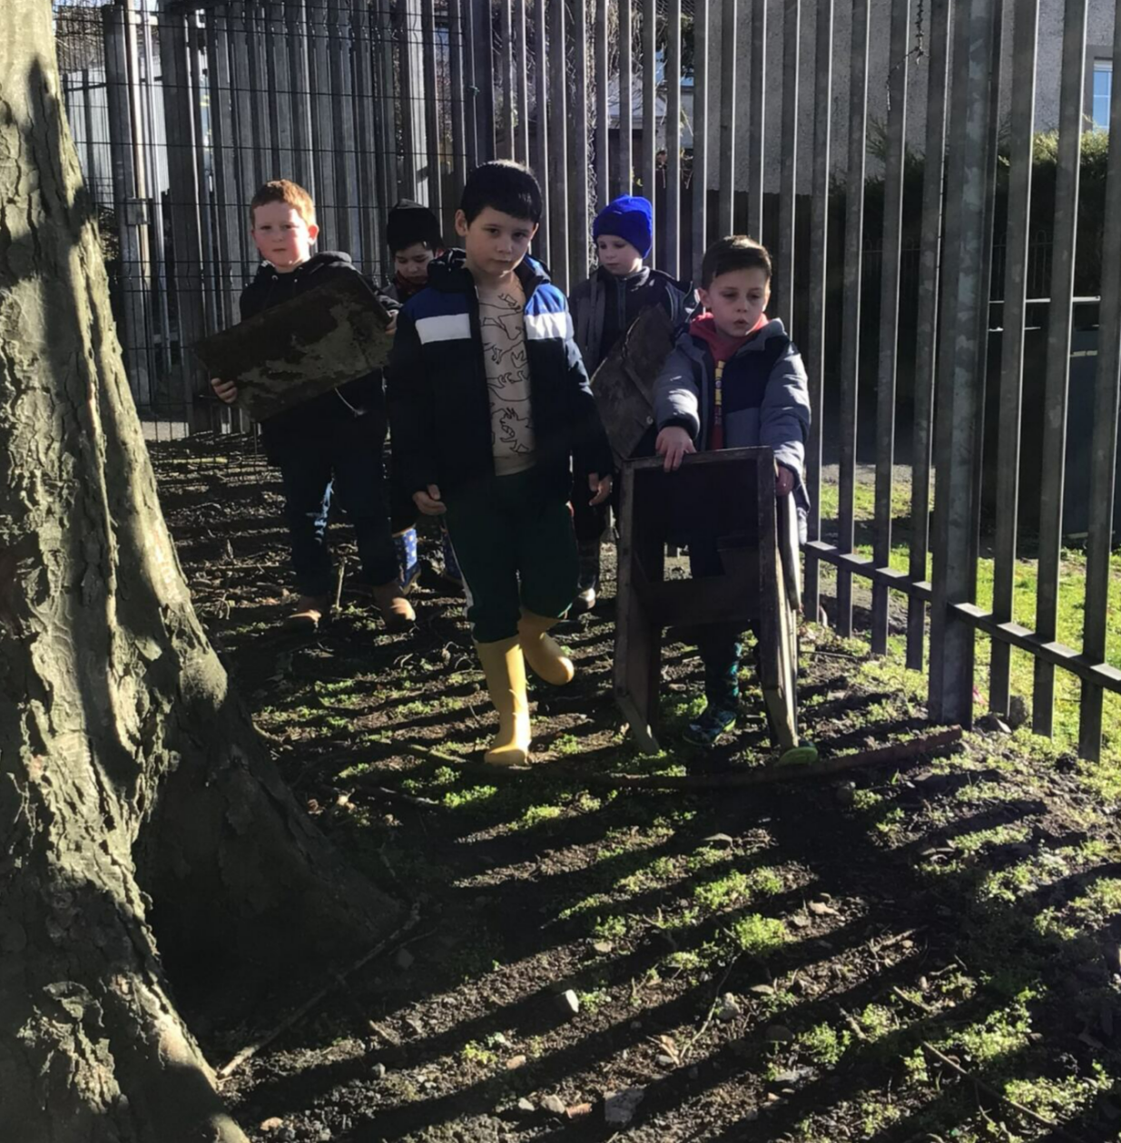

Slide 5
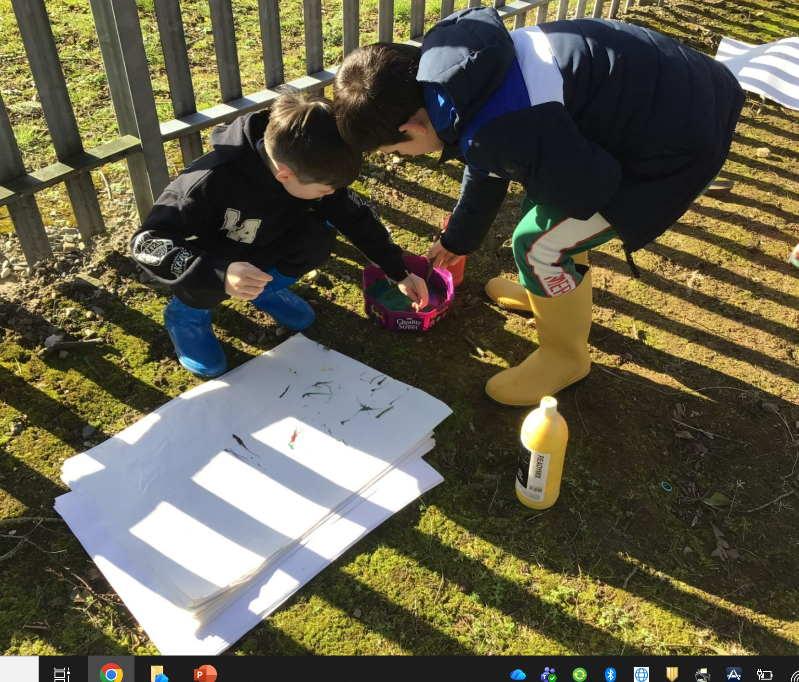

Slide 6
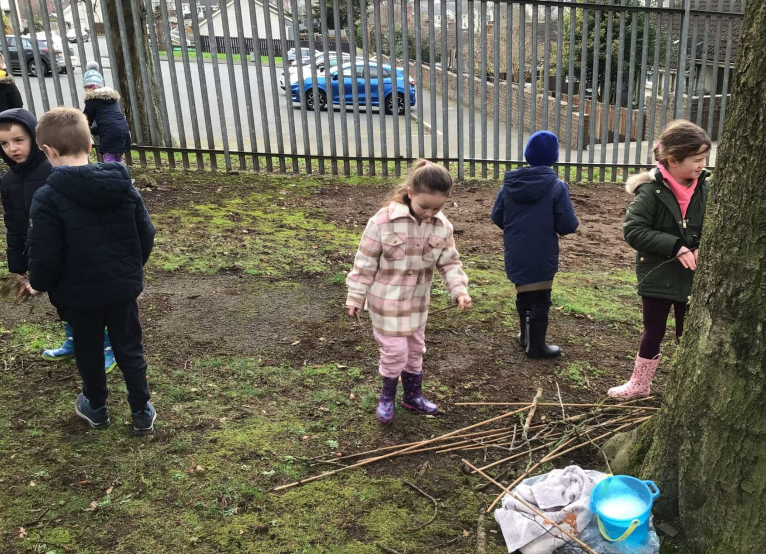
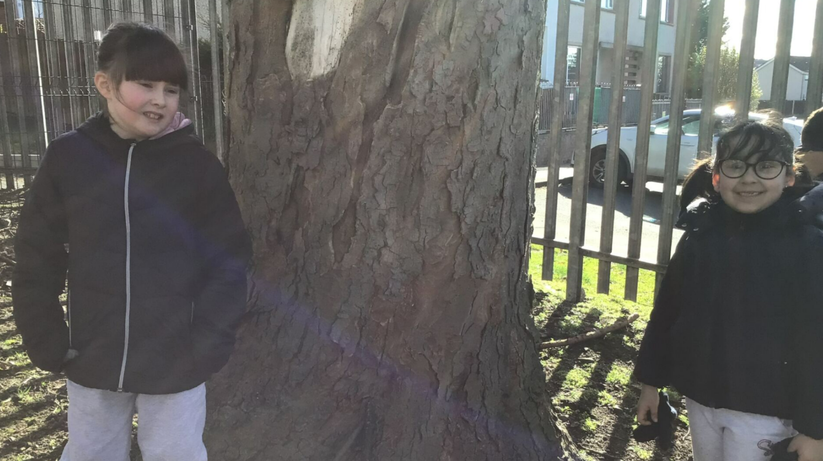

Slide 7
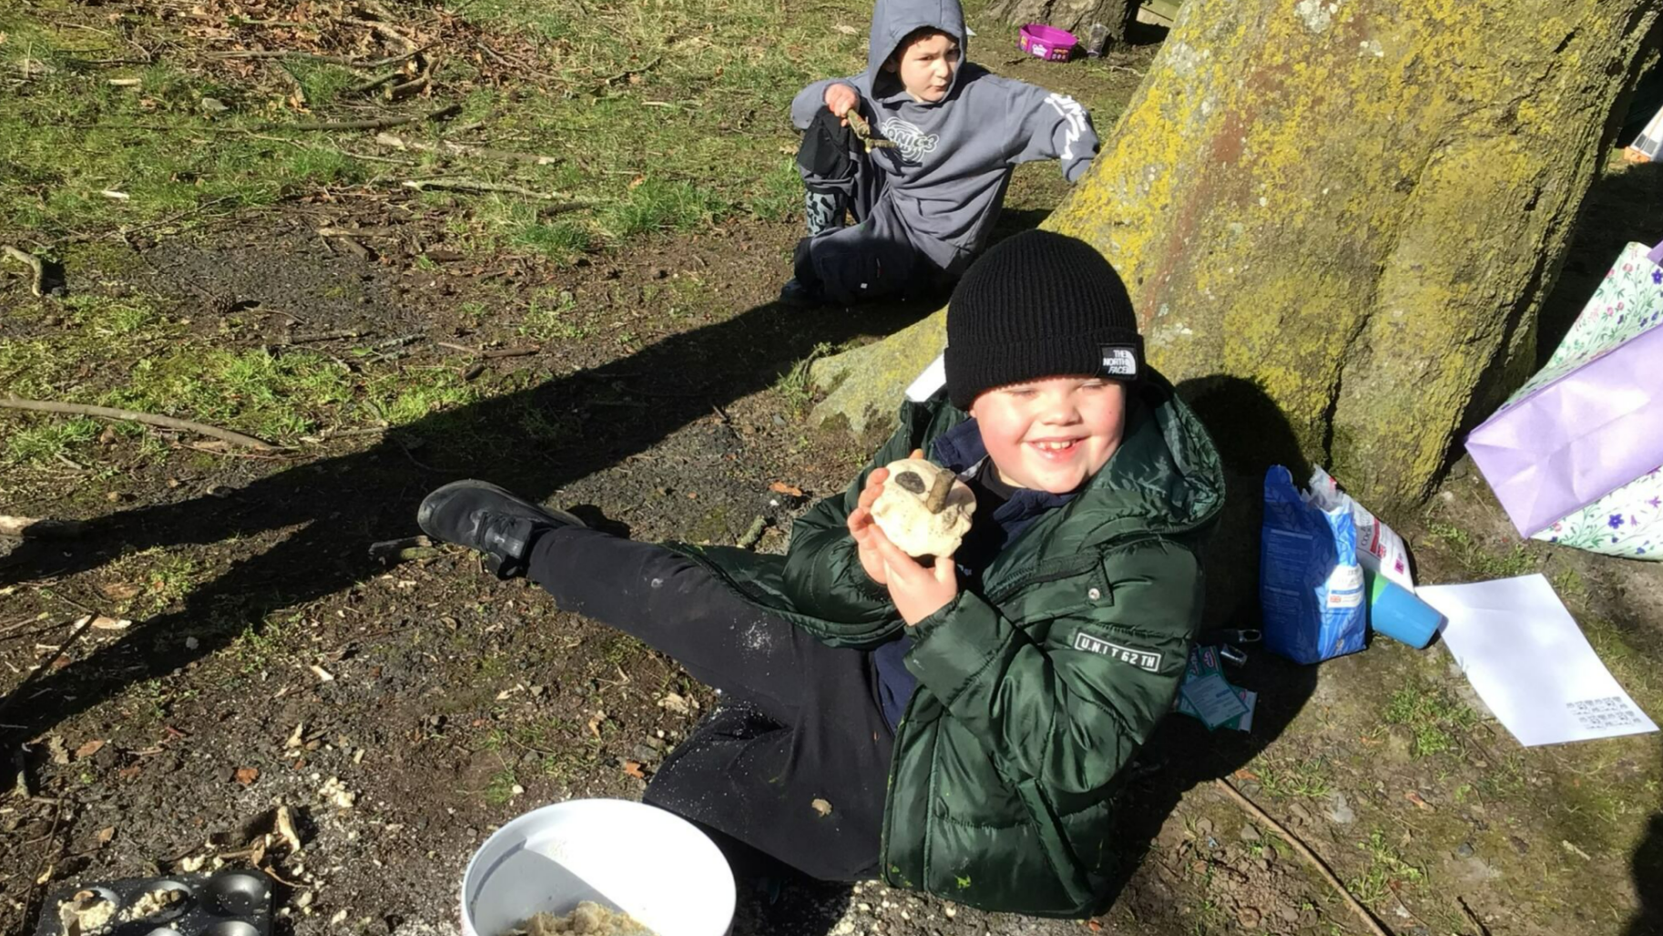

Slide 8
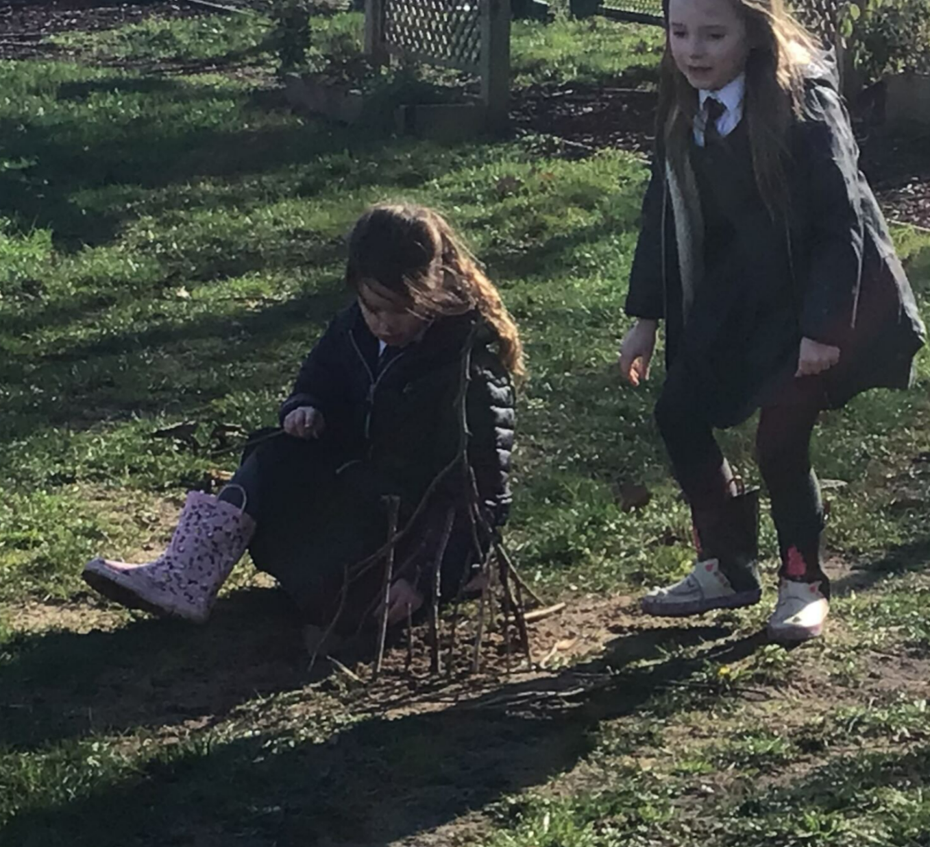

Slide 9
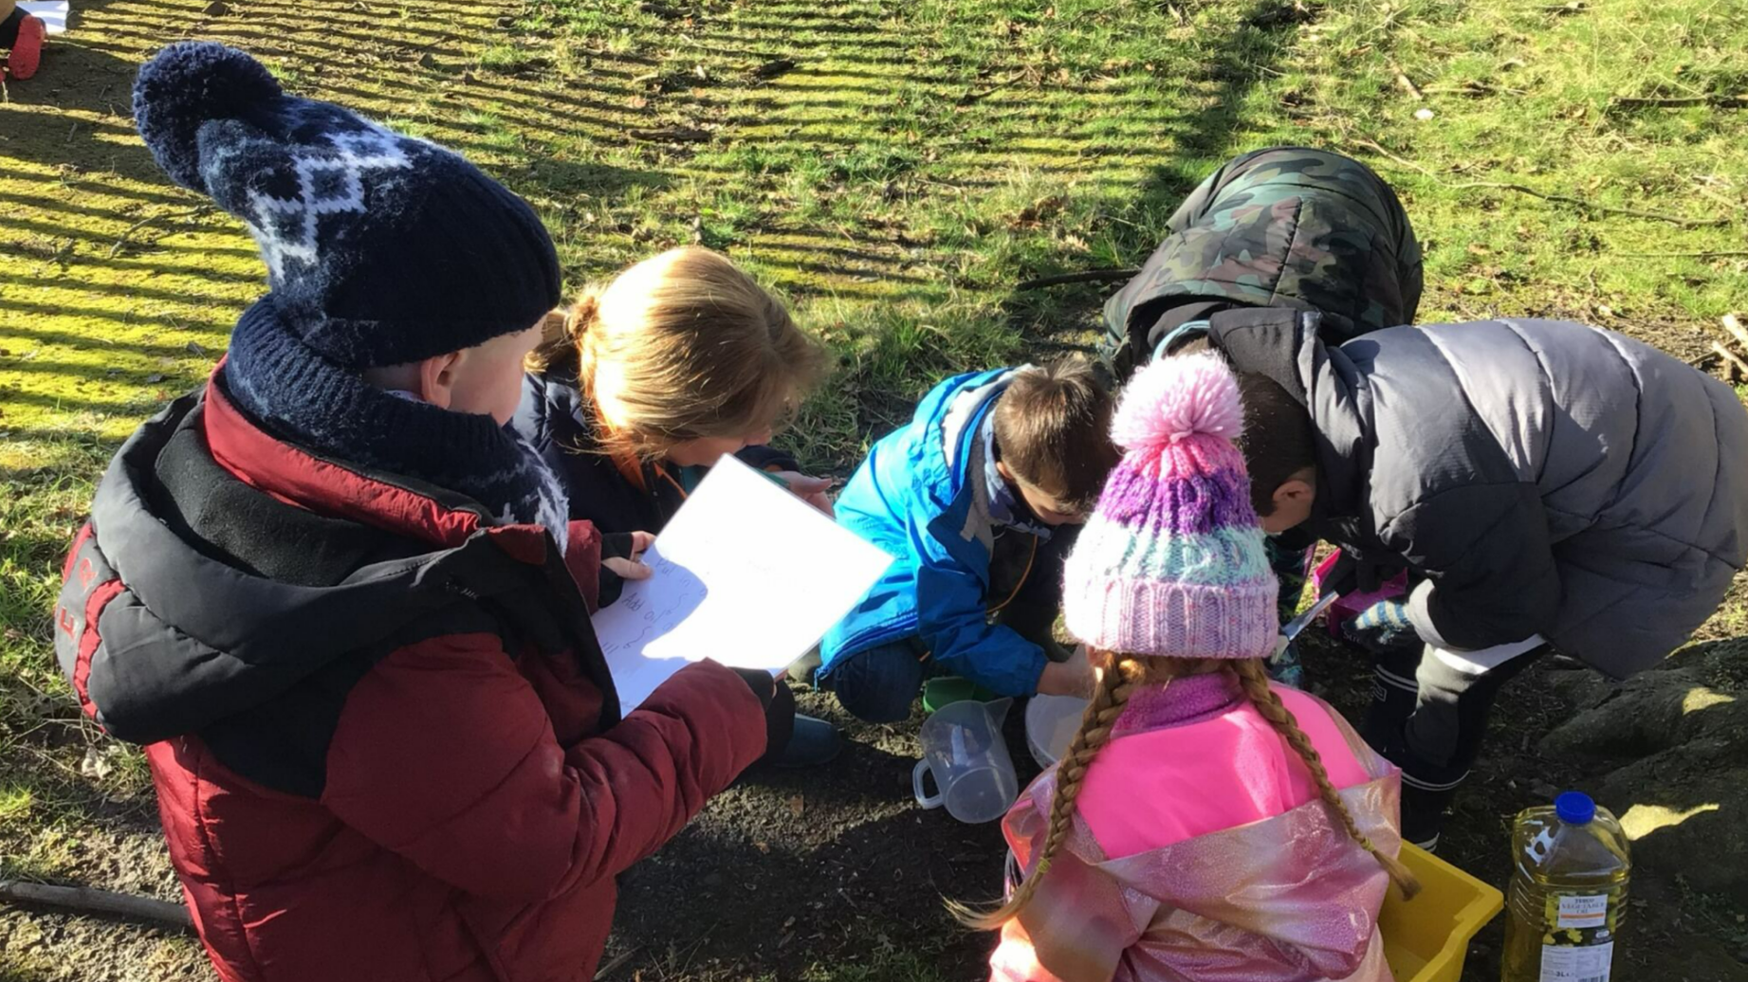

Slide 10
