Slide 1
Number bond scavenger hunt
Maths week 2026

Slide 2
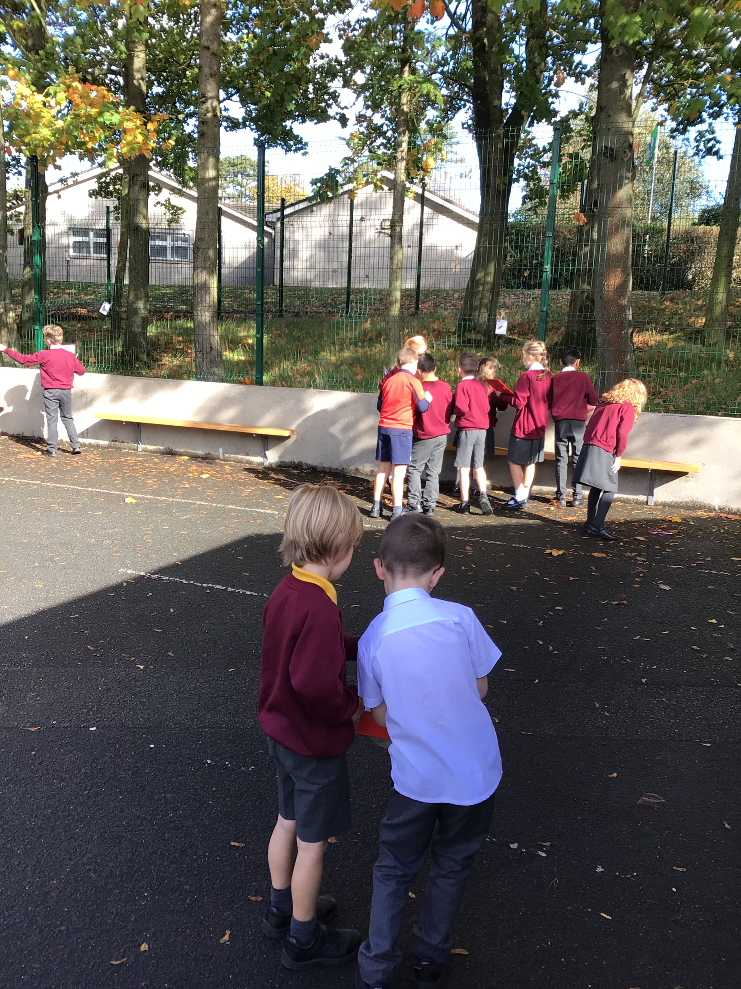
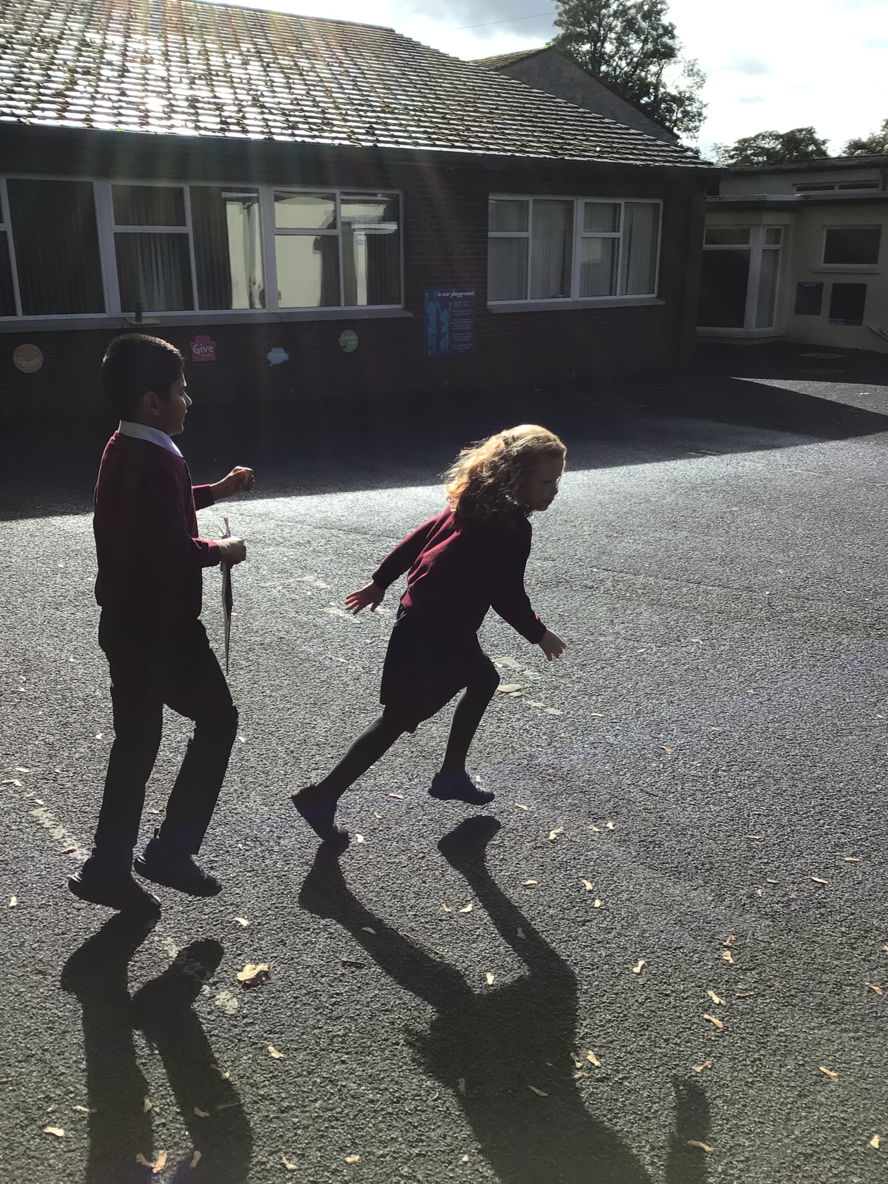
P4 had fun finding the mini-beasts and their sums!

Slide 3
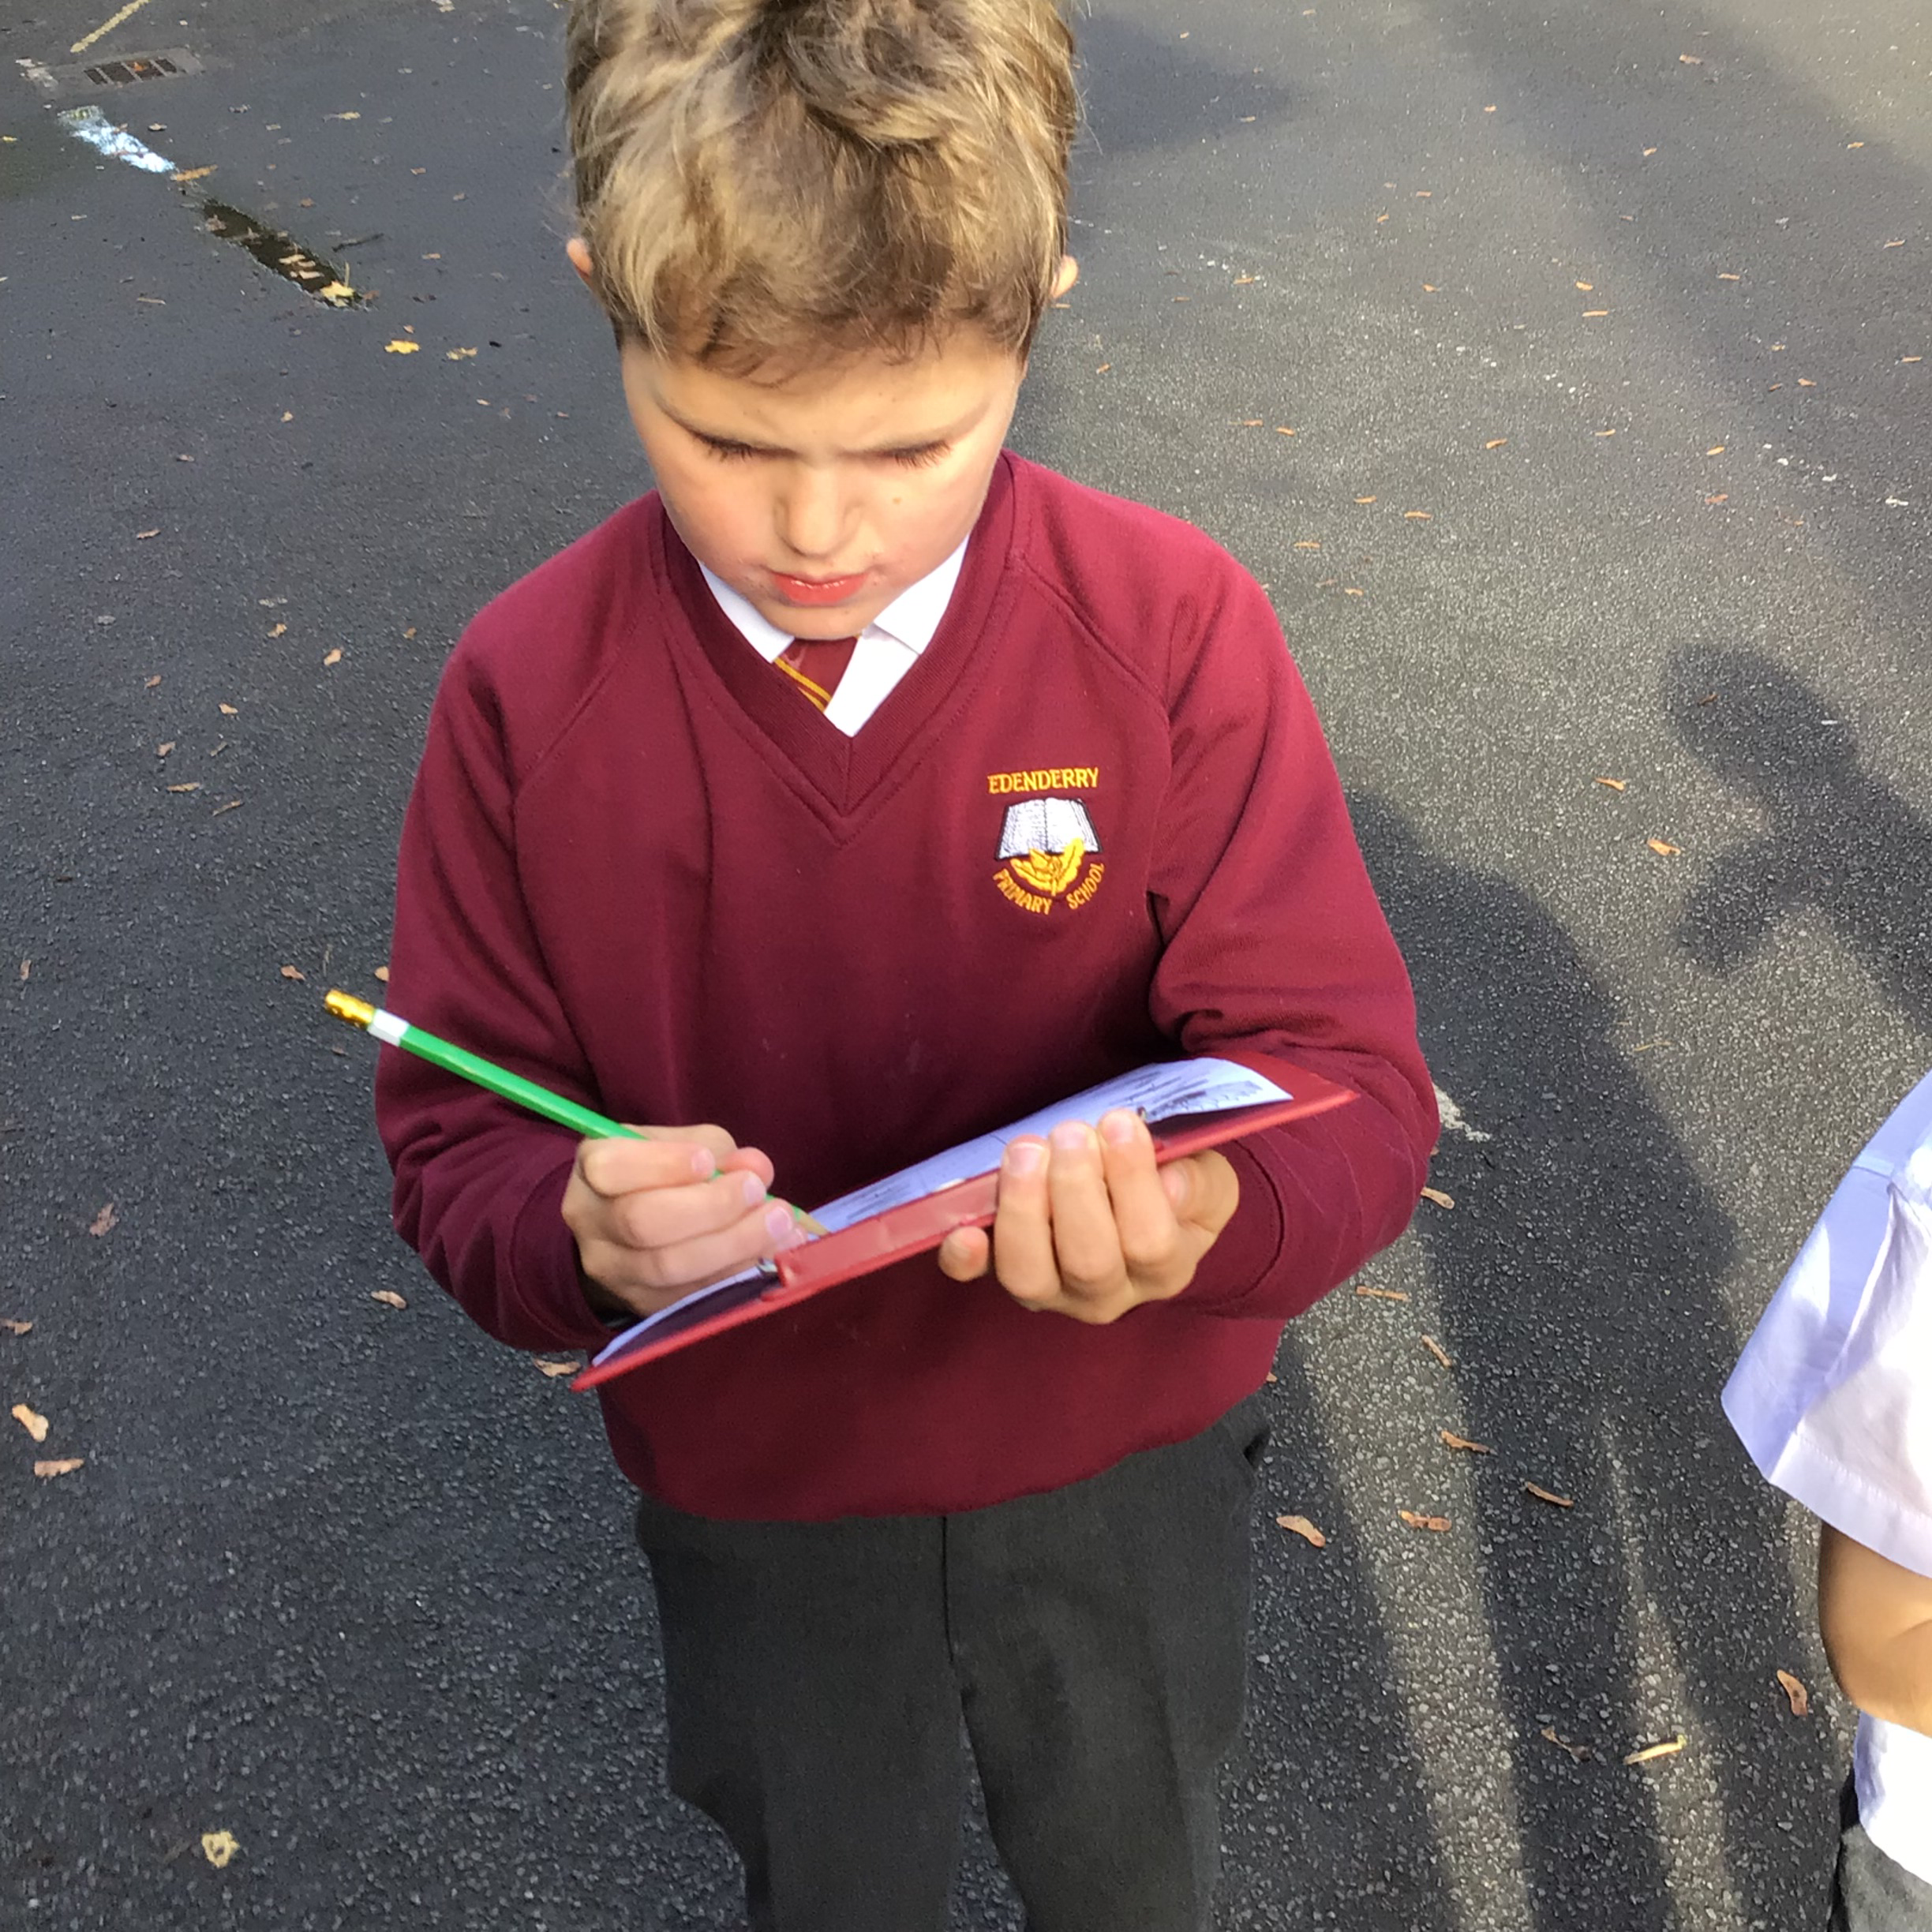
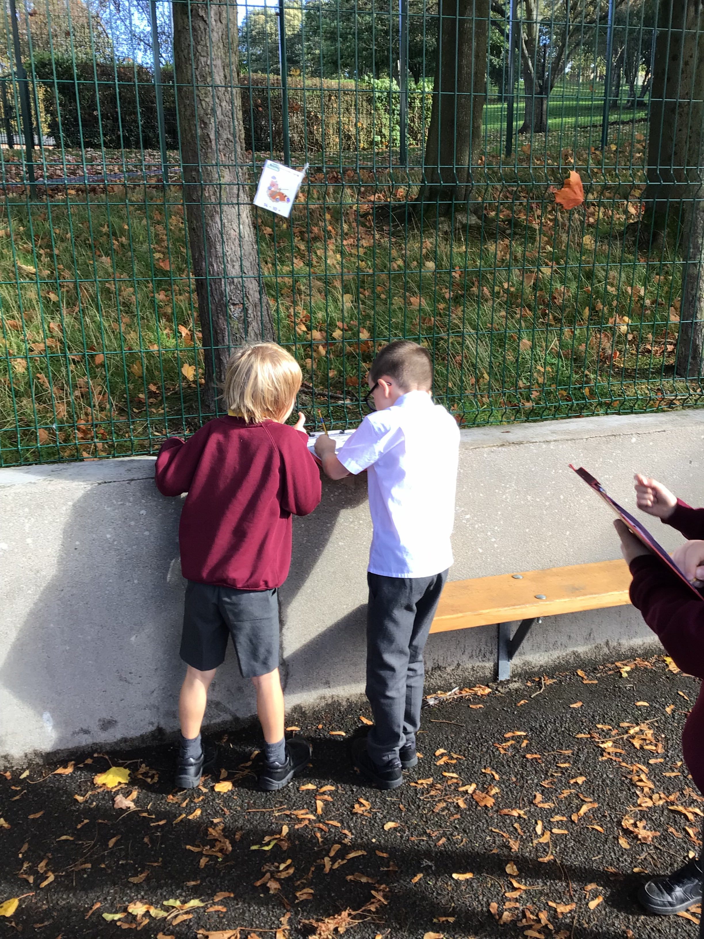
Then we had to work out the answer with our partners.

Slide 4
