Slide 1
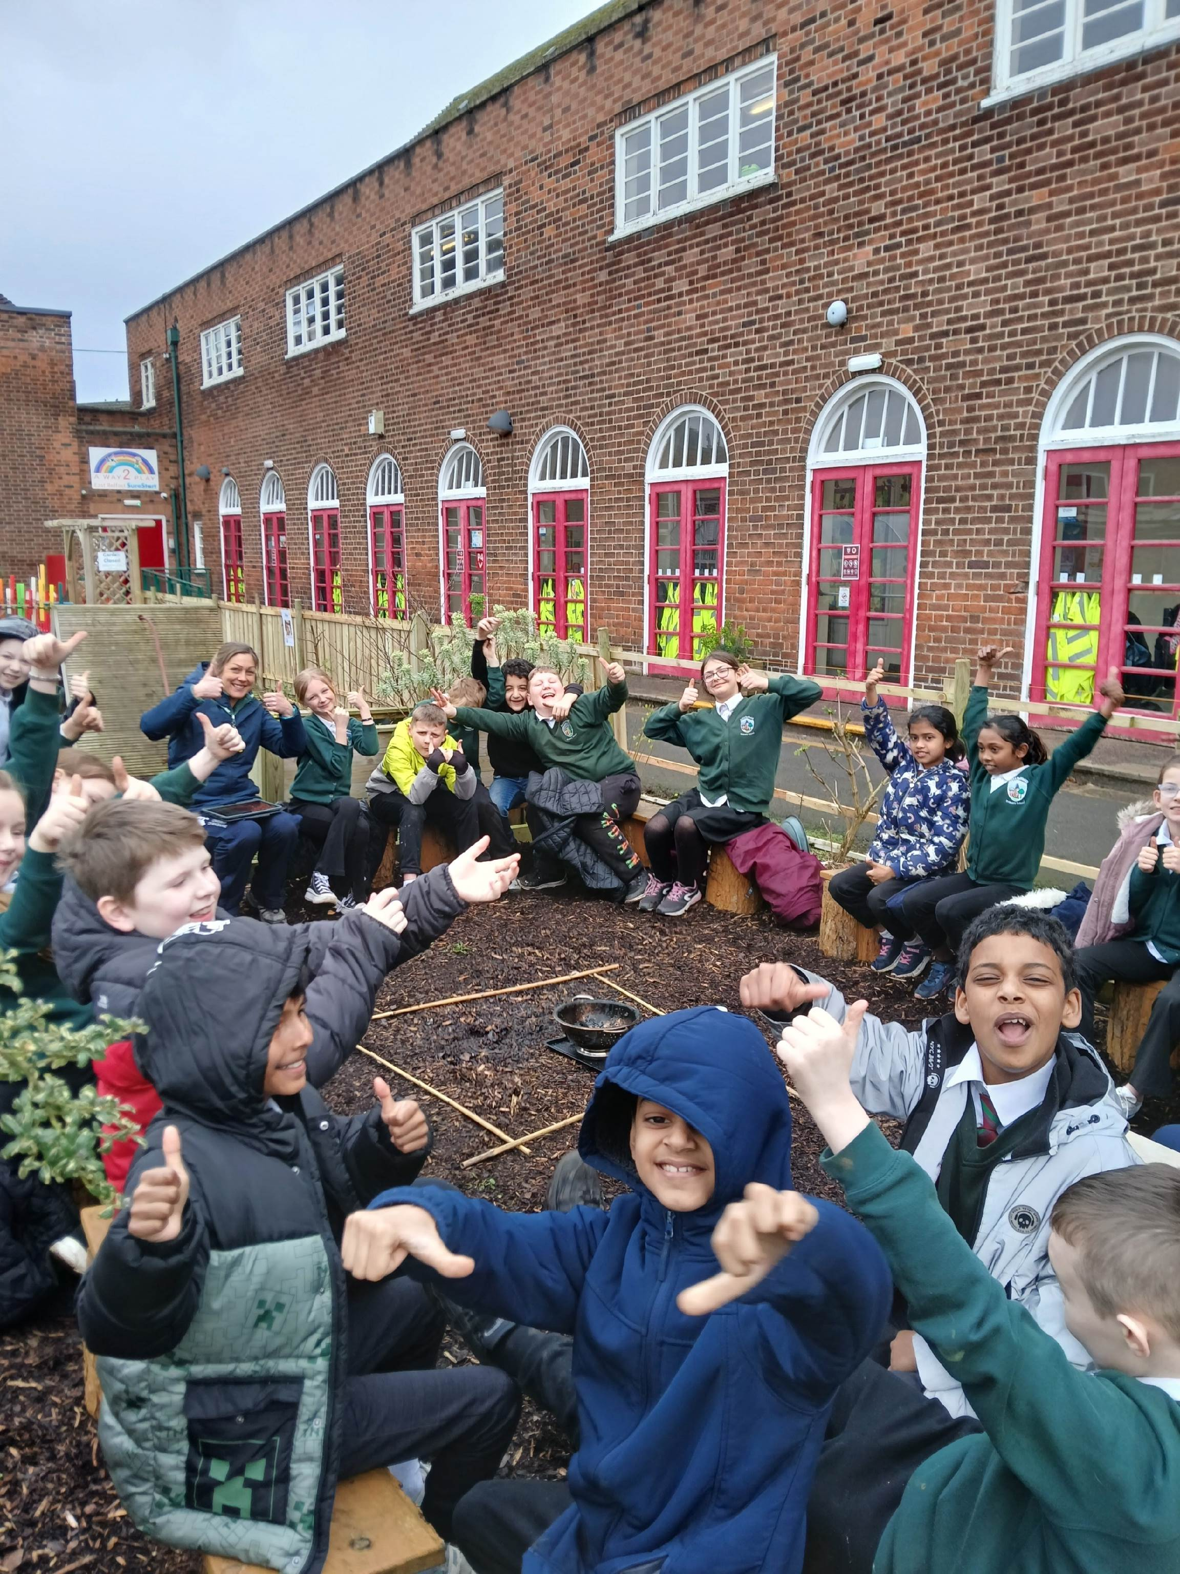
nettlefield PS Our Forest School Diary Friday 7th March 2025

Slide 2
Rules
We go over our Forest School rules:
1 whistle: stop
2 whistles: back to base
3rd rule: have fun and learn

Slide 3
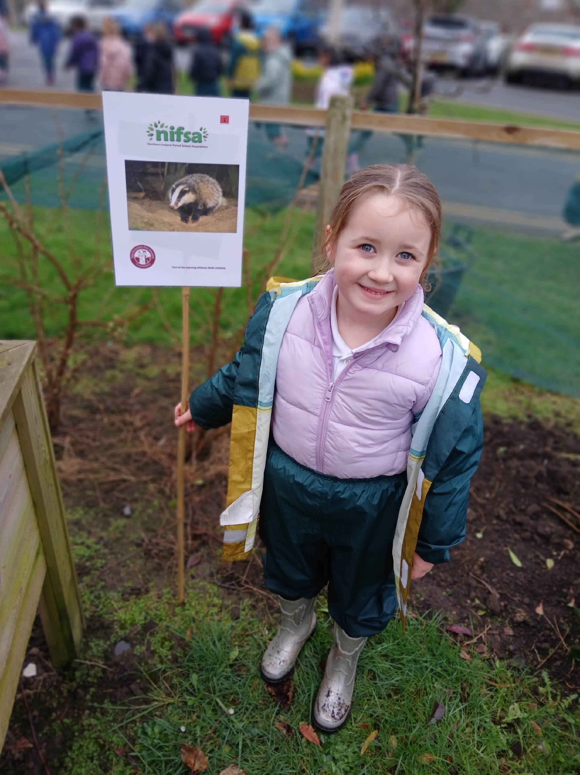
Rules
We put out the boundaries so we knew how far we could go during the activities.

Slide 4
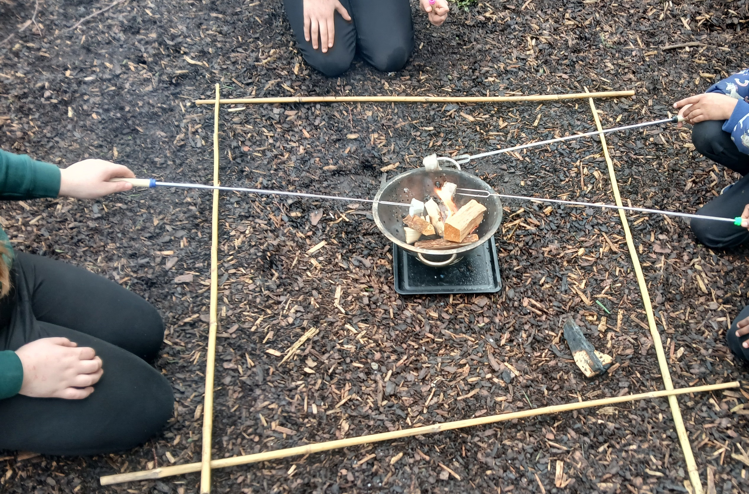
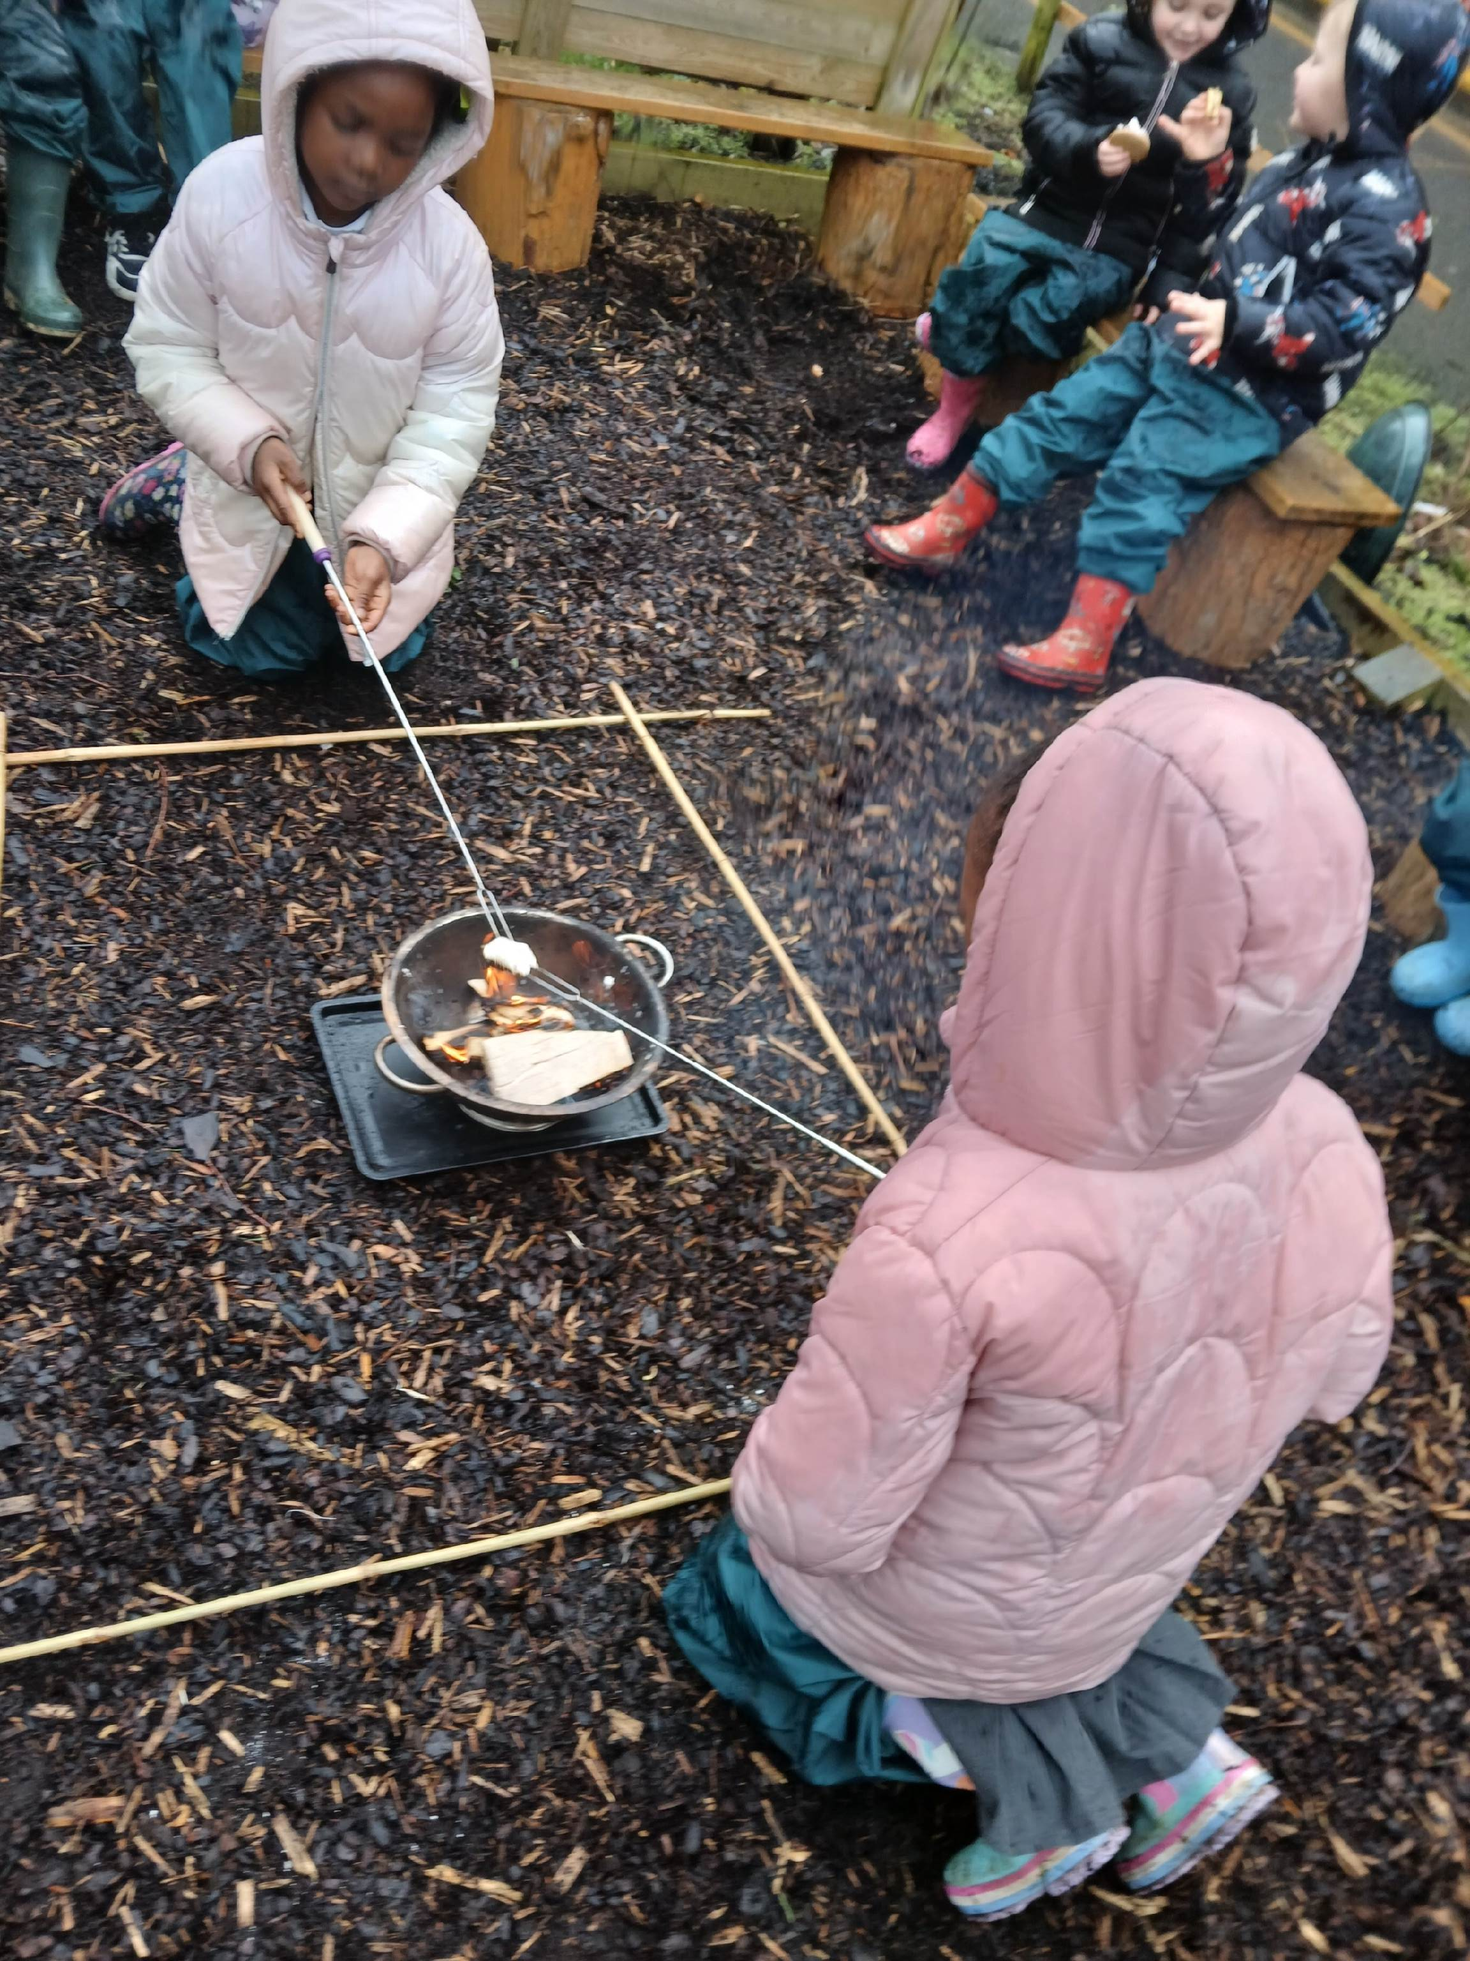
Fire
We discussed fire safety and lit the fire

Slide 5
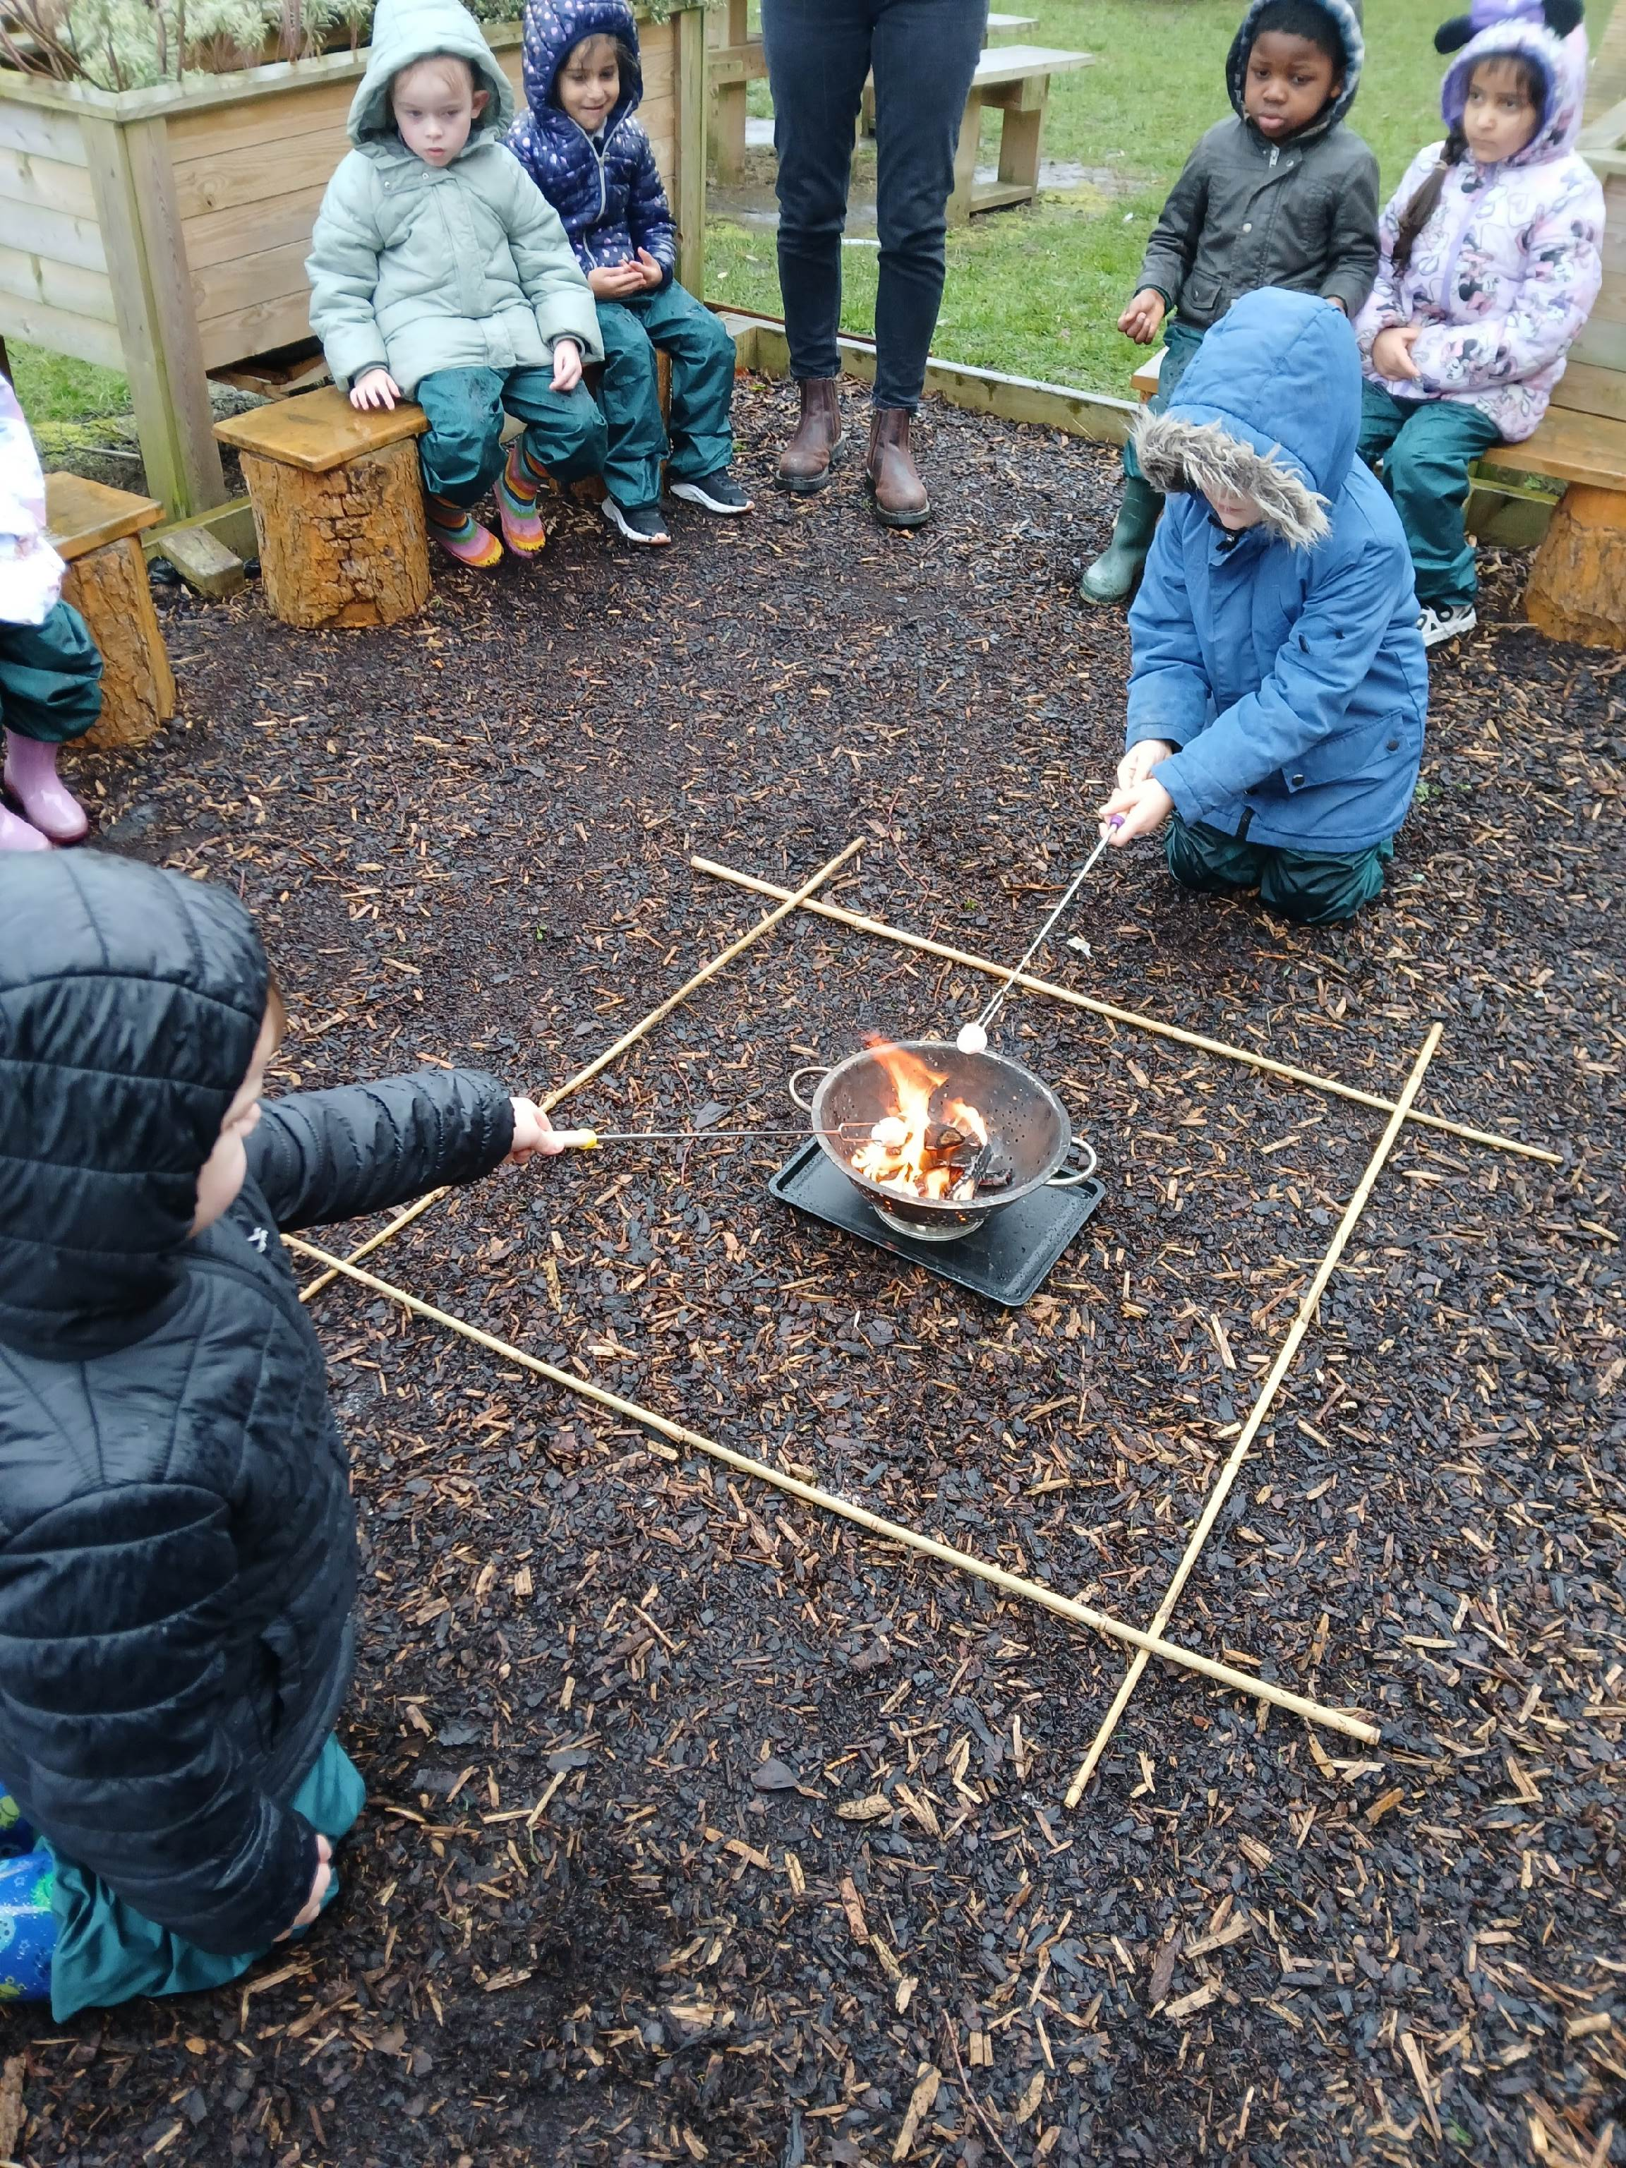
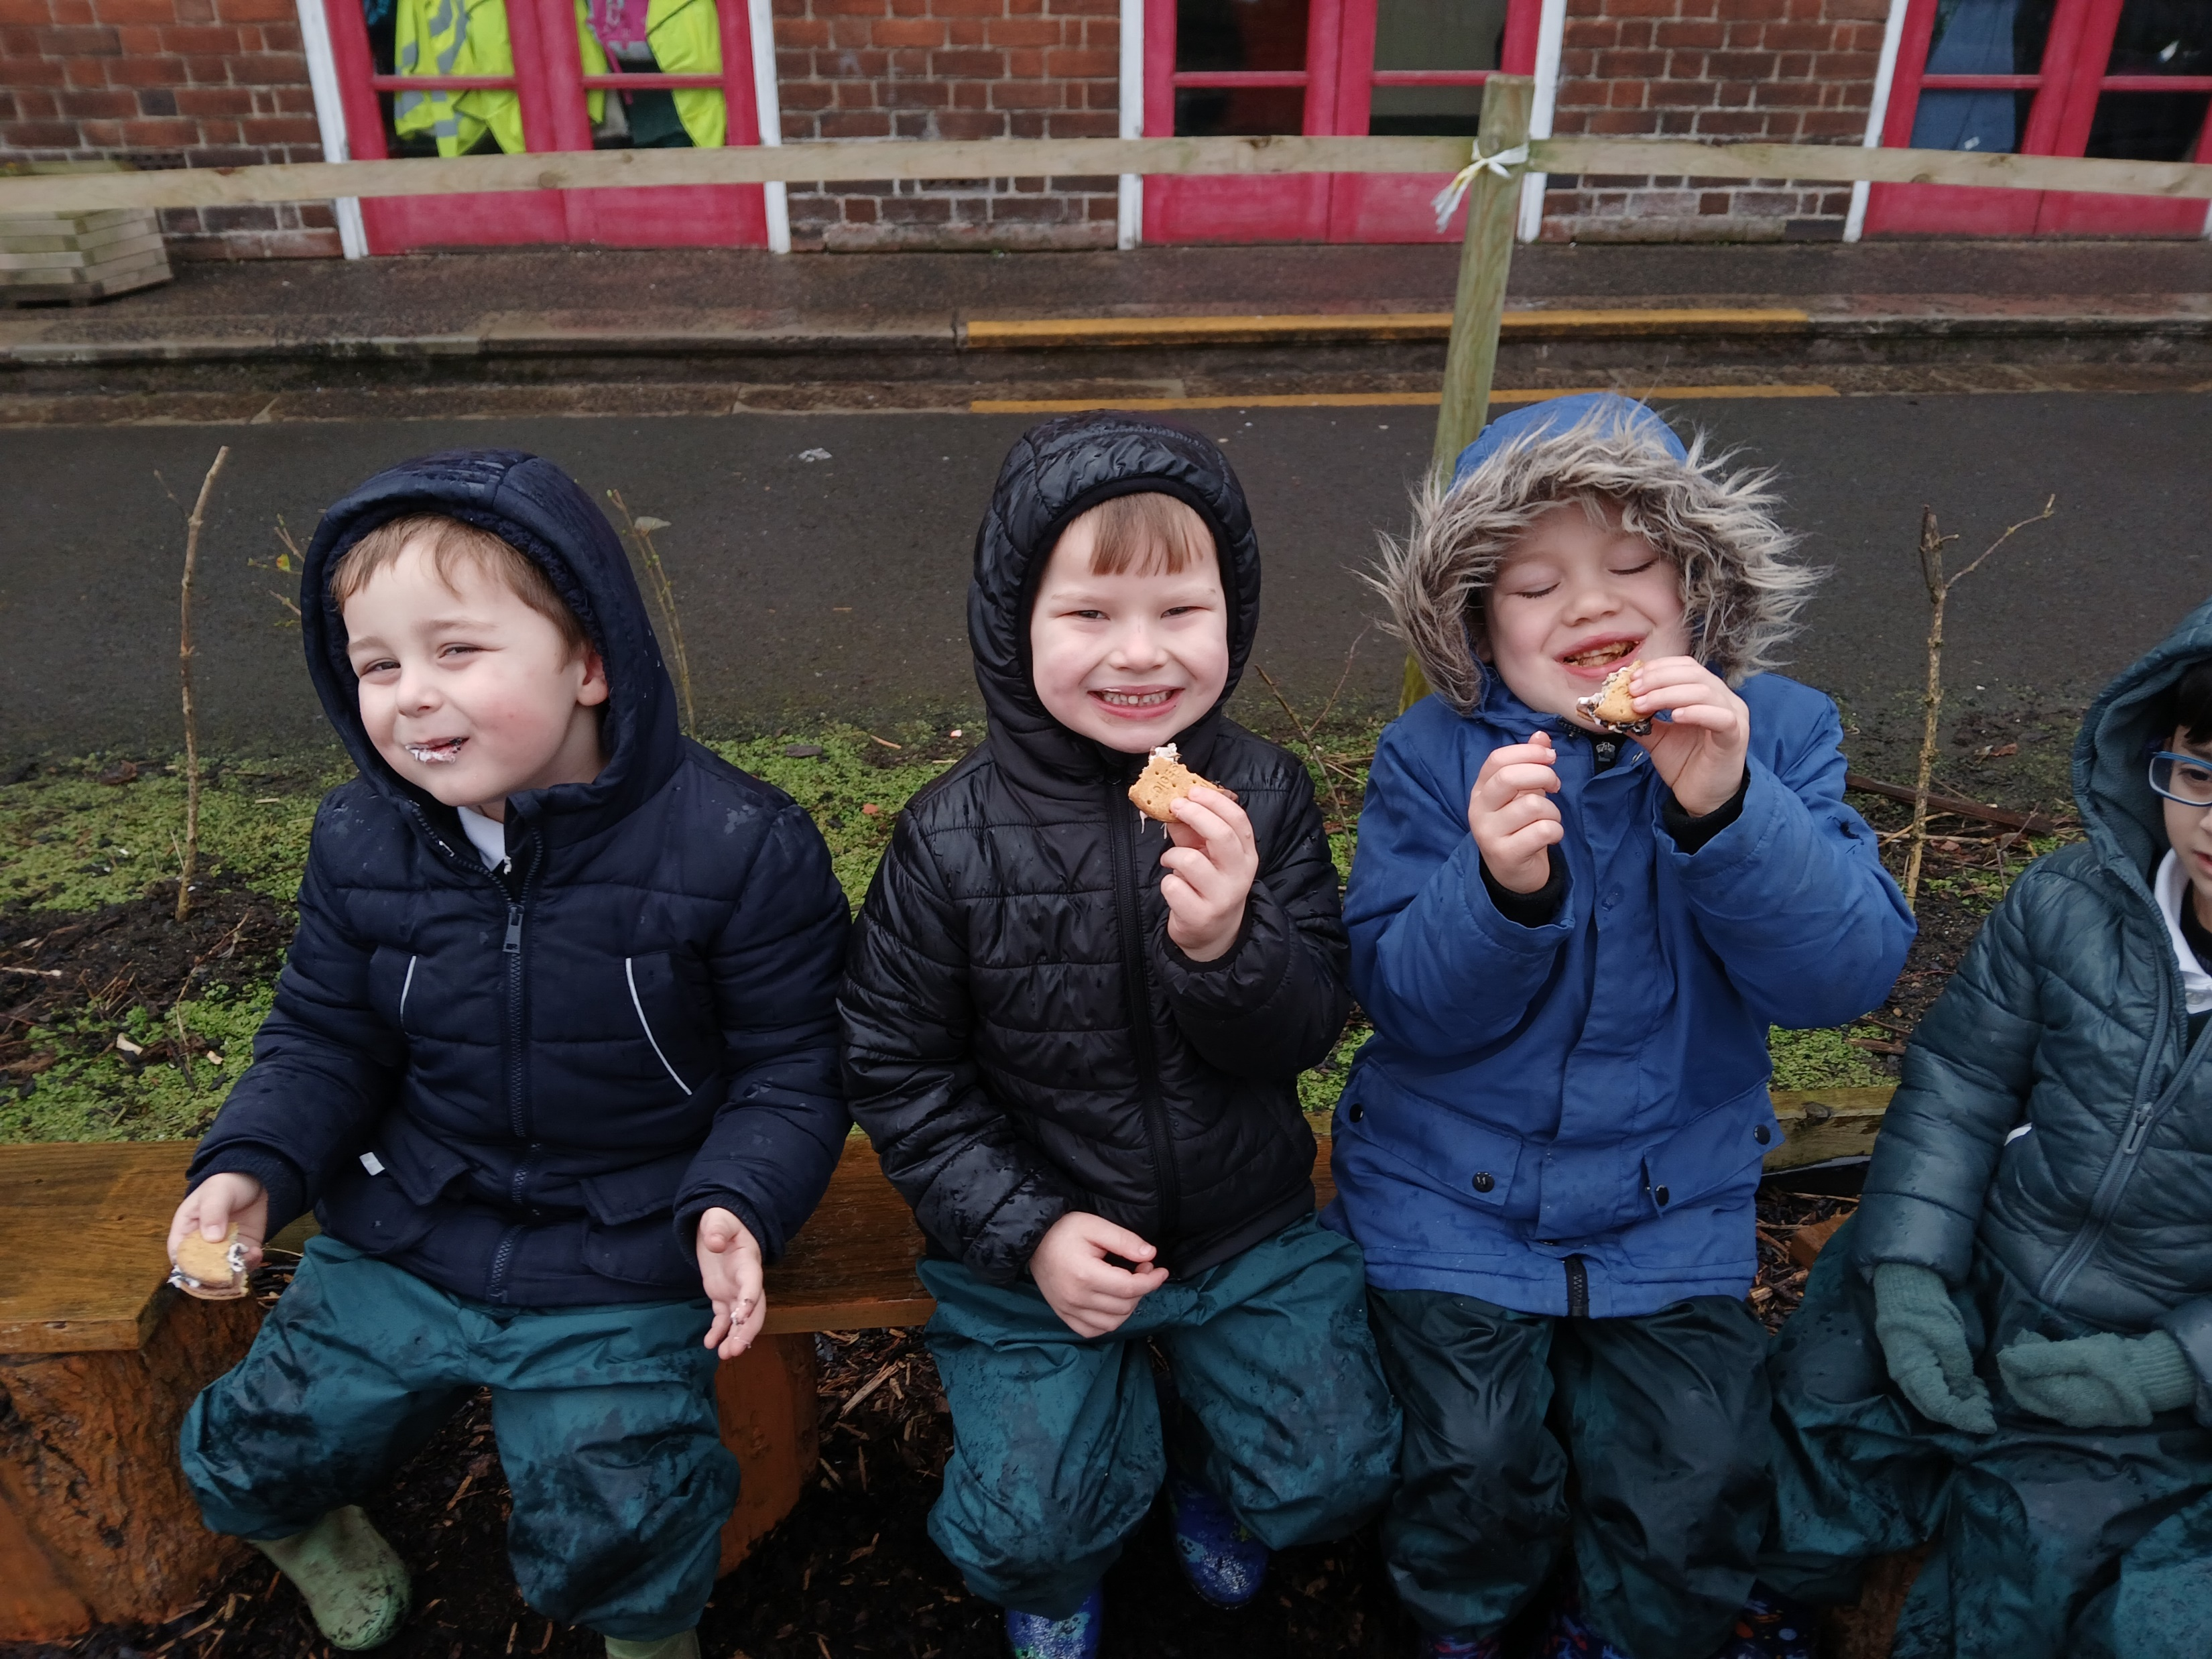
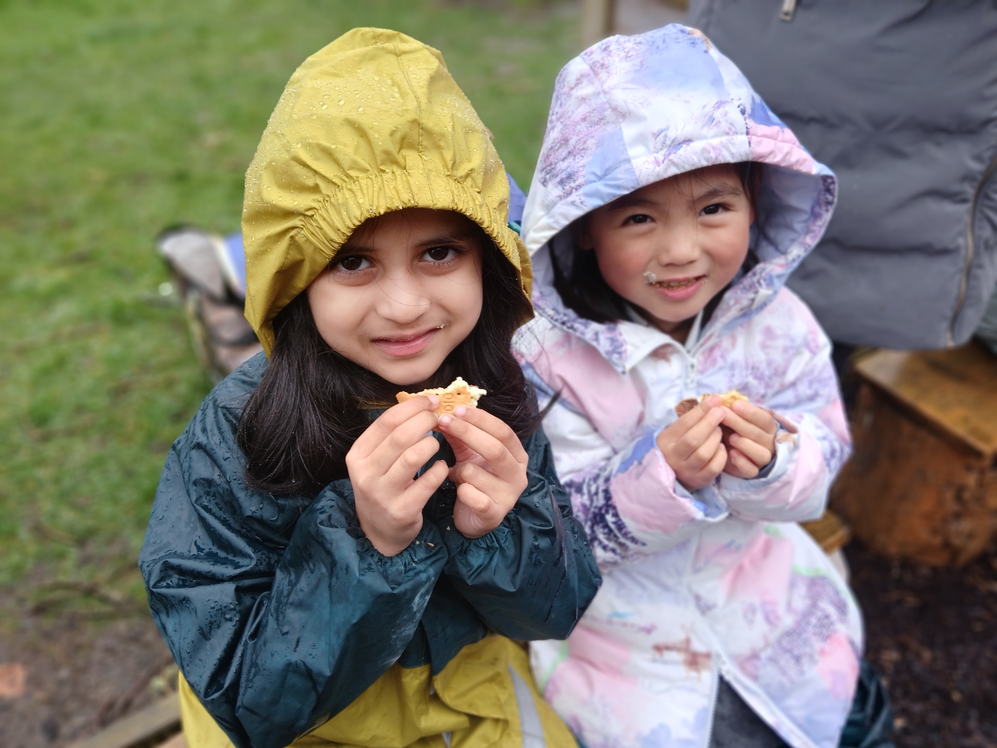
Fire
We toasted marshmallows.
We made some smore’s. Best bit was eating them!

Slide 6
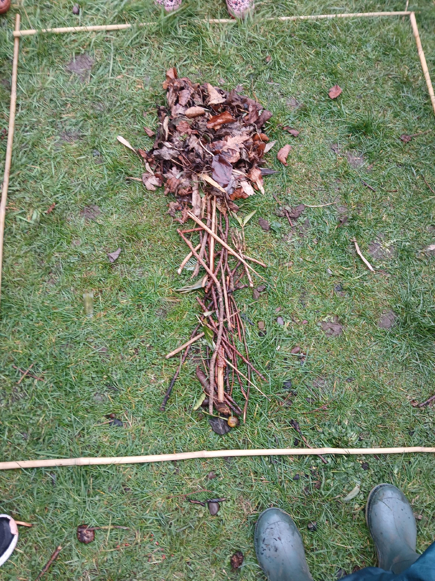
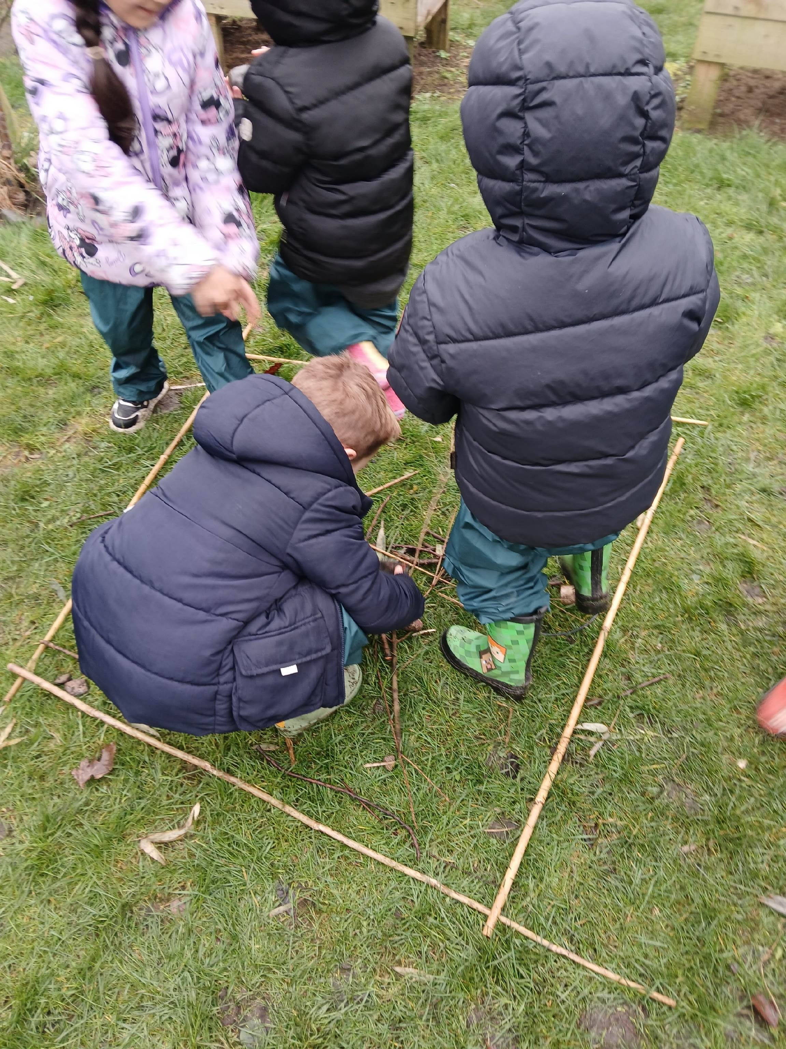
Trees
Time to make our own tree. We use bamboo canes to make our picture frame.

Slide 7
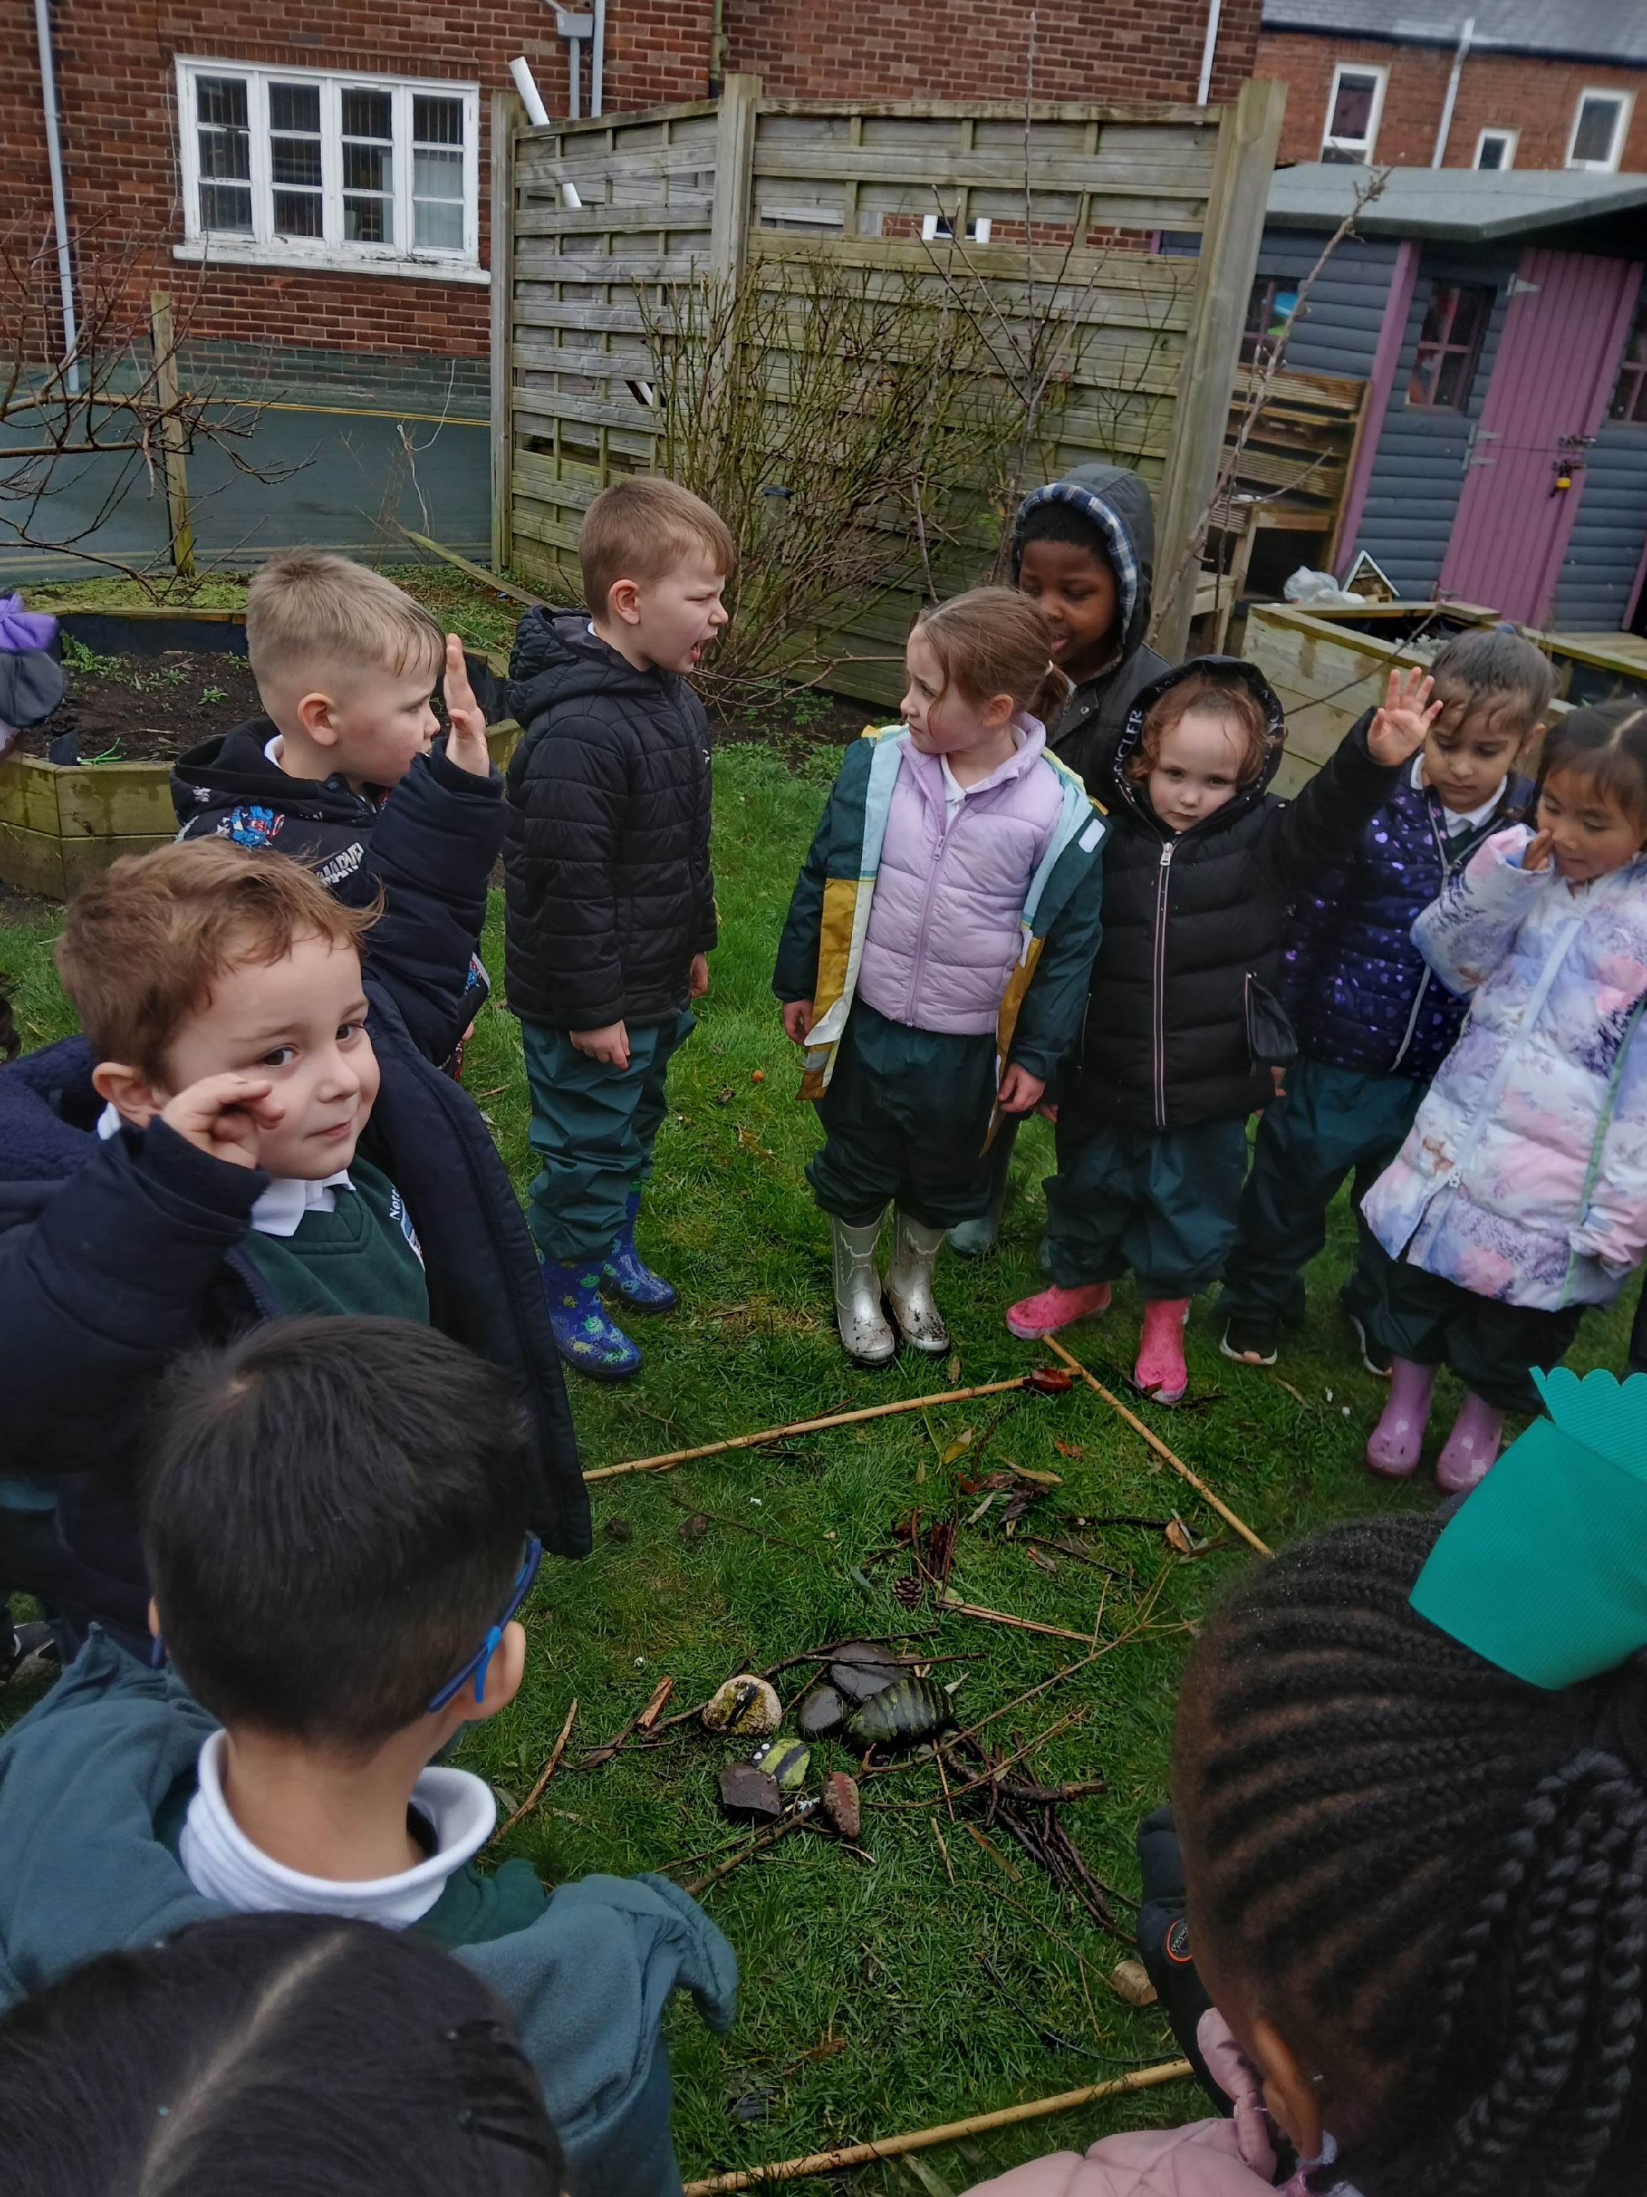
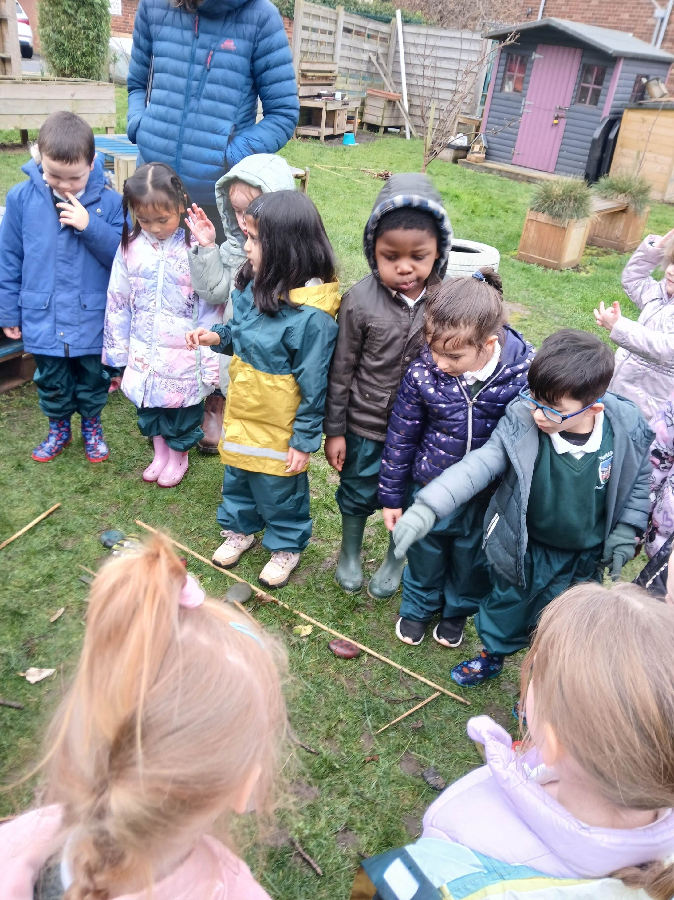
Trees
We shared our tree pictures with the rest of the class.

Slide 8
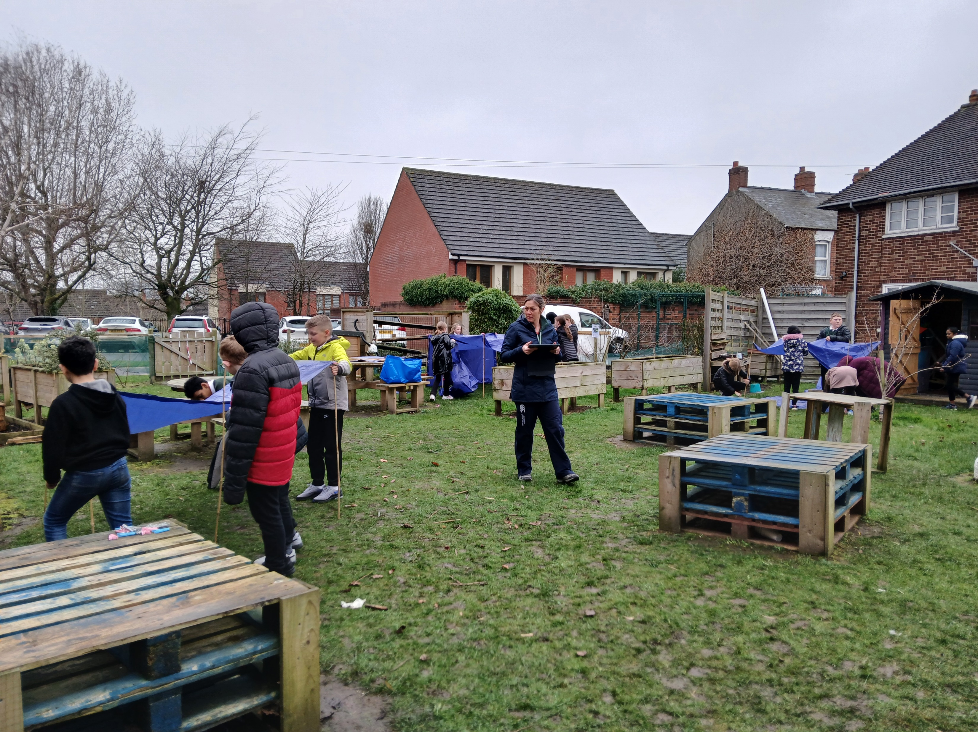
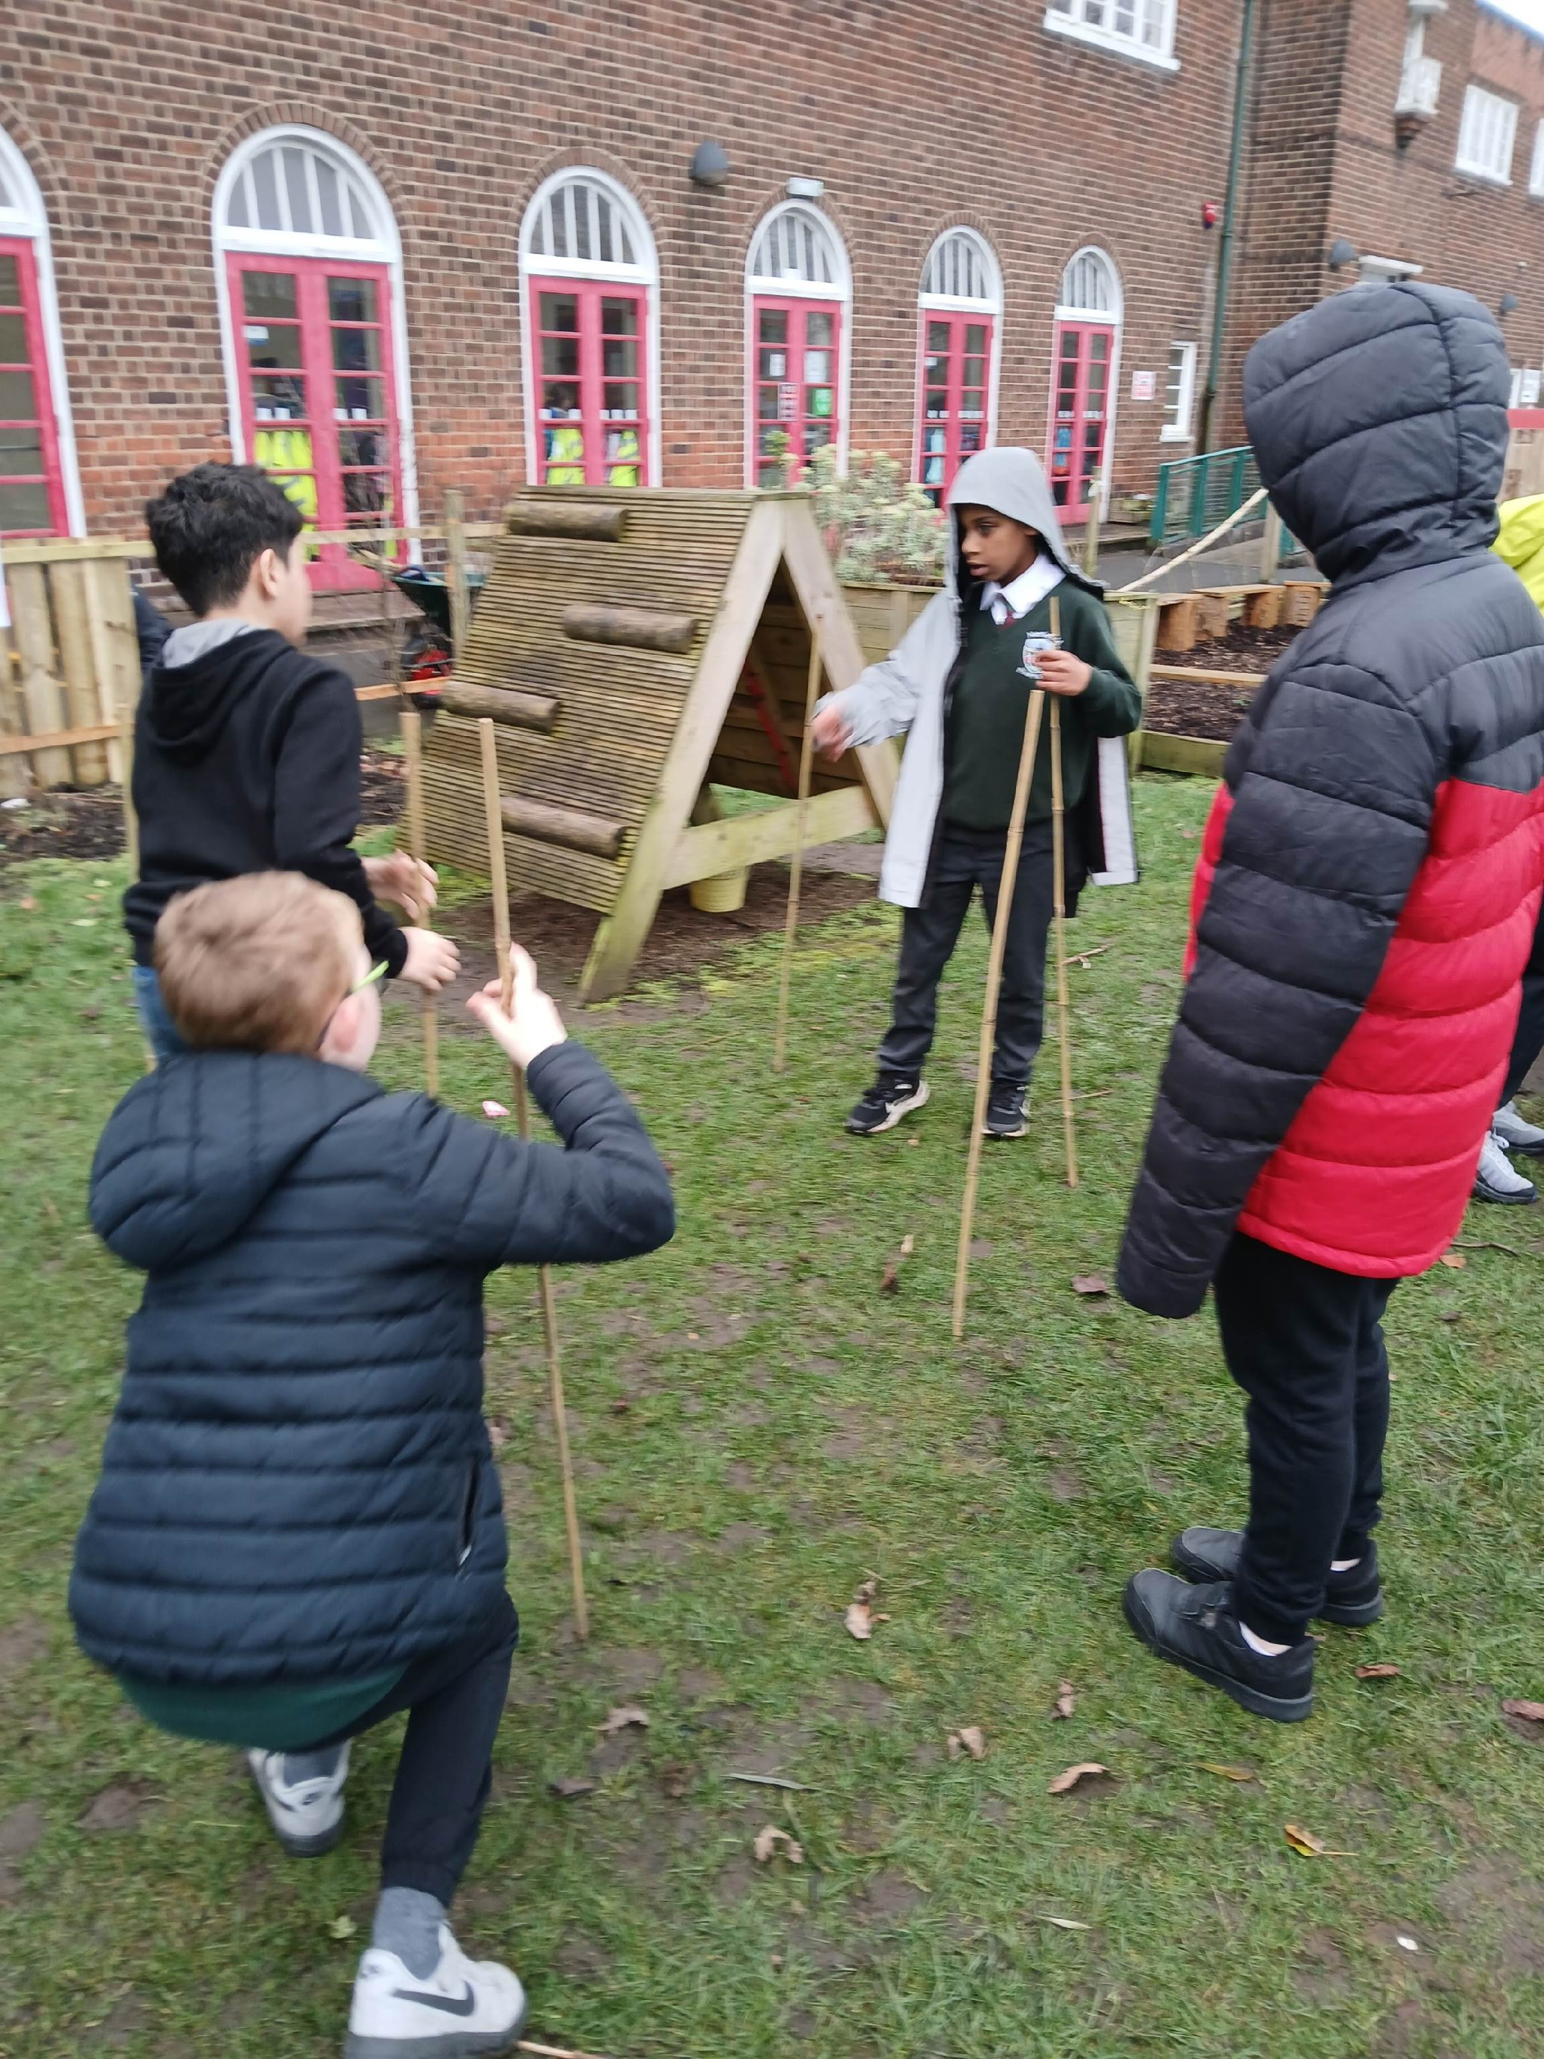
Den building
Today we are building dens – we use bamboo canes, tarpaulins and clothes pegs.

Slide 9
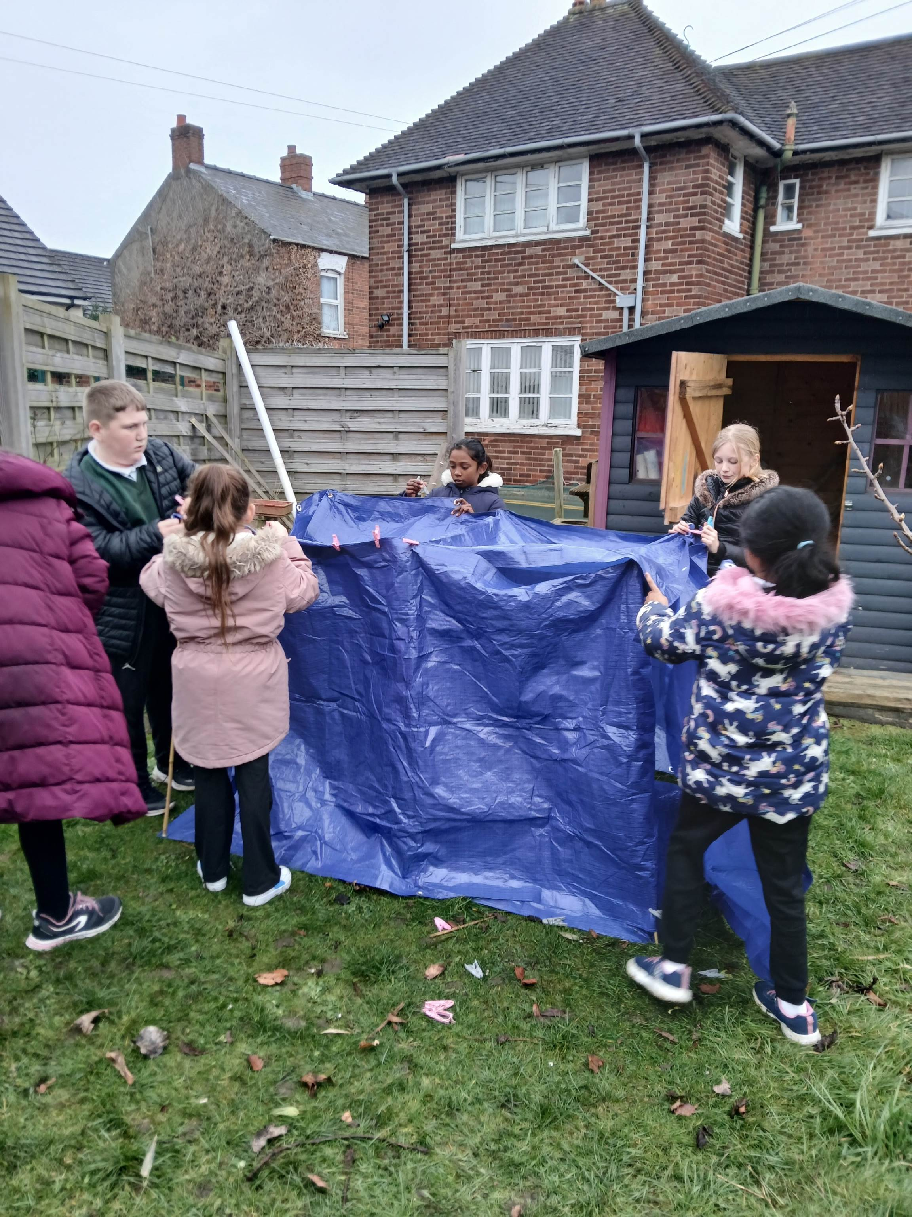
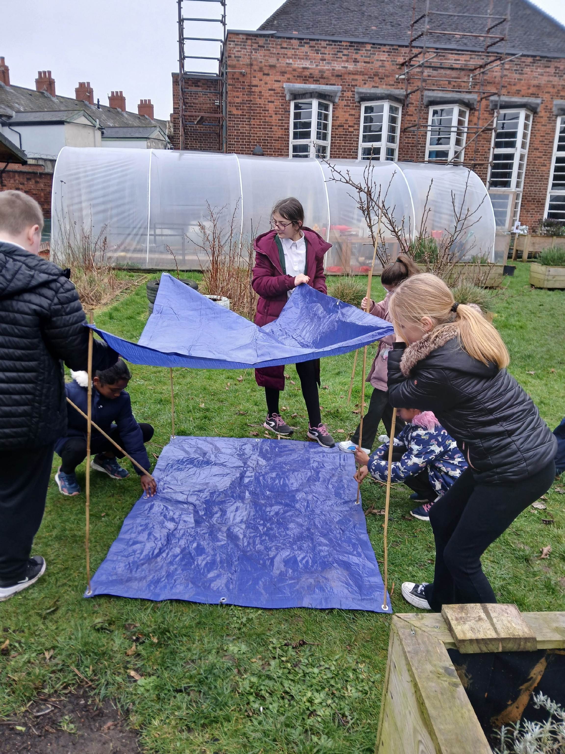
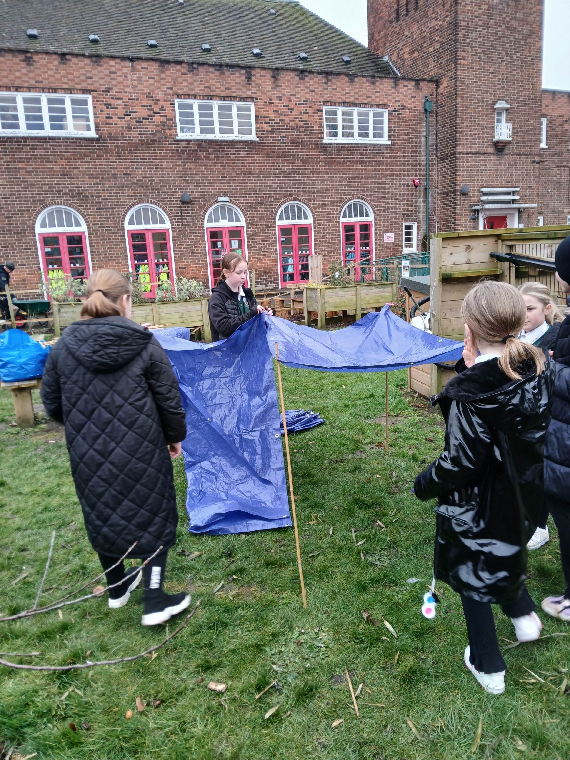
Den building
Great team work!

Slide 10
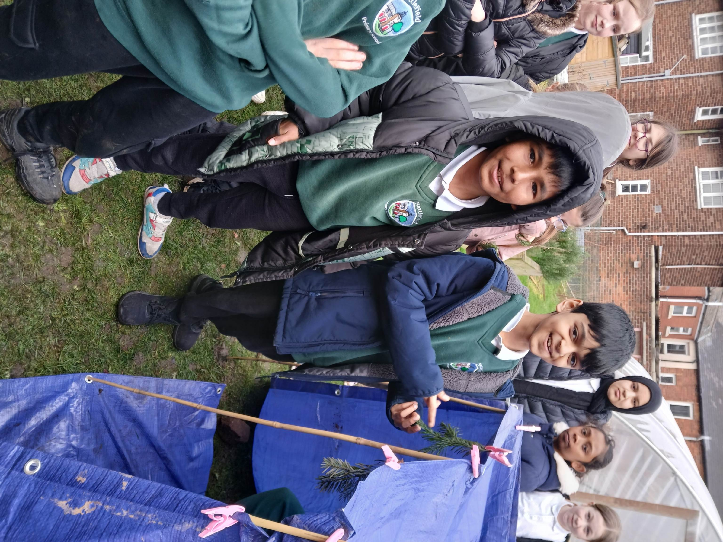
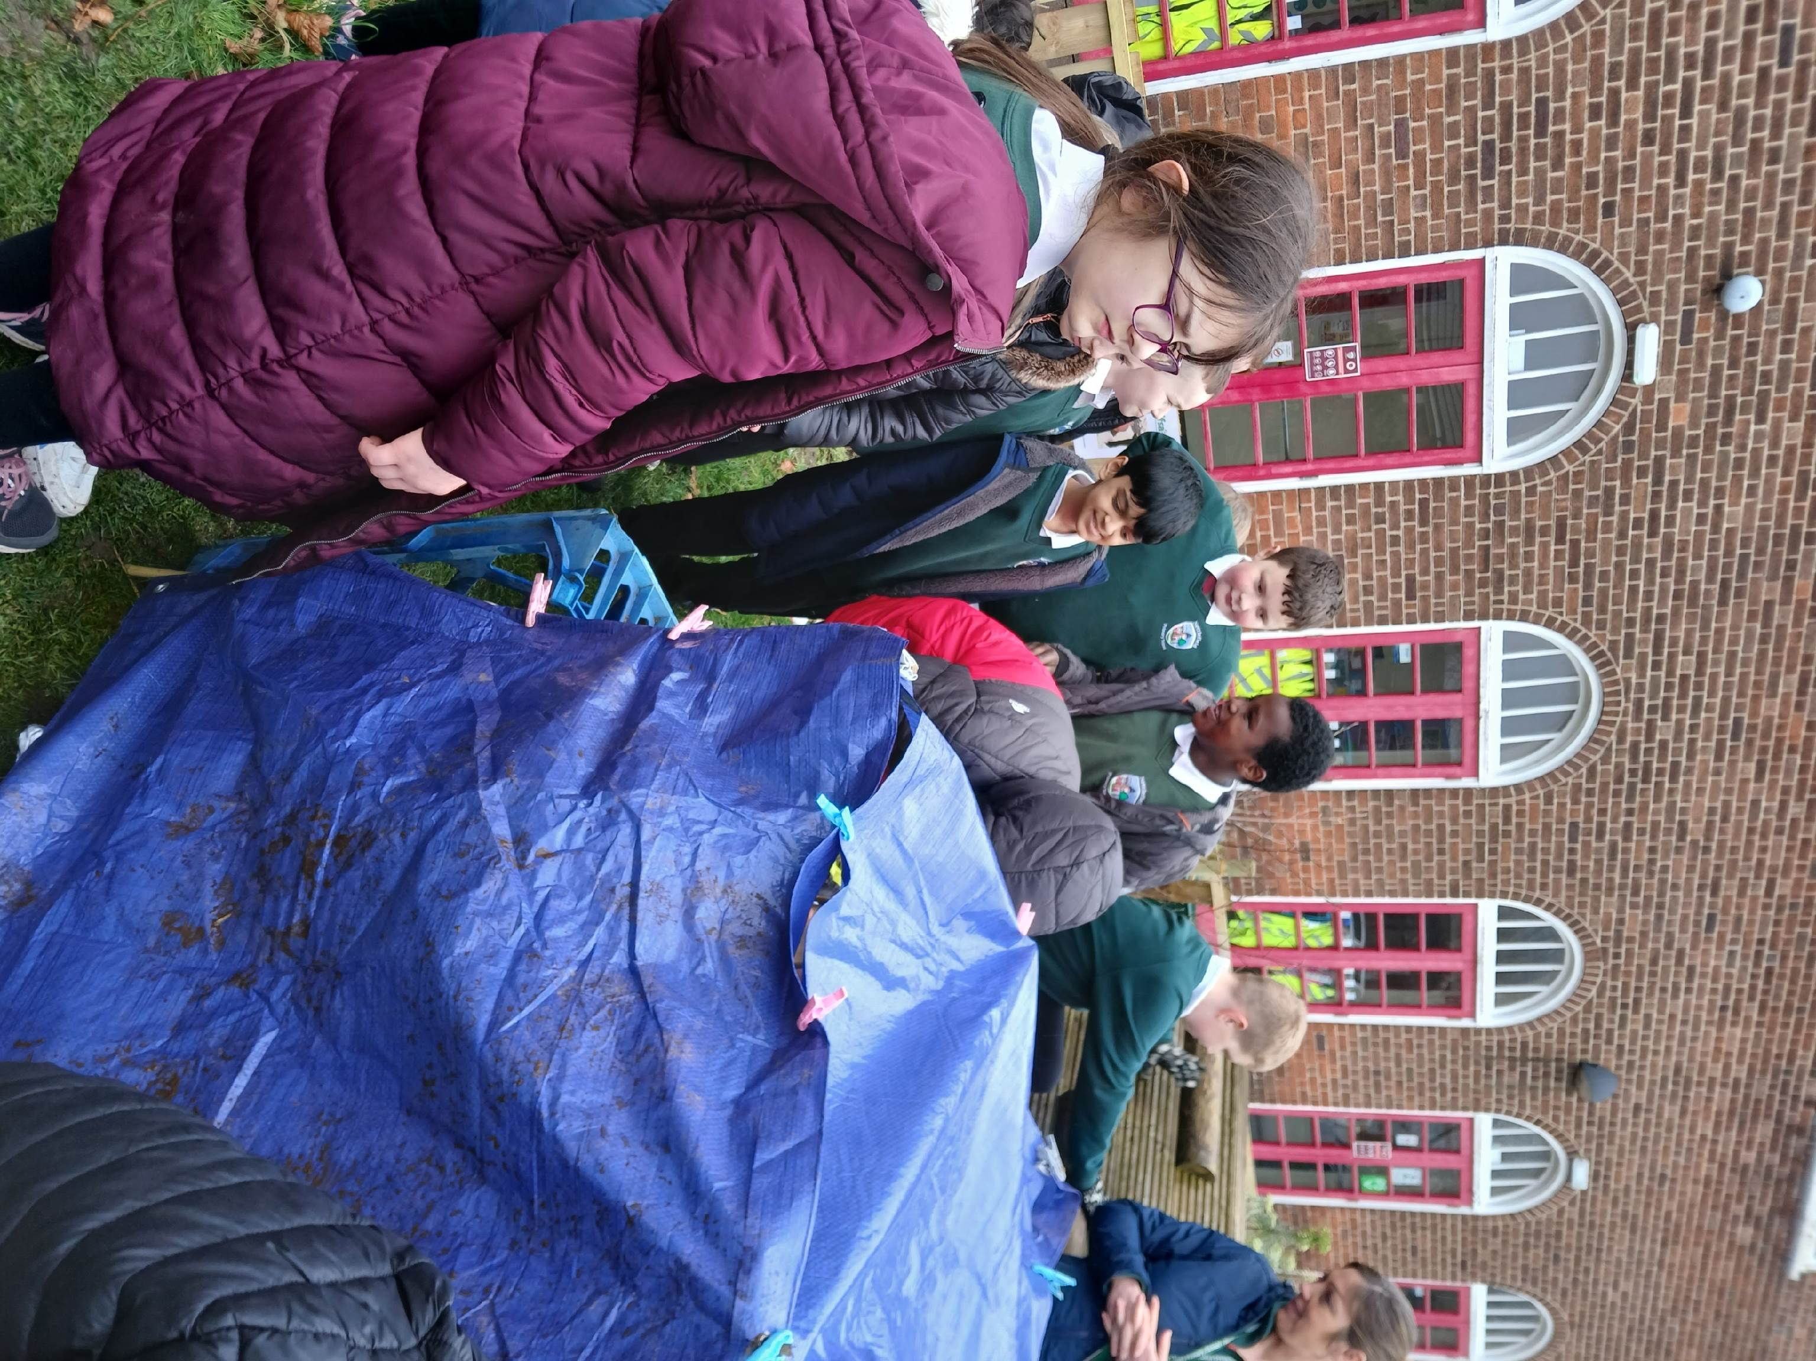
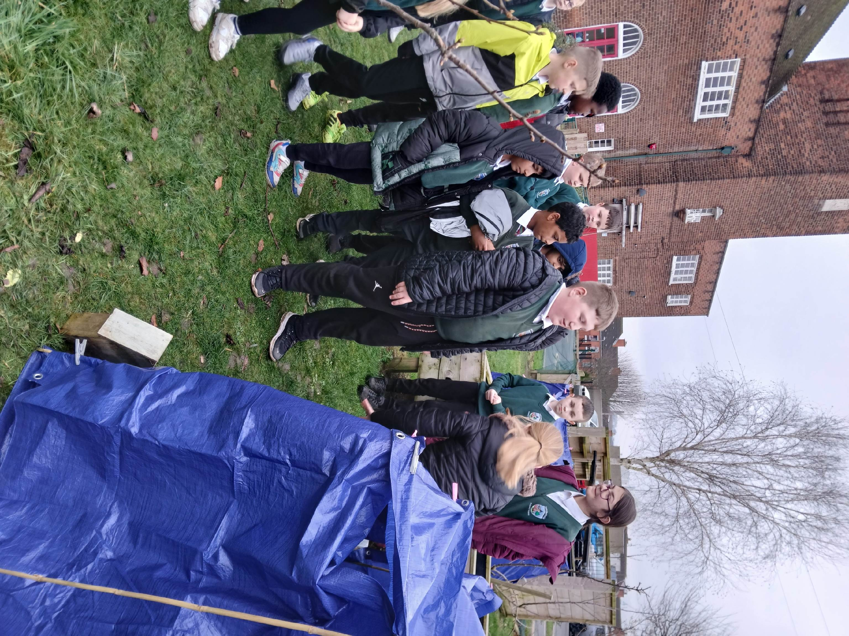
Den building
We tell the other groups about our dens.

Slide 11
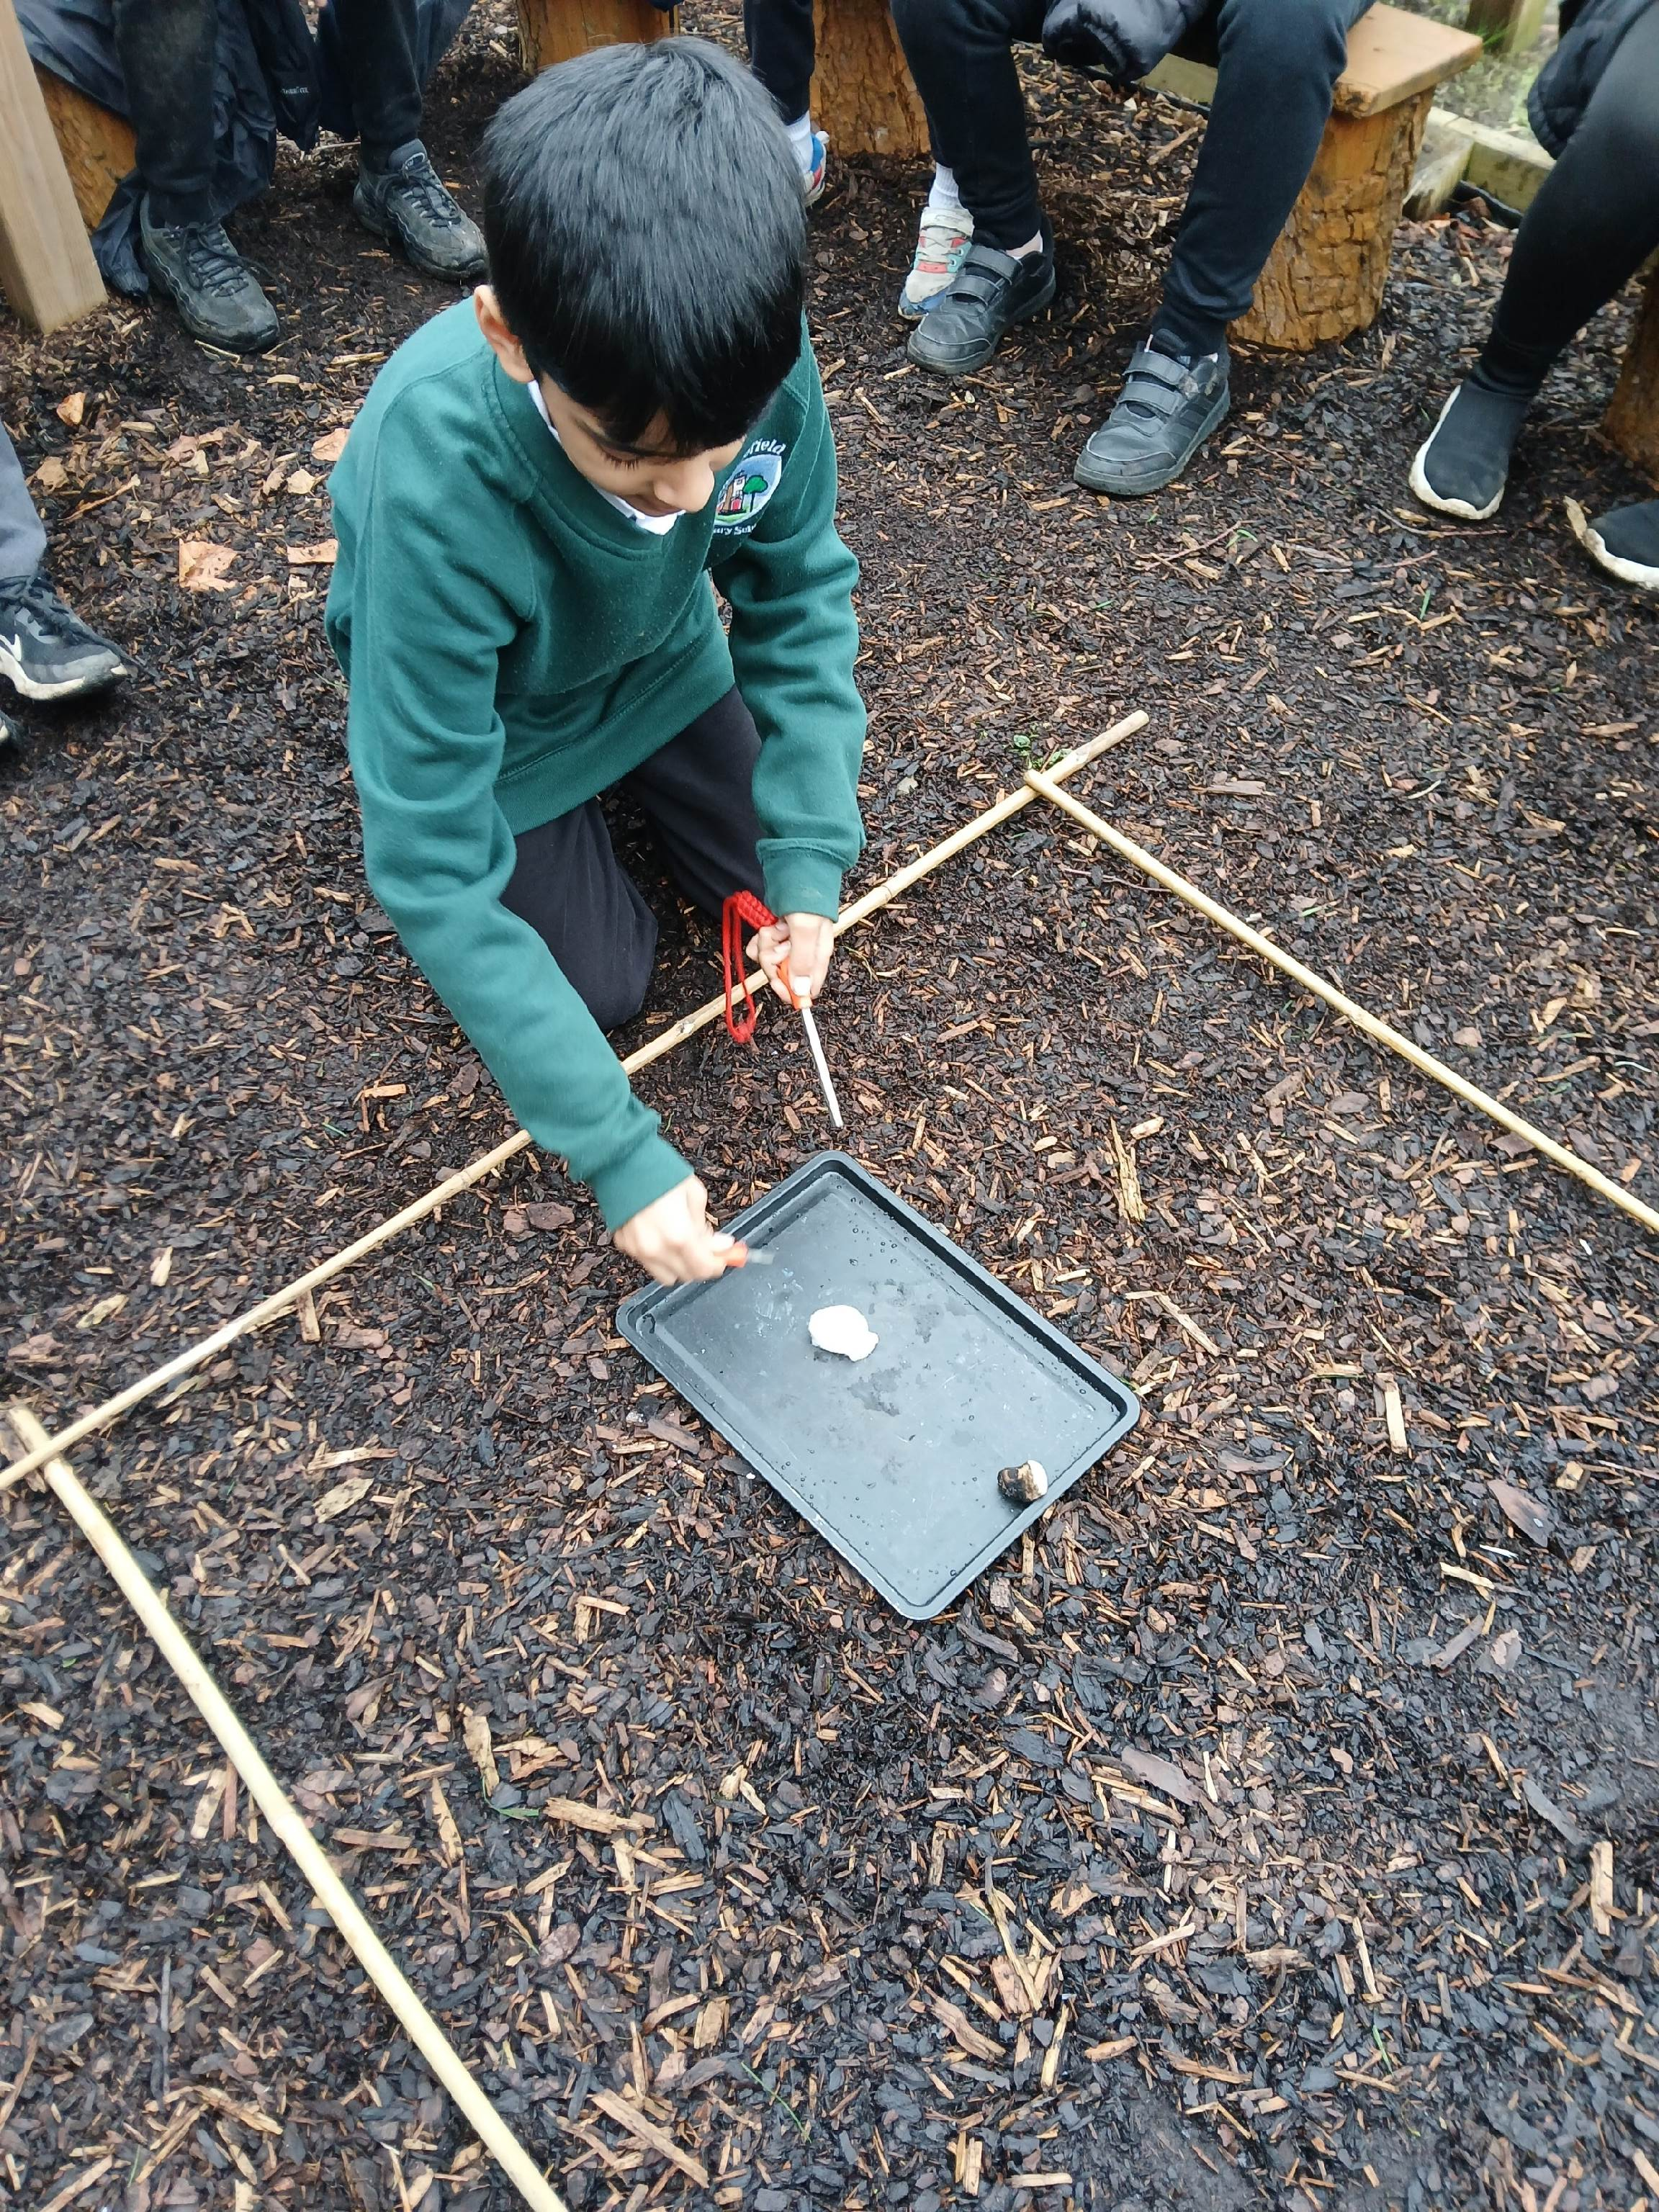
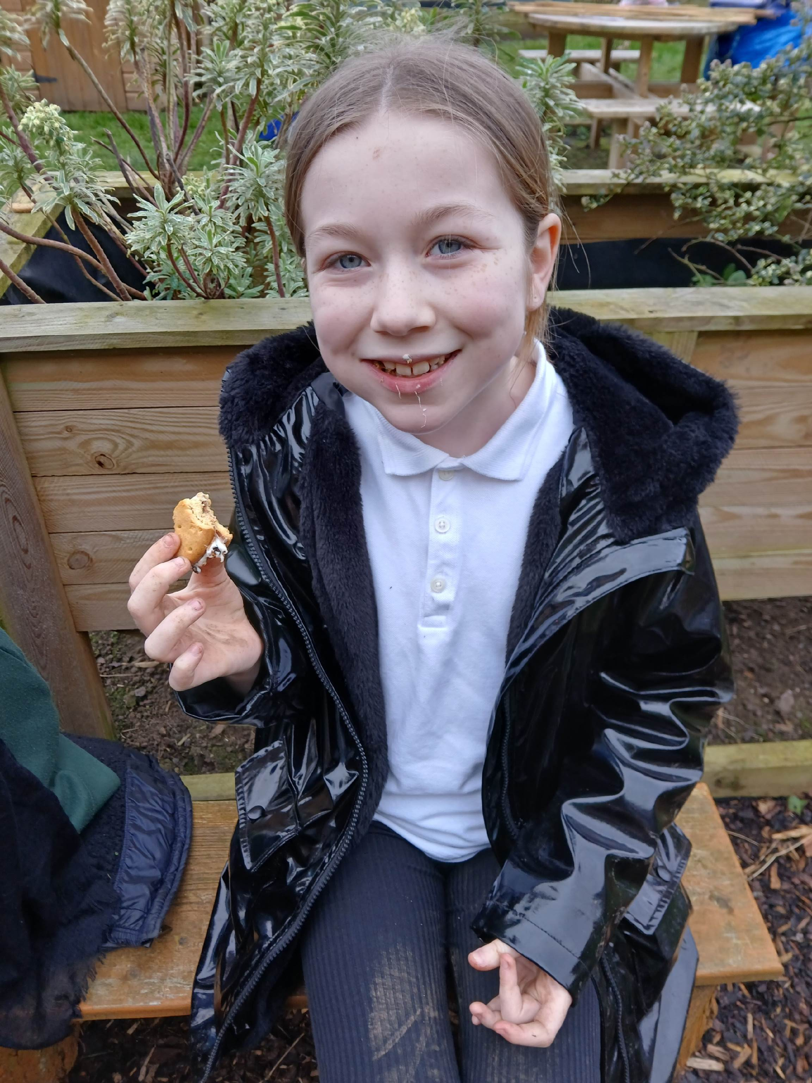
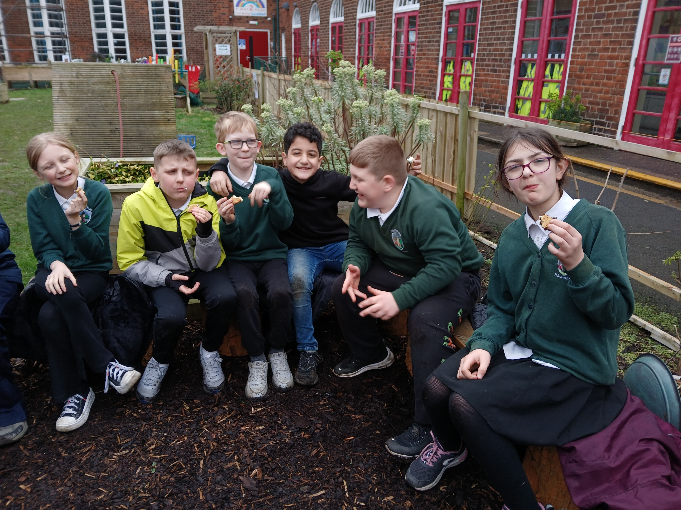
Fire
P6 practiced using the fire rods before toasting marshmallows

Slide 12
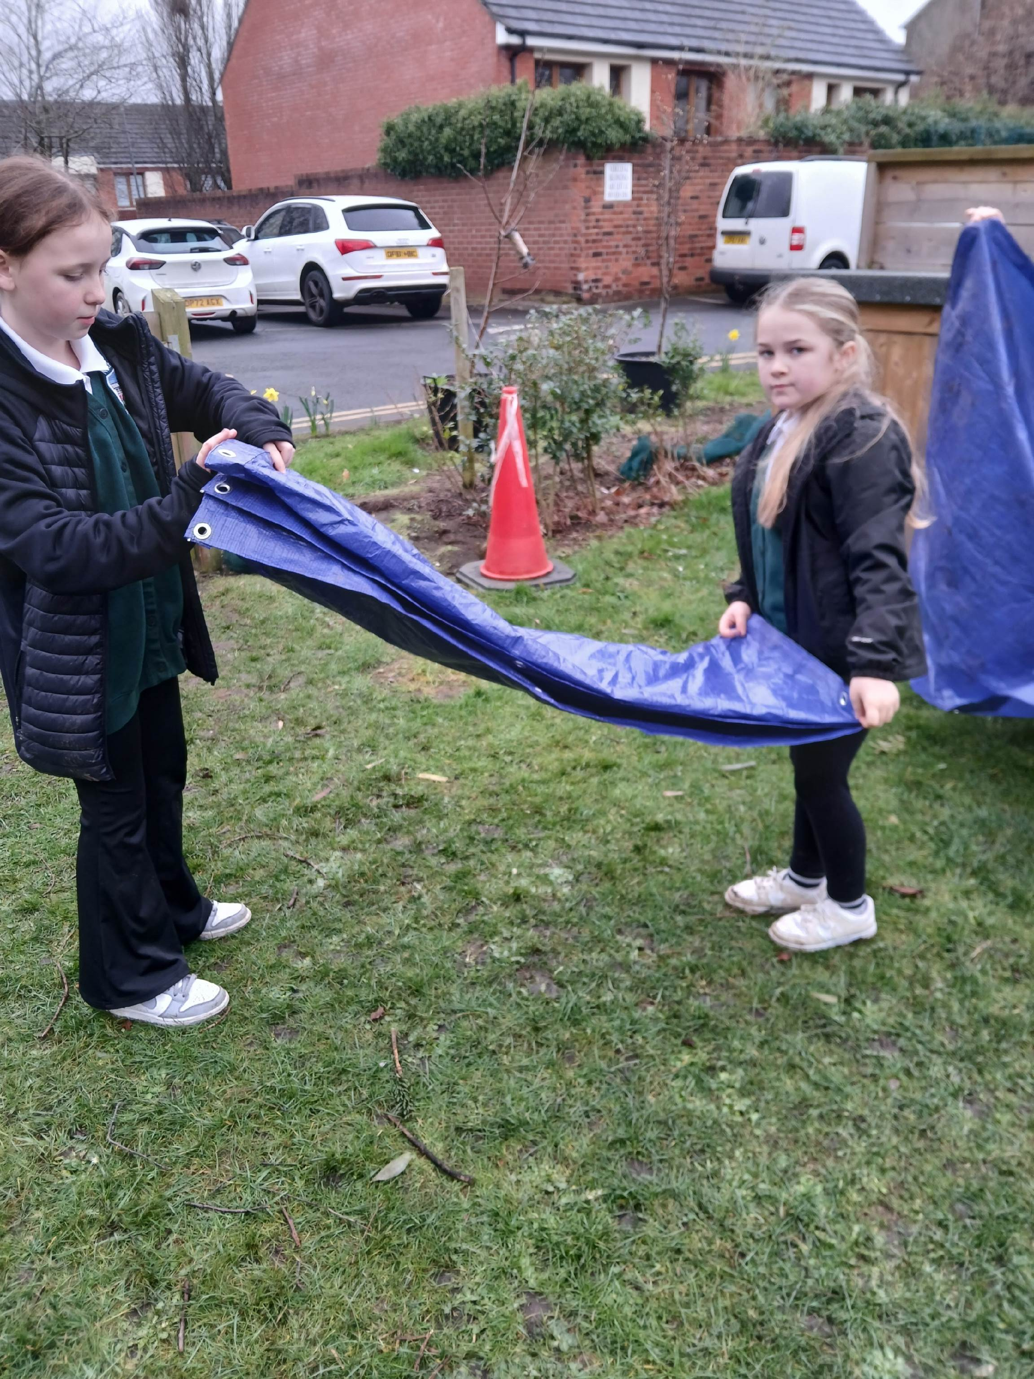
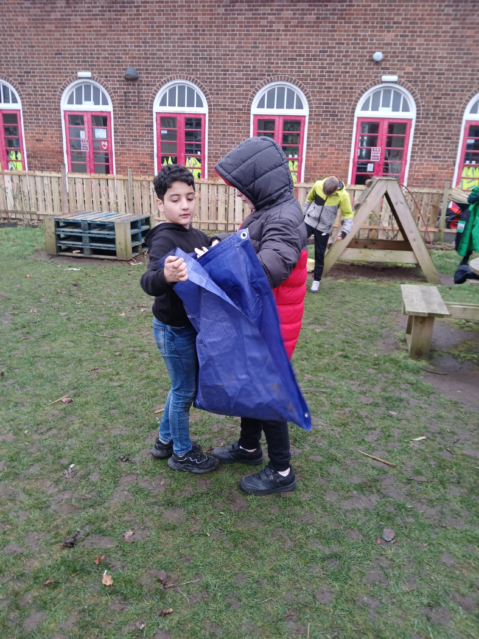
Leave no trace
We tidied up all our resources at the end. Great folding everybody.

Slide 13
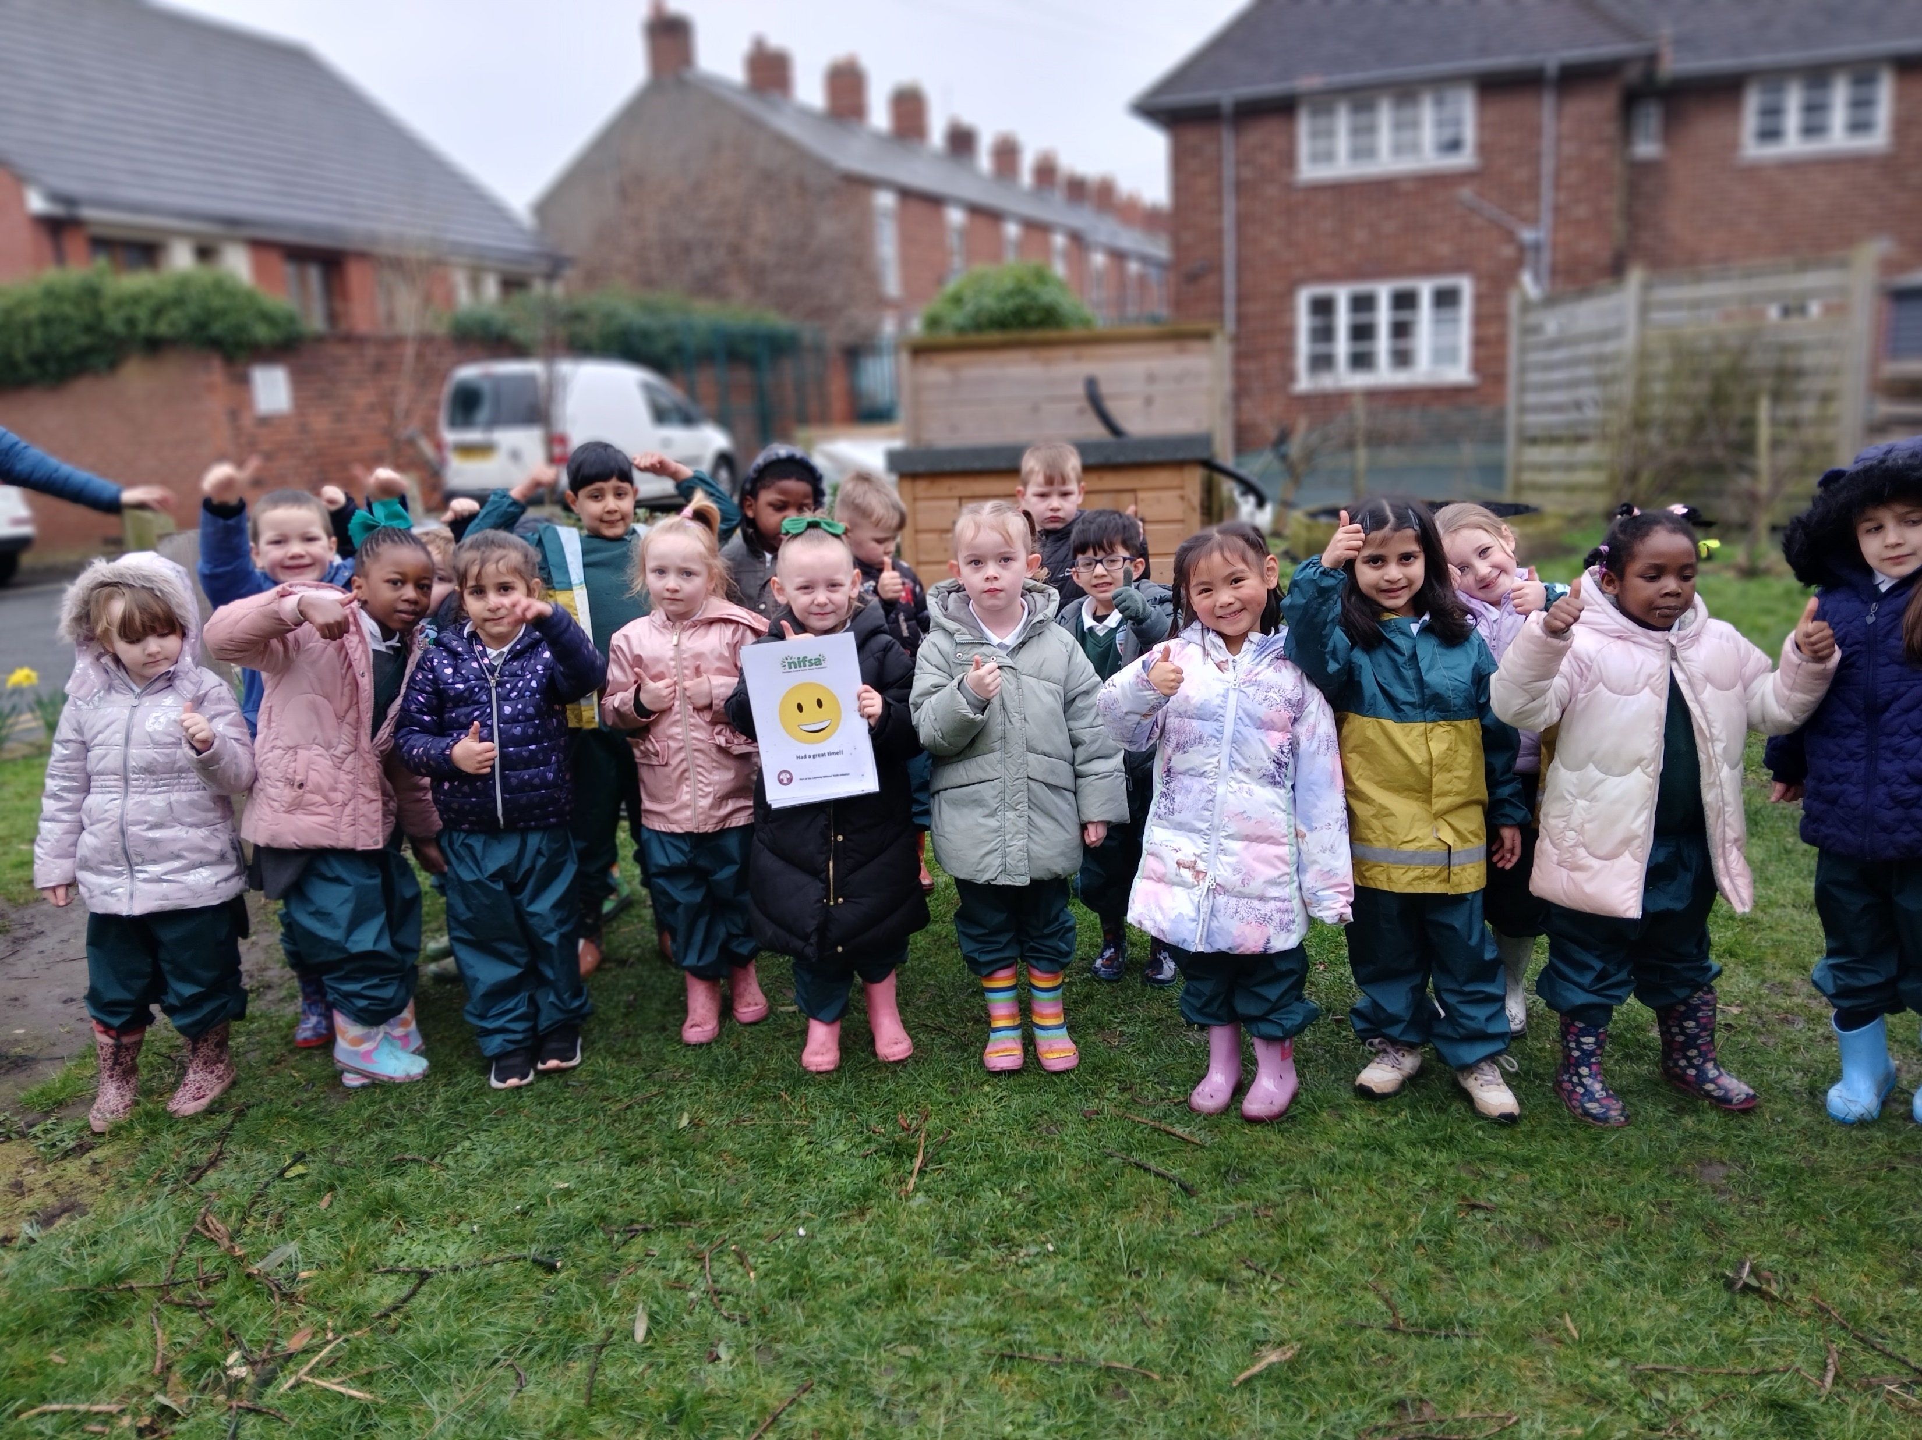
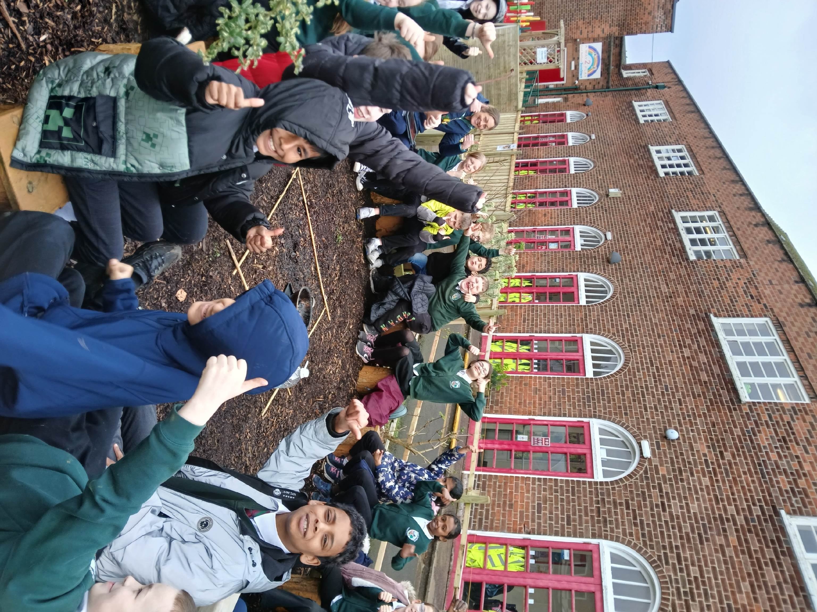
Did you enjoy it?
Smiley faces all around.

