Slide 1


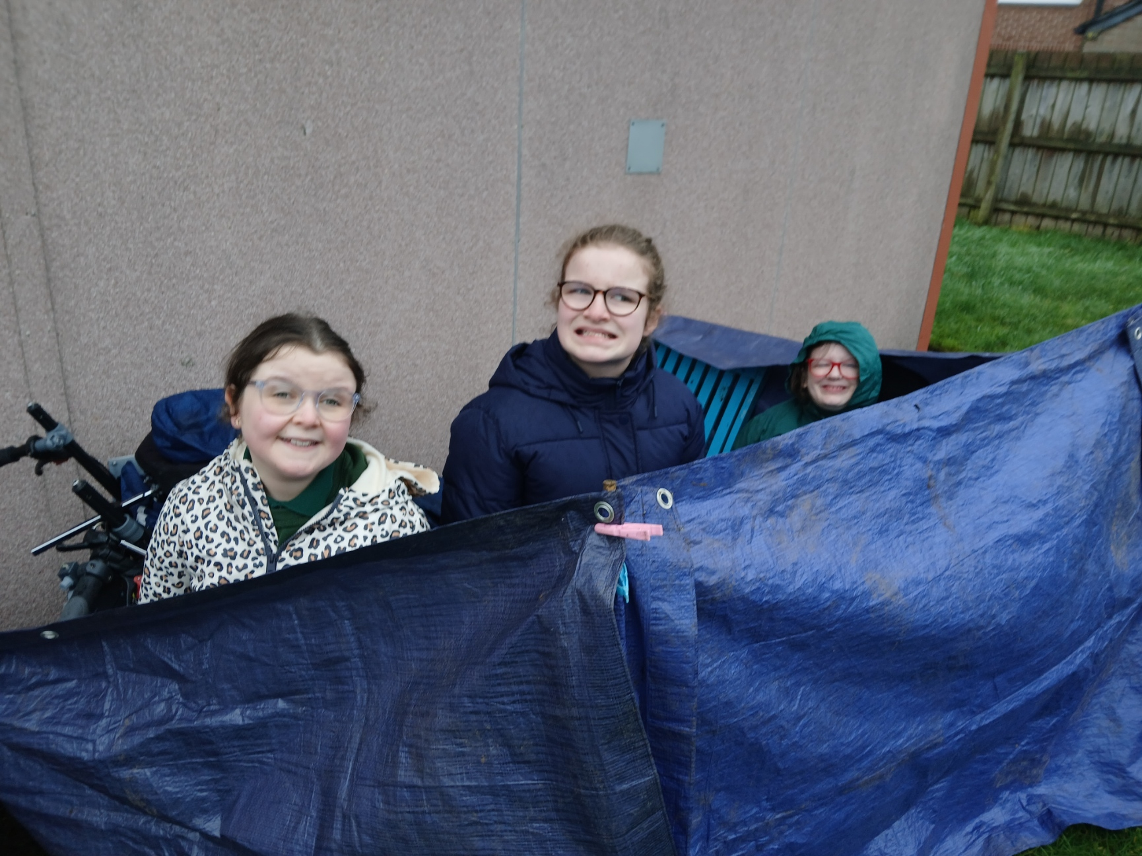
OUR FOREST SCHOOL DIARY Wednesday 4th February 2026
Mitchell House Special School

Slide 2
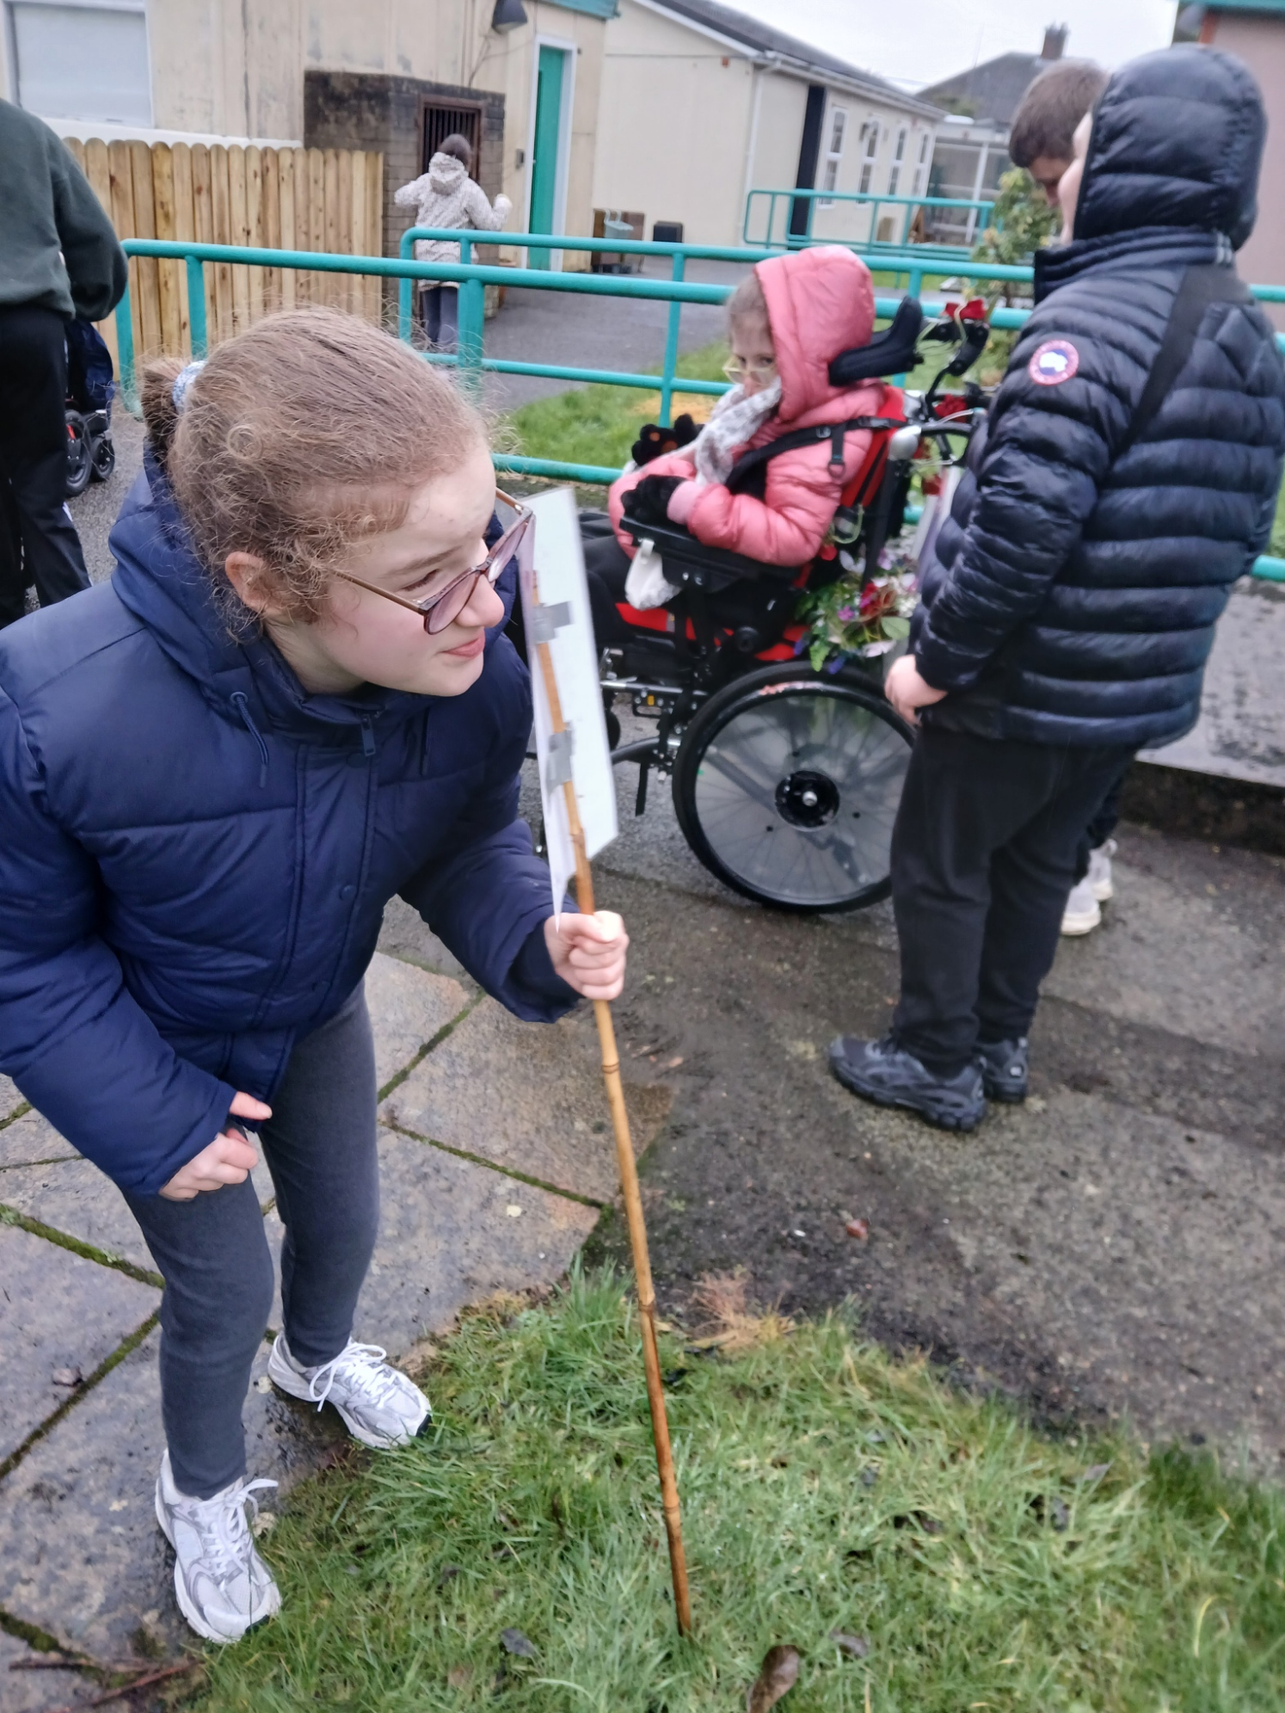
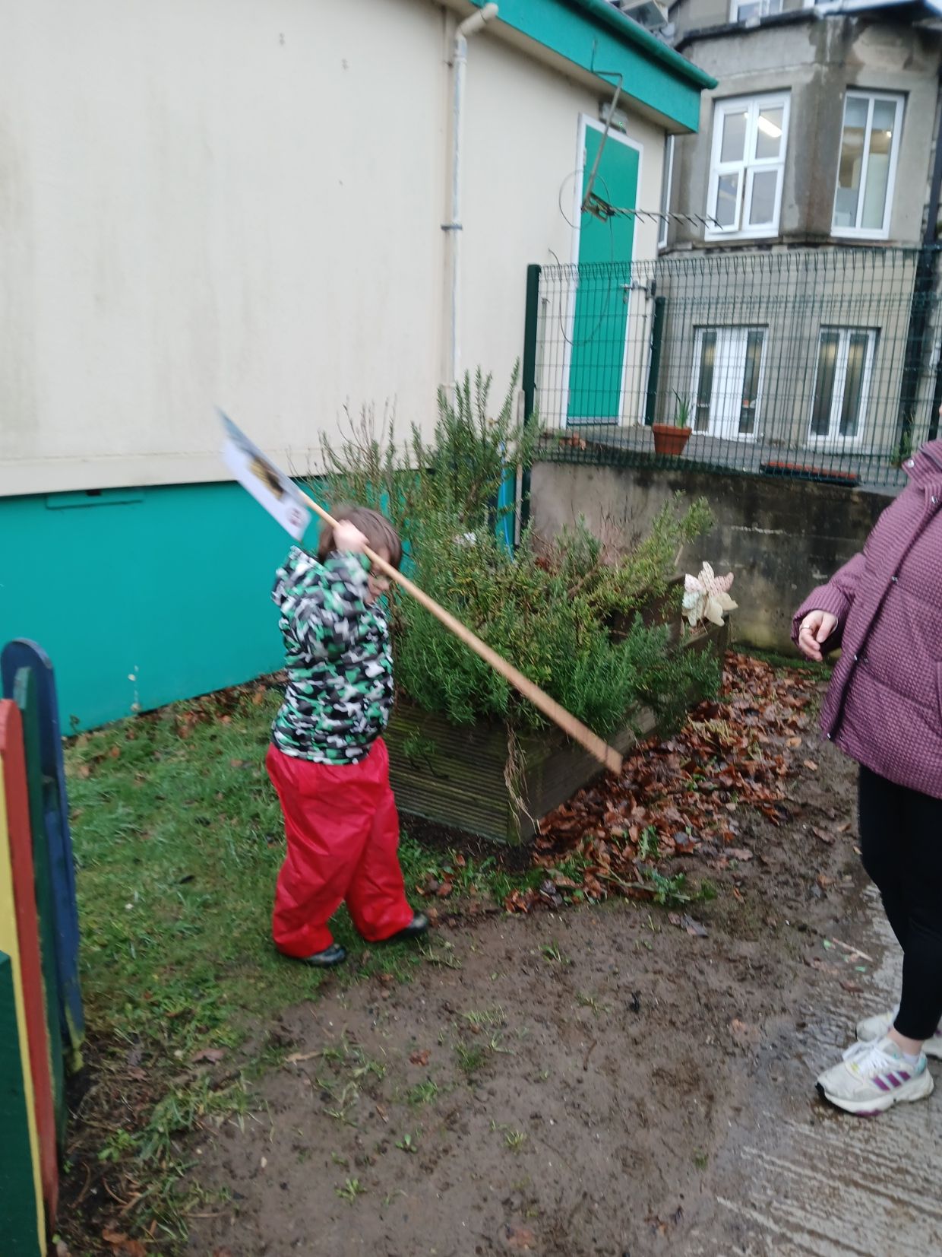
FOREST SCHOOL
We put our boundaries out so we knew where we could play.

Slide 3
RULES
We go over our Forest School rules:
1 whistle: Stop
2 whistles: Back to base
3rd rule: Have fun and learn

Slide 4
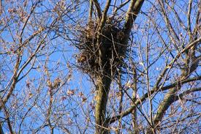
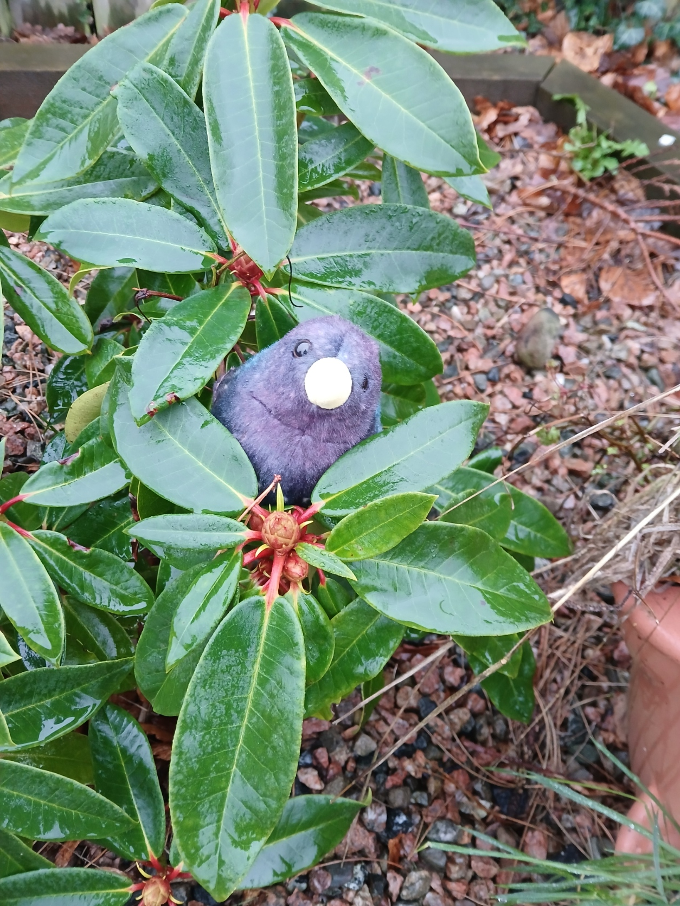
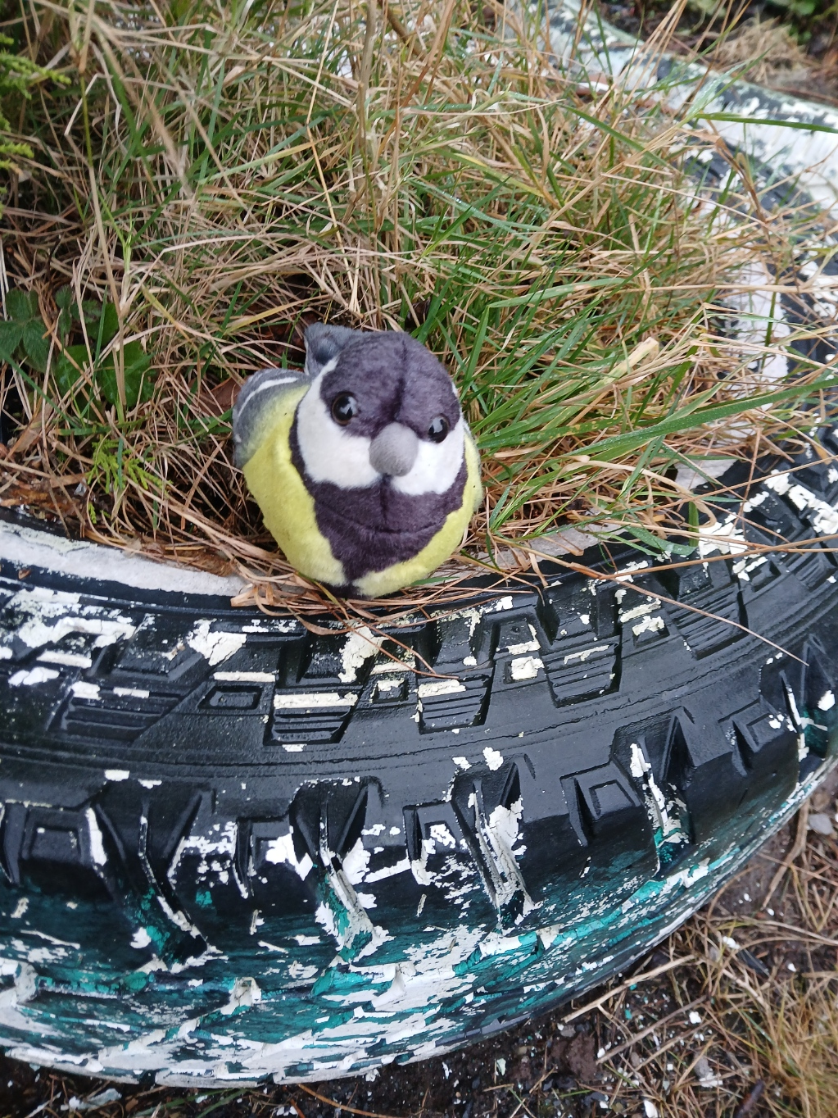
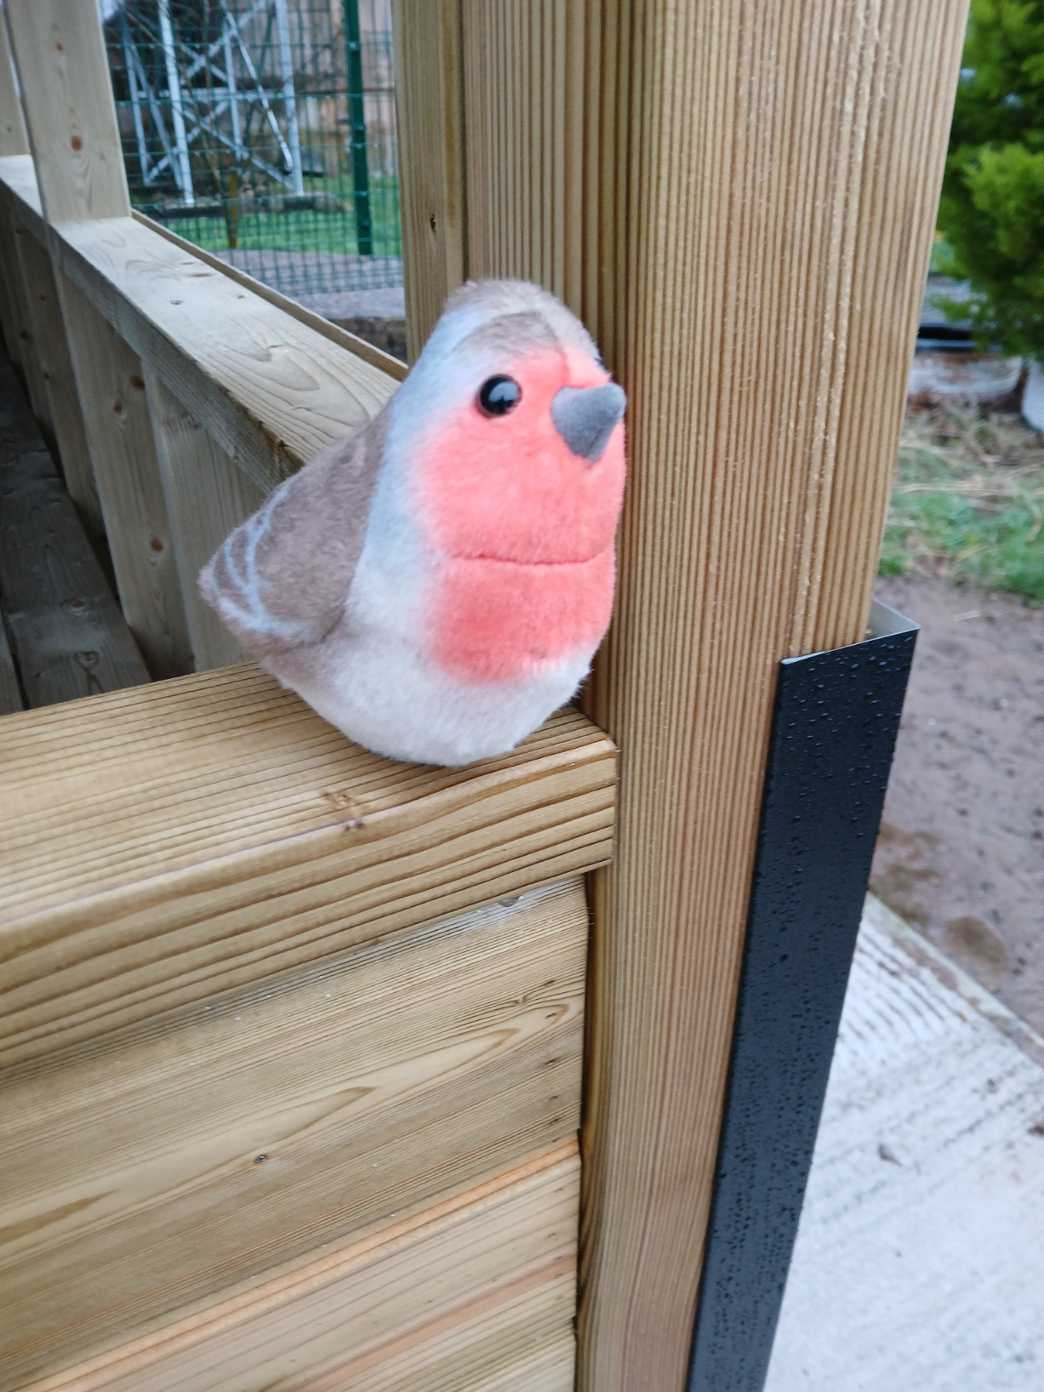

NESTS
We found some birds in our garden and talked about building some birds' nests.
We discussed what things we might need to make a nest.
We heard lots of birds near by.

Slide 5
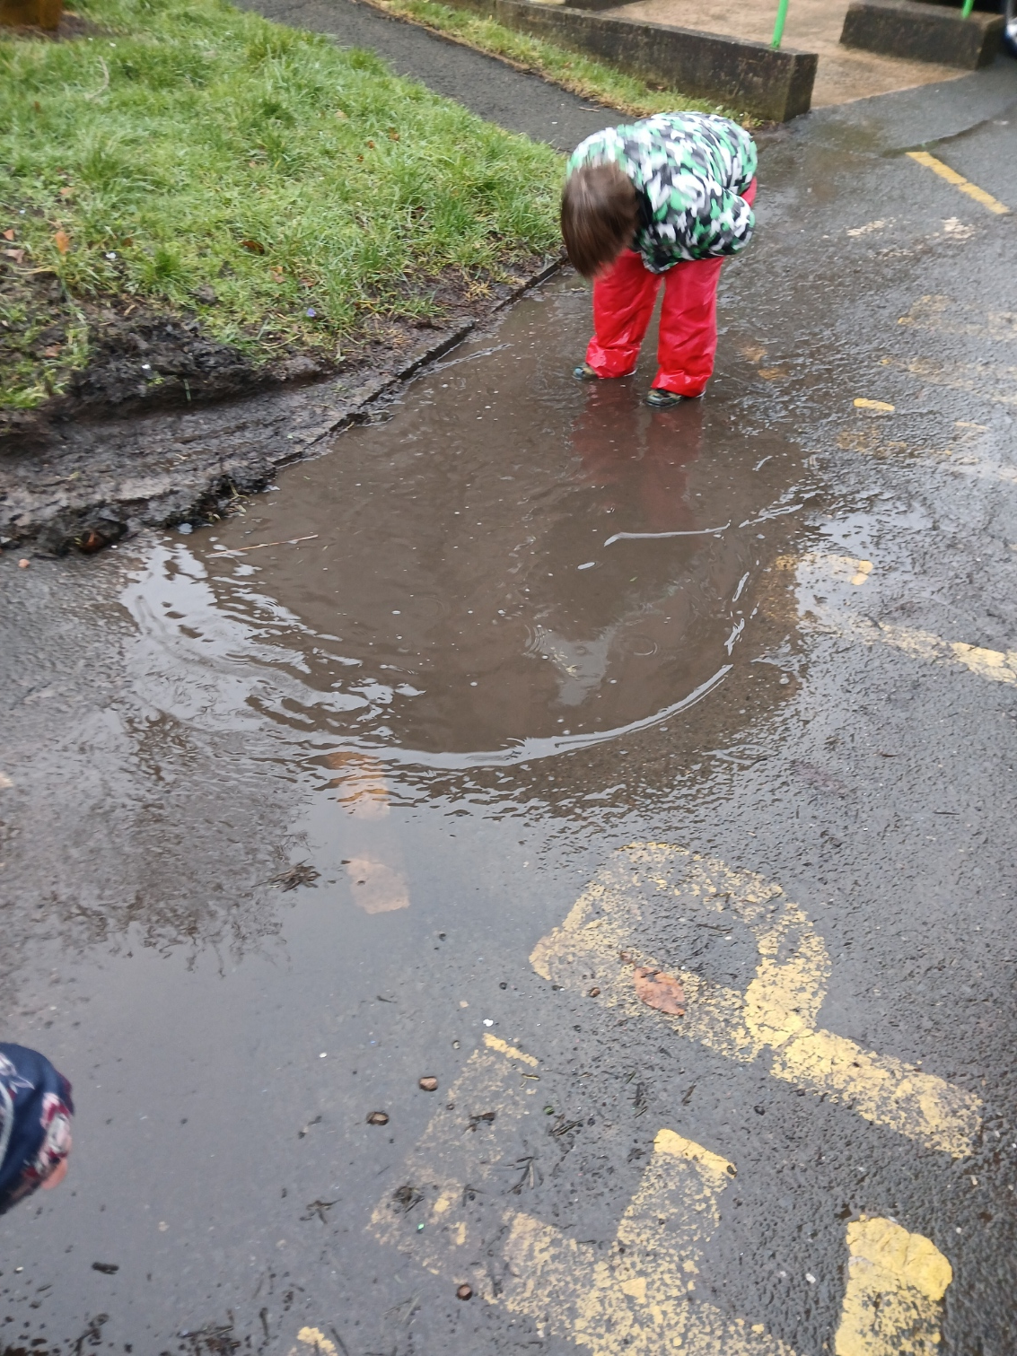
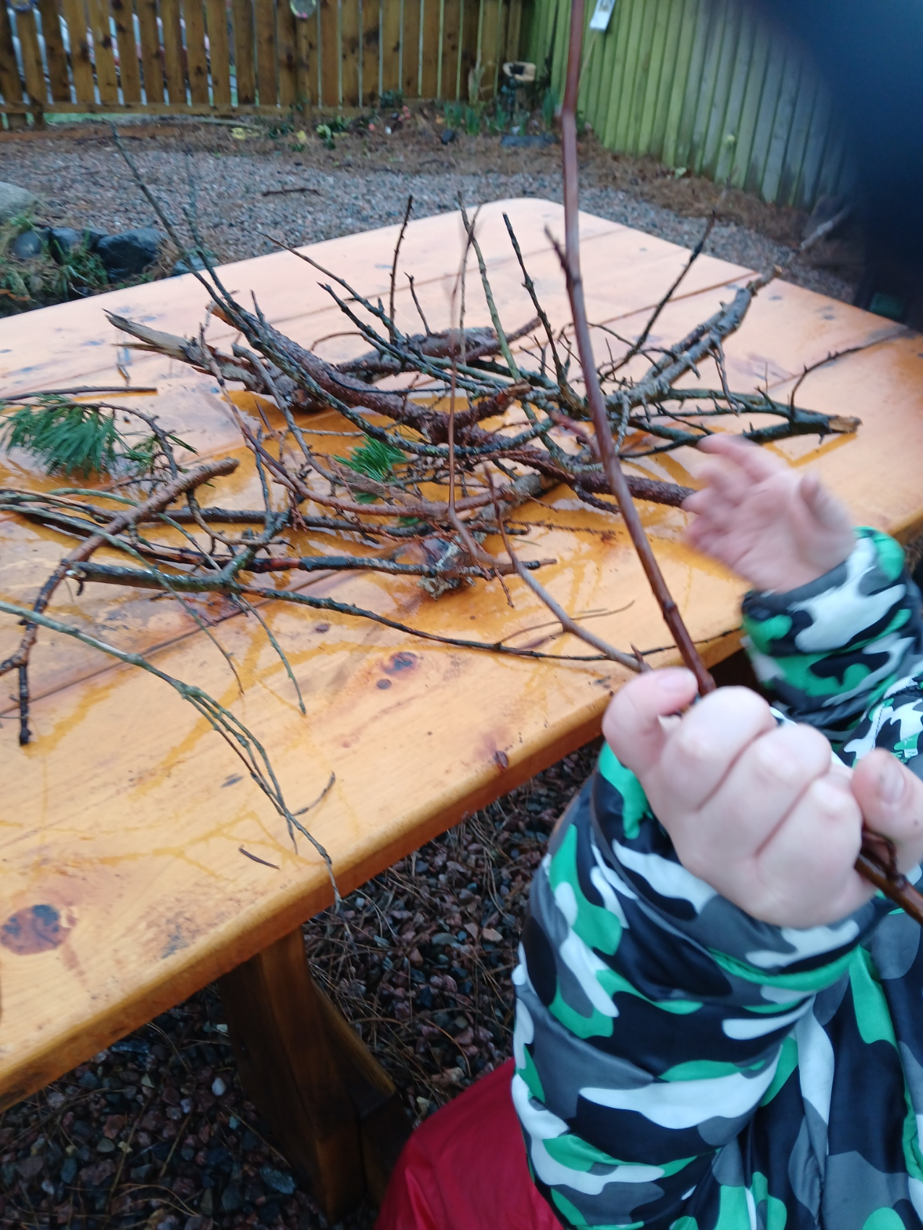
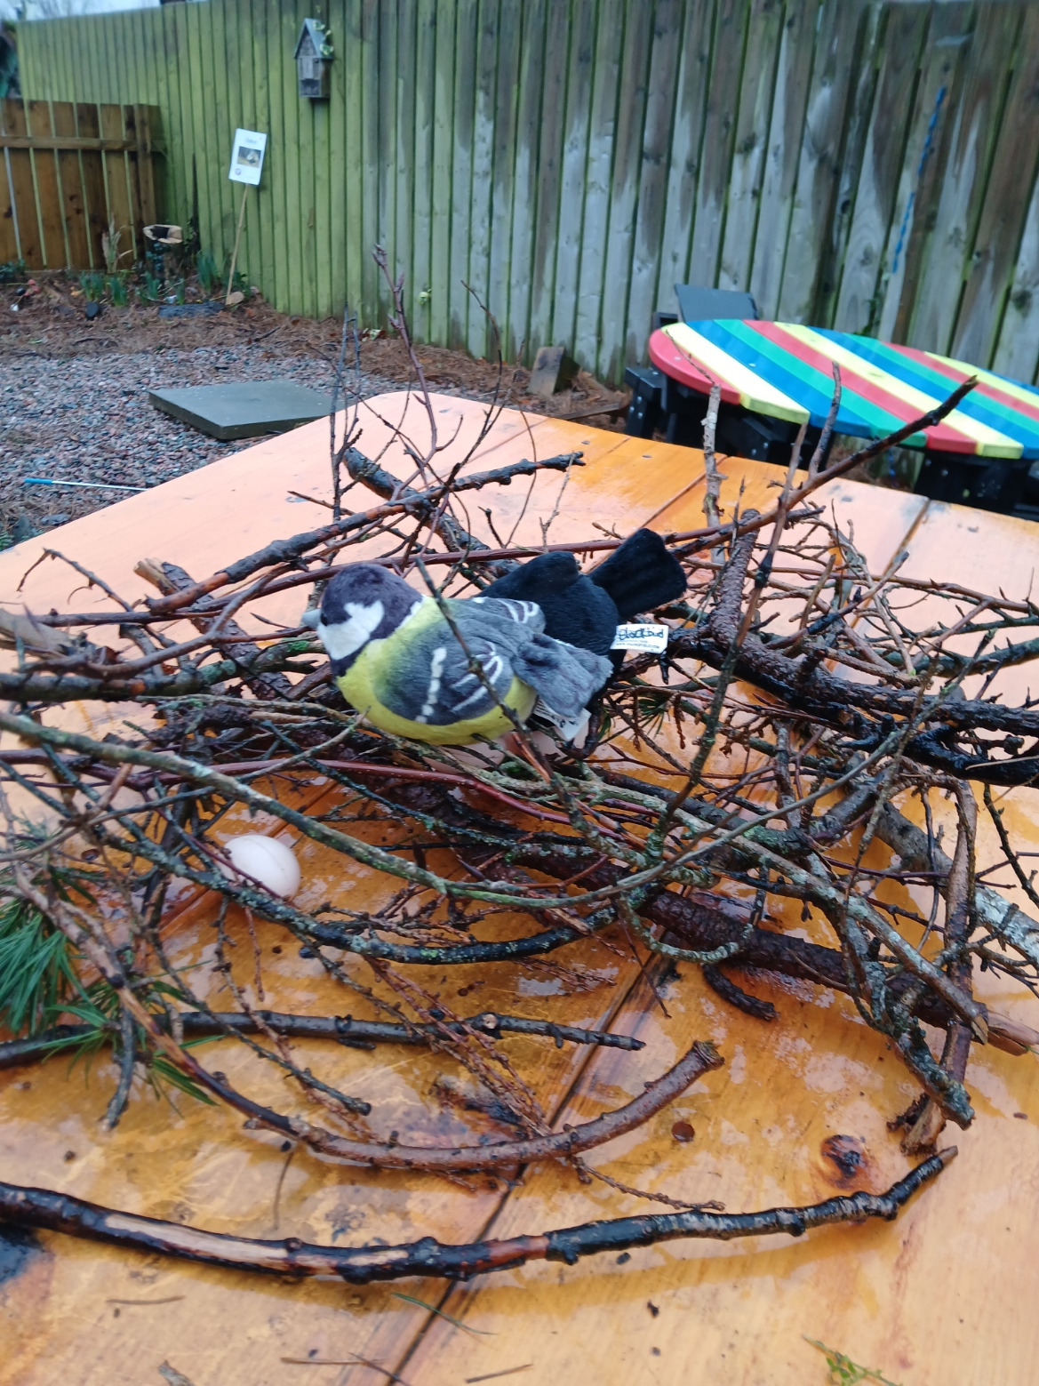
NESTS
We went for a walk to collect natural materials to build our nest.
Best bit was finding a puddle to jump in.
Doesn’t it look great!

Slide 6
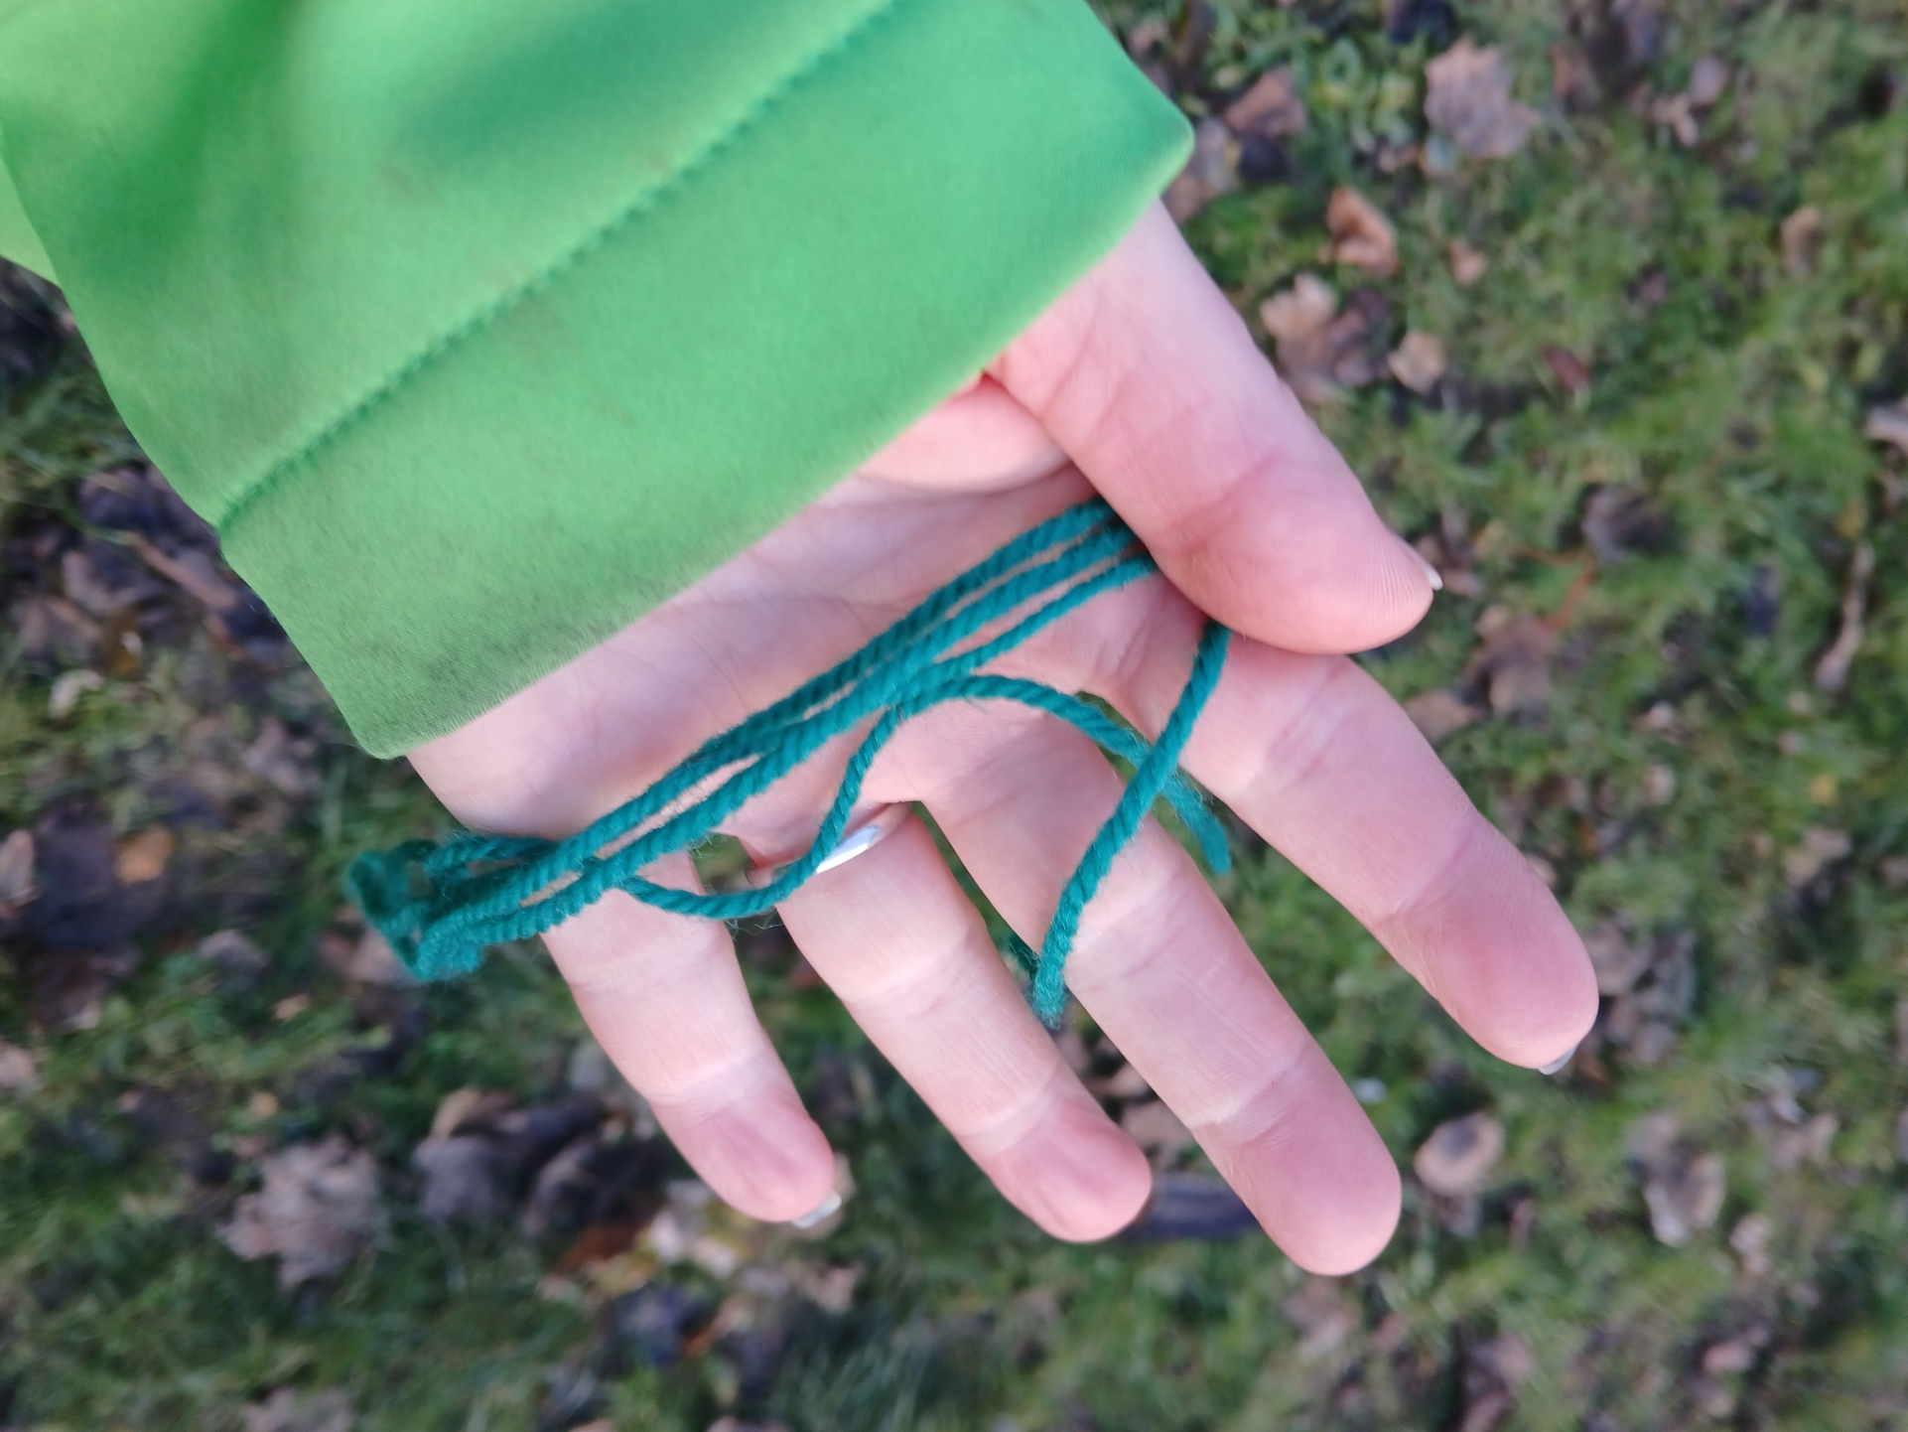
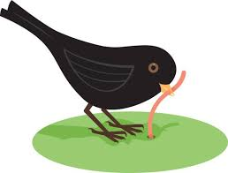

Birds and Worms
We played birds and worms.
We hid the worms and the birds tired to find them.

Slide 7
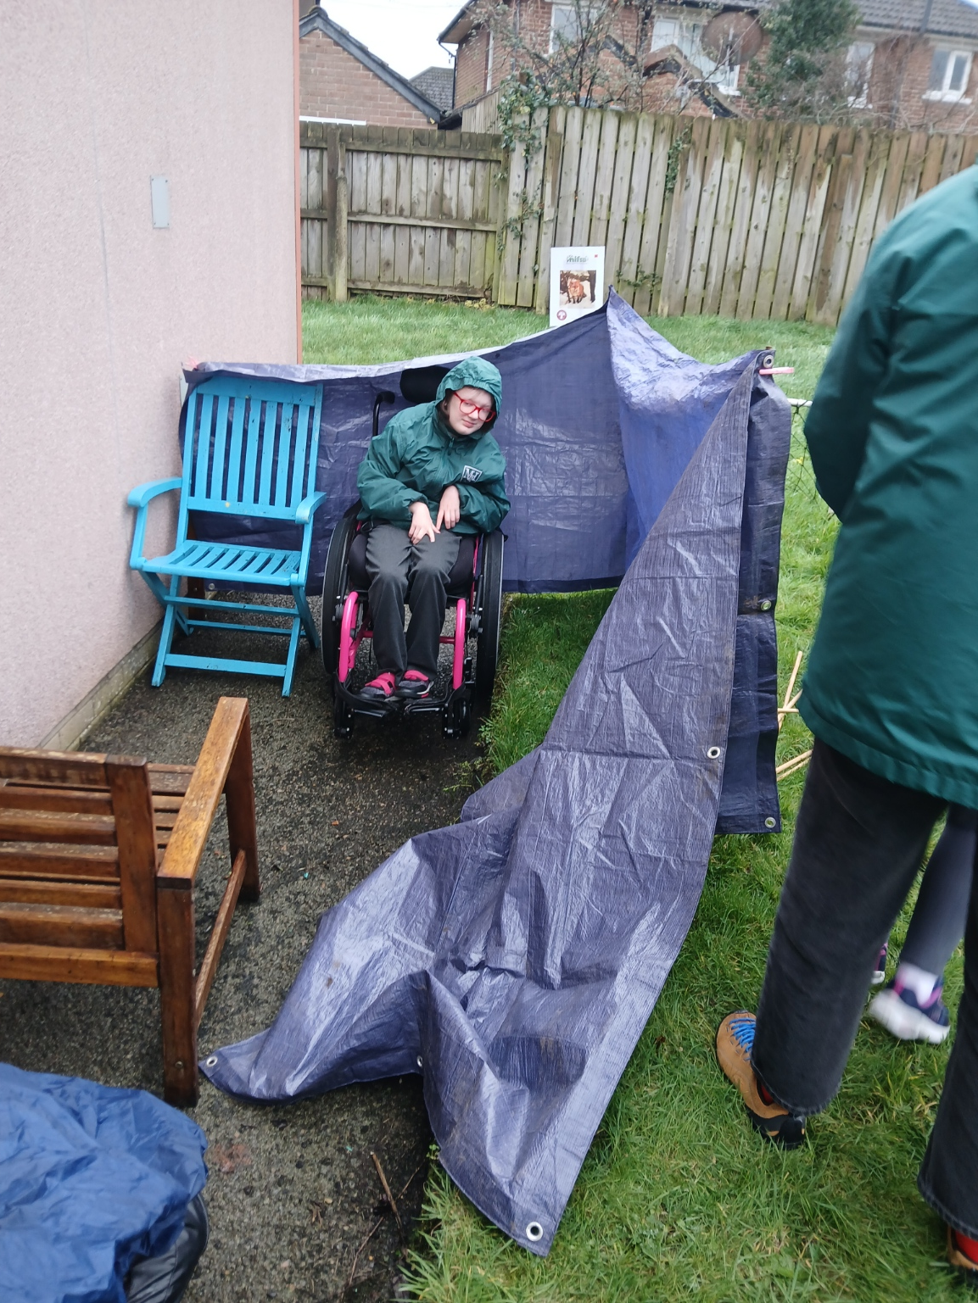
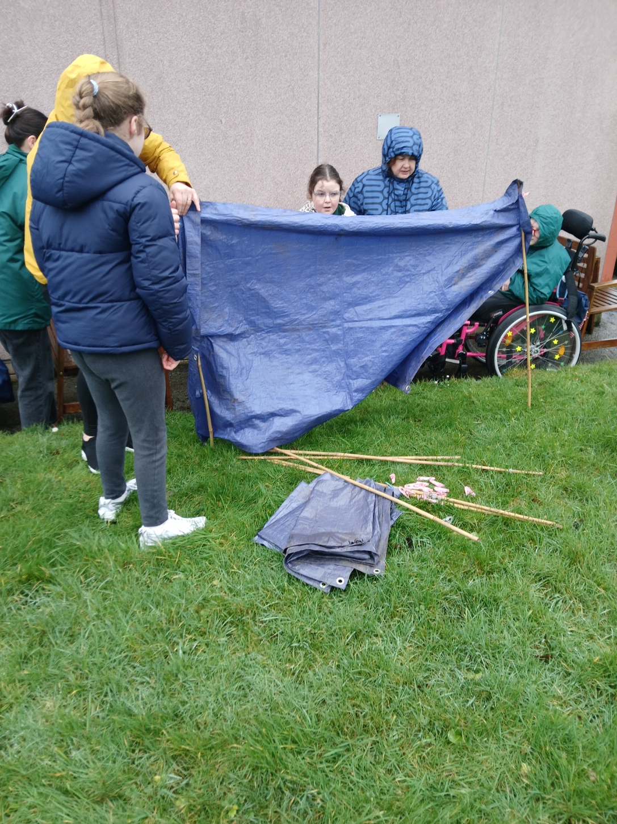
Den building
Today we are building dens – we used bamboo canes, tarpaulins and clothes pegs.

Slide 8
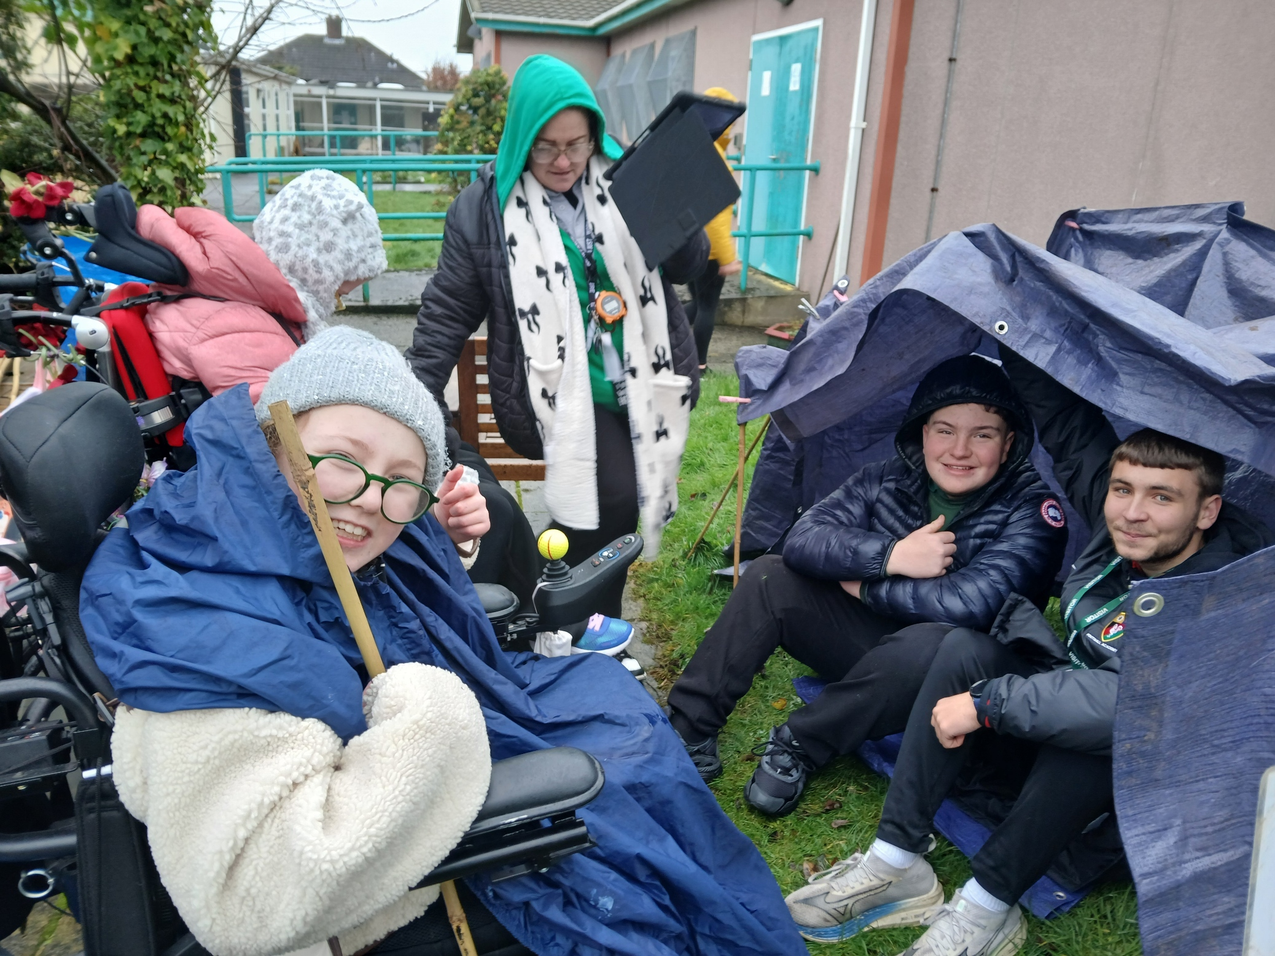
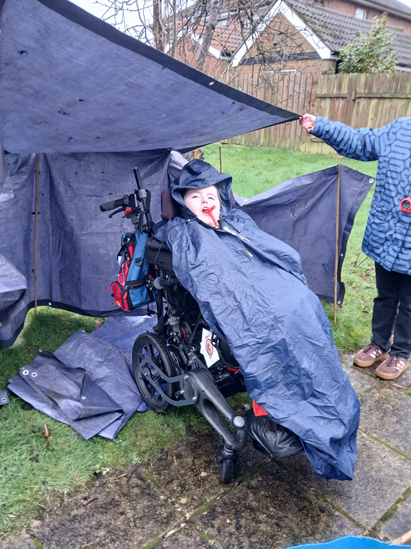
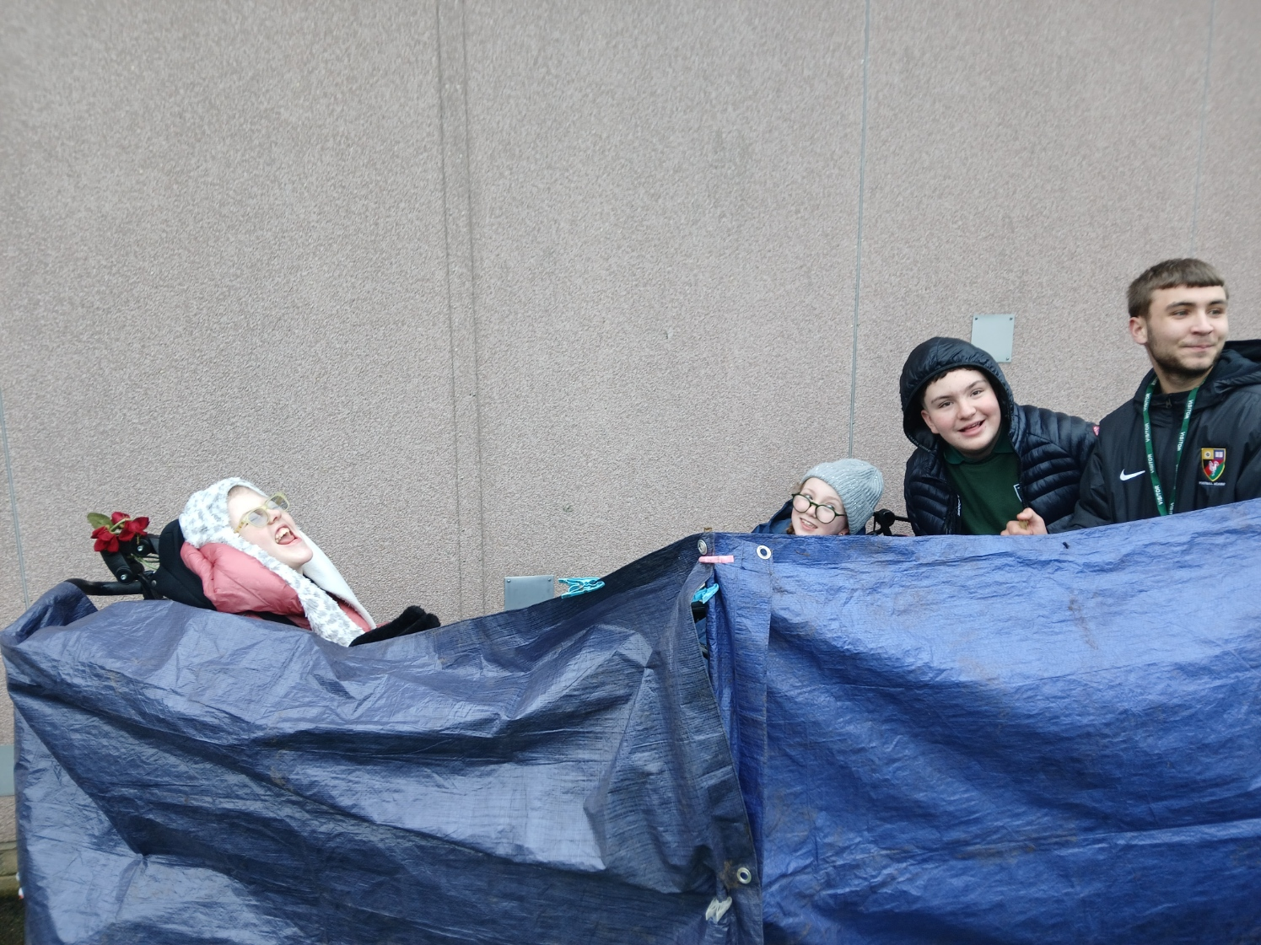
Den building
We tell the other groups about our dens.

Slide 9
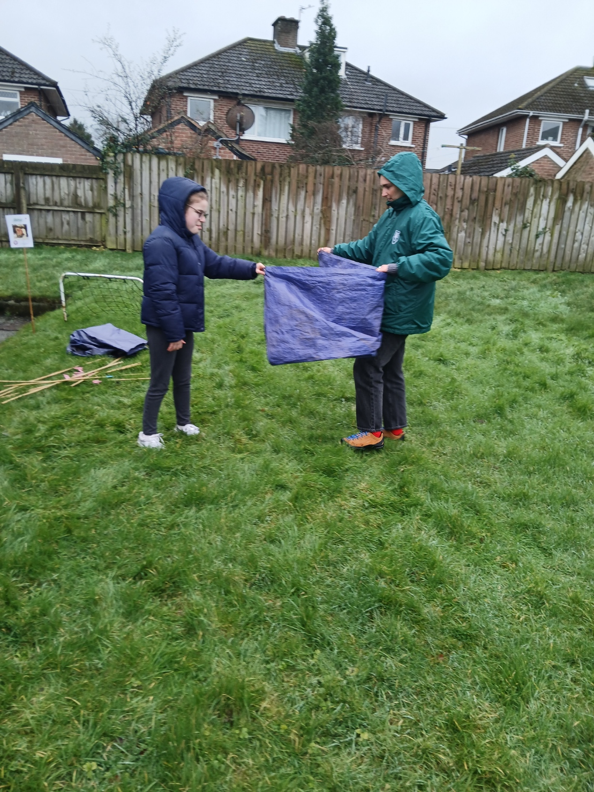
LEAVE NO TRACE
We put everything away and tidied our area to leave the place safe for the wildlife.
Great Teamwork!

Slide 10
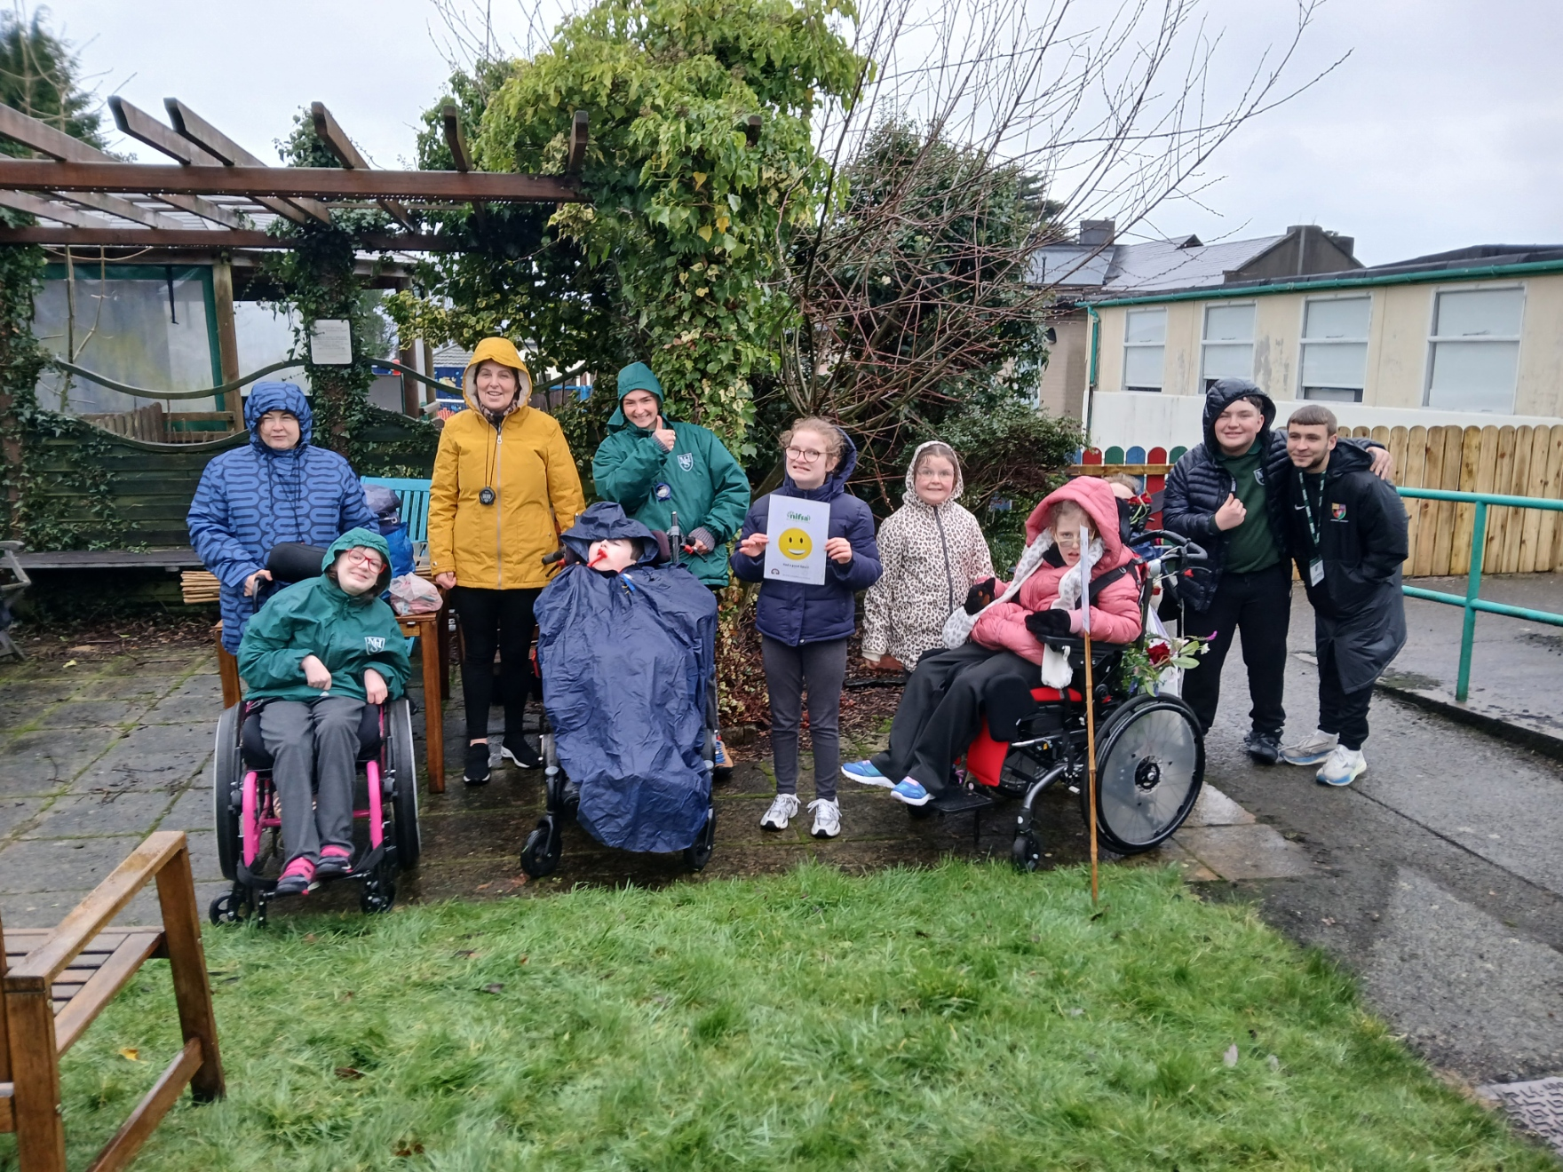
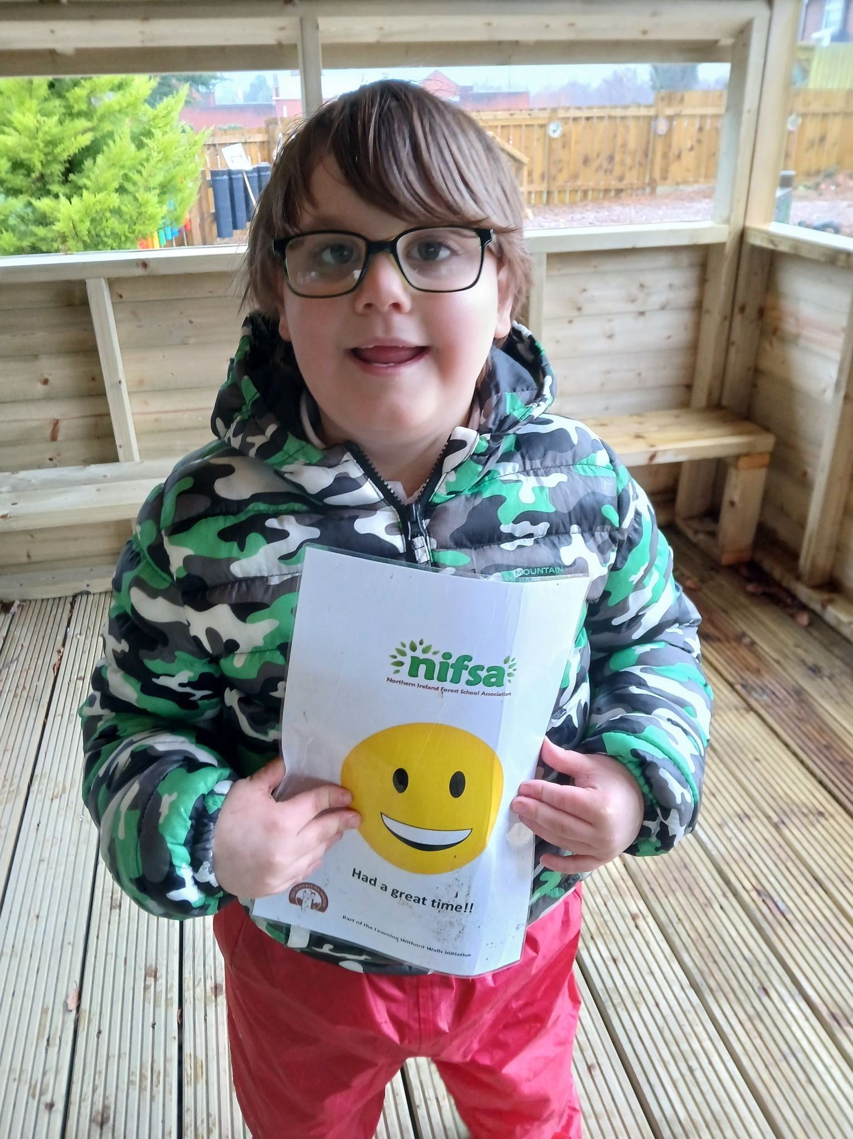
DID YOU ENJOY IT?
All smiley faces today.

