Slide 1


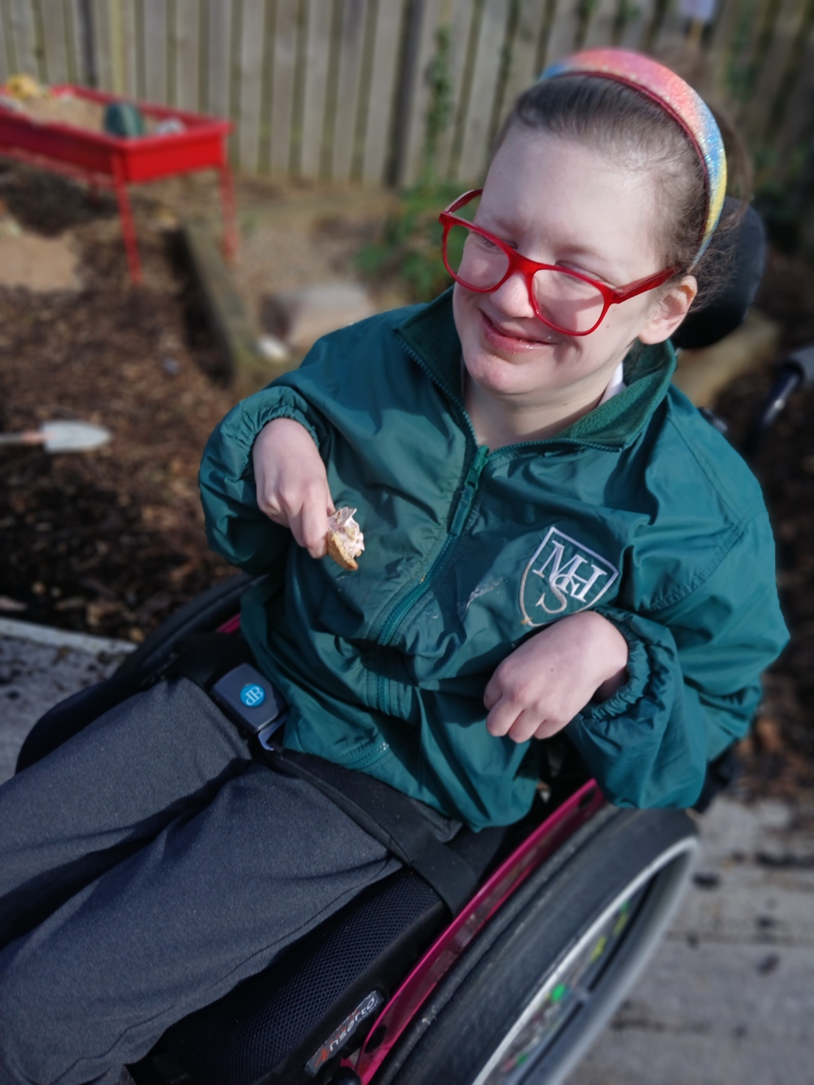
OUR FOREST SCHOOL DIARY Wednesday 11th March 2026
Mitchell House Special School

Slide 2
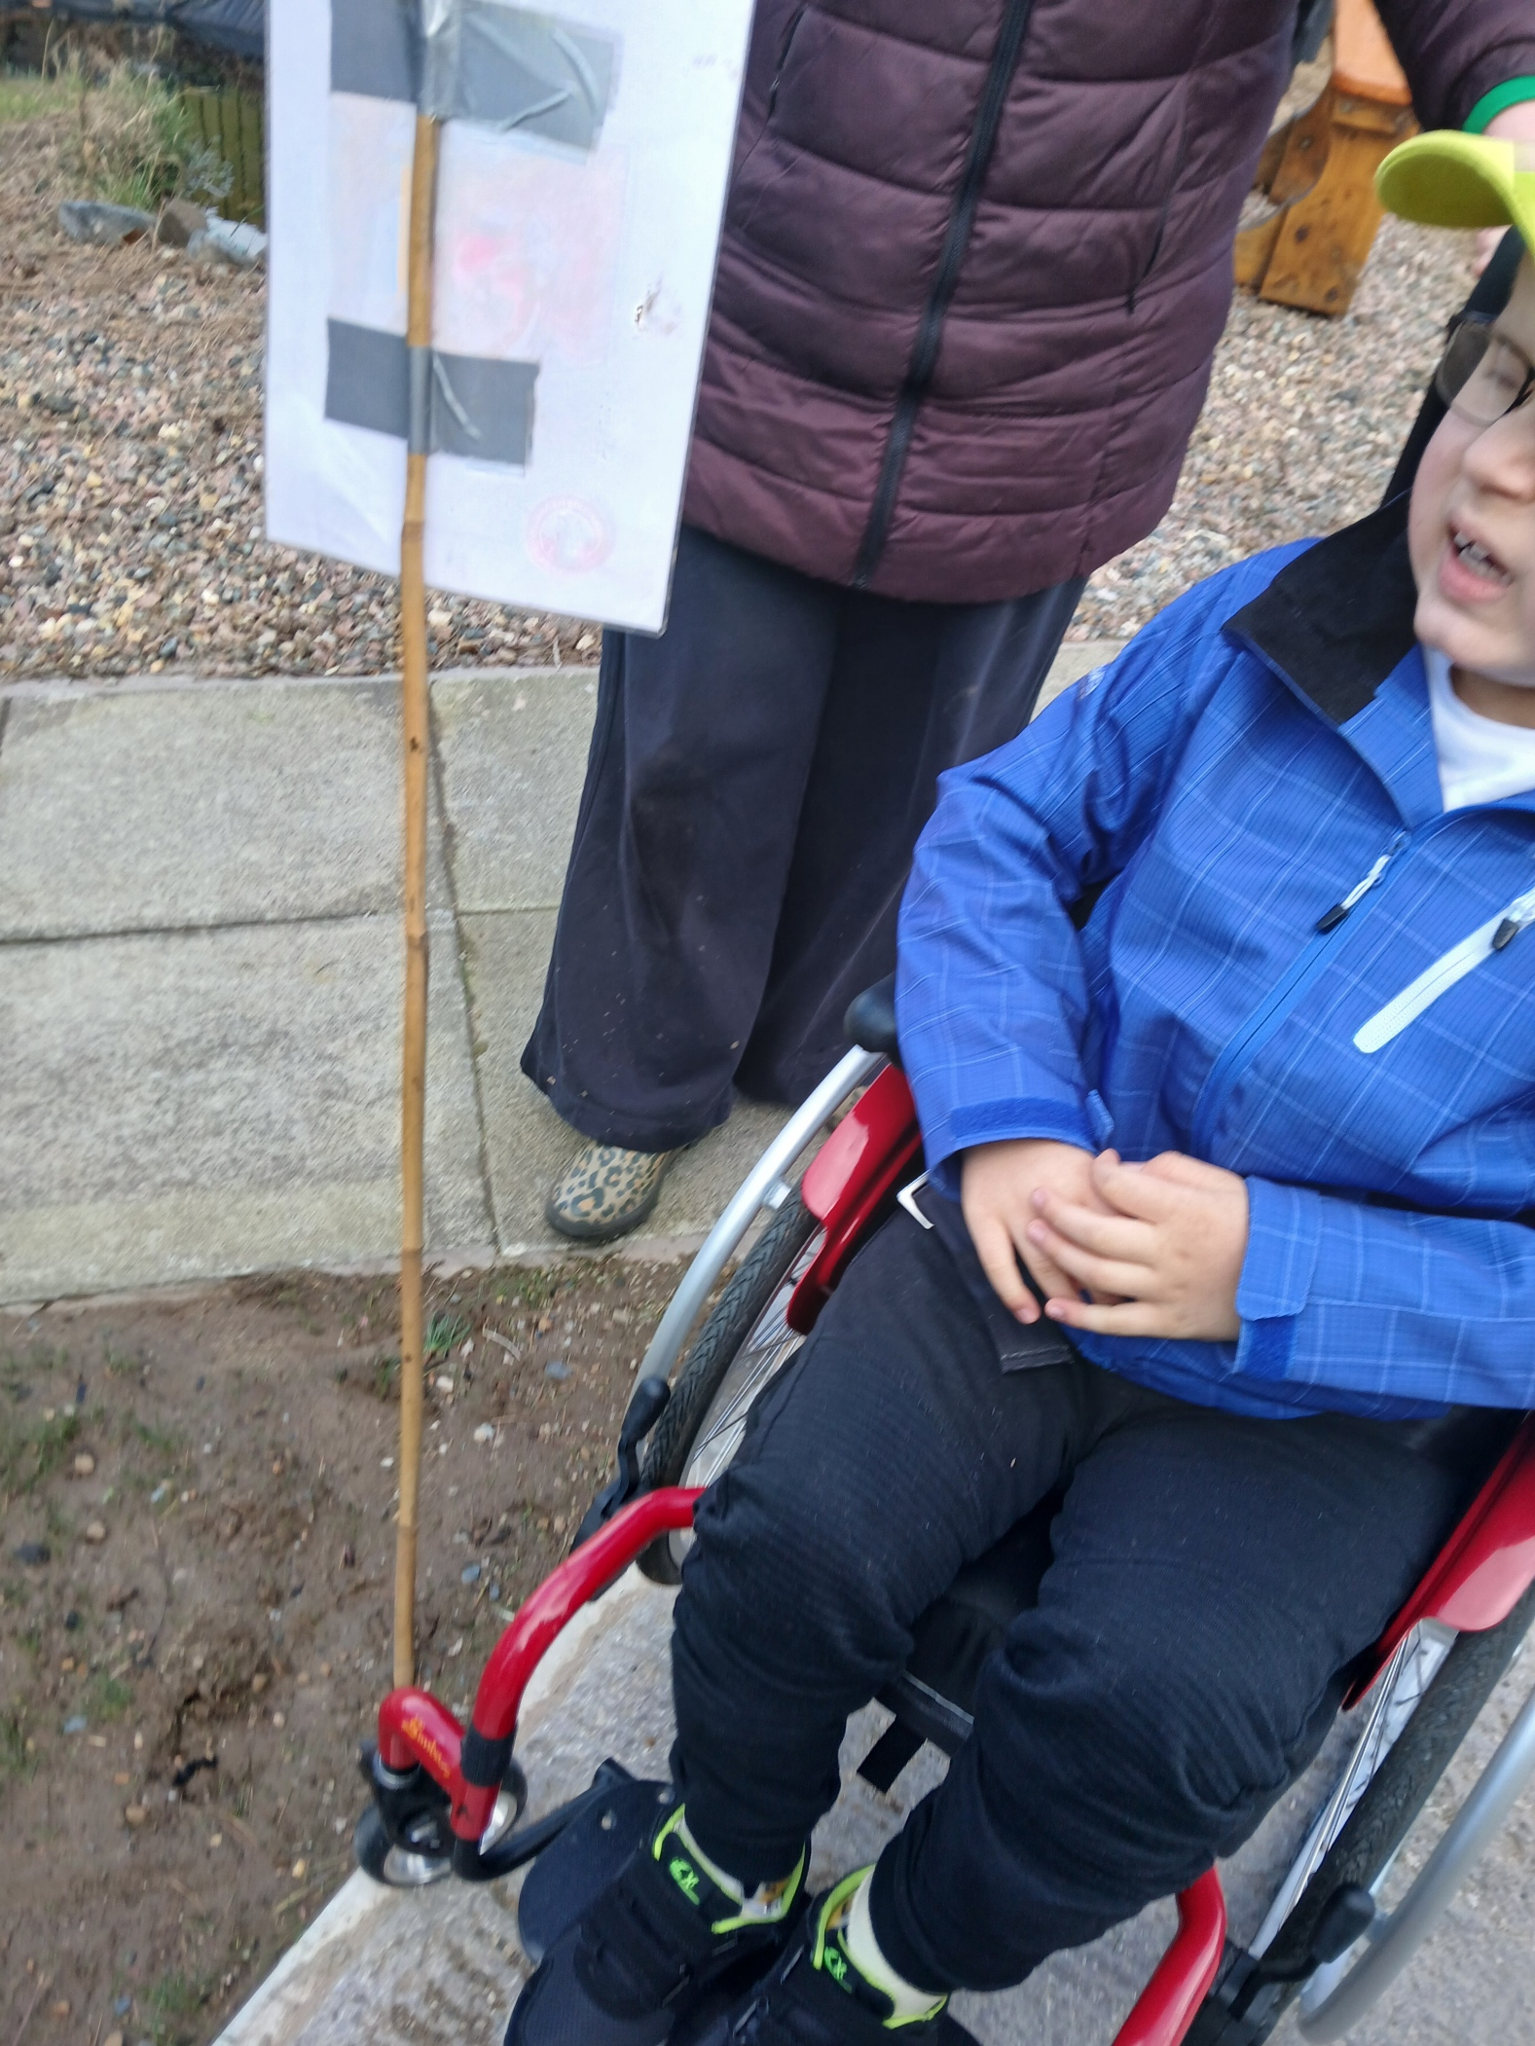
FOREST SCHOOL
We put our boundaries out so we knew where we could play.

Slide 3
RULES
We go over our Forest School rules:
1 whistle: stop
2 whistles: back to base
3rd rule: have fun and learn

Slide 4

Fire
We learnt about the 3 things we need to light a fire!

Slide 5
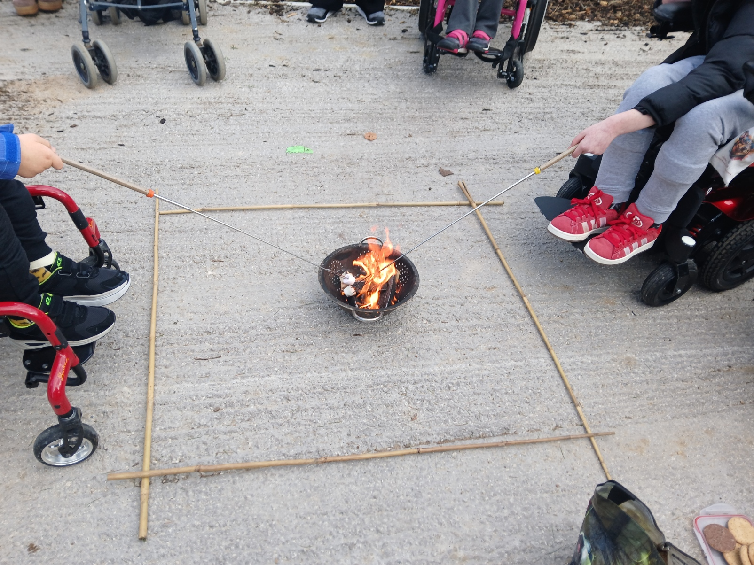
Fire
We toasted marshmallows.
We made some smore’s.
Best bit was eating them!

Slide 6
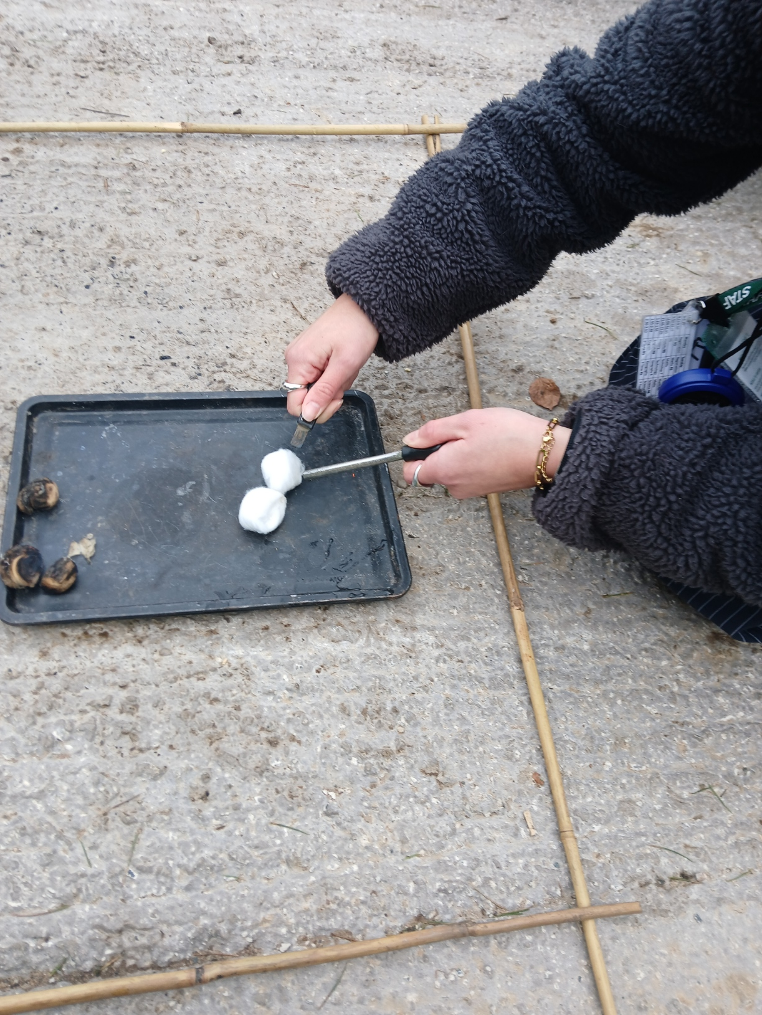
Fire
We practiced using the fire rods and lighting the cotton wool.

Slide 7
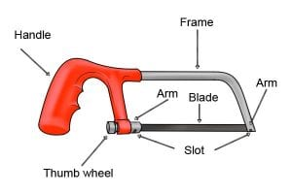
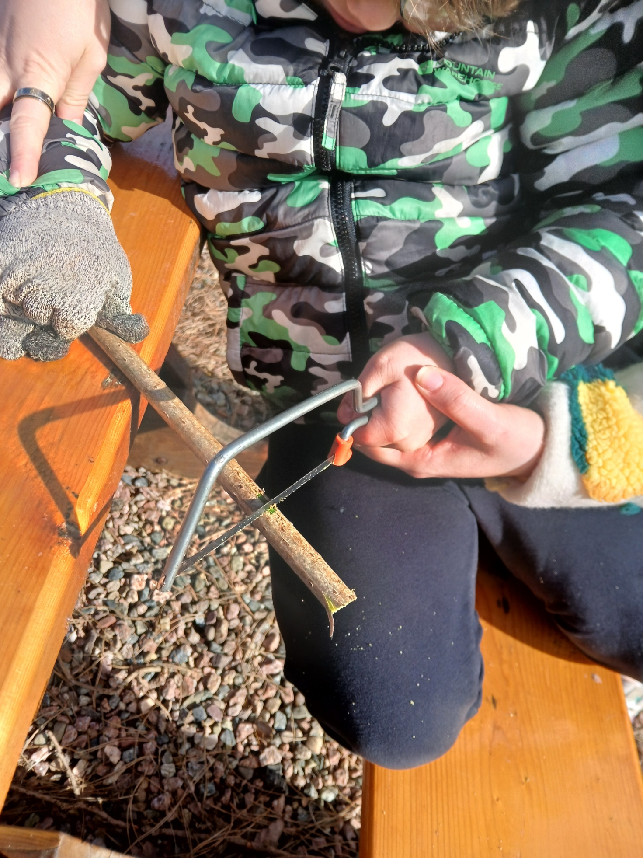
Saw Skills
Today we learnt how to use a saw safety and cut some Elder.

Slide 8

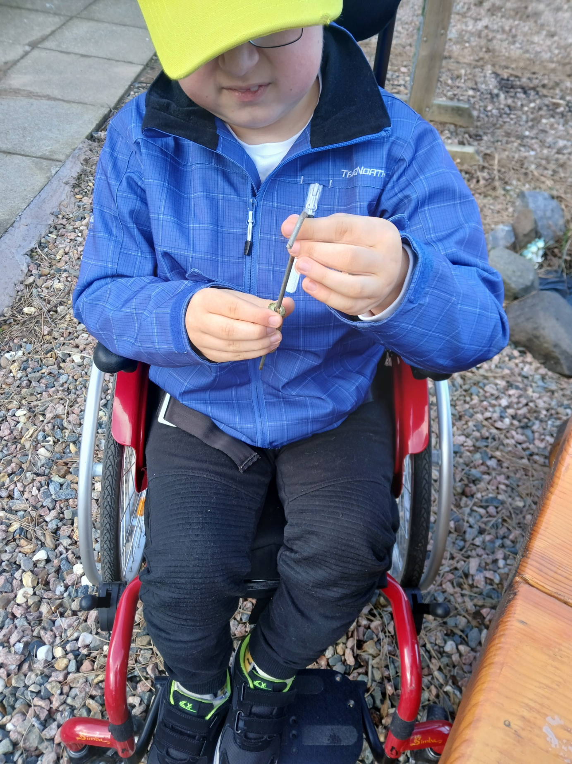
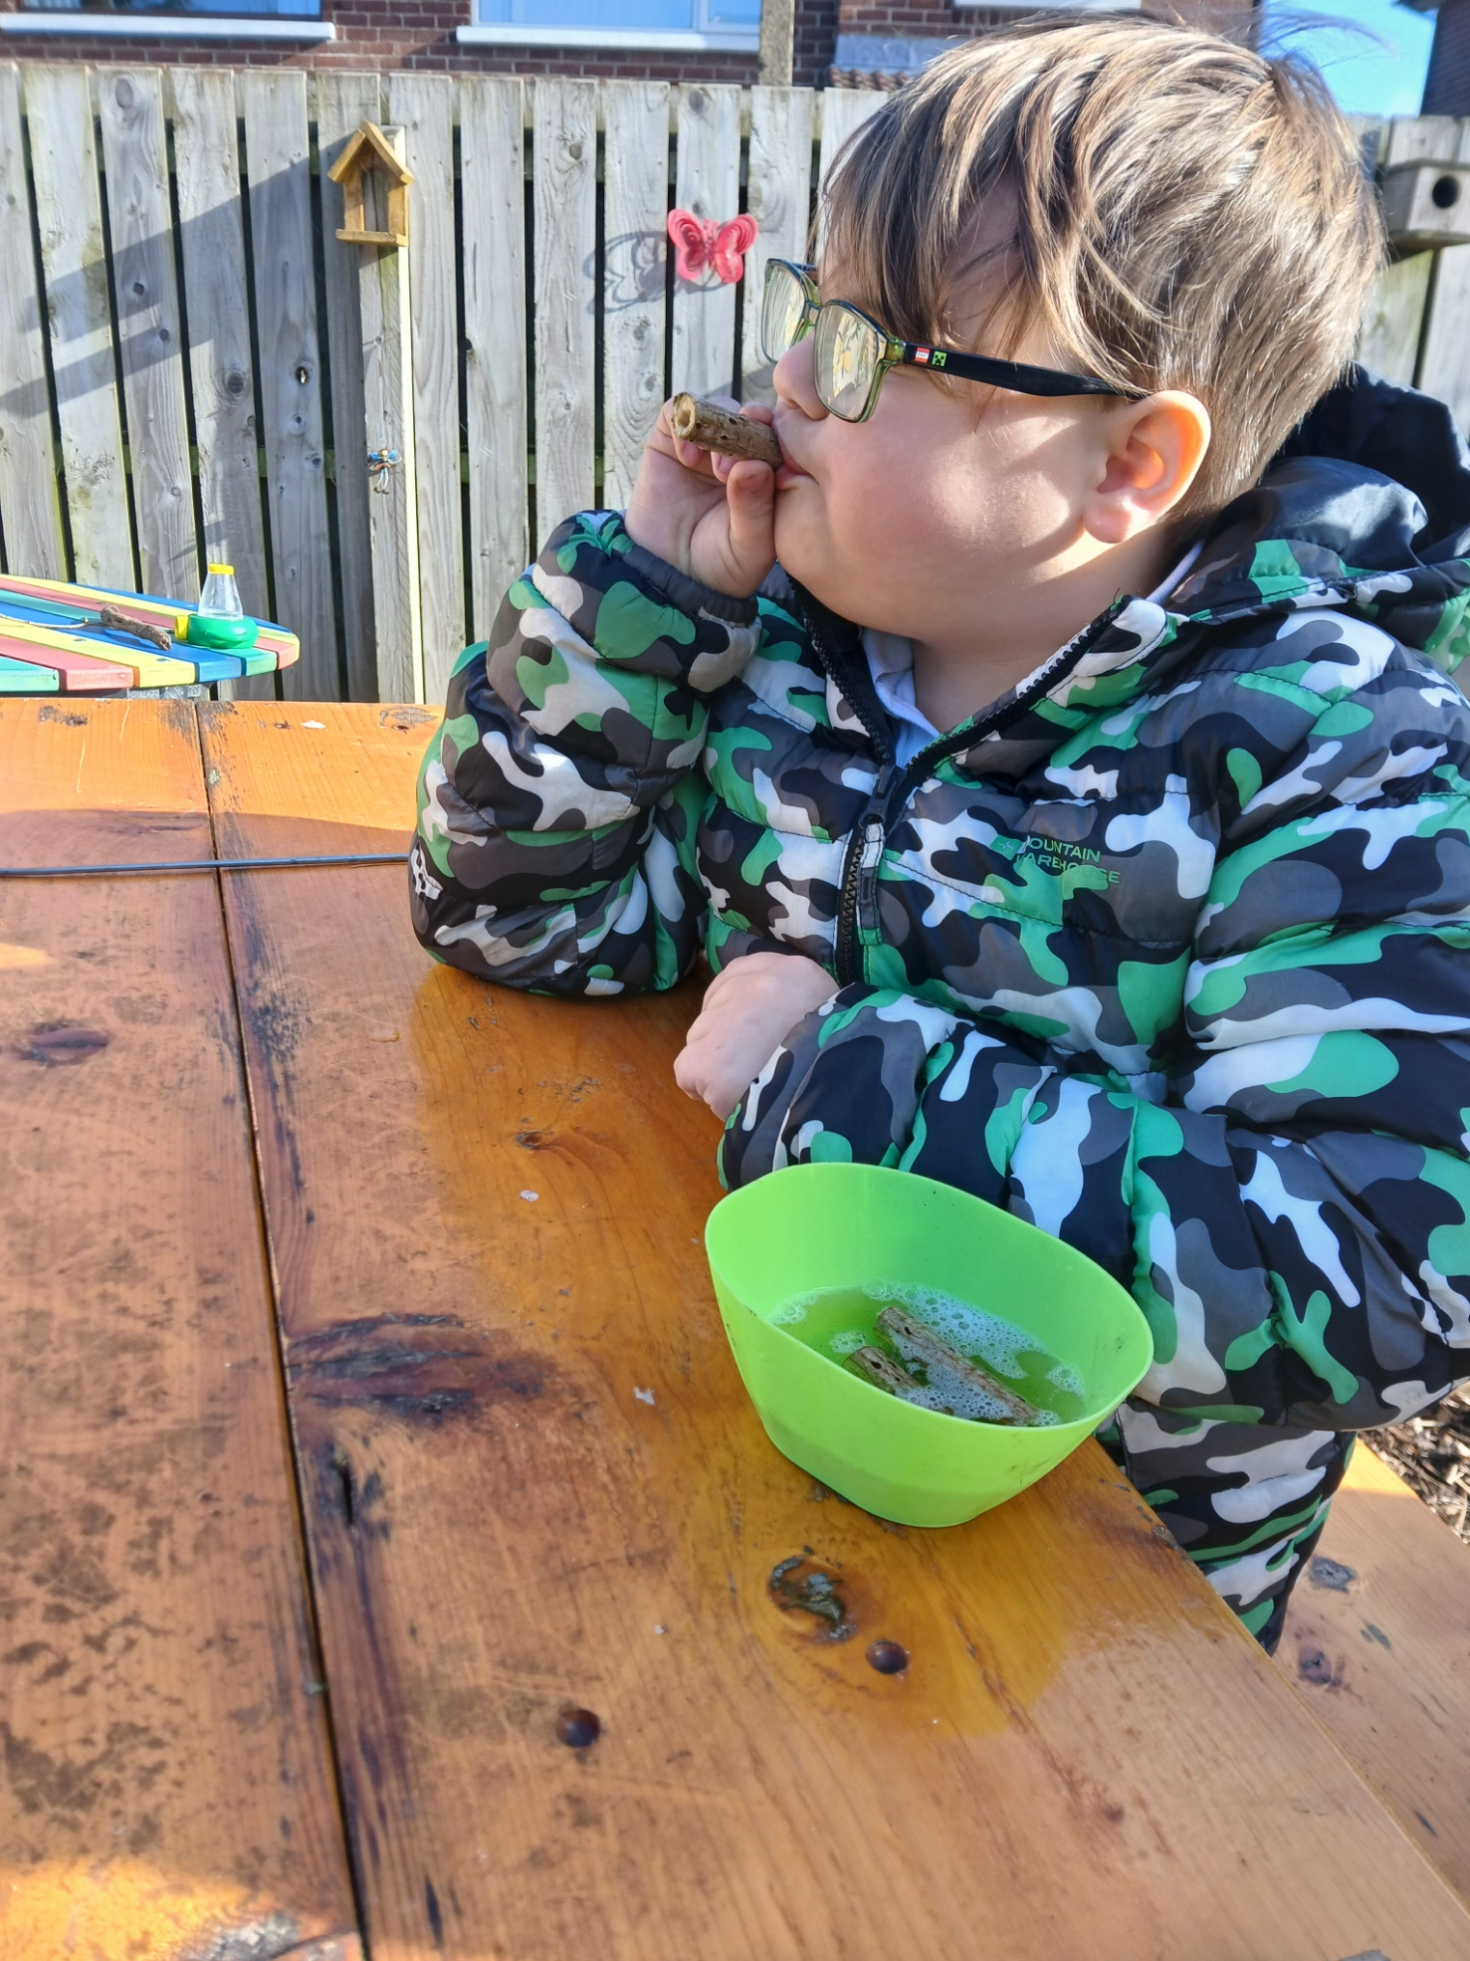
Bubble Wands
We used our tent peg to push the centre (pith) of the elder out. We dipped in to bubble mixture and blew bubbles.
Some were successful.

Slide 9
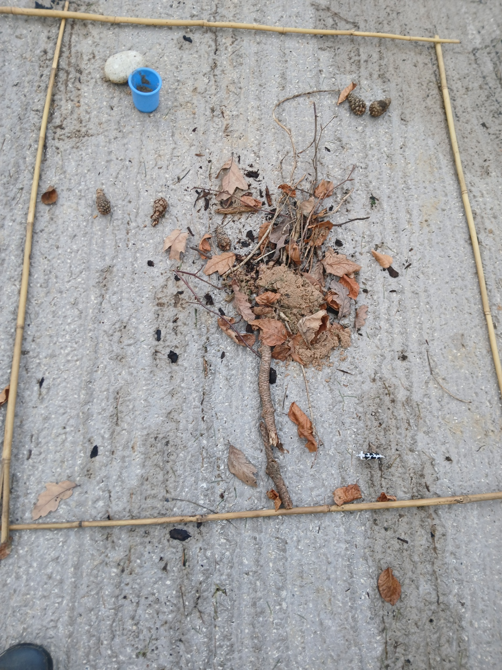
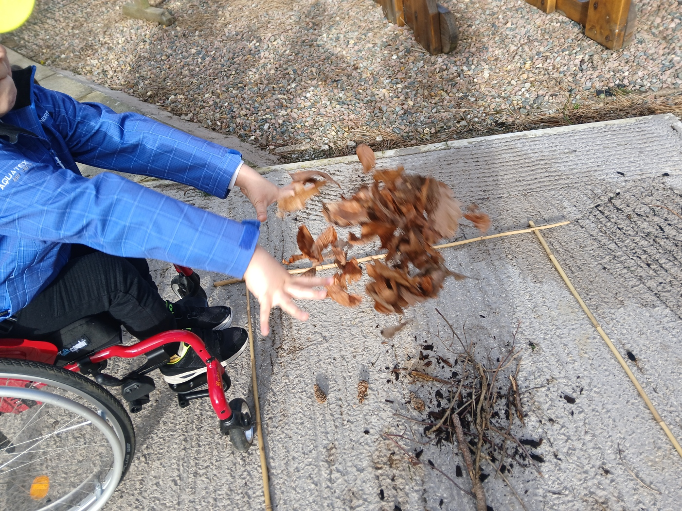
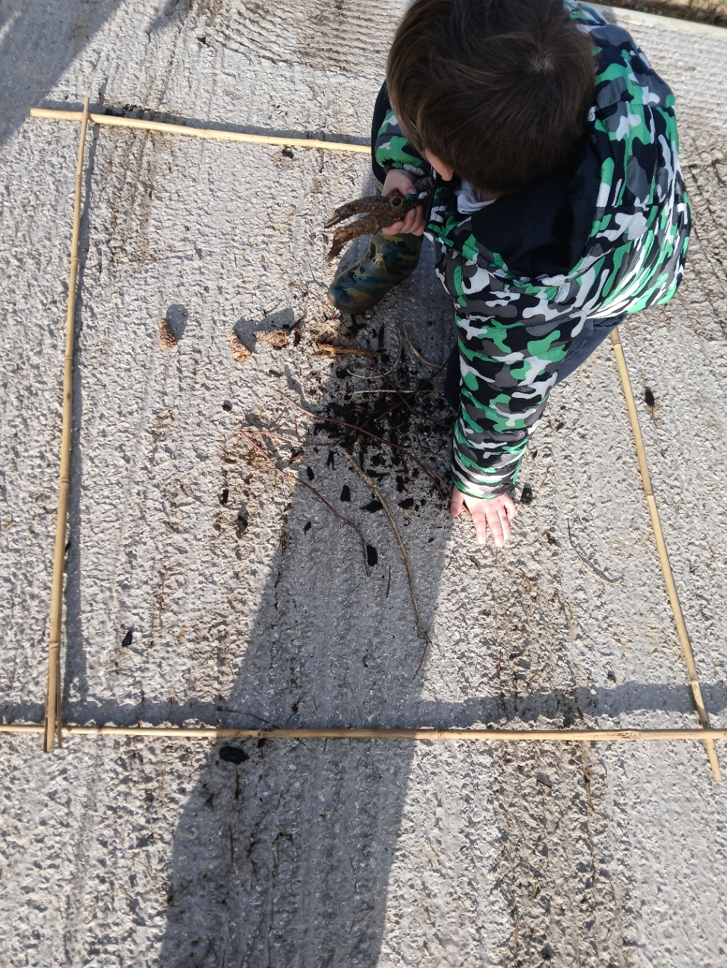
Tree Picture
Time to make our own tree. We use bamboo canes to make our picture frame.

Slide 10
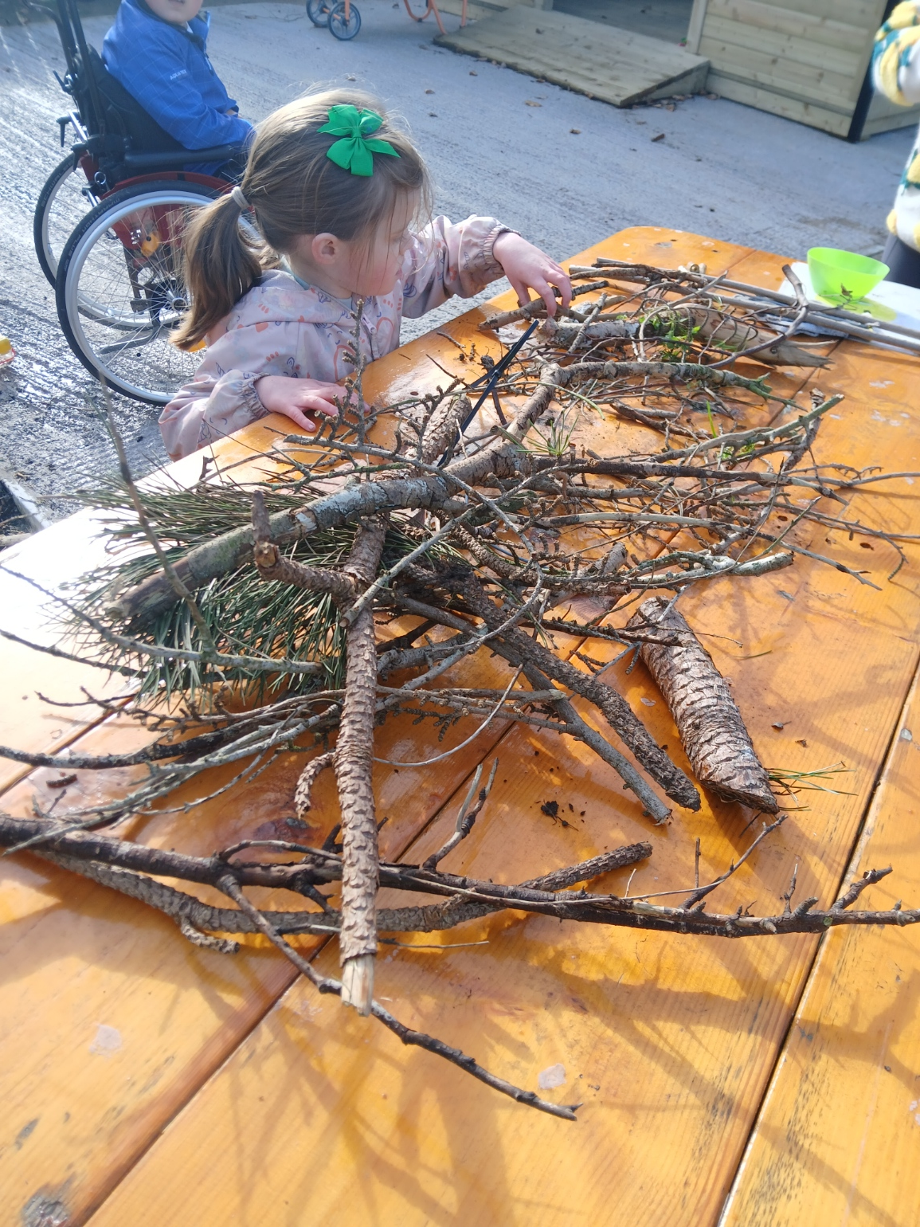
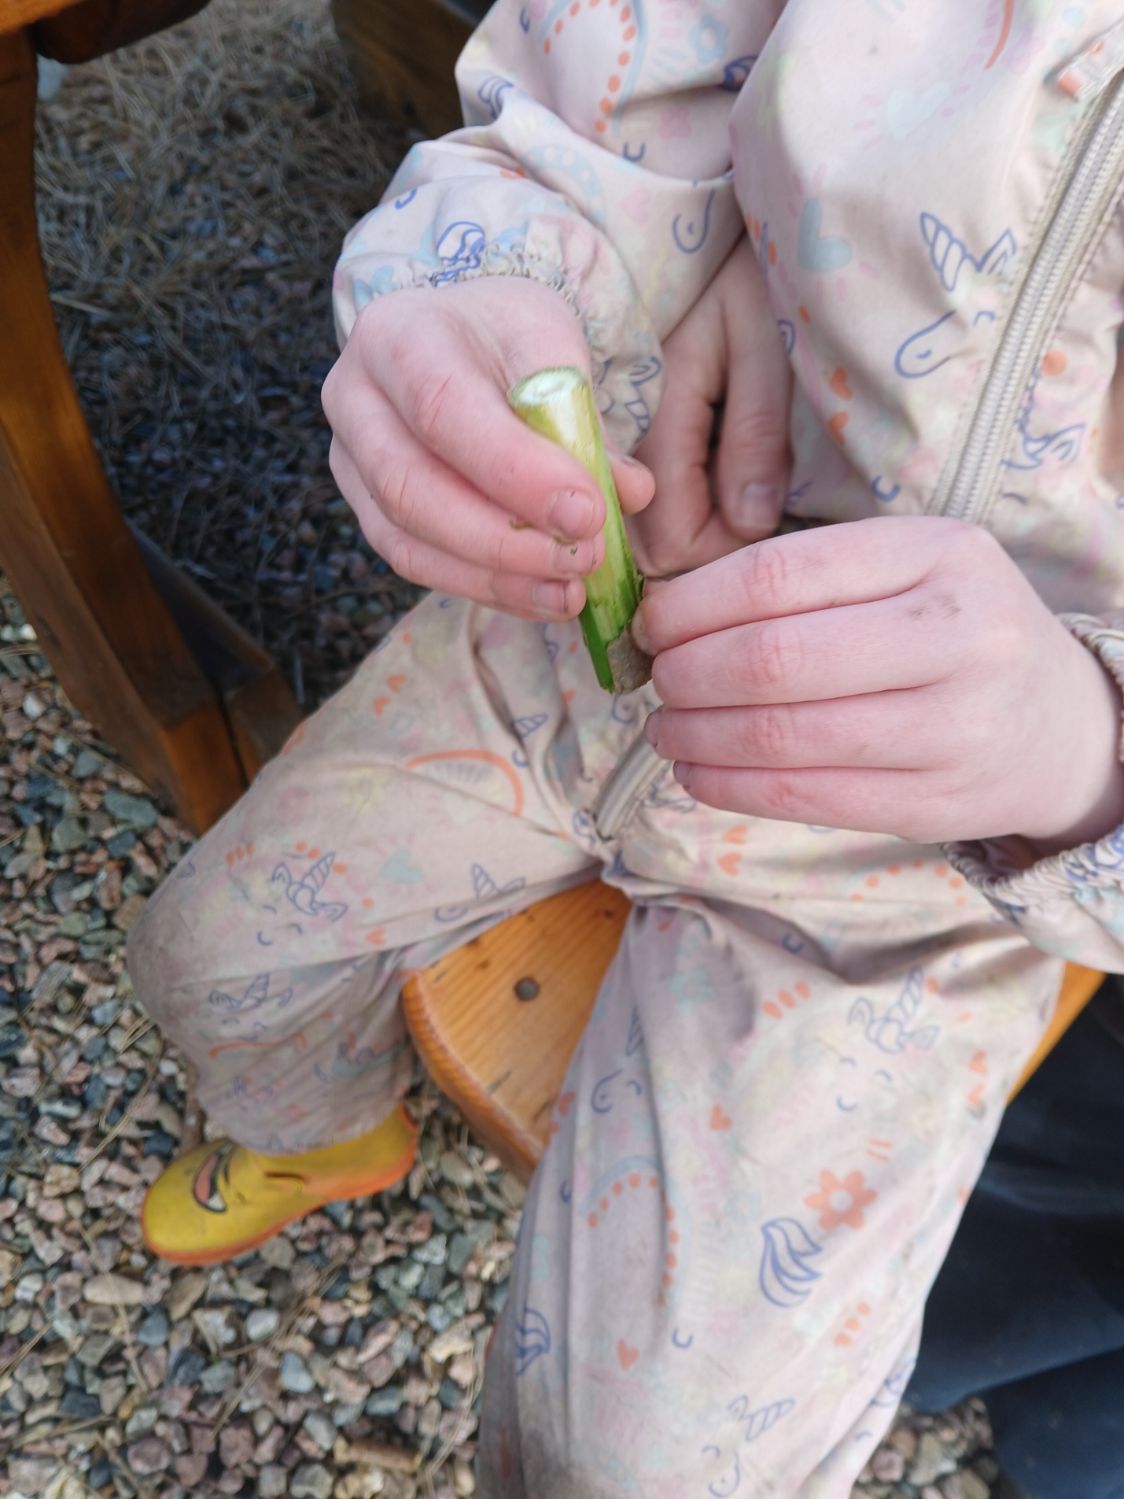
Exploring Nature
We explored our garden area.
We collected some sticks to make some birds nests.

Slide 11
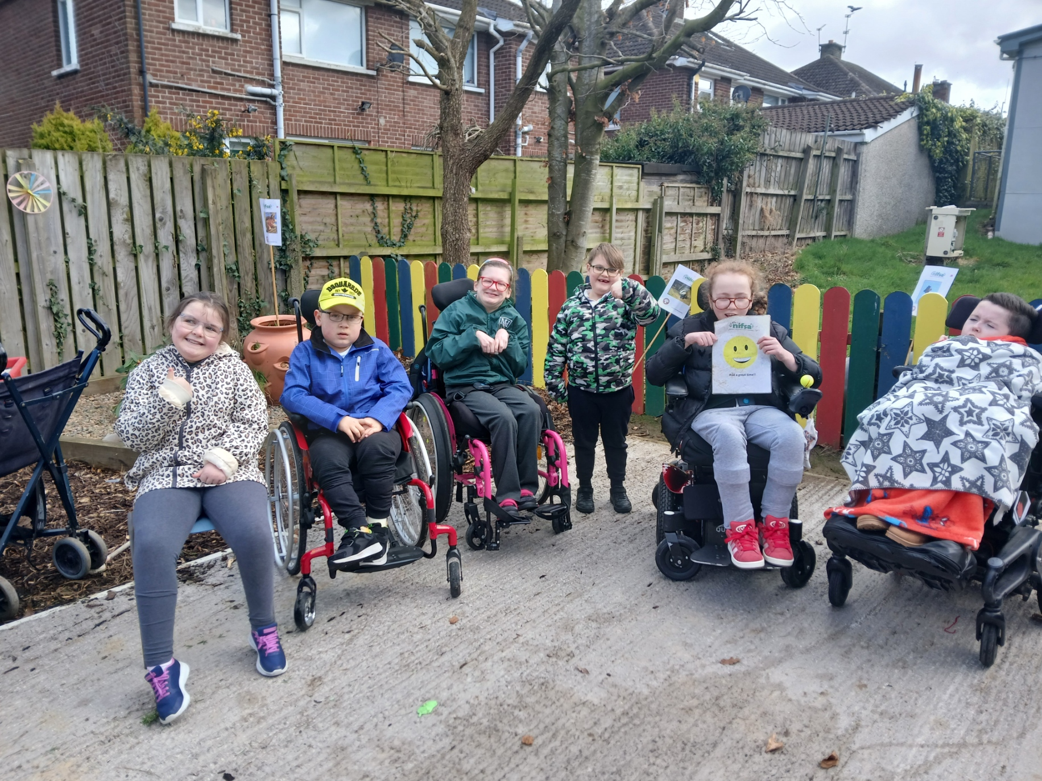
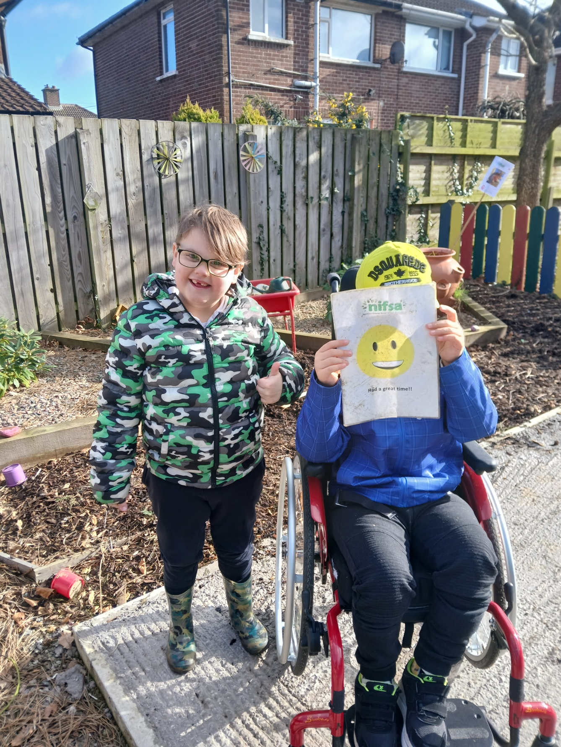
DID YOU ENJOY IT?
All smiley faces today.

