Slide 1
Forest School St. Trea’s PS Mapping 26th March

Slide 2
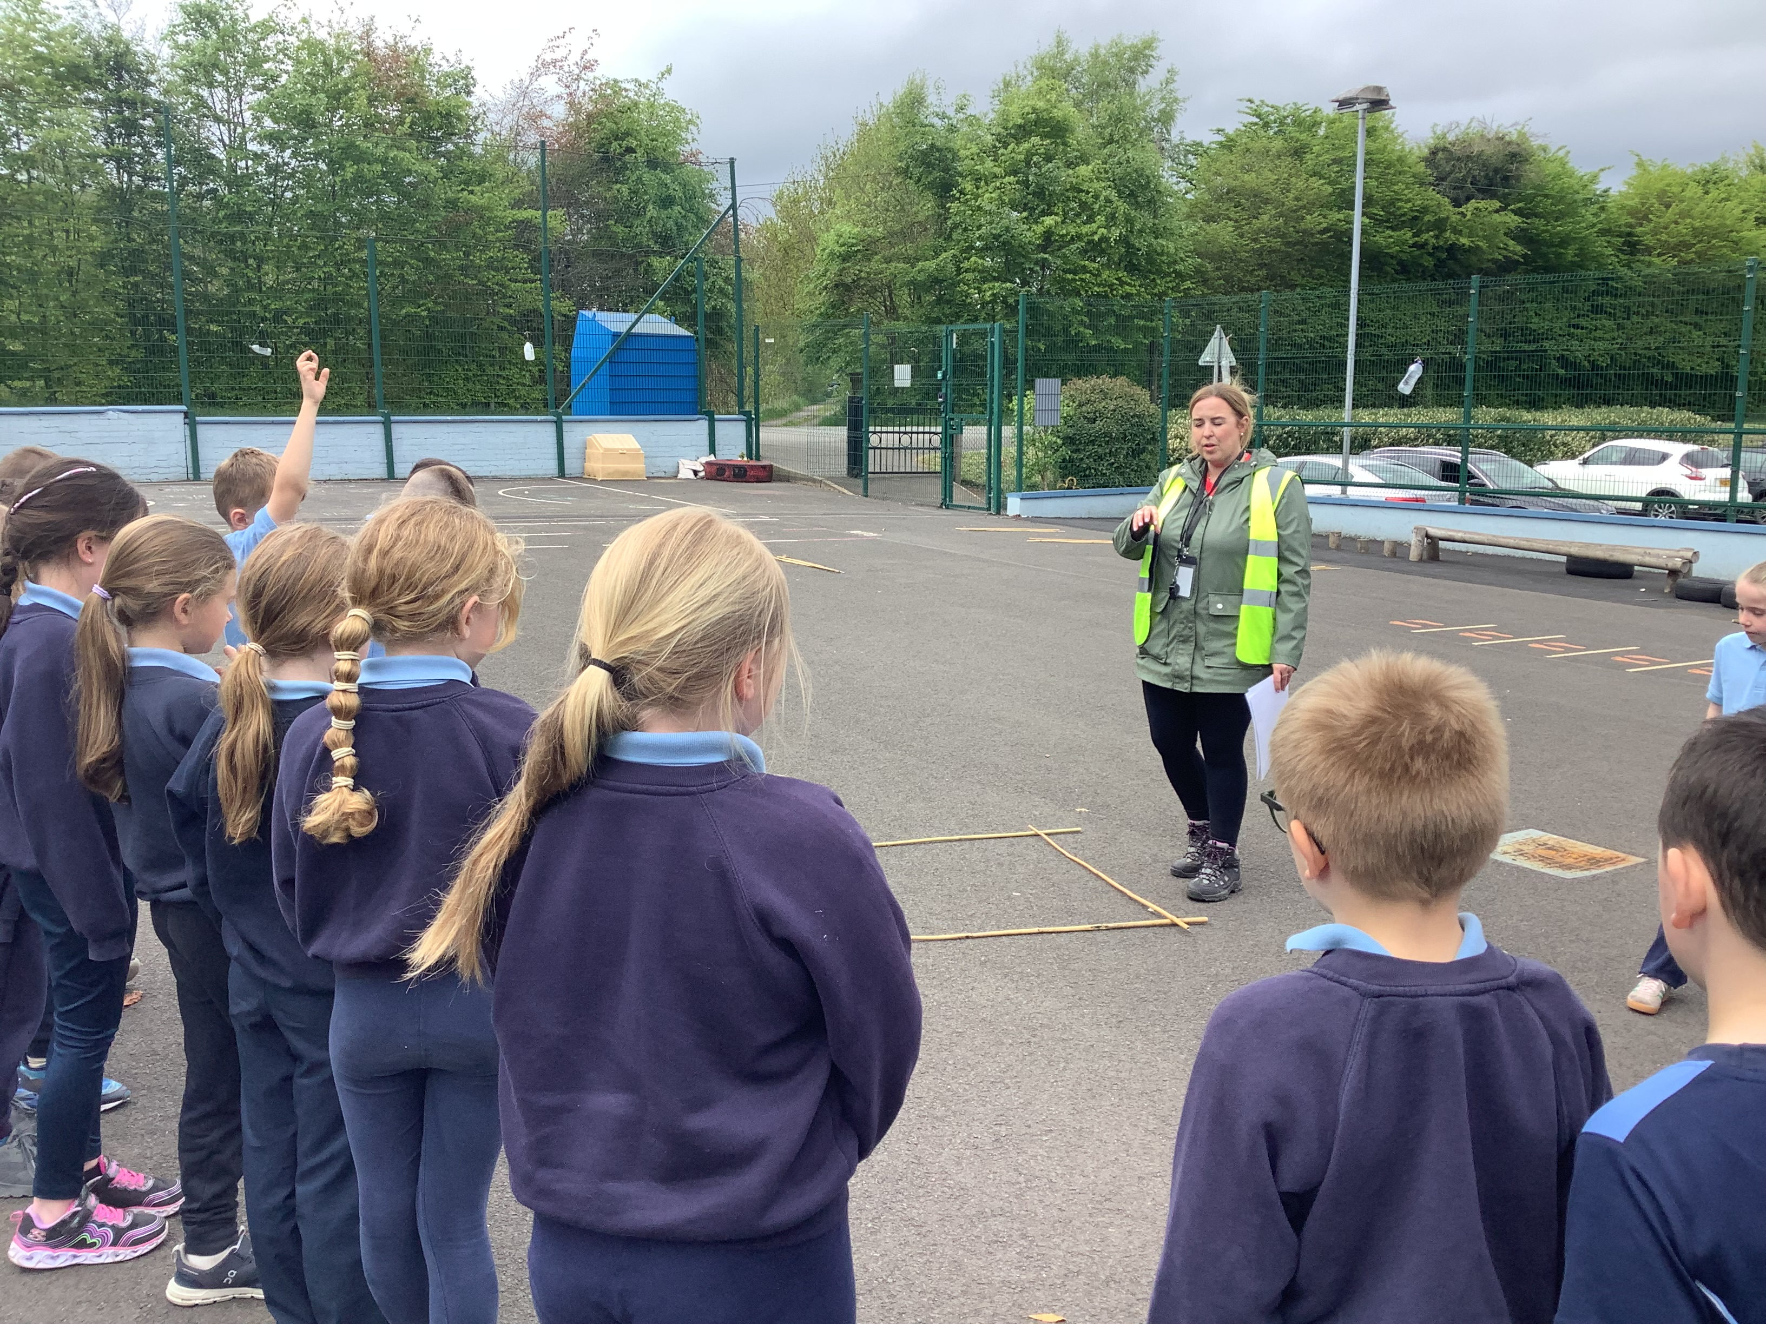
RULES
We went over our Forest School rules:
1 whistle: freeze like a tree
2 whistles: back to base
3rd rule: have fun and learn.

Slide 3
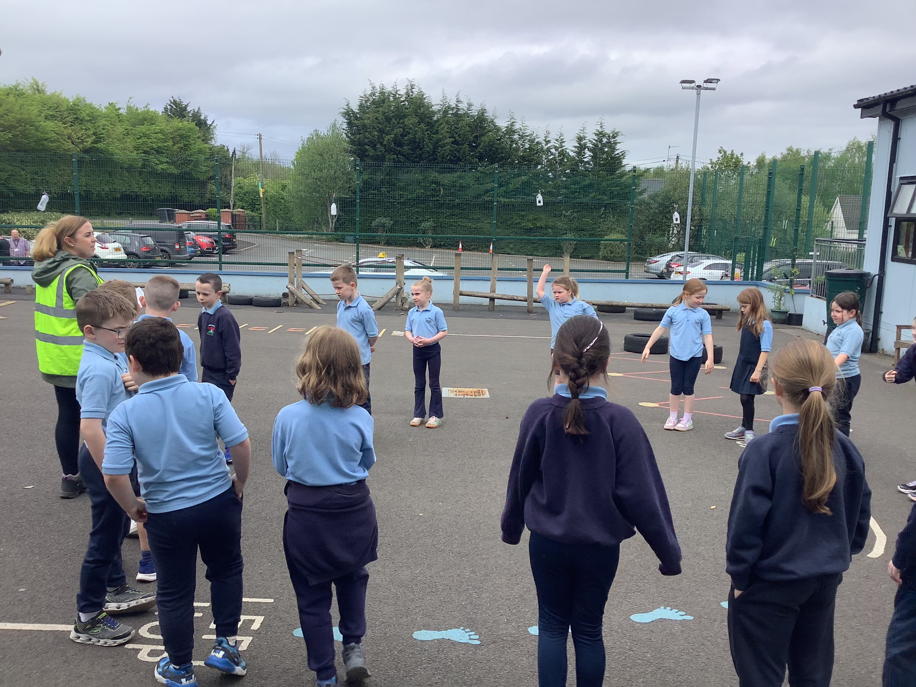
RULES We put up boundaries around the area we were using.

Slide 4
Map Making
We talked about previous learning, including using a compass and reading North, South, East and West.
We discussed the importance of maps in everyday life and how we use them in different situations.
We took observations of our school and decided to make a map of the school setting.

Slide 5
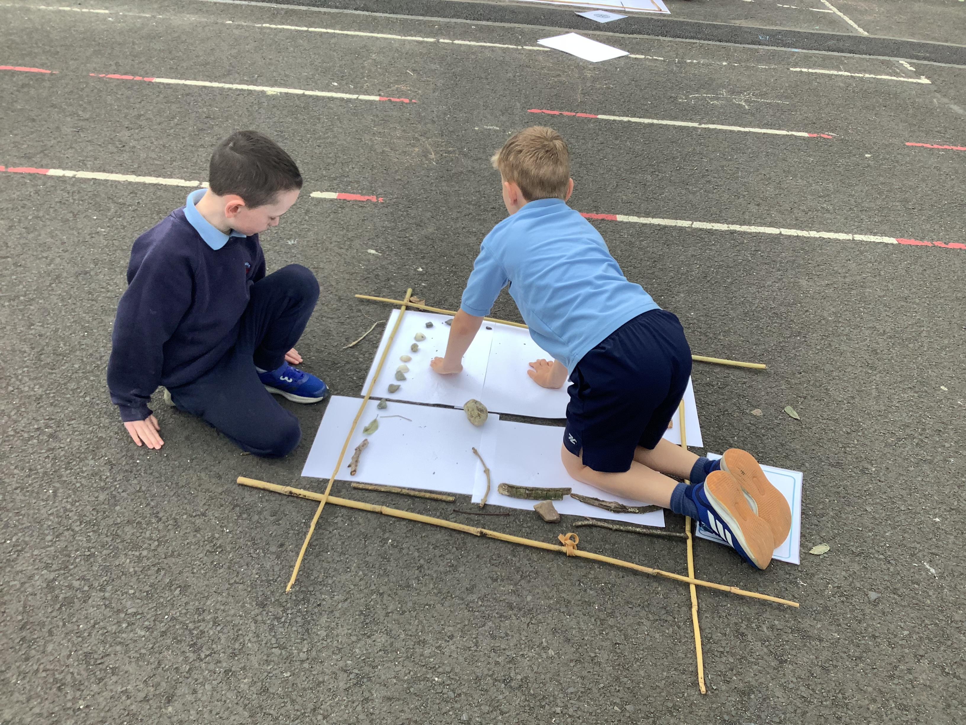
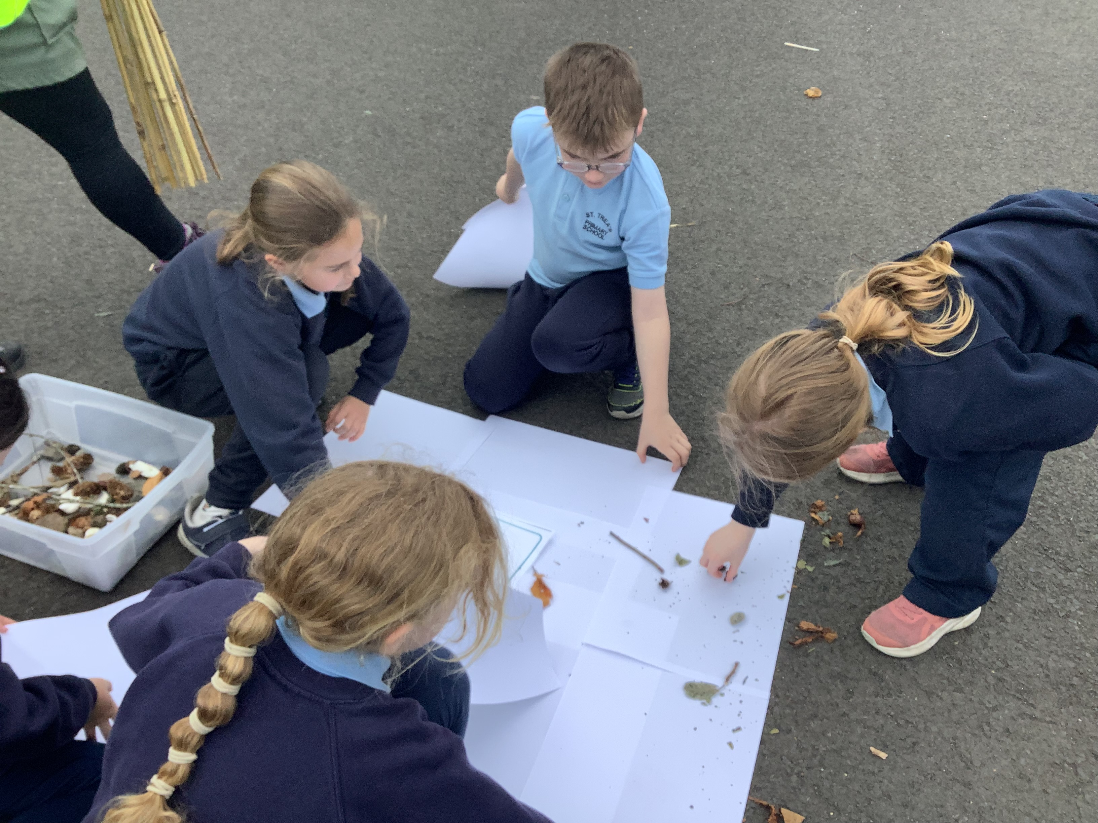
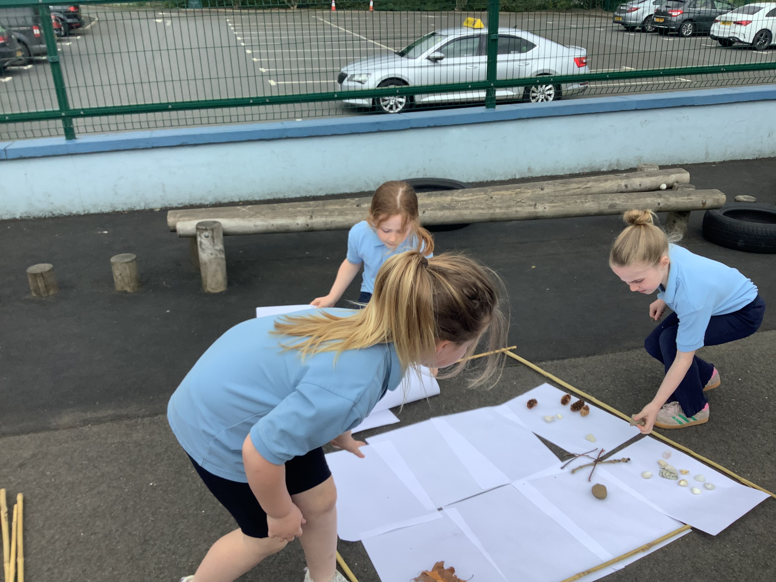
Map Making
We started to build our maps in small groups working together collaboratively.

Slide 6
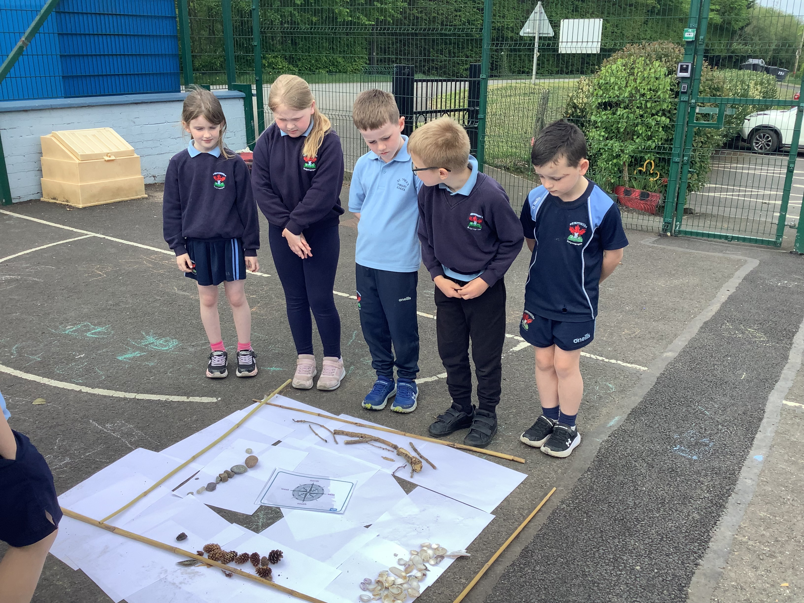
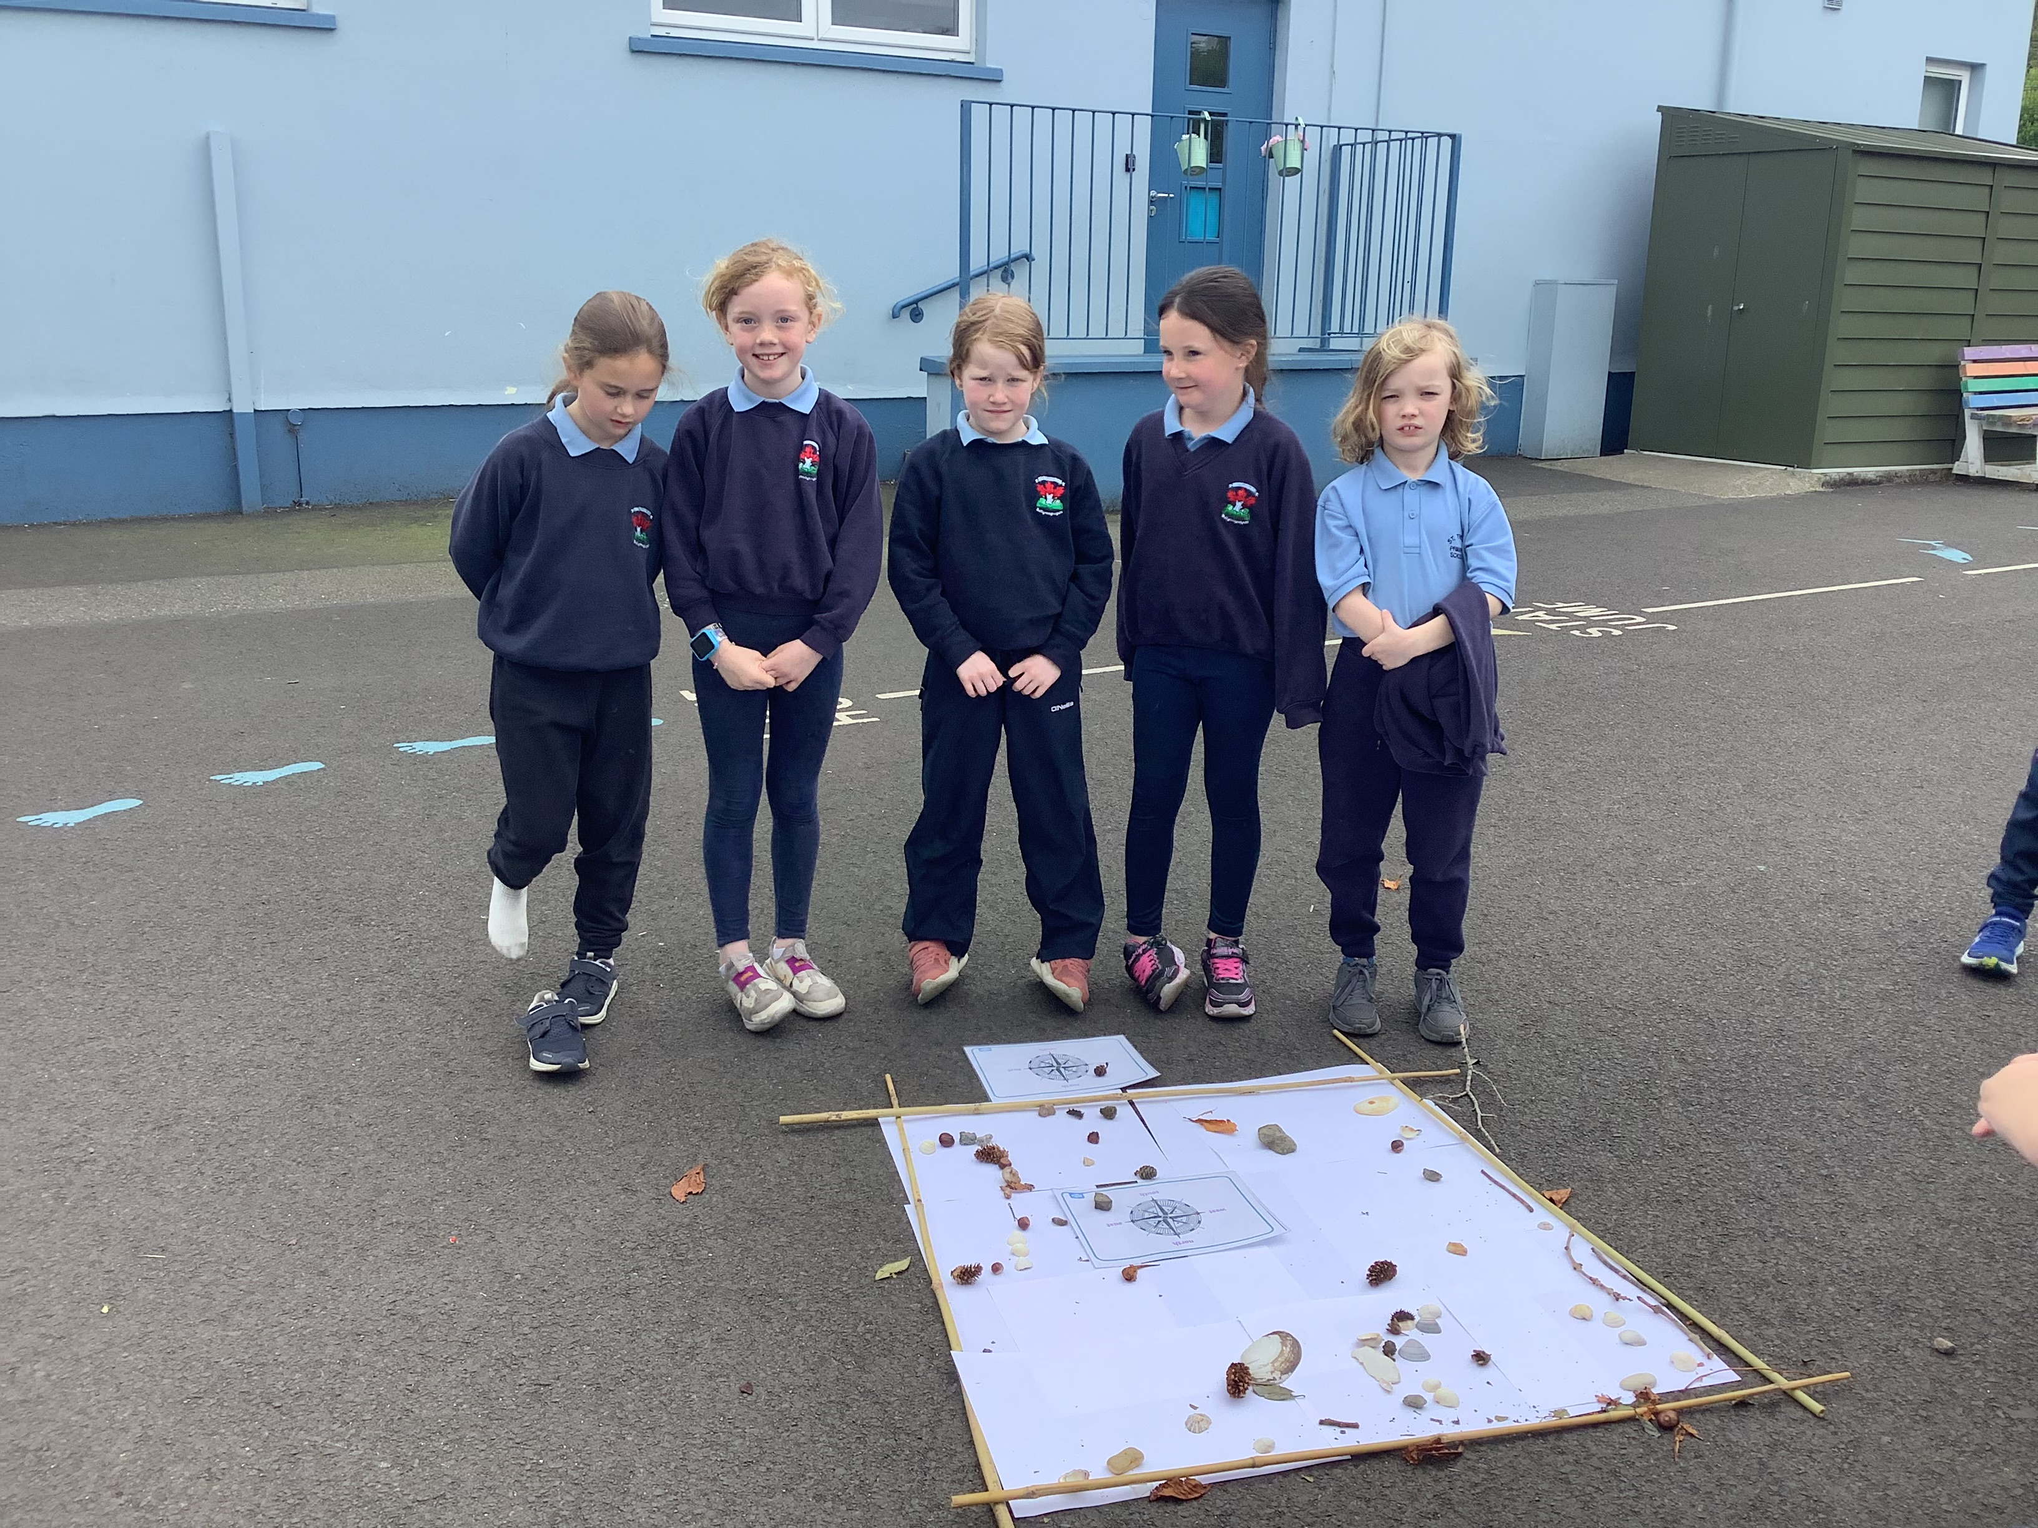
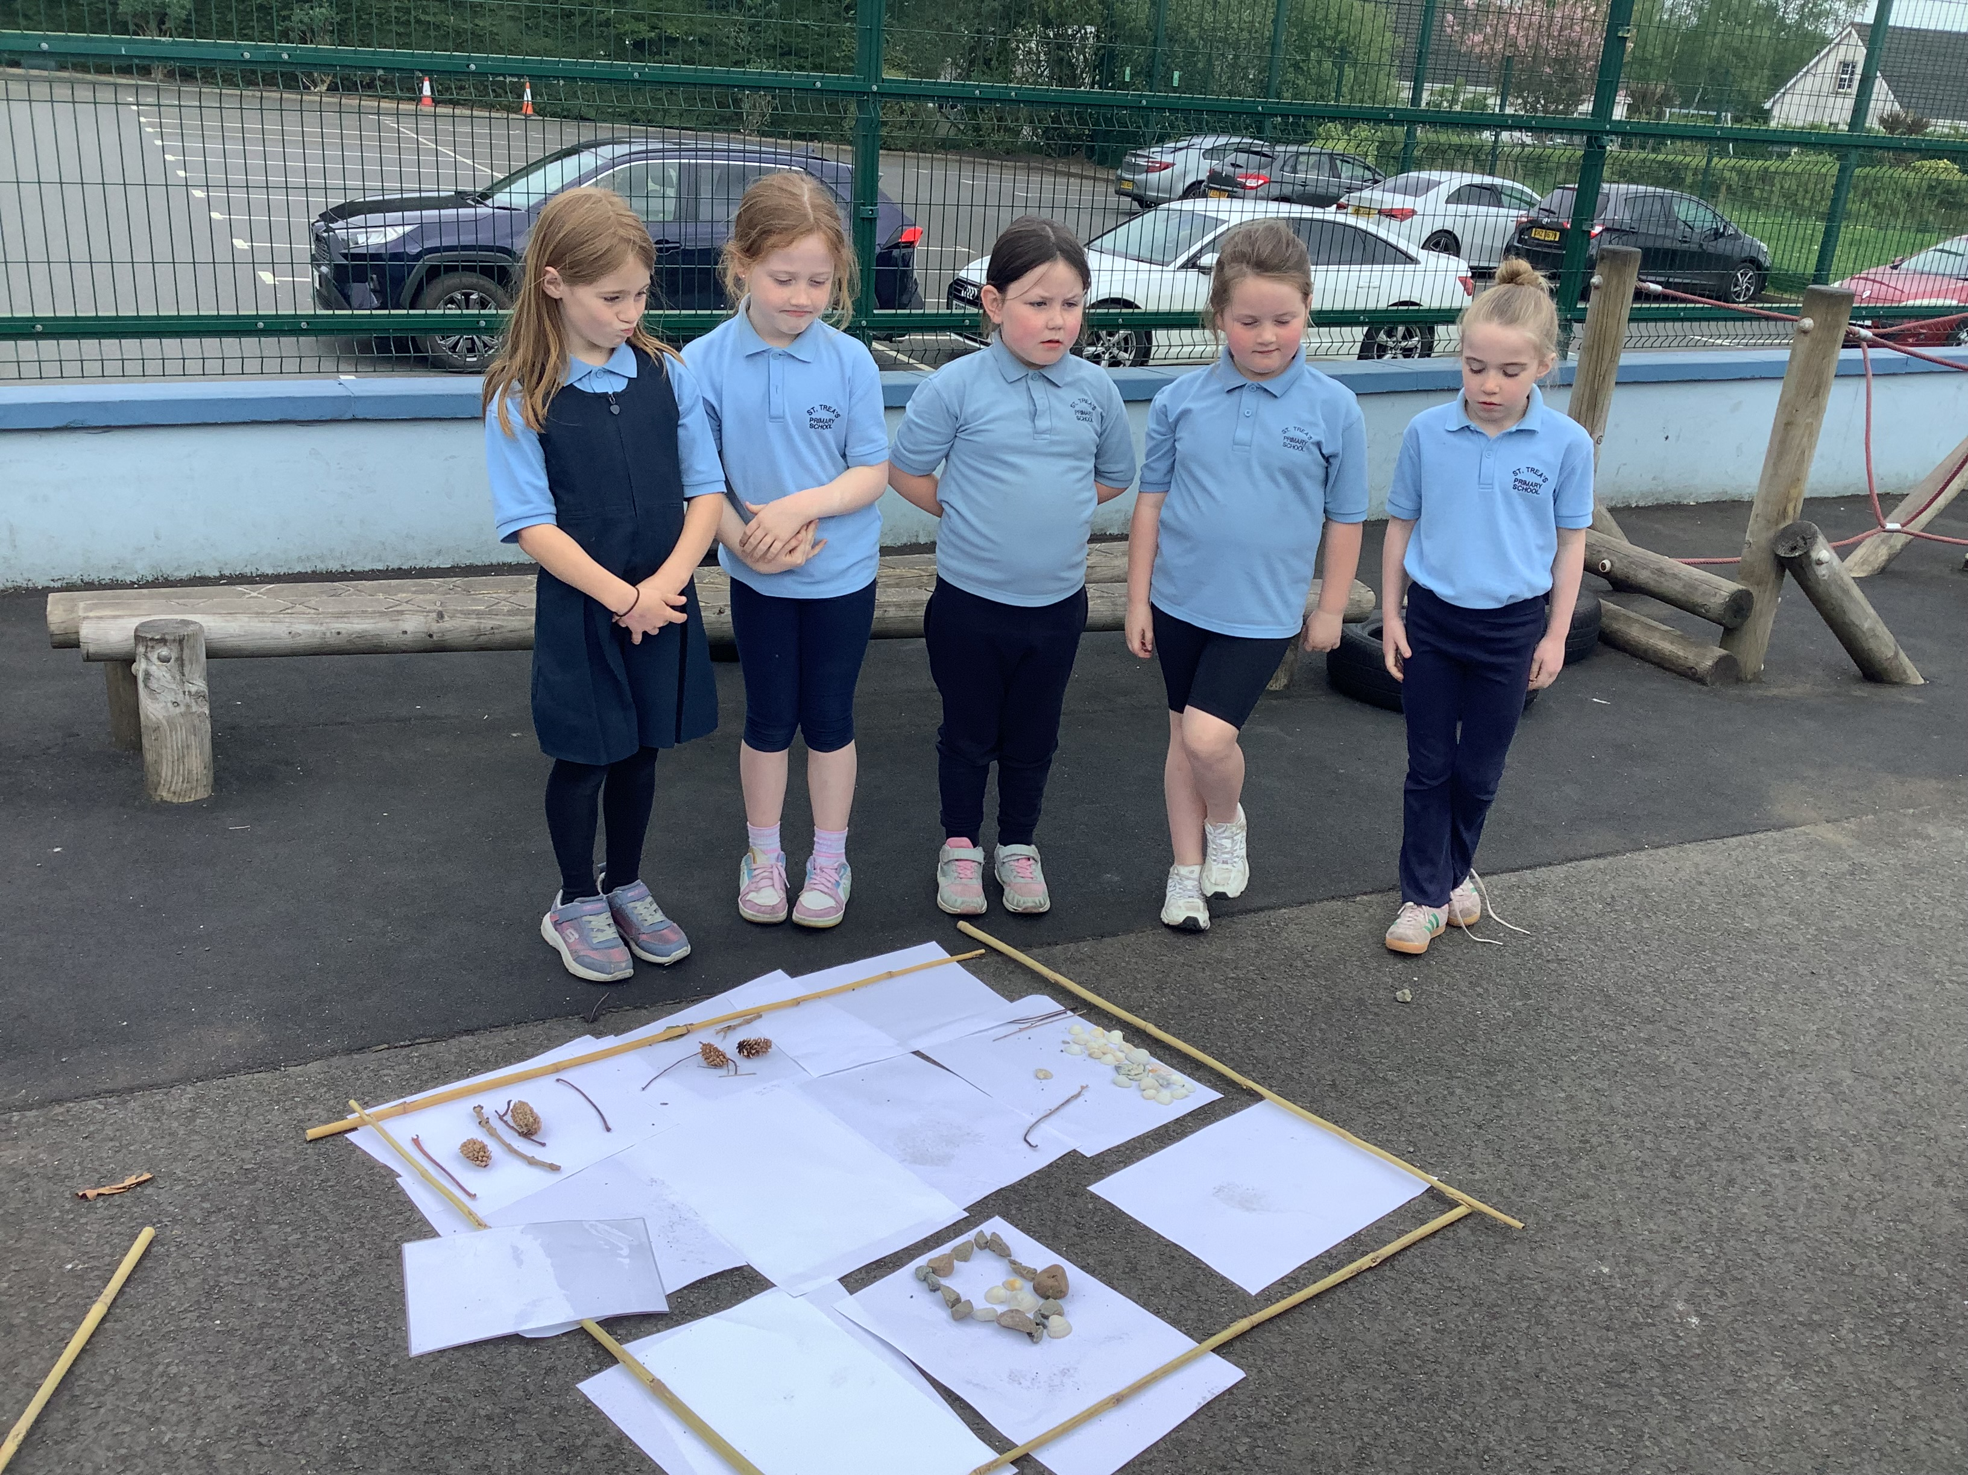
Map Making
Look at some of our creations!
We described our maps; each taking a turn to speak and use the positional language relating to using a compass.

Slide 7
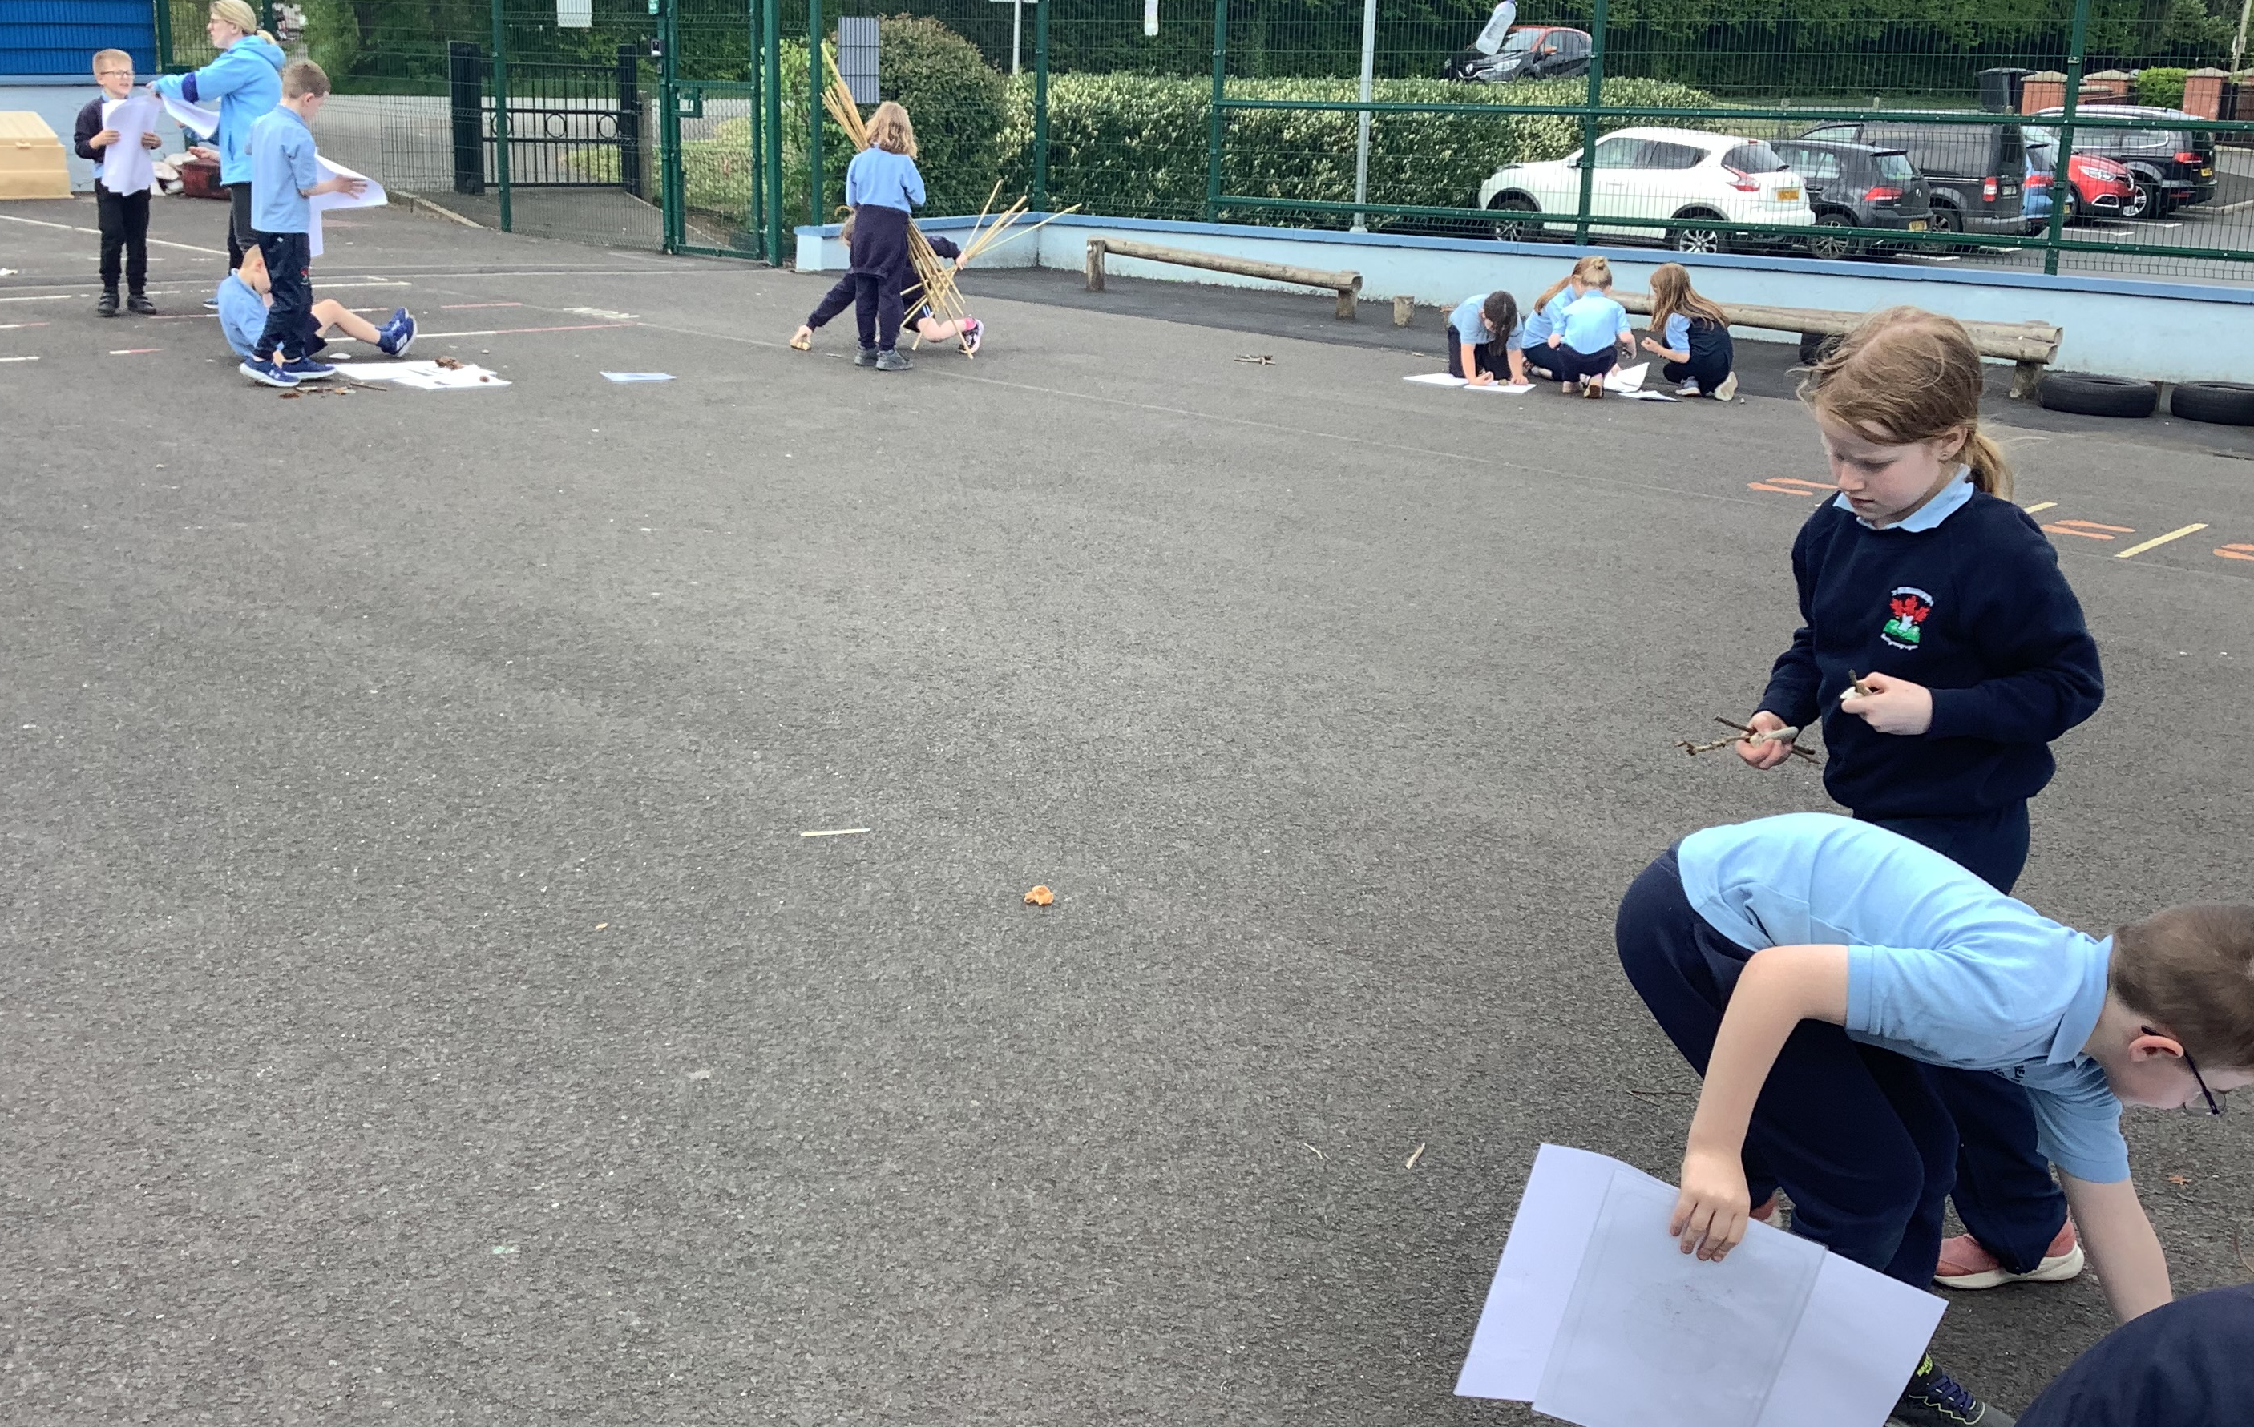
LEAVE NO TRACE
We collected the boundaries and tidied the resources to leave the place as we found it.

Slide 8
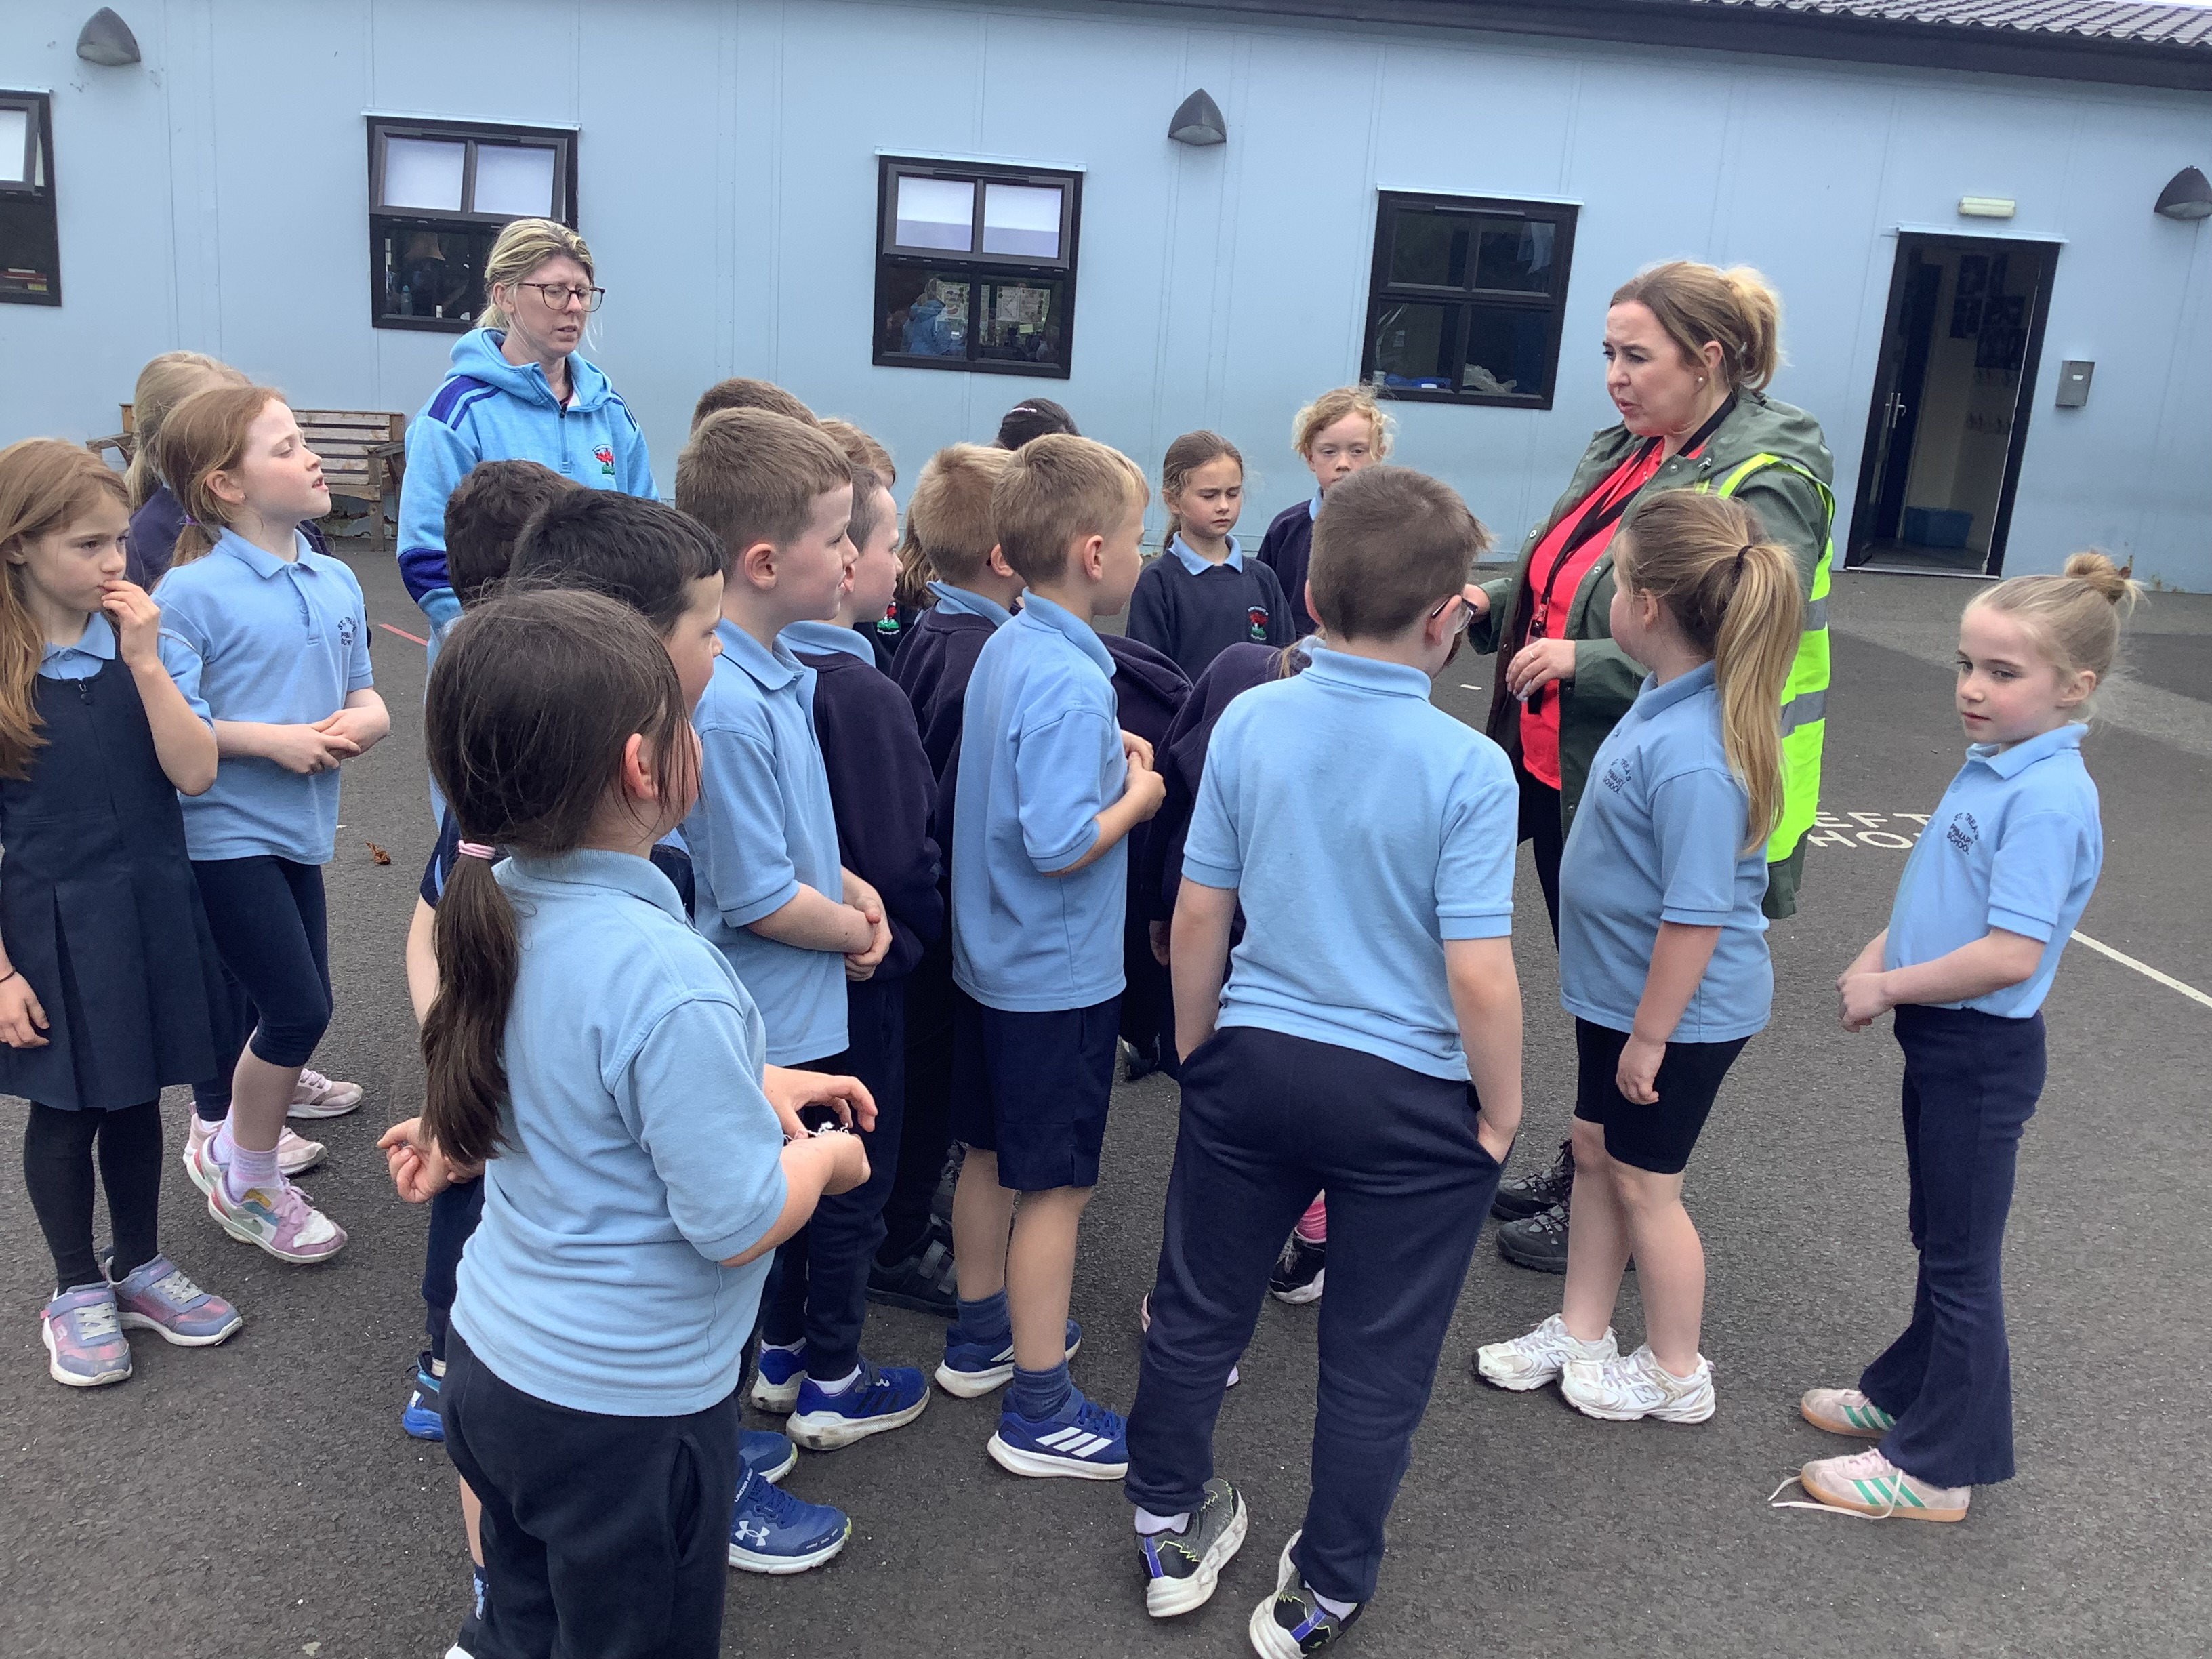
DID YOU ENJOY IT?
The P3/4 children enjoyed taking their lesson outside today!

