Slide 1
Holy evangelist P.S Our Forest School Diary Wednesday 5th march 2025

Slide 2
Rules
We go over our Forest School rules:
1 whistle: stop
2 whistles: back to base
3rd rule: have fun and learn

Slide 3
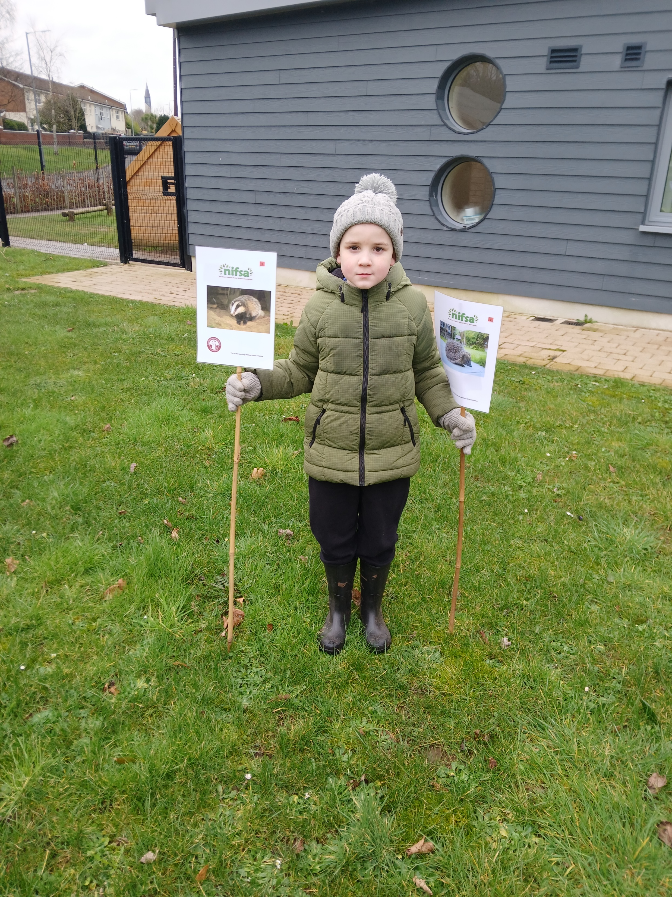
Staying safe
We put out our boundary flags for us to stay inside.

Slide 4
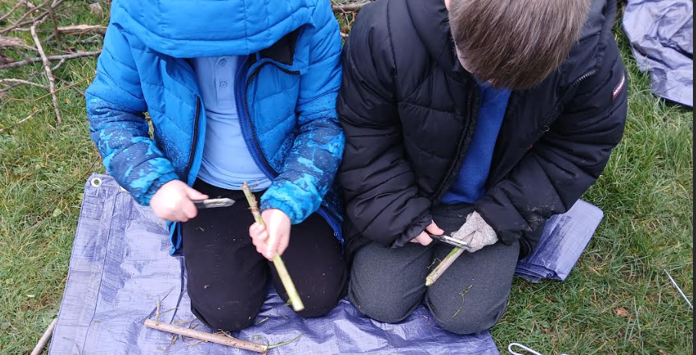
Whittling
Today we are whittling to make bug houses – we use elder rods, potato peelers, tent pegs and wool.

Slide 5
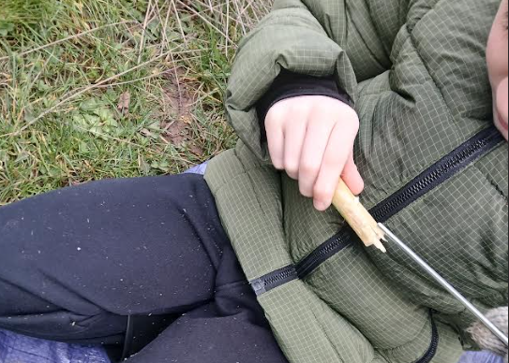
Whittling
Then we use our tent peg to push the centre (pith) of the bark out.

Slide 6
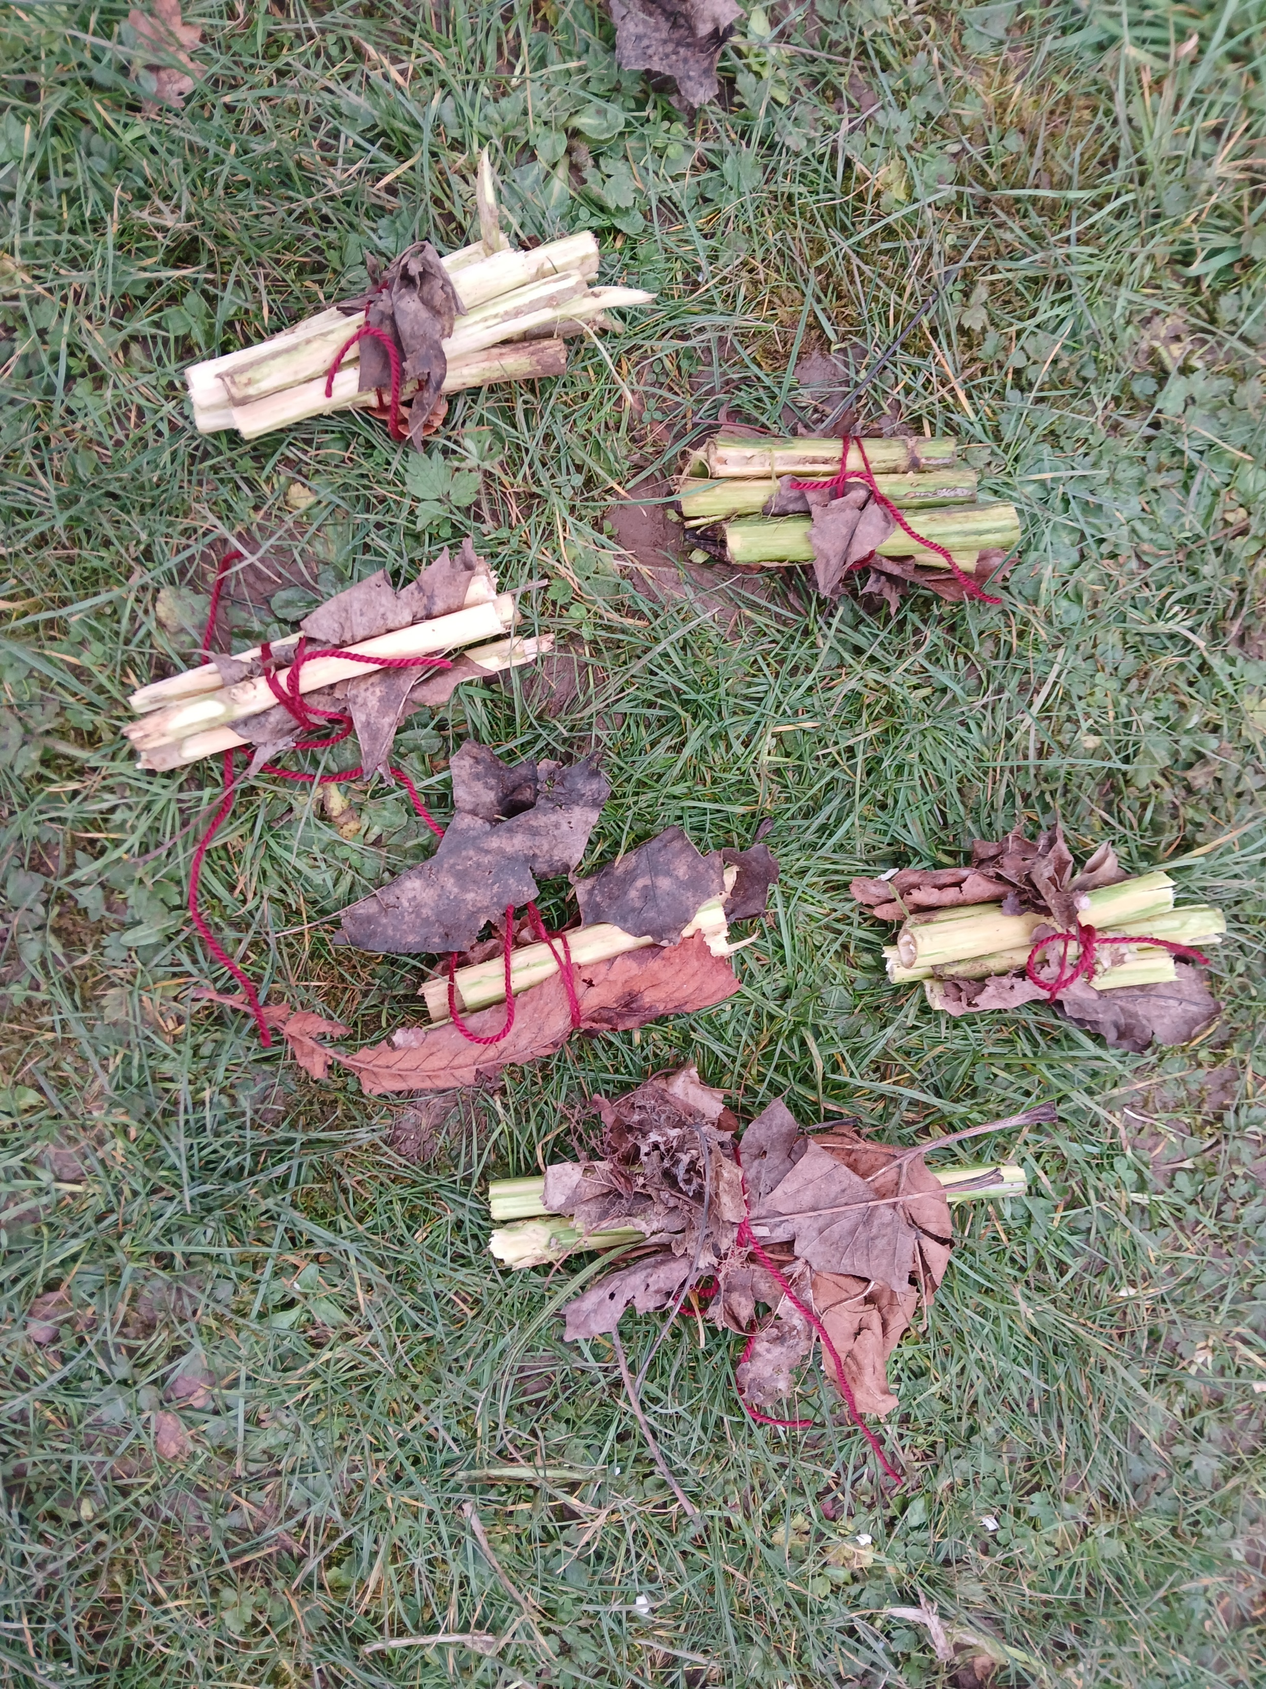
Whittling
We tie them together to make a bug house and leave them in trees/under hedges.

Slide 7
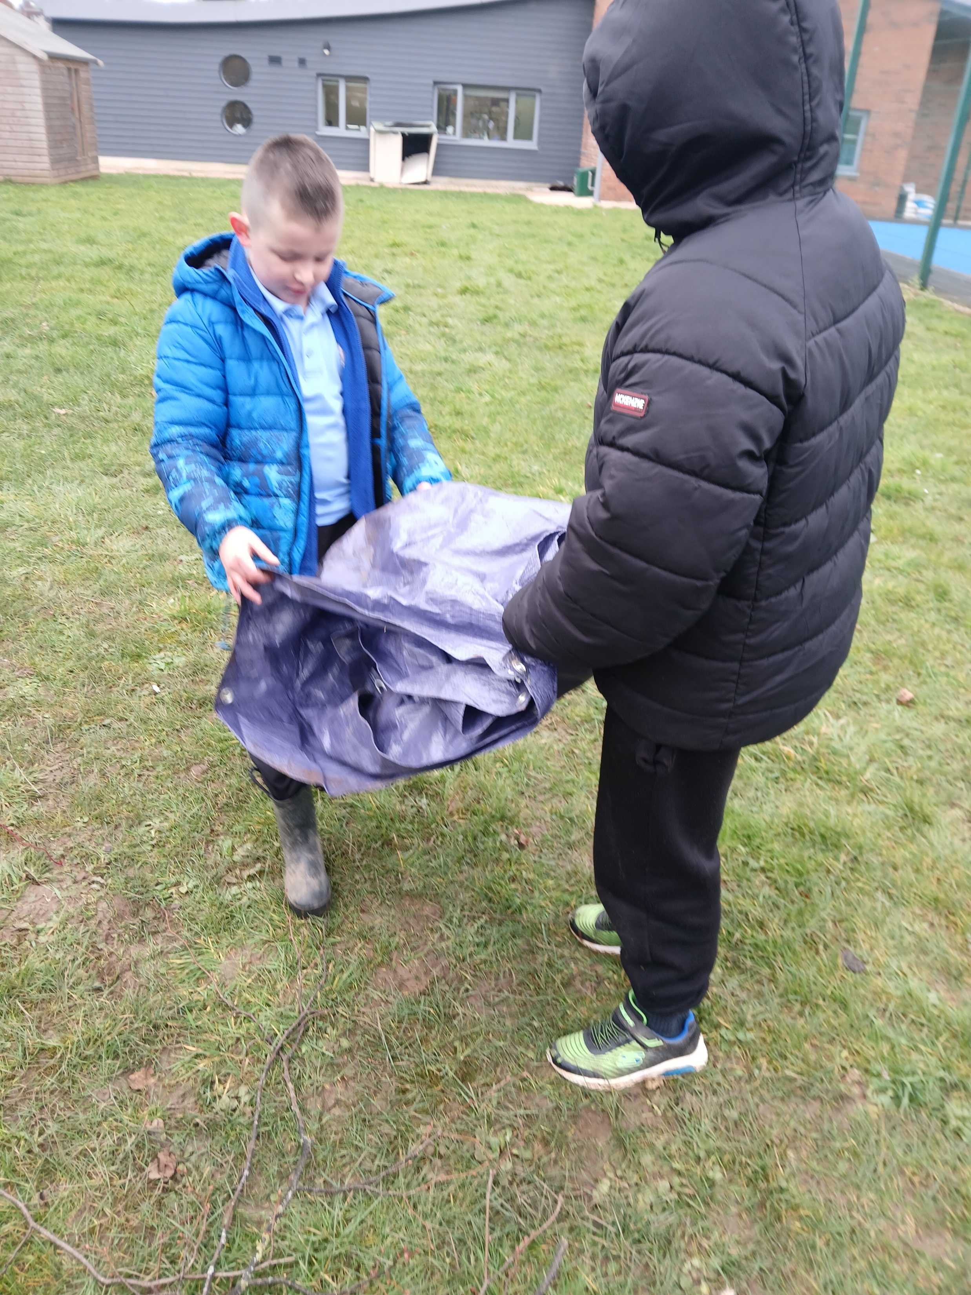
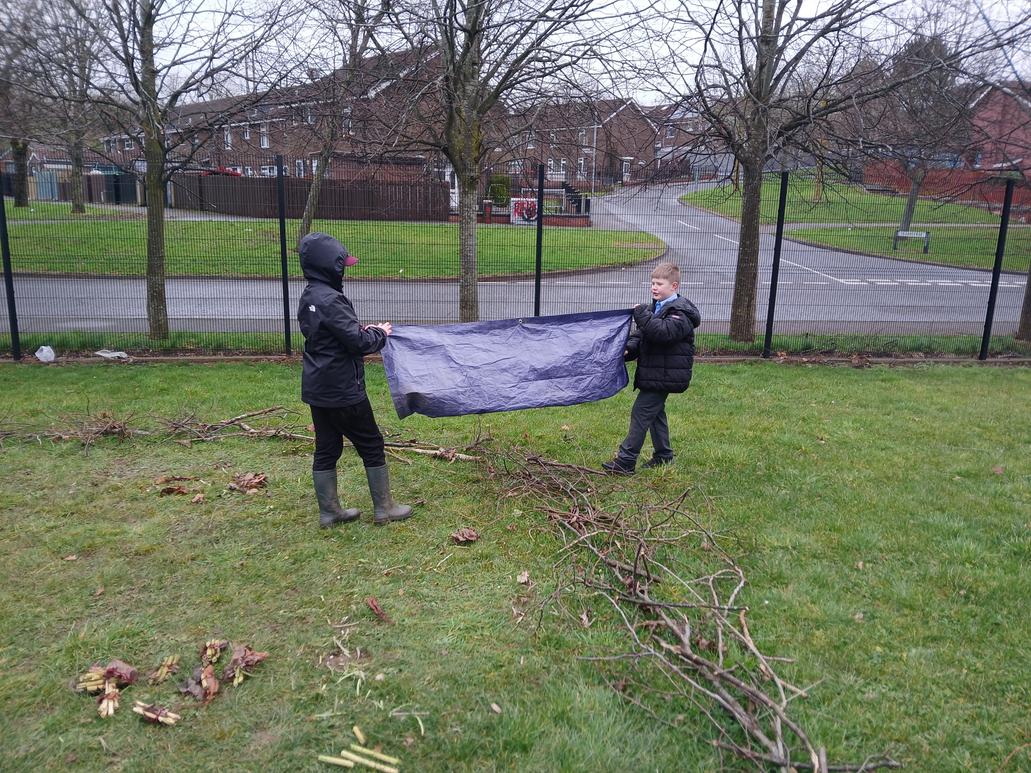
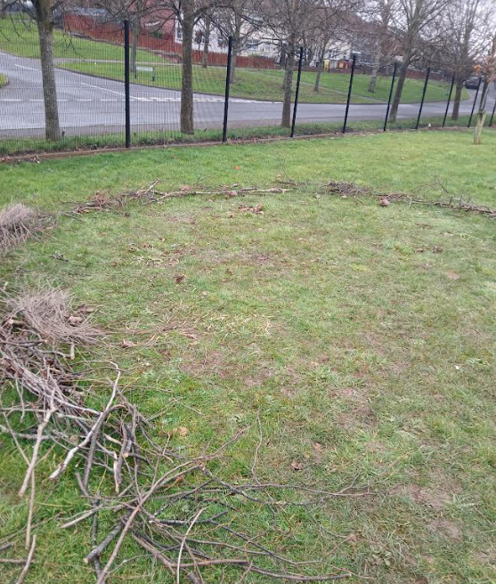
Leave no trace
We have to tidy up afterwards to make it safe for wildlife.

Slide 8
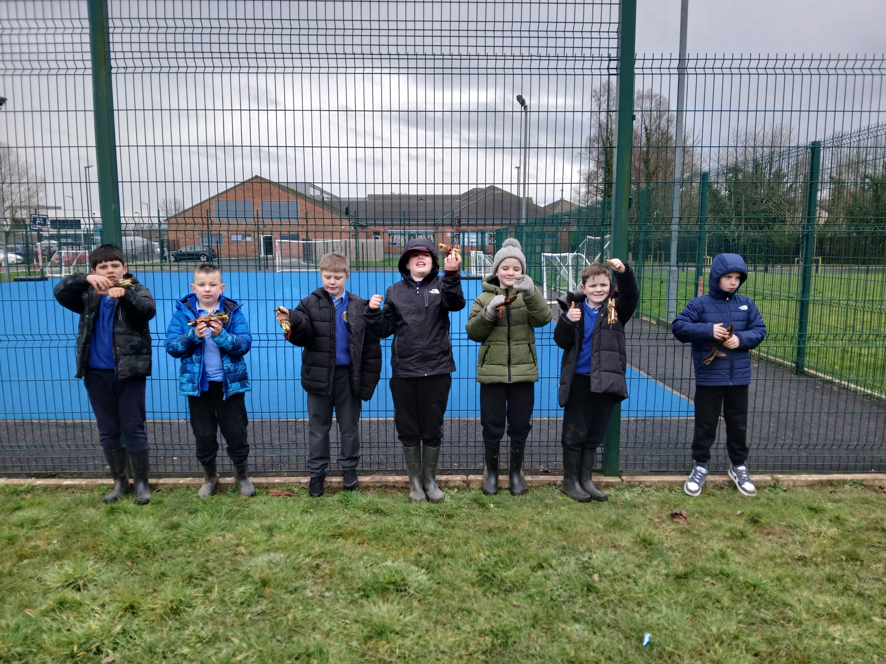
Did you enjoy it?
All smiley faces today. “I enjoyed making the bug houses.” “I enjoyed using the potato peeler.”

