Slide 1


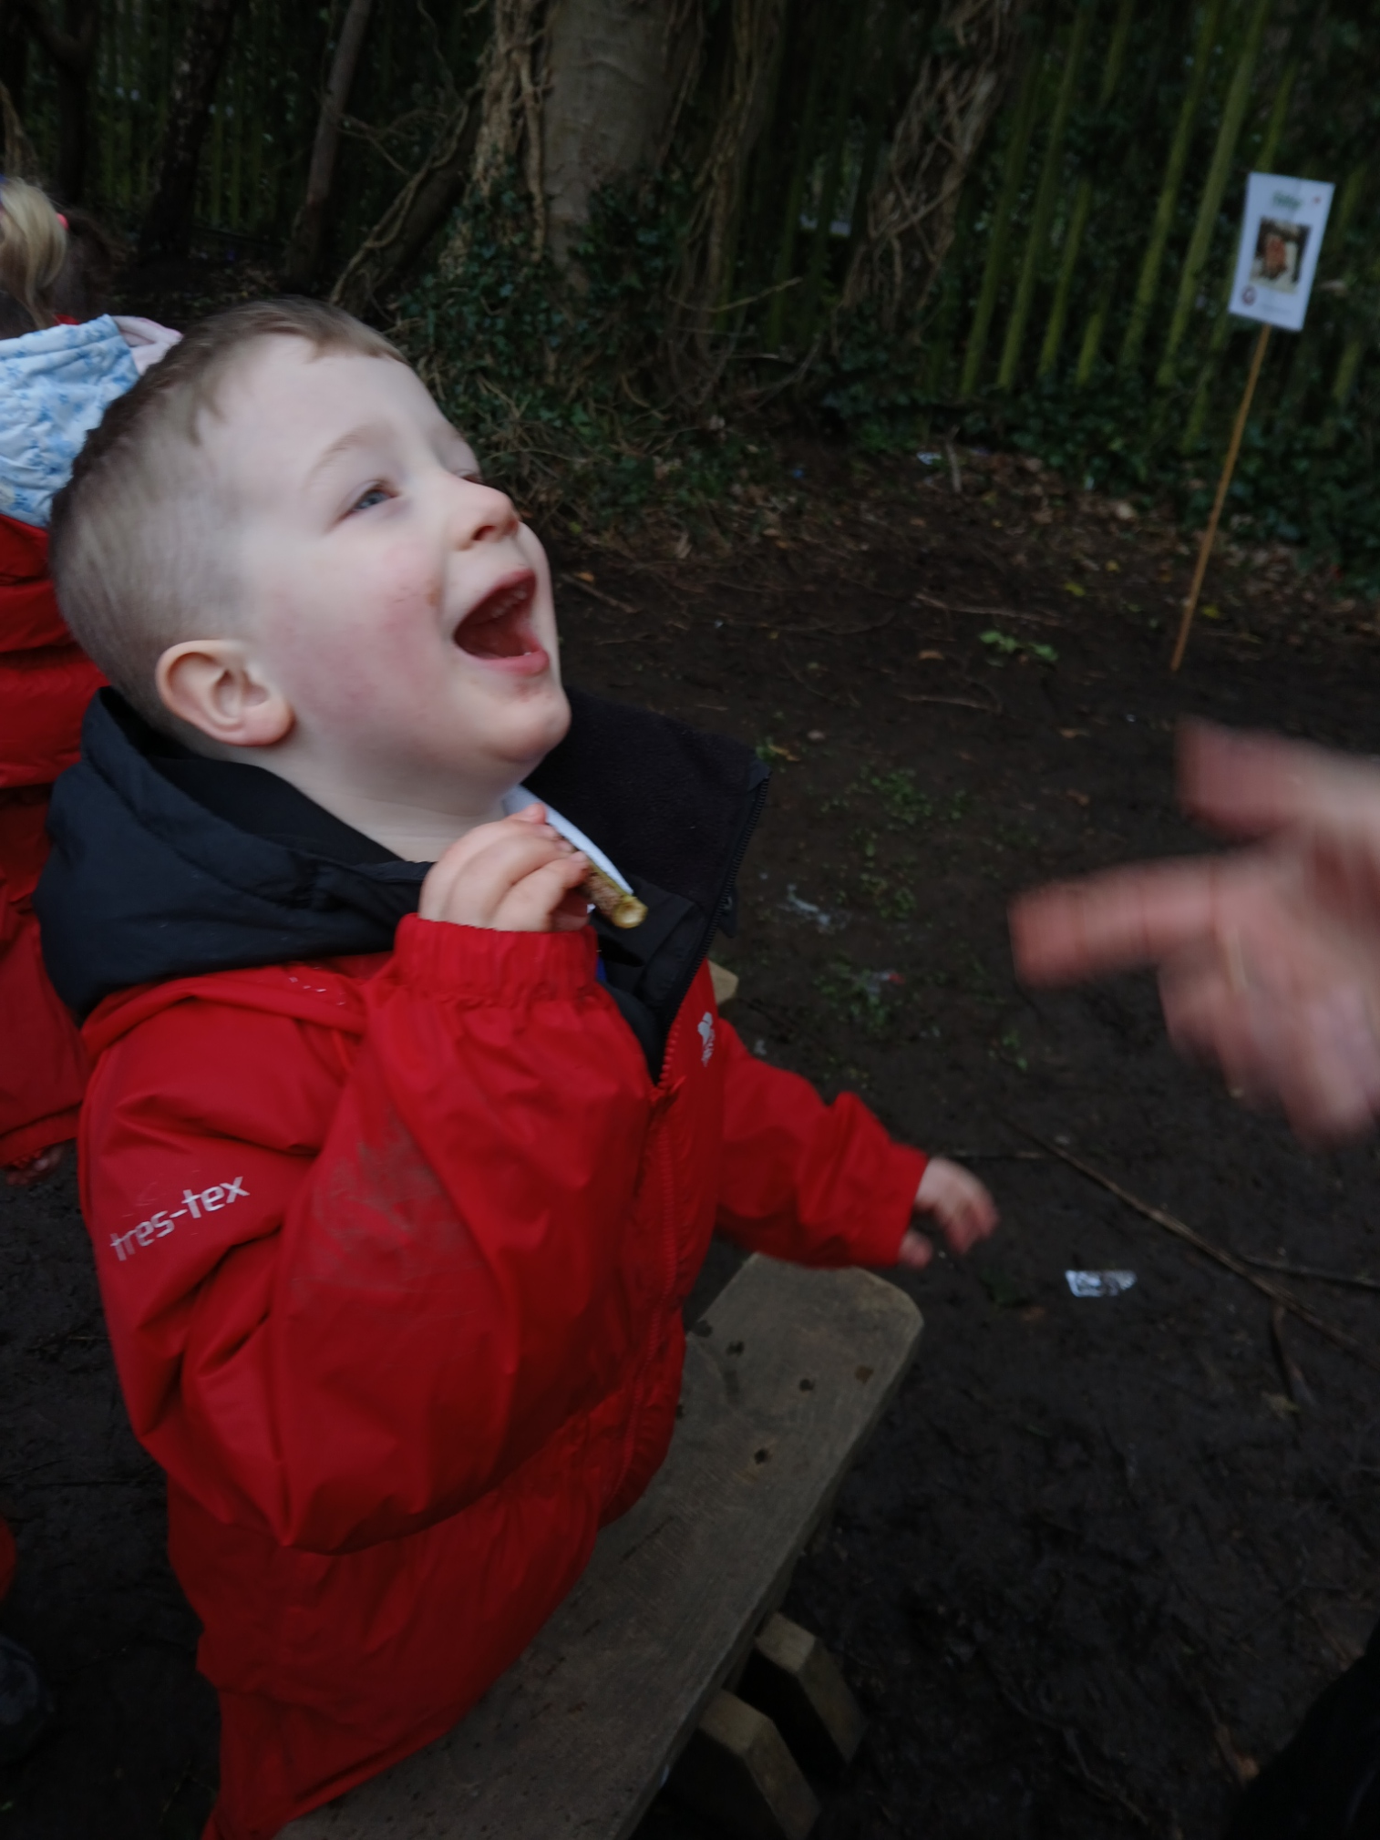
OUR FOREST SCHOOL DIARY Tuesday
Good Shepard Nursery School

Slide 2
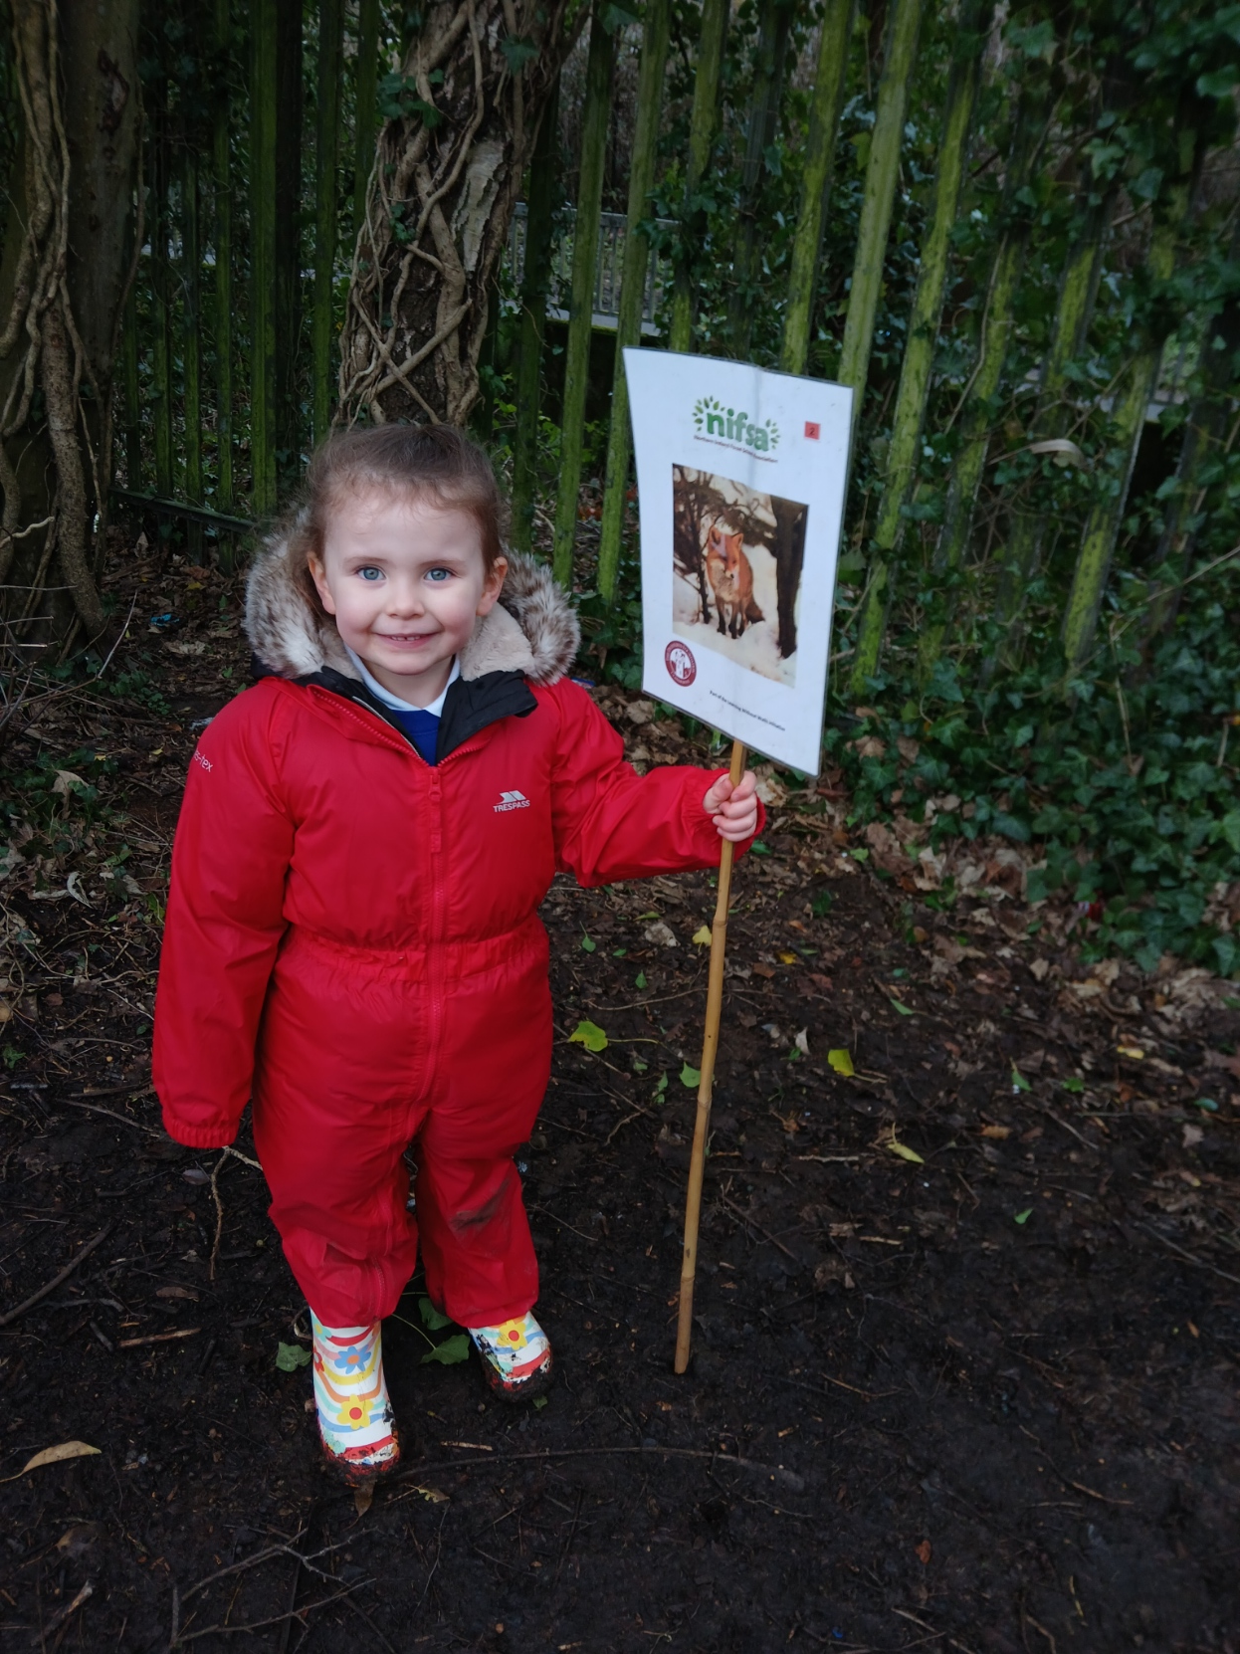
FOREST SCHOOL
We put our boundaries out so we knew where we could play.

Slide 3
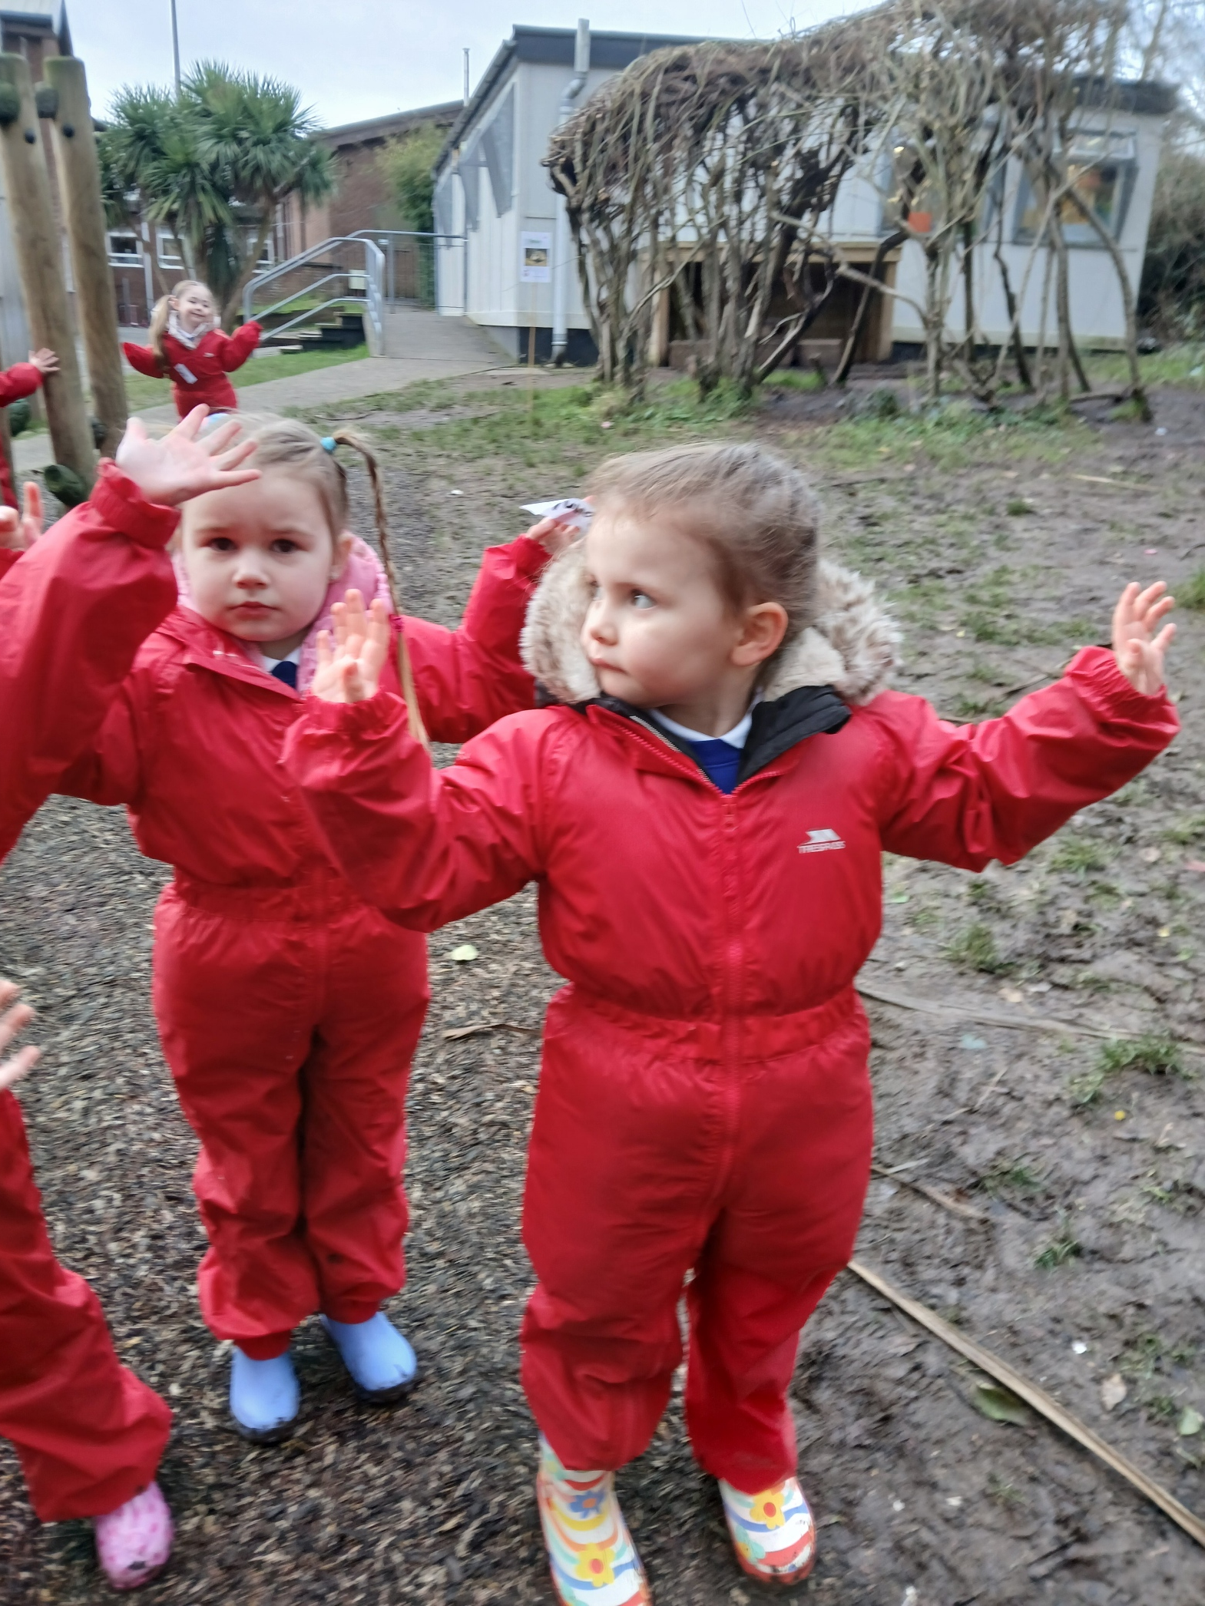
RULES
We go over our Forest School rules:
1 whistle: stop
2 whistles: back to base
3rd rule: have fun and learn

Slide 4

Fire
We learnt about the 3 things we need to light a fire!

Slide 5
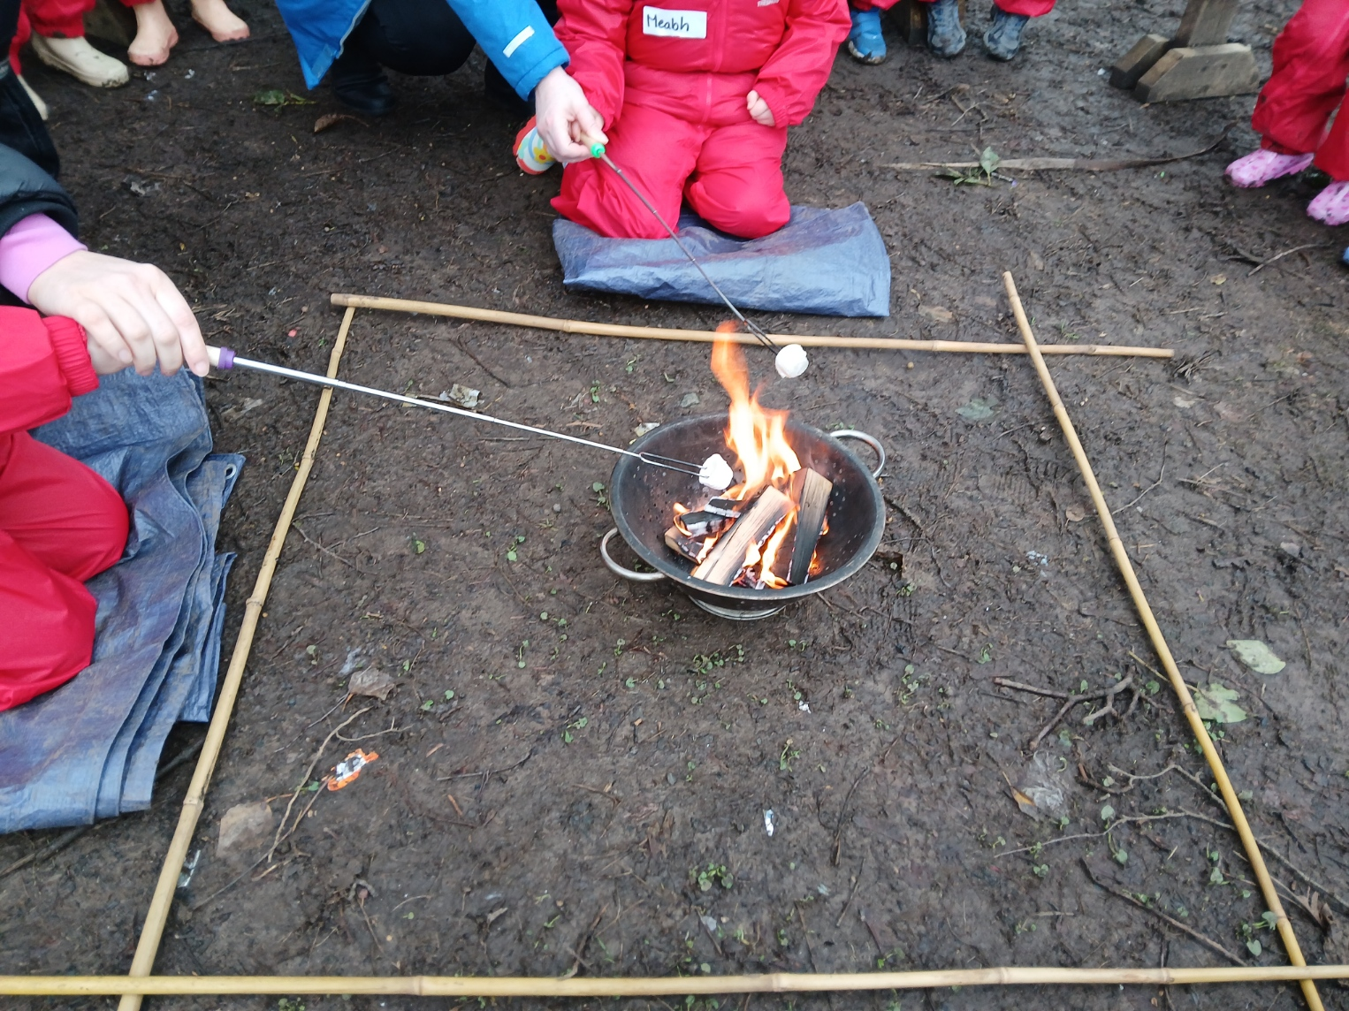
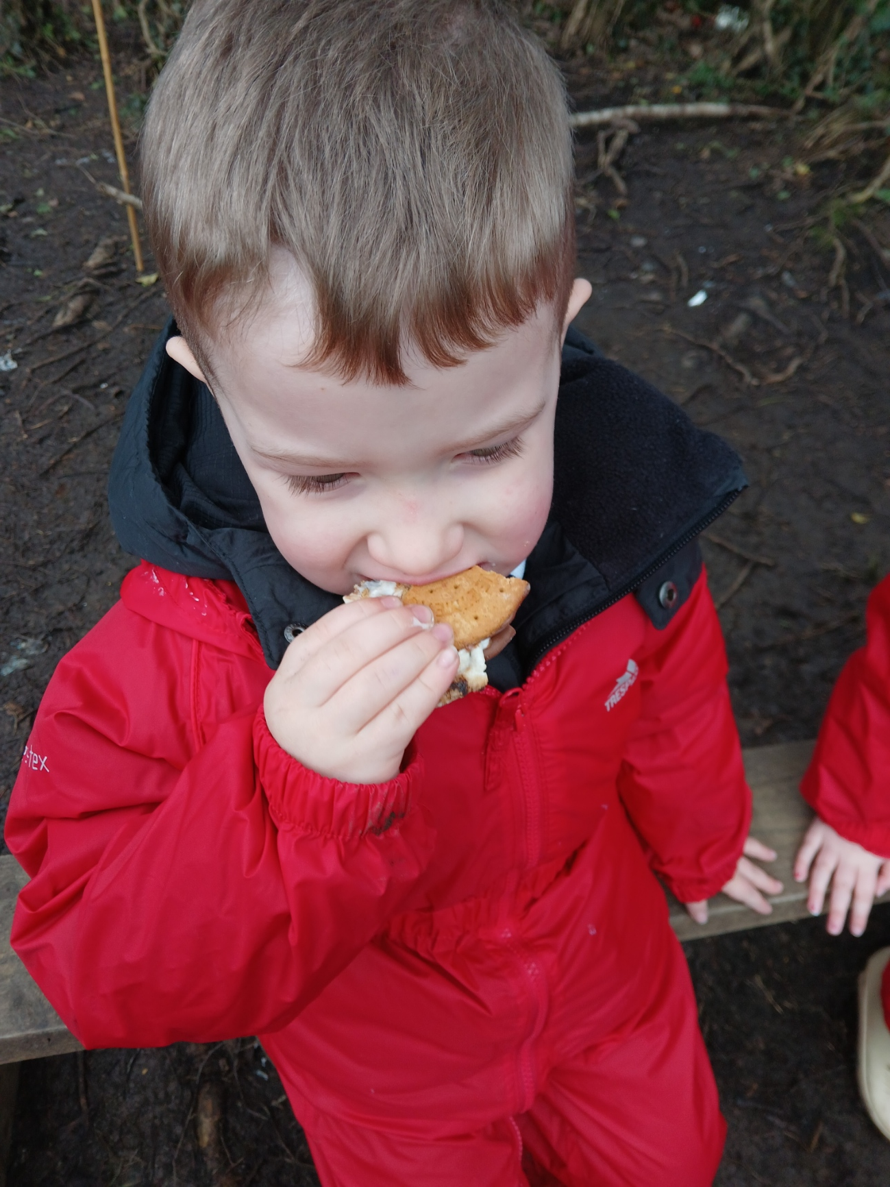
Fire
We toasted marshmallows.
We made some smore’s.
Best bit was eating them!

Slide 6
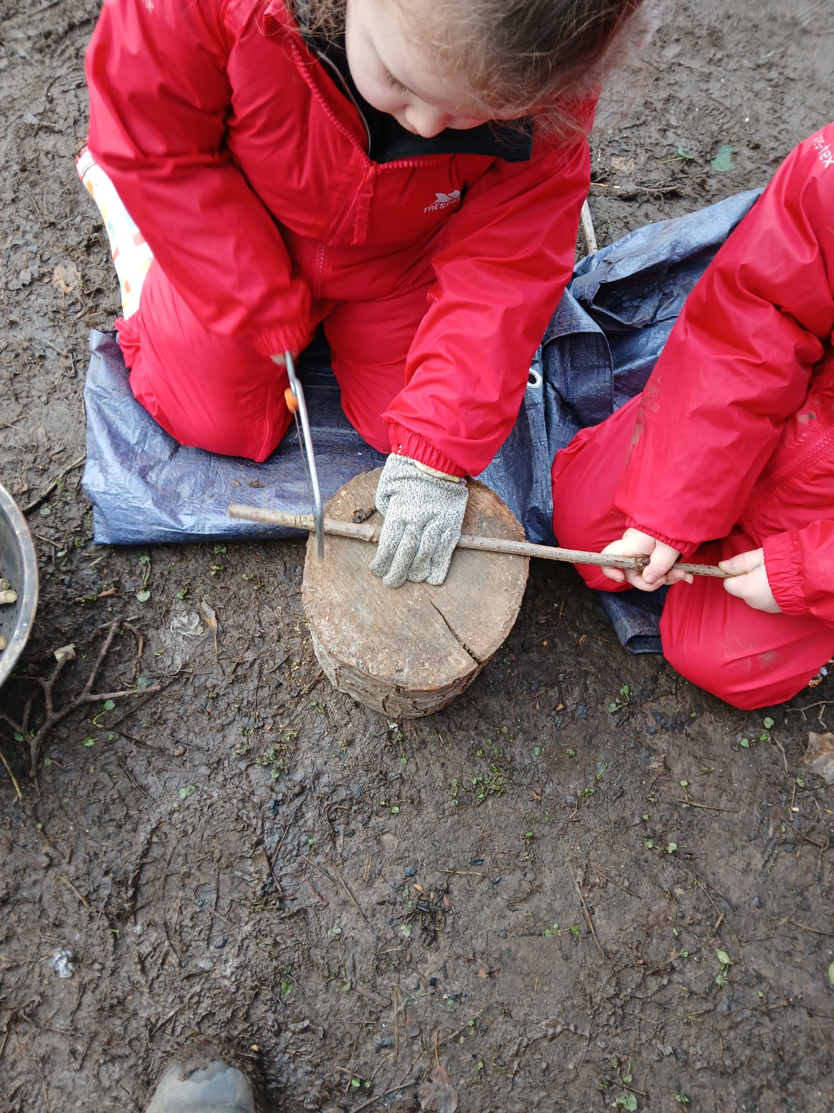
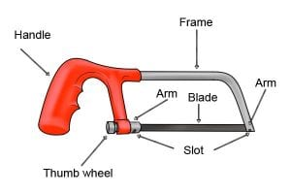
Saw Skills
Today we learnt how to use a saw safety and cut some Elder.

Slide 7
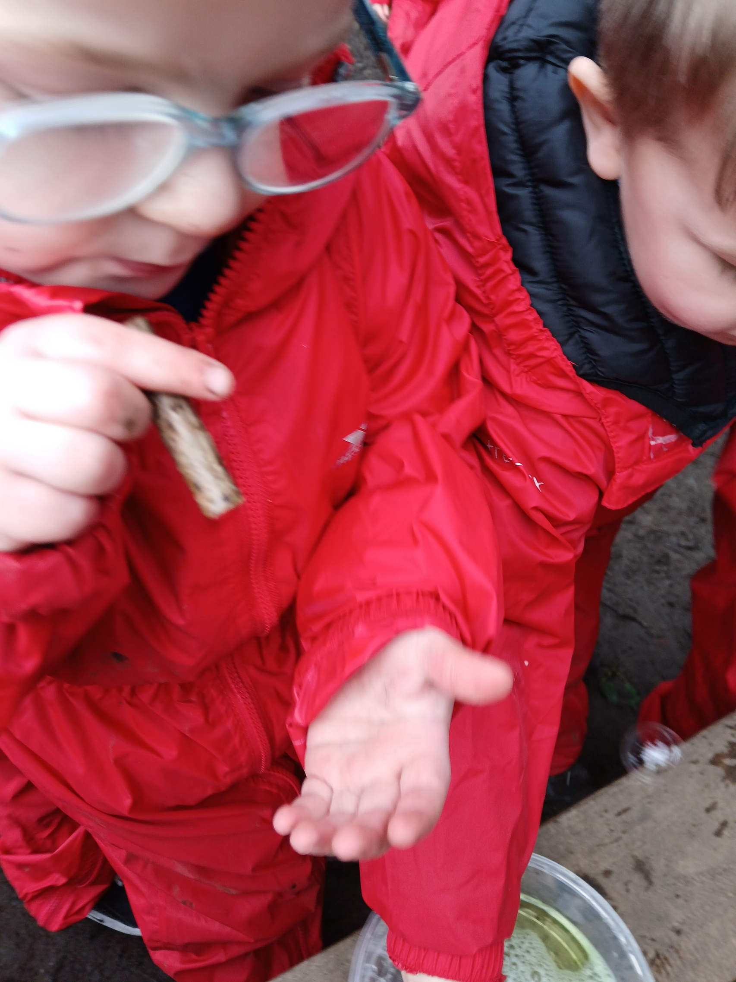
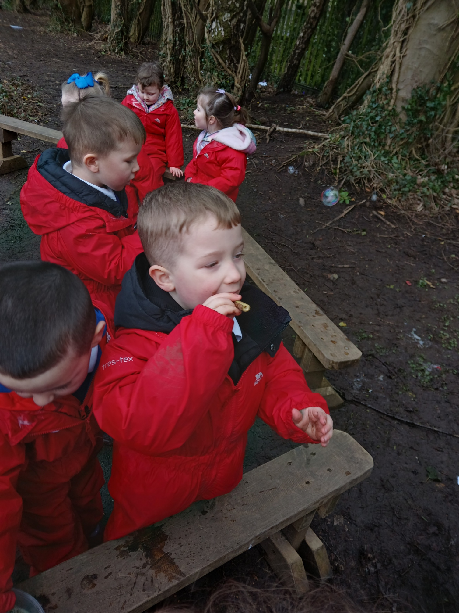
Bubble Wands
We used our tent peg to push the centre (pith) of the elder out. We dipped in to bubble mixture and blew bubbles.
Some were successful.

Slide 8
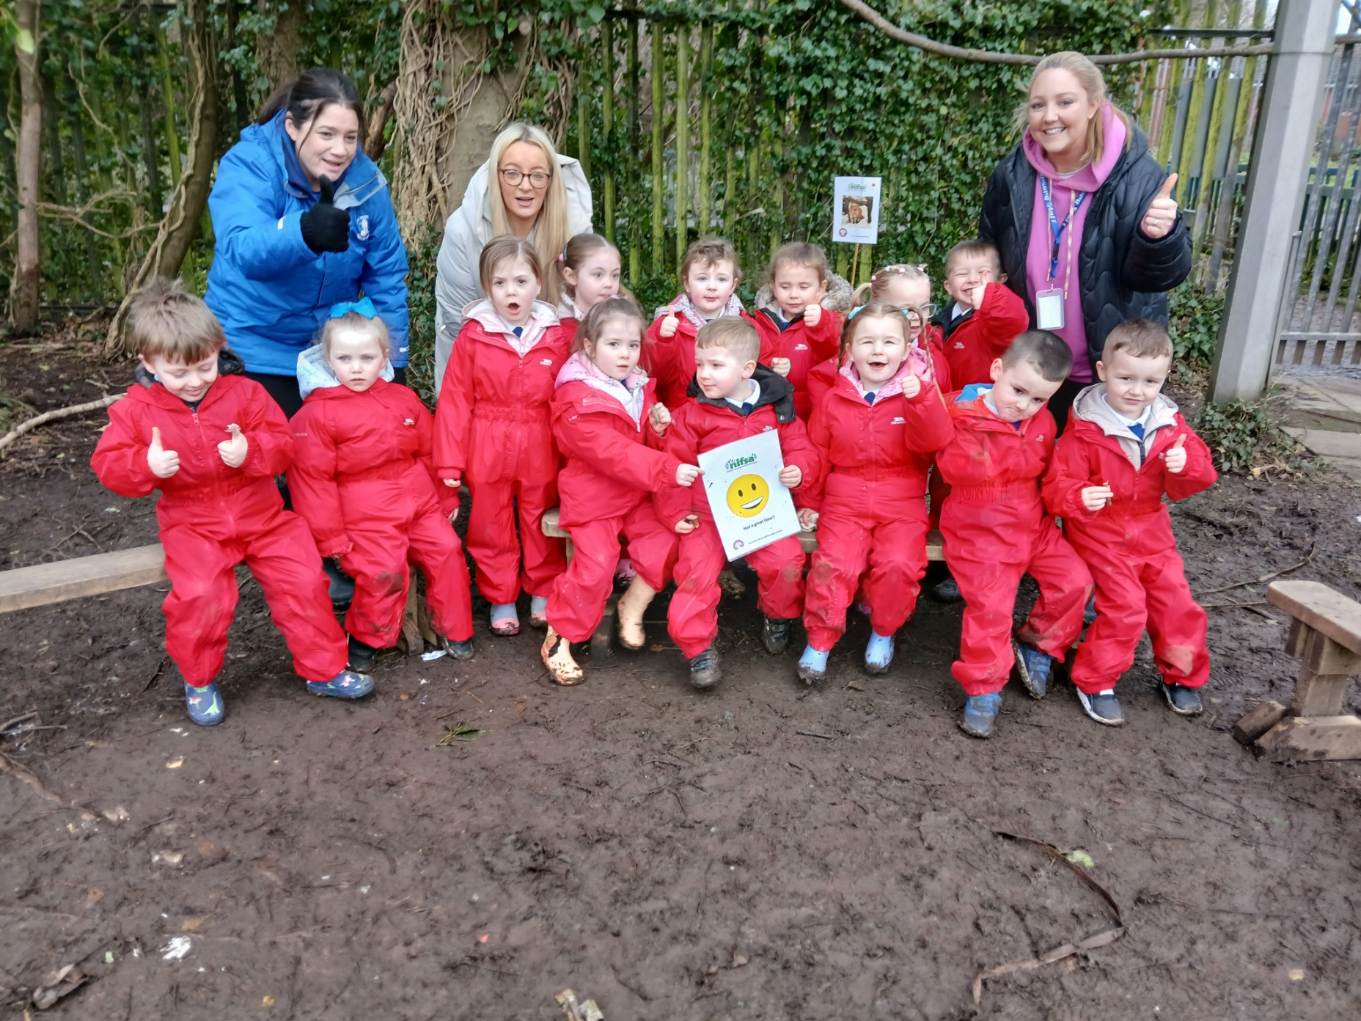
DID YOU ENJOY IT?
All smiley faces today.

