Slide 1


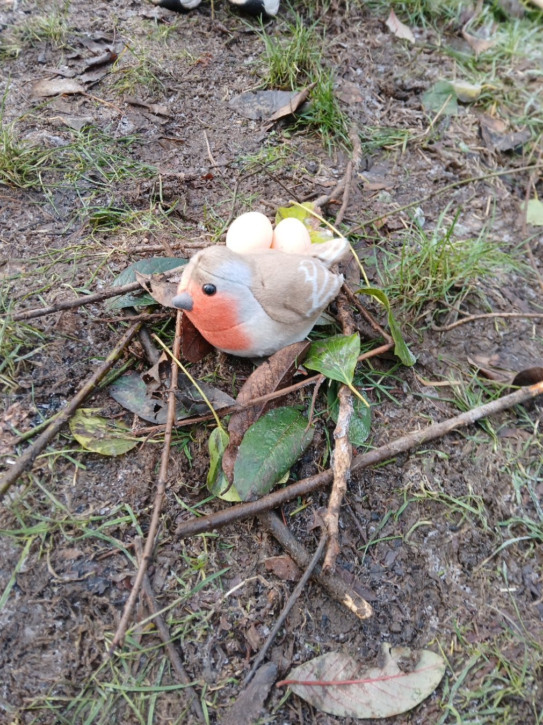
OUR FOREST SCHOOL DIARY Tuesday 17th February 2026
Good Shepard Nursery School
Belfast

Slide 2
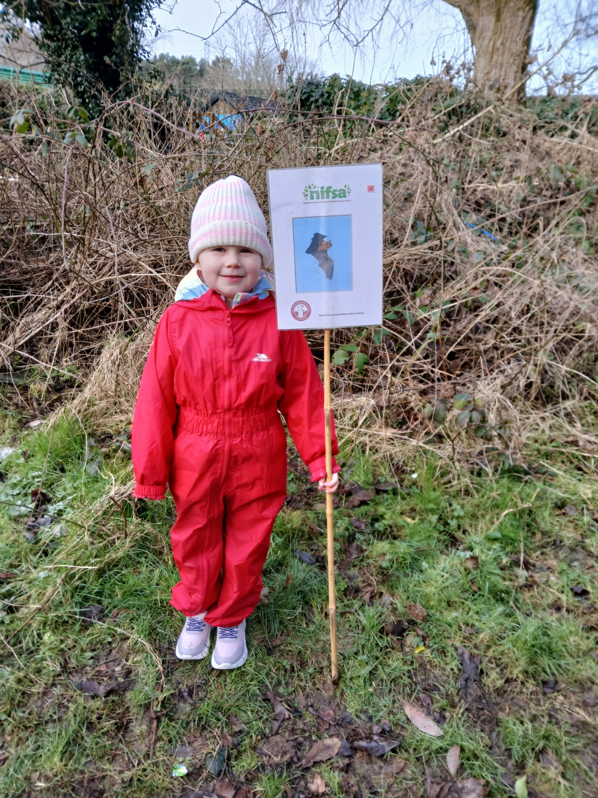
FOREST SCHOOL
We put our boundaries out so we knew where we could play.

Slide 3
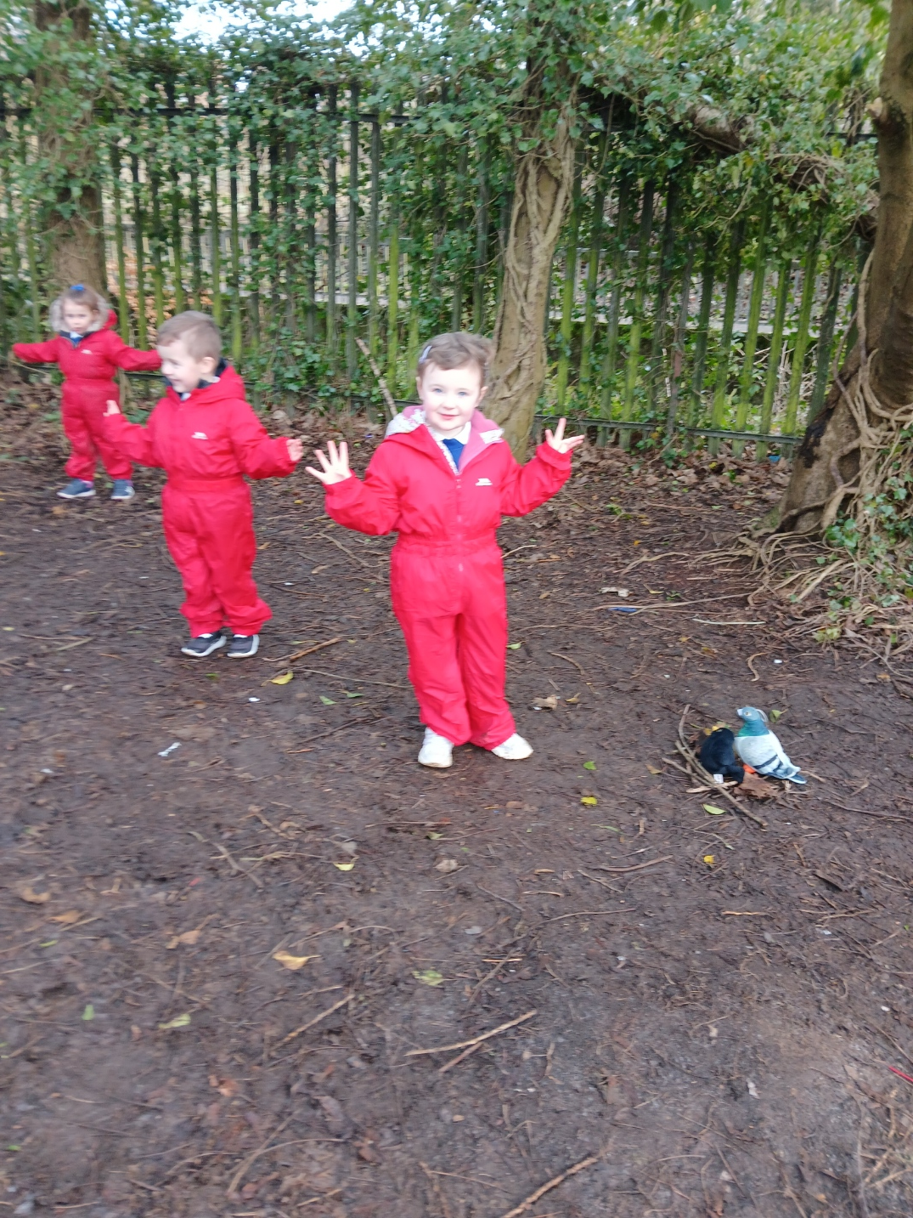
RULES
We go over our Forest School rules:
1 whistle: Stop
2 whistles: Back to base
3rd rule: Have fun and learn

Slide 4
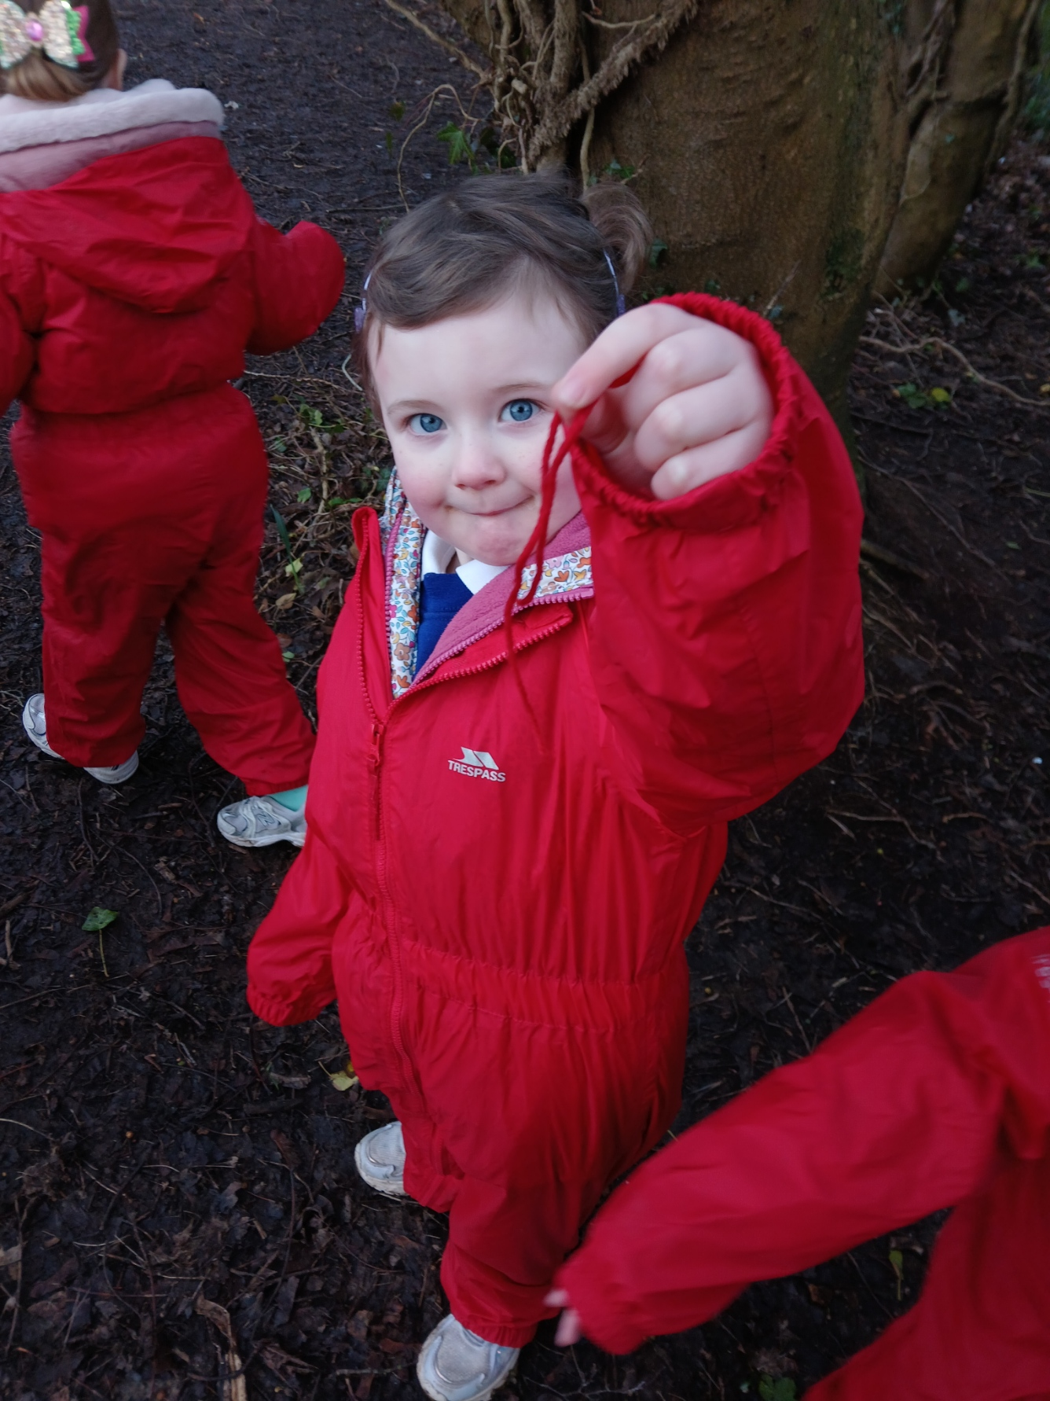
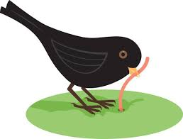
Birds and Worms
We played birds and worms.
We hid the worms and the birds tired to find them.

Slide 5

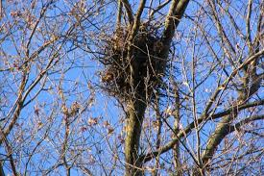
NESTS
We talked about birds nest and what things we might need to make a nest.
We heard lots of birds near by and looked for real nests up in the trees.

Slide 6
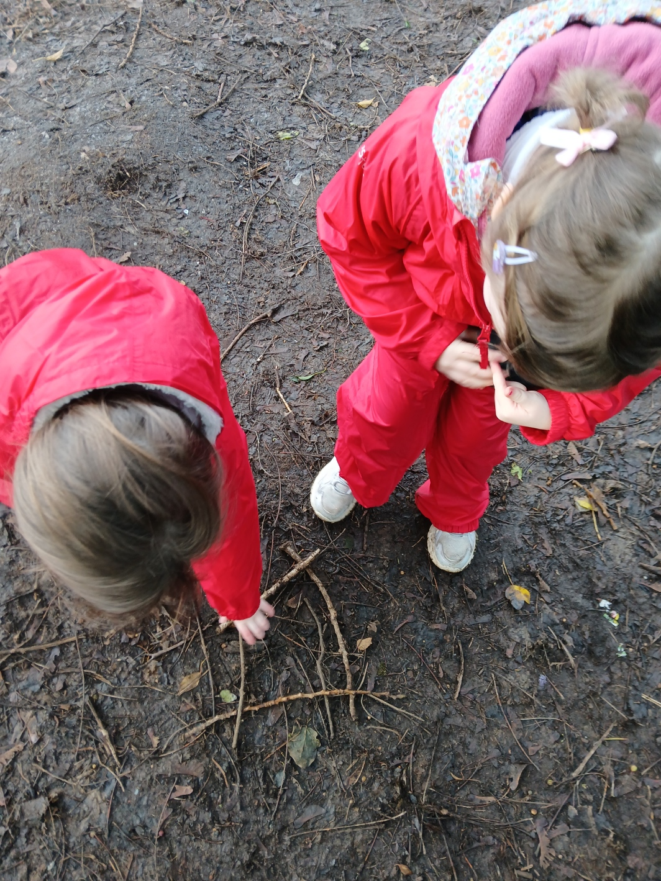
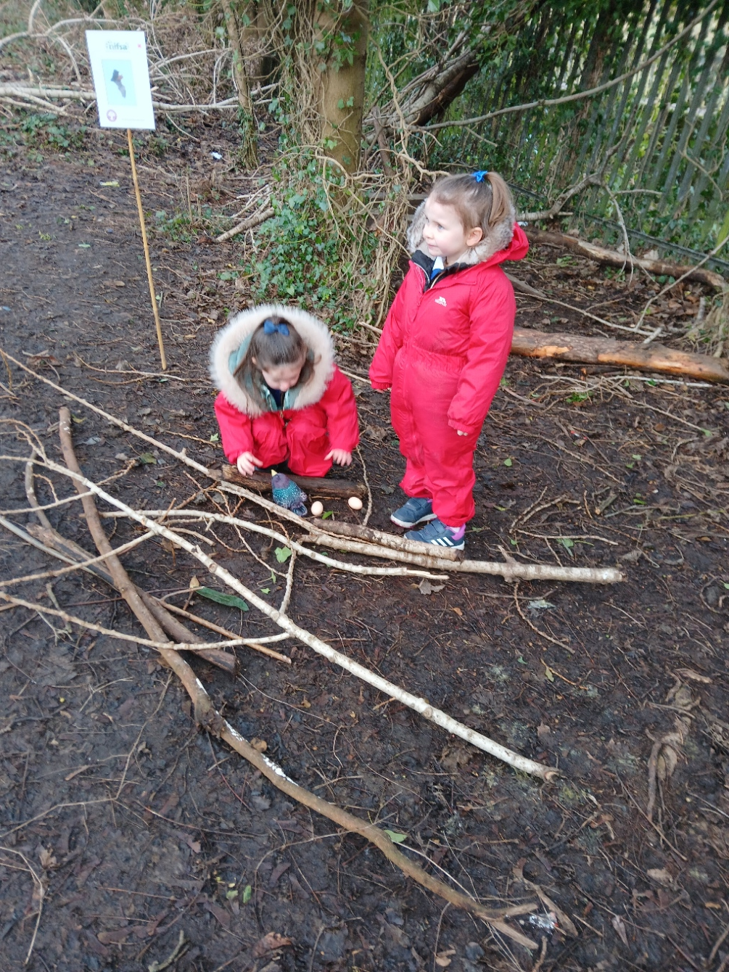
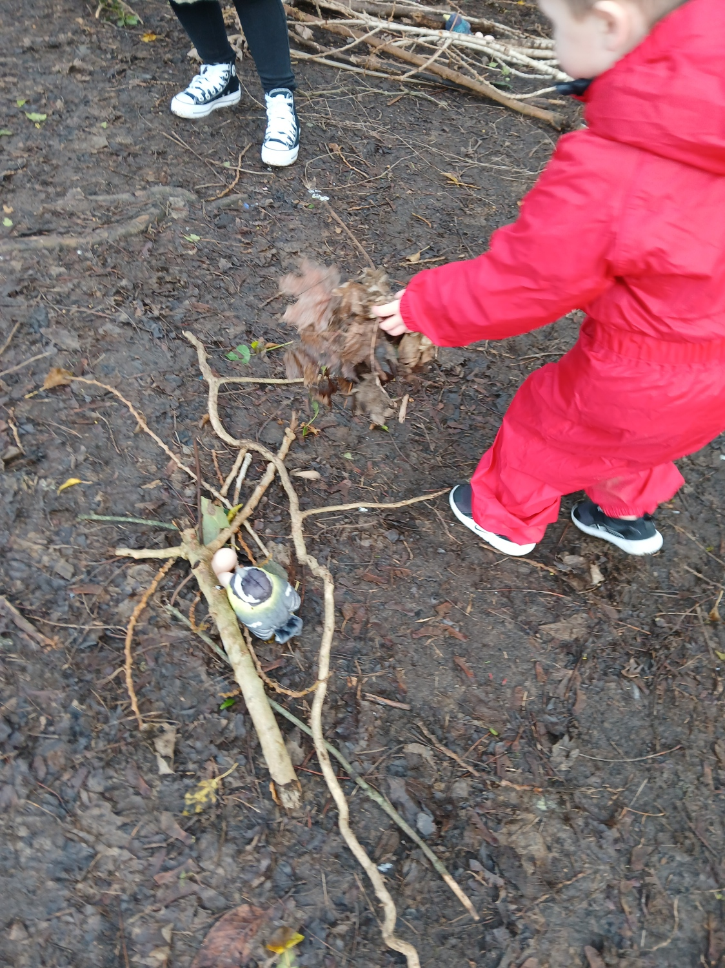
NESTS
We worked in small groups to make nests for birds using natural materials.

Slide 7
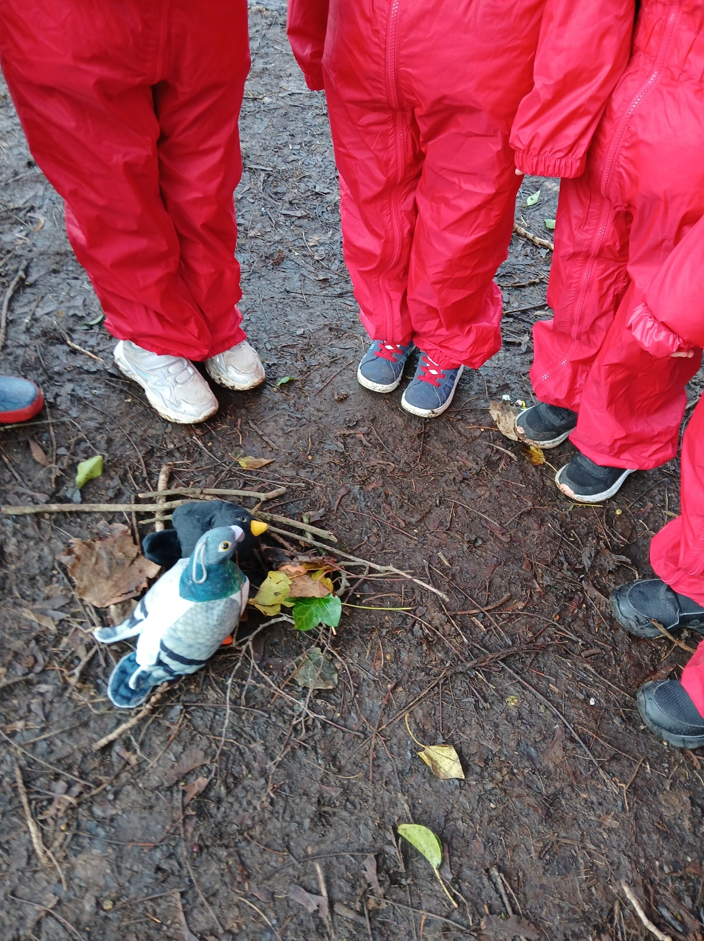
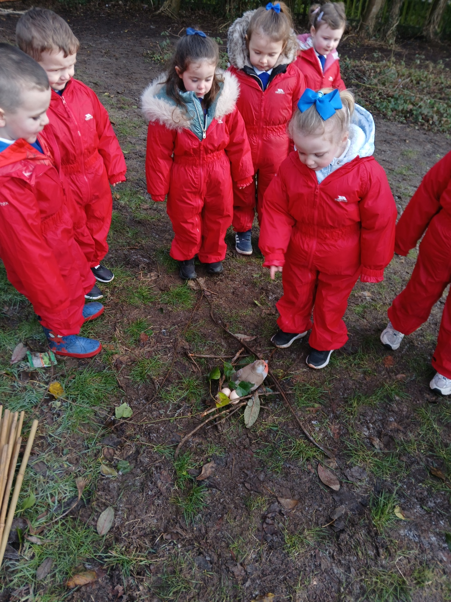
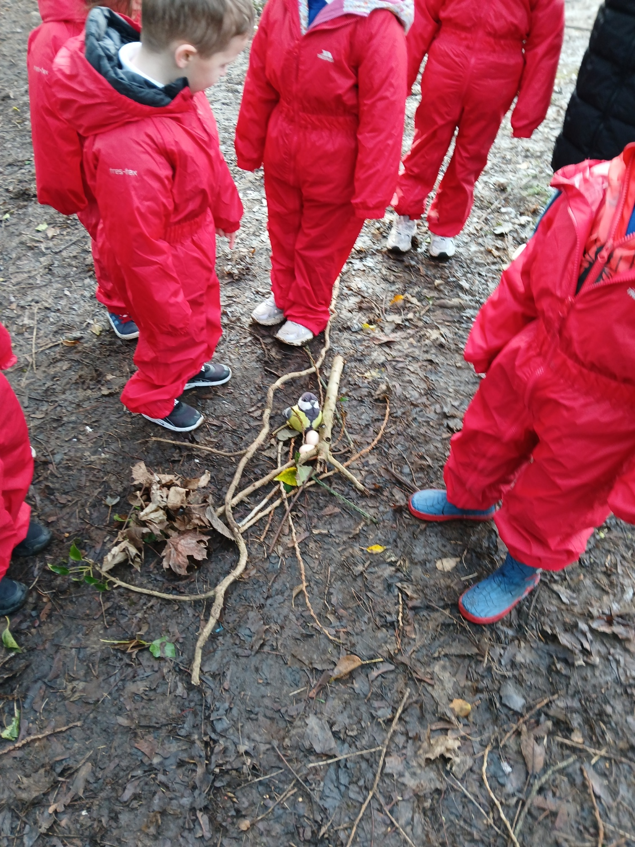
NESTS
We told the other groups about our nests.

Slide 8
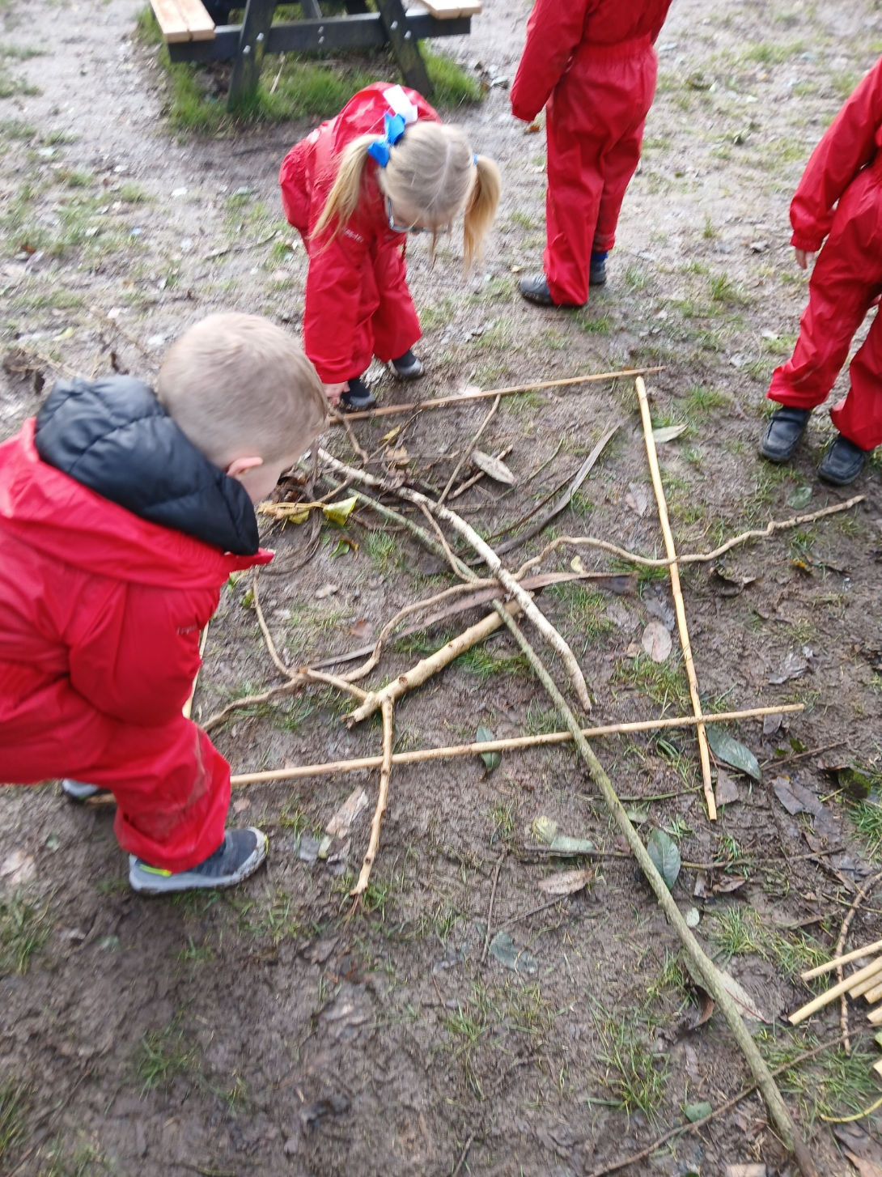
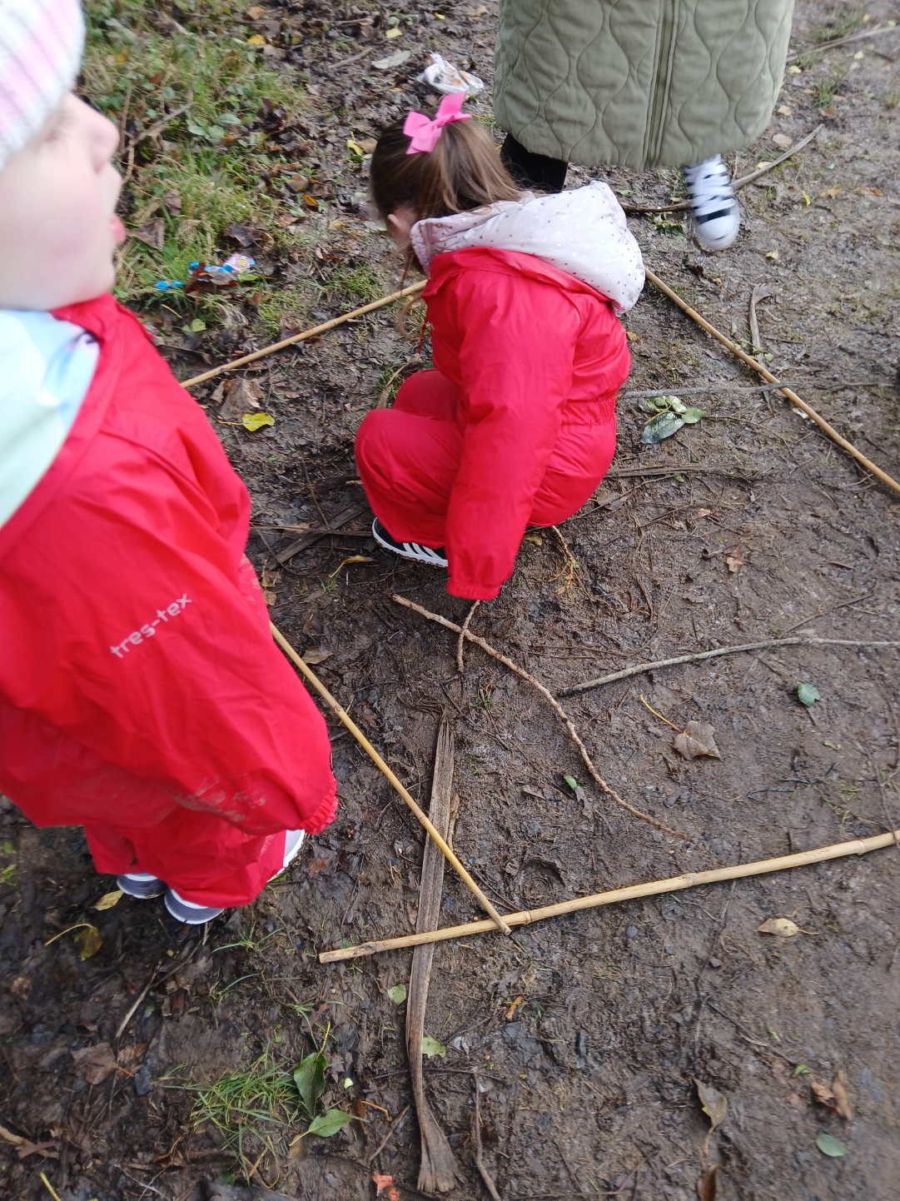

Picture Art
This week we are celebrating Chinese New Year. We worked in small groups to create a Chinese Dragon picture using natural materials.

Slide 9
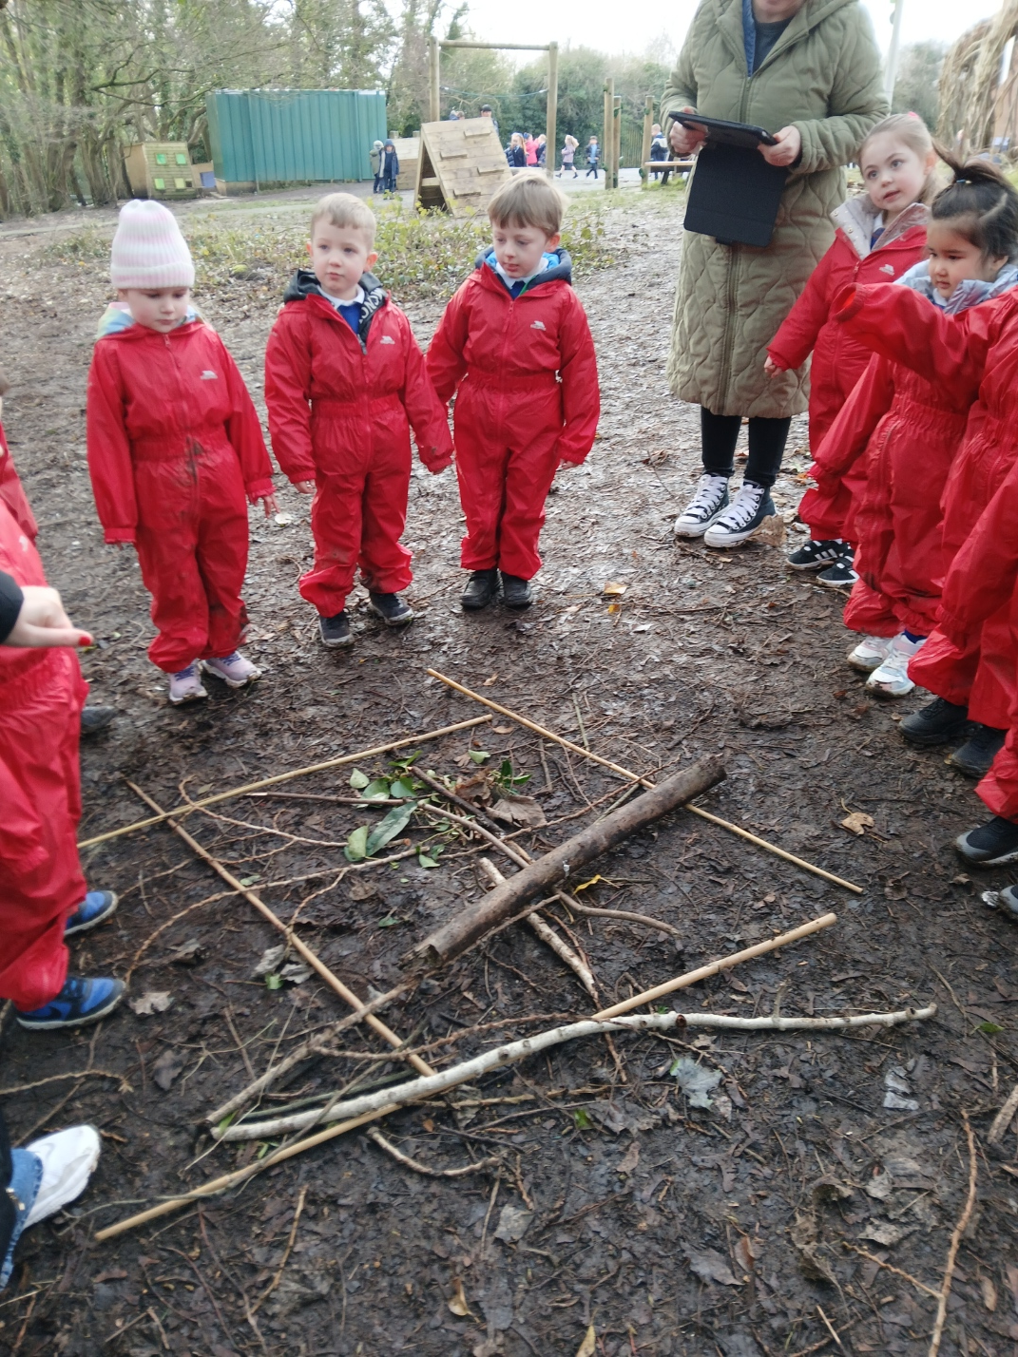
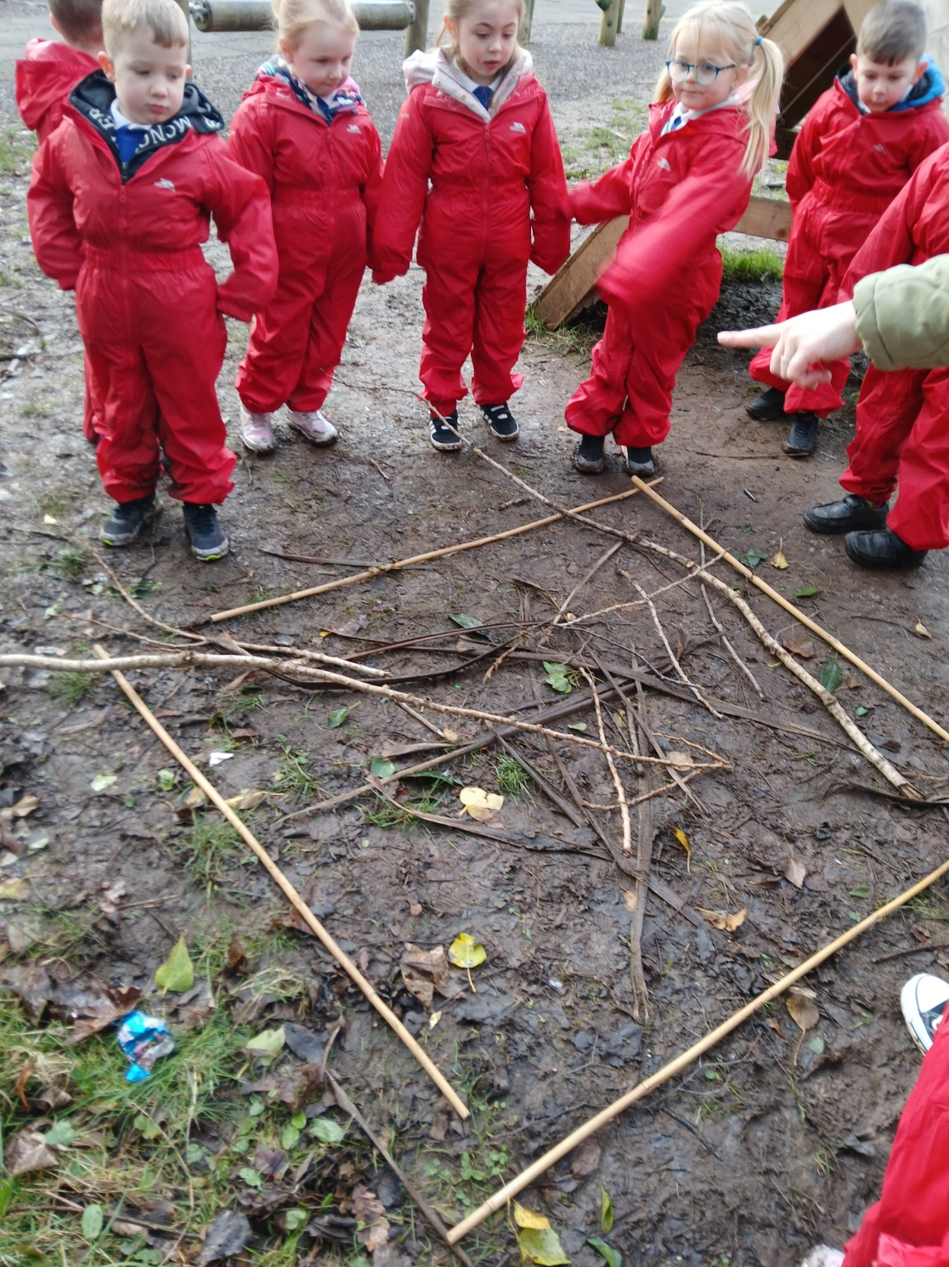
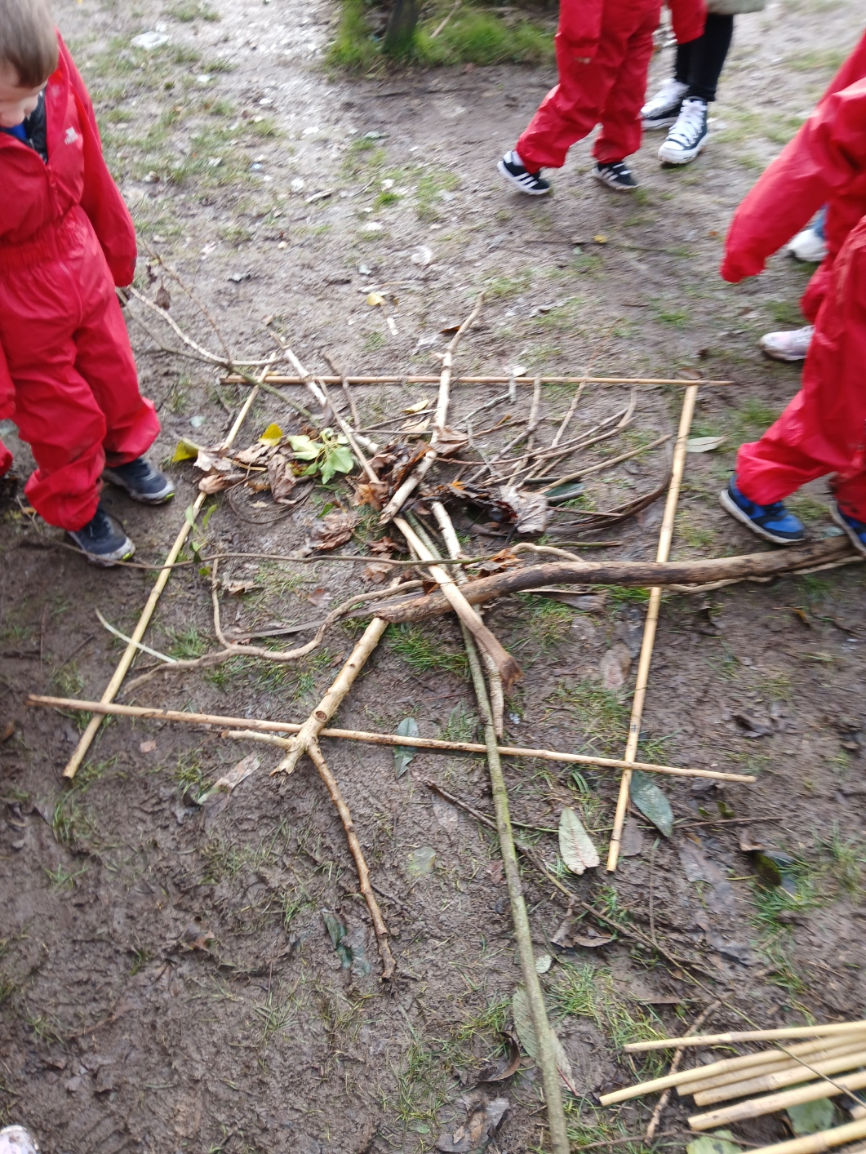
Picture Art
Time to hear how all the groups did.
Great explaining and lovely feedback

Slide 10
LEAVE NO TRACE
We put everything away and tidied our area to leave the place safe for the wildlife.
Great Teamwork!

Slide 11
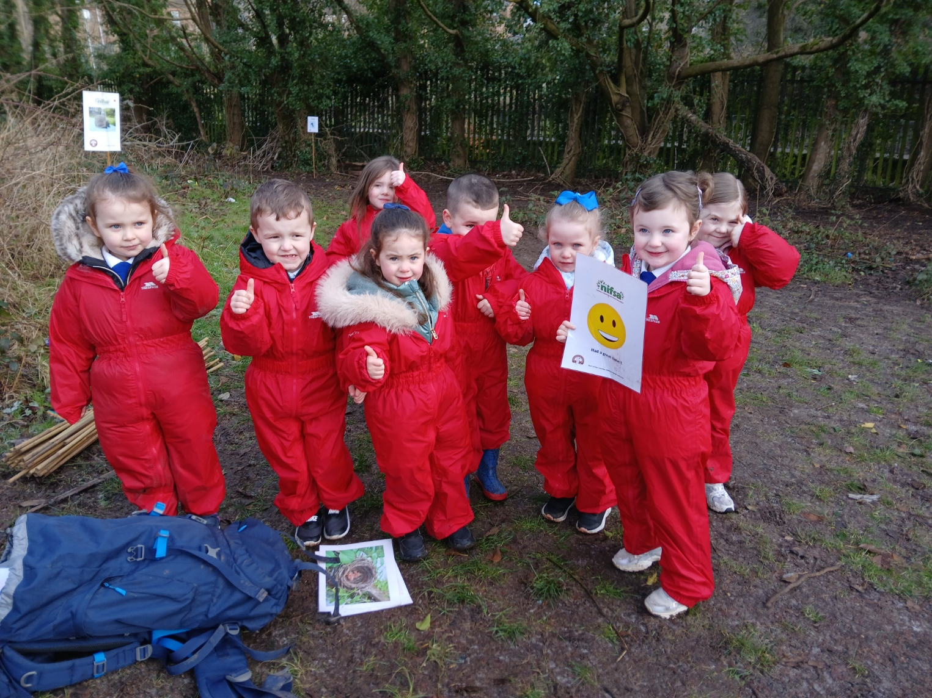
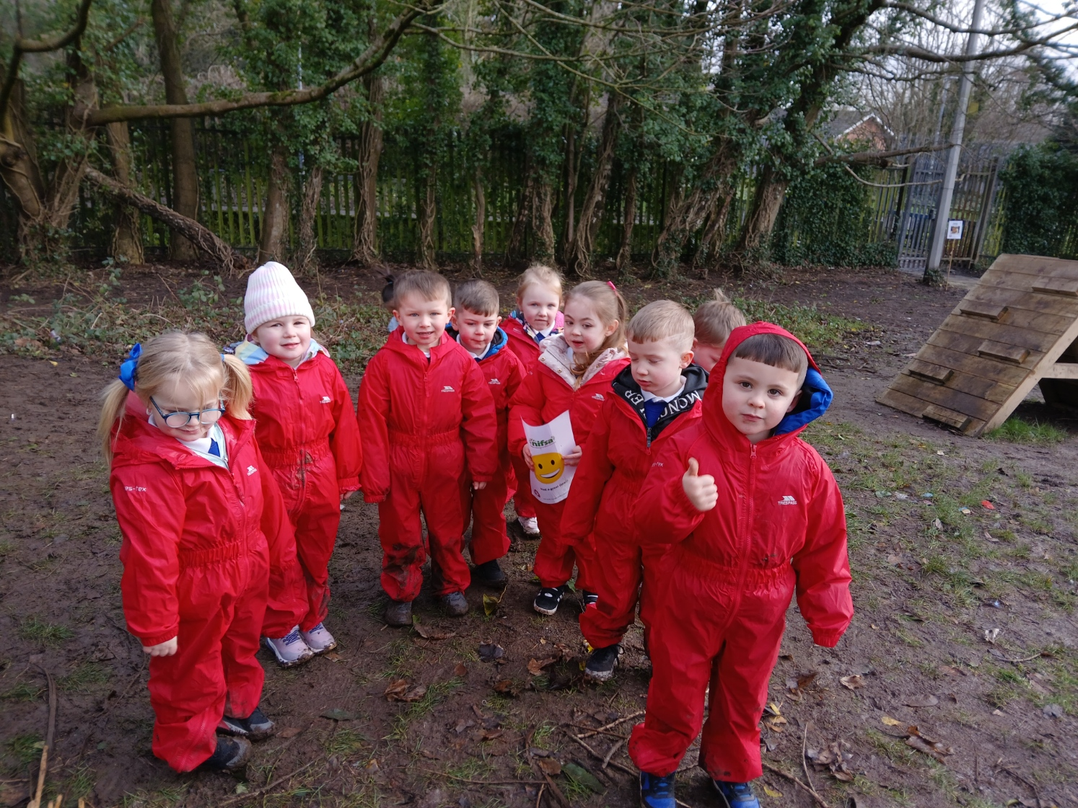
DID YOU ENJOY IT?
All smiley faces today.

