Slide 1
Forest schools

Slide 2
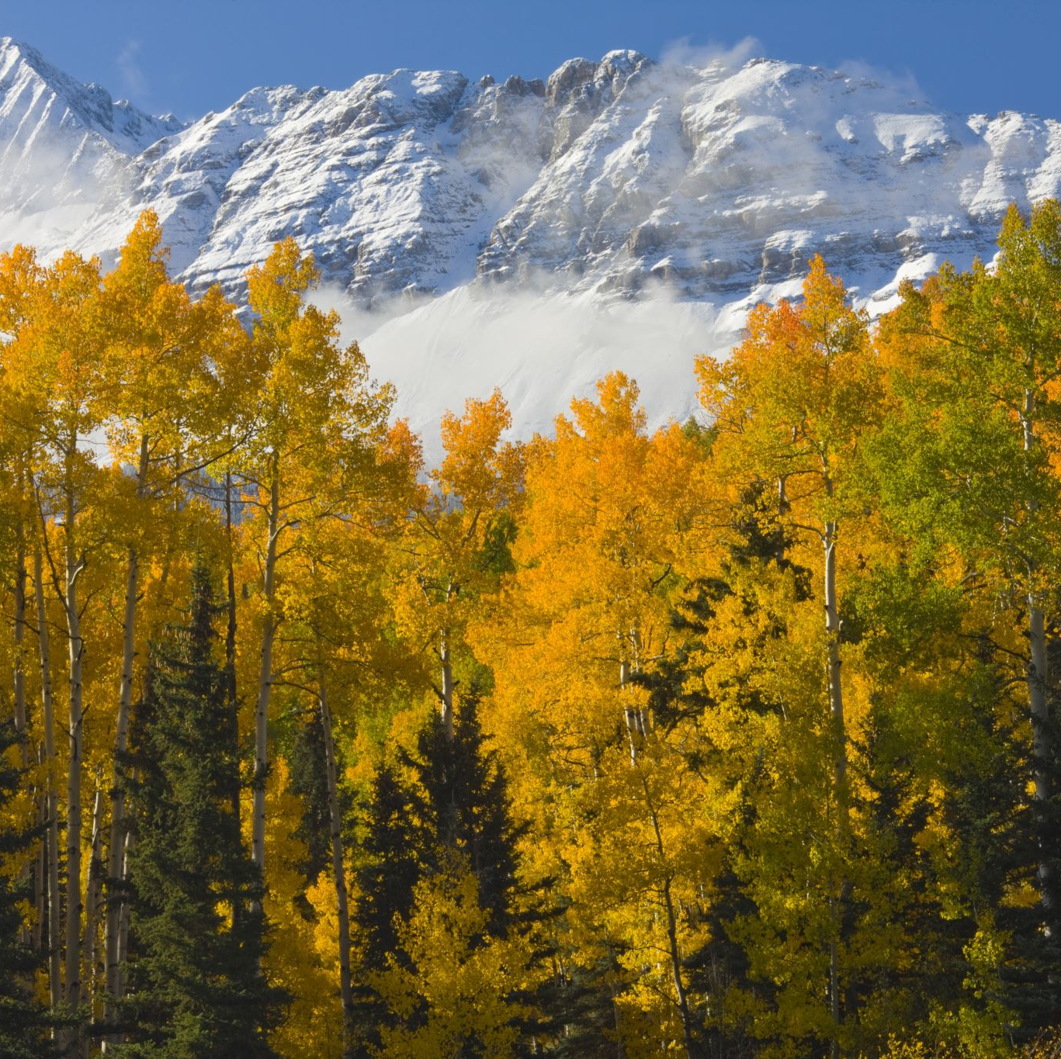
Rules
Look after the forest area and leave the site as you found it
Stay within the boundary markers
Do not pick anything growing (unless permitted by an adult e.g. leaves in Autumn)
Do not put your fingers or anything else, in your mouth
Look above, below and around for hazards
Come to the base camp when the whistle blows
Call an adult if you find anything dangerous
Do not climb trees or go onto the swing or tyres
Have fun!

Slide 3
Collection of items
We are going to go into our forest area and collect different signs of Autumn e.g. sticks, feathers, stones, pine cones, leaves, conkers etc.
Do not pick anything that had been planted. Just be sure not to disturb any living thing or pick anything still growing

Slide 4
Creating A Nature Mandela
A mandela is a symmetrical, circular, geometric pattern
Using your items you are going to work as a group to create your own nature mandela
Work together as a group
Have fun and be creative
You can take inspiration from some of the images on the next page

Slide 5
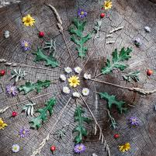
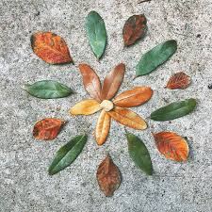
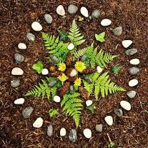
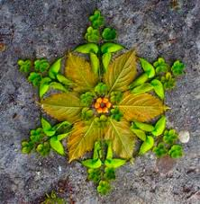
Nature Mandelas
You can use these images as inspiration

