Slide 1
Forest School Trip to Tannaghmore Gardens
We had a great time making clay peeps and homes for them. We made natures bracelets and had fun in the park.

Slide 2
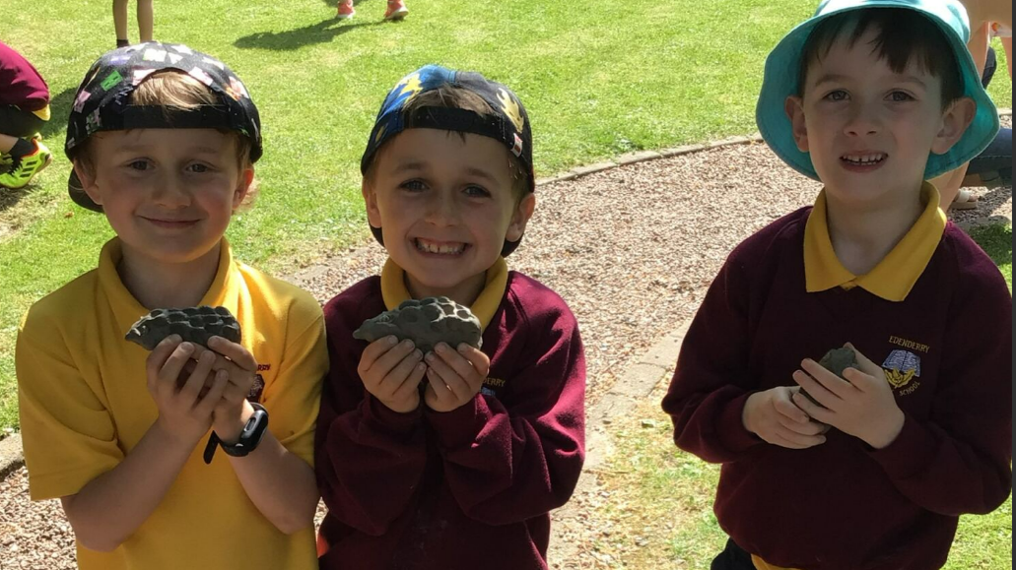

Slide 3
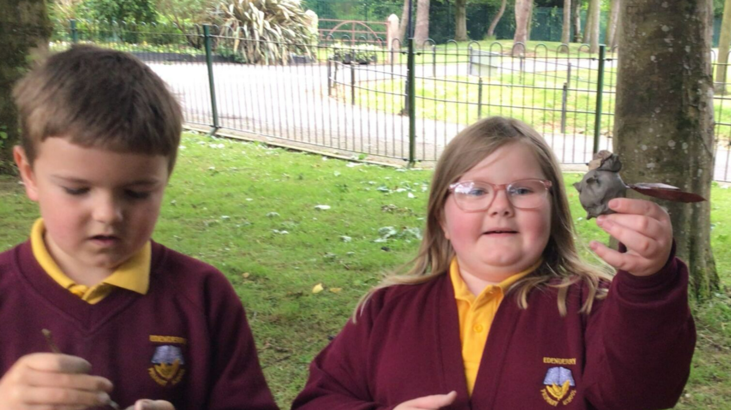

Slide 4
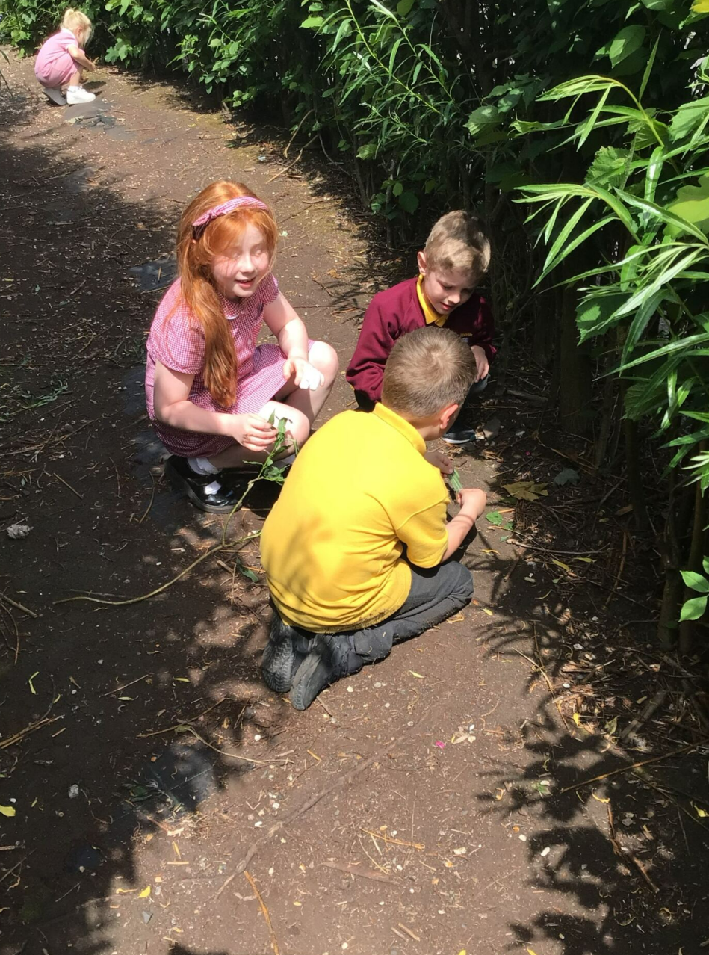
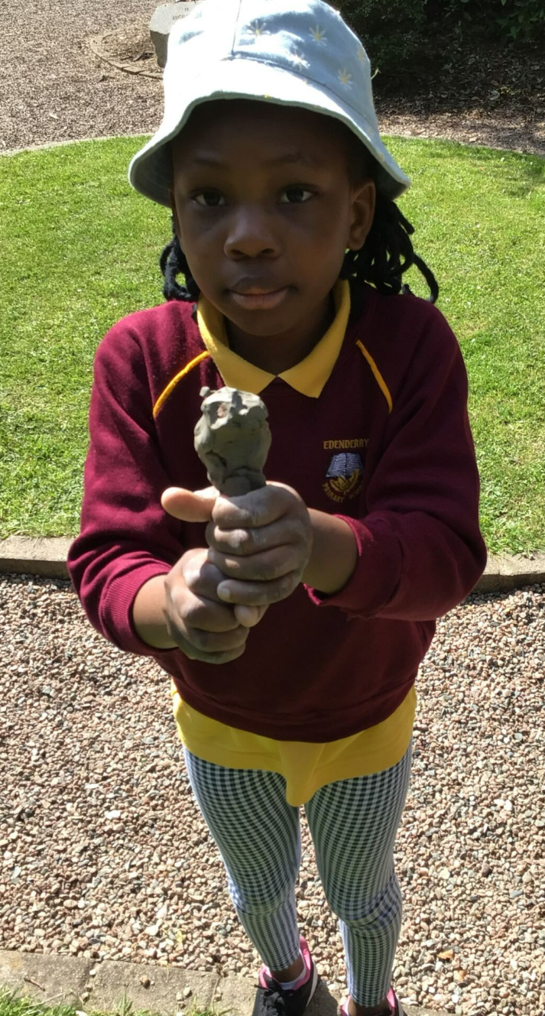

Slide 5
