Slide 1
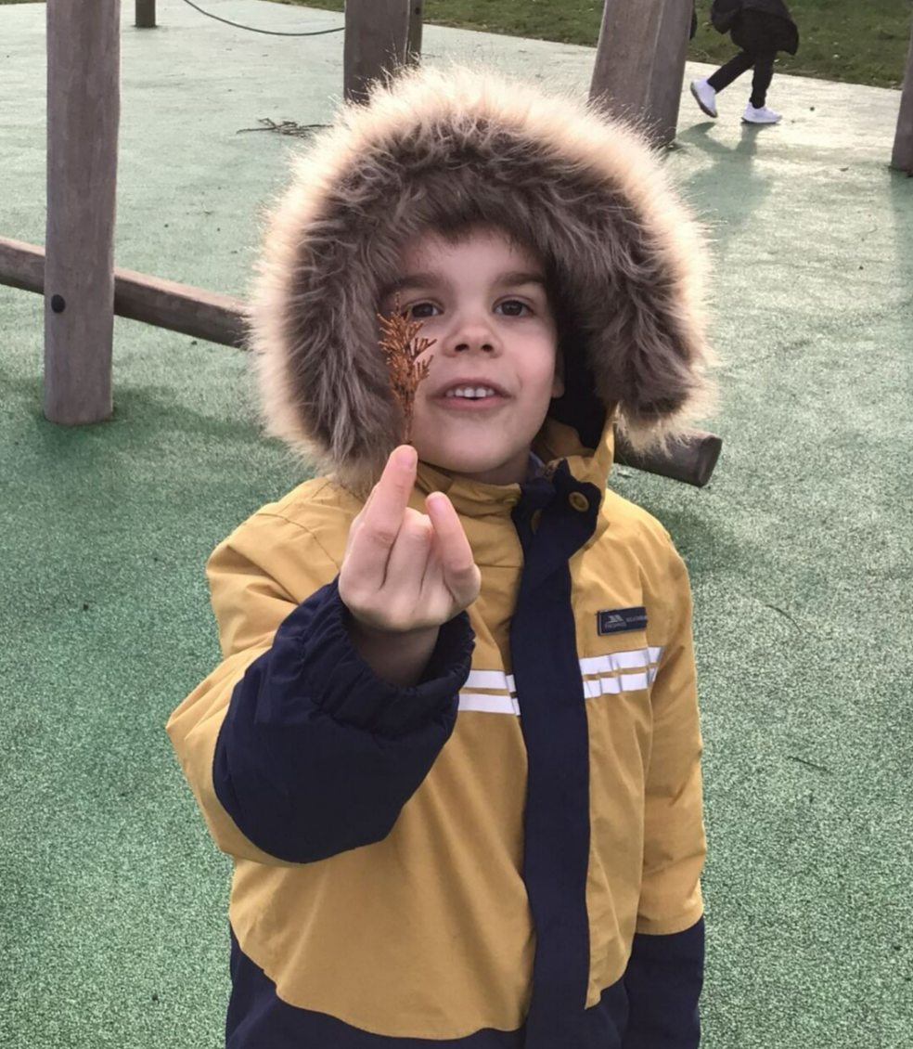
Forest Faces
We worked together as a team to make faces using natural materials.

Slide 2
