Slide 1
Making Fairy Houses
P3McG and P4F Forest Friends

Slide 2
WALT: make decisions in a group.

Slide 3

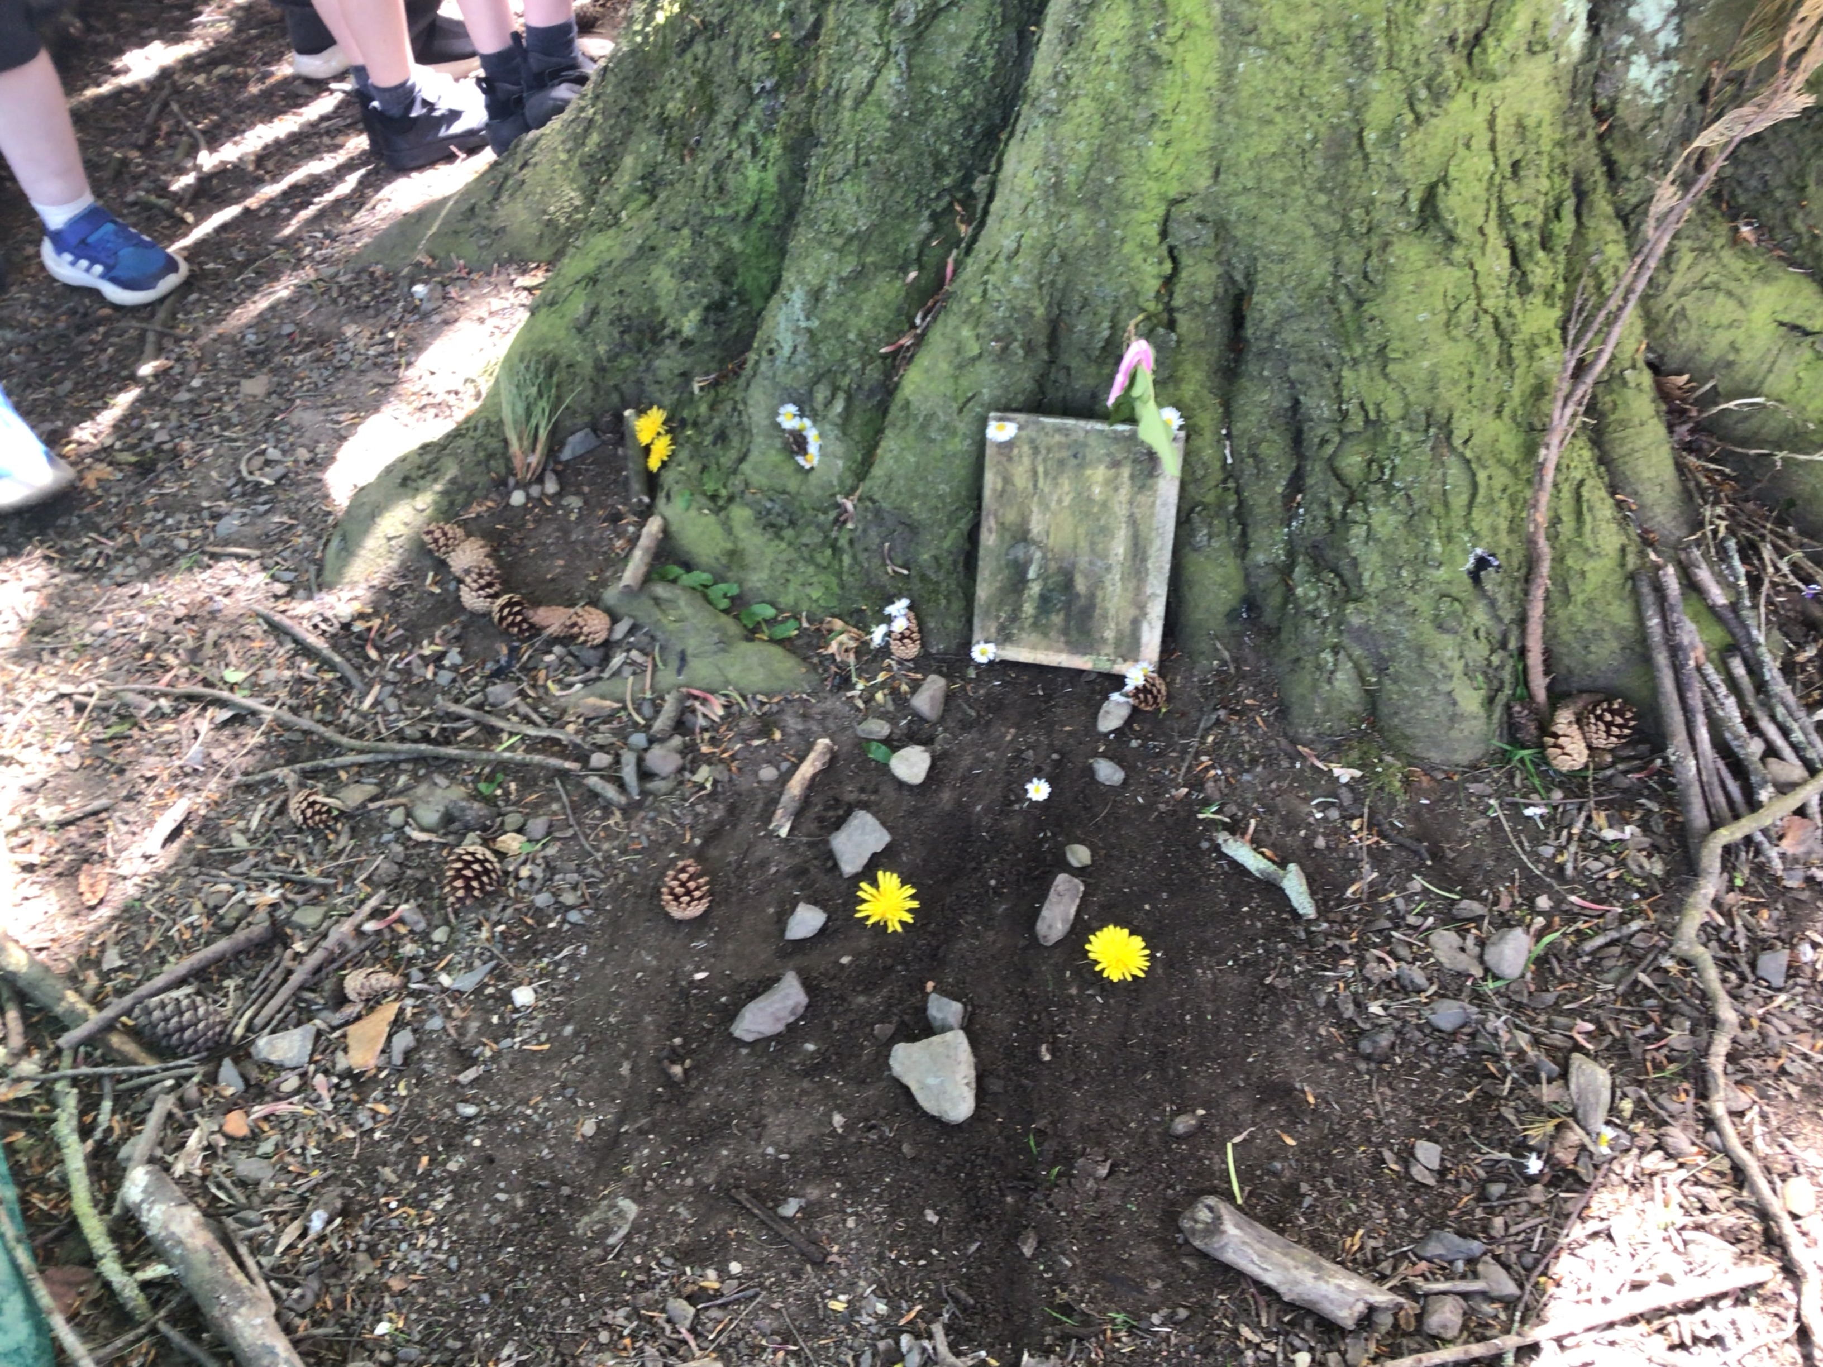
Task: to create a fairy house in groups and stick people if time.

Slide 4
Revisiting our Forest School rules.
Whistle rules – 1 = freeze 2 = return to Mother Tree
Keep in the boundaries
Walking safely
We are safe
Respect our environment
Leave no trace
Have fun!

Slide 5
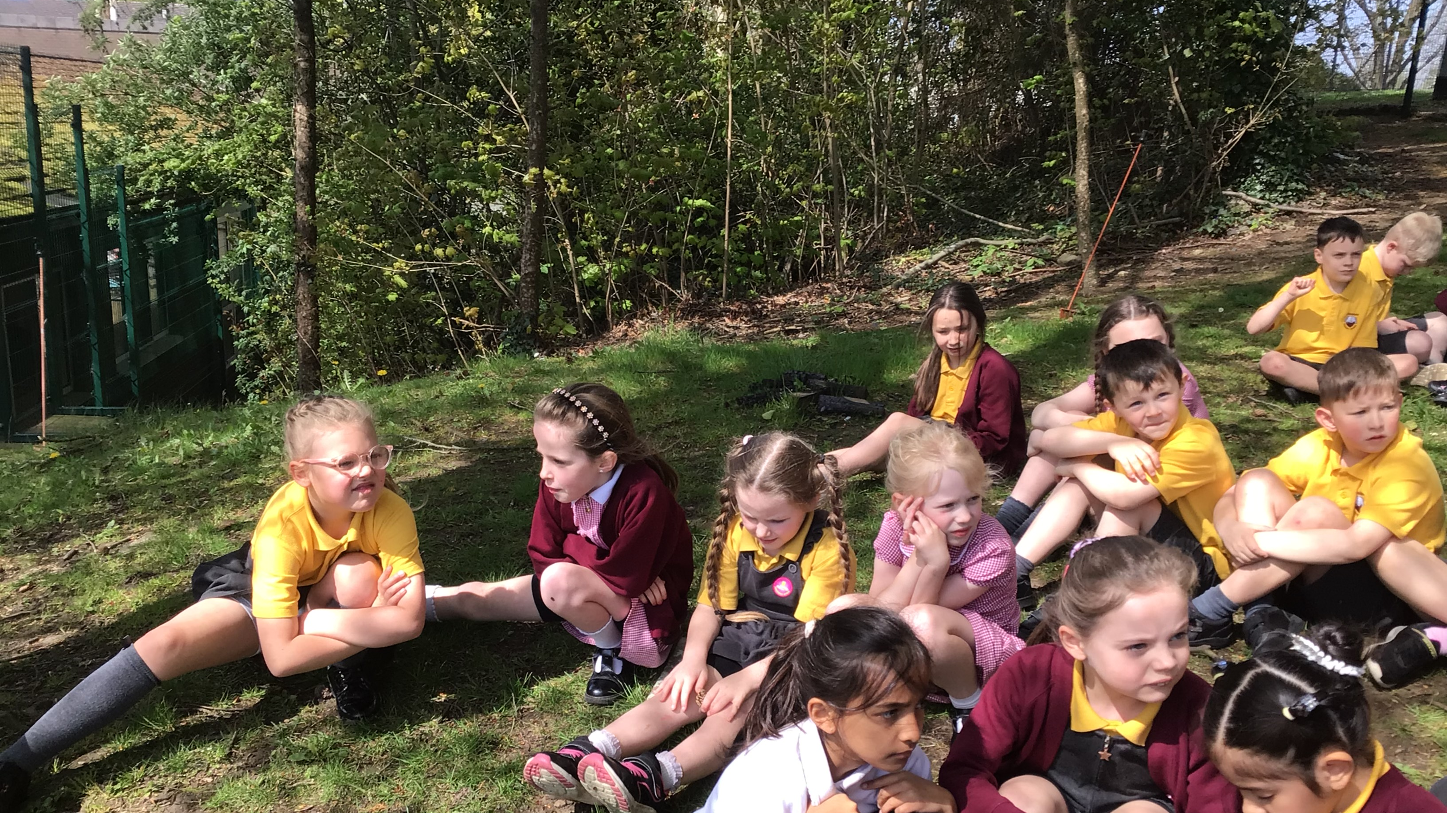
Get into our groups and use a talking stick to plan Fairy House.

Slide 6
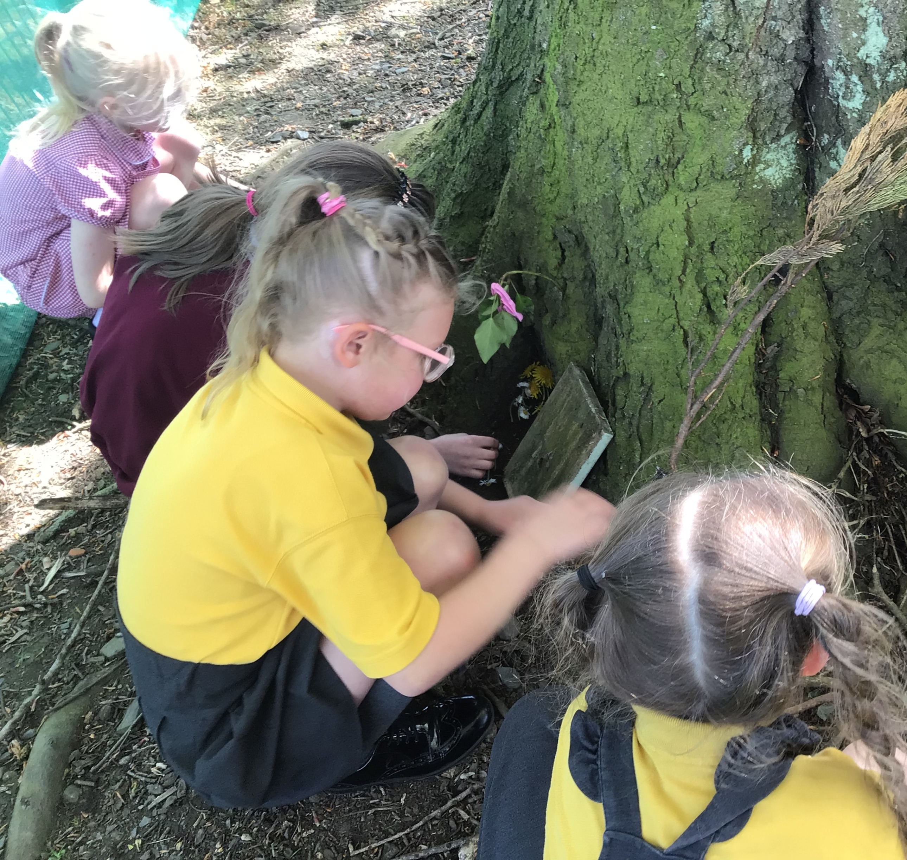
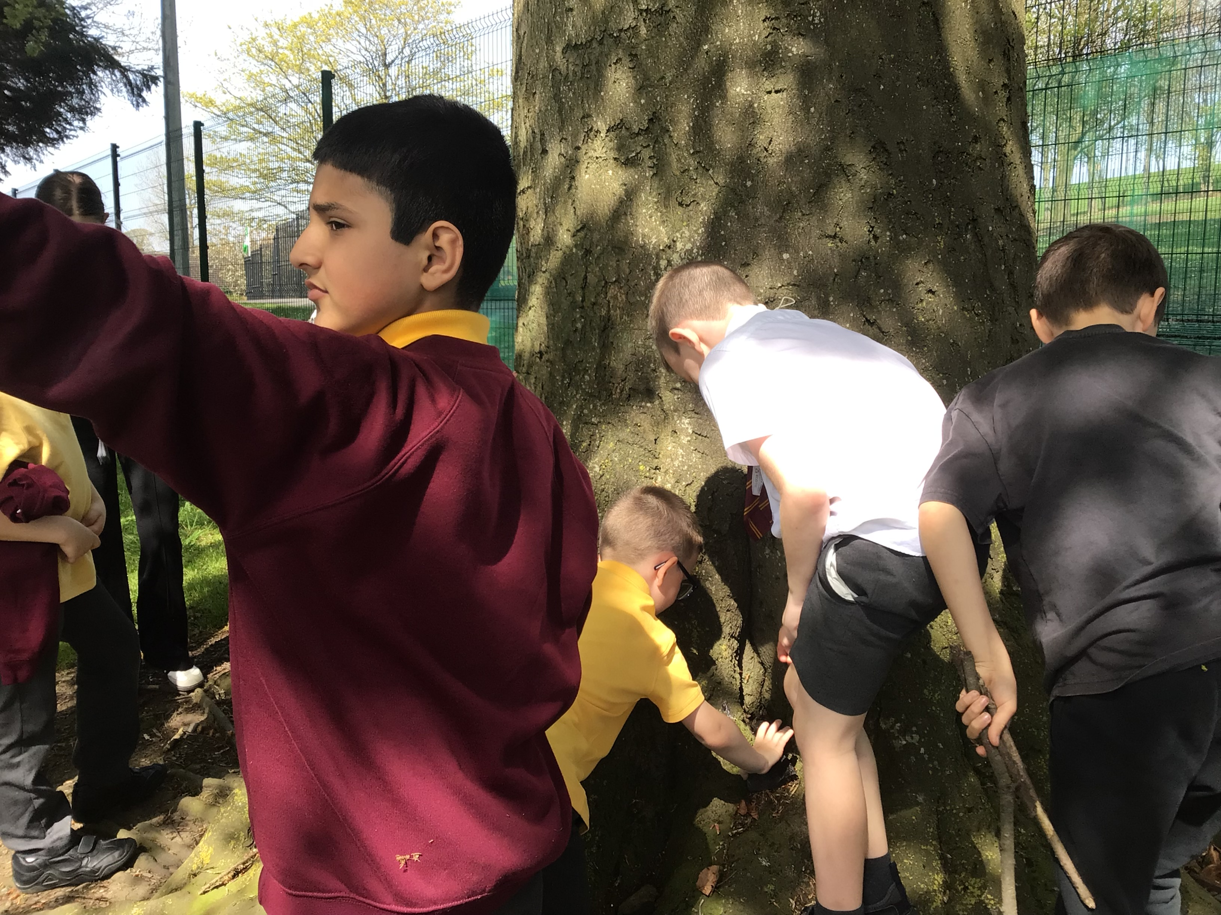
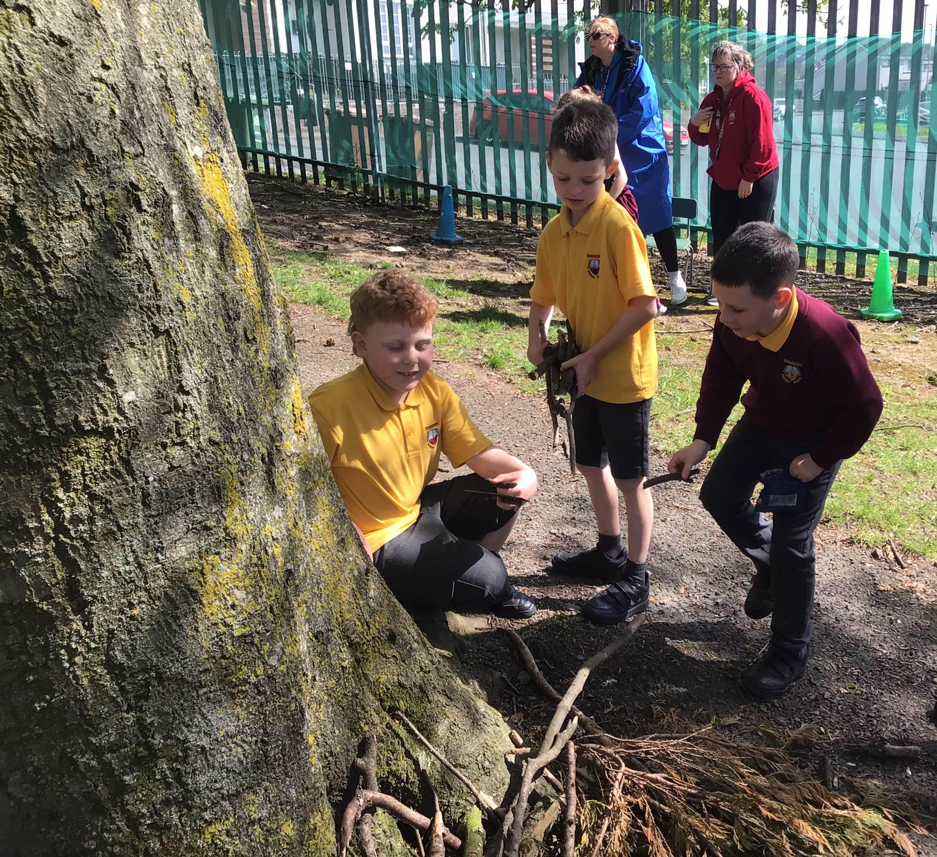
P3 and P4 had great fun searching for materials to find create a home for a fairy.

Slide 7
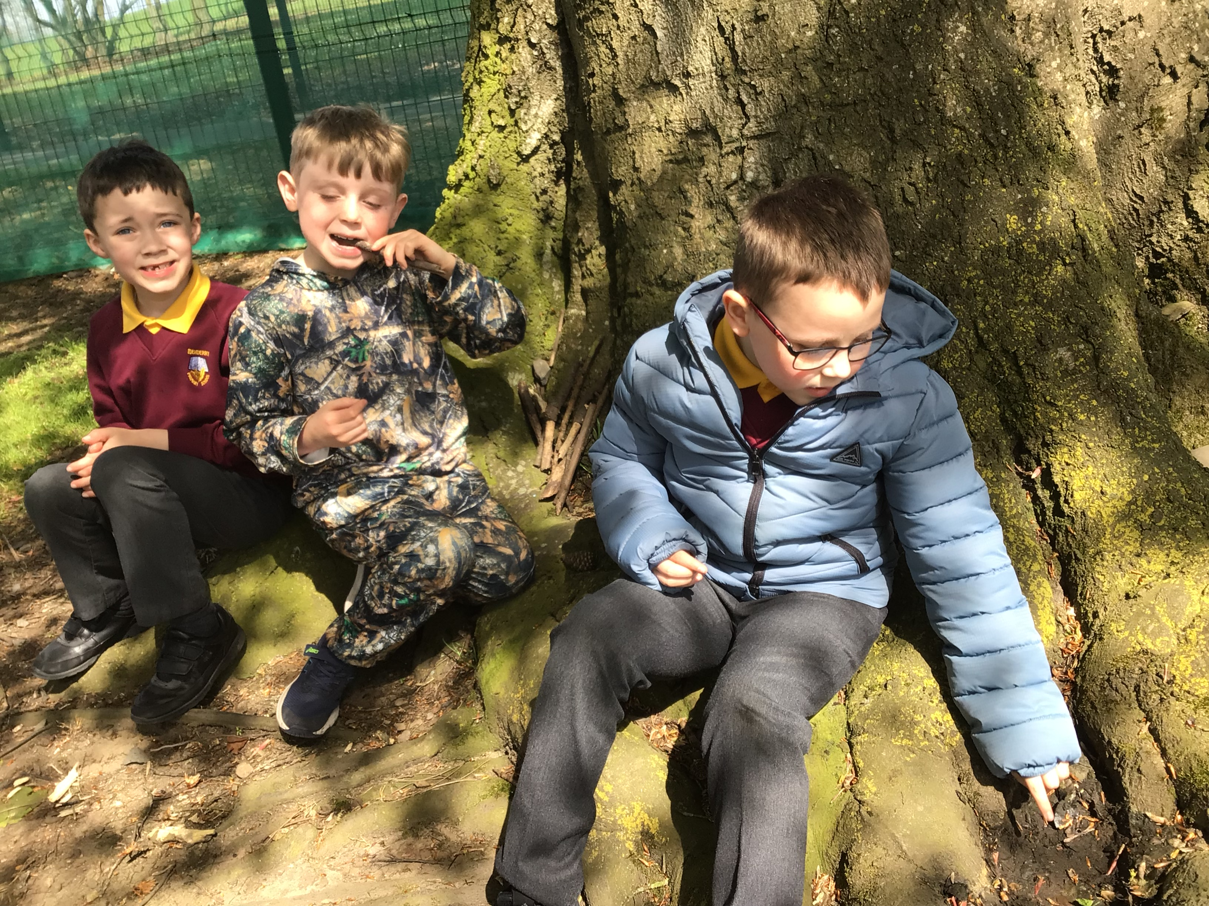
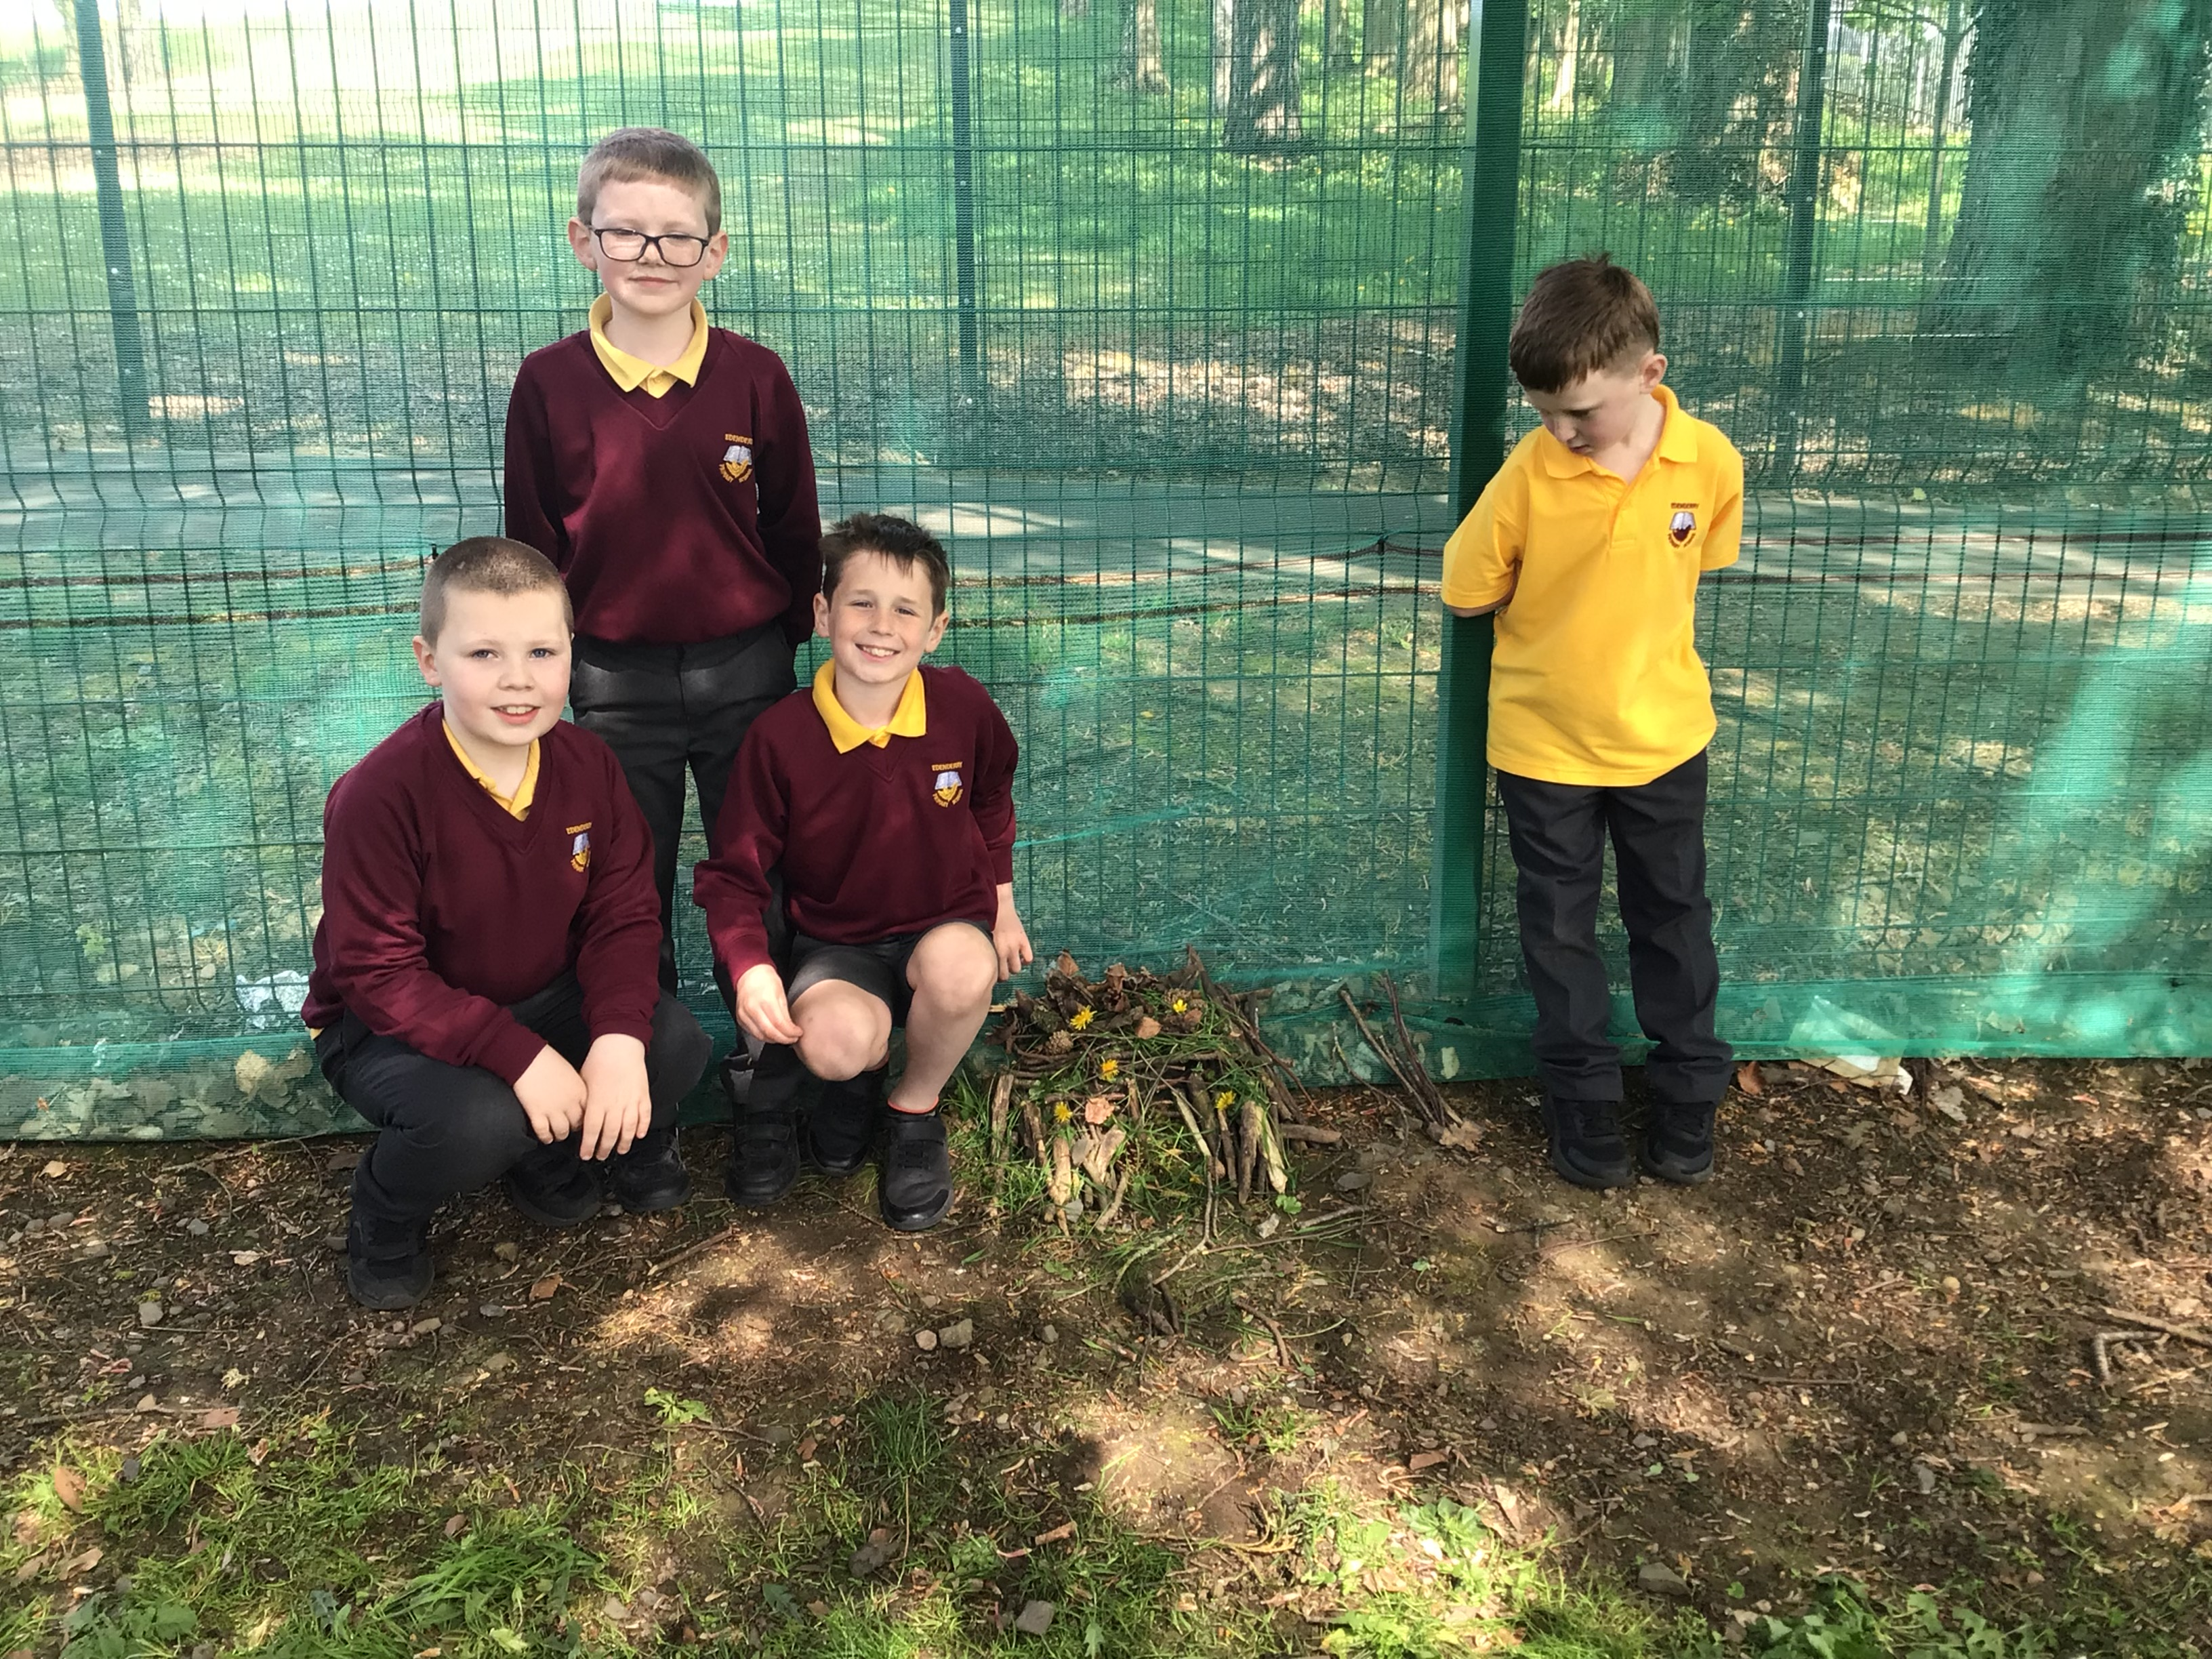
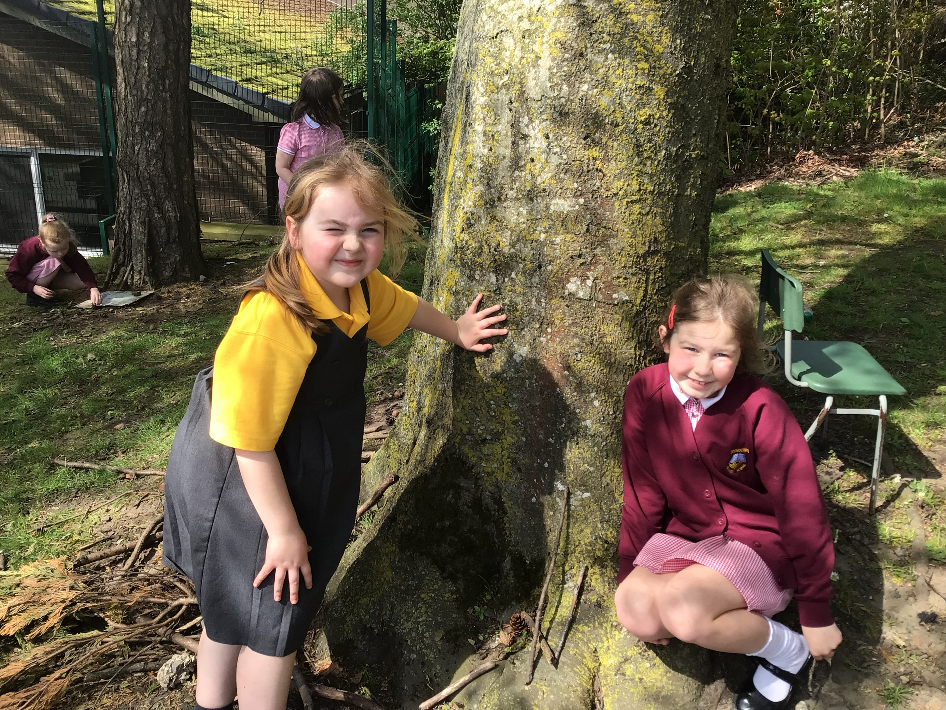
P3 and P4 loved sharing their houses with the rest of the group.

Slide 8
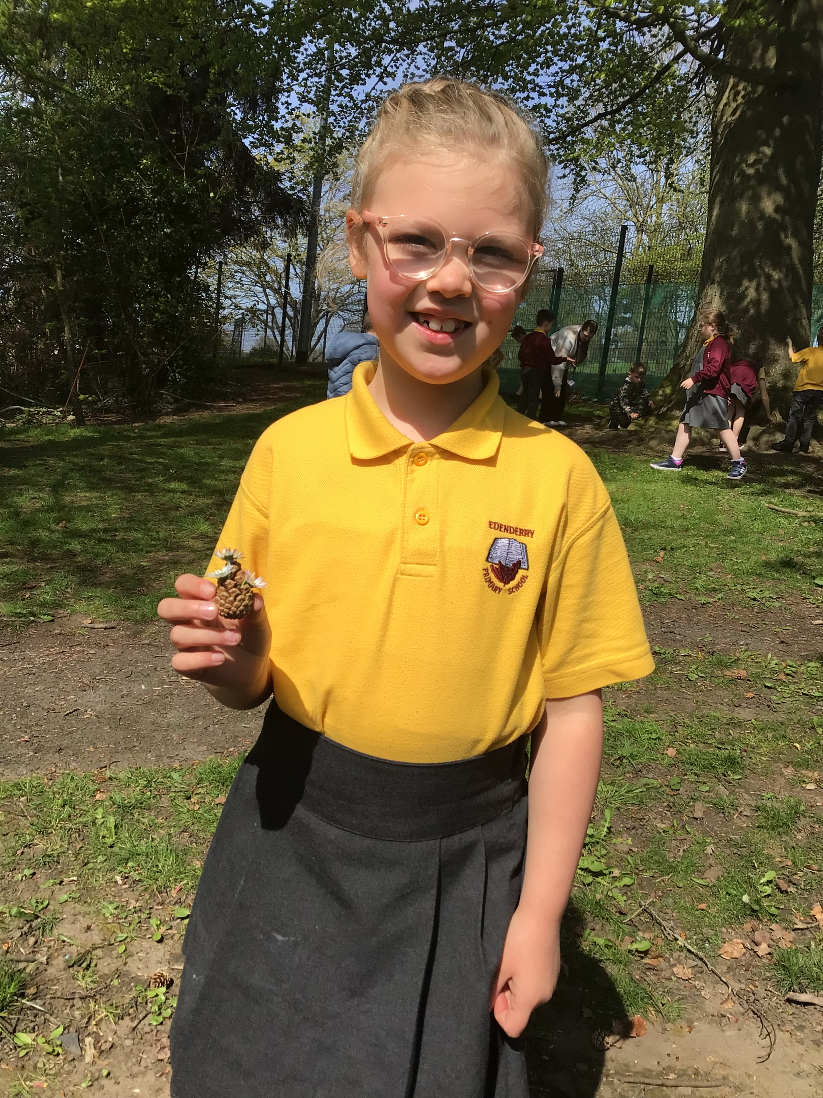
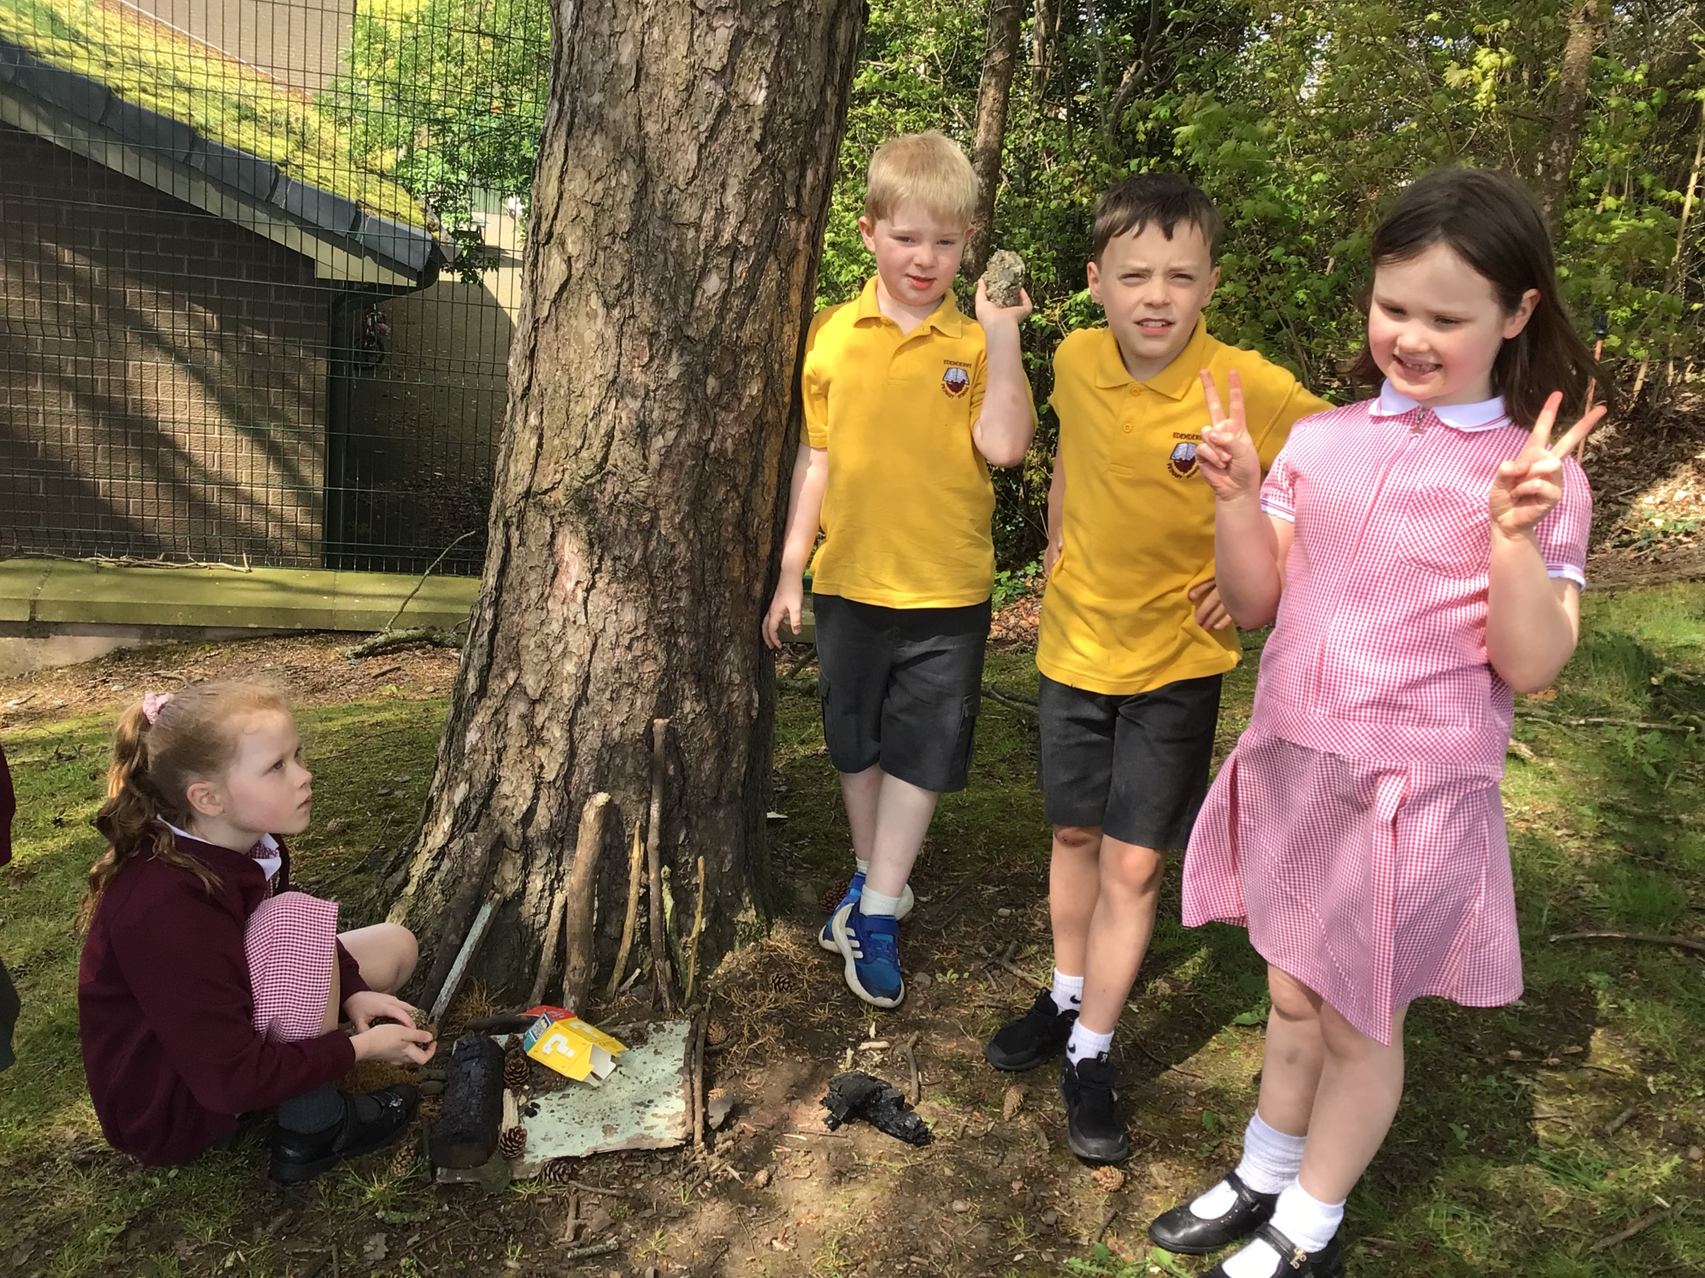
We even had wonderful flower pots made for our Fairy house garden. So creative!

Slide 9
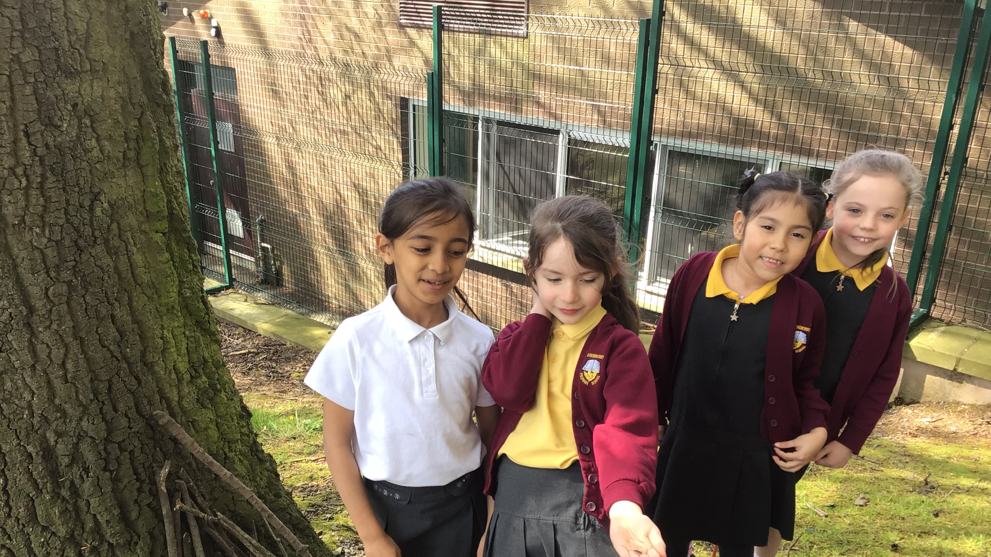
We self-evaluated our team work with 5,4,3,2,1.

Slide 10
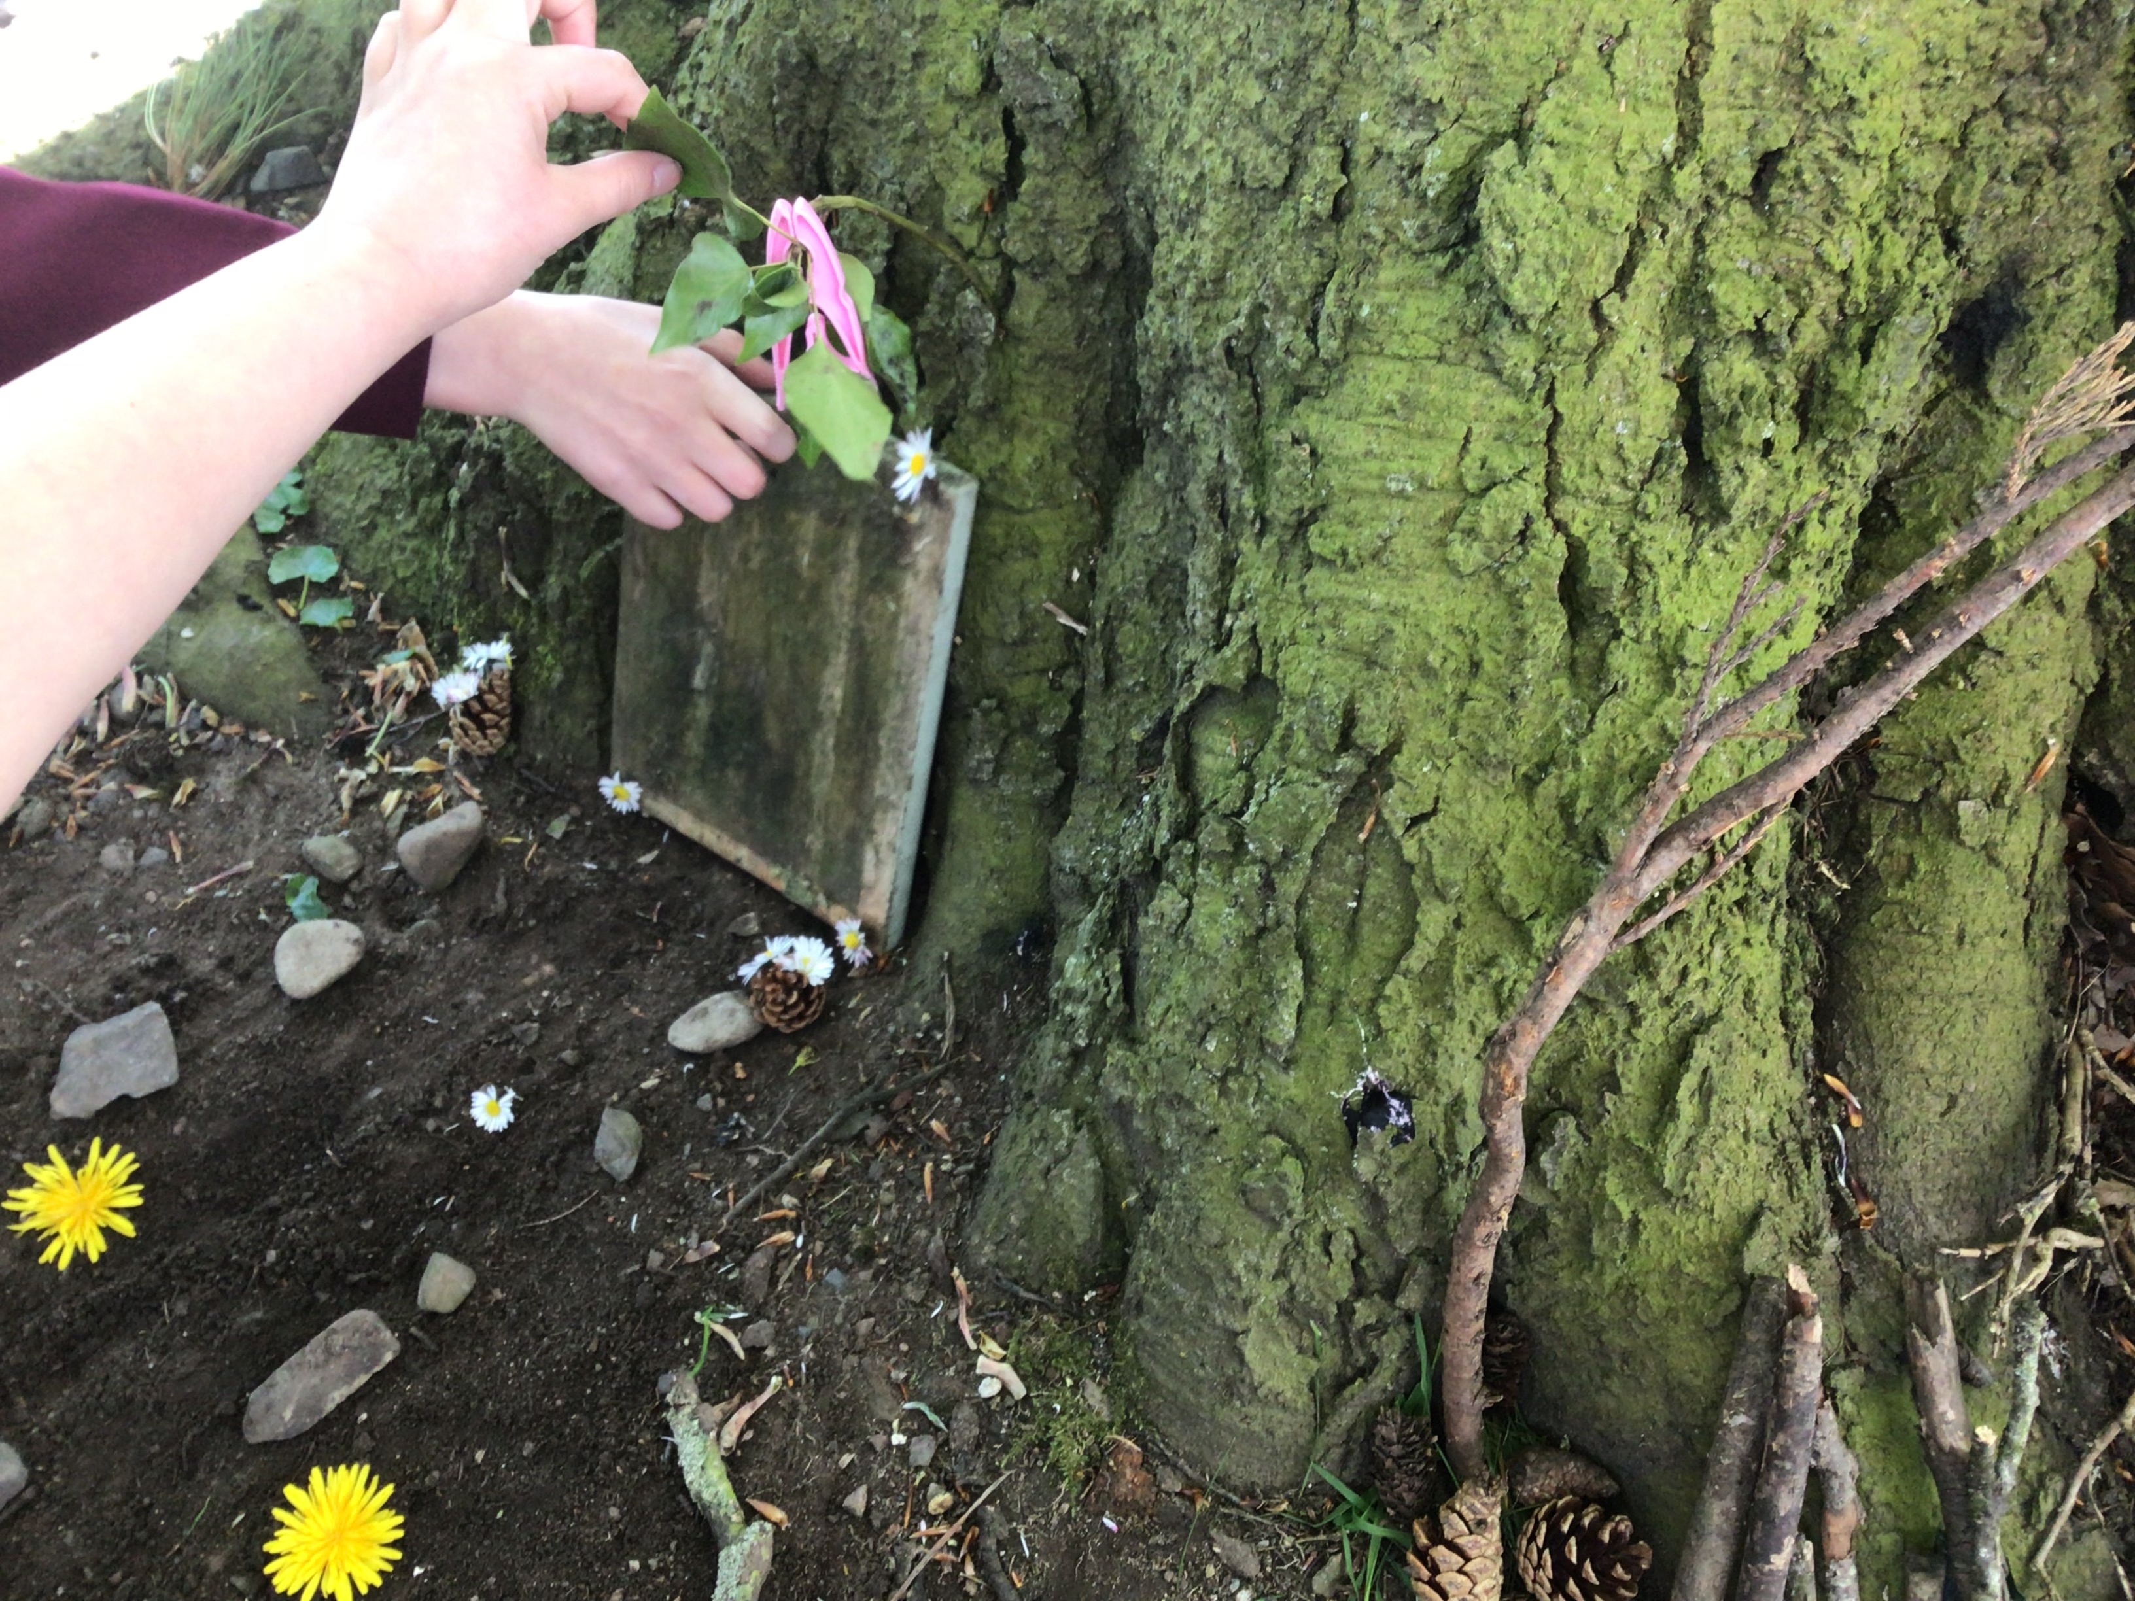
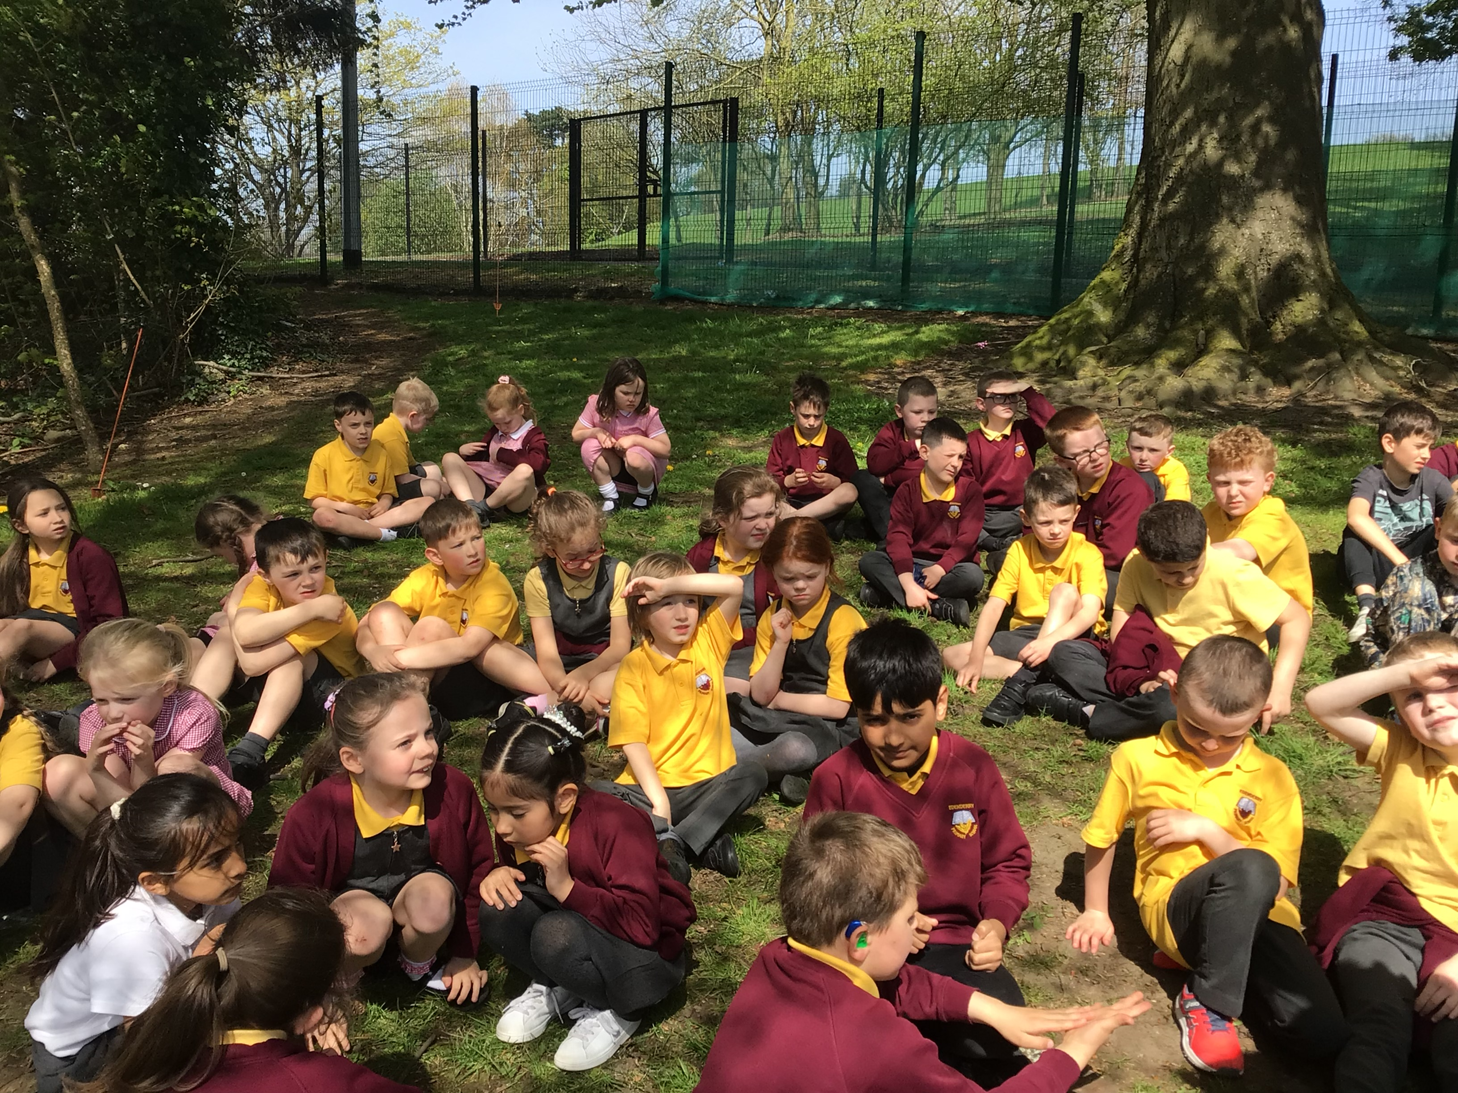
We had such fun! We finished the session by evaluating with smiley faces and of leaving no trace!

