Slide 1

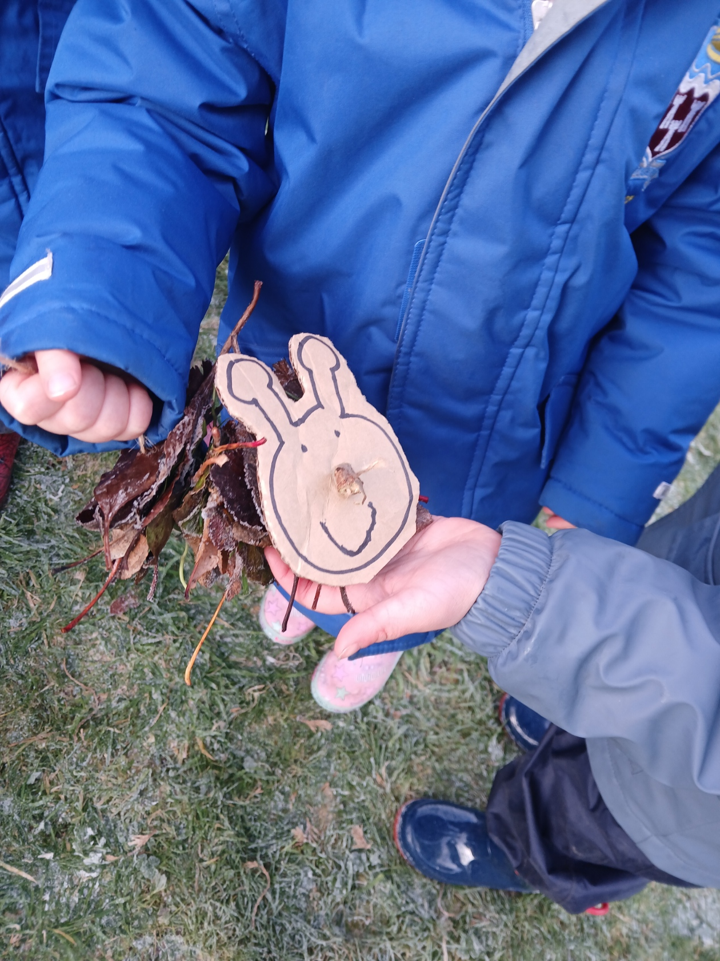


OUR FOREST SCHOOL DIARY Friday 21st November 2025
Brooklands Primary School

Slide 2
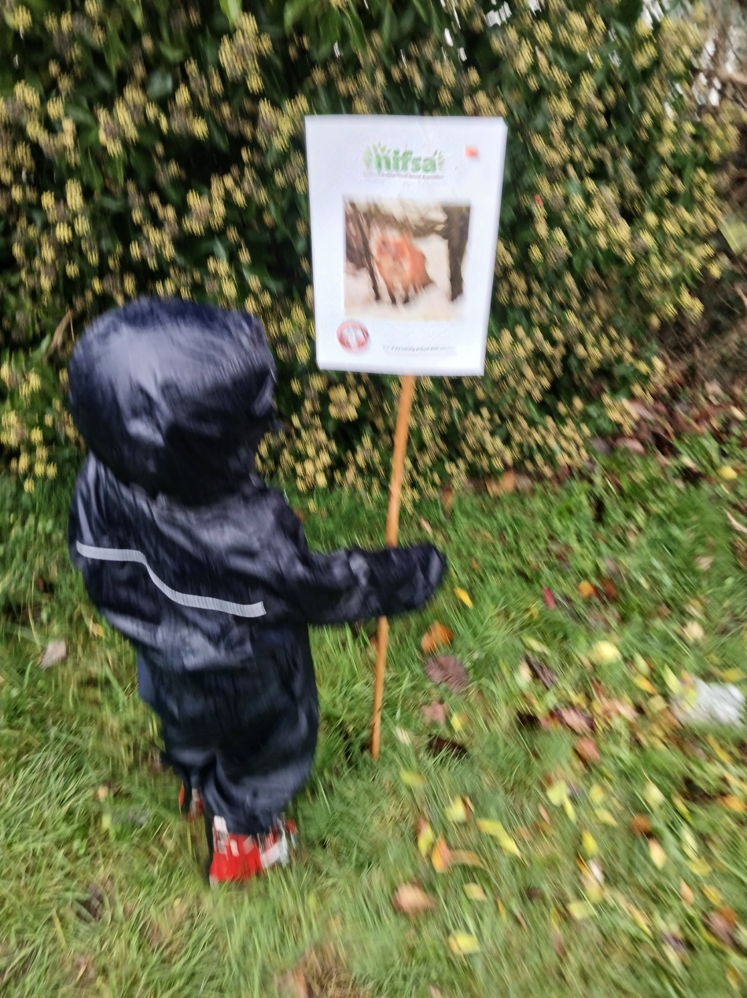
FOREST SCHOOL
We put our boundaries out so we knew where we could play.

Slide 3
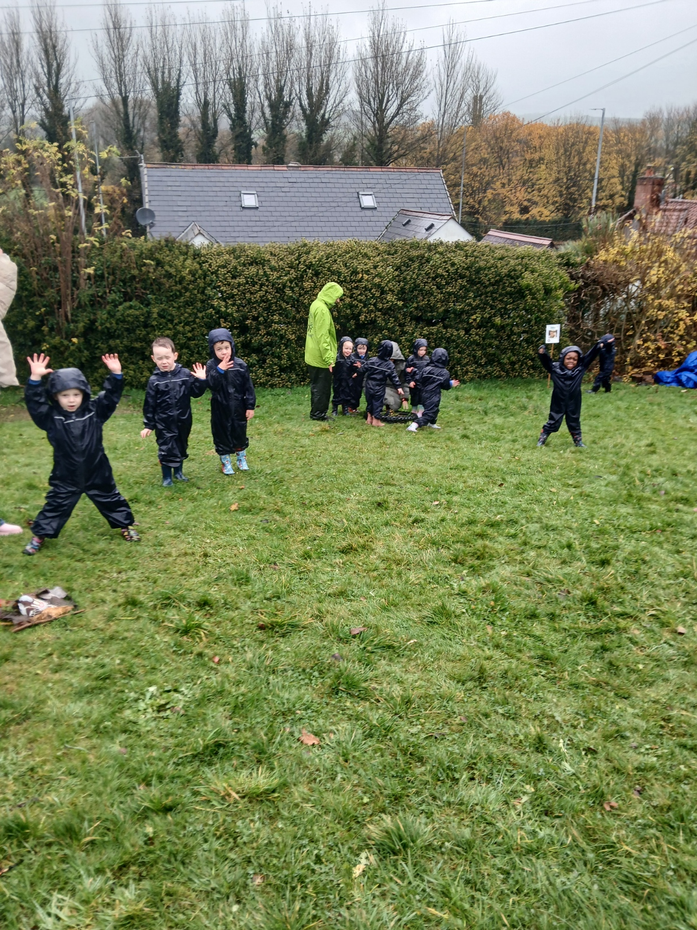
RULES
We go over our Forest School rules:
1 whistle: stop
2 whistles: back to base
3rd rule: have fun and learn

Slide 4
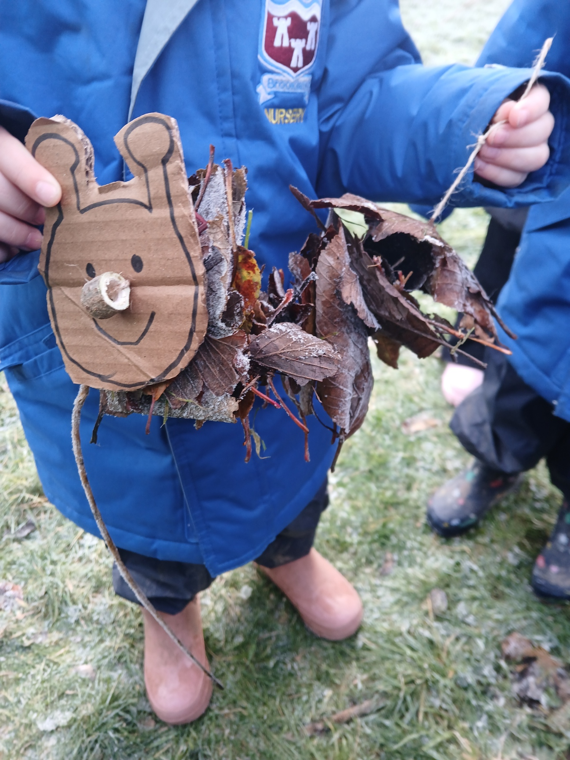
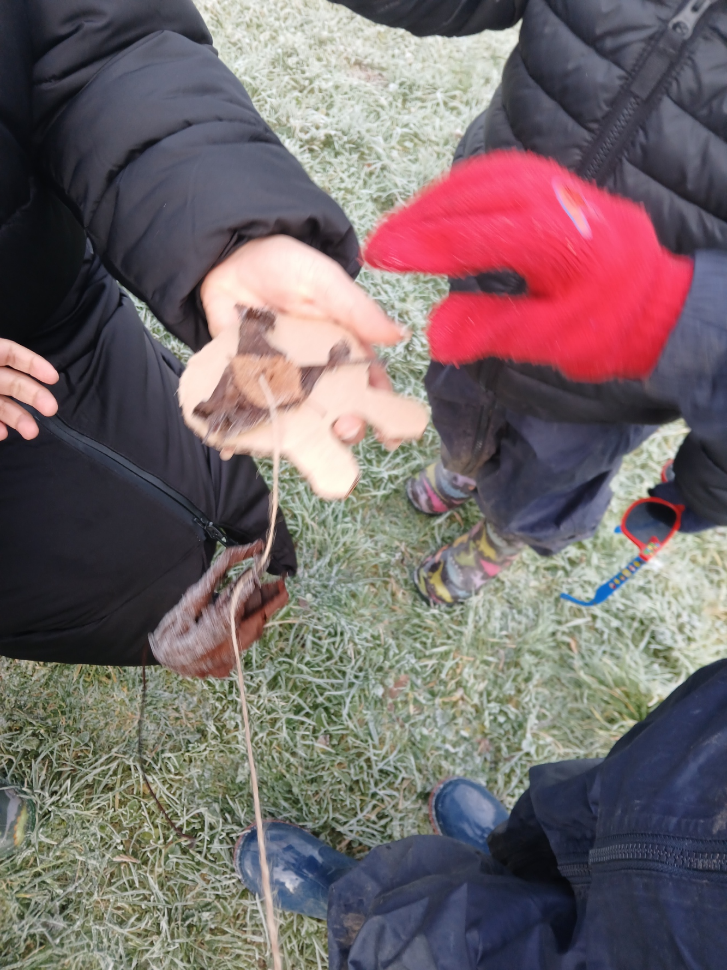
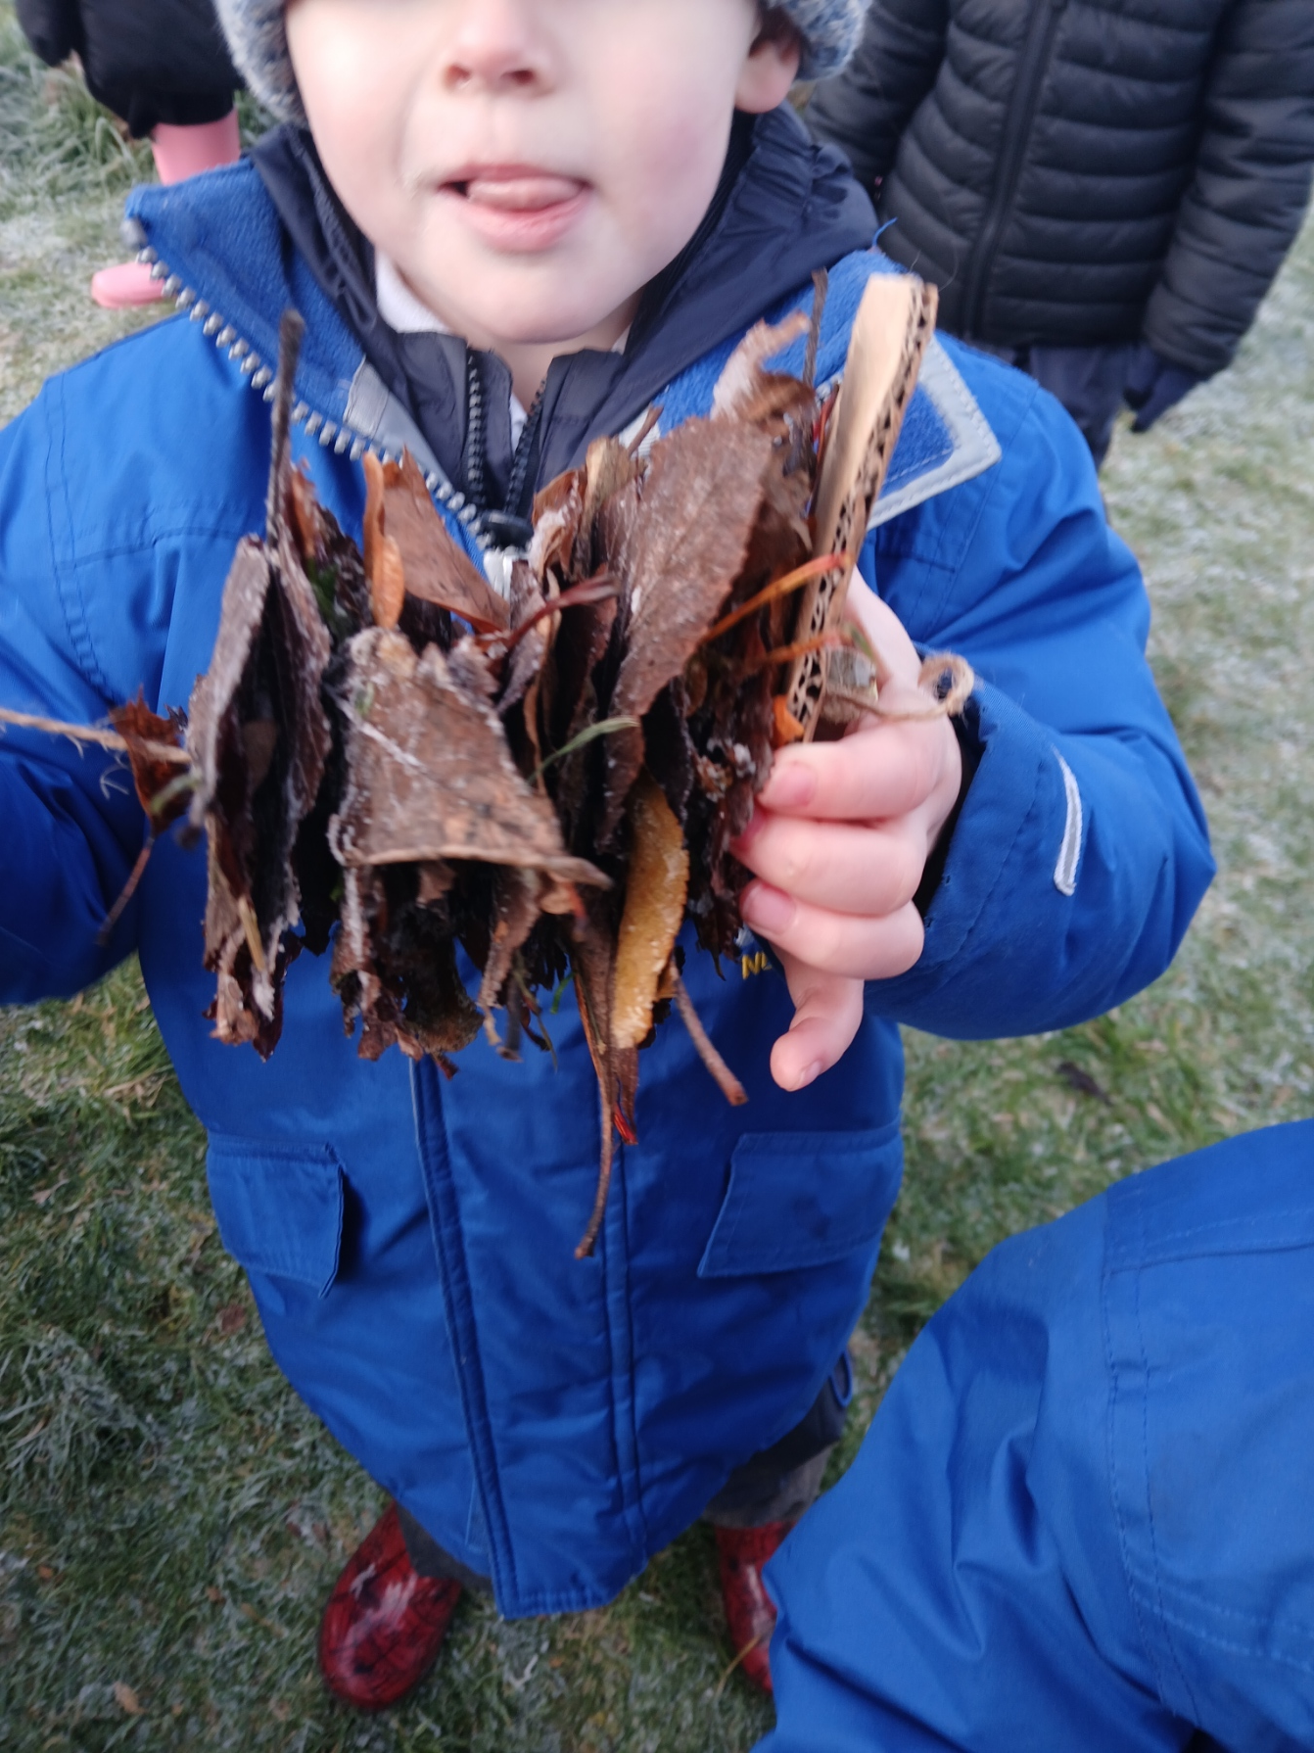
Hungry Caterpillars
We collected lots of leaves.
We treaded them on to some string to make some caterpillars. The leaves were frozen.

Slide 5
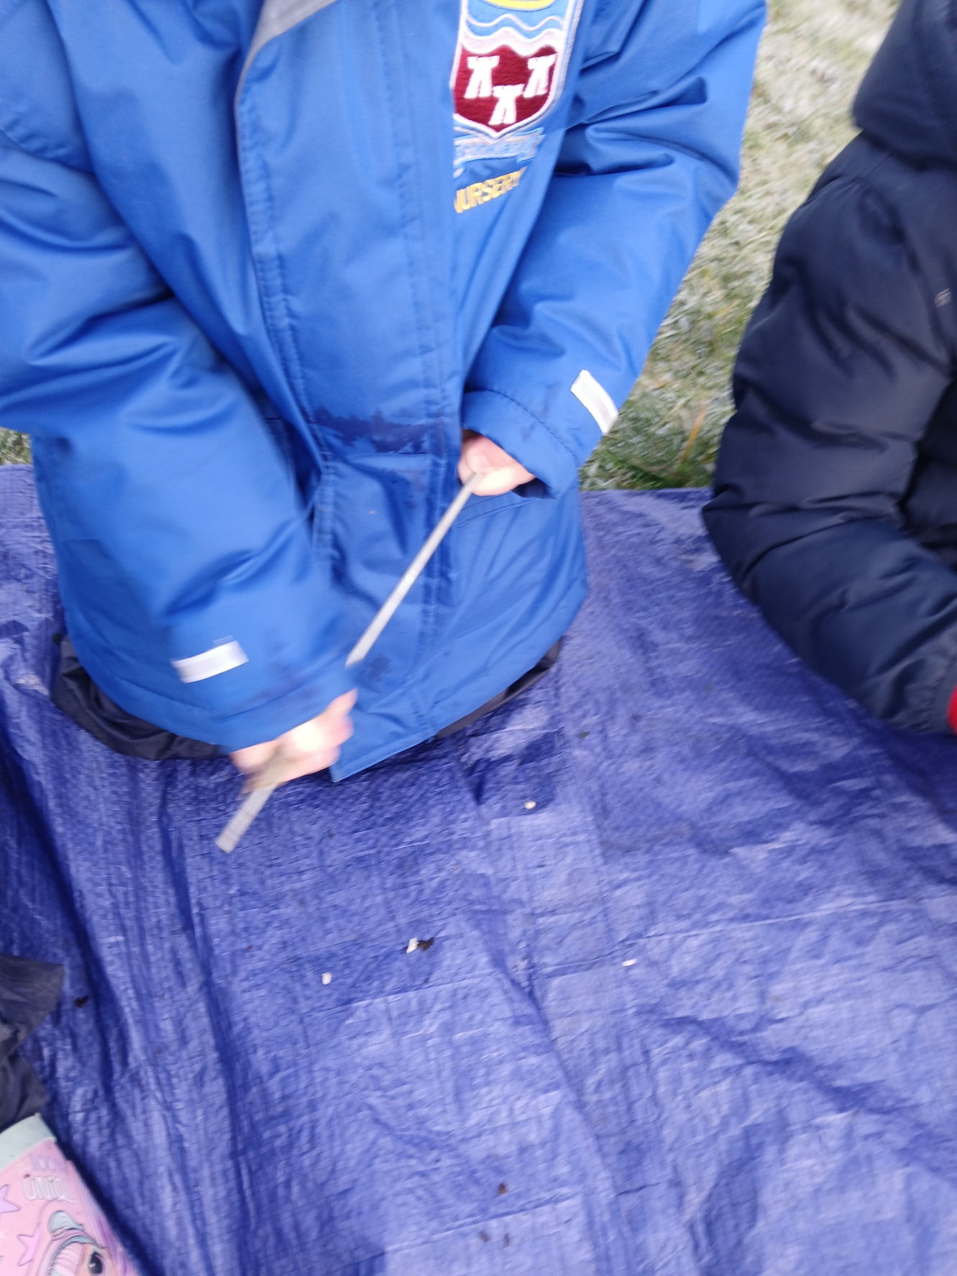
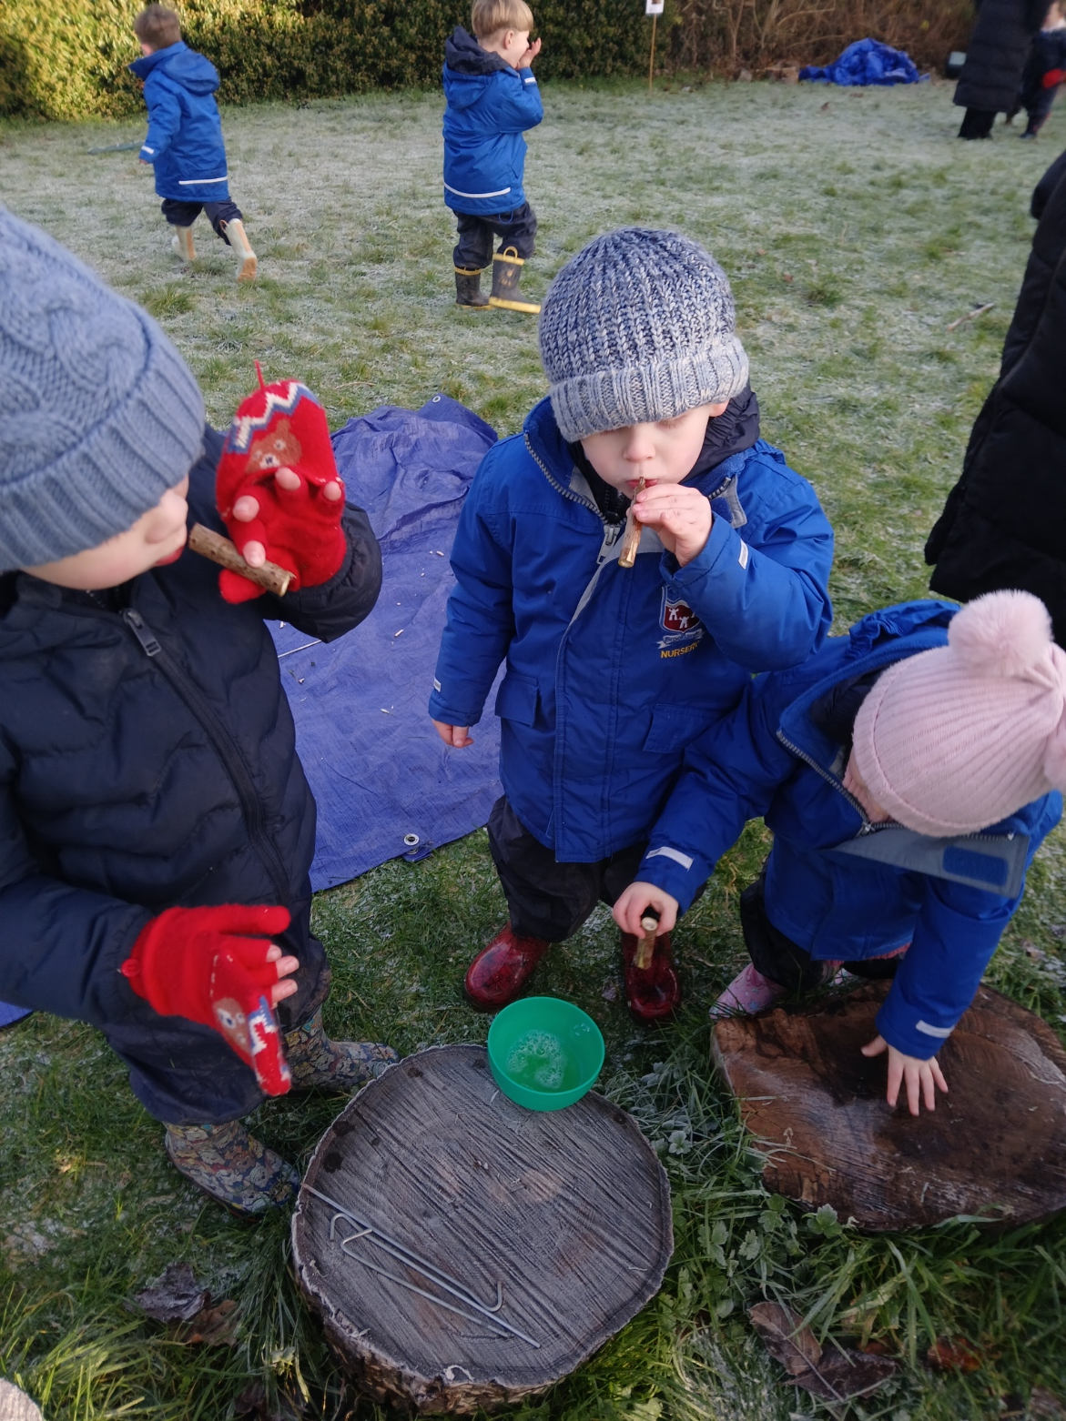
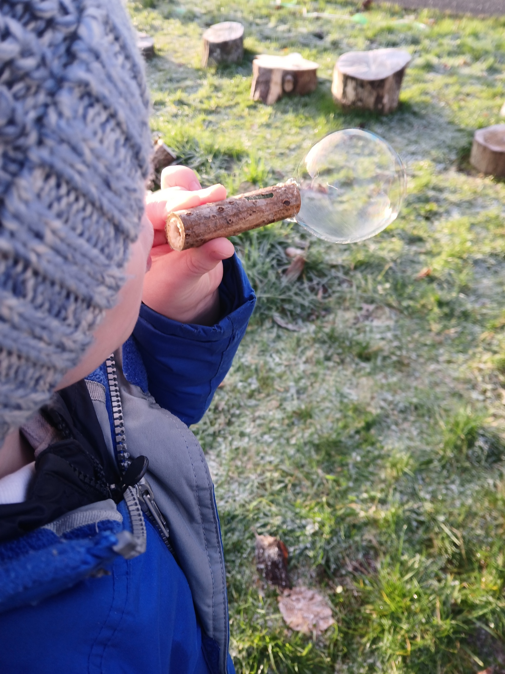
Bubble Wands
We used our tent peg to push the centre (pith) of the elder out. We dipped in to bubble mixture and blew bubbles.
.
Some were successful.

Slide 6
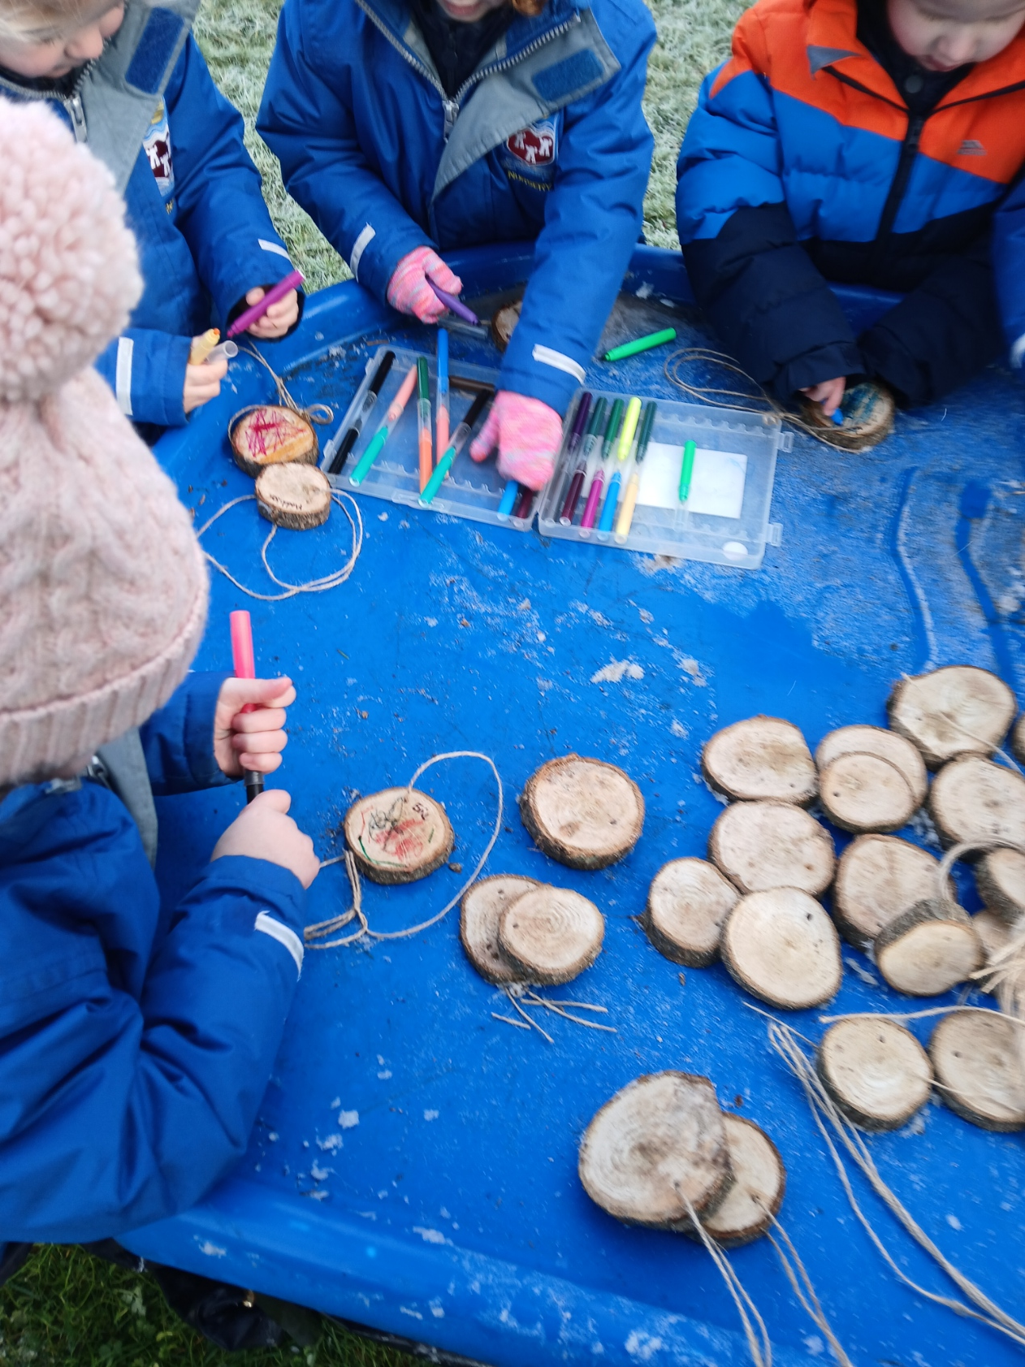
Wood Cookies
We decorated wood cookie to take home.

Slide 7

Fire
We learnt about the 3 things we need to light a fire!

Slide 8
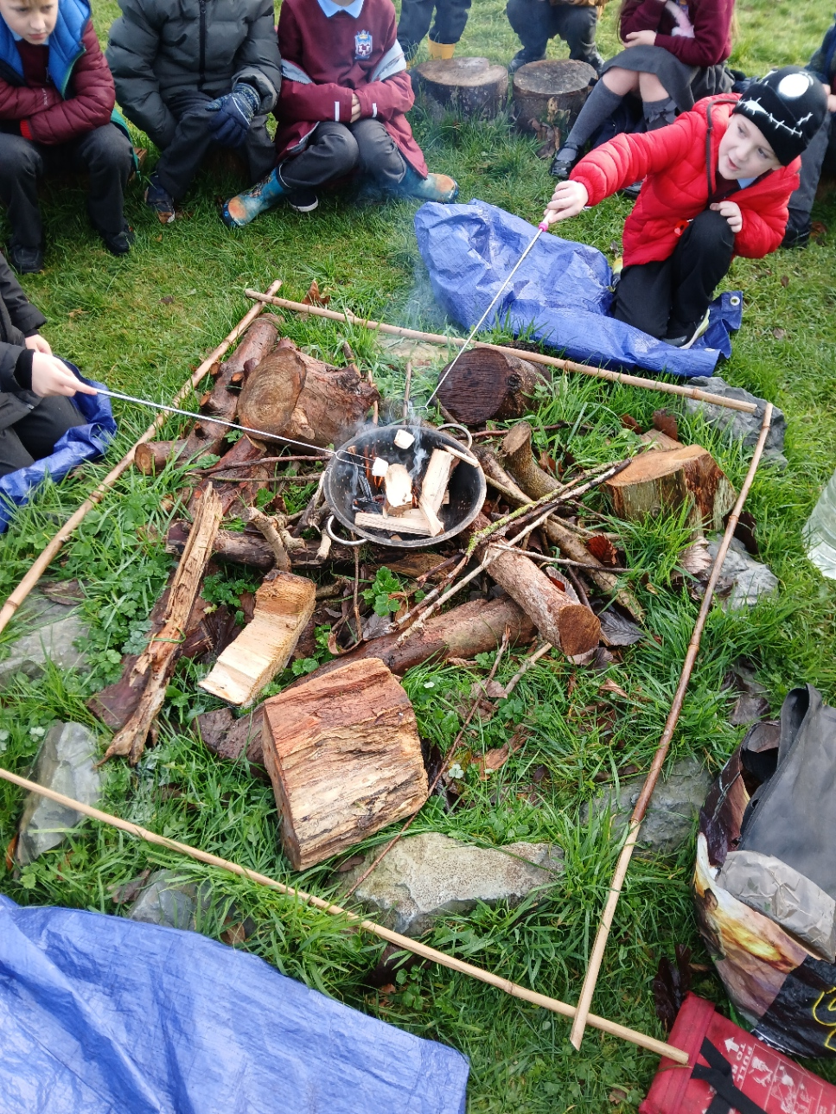
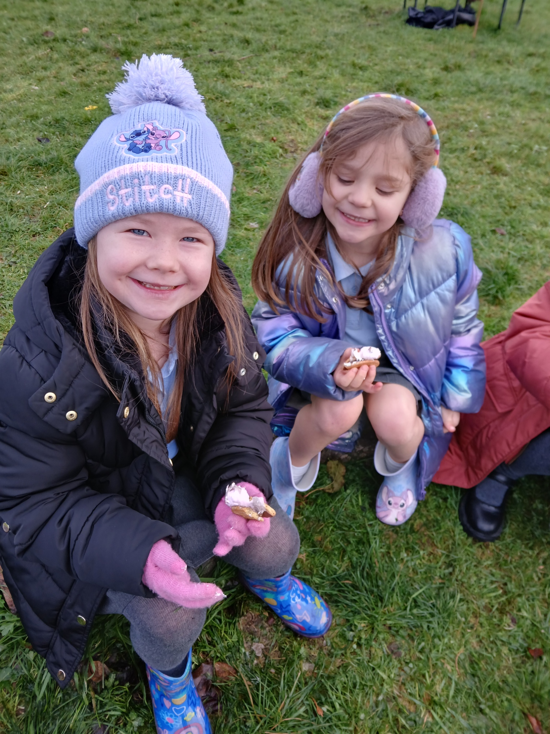
Fire
We toasted marshmallows.
We made some smore’s.
Best bit was eating them!

Slide 9
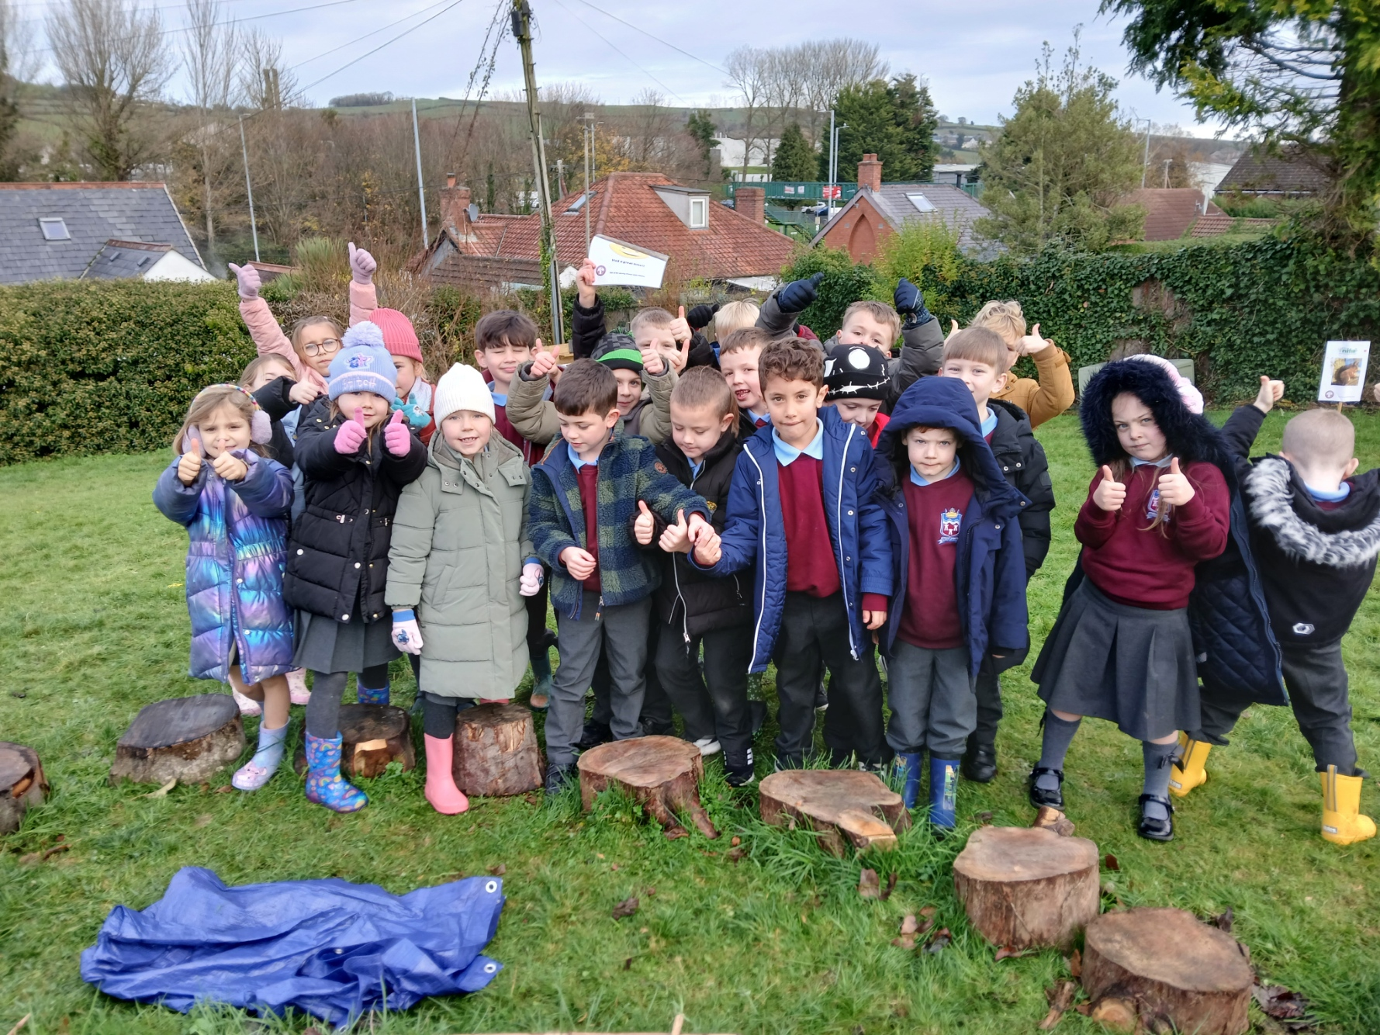
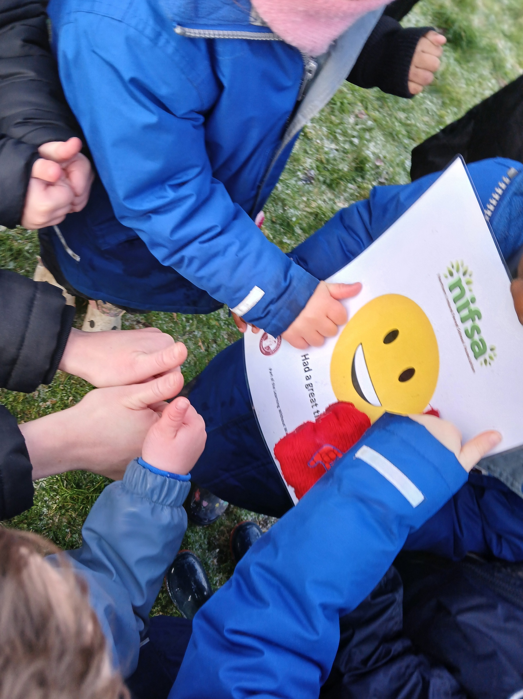
DID YOU ENJOY IT?
All smiley faces today.

