Slide 1


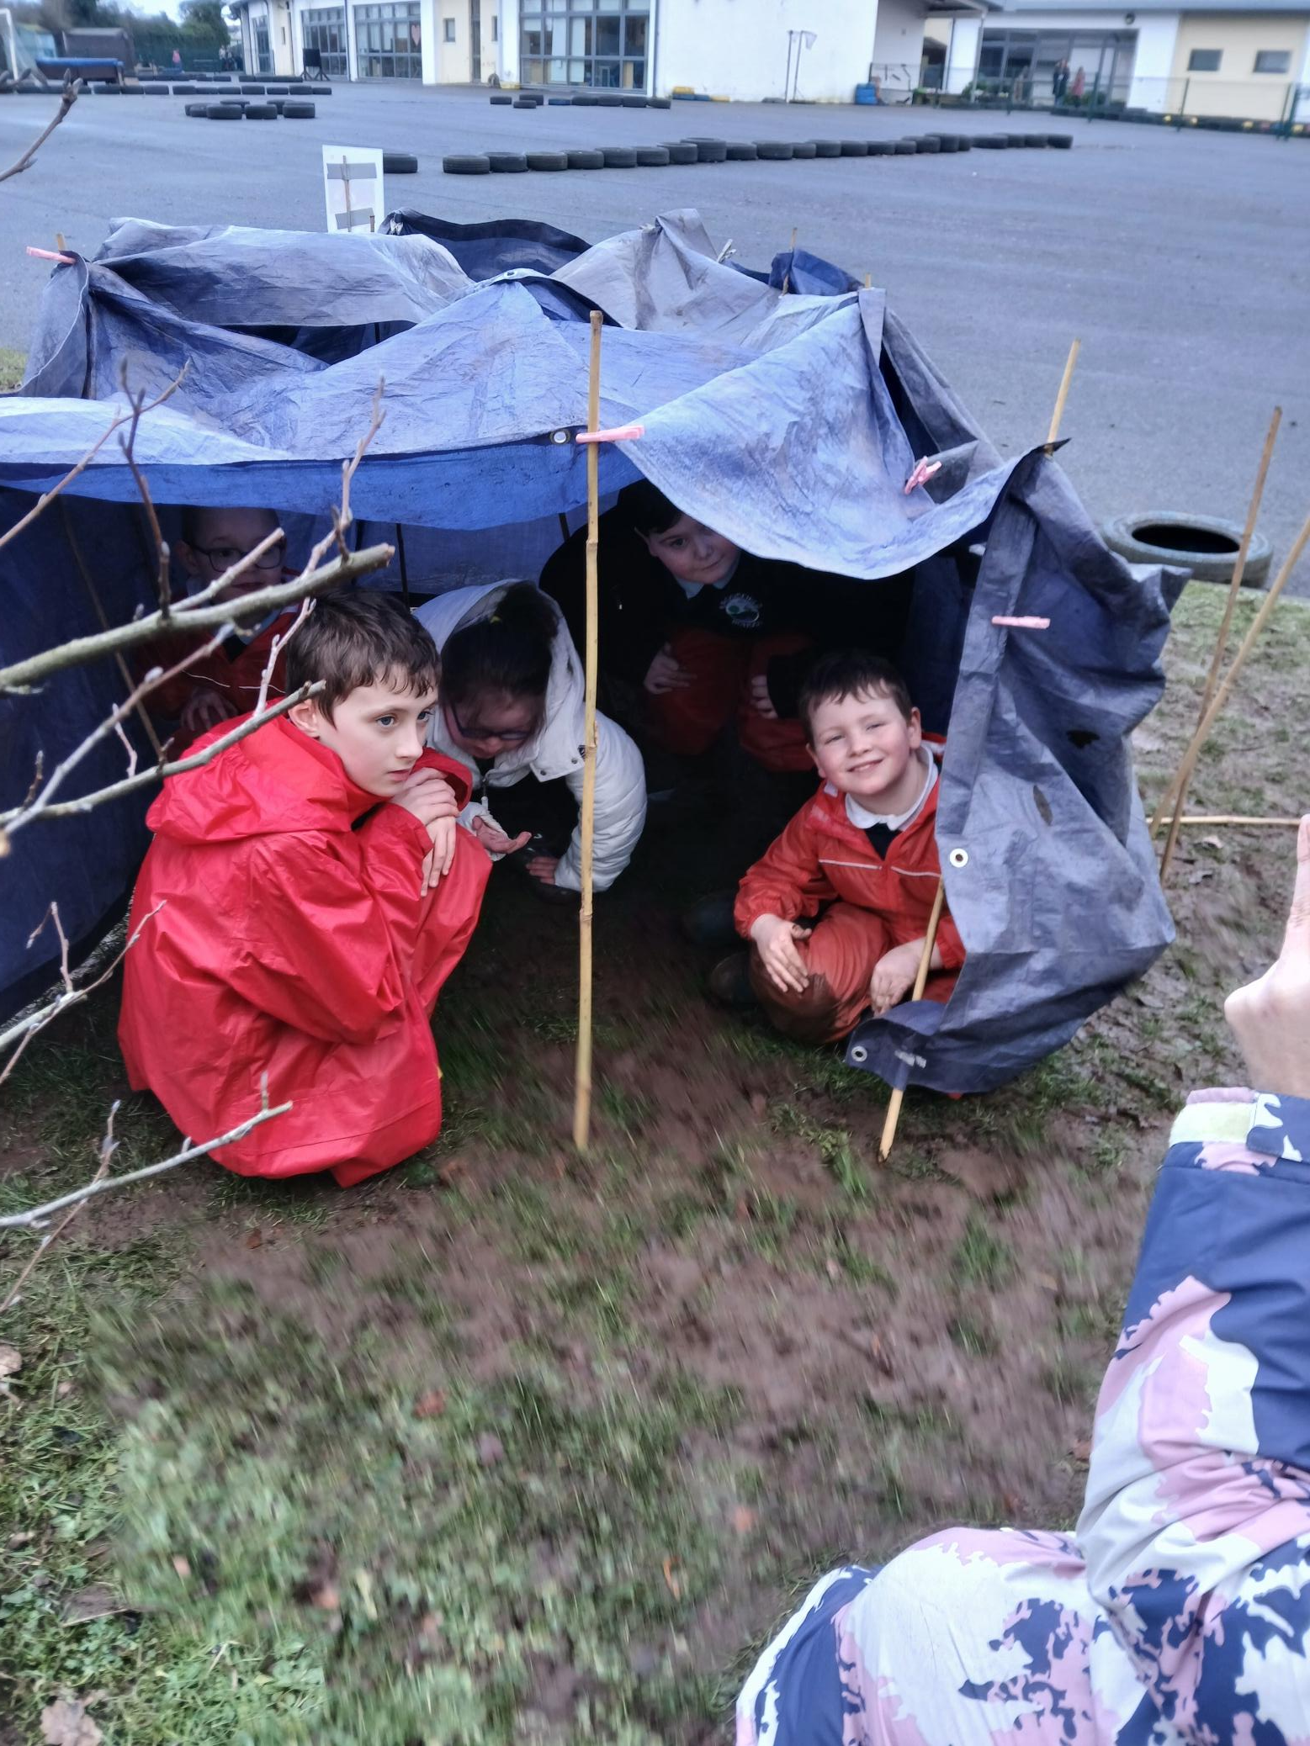
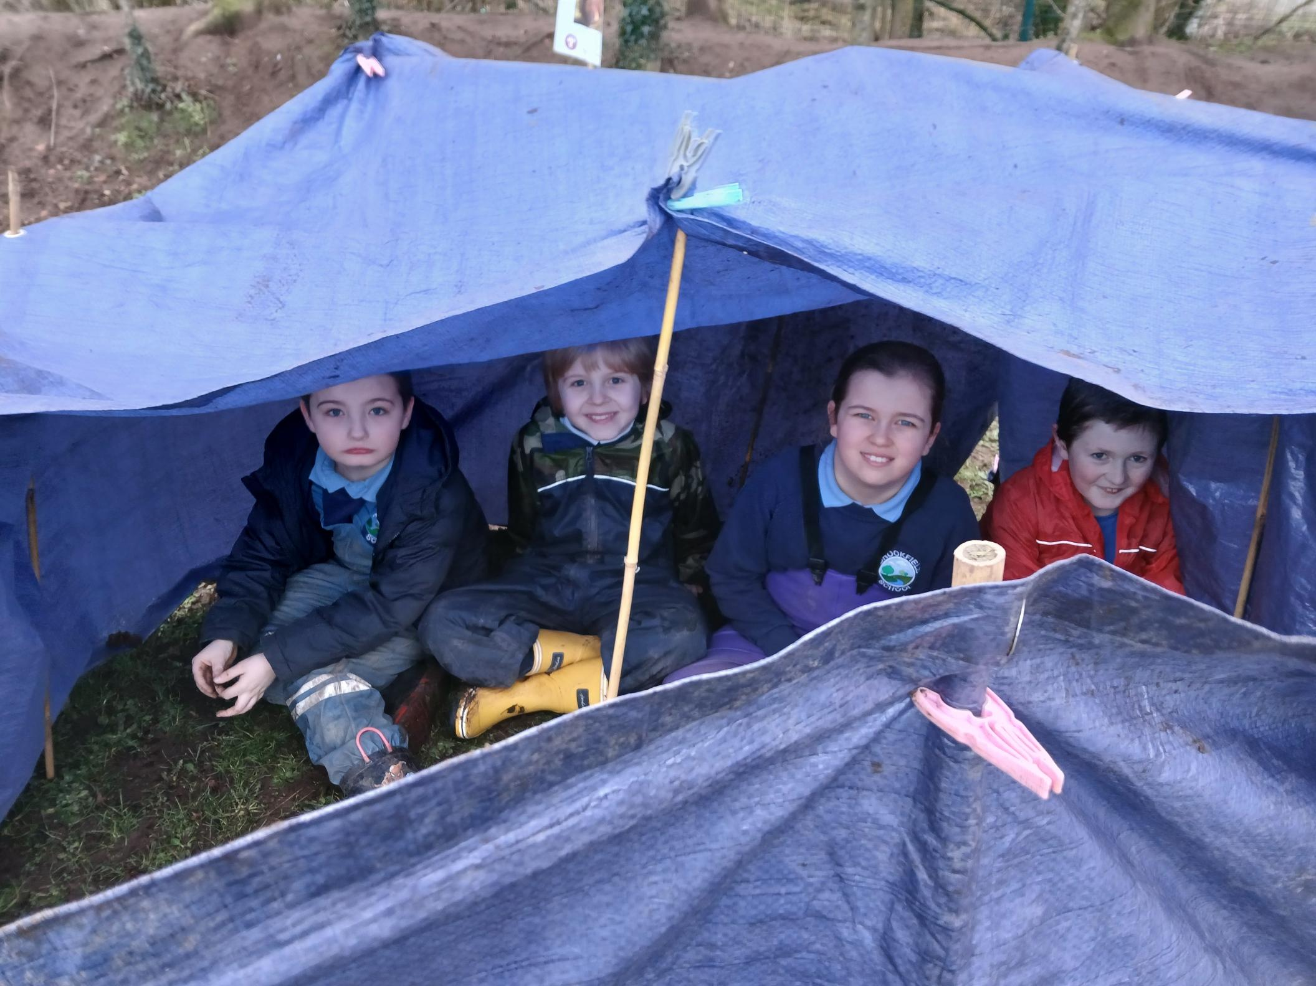

OUR FOREST SCHOOL DIARY
Friday 20st February 2026
Brookfield Special School
Moria

Slide 2
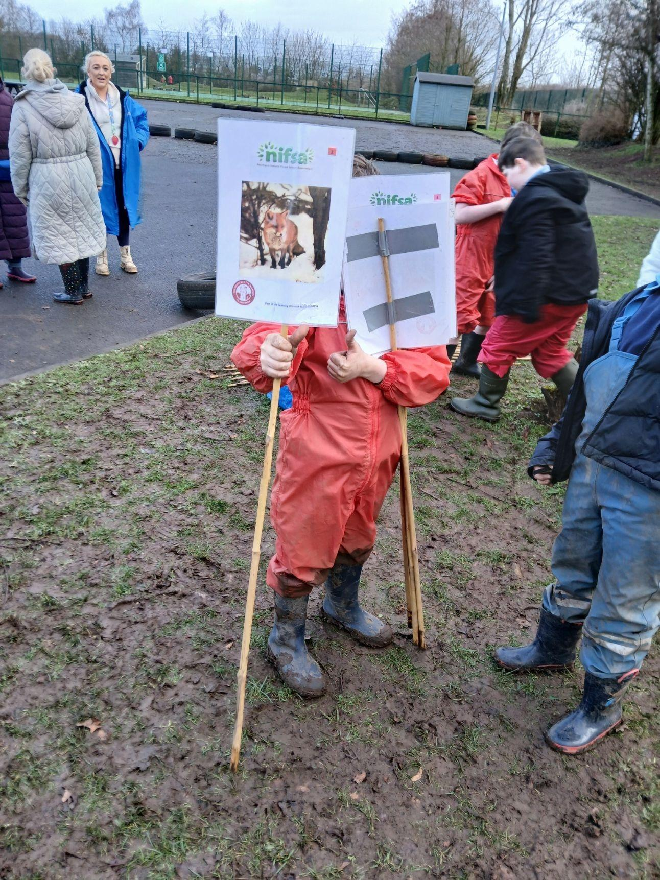
FOREST SCHOOL
We put our boundaries out so we knew where we could play.

Slide 3
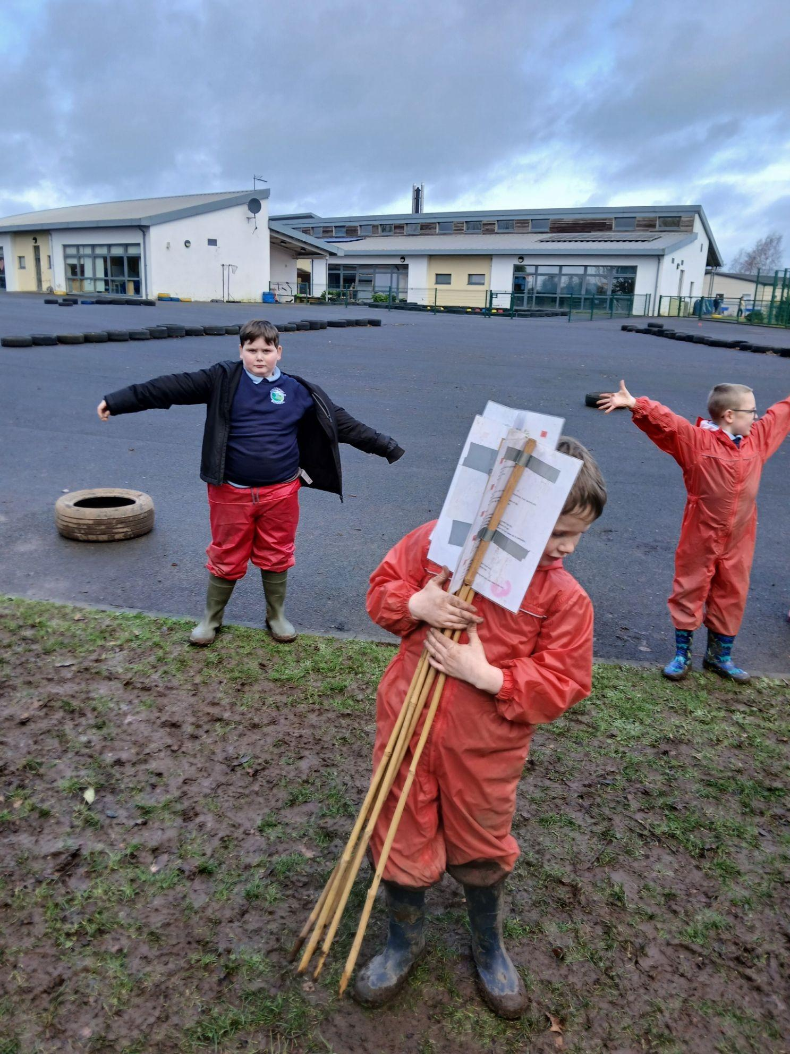
RULES
We go over our Forest School rules:
1 whistle: Stop
2 whistles: Back to base
3rd rule: Have fun and learn

Slide 4
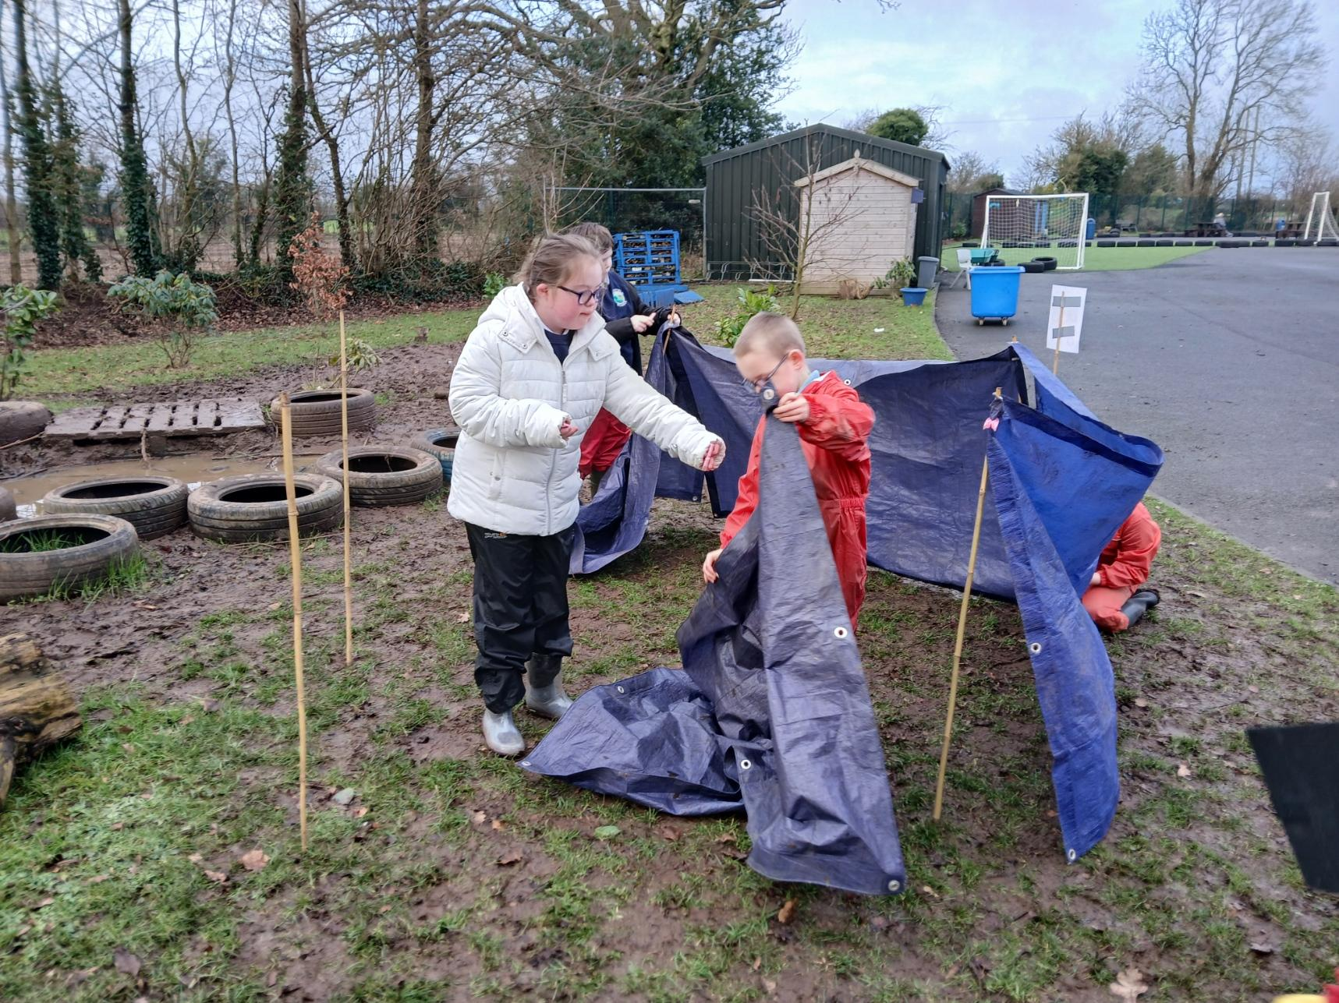
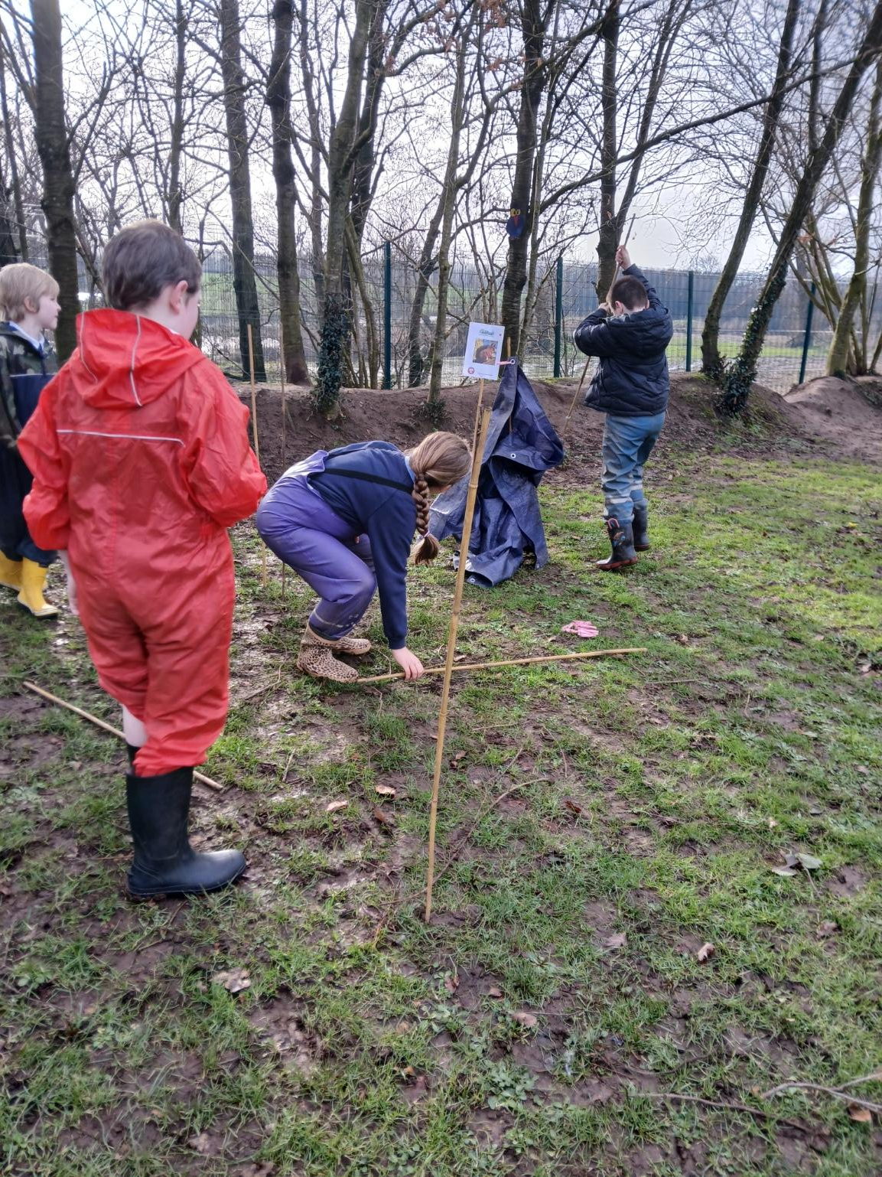
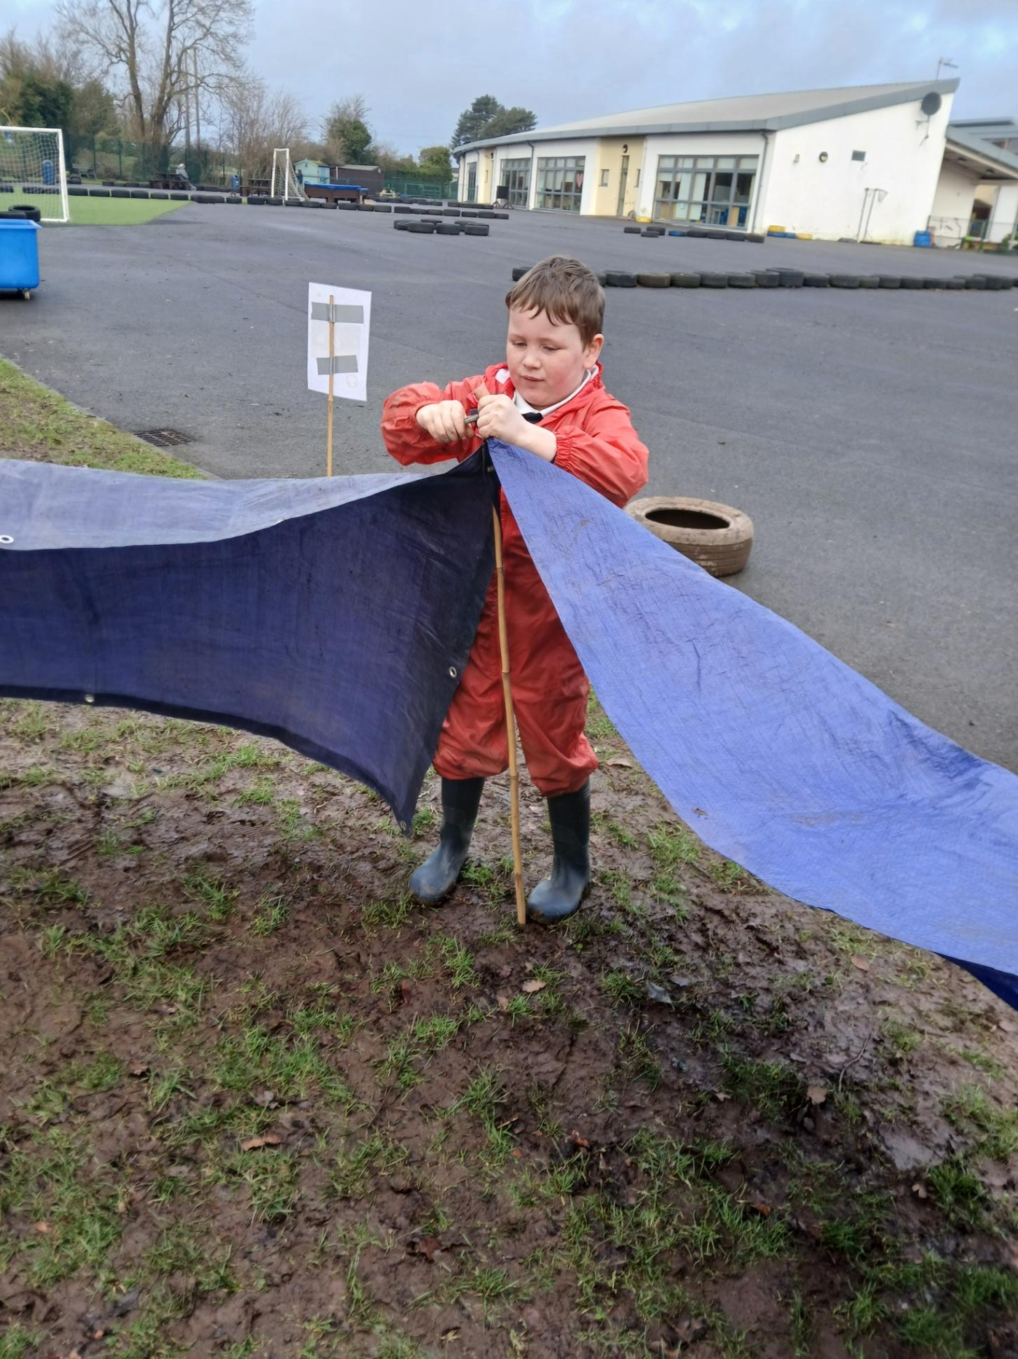
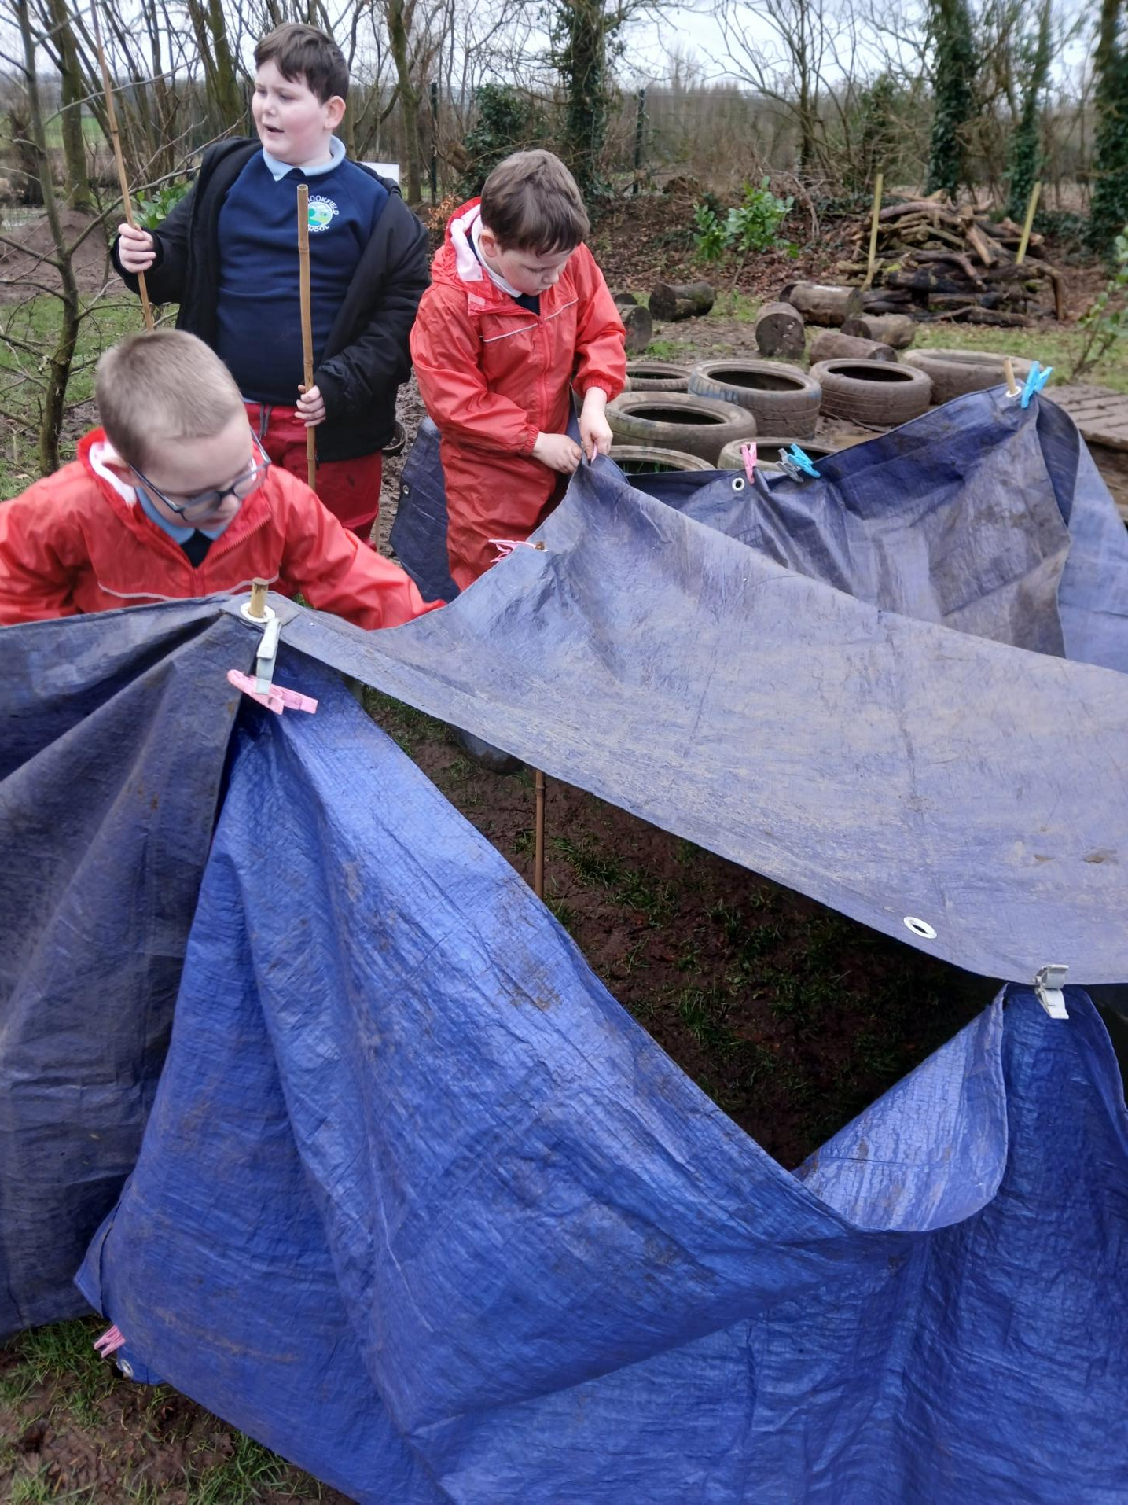
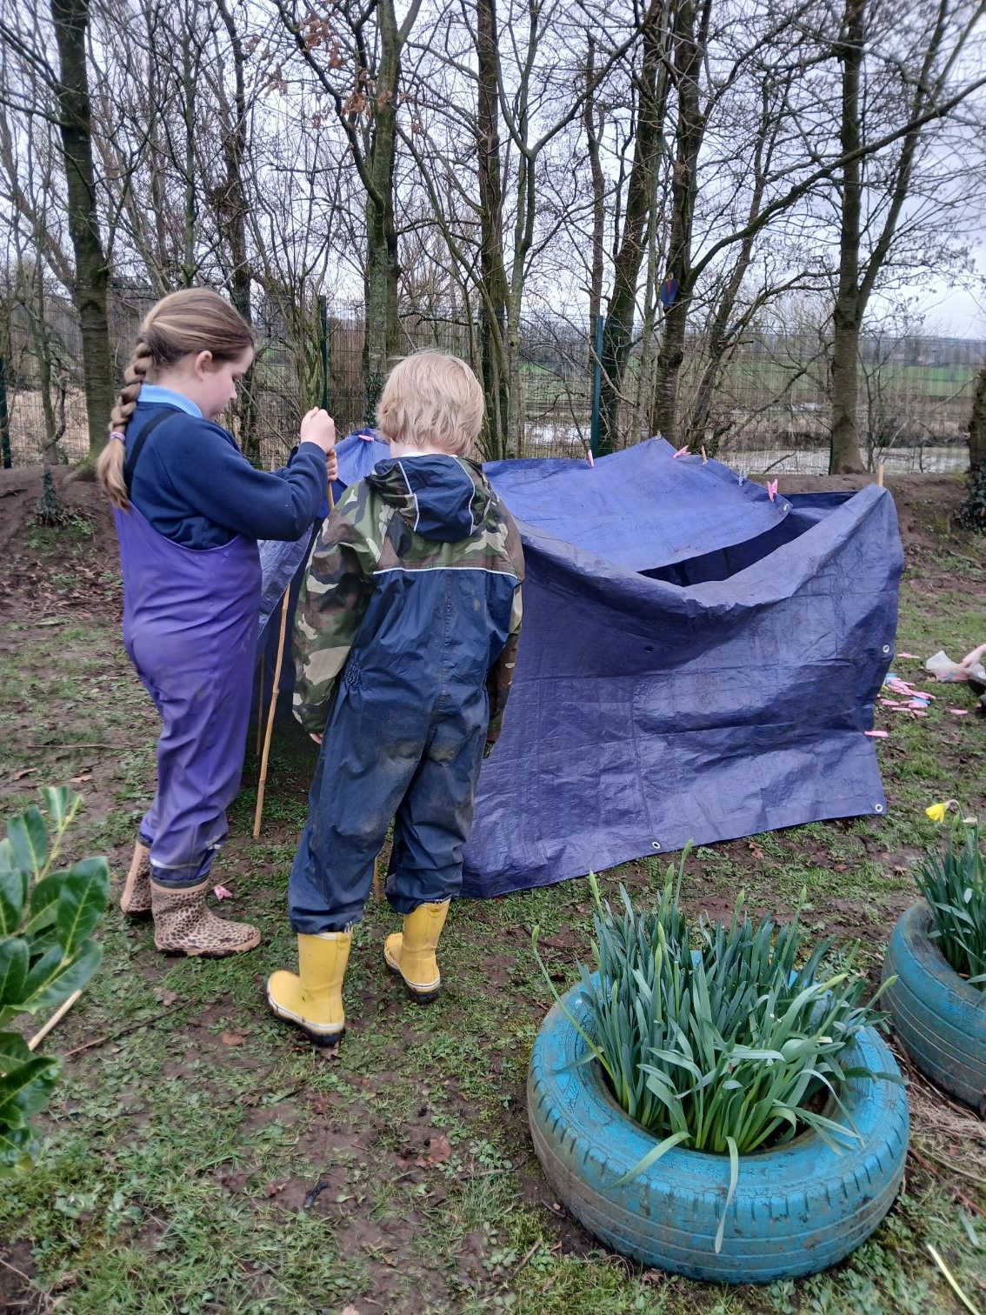
Den building
Today we are building dens – we used bamboo canes, tarpaulins and clothes pegs.

Slide 5
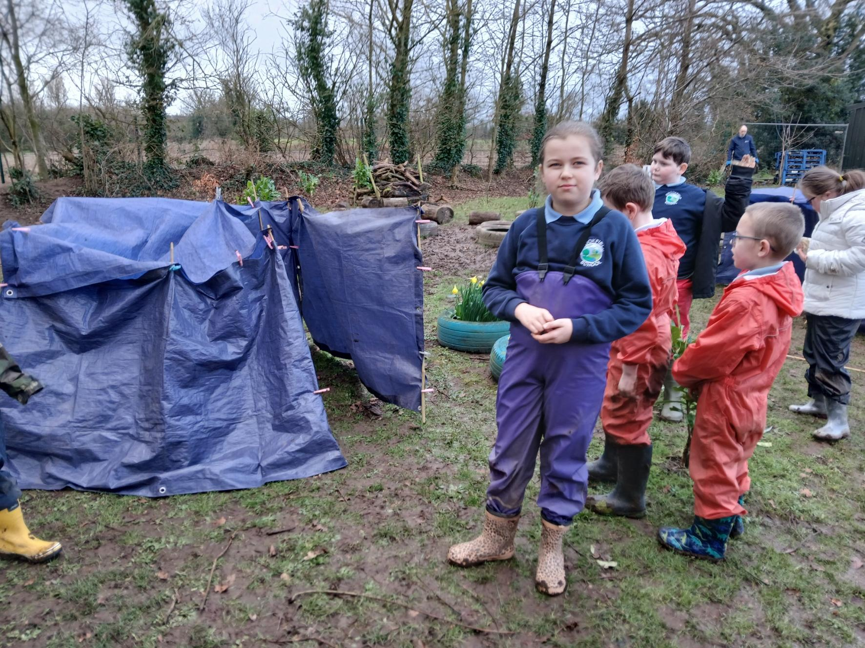
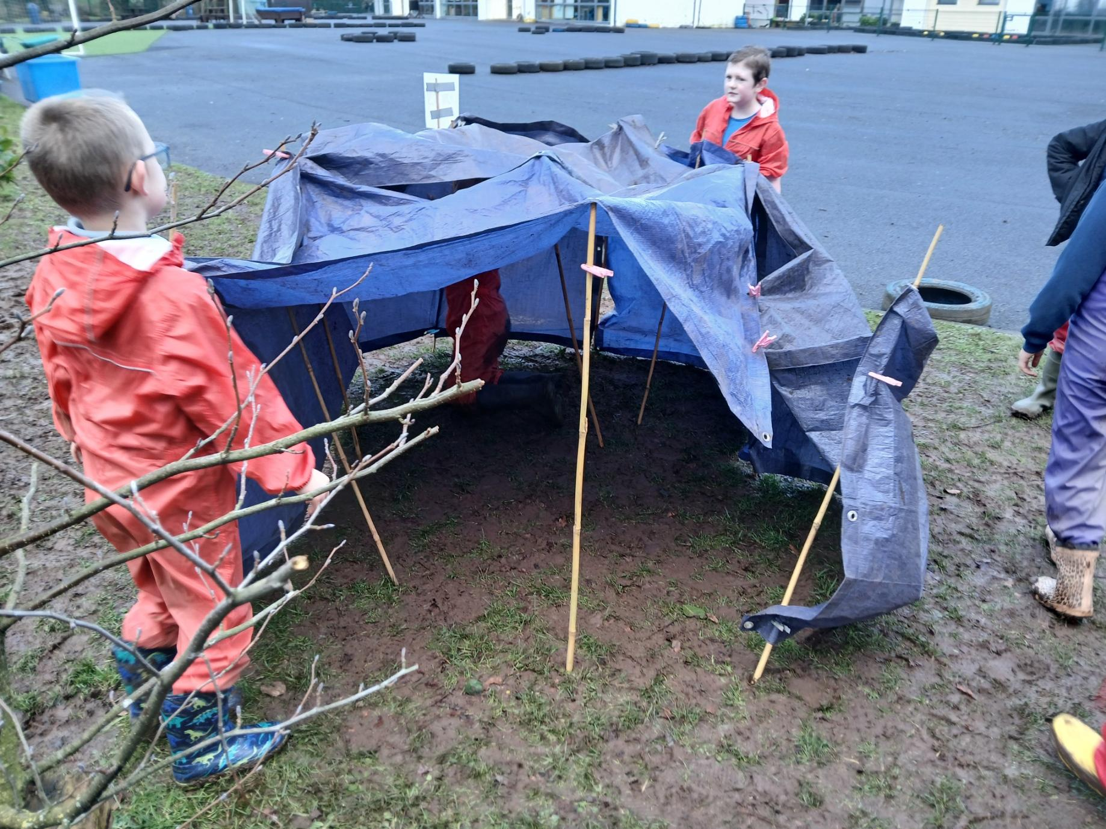
Den building
We tell the other groups about our dens.

Slide 6
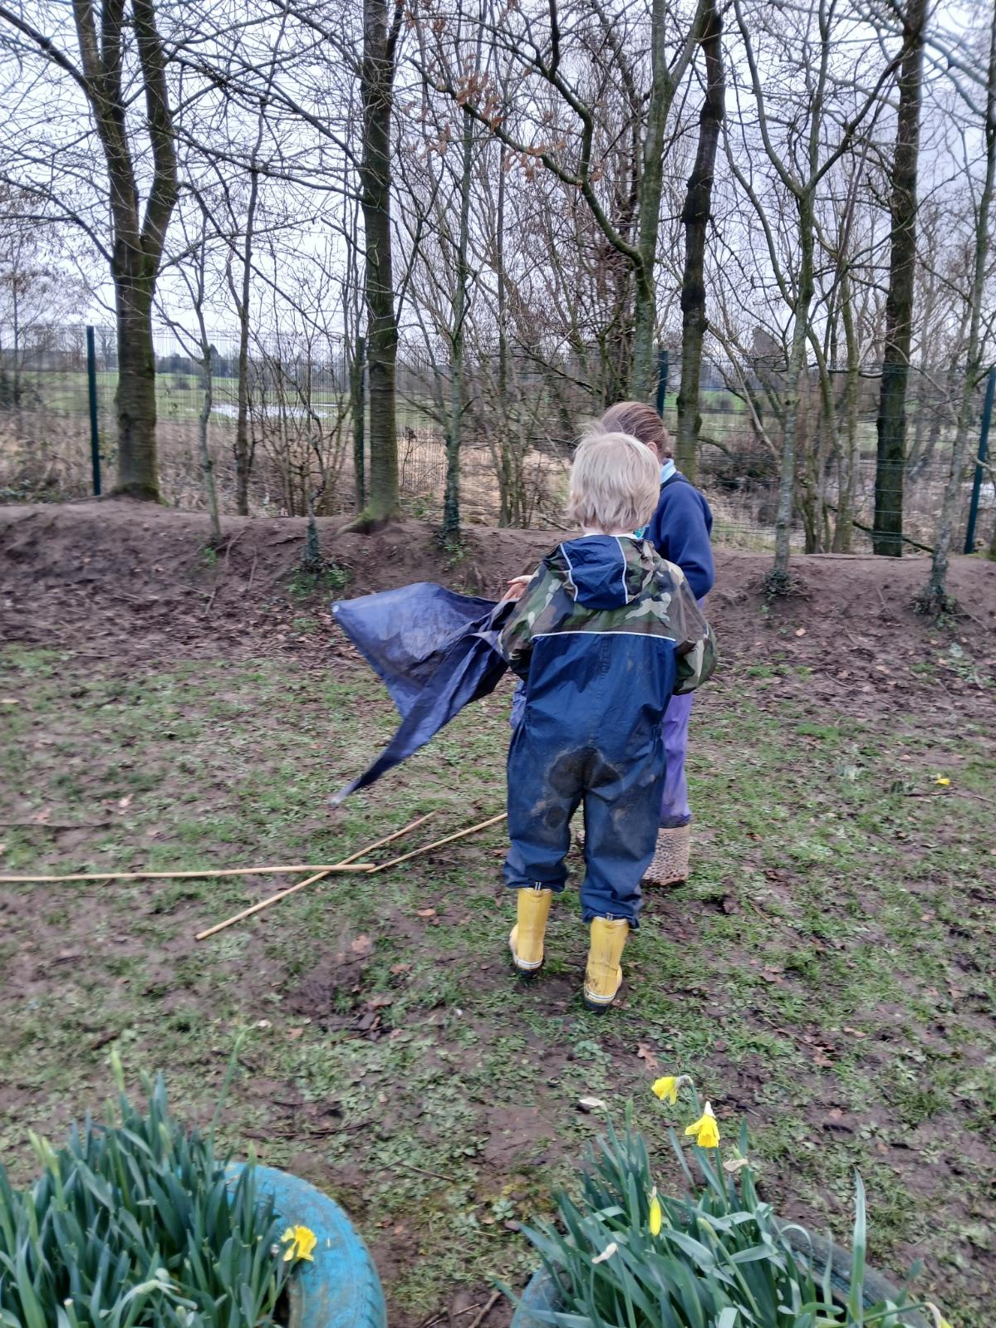
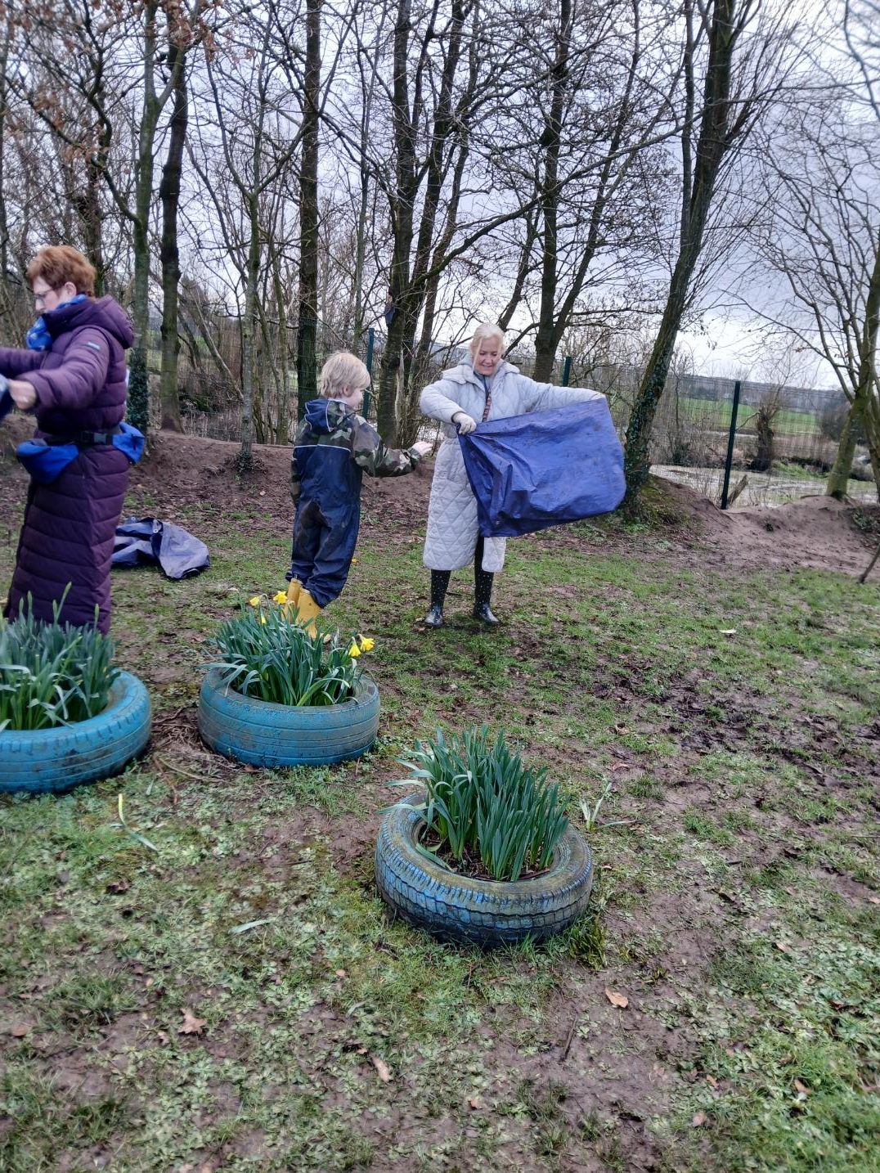
LEAVE NO TRACE
We put everything away and tidied our area to leave the place safe for the wildlife.
Great Teamwork!

Slide 7
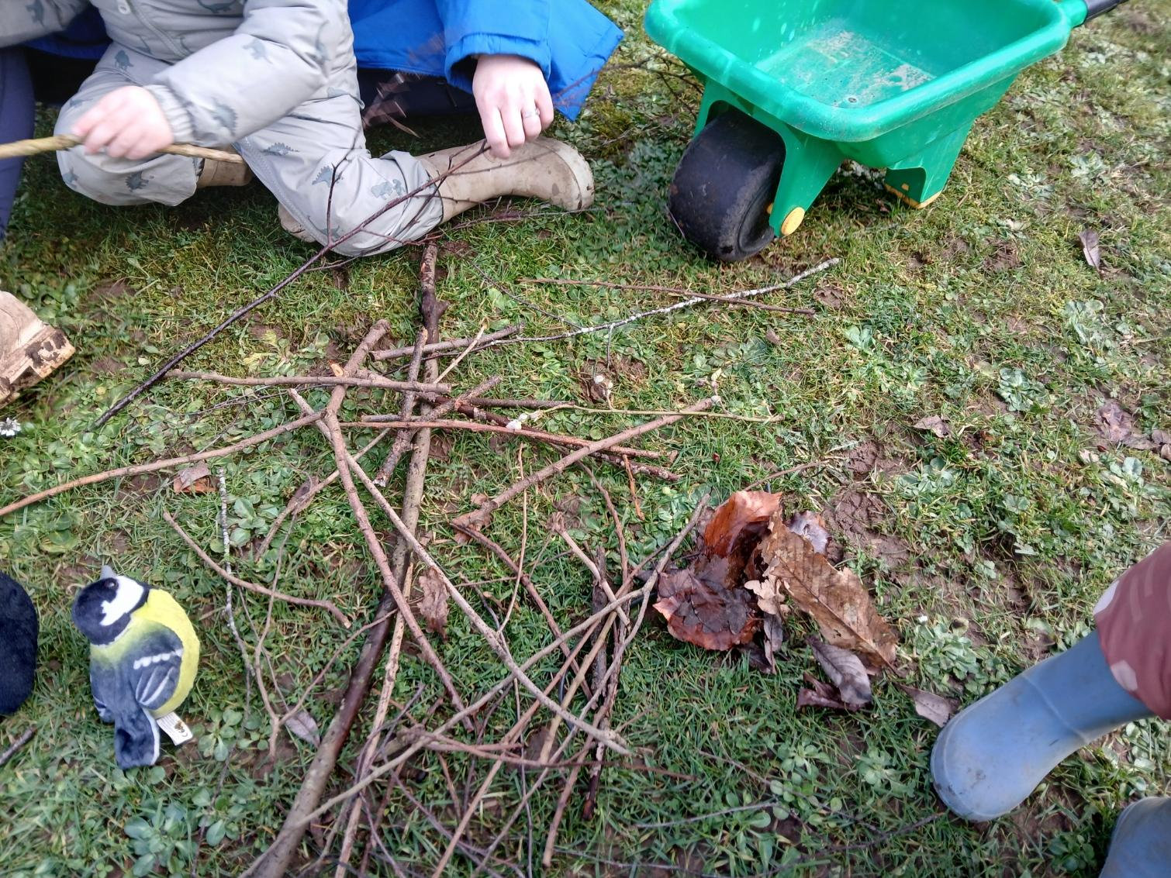
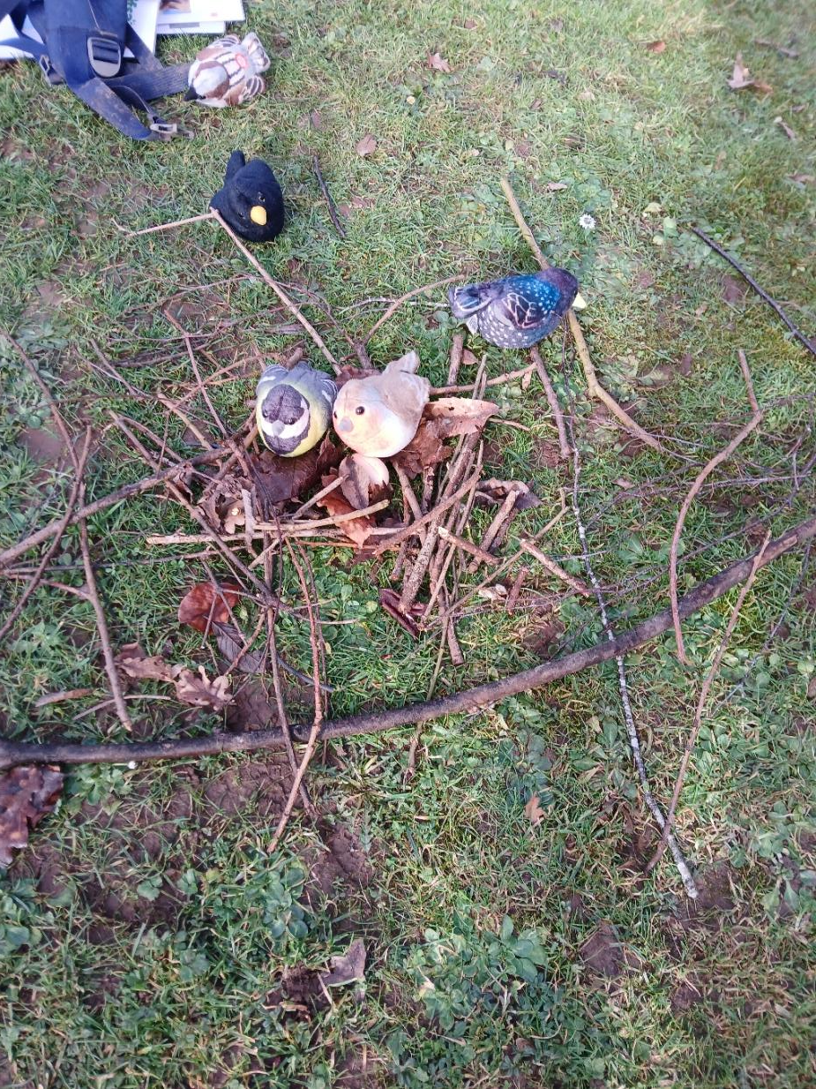
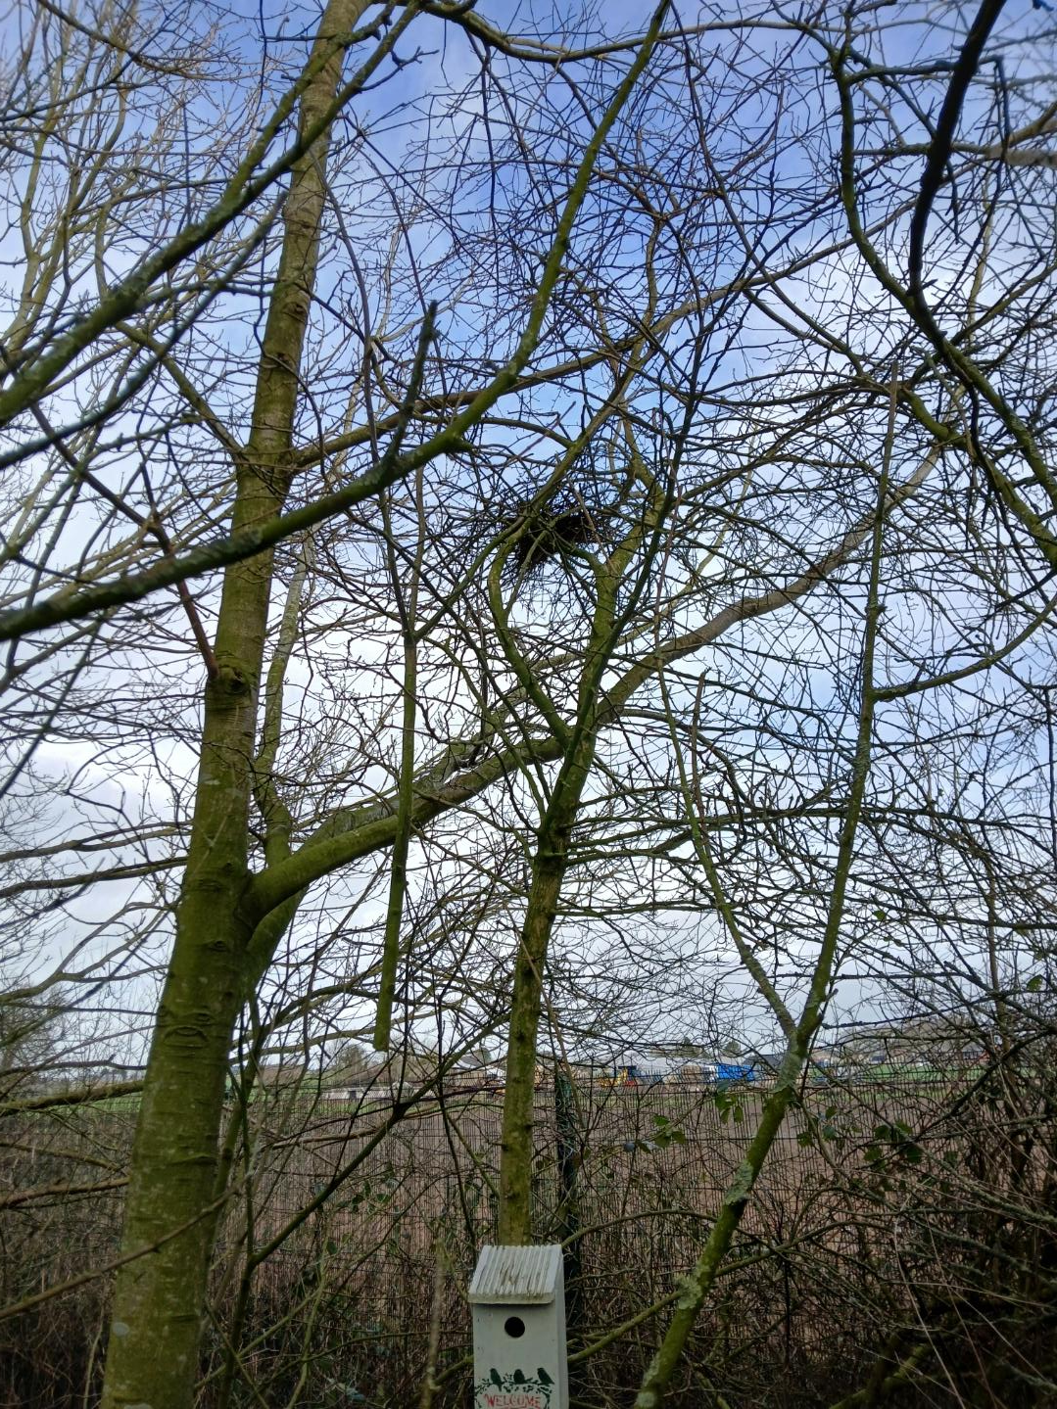
NESTS
We looked at some birds in our garden and talked about building a nest for them.
We went for a walk to find things to make our nests with.
We found a real nest up high in the tree.

Slide 8
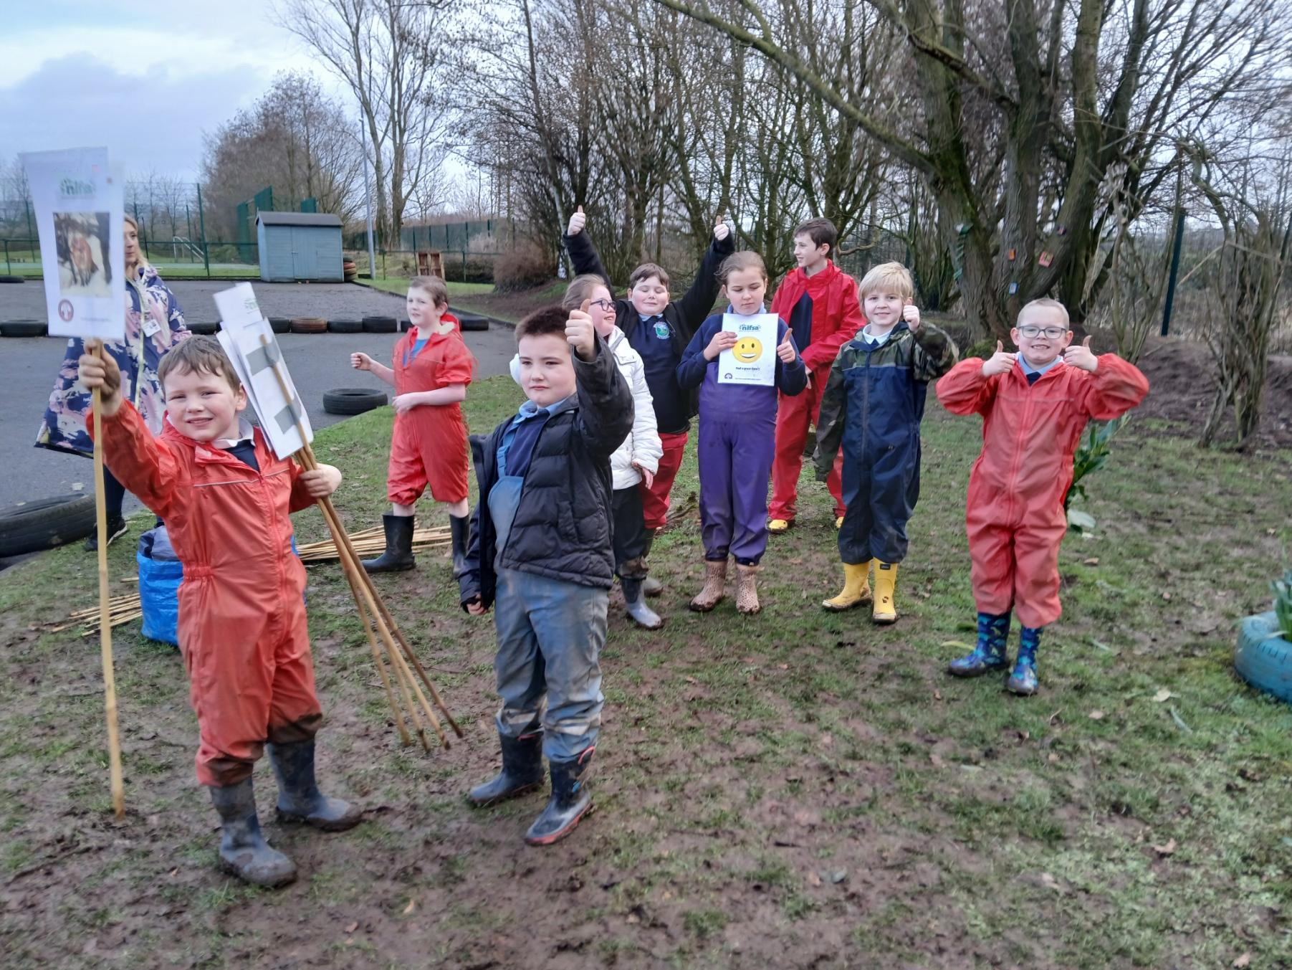
DID YOU ENJOY IT?
All smiley faces today.

