Slide 1


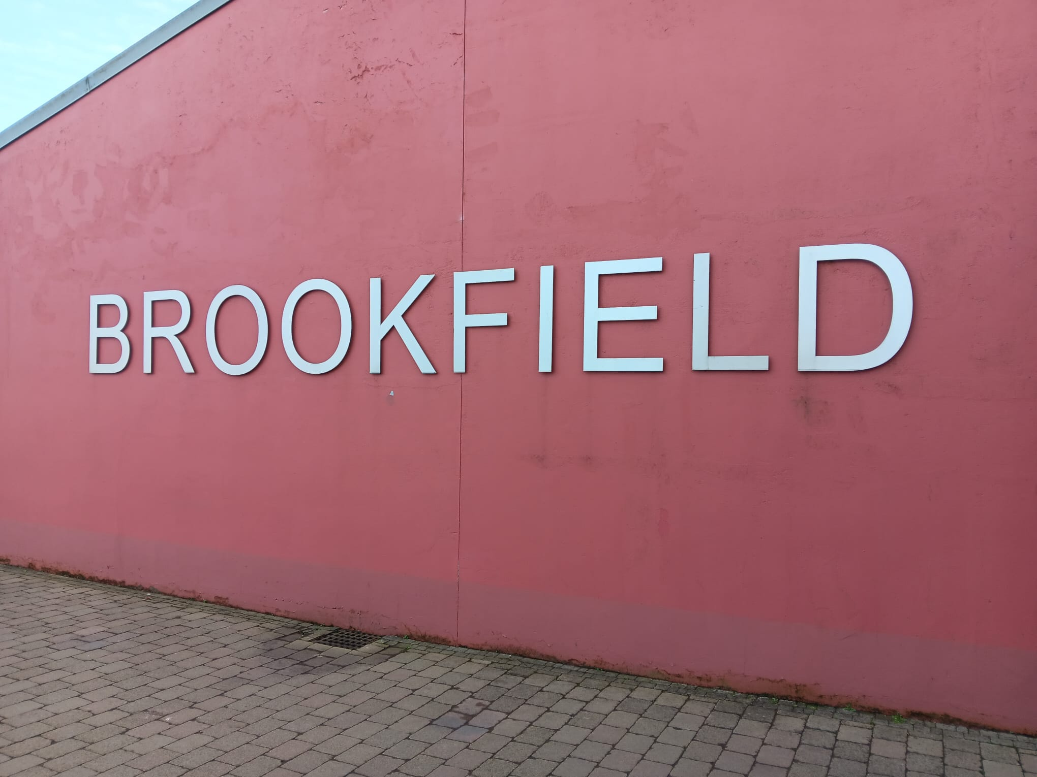

OUR FOREST SCHOOL DIARY Friday 27th Februry 2026
Brookfield Special School

Slide 2
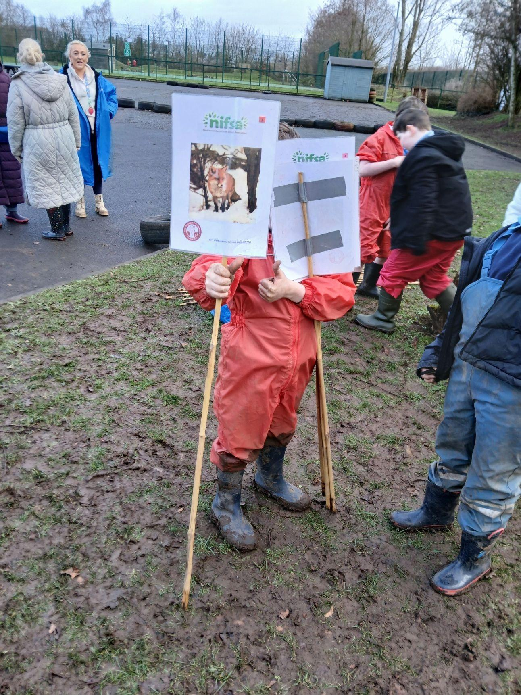
FOREST SCHOOL
We put our boundaries out so we knew where we could play.

Slide 3
RULES
We go over our Forest School rules:
1 whistle: stop
2 whistles: back to base
3rd rule: have fun and learn

Slide 4

Fire
We learnt about the 3 things we need to light a fire!

Slide 5
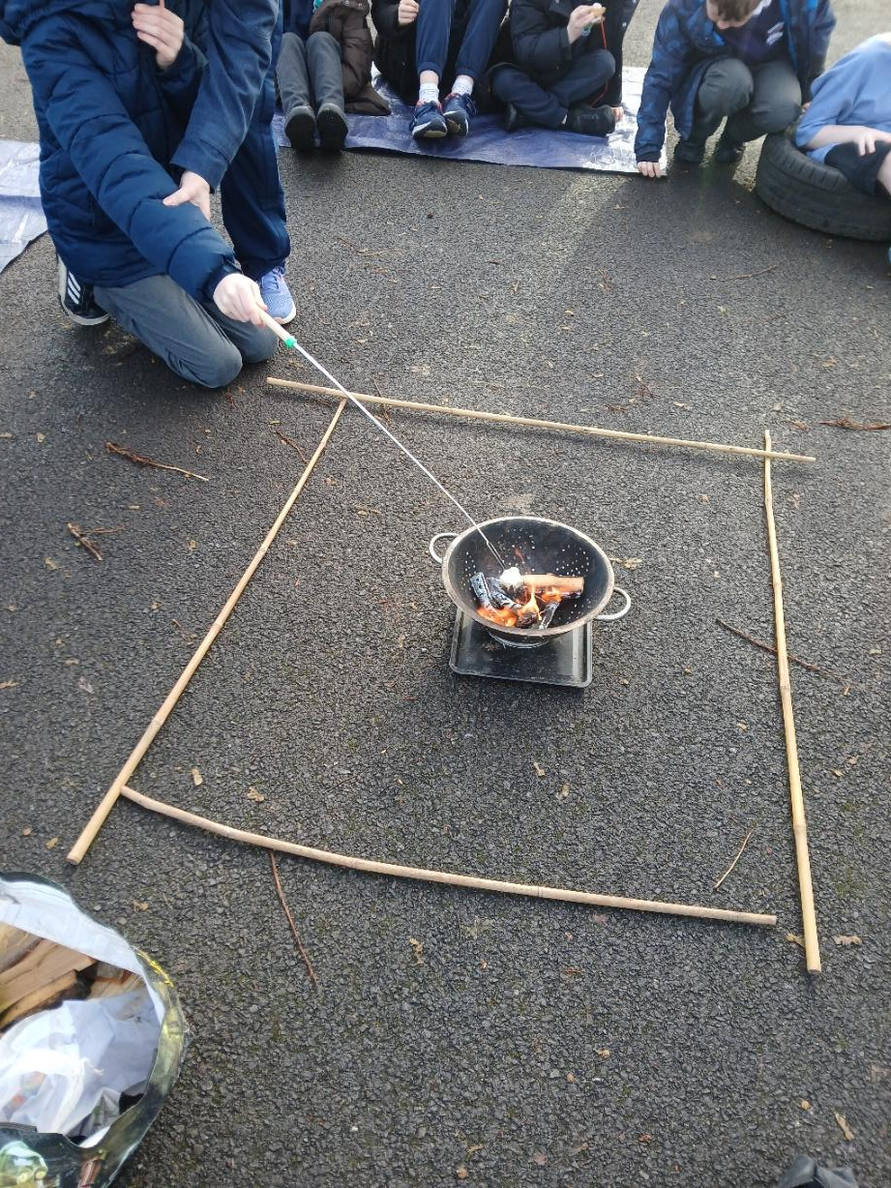
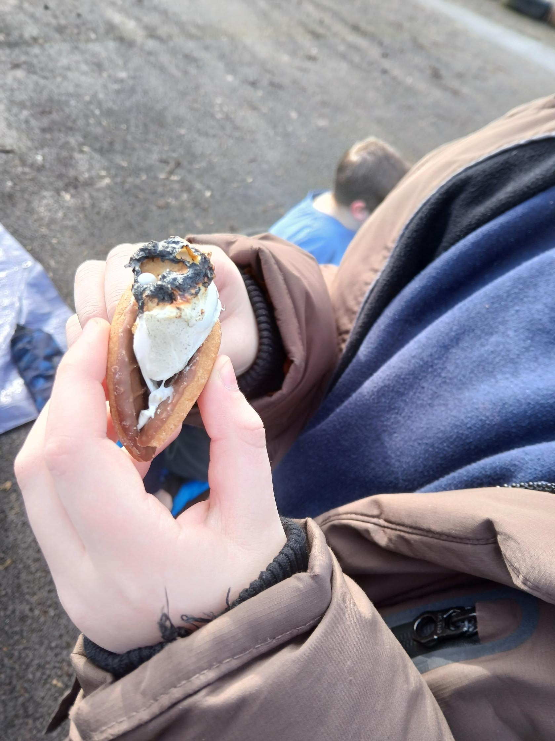
Fire
We toasted marshmallows.
We made some smore’s.
Best bit was eating them!

Slide 6
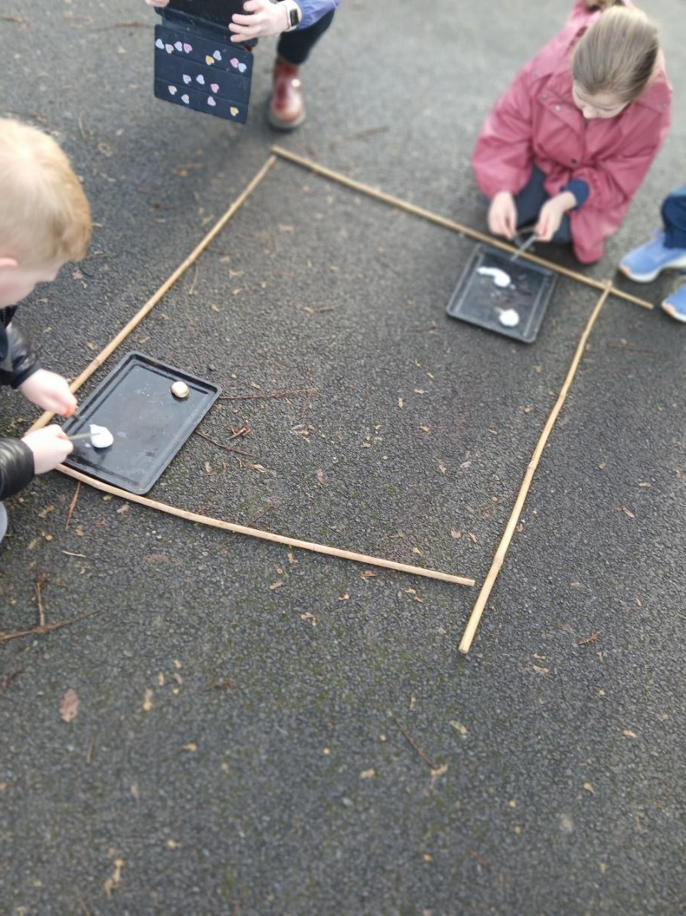
Fire
We practiced using the fire rods and lighting the cotton wool.

Slide 7
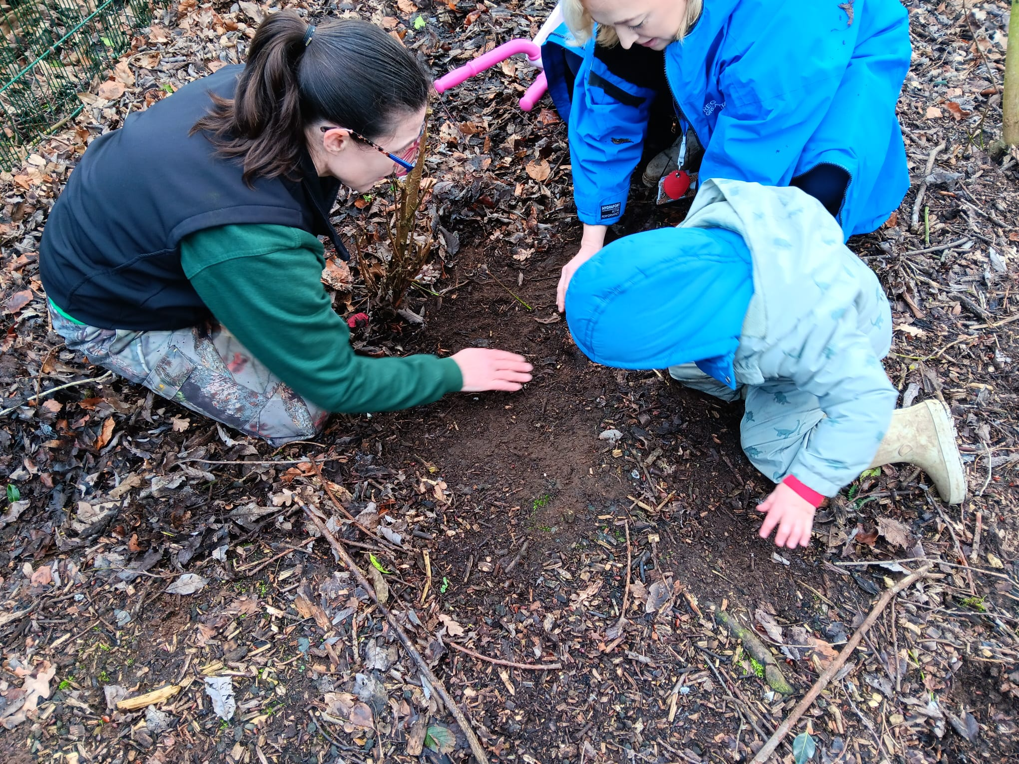
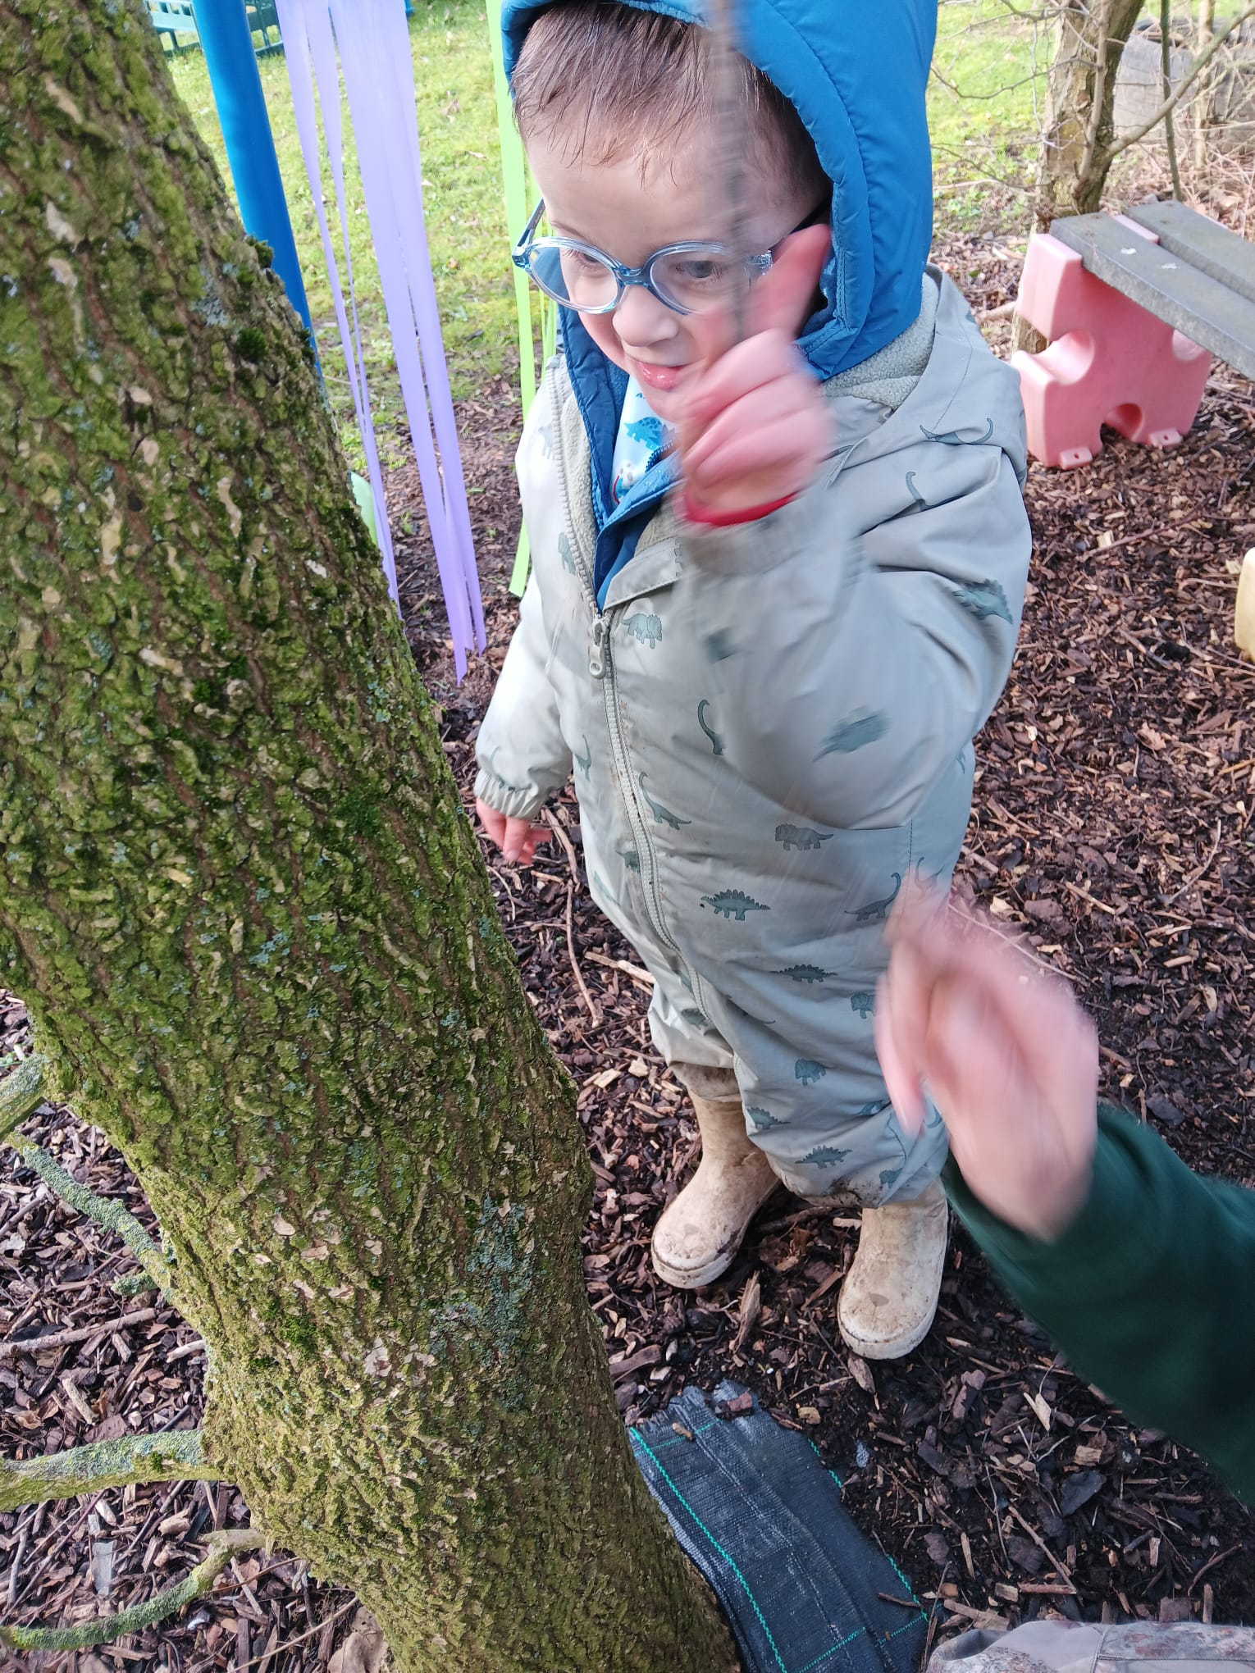
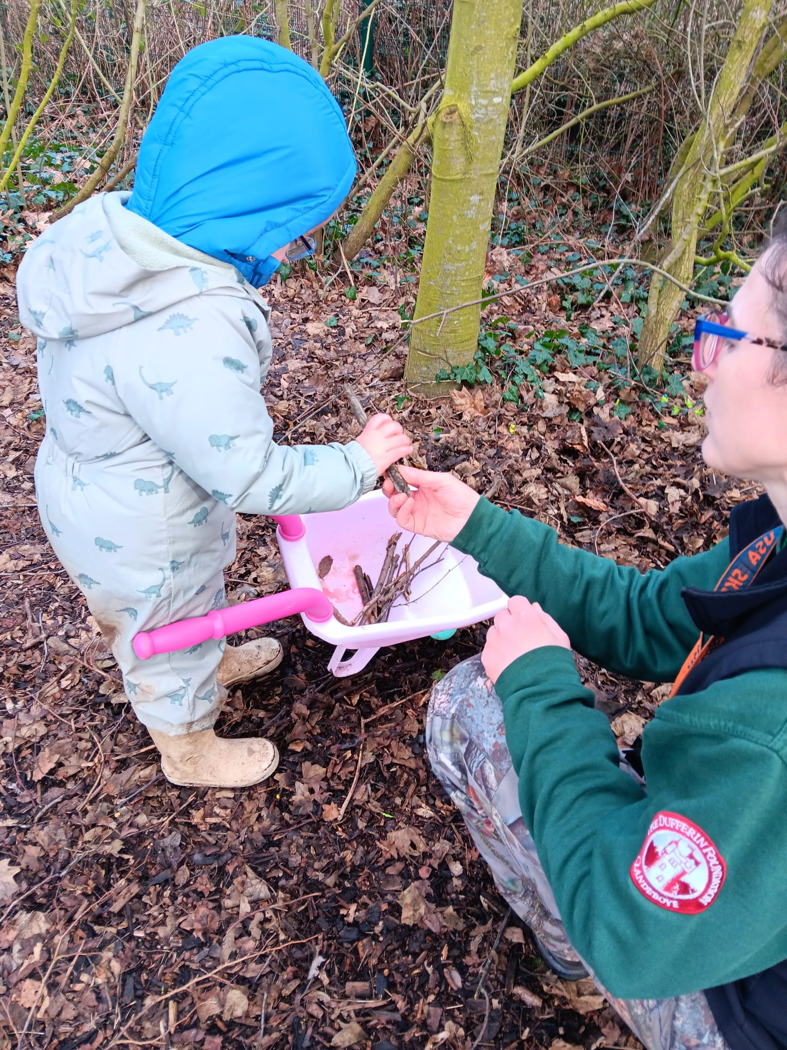
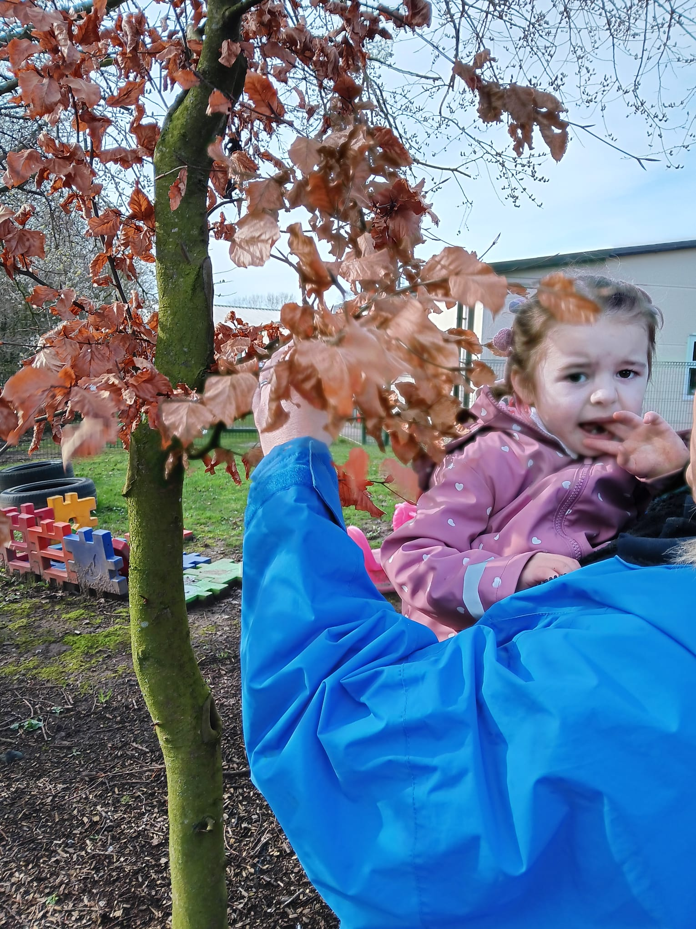
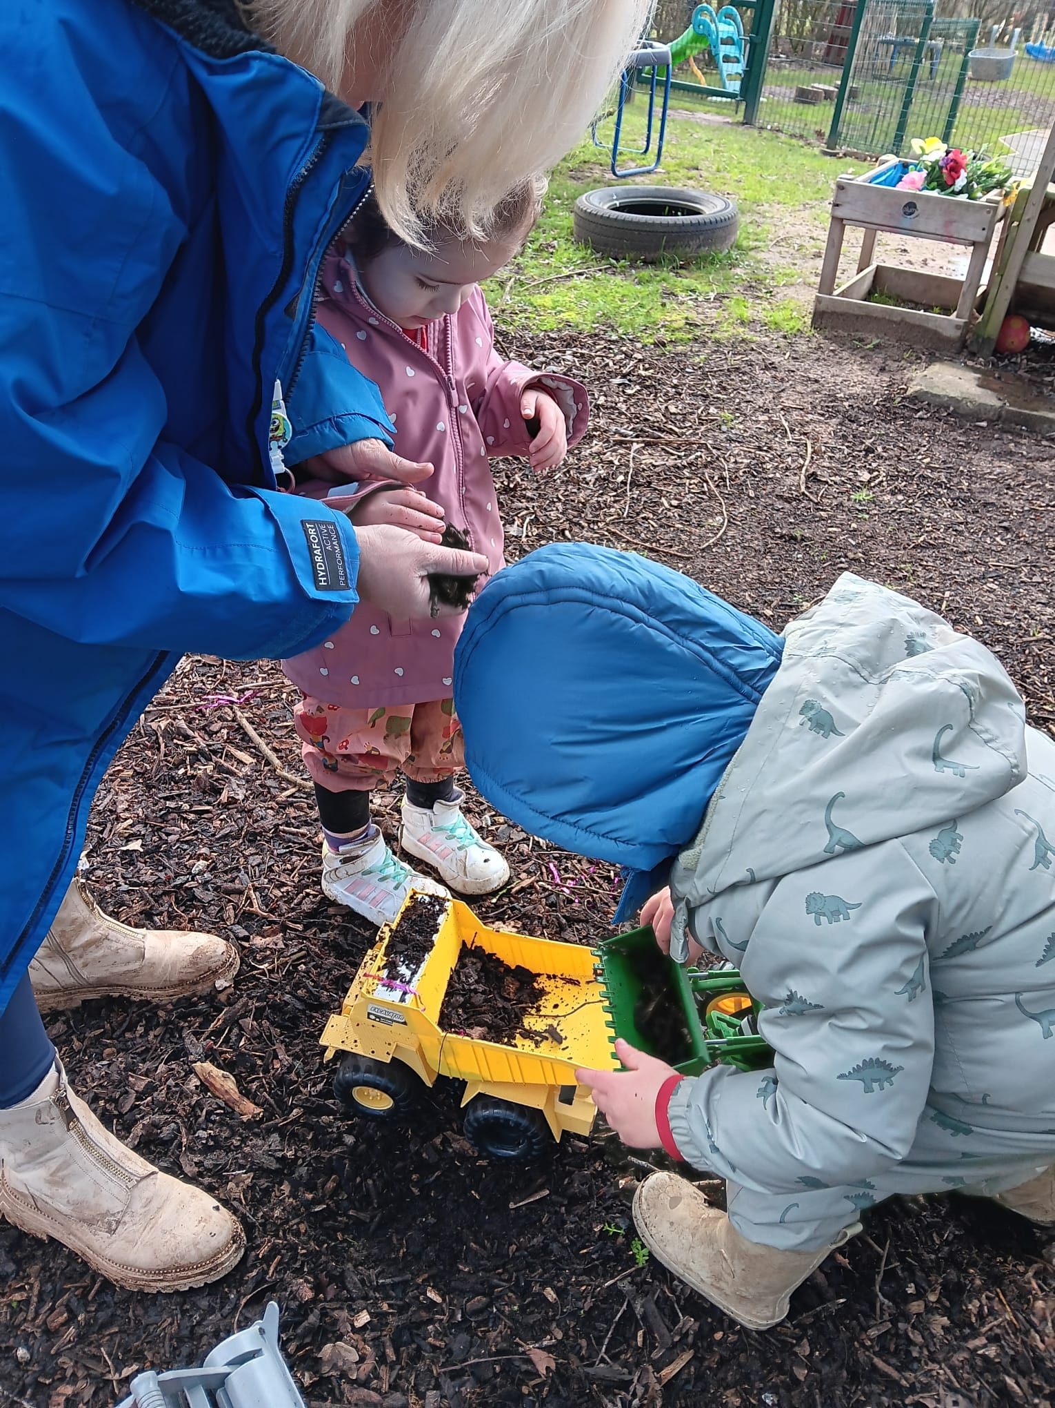
Exploring Nature
We explored our garden area.
We collected some sticks and leaves to make noise .
We did some digging.

Slide 8
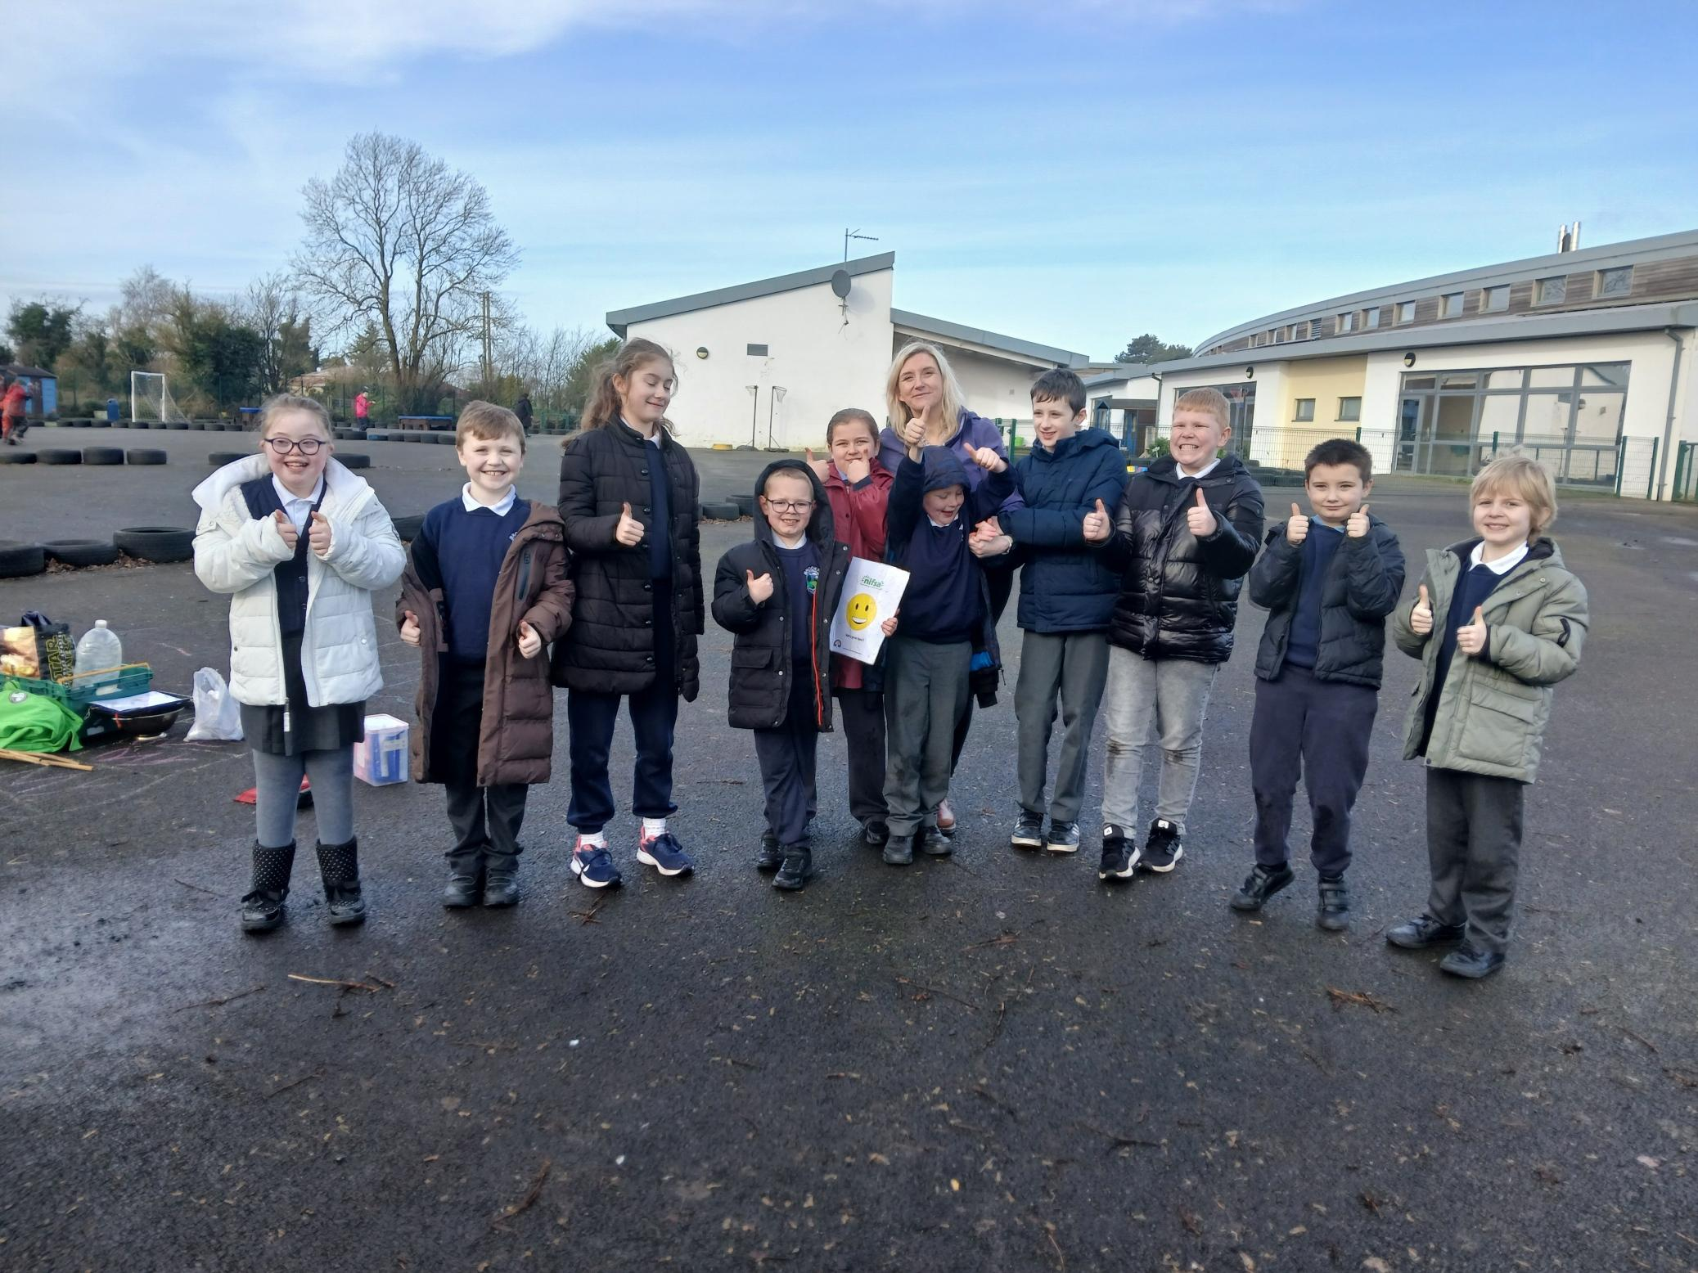
DID YOU ENJOY IT?
All smiley faces today.

