Slide 1
P4F Adding and subtracting 1 and 10 outdoor hunt
Maths week activity

Slide 2

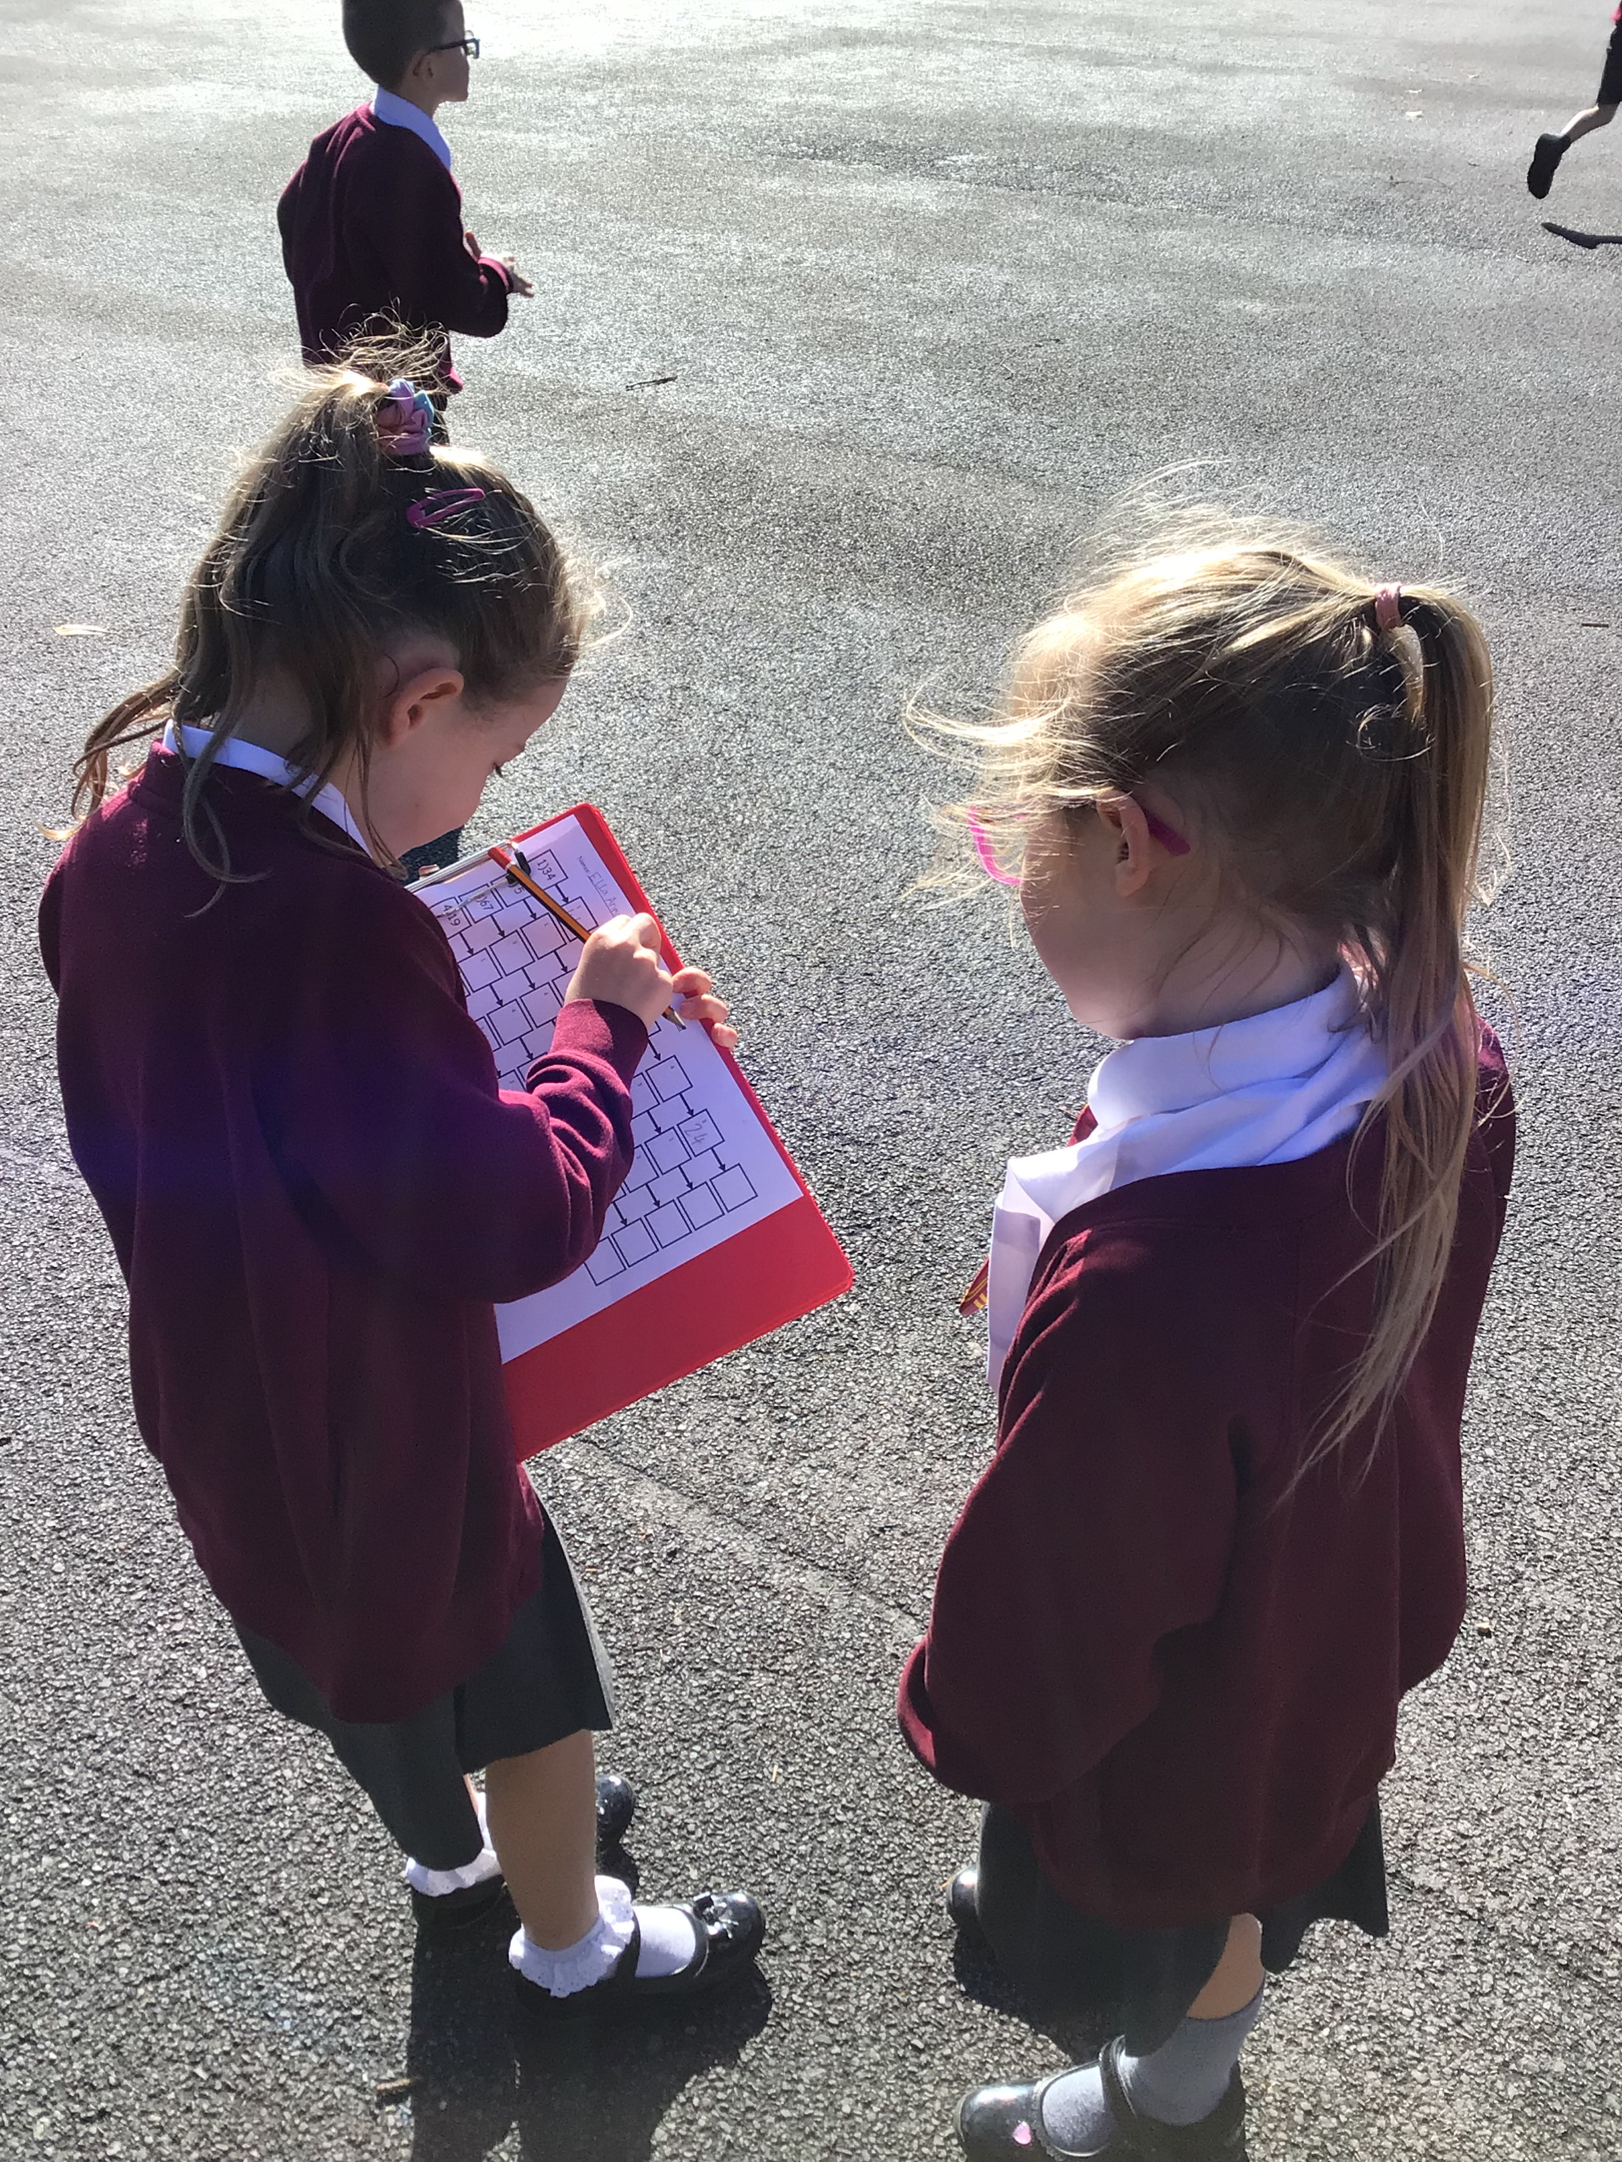
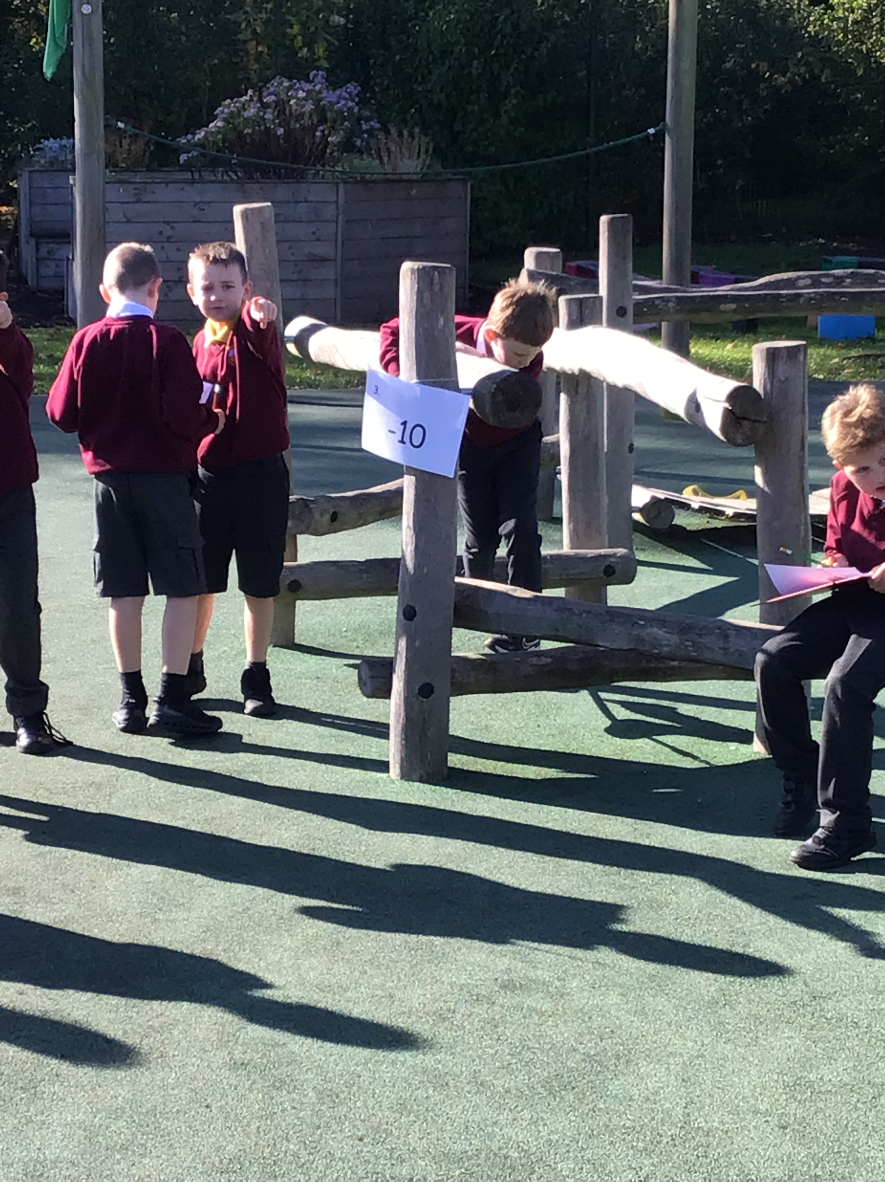
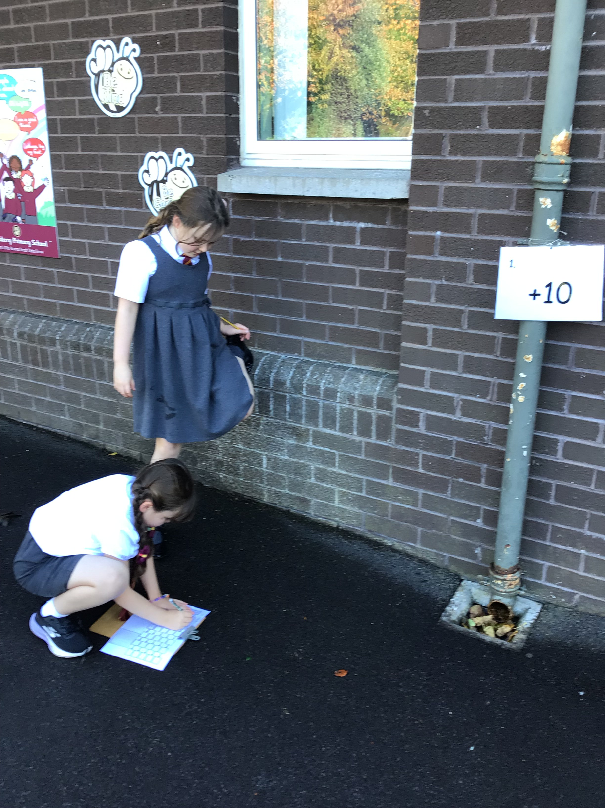
P4 enjoyed hunting to find the action to complete the chain. They worked with their partner.

Slide 3
