Slide 1
Primary 2
Forest School Diary 2024/2025
Mrs Gamble

Slide 2
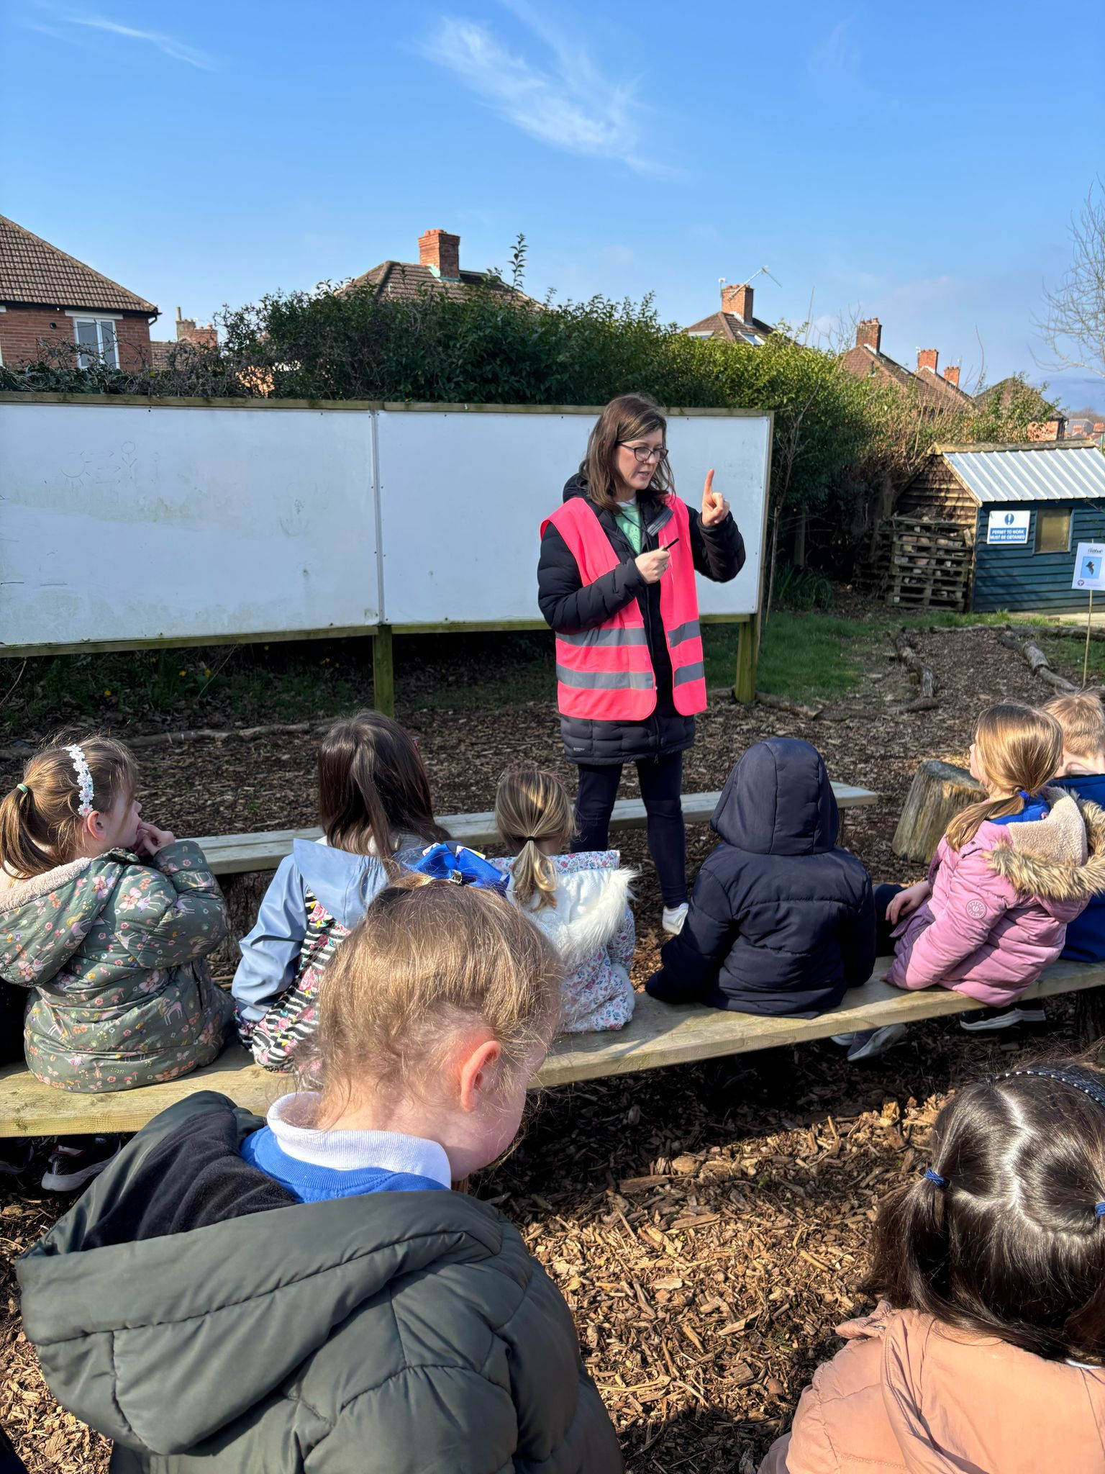
Lesson 6 – Wednesday 19th March 2025
We met in our circle, to talk about our activity and our forest school rules.
1 whistle – freeze
2 whistles – return
Agreed to have fun, learn and leave no trace

Slide 3
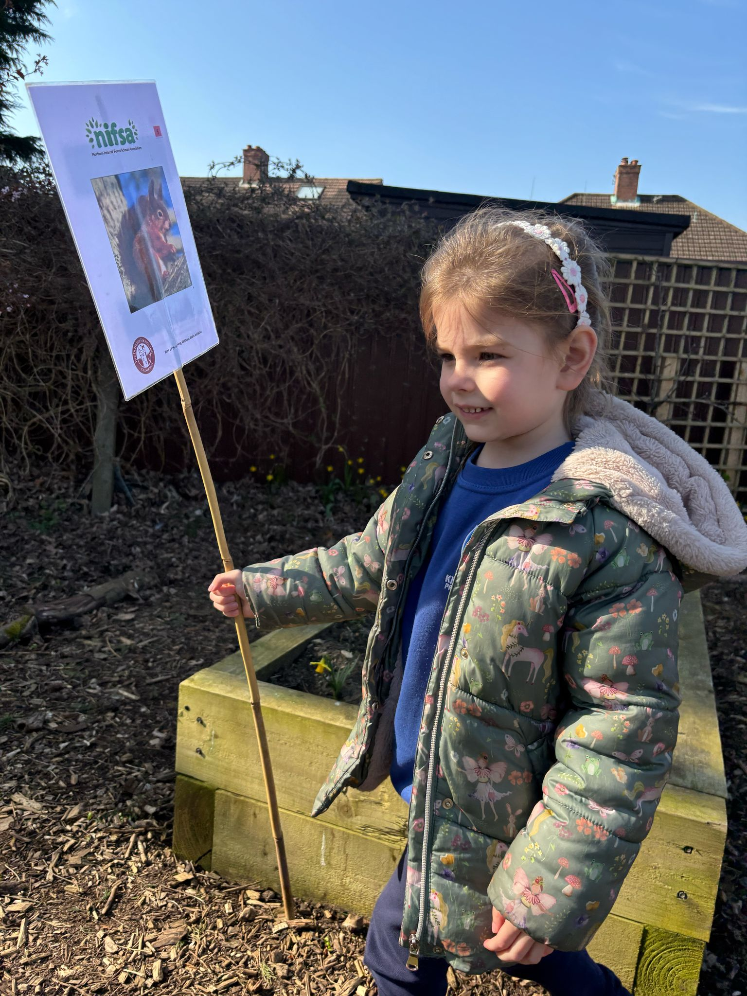
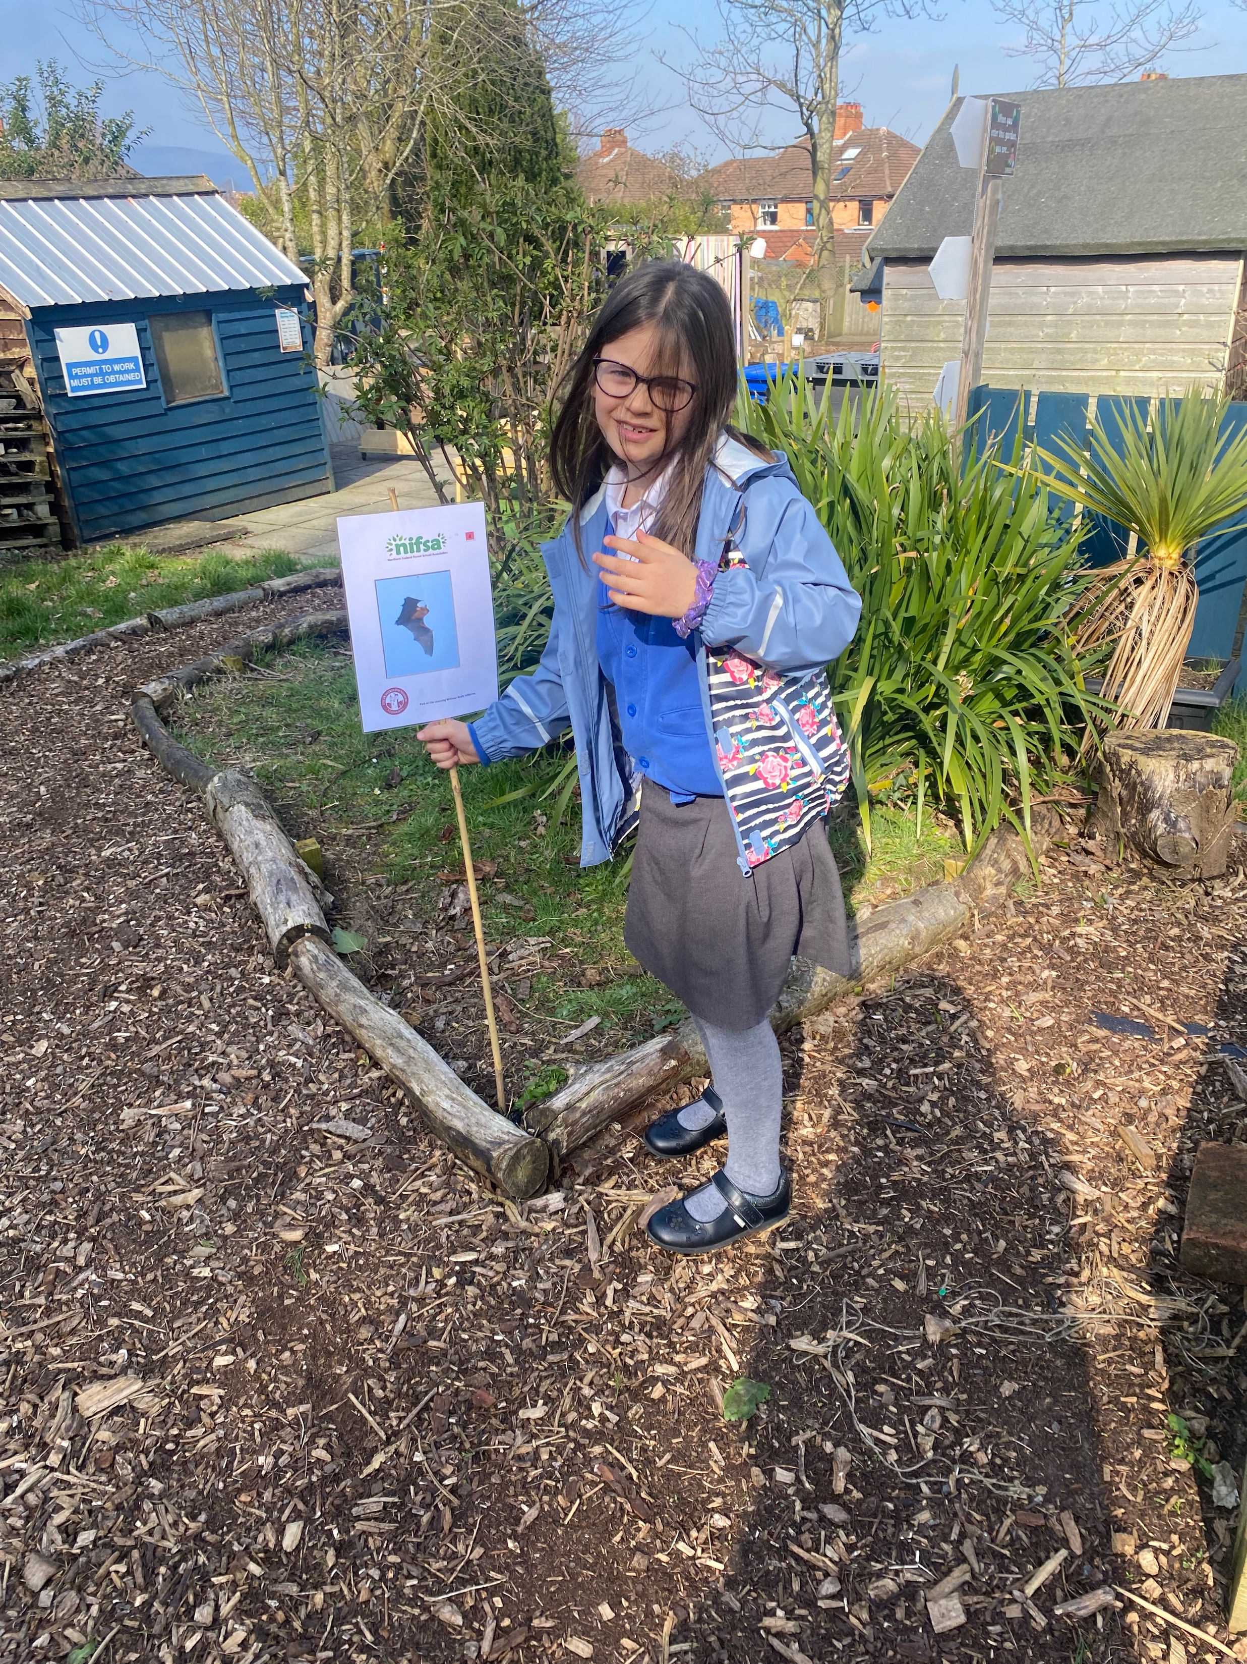
Setting up Boundary flags.
Volunteers set our boundaries.

Slide 4
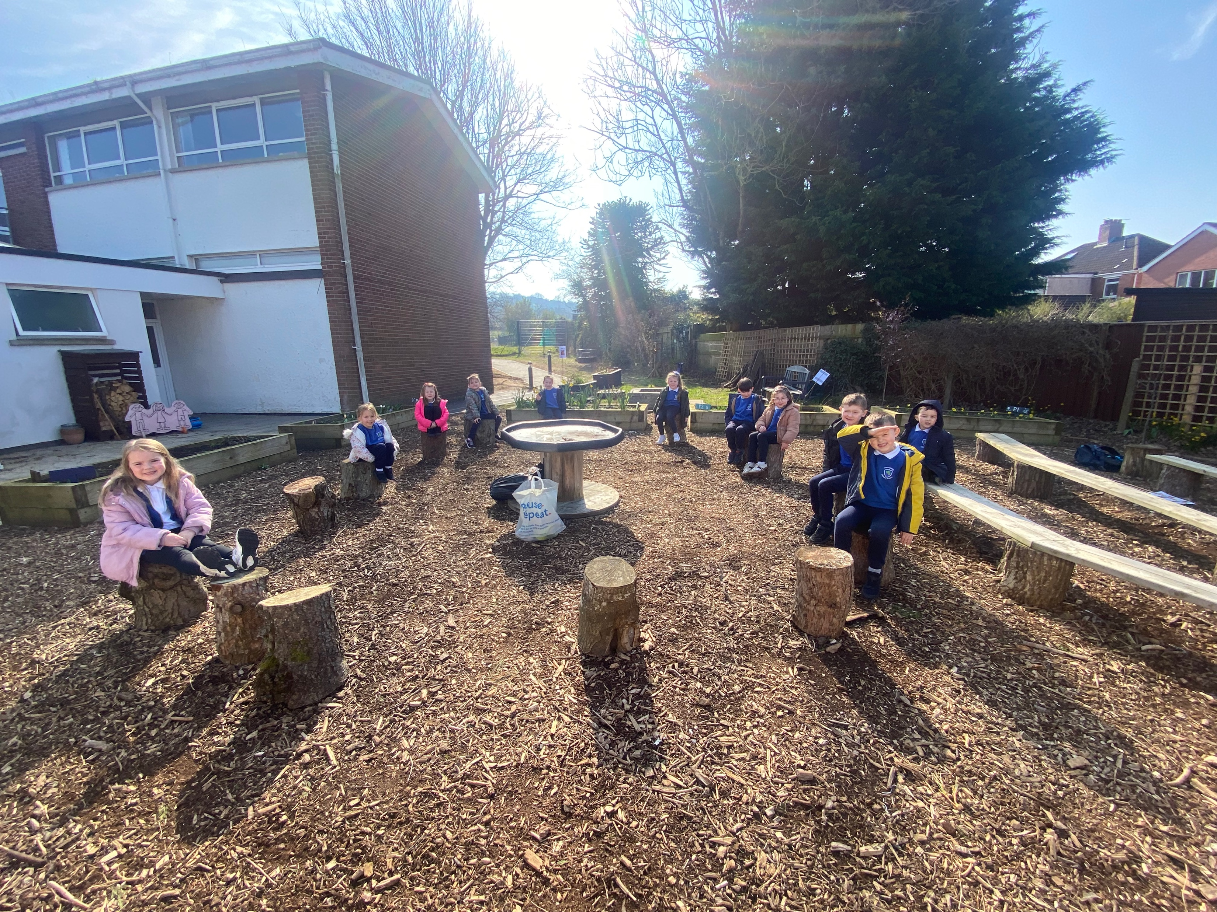
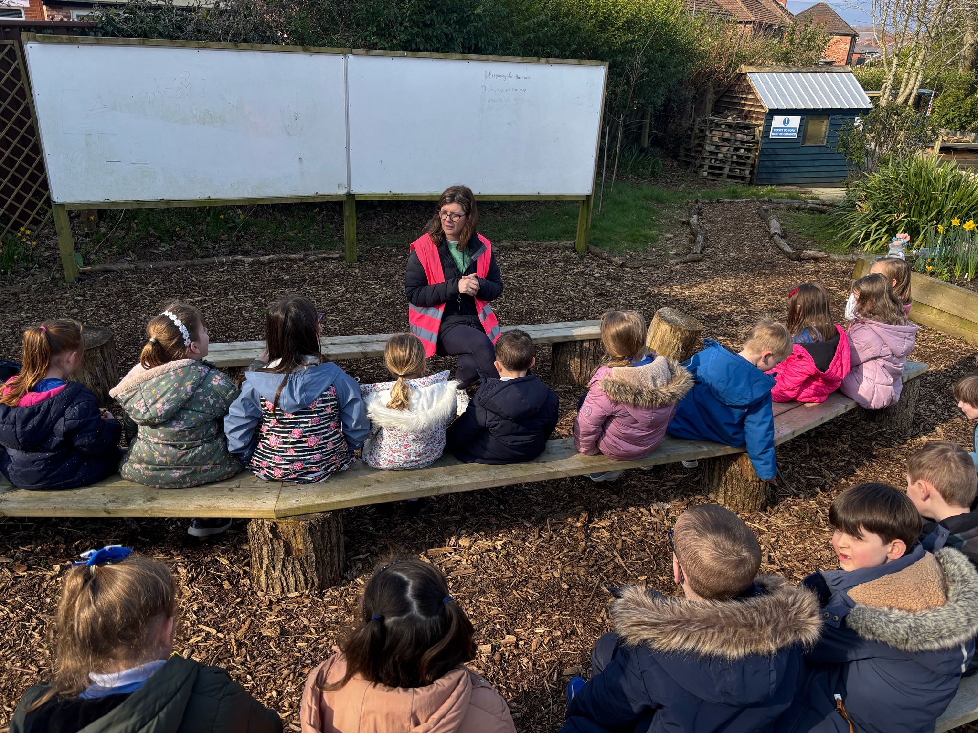
Finding out about our activity.

Slide 5
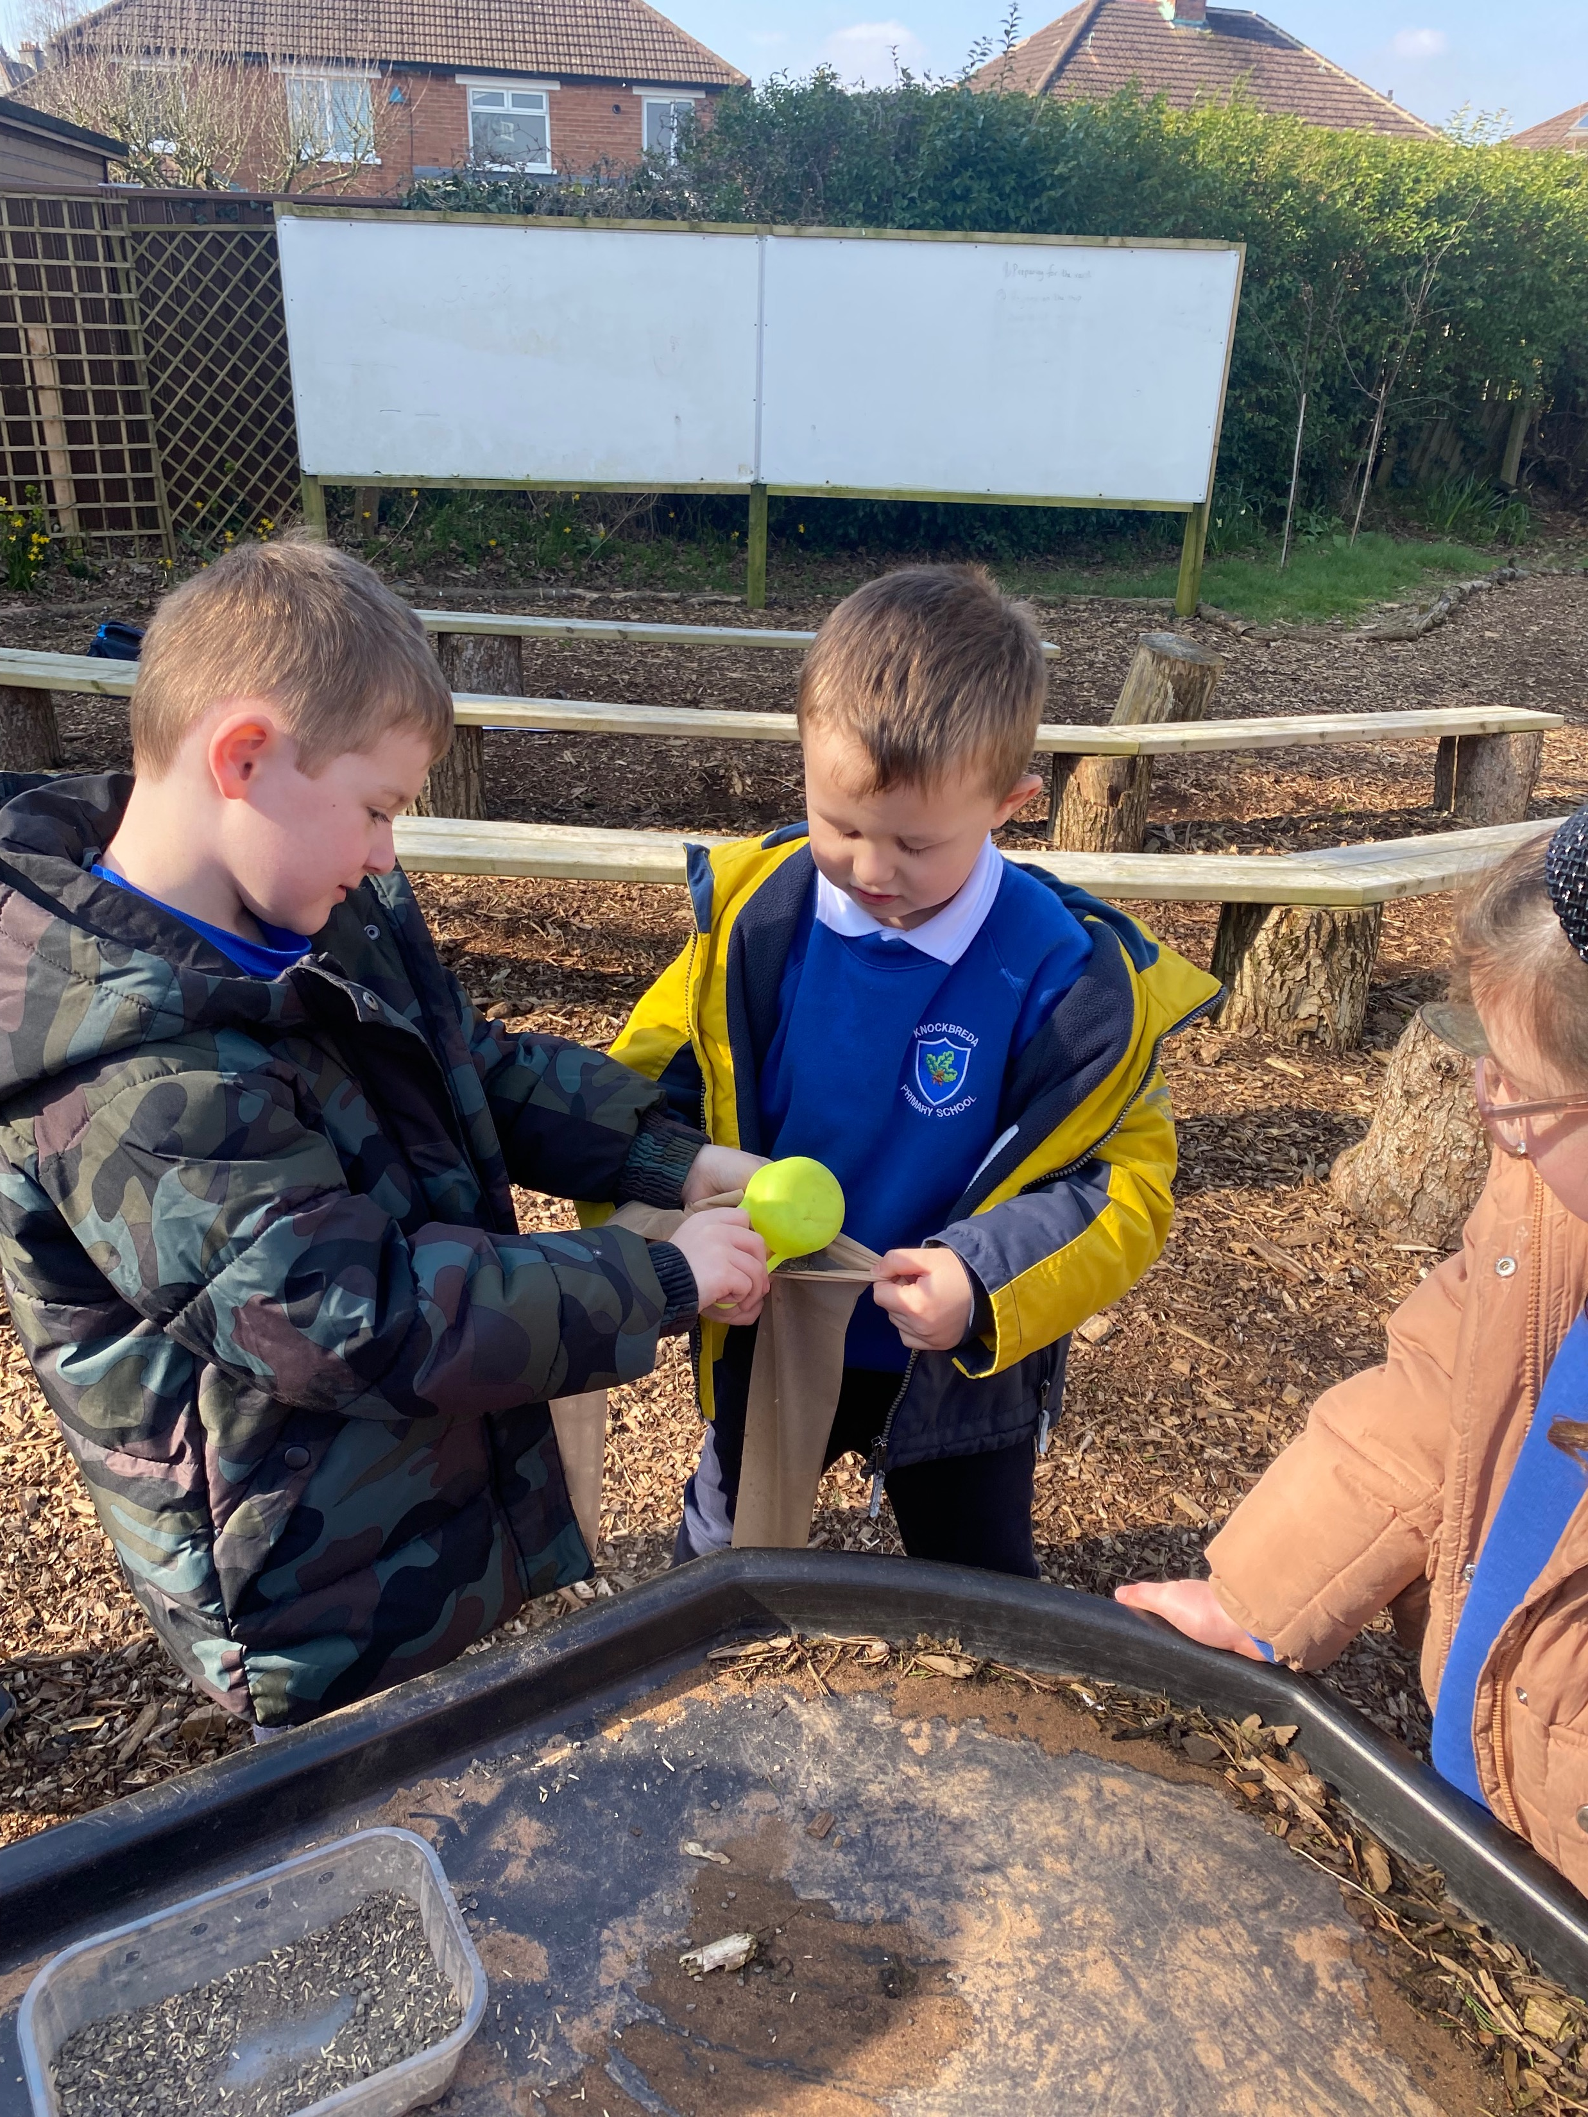
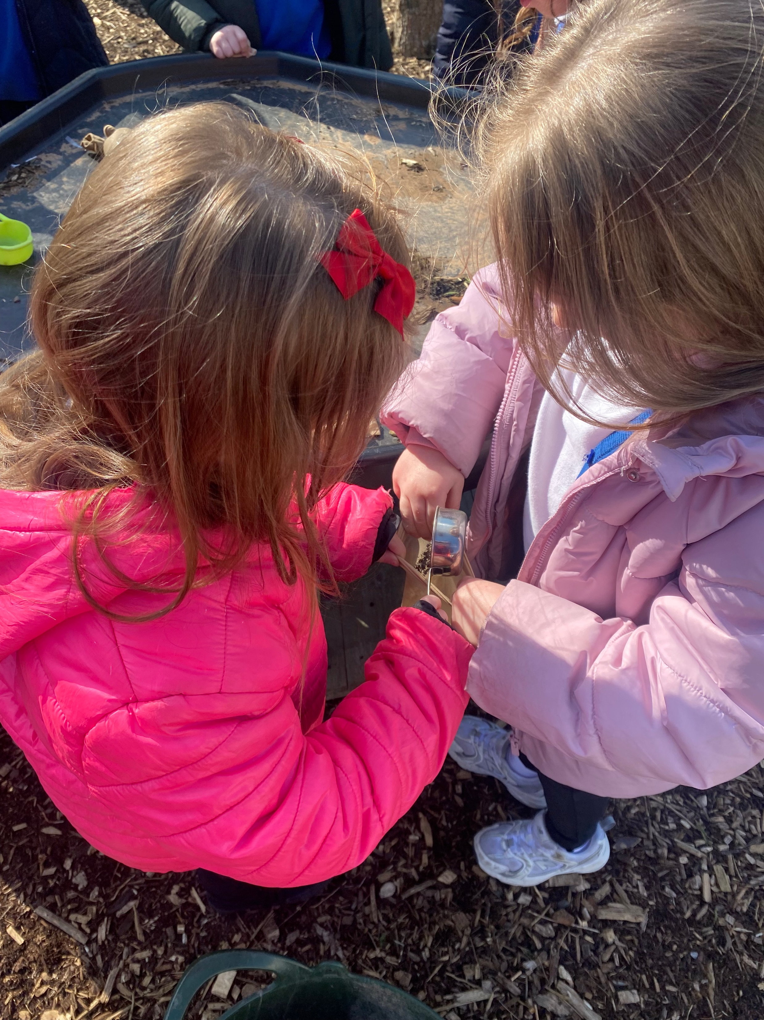
Working In pairs to help each other fill their socks with seeds and soil.

Slide 6
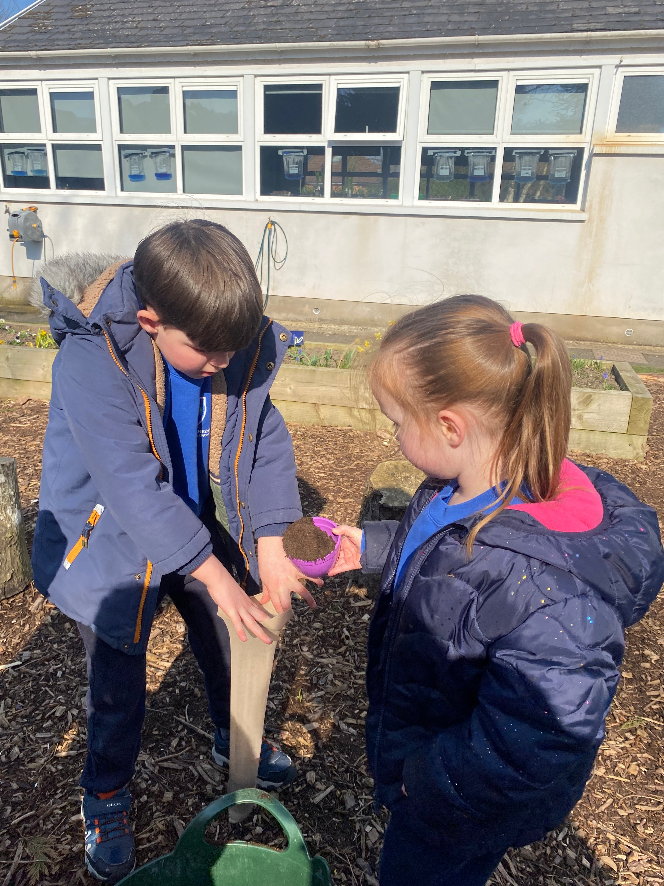
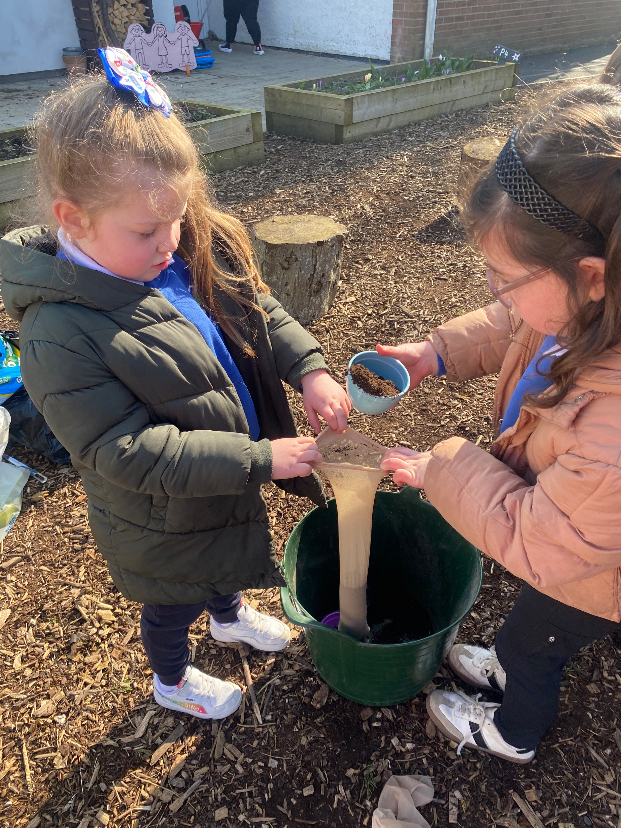
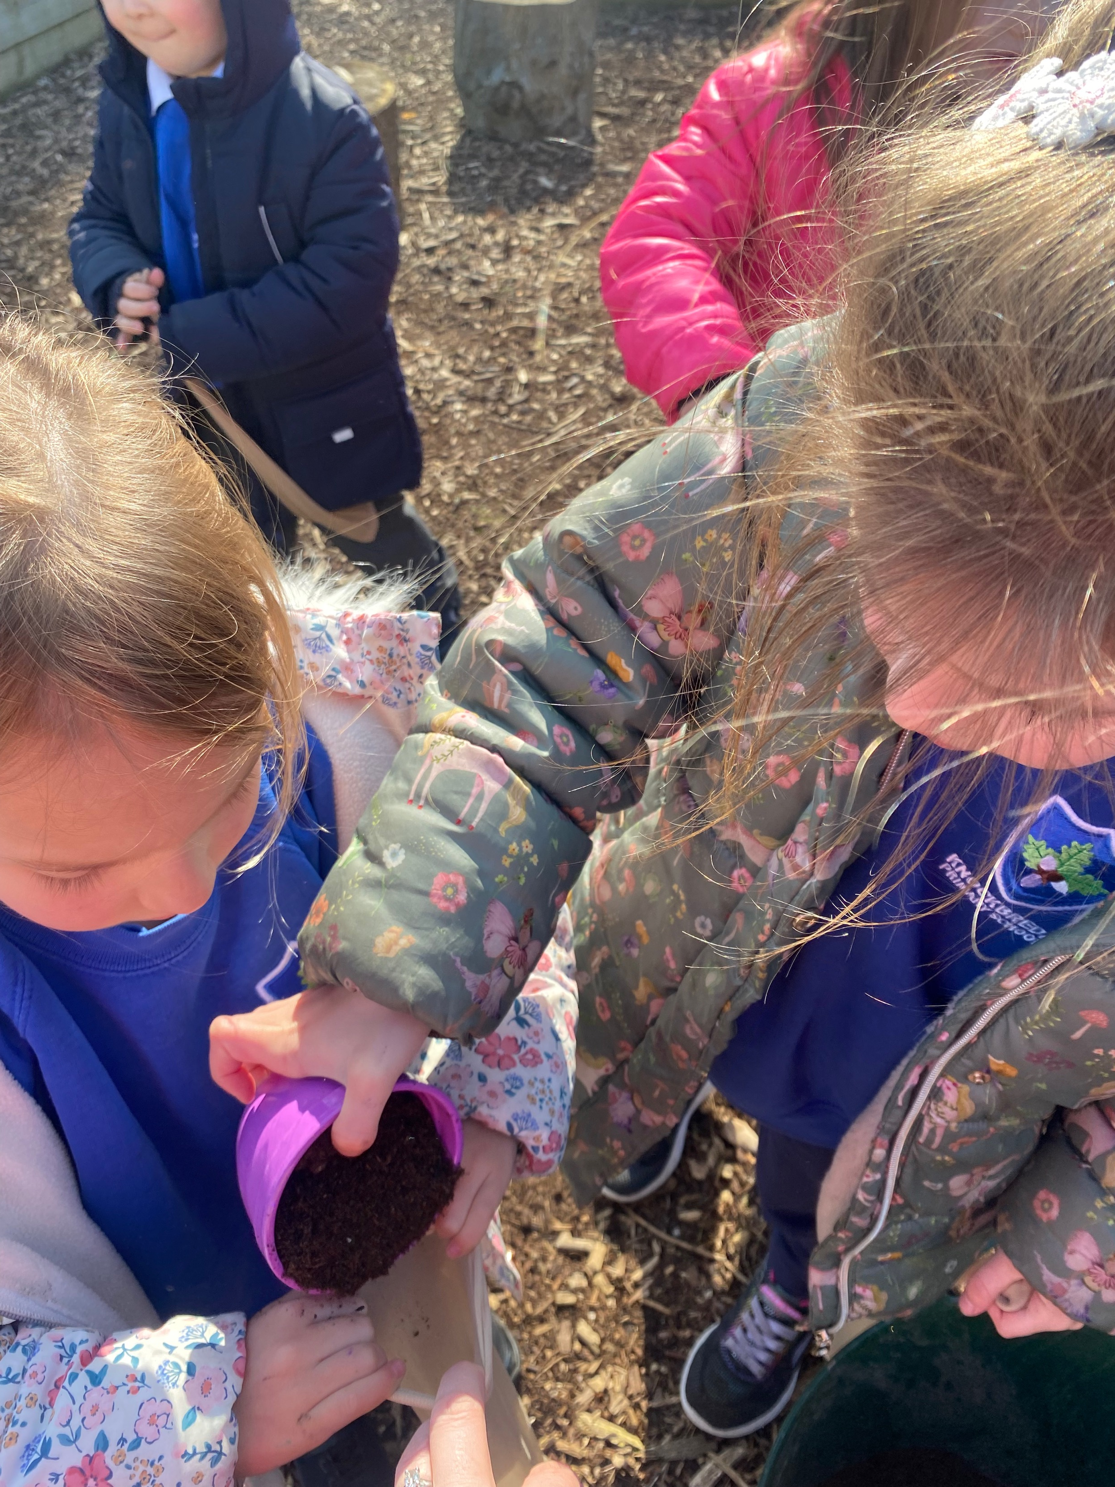
Working In pairs to help each other fill their socks with seeds and soil.

Slide 7
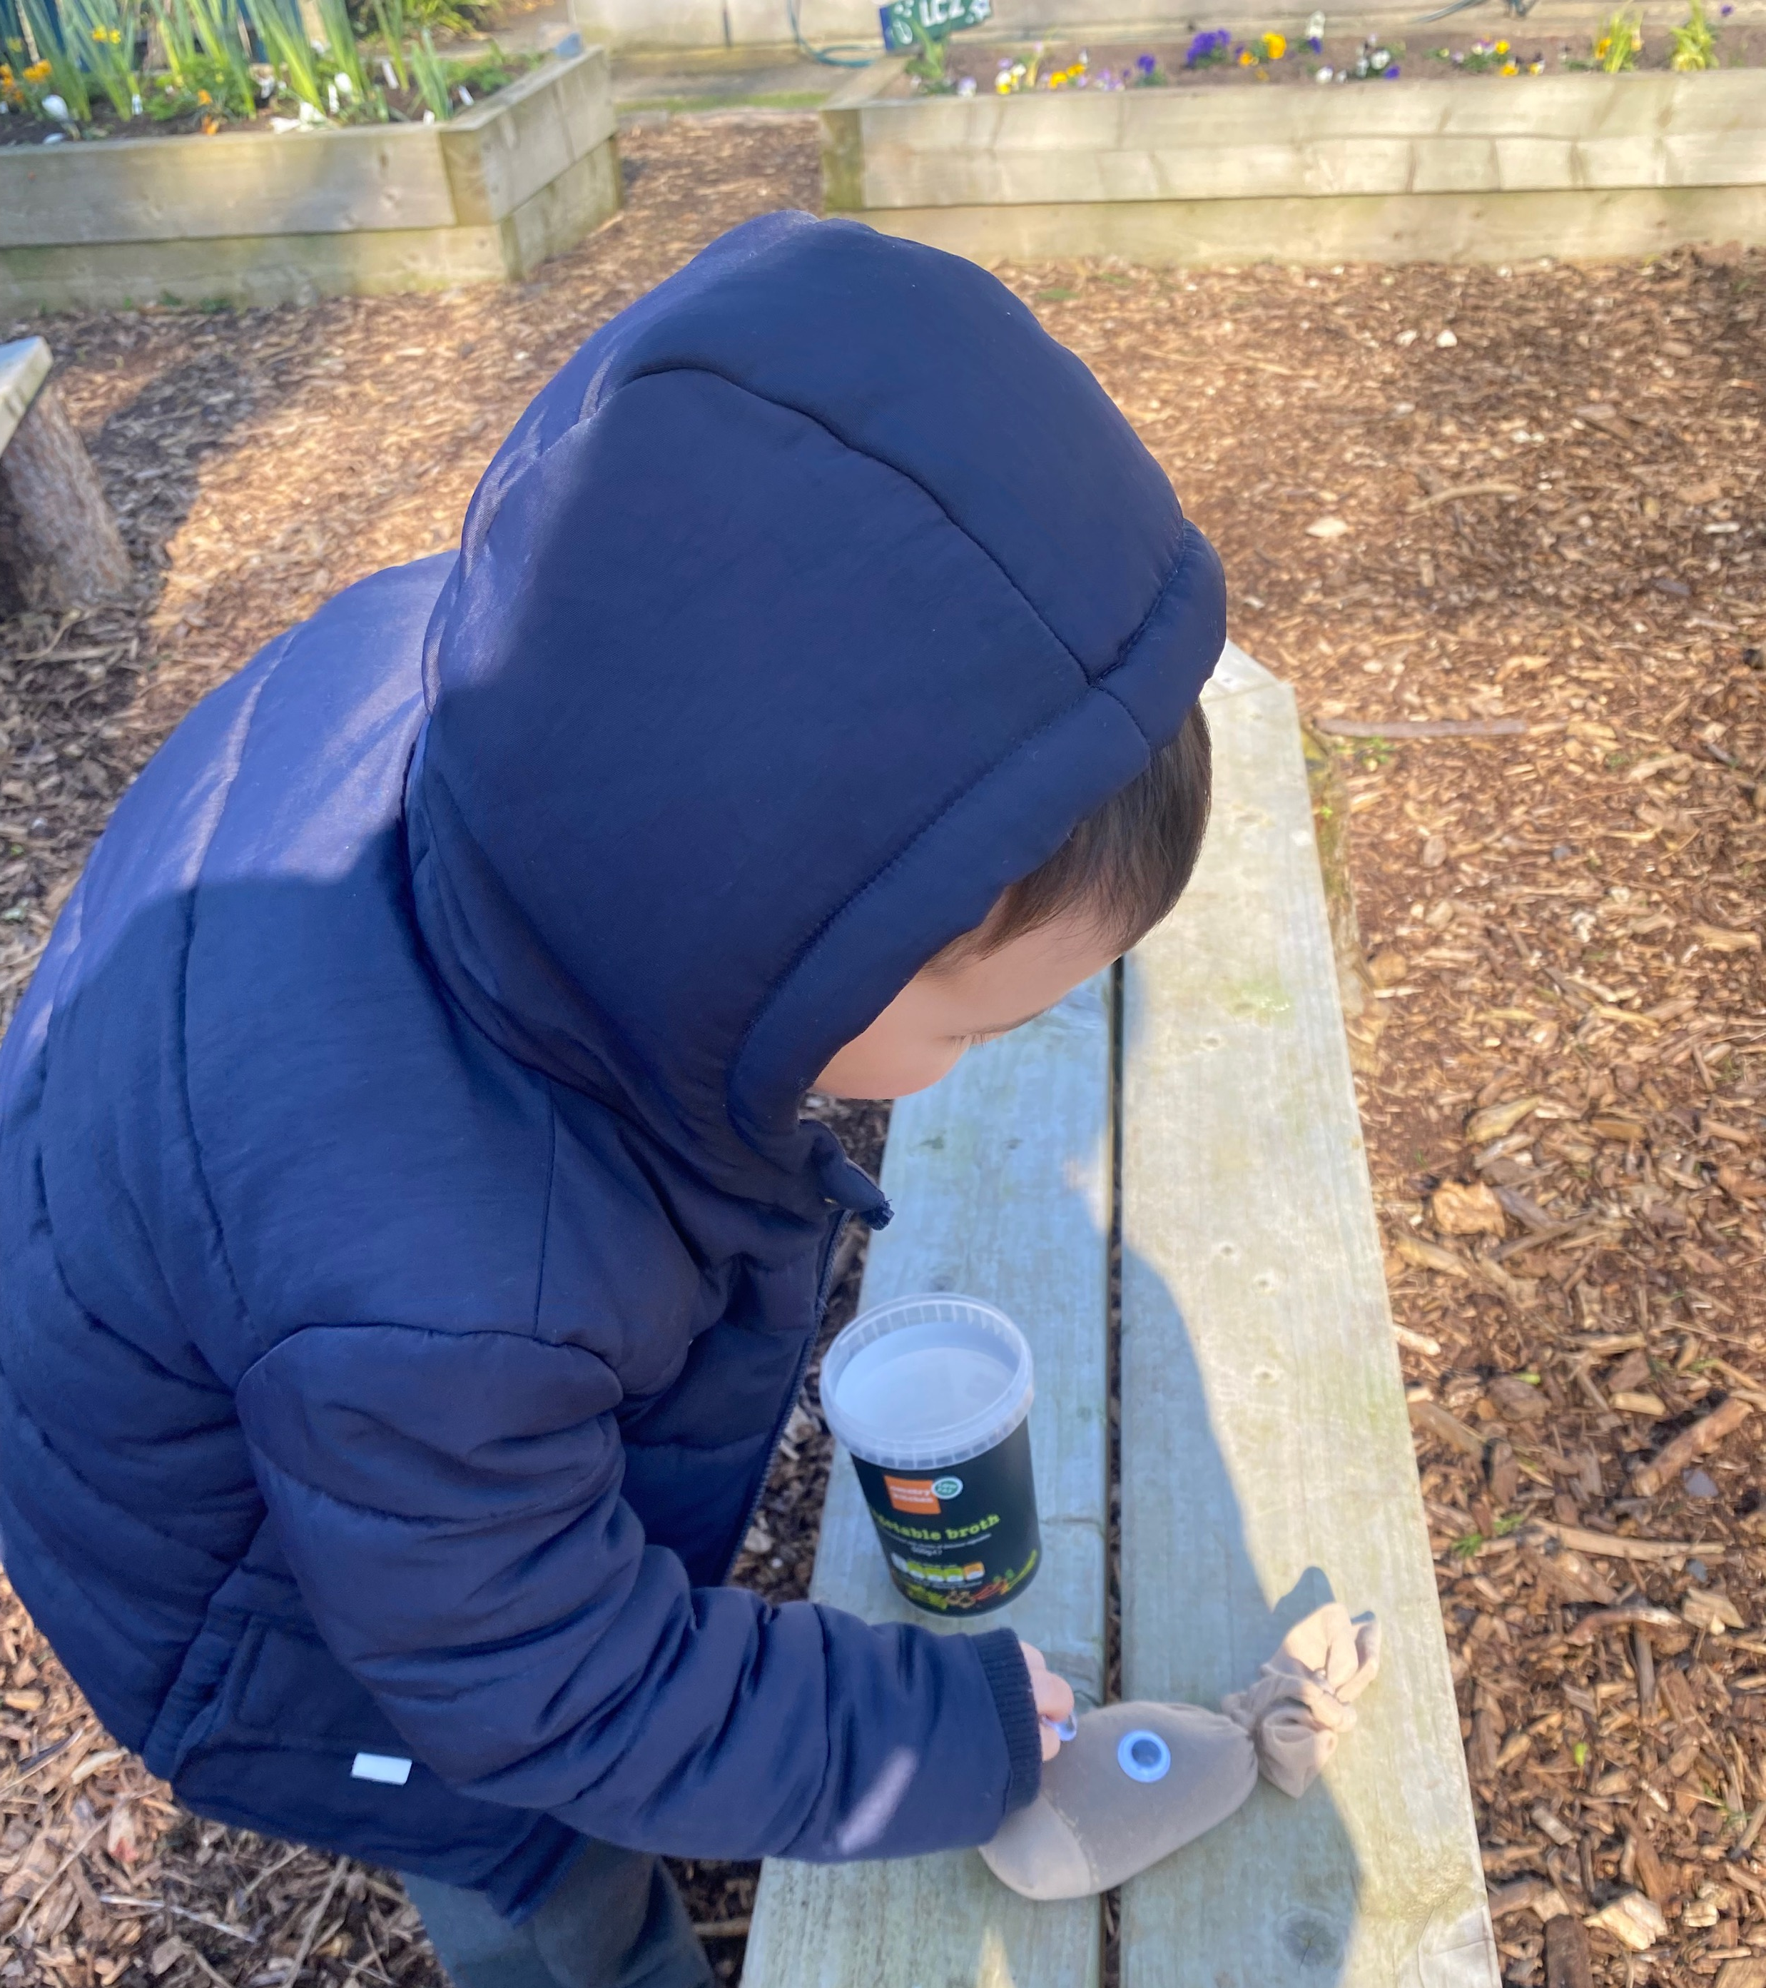
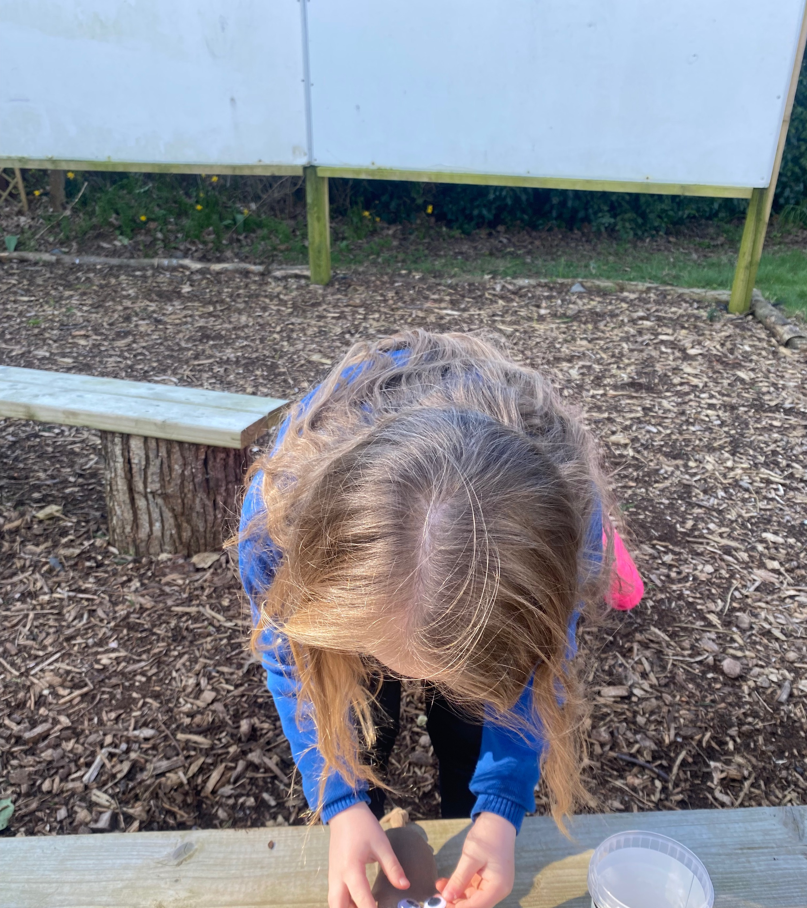
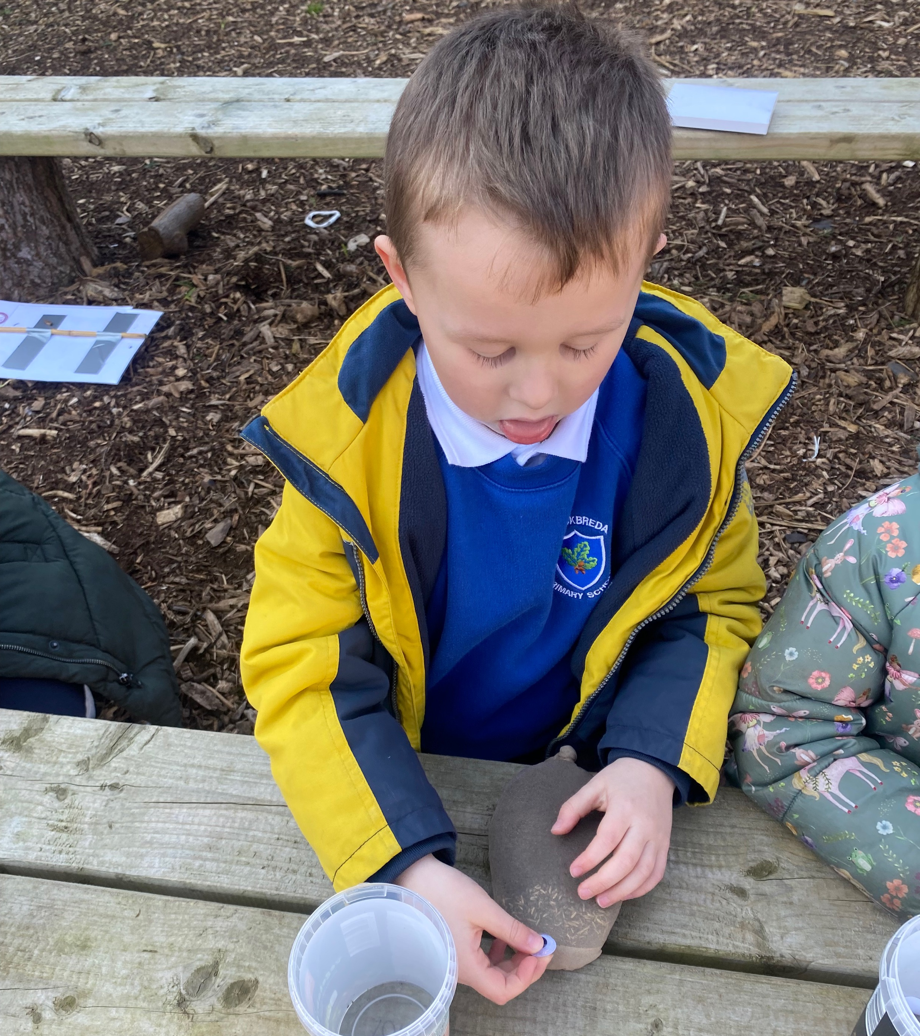
Adding eyes to our grass heads.

Slide 8
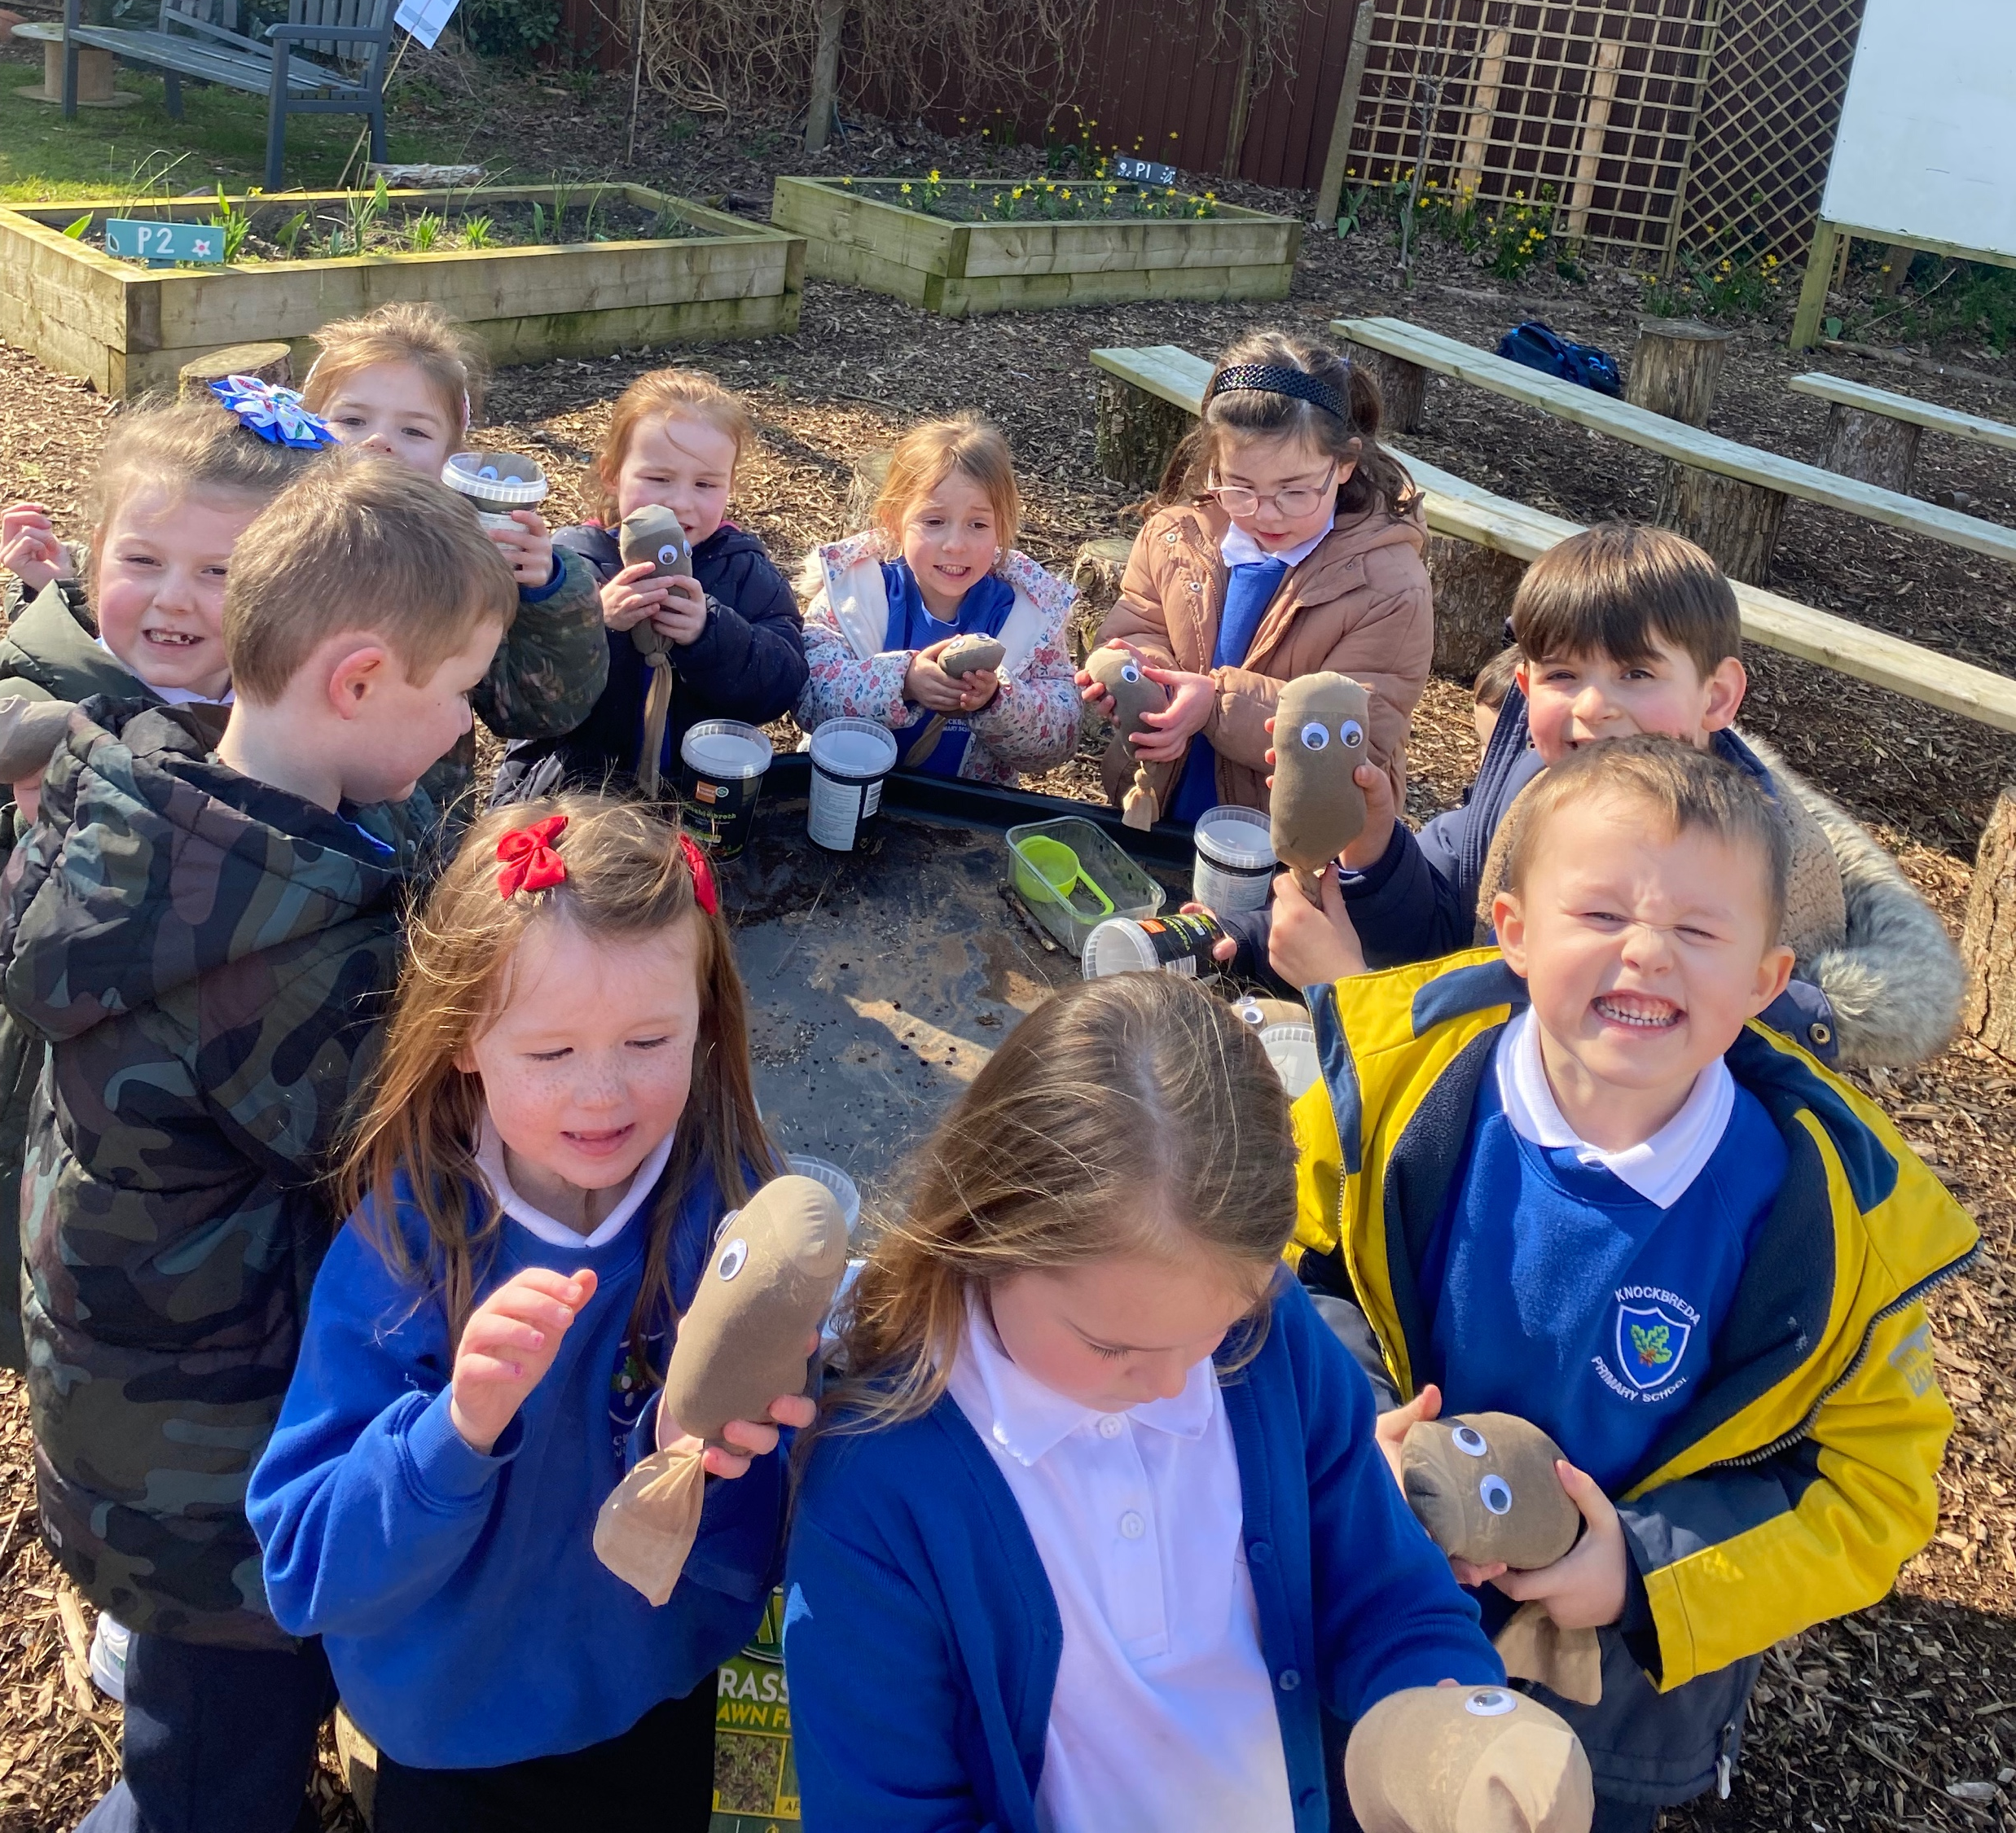
Showing of our super grass heads.

Slide 9
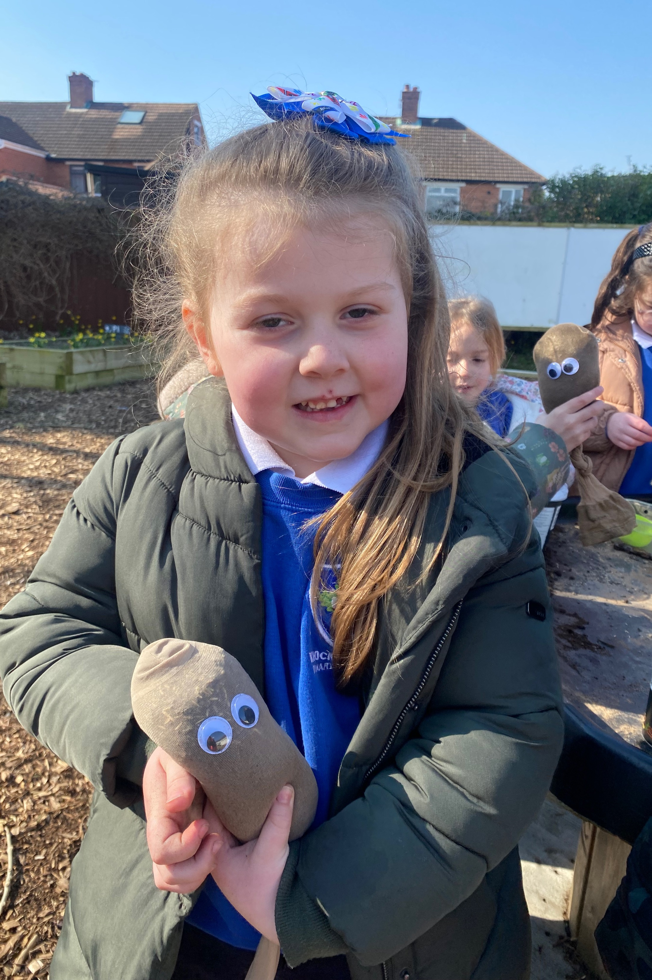
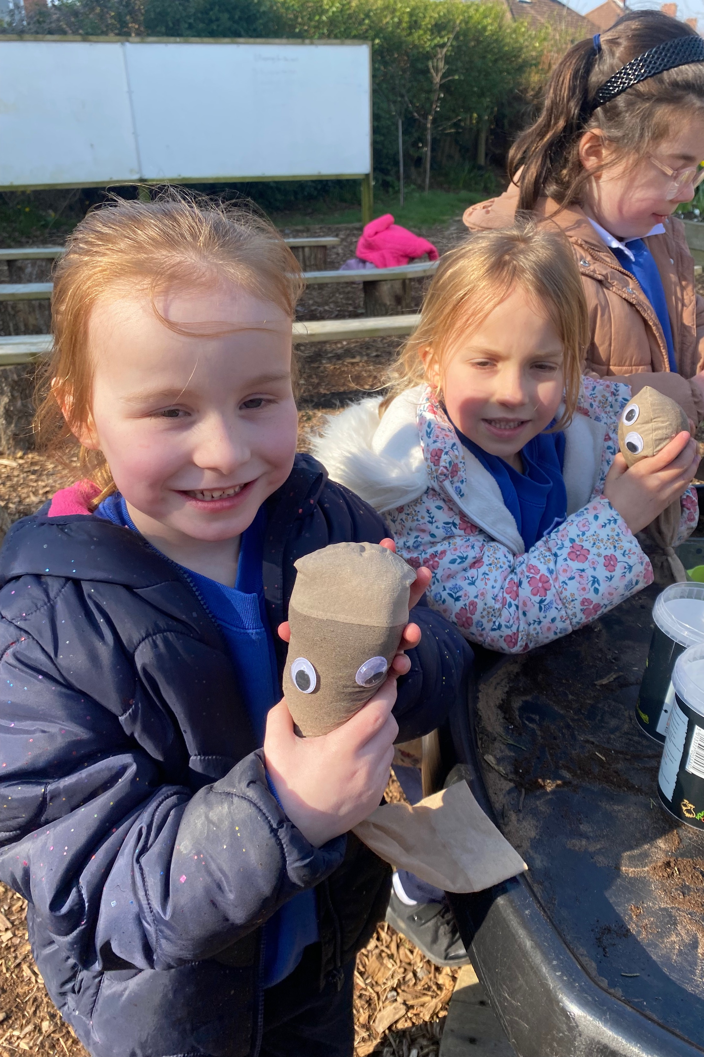
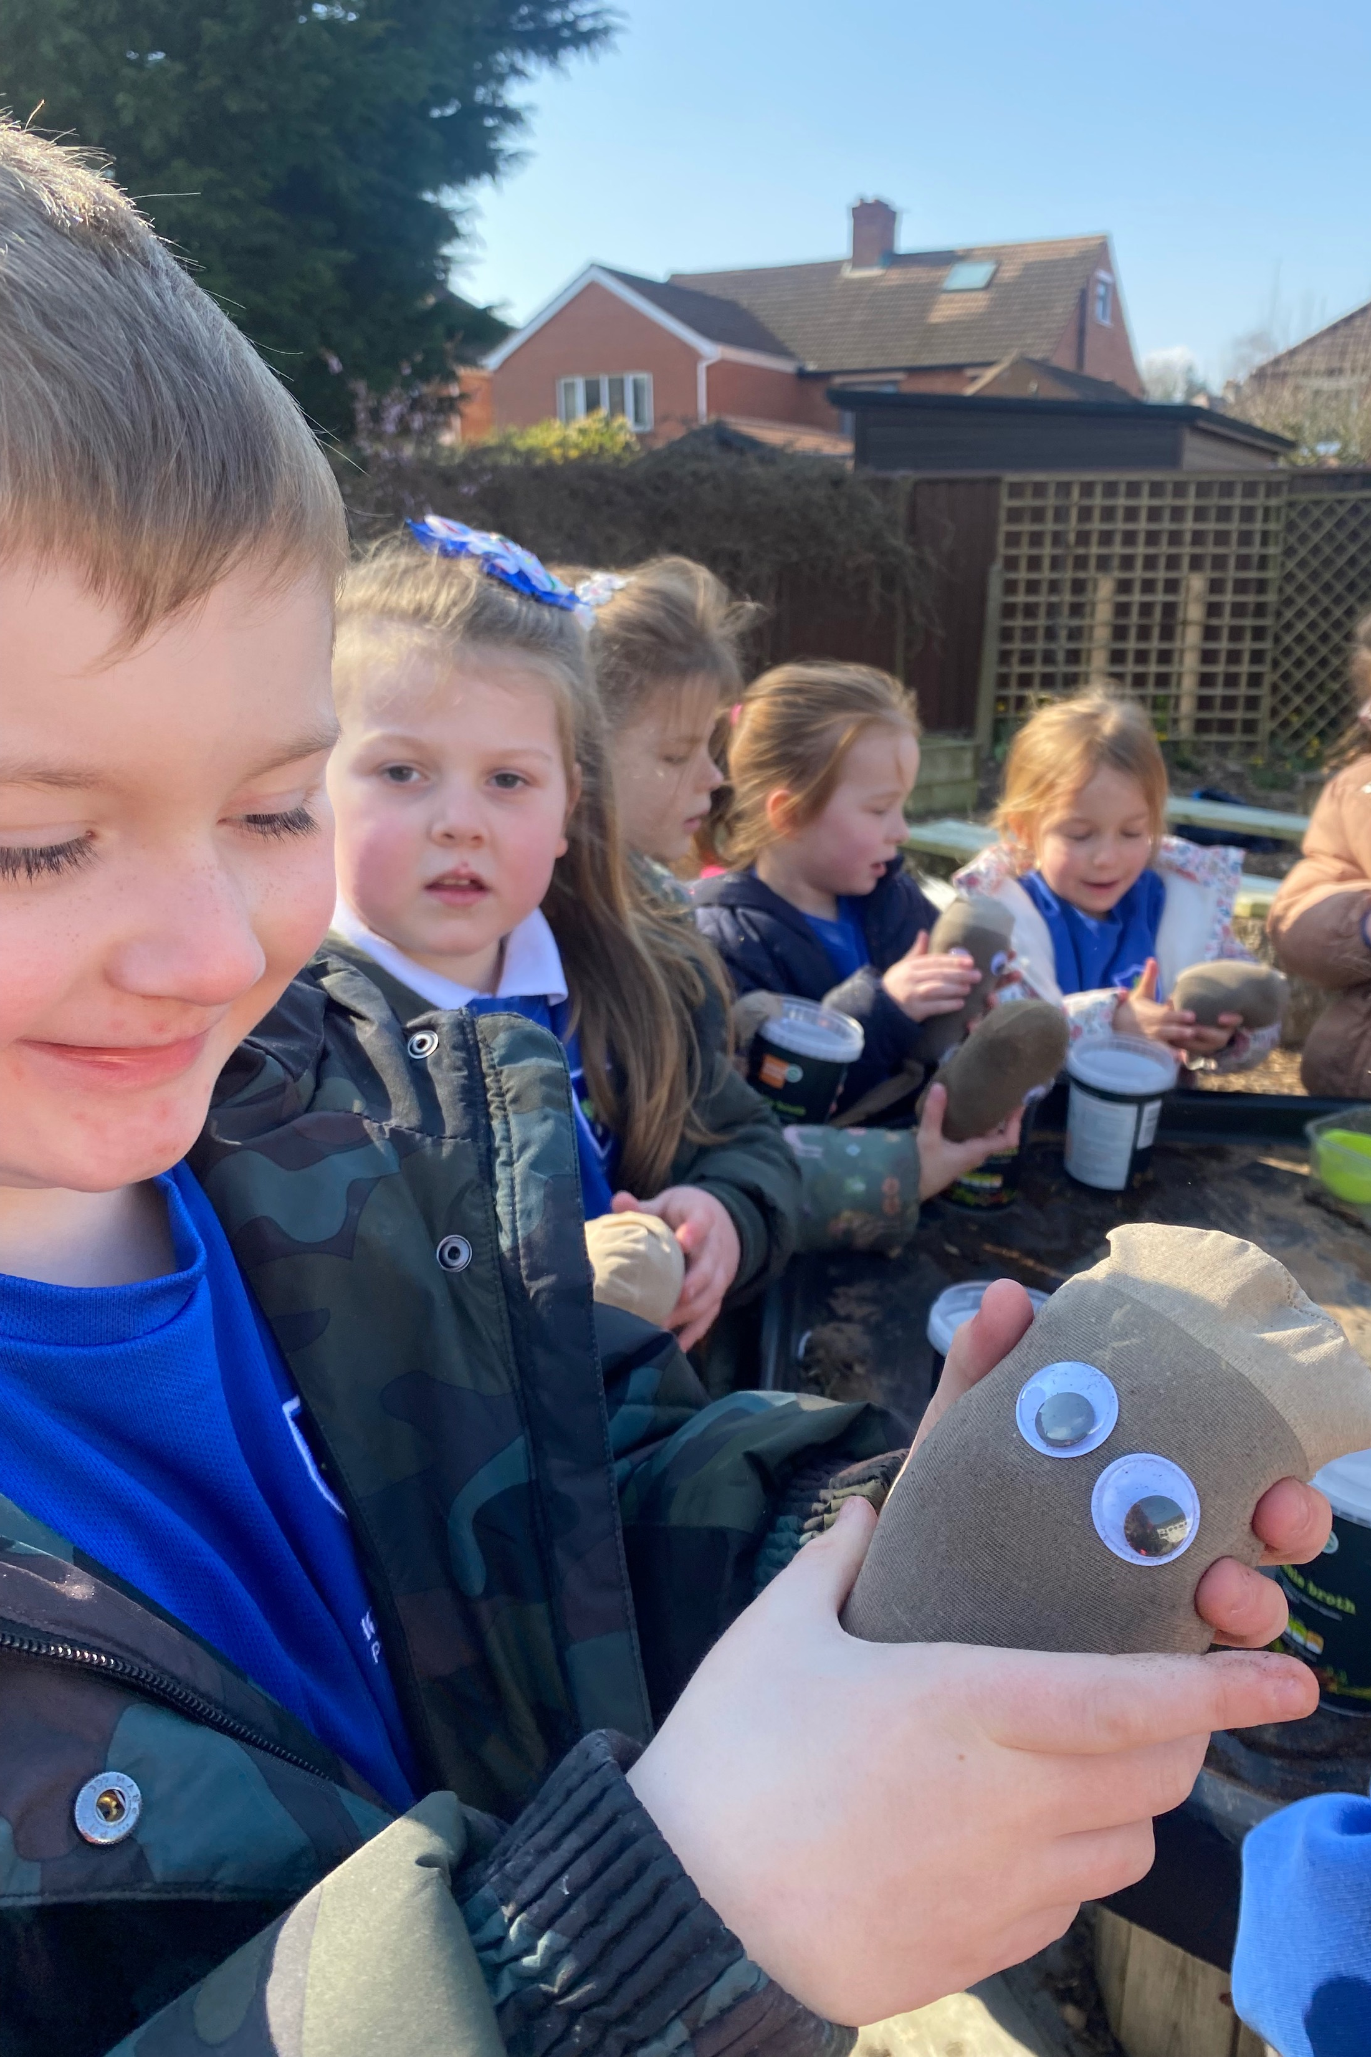
Super grass heads P2

Slide 10
Everyone enjoyed the lesson and voted for a big yes!!

