Slide 1
Primary 2
Forest School Diary 2024/2025
Mrs Gamble

Slide 2
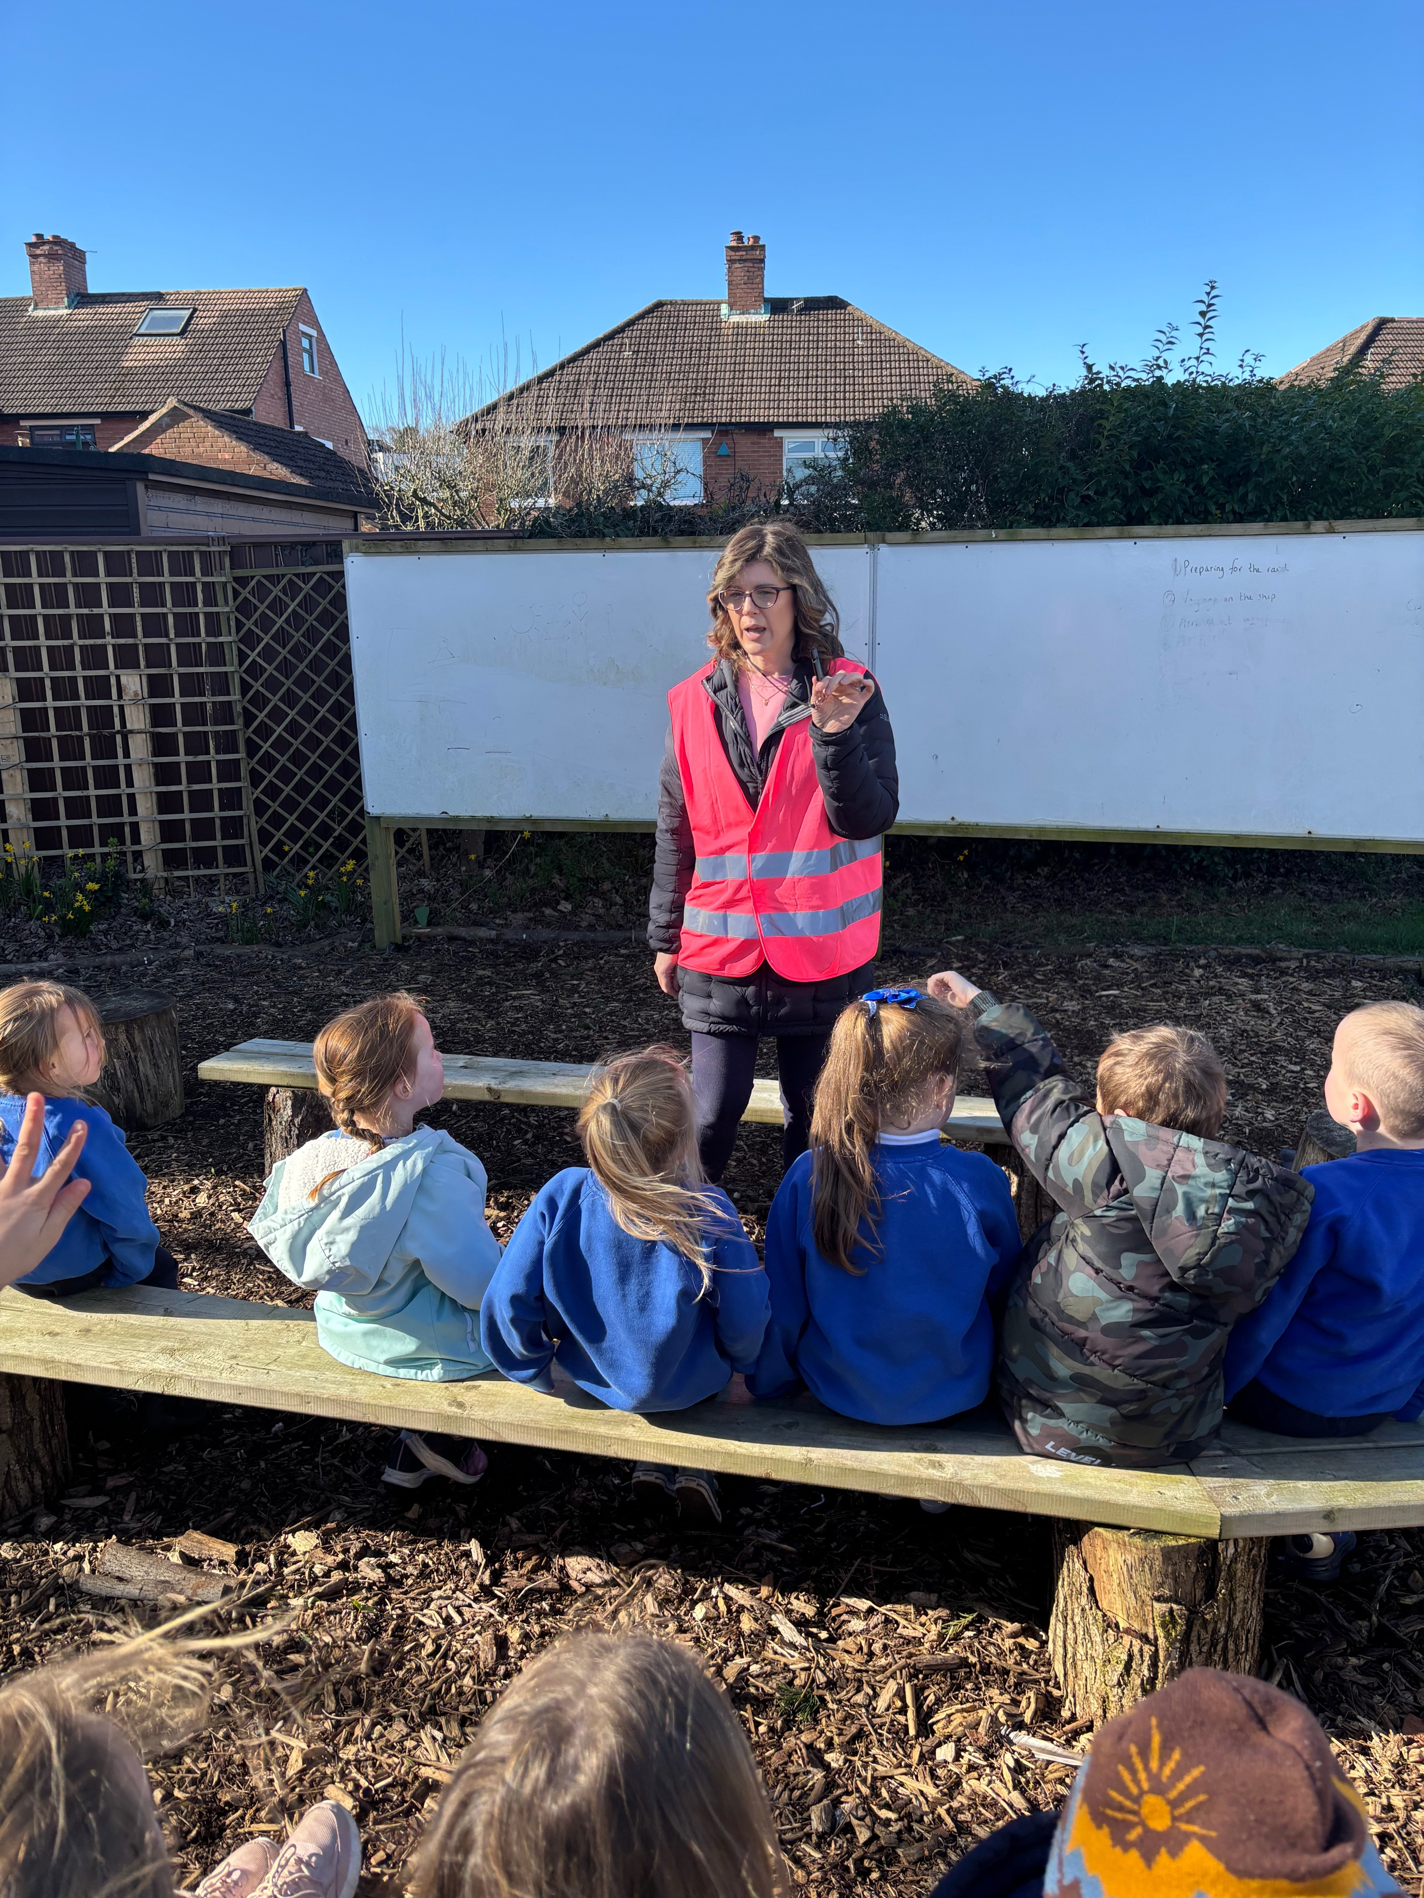
Lesson 5 – Wednesday 12th March 2025
We met in our circle, to talk about our activity and our forest school rules.
1 whistle – freeze
2 whistles – return
Agreed to have fun, learn and leave no trace

Slide 3
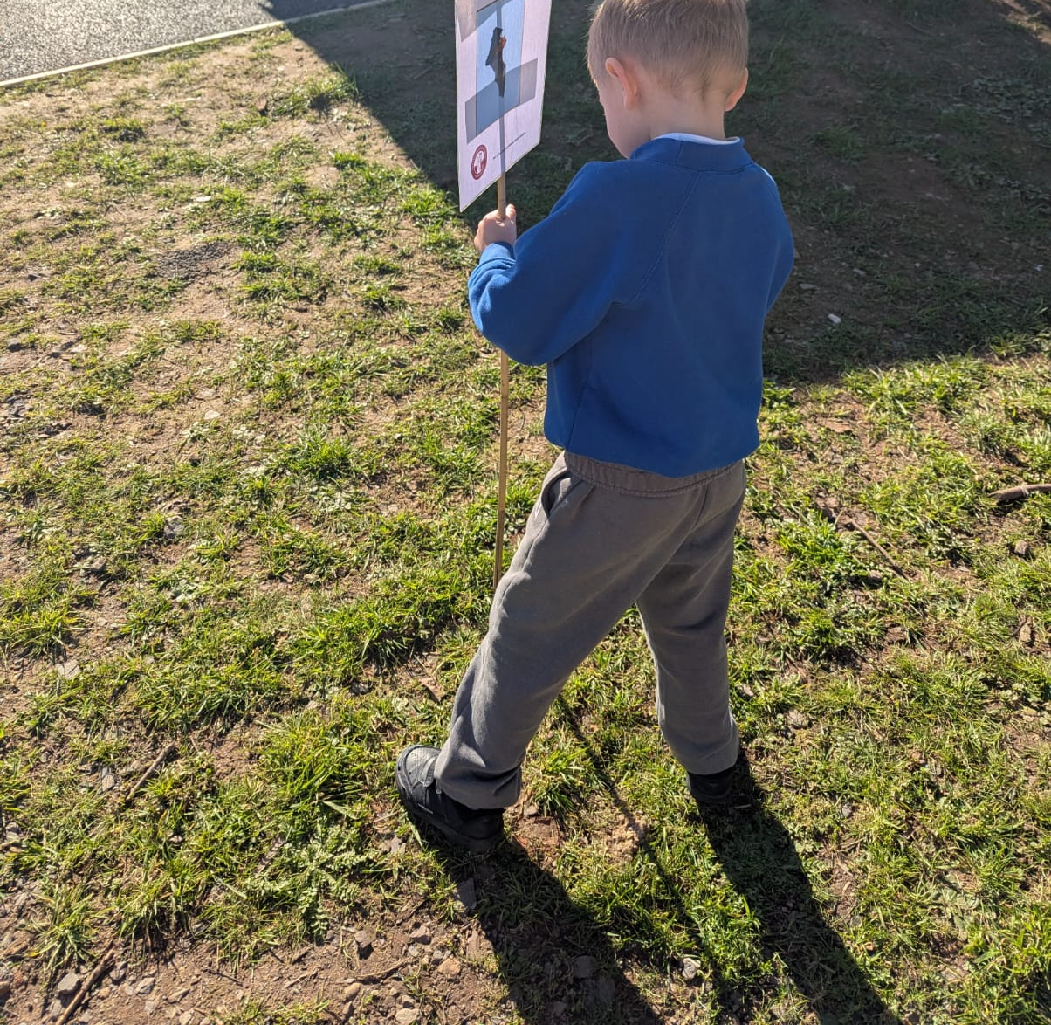
Setting up Boundary flags.
Volunteers set our boundaries with some adult help.

Slide 4
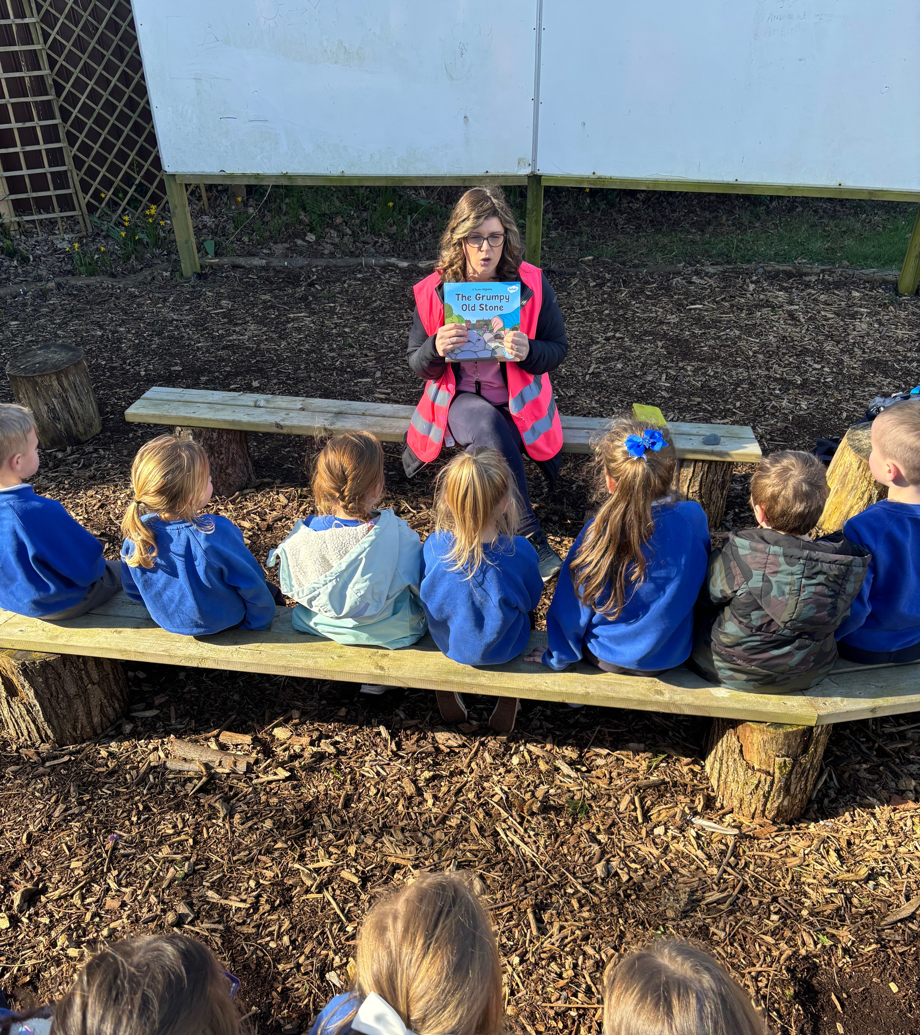
Reading story – The Grumpy old stone

Slide 5
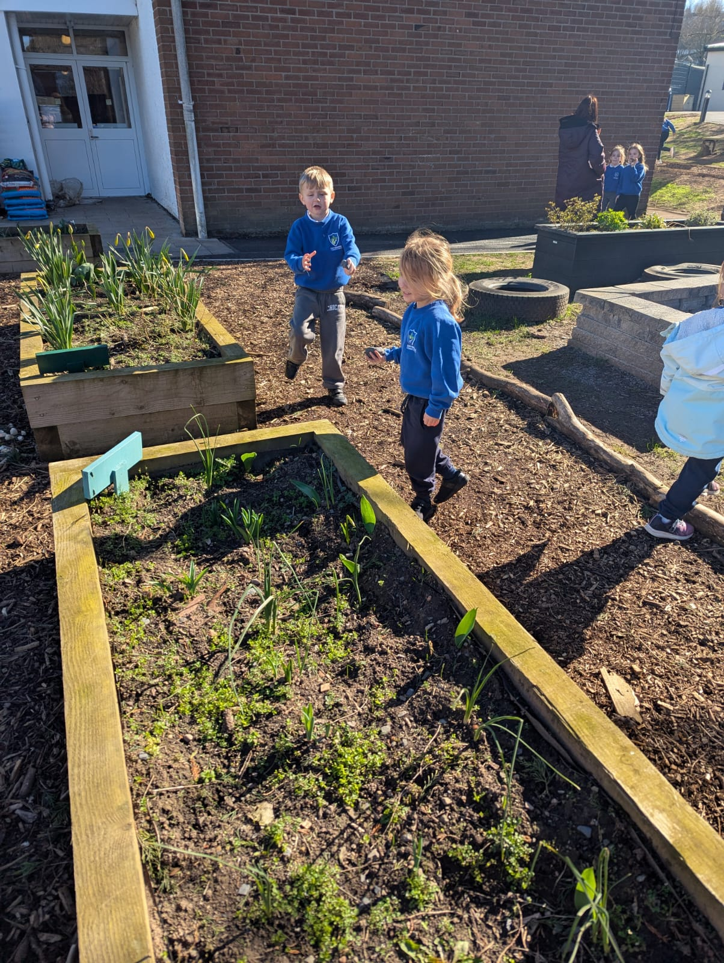
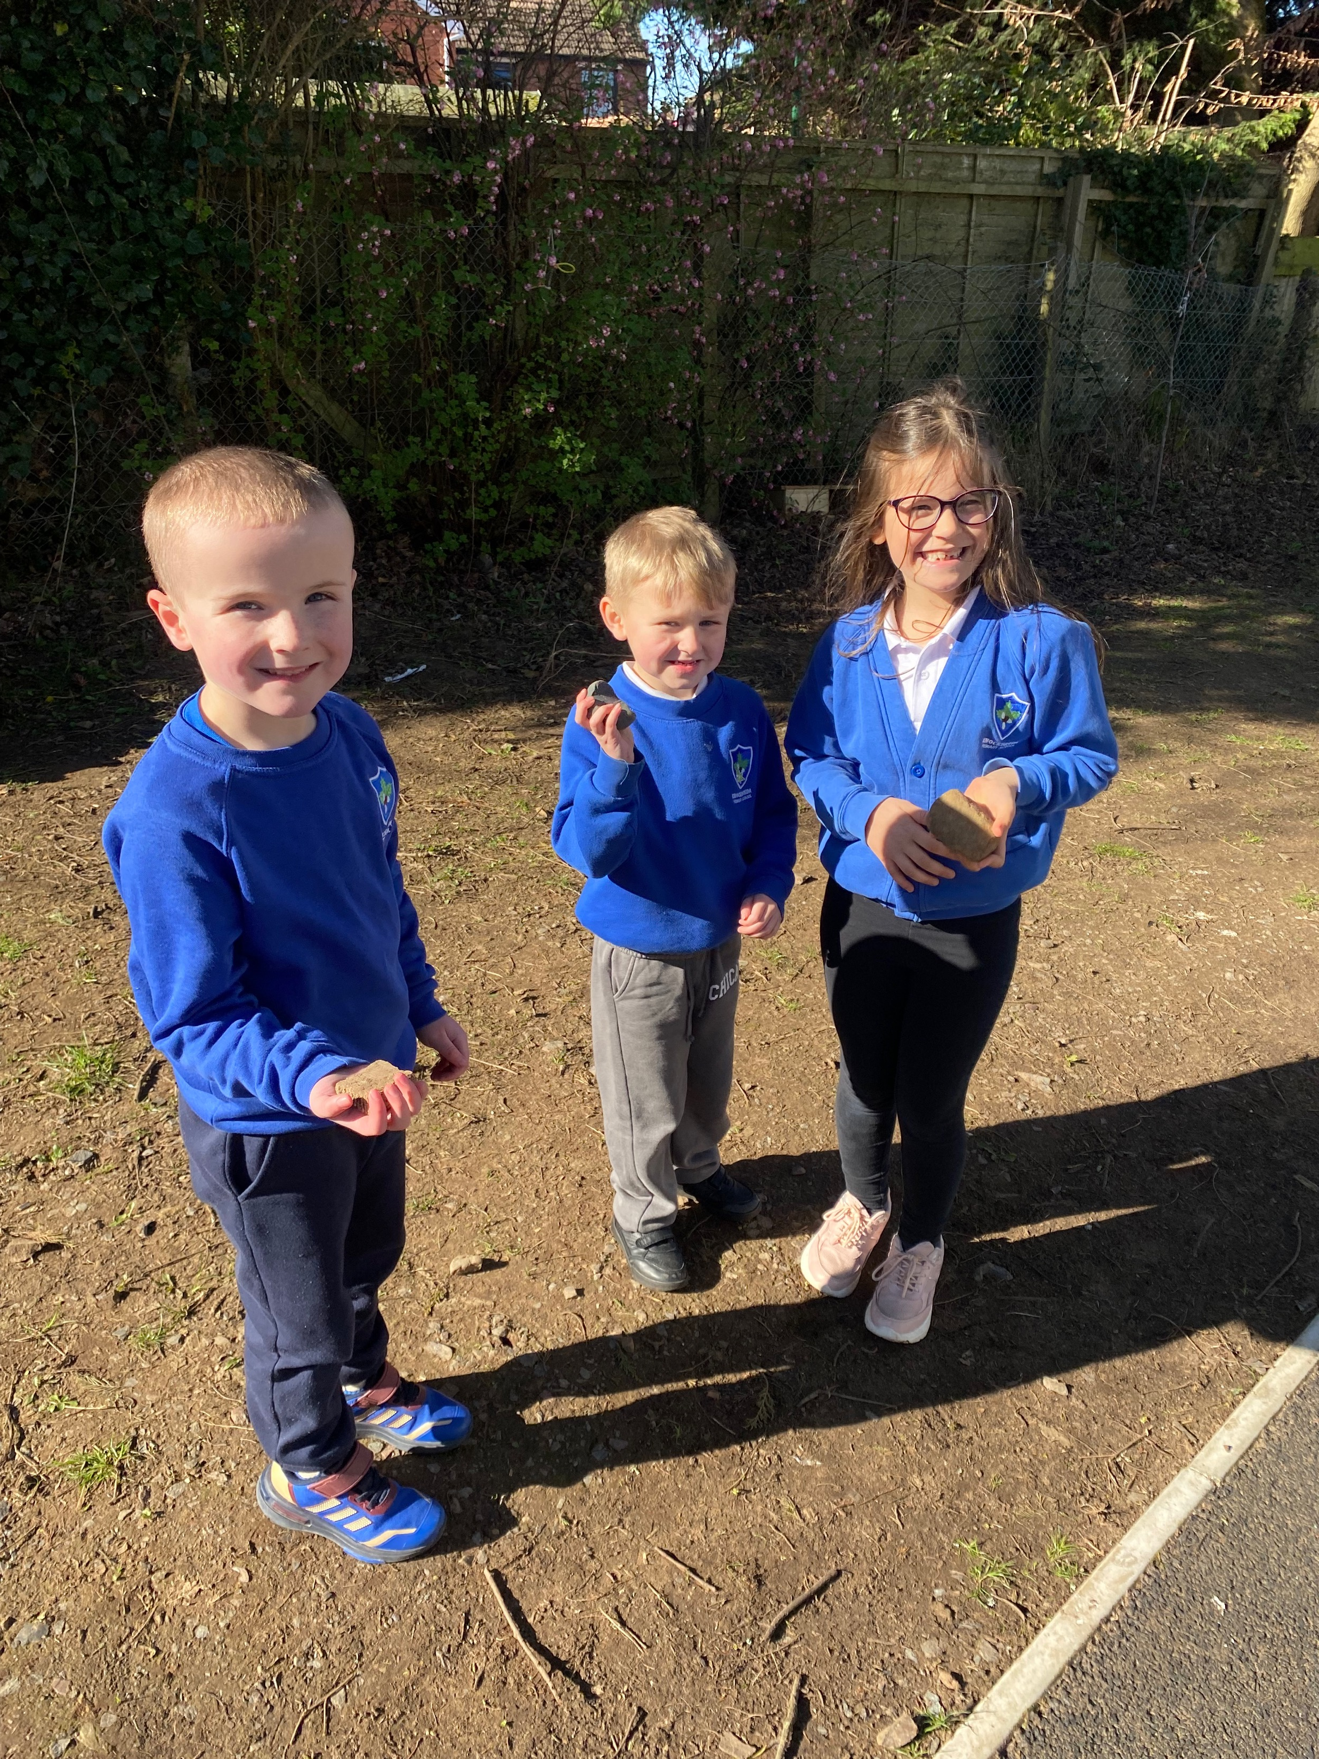
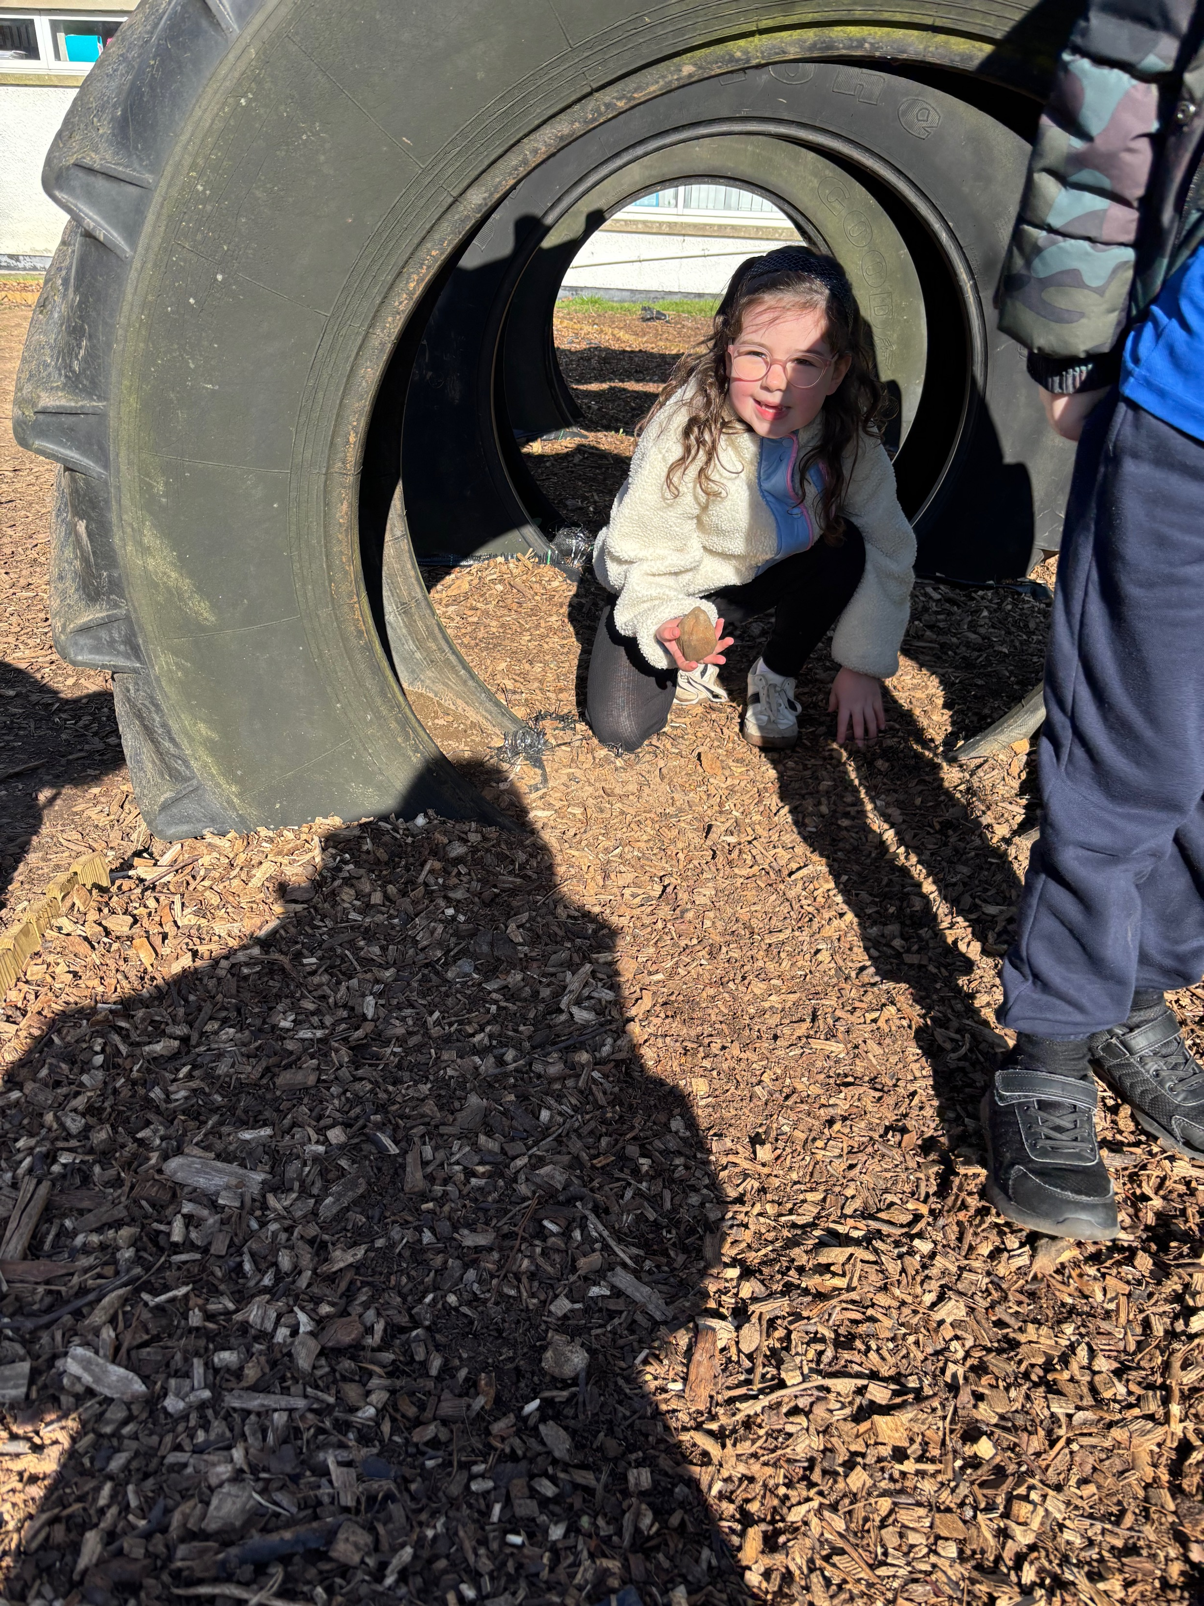
Everybody set off to find their own stone around the school grounds.

Slide 6
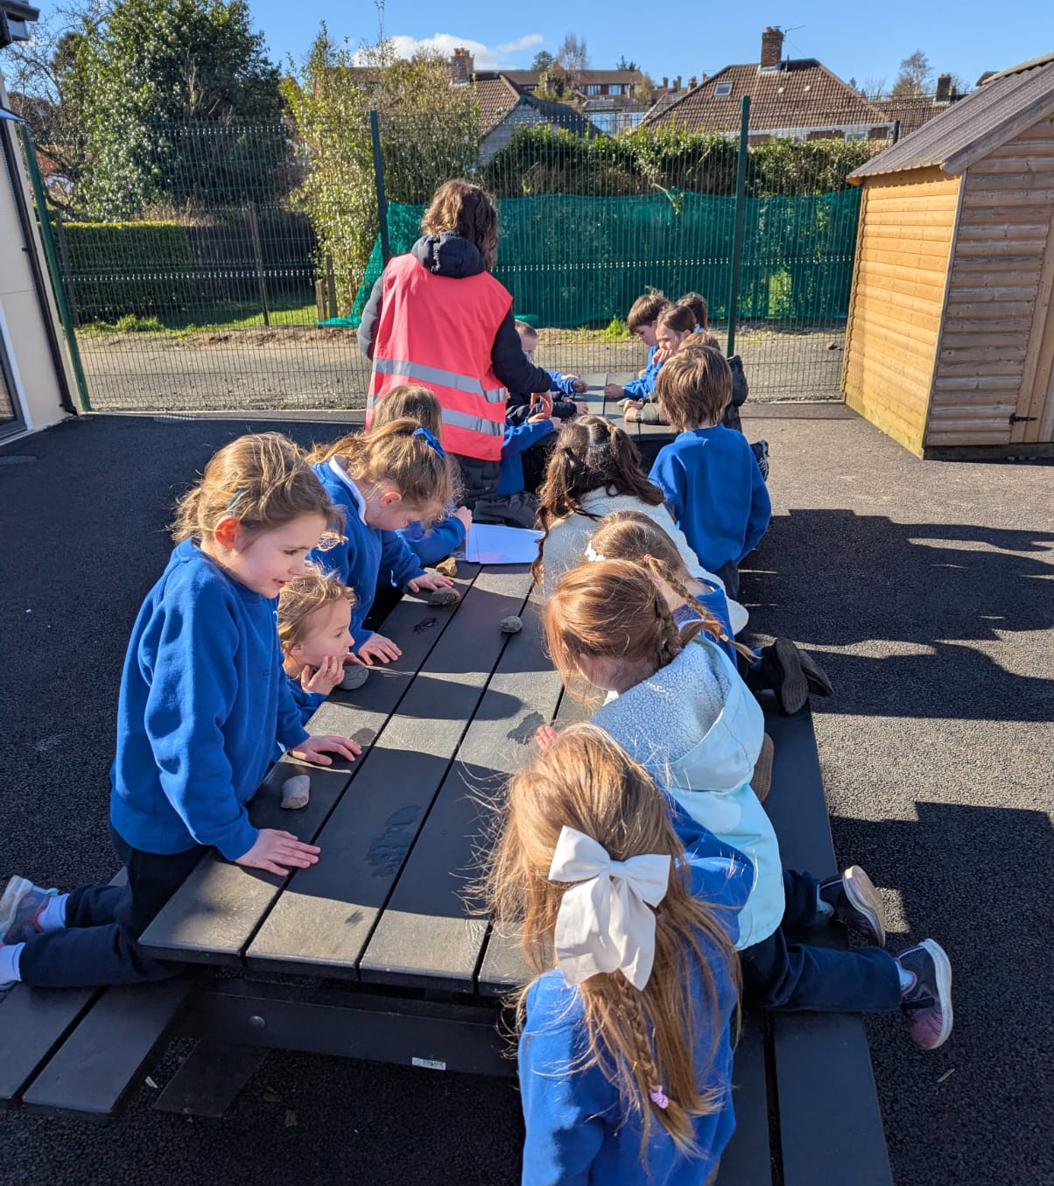
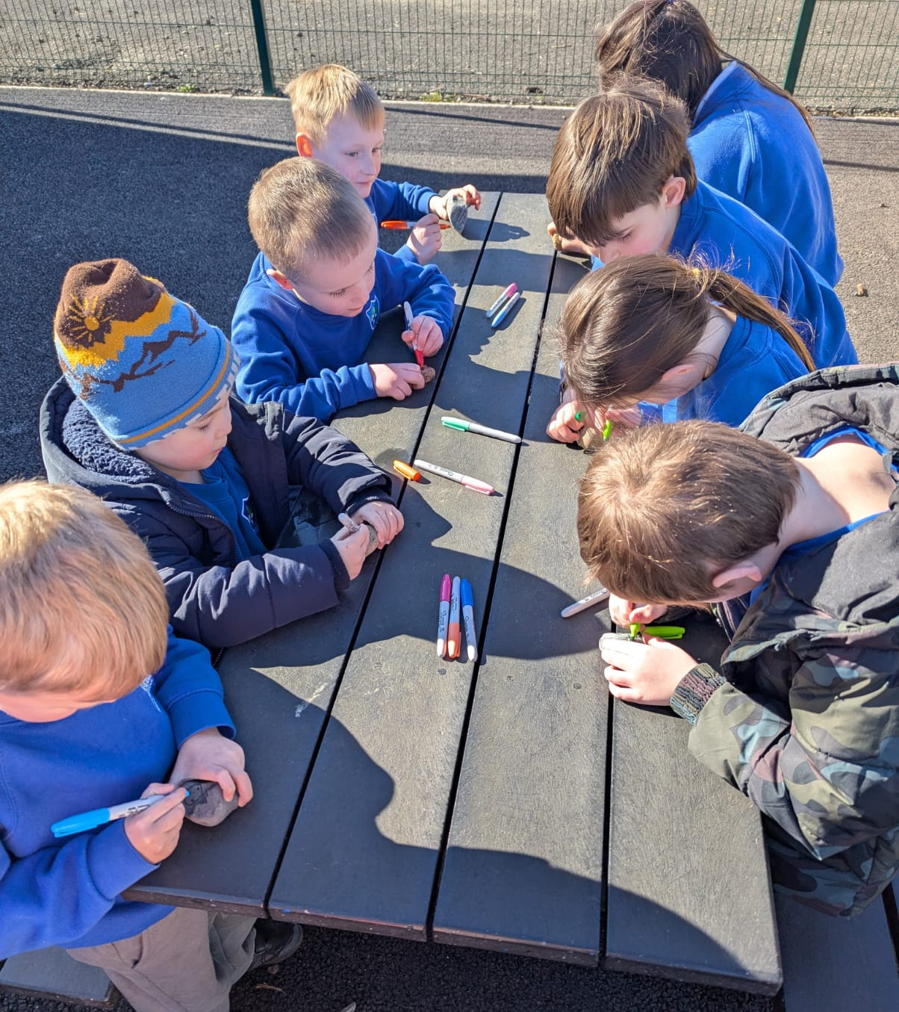
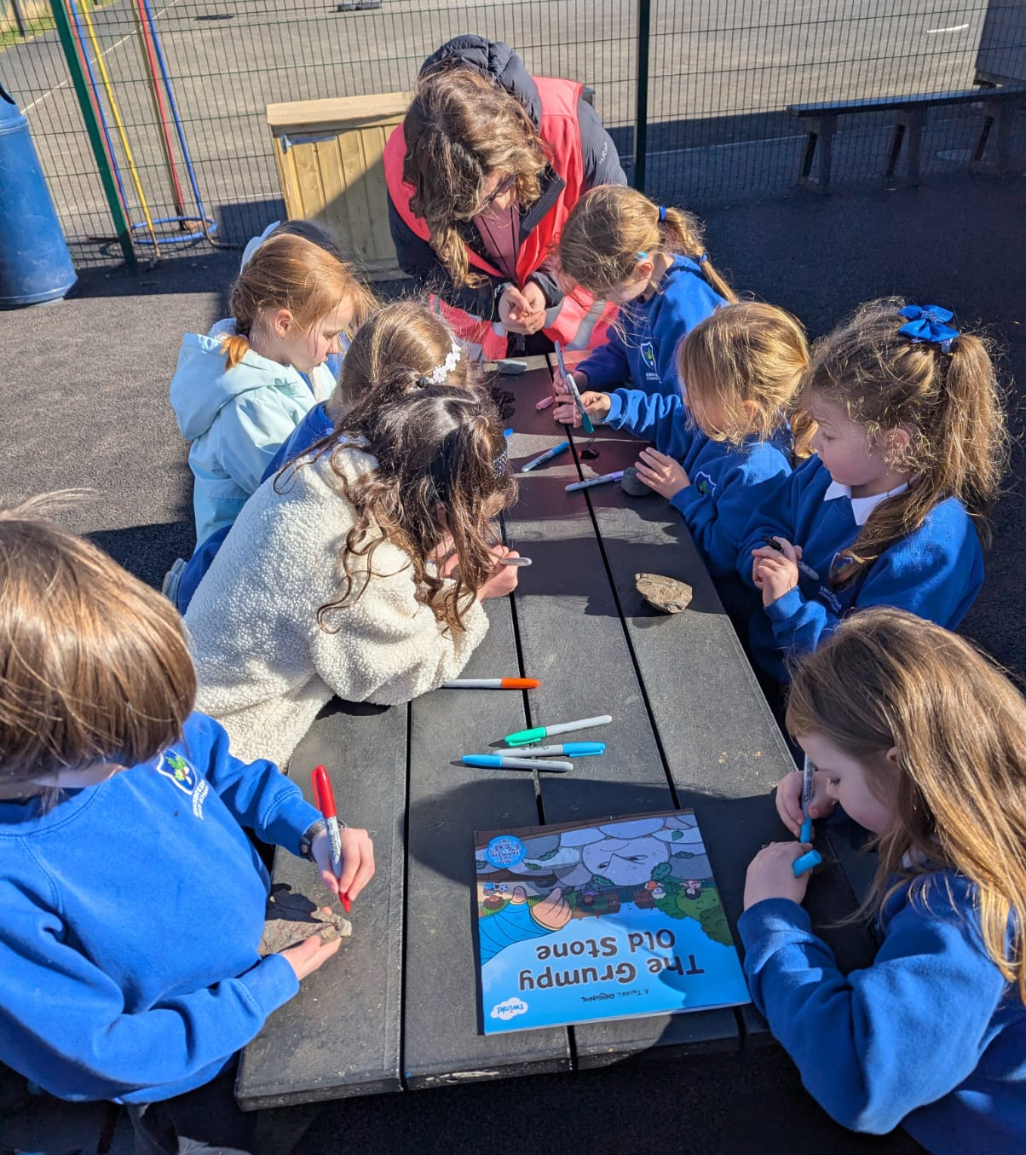
Getting creative and designing our own object/character on the stones.

Slide 7
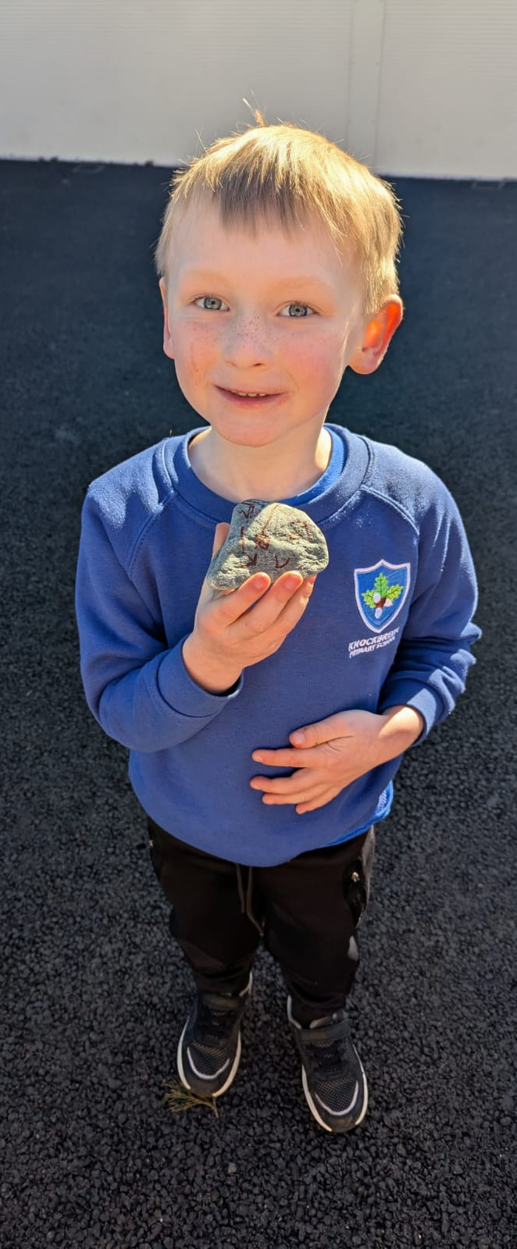
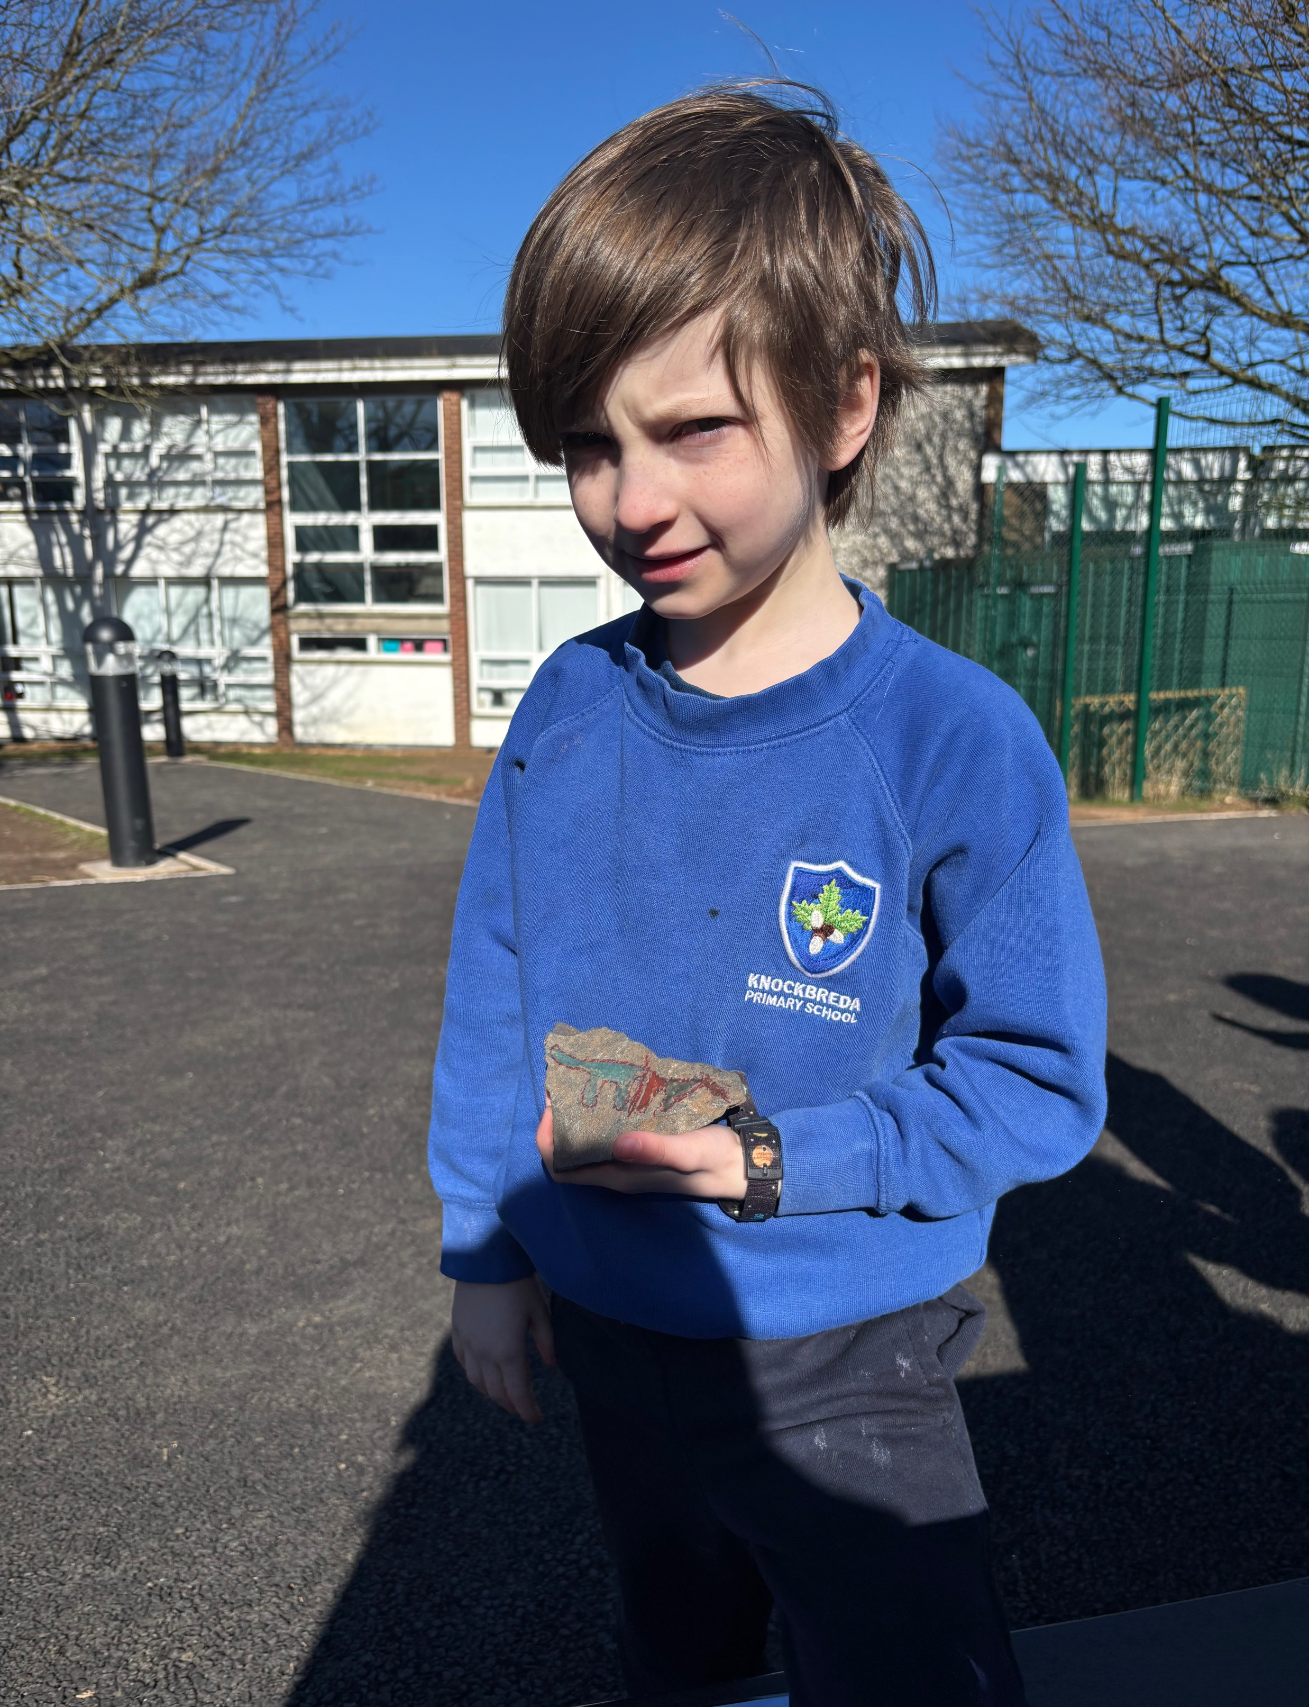
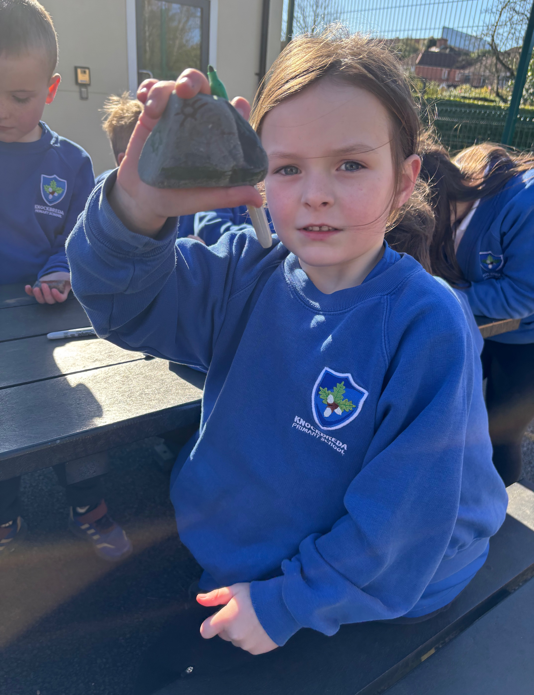
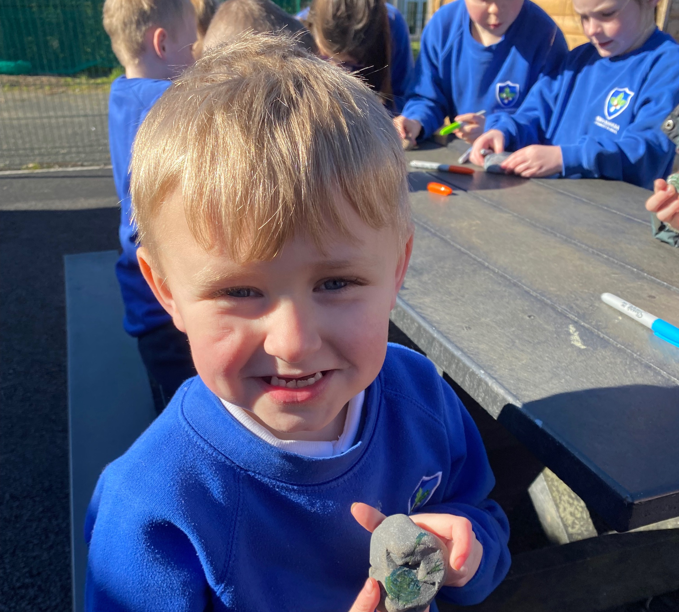
Some of our amazing creations

Slide 8
Showing our creations to the rest of class, talking and listening to others about what they have made.

Slide 9
Everyone enjoyed the lesson and voted for a big yes!!

