Slide 1
Primary 2
Forest School Diary 2024/2025
Mrs Gamble

Slide 2
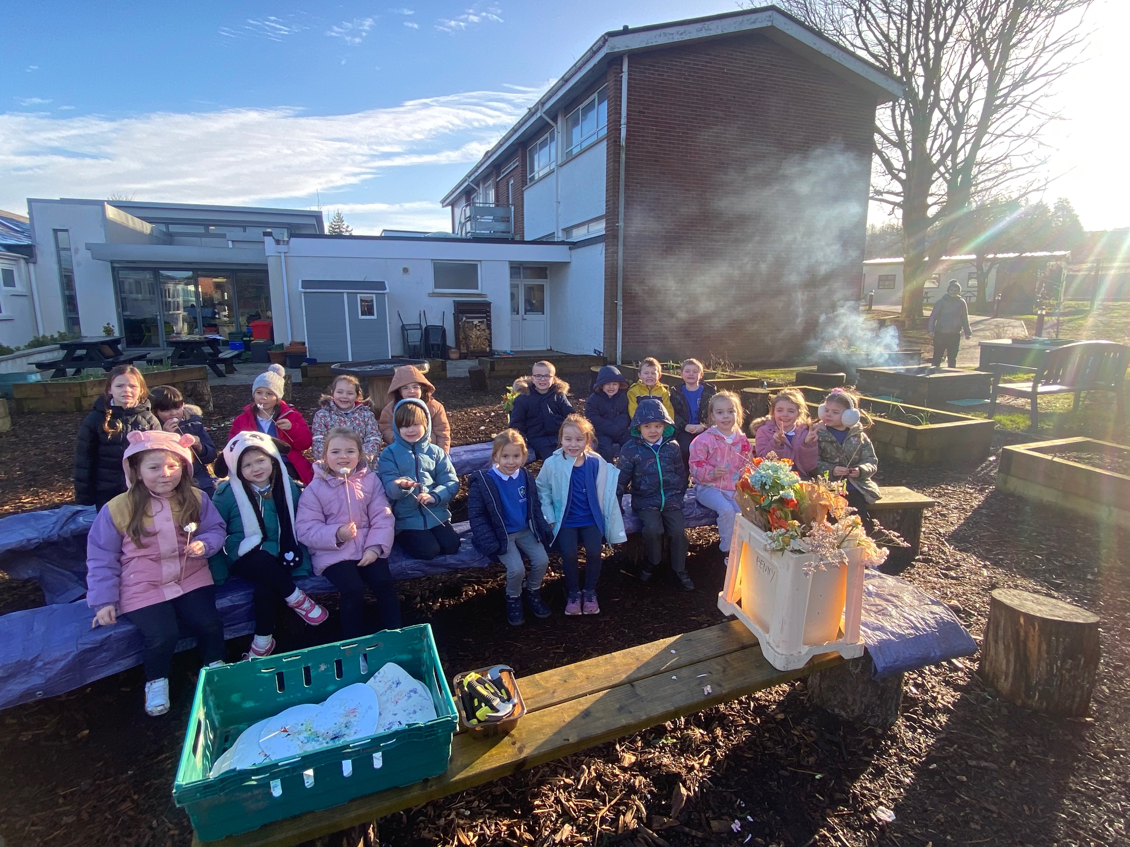
Lesson 4 – Wednesday 5th February 2025
We met in our circle, to talk about our activity and our forest school rules.
1 whistle – freeze
2 whistles – return
Agreed to have fun, learn and leave no trace
Volunteers set our boundaries with some adult help.

Slide 3
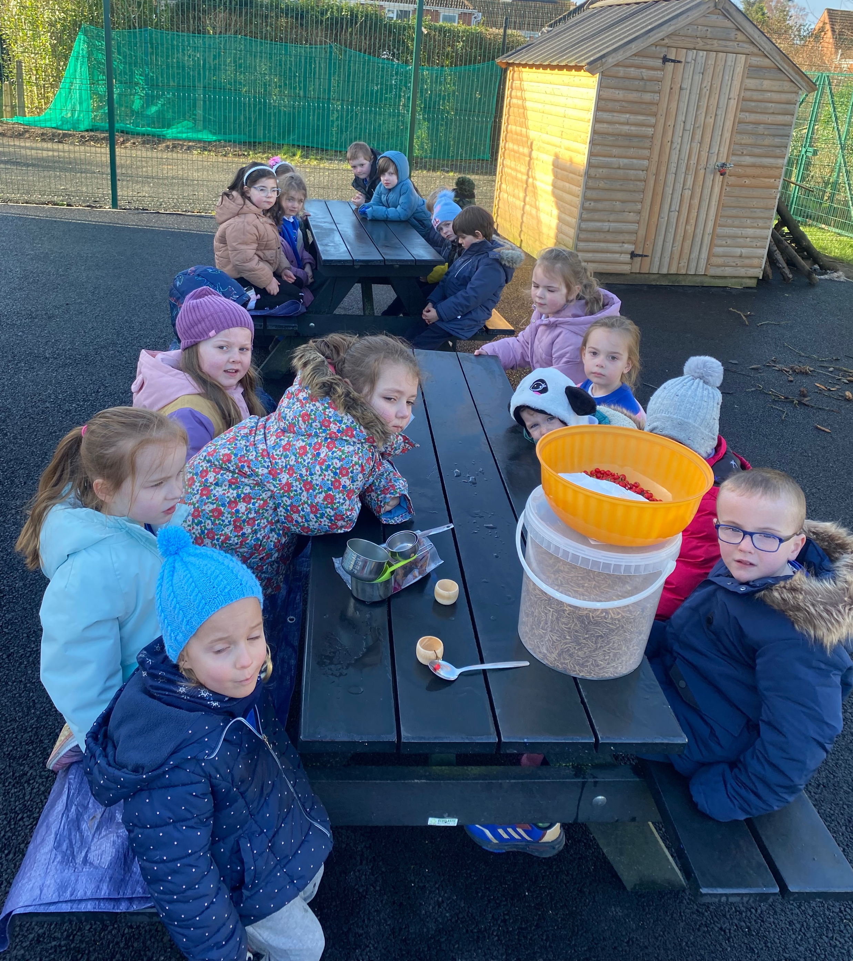
Discussing what birds would like to eat.

Slide 4
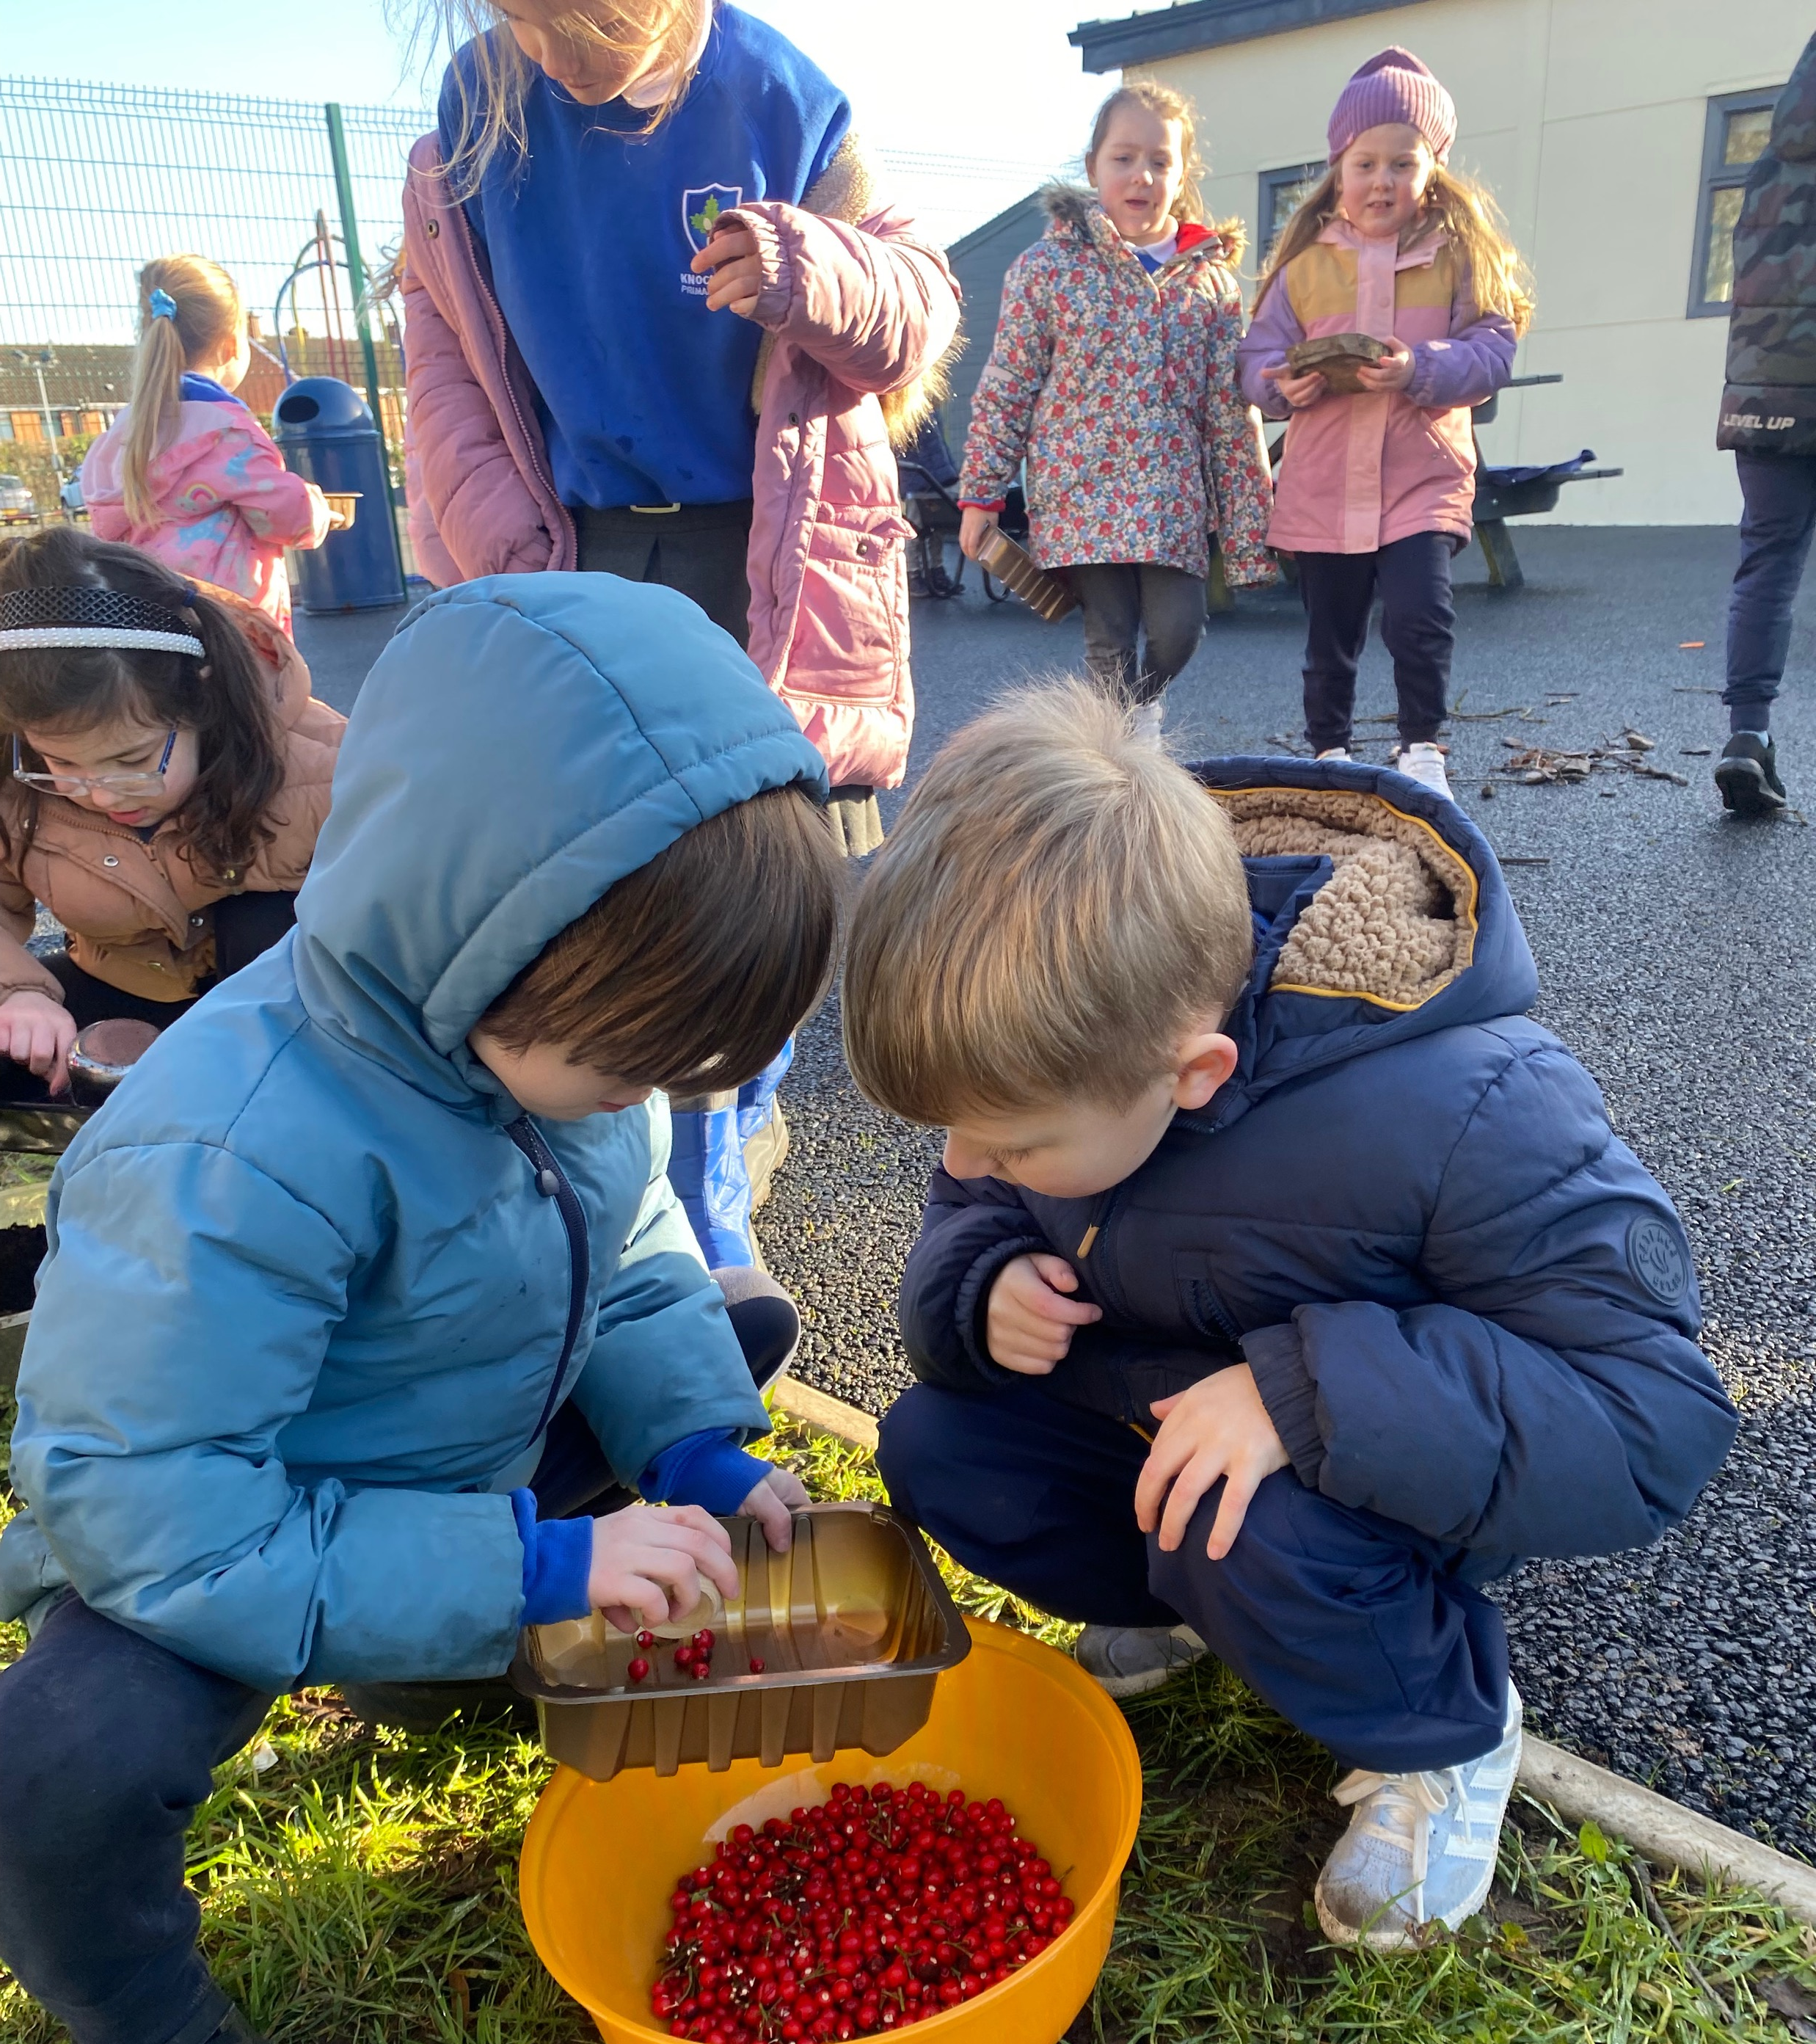
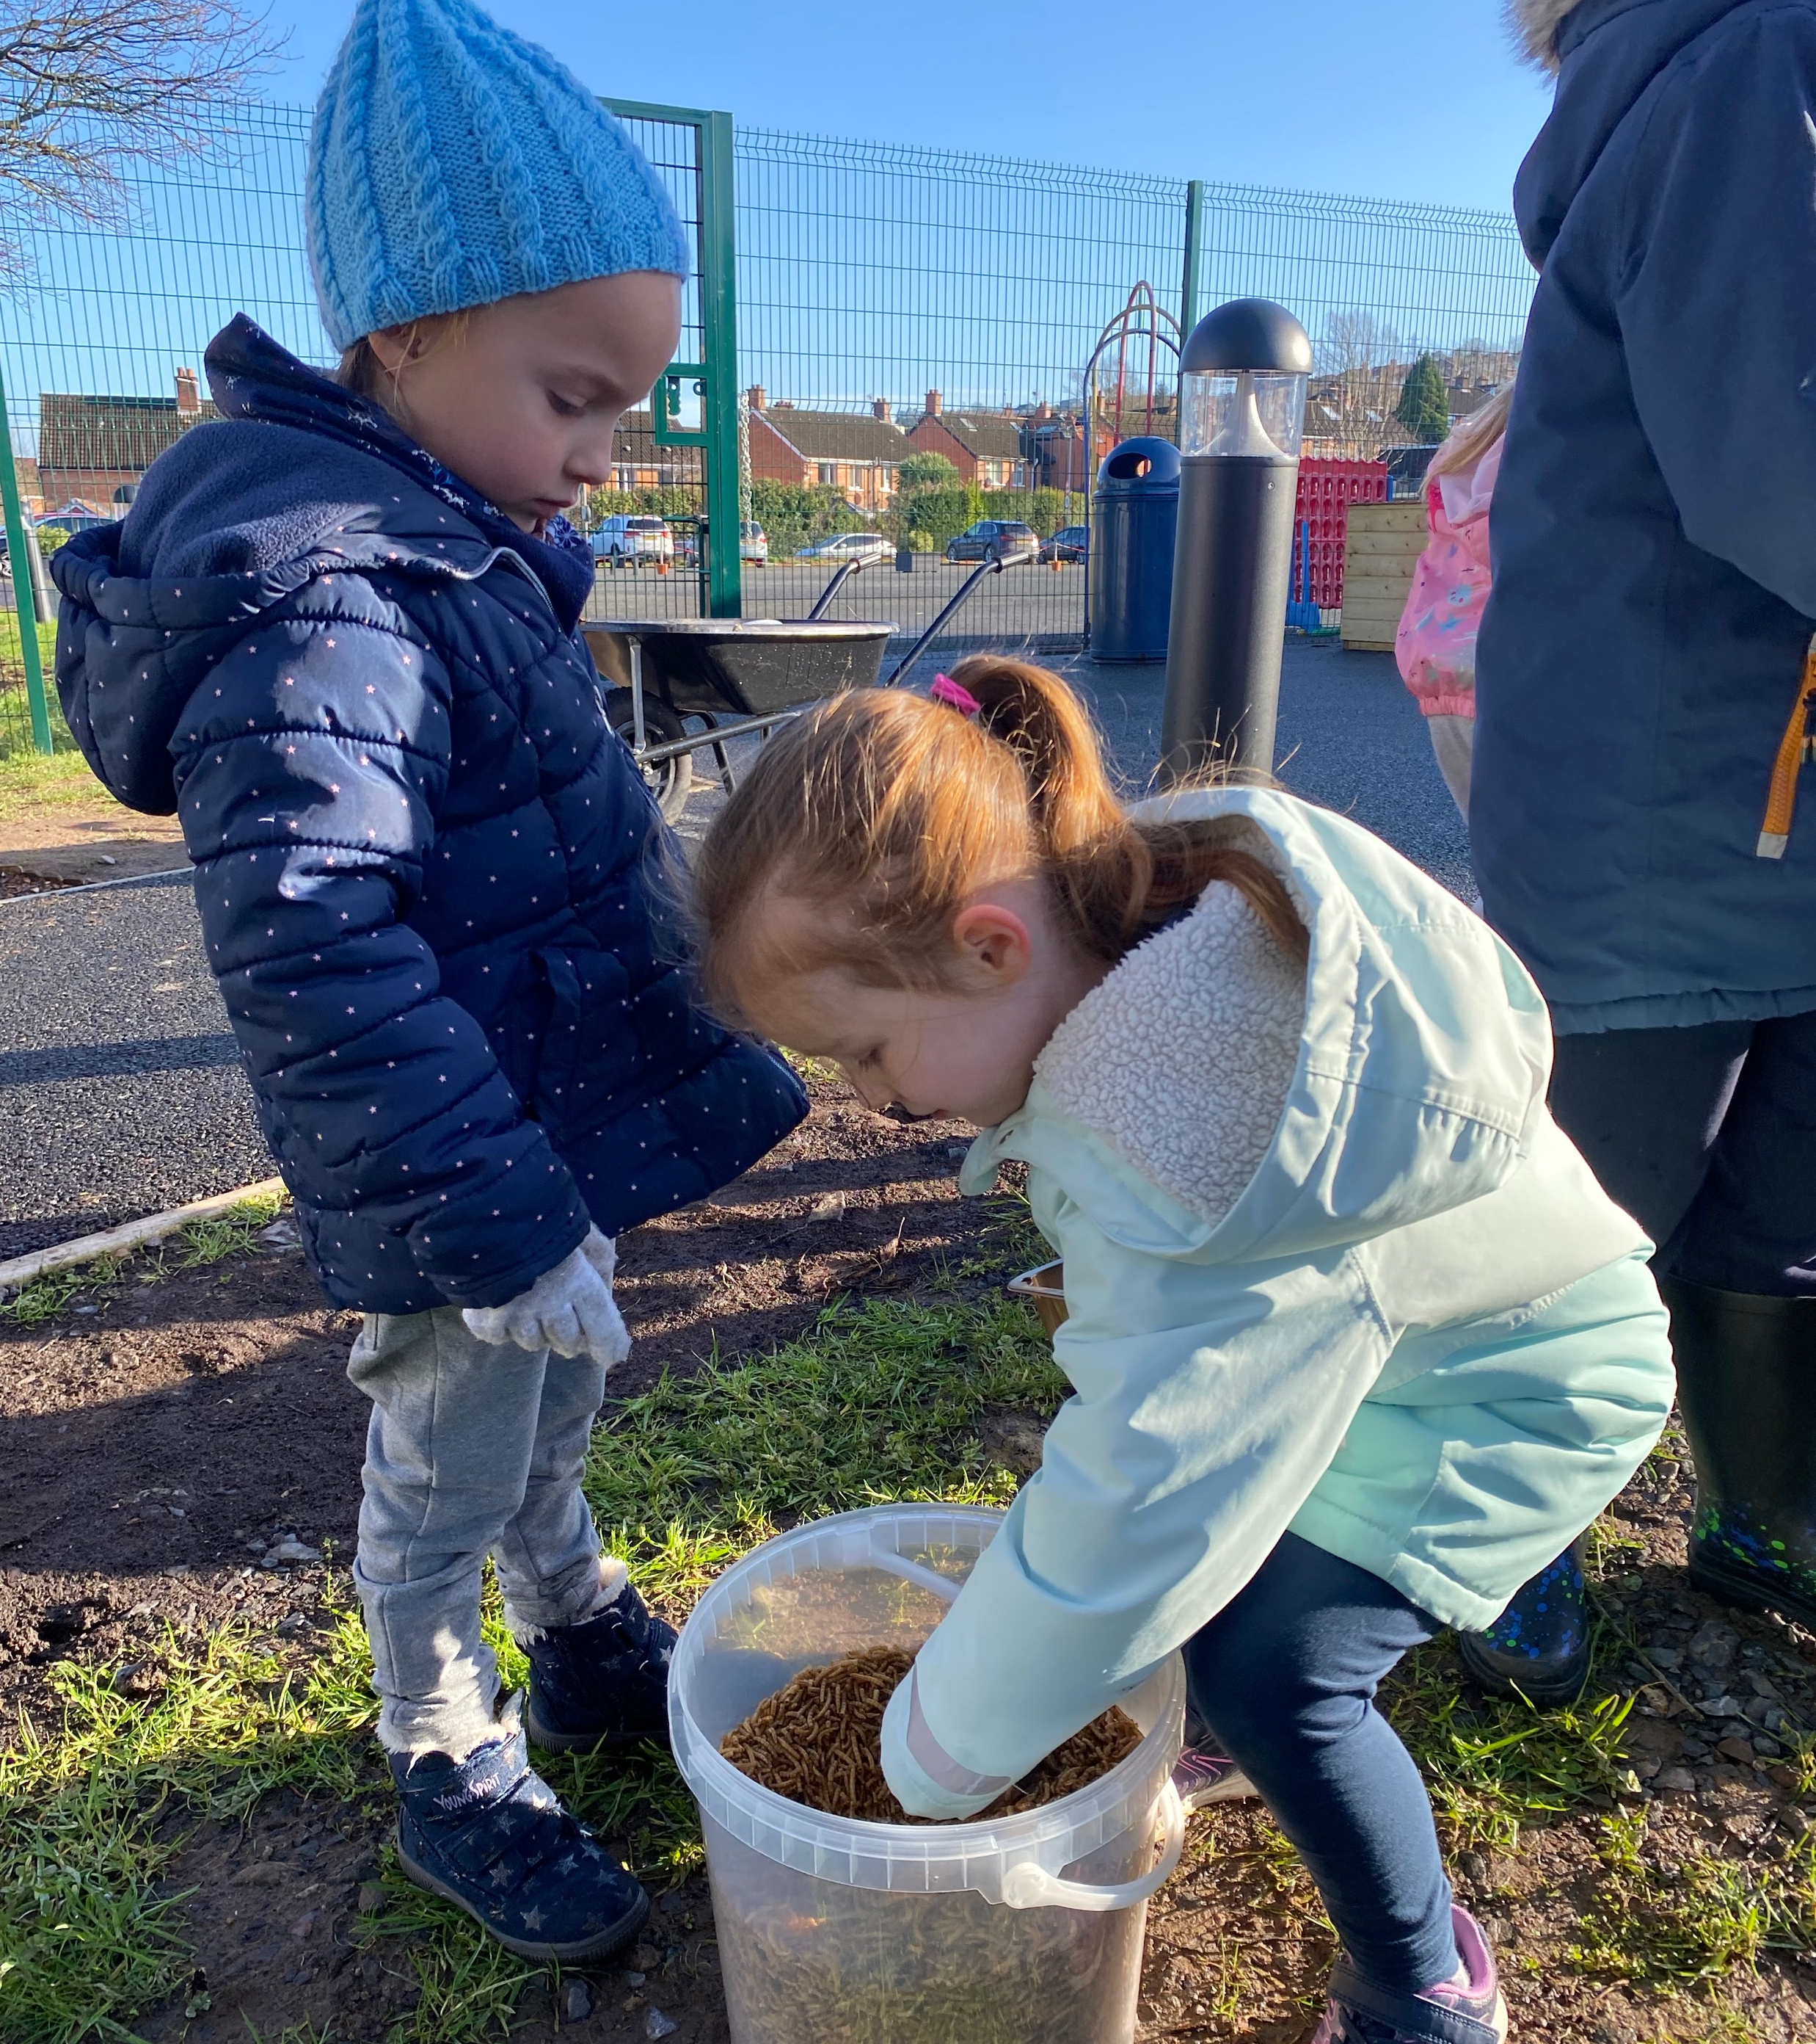
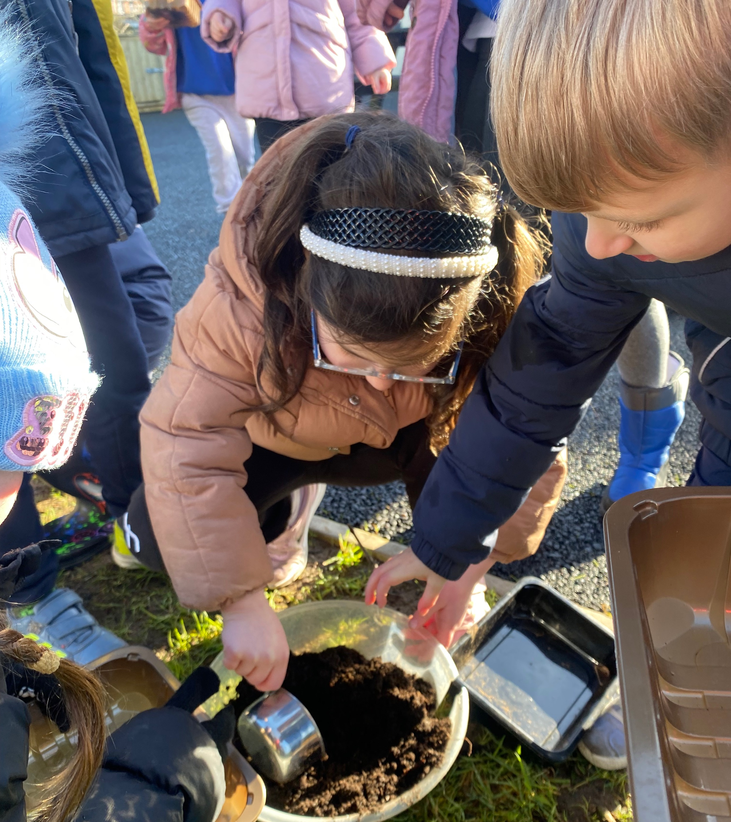
Measuring ingredients for bird feeders

Slide 5
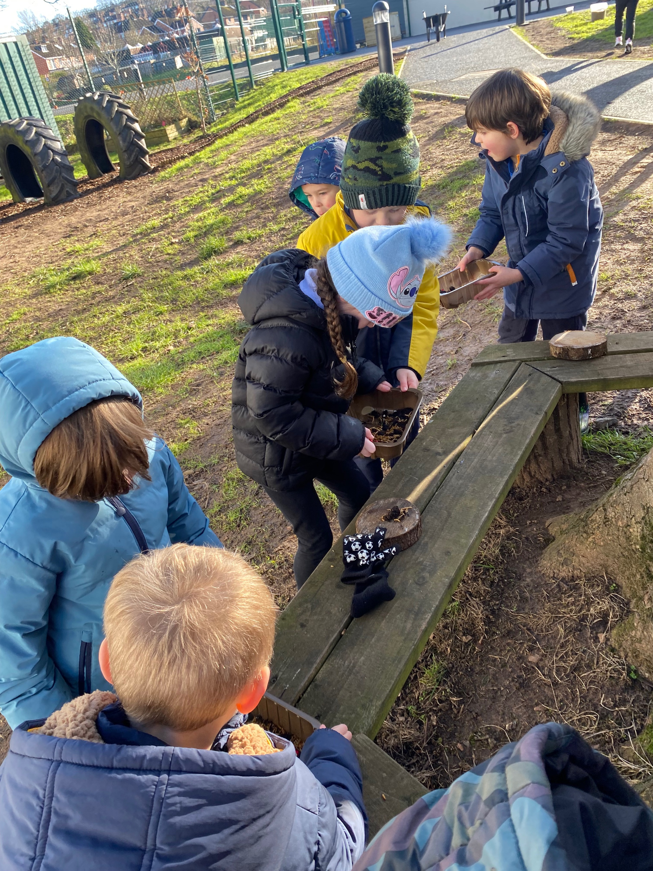
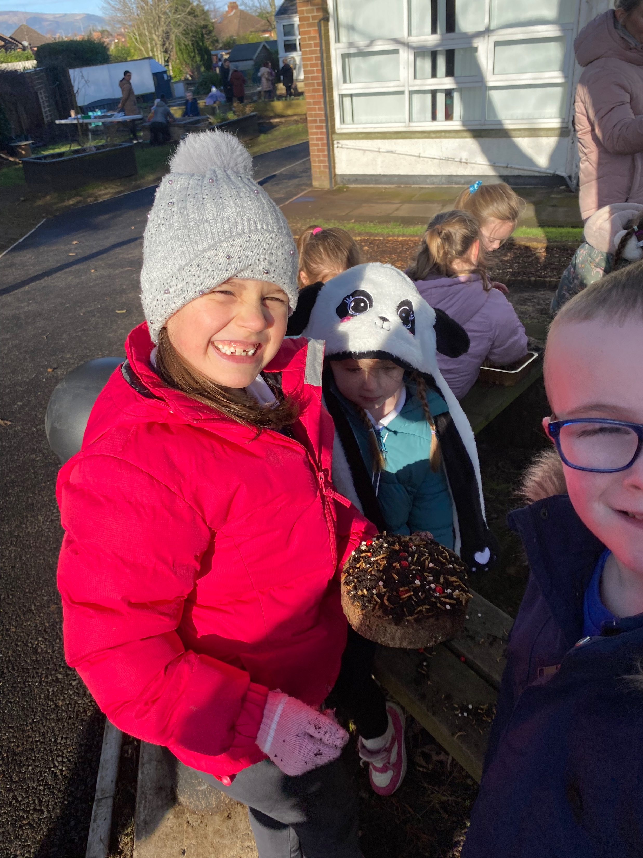
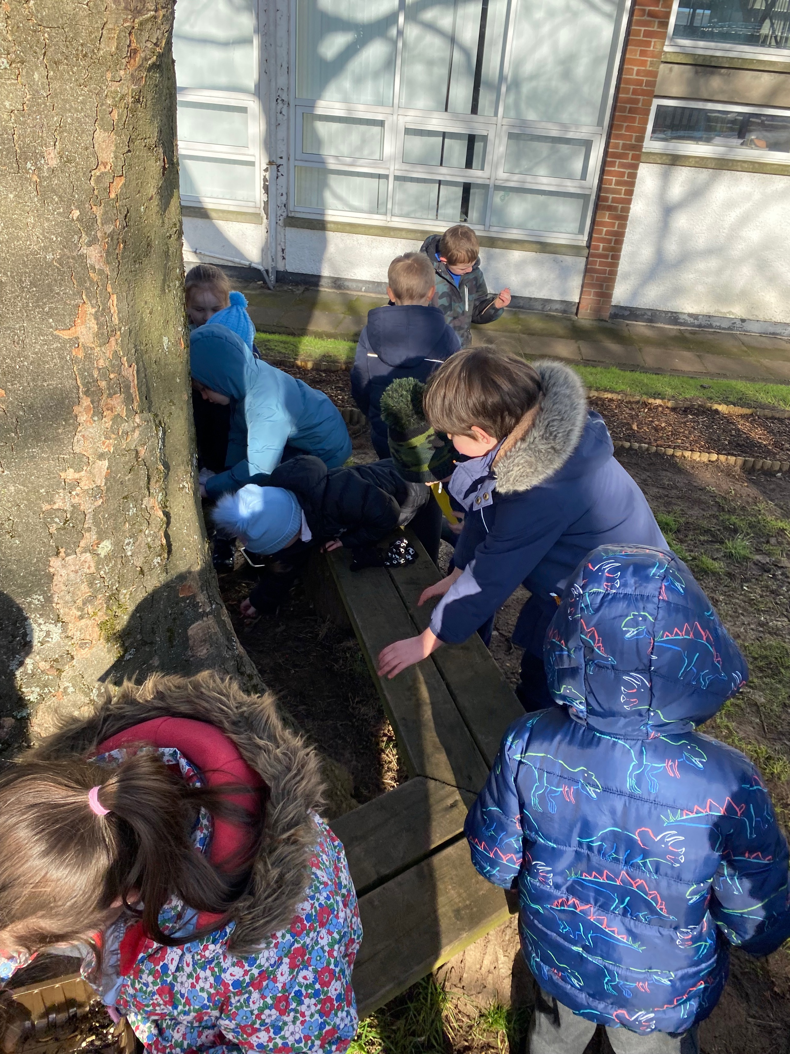
Everybody working together to make their bird feeder pizzas

Slide 6
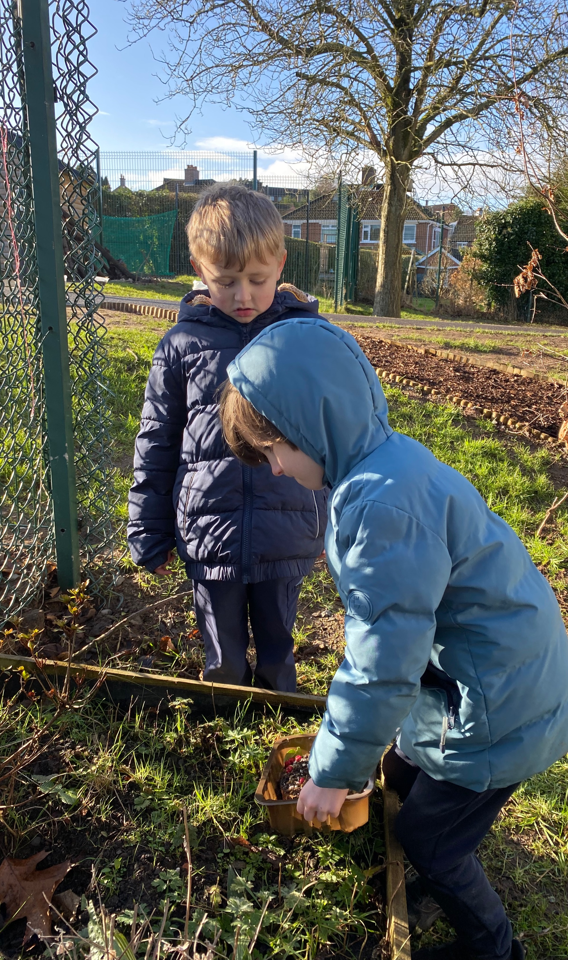
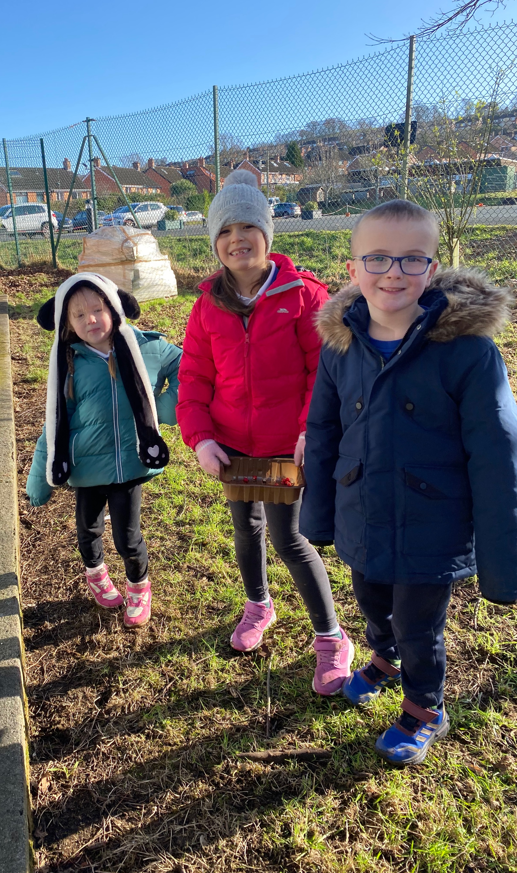
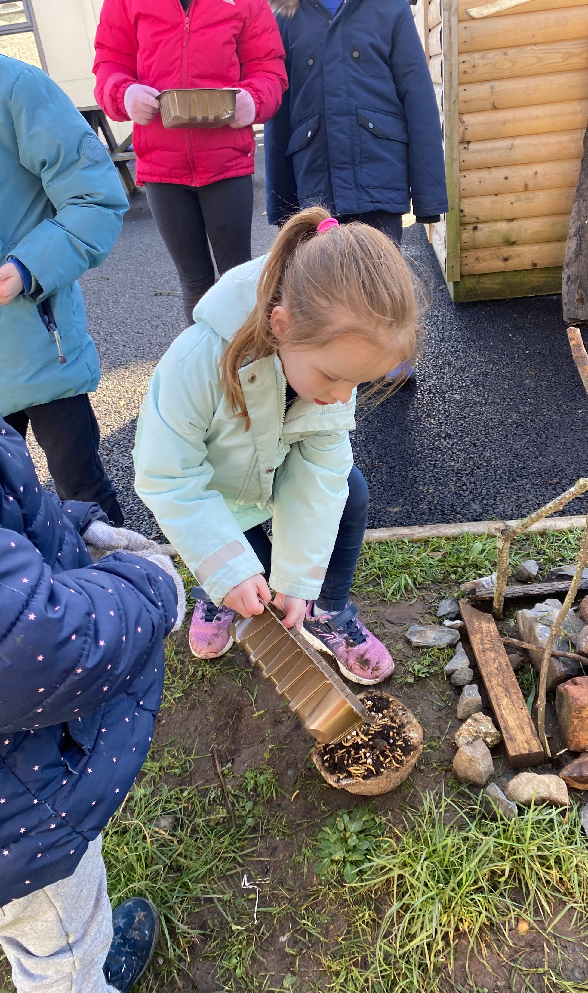
Placing the bird feeders throughout the school grounds.

Slide 7
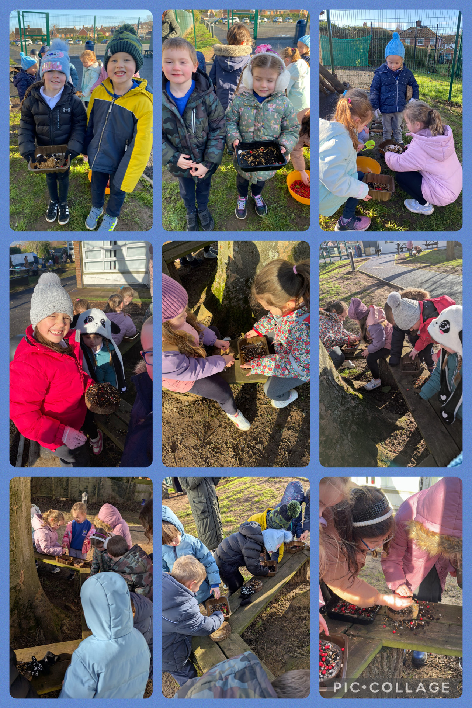
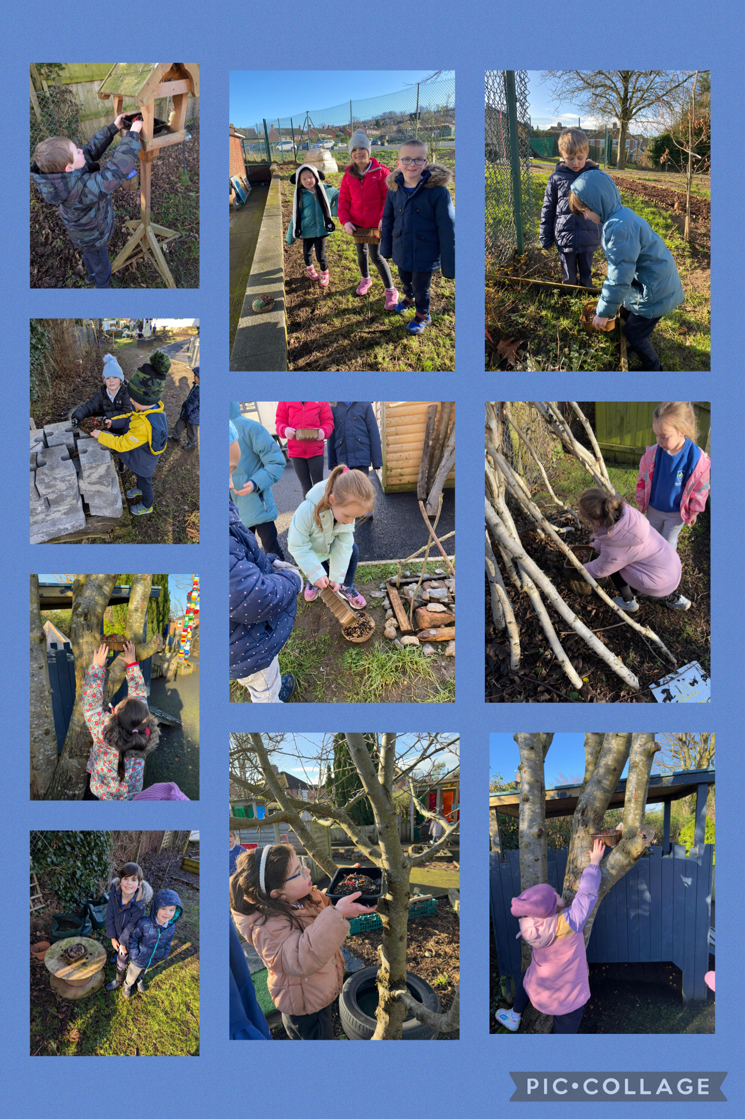
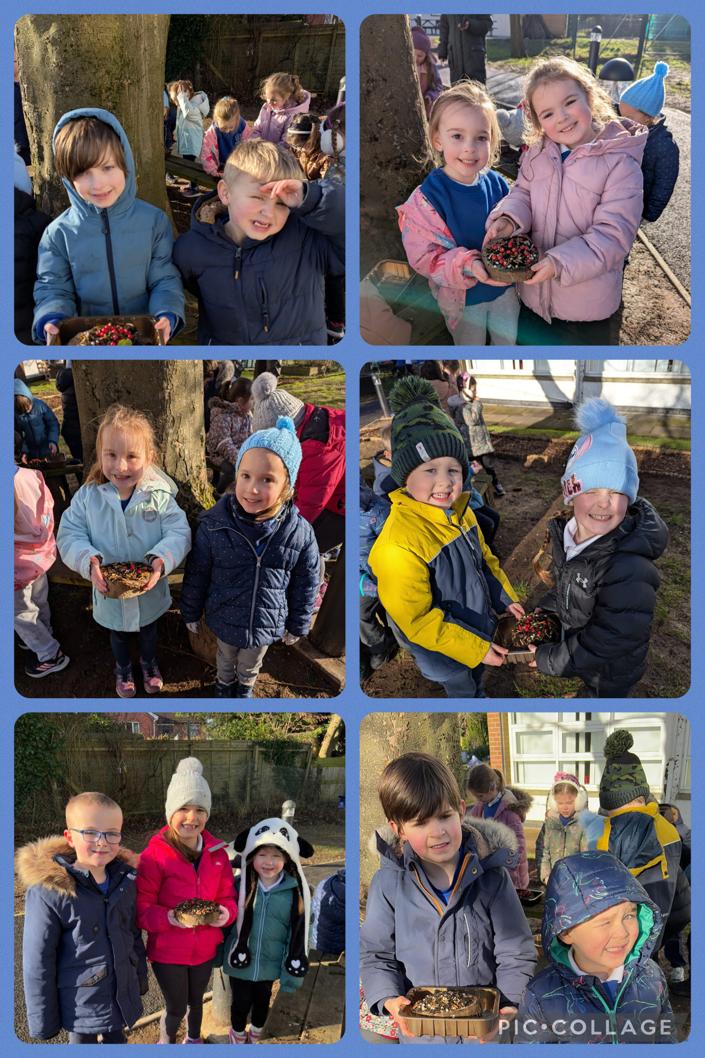
Making Pizza bird feeders

Slide 8
P2 all enjoyed their Forest School session

