Slide 1
Primary 2
Forest School Diary 2024/2025
Mrs Gamble

Slide 2
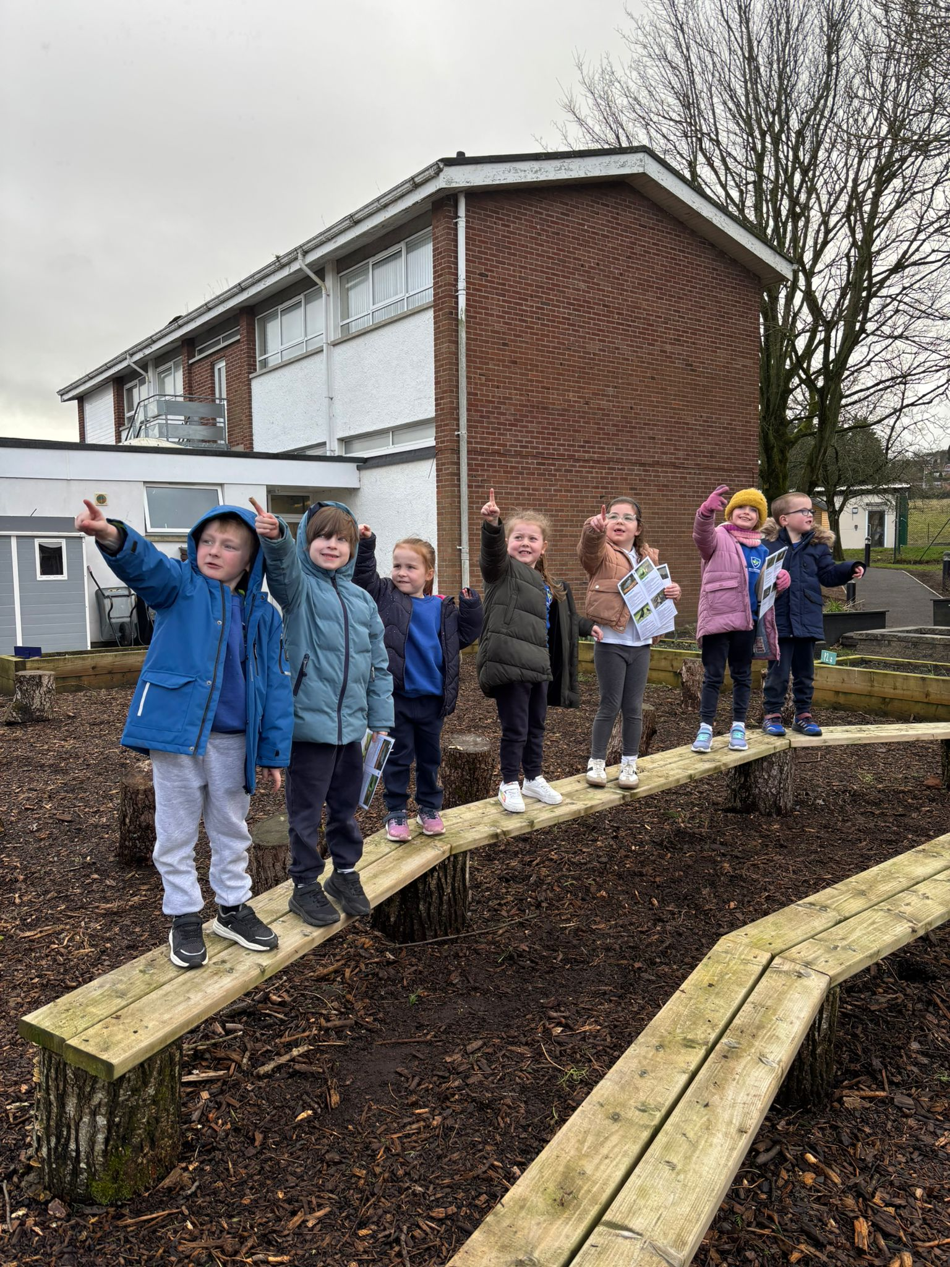
Lesson 3 – Tuesday 28th January 2025
We met in our circle, to talk about our activity and our forest school rules.
1 whistle – freeze
2 whistles – return
Agreed to have fun, learn and leave no trace
Volunteers set our boundaries with some adult help.

Slide 3
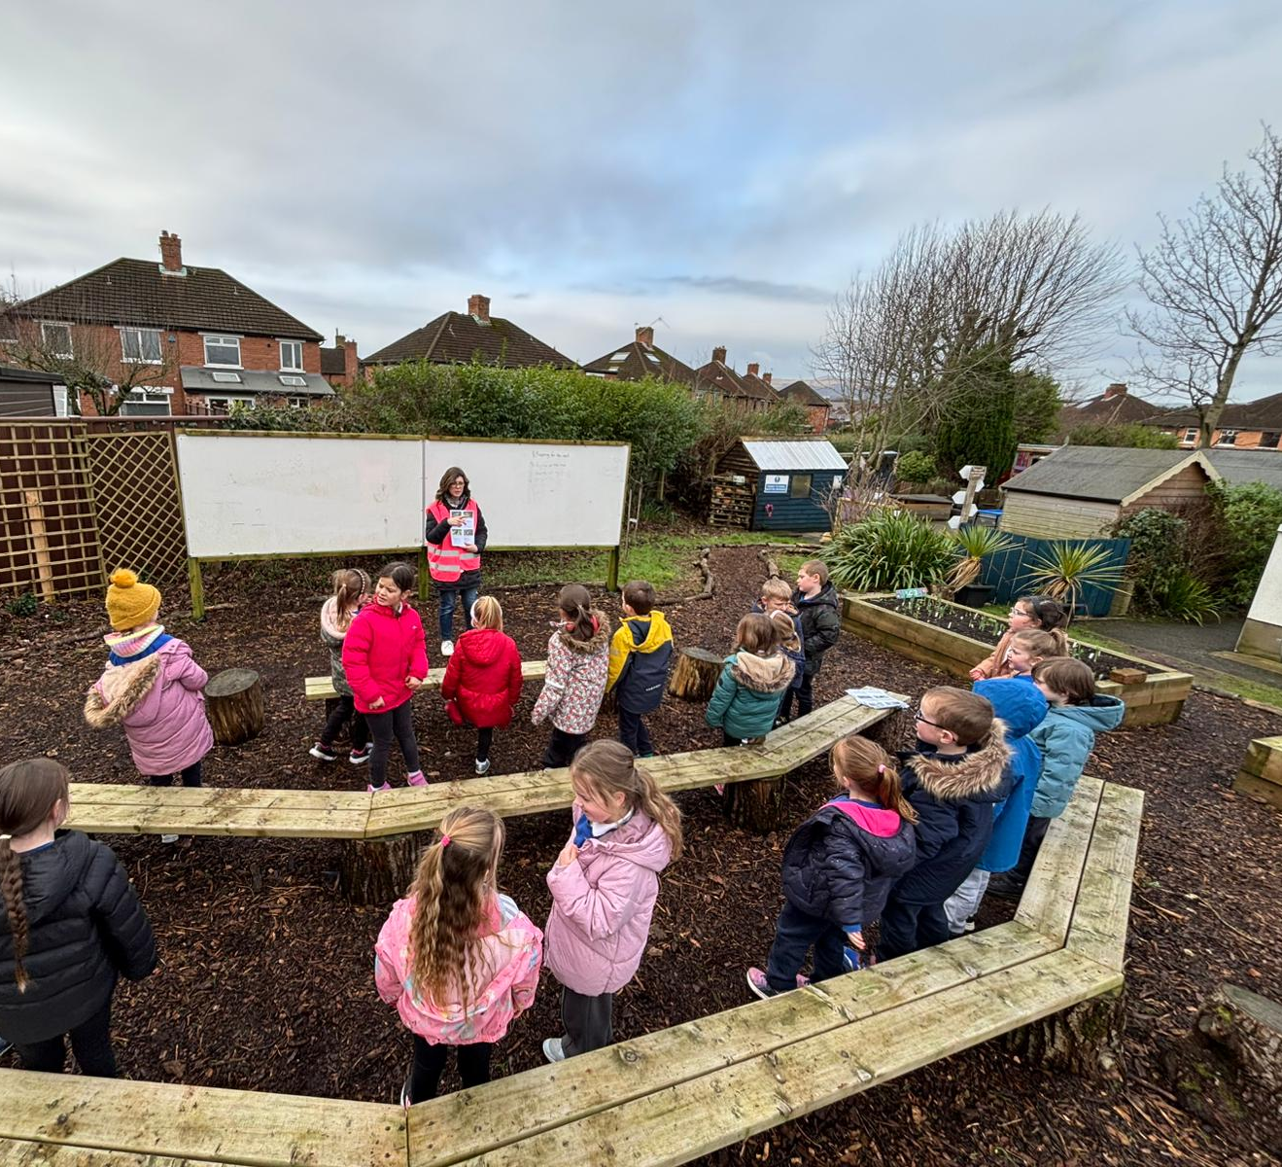
Using the natural resources to create pictures.

Slide 4
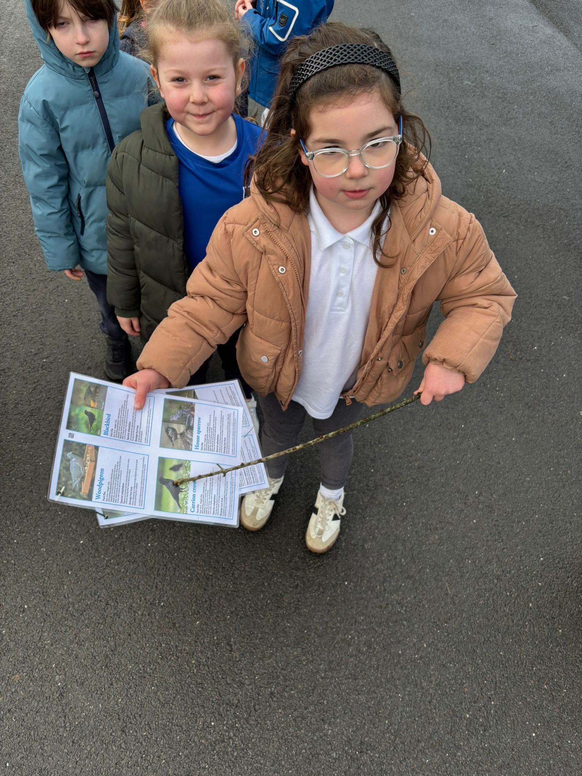
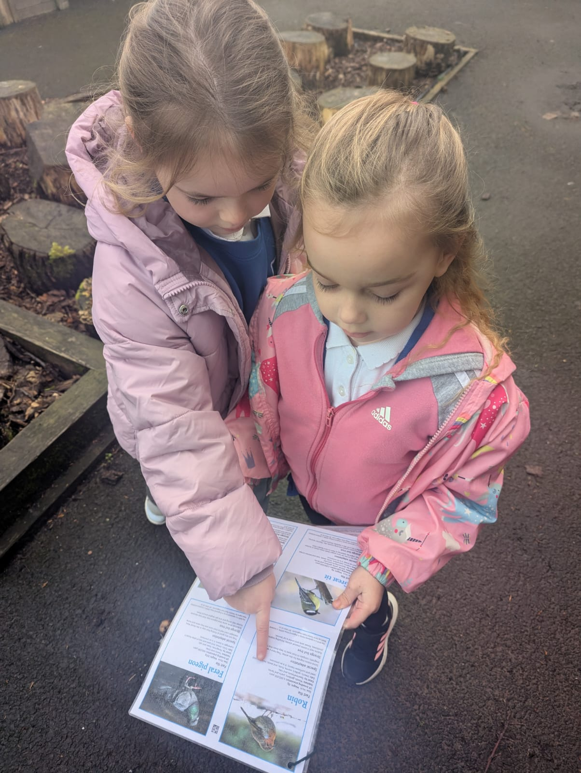
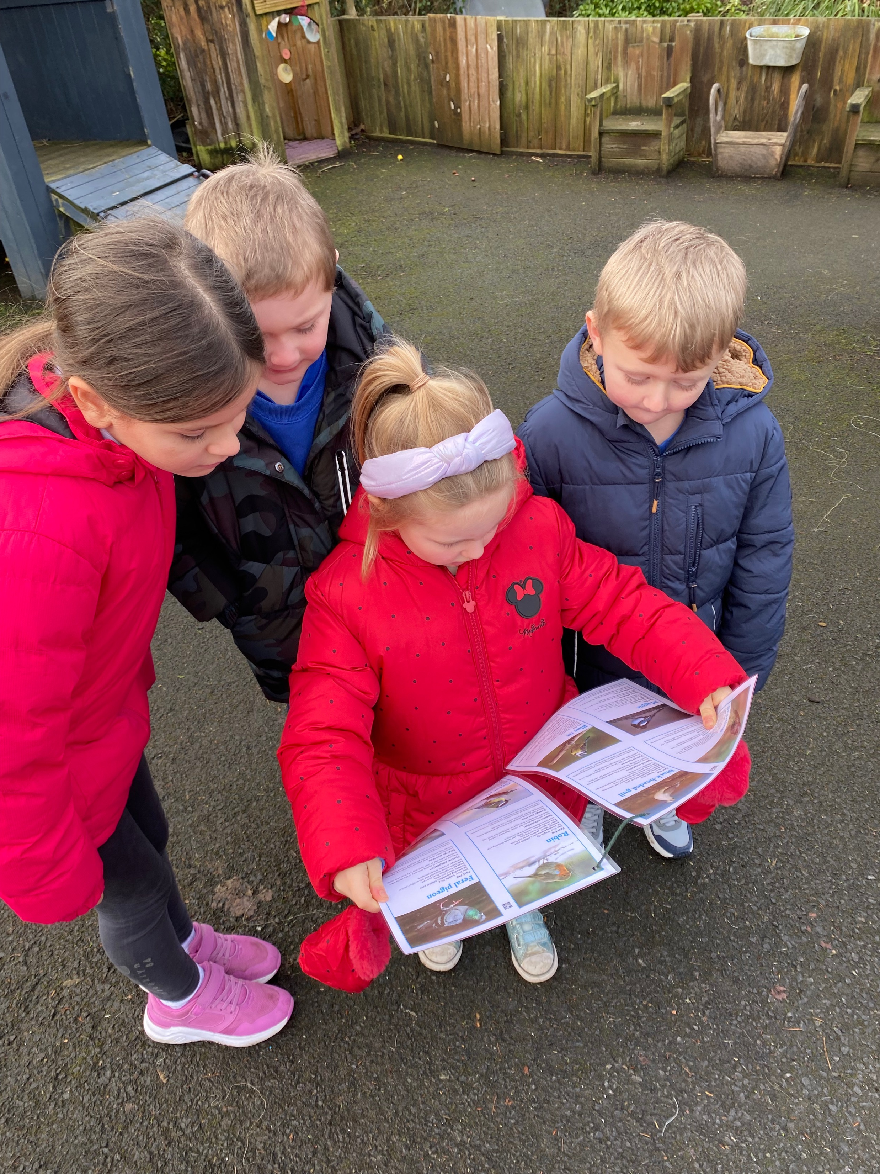
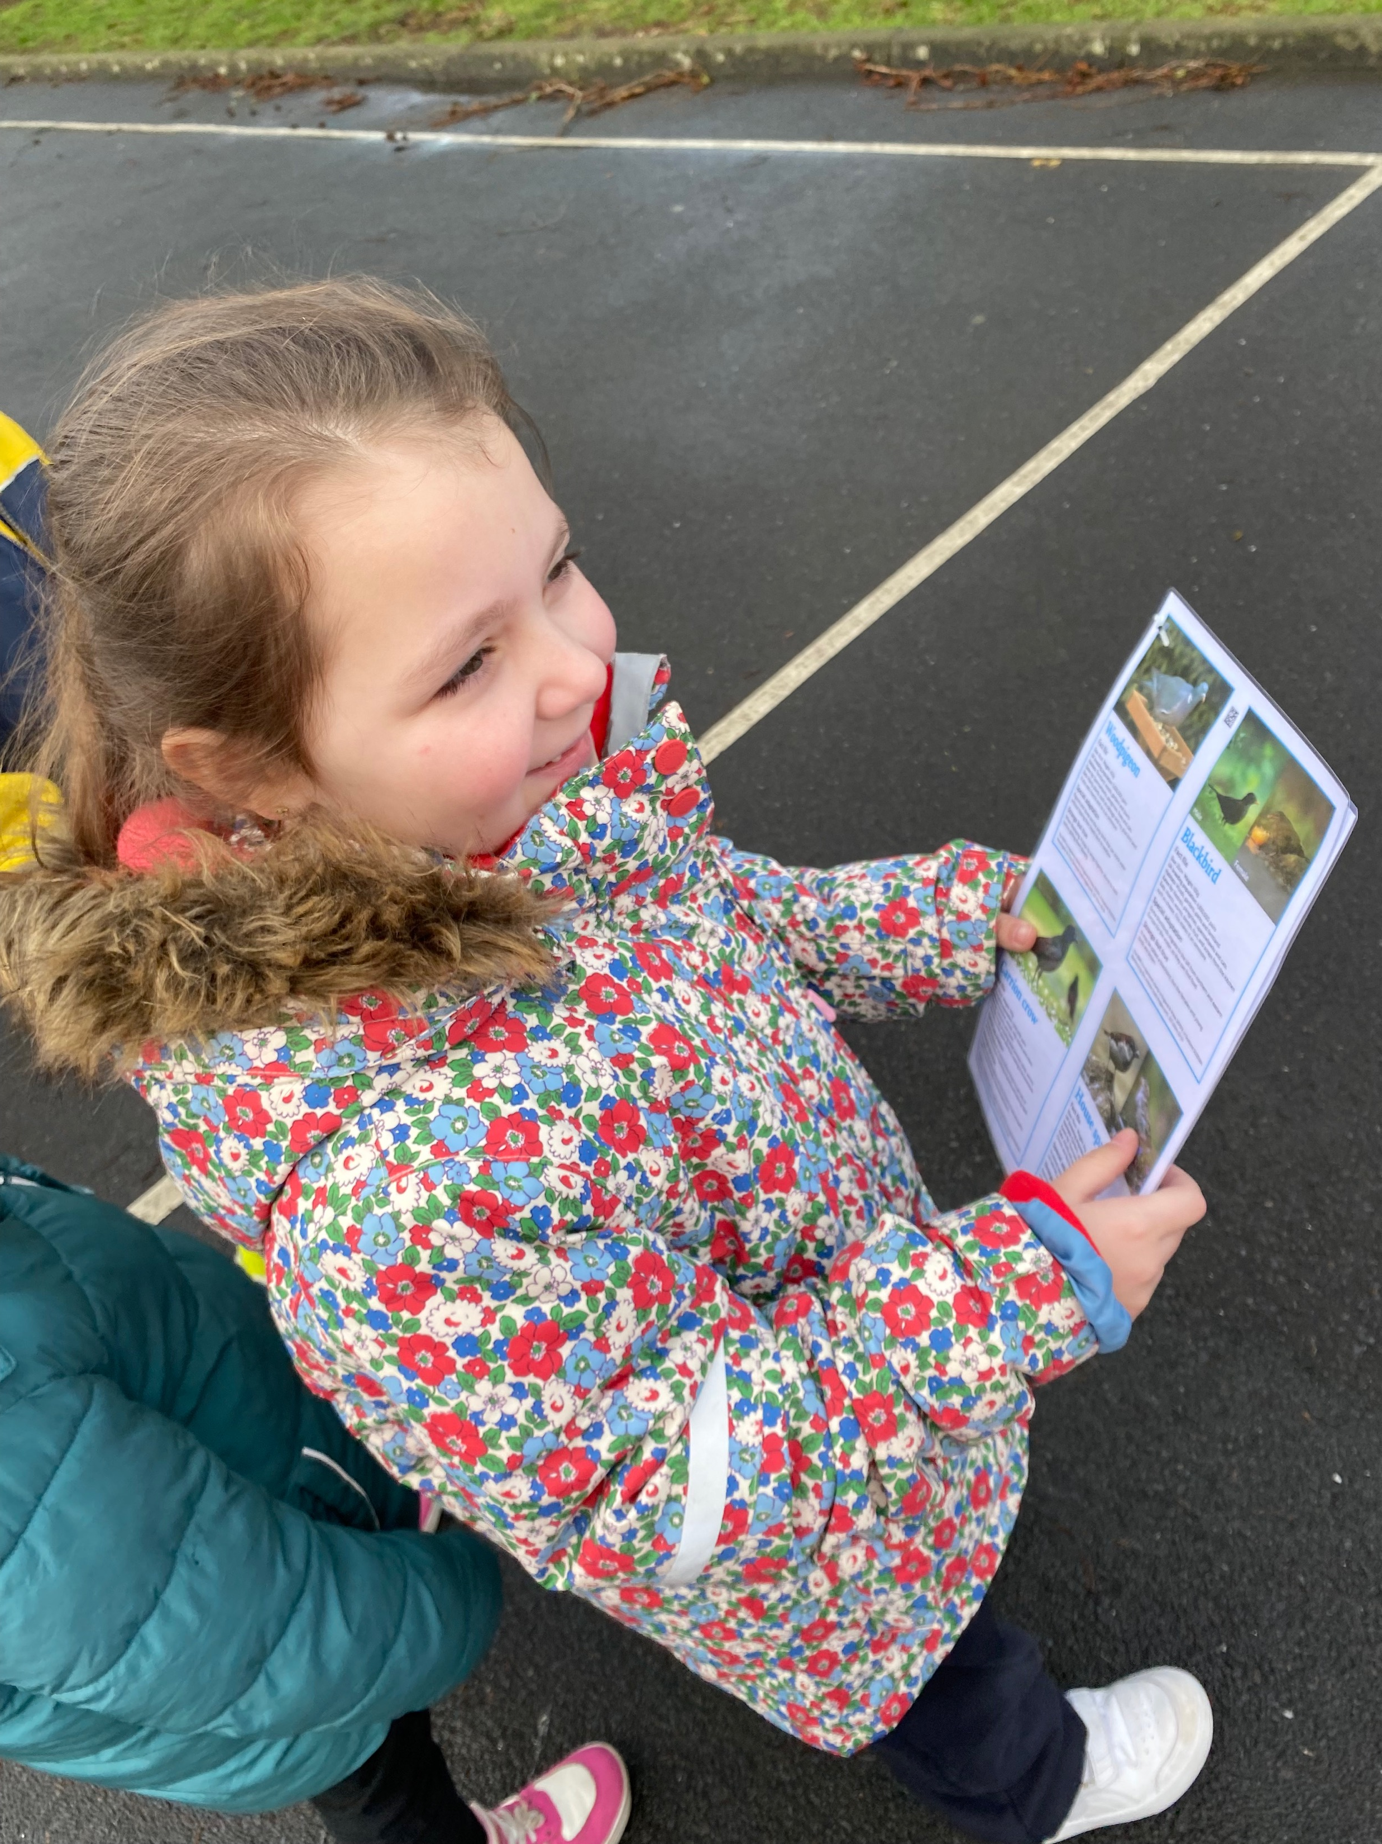
On the hunt for Birds

Slide 5
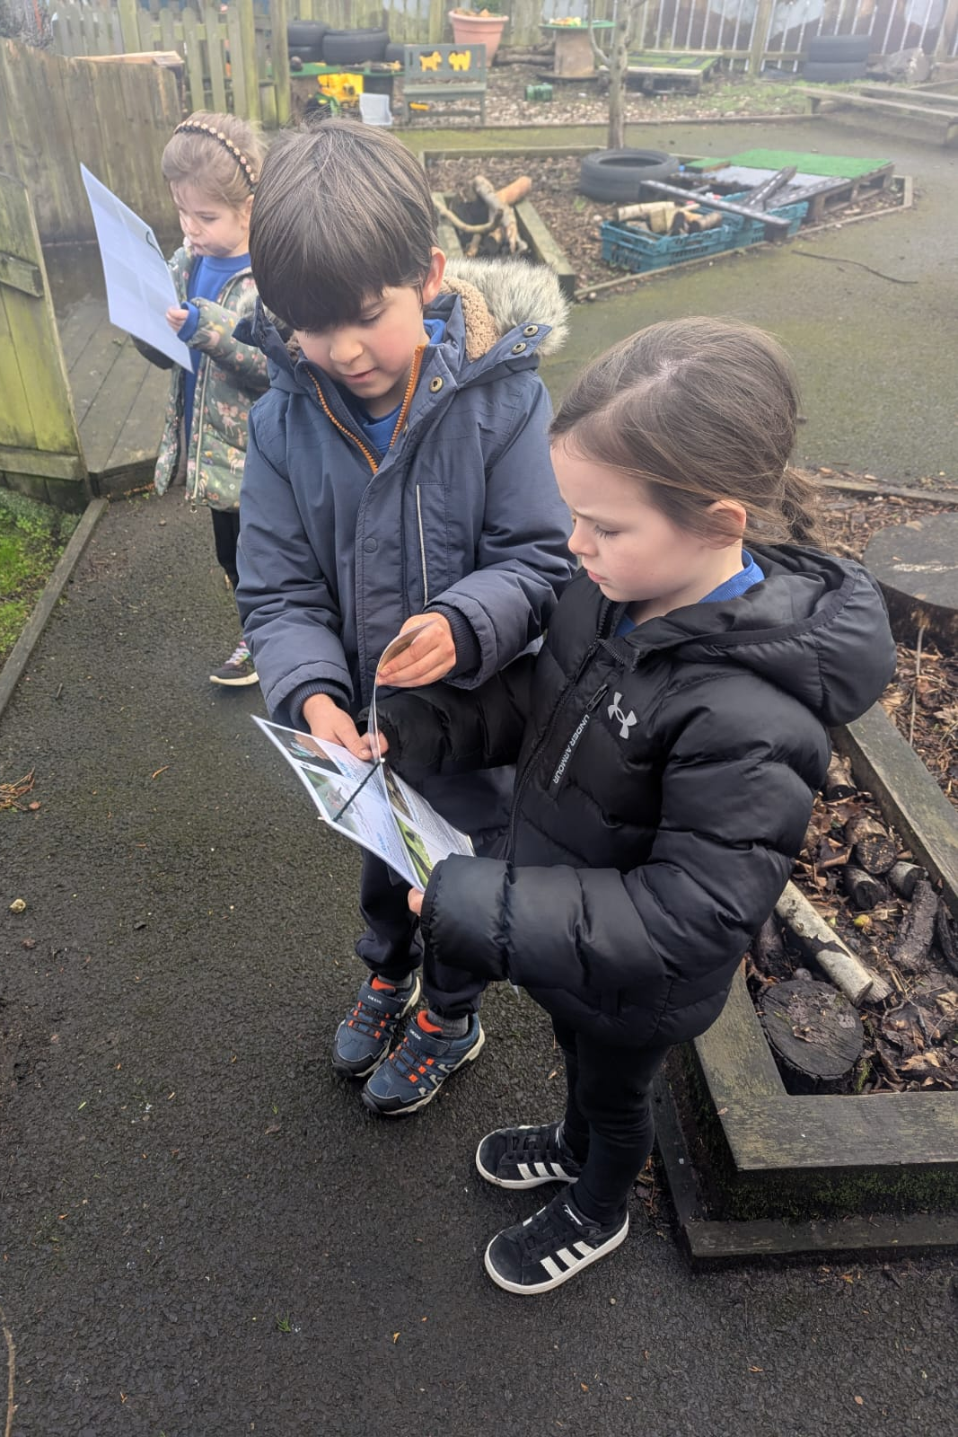
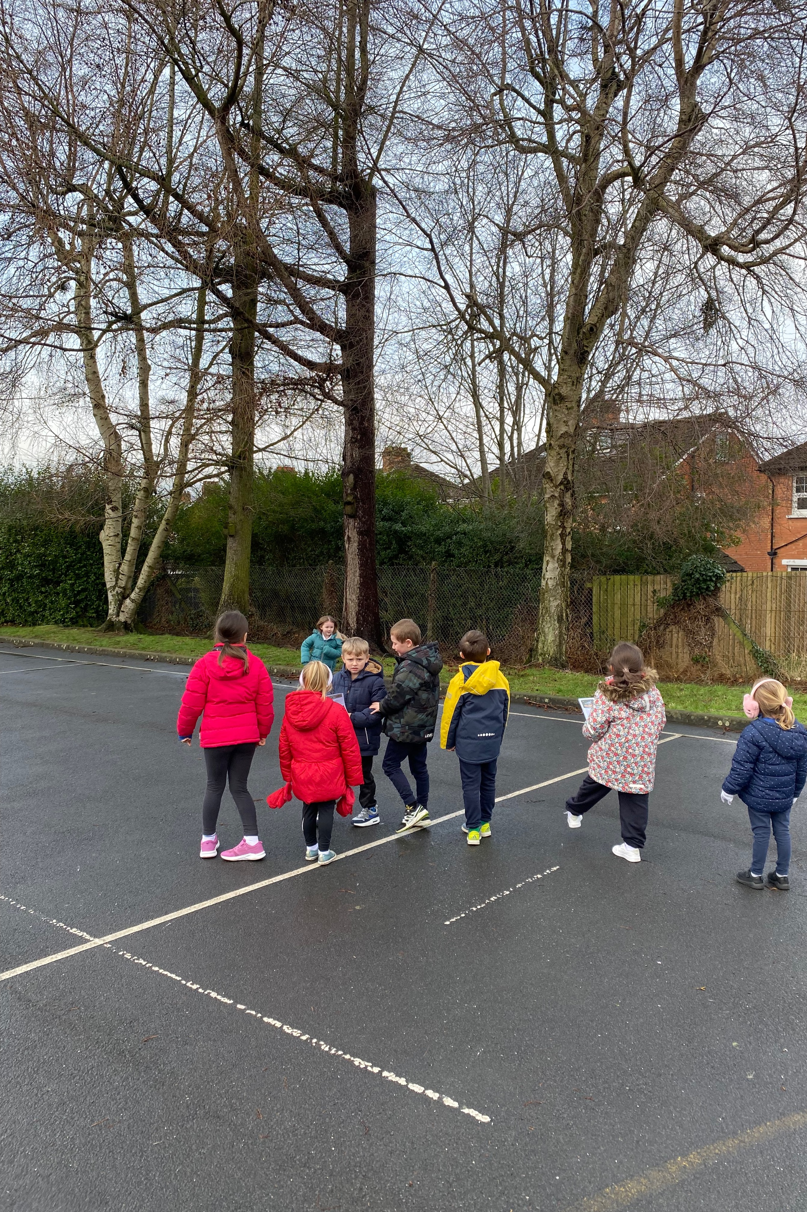
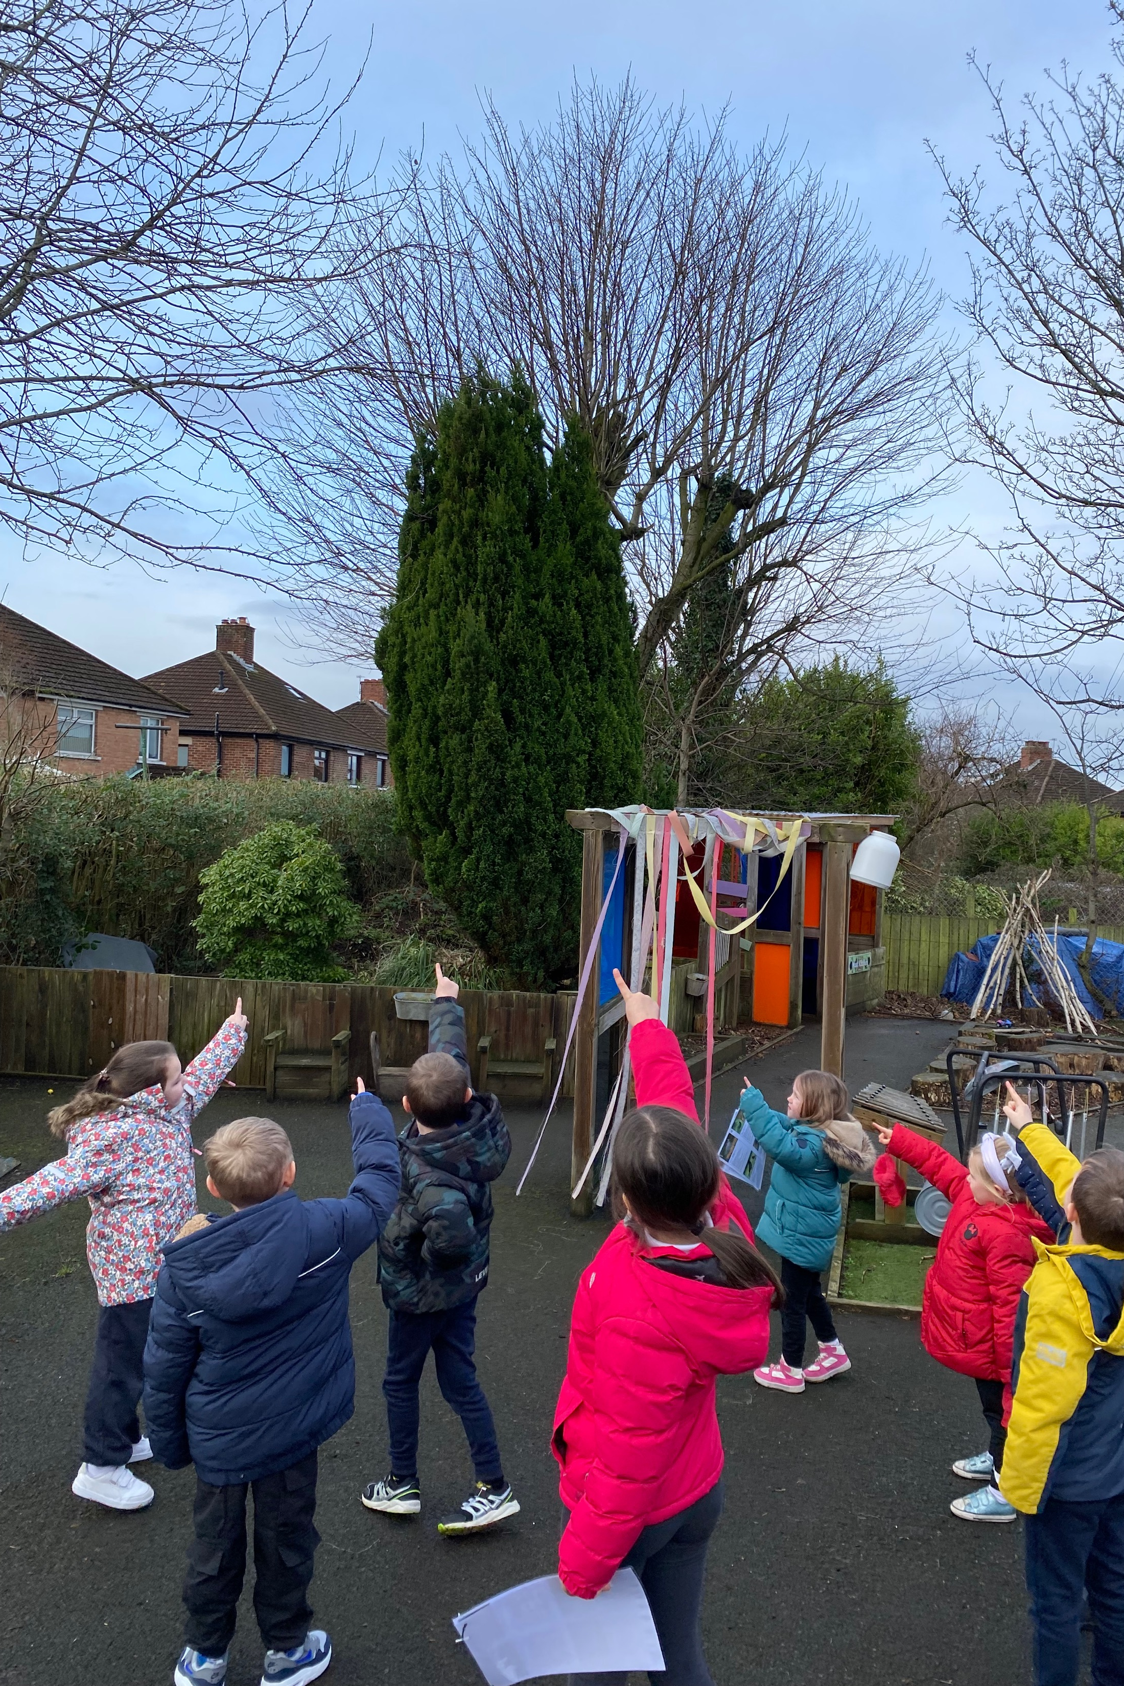
Everybody working together to look for birds in our school grounds

Slide 6
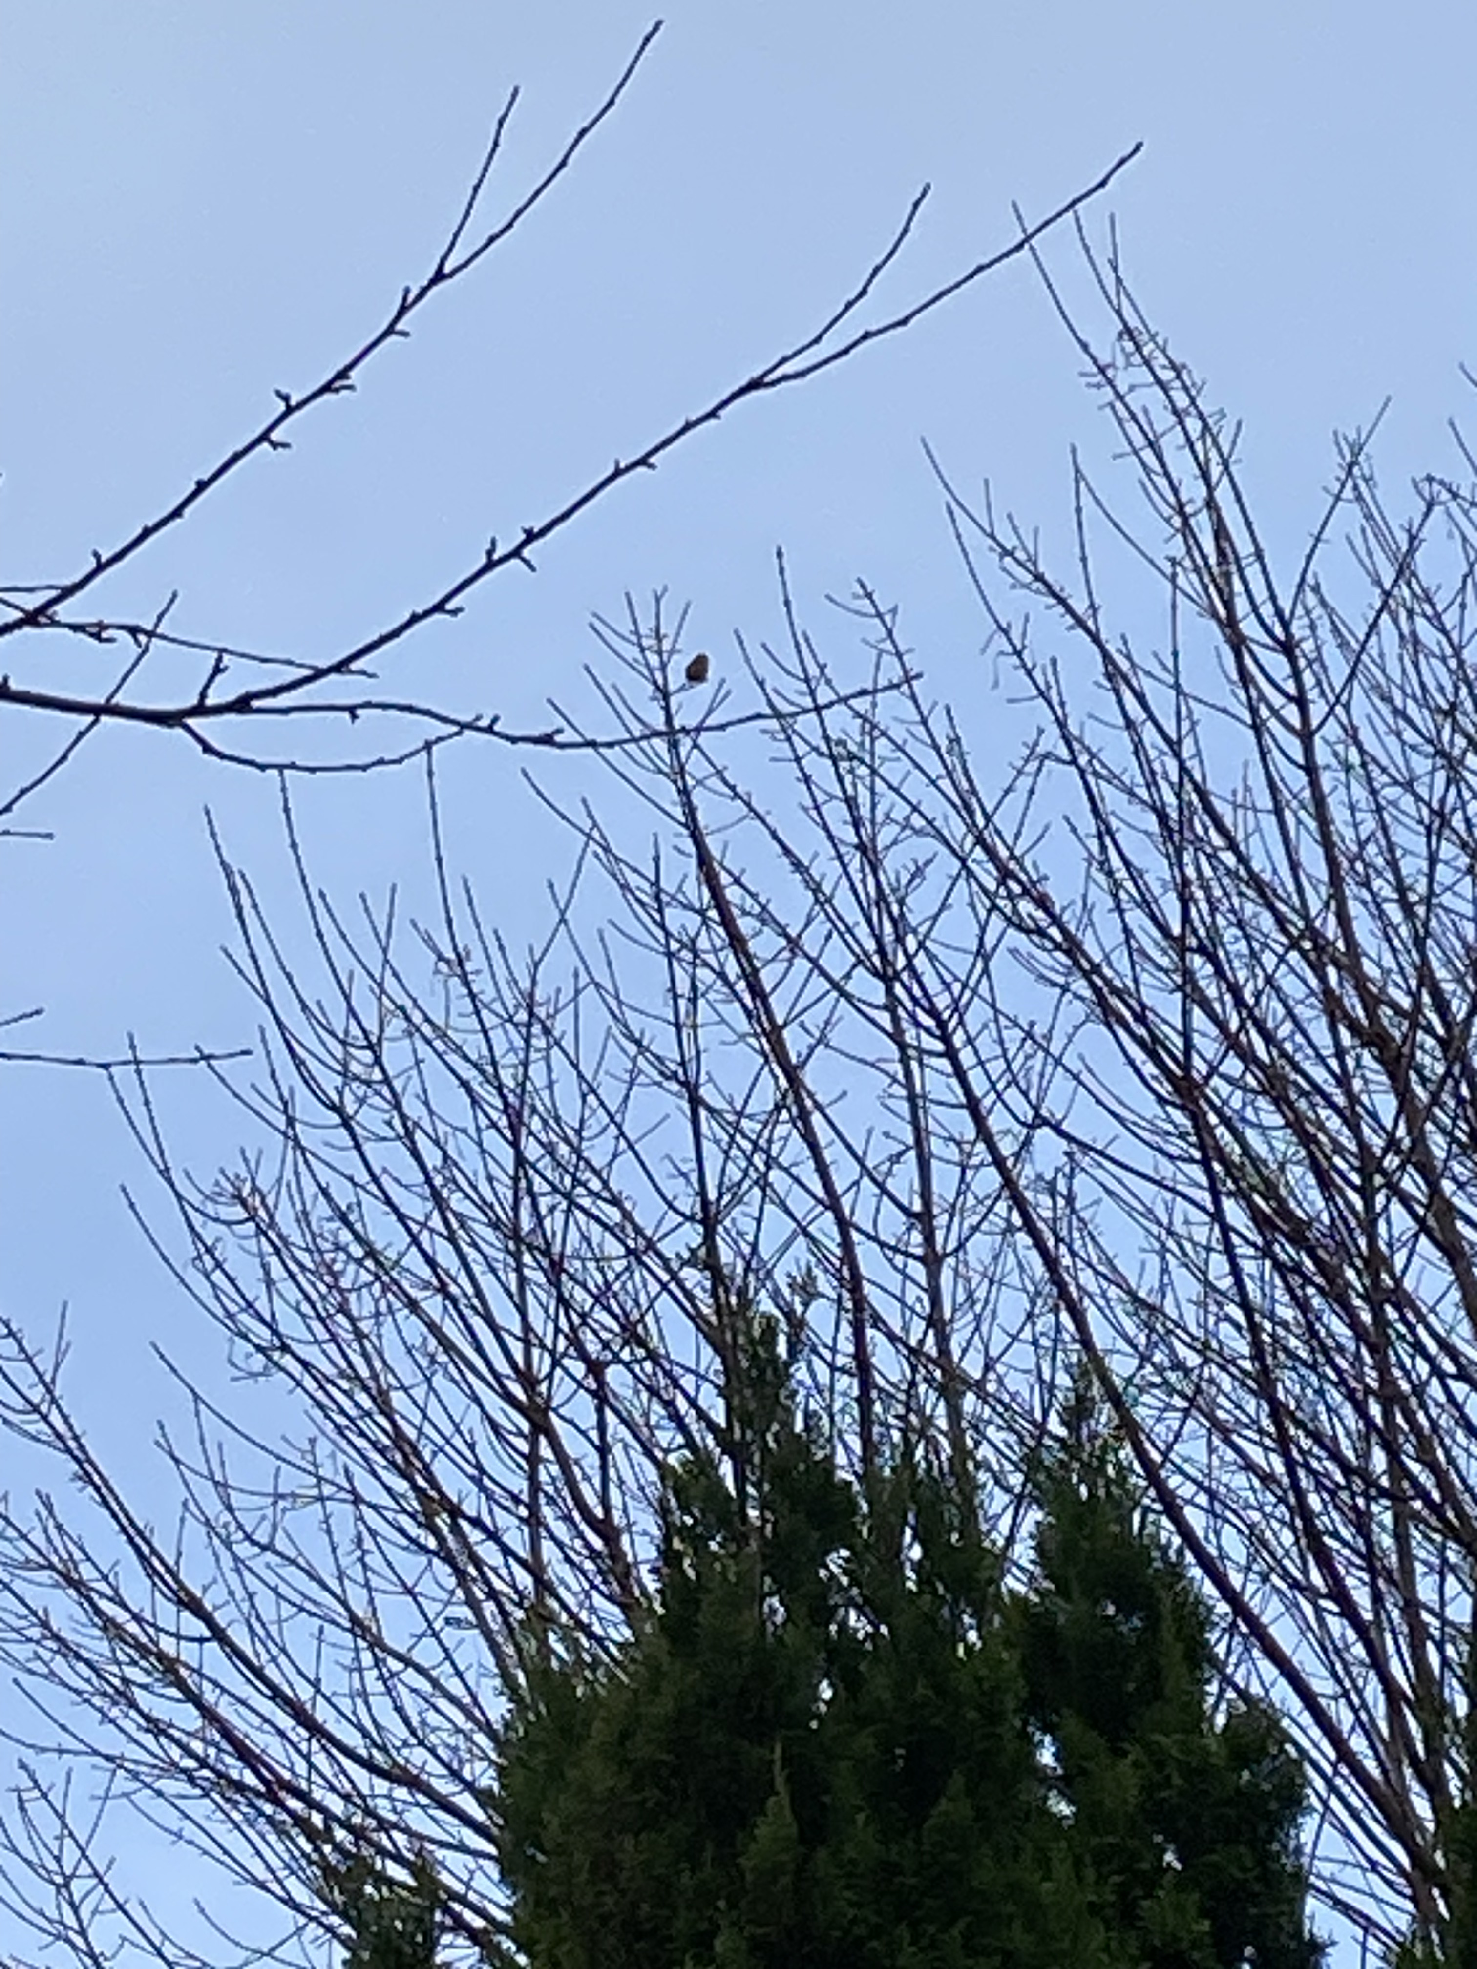
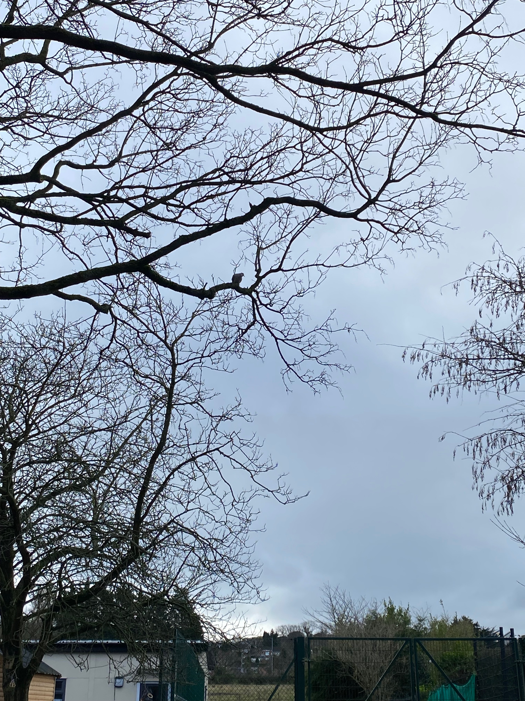
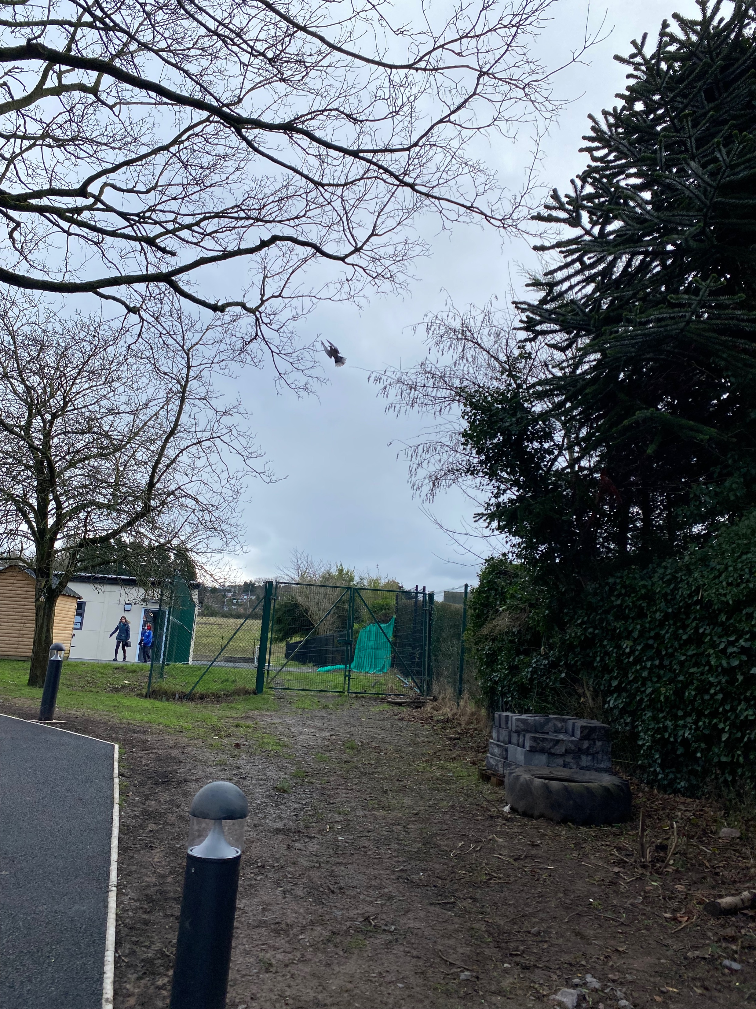
Spotting birds in our school grounds.

Slide 7
P2 all enjoyed their Forest School session

