Slide 1
Primary 2
Forest School Diary 2024/2025
Mrs Gamble

Slide 2
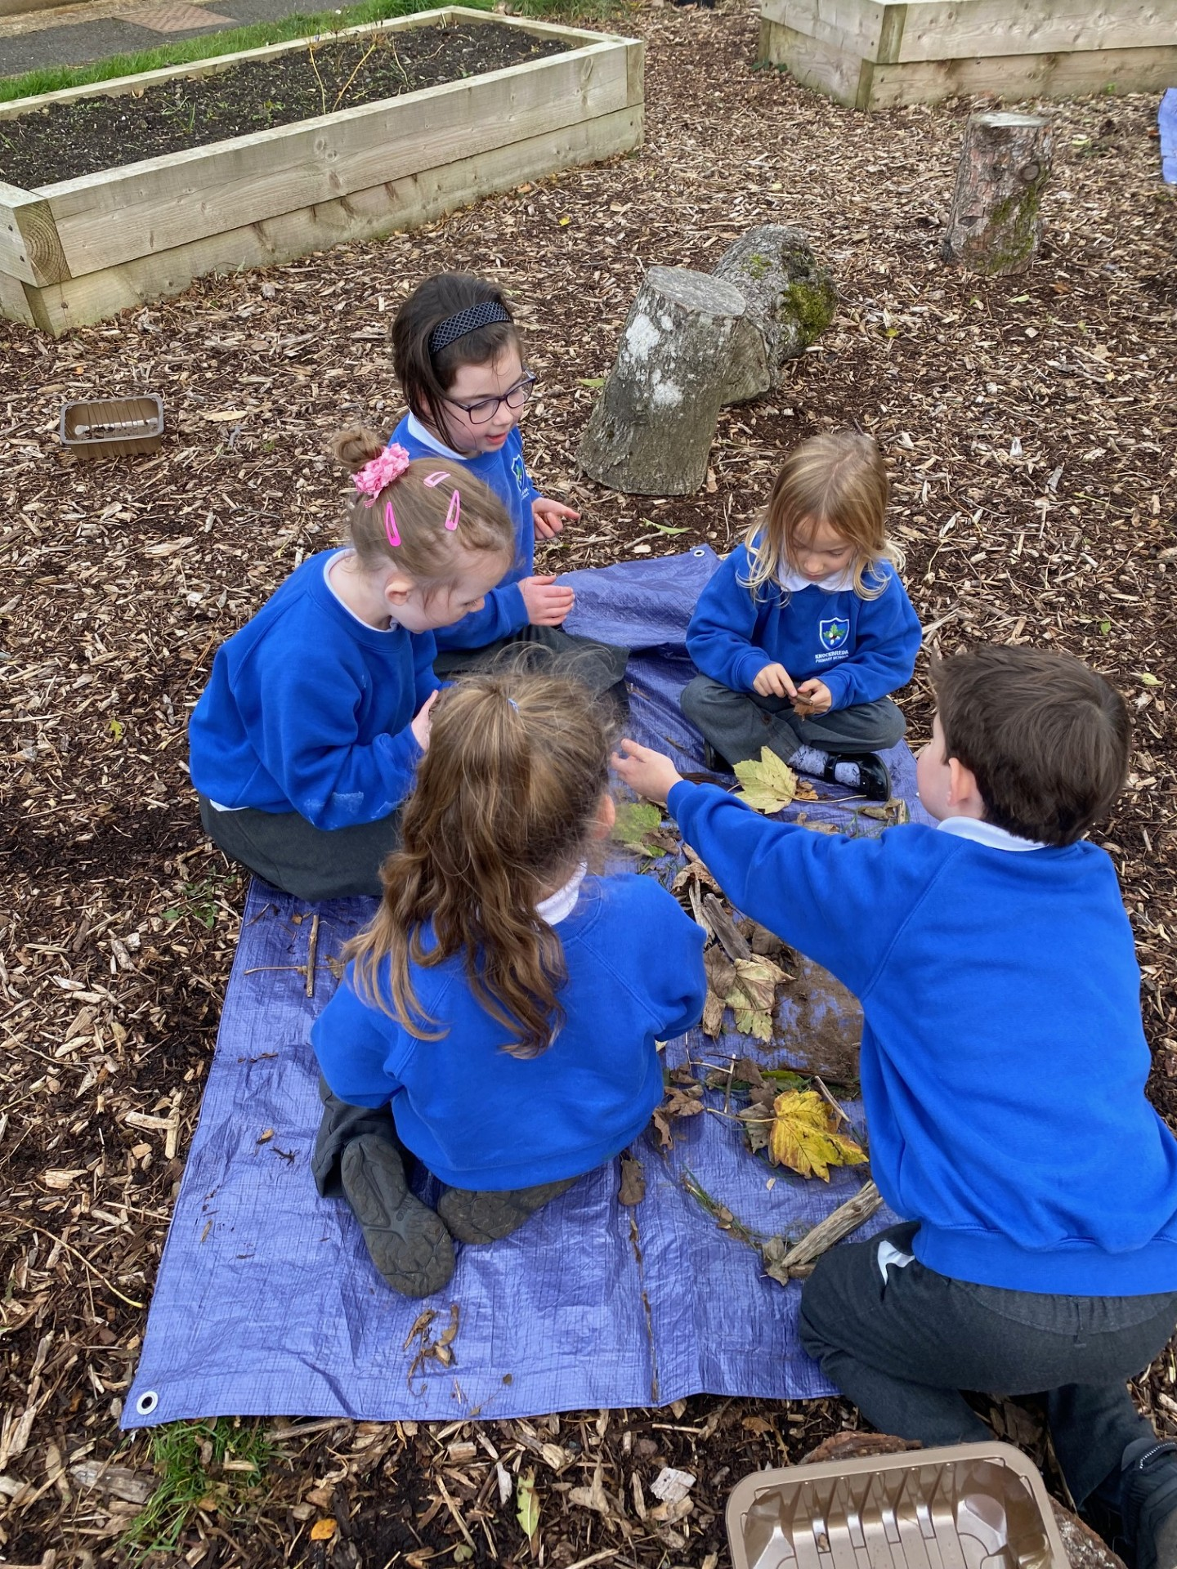
Lesson 2 – Wednesday 23rd October 2024
We met in our circle, to talk about our activity and our forest school rules.
1 whistle – freeze
2 whistles – return
Agreed to have fun, learn and leave no trace
Volunteers set our boundaries with some adult help.

Slide 3
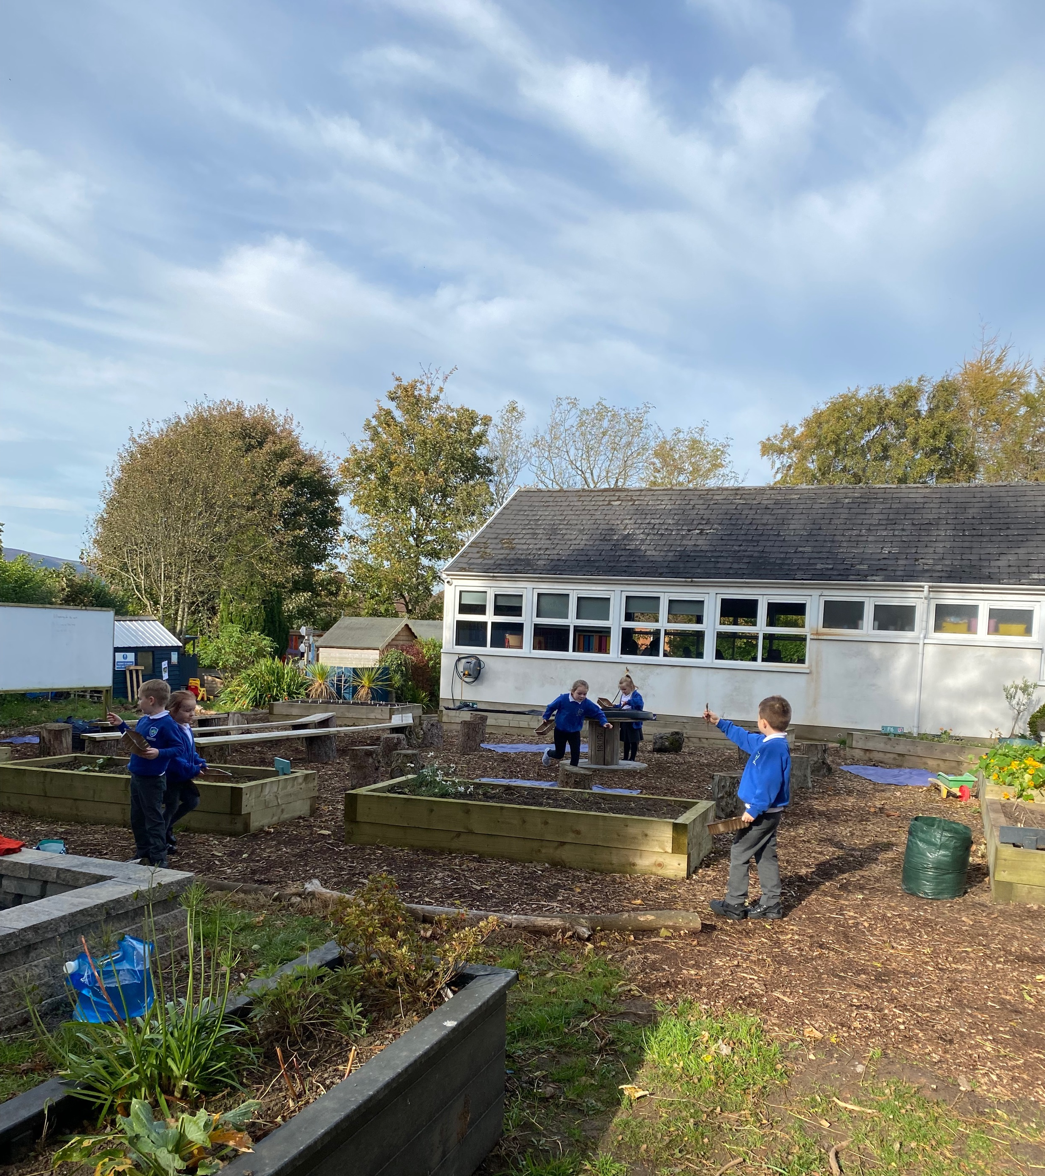
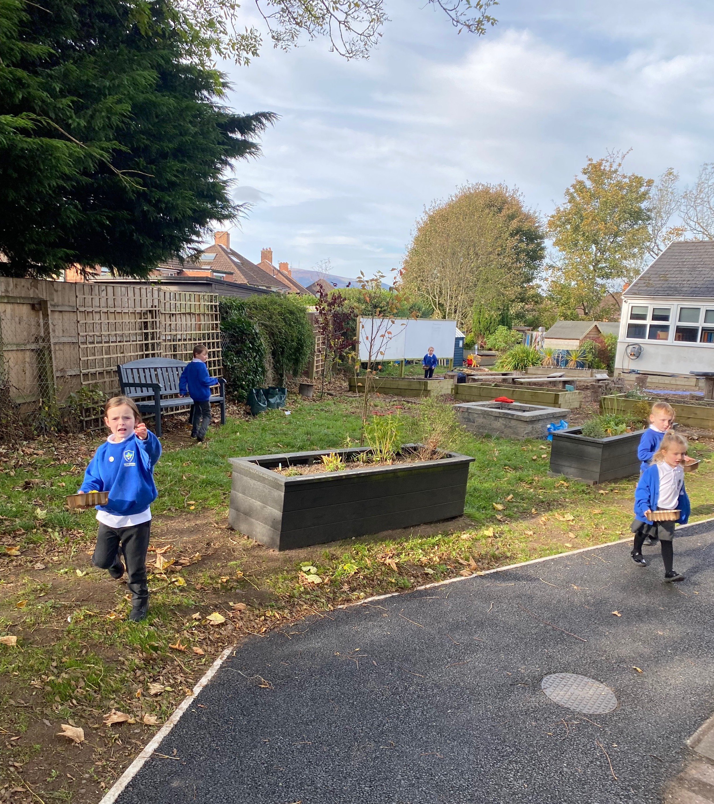
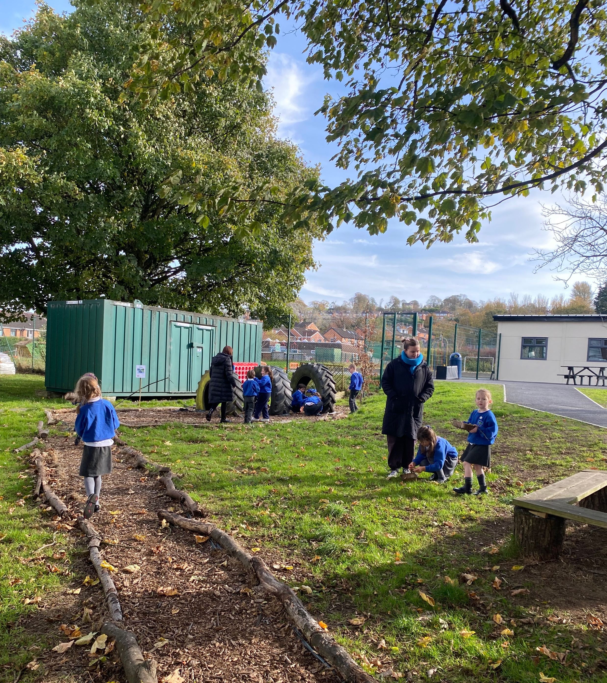
Gathering twigs and leaves

Slide 4
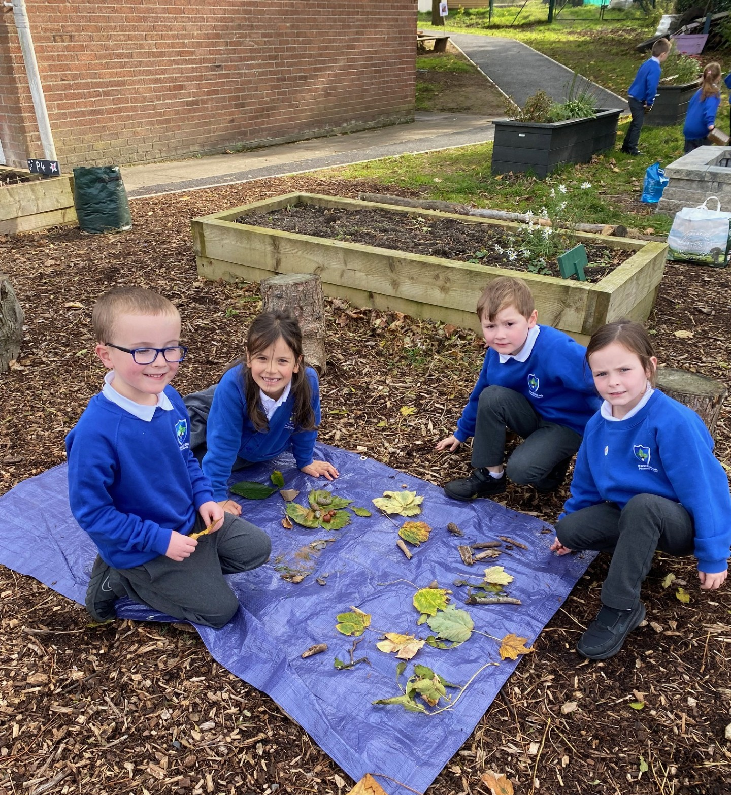
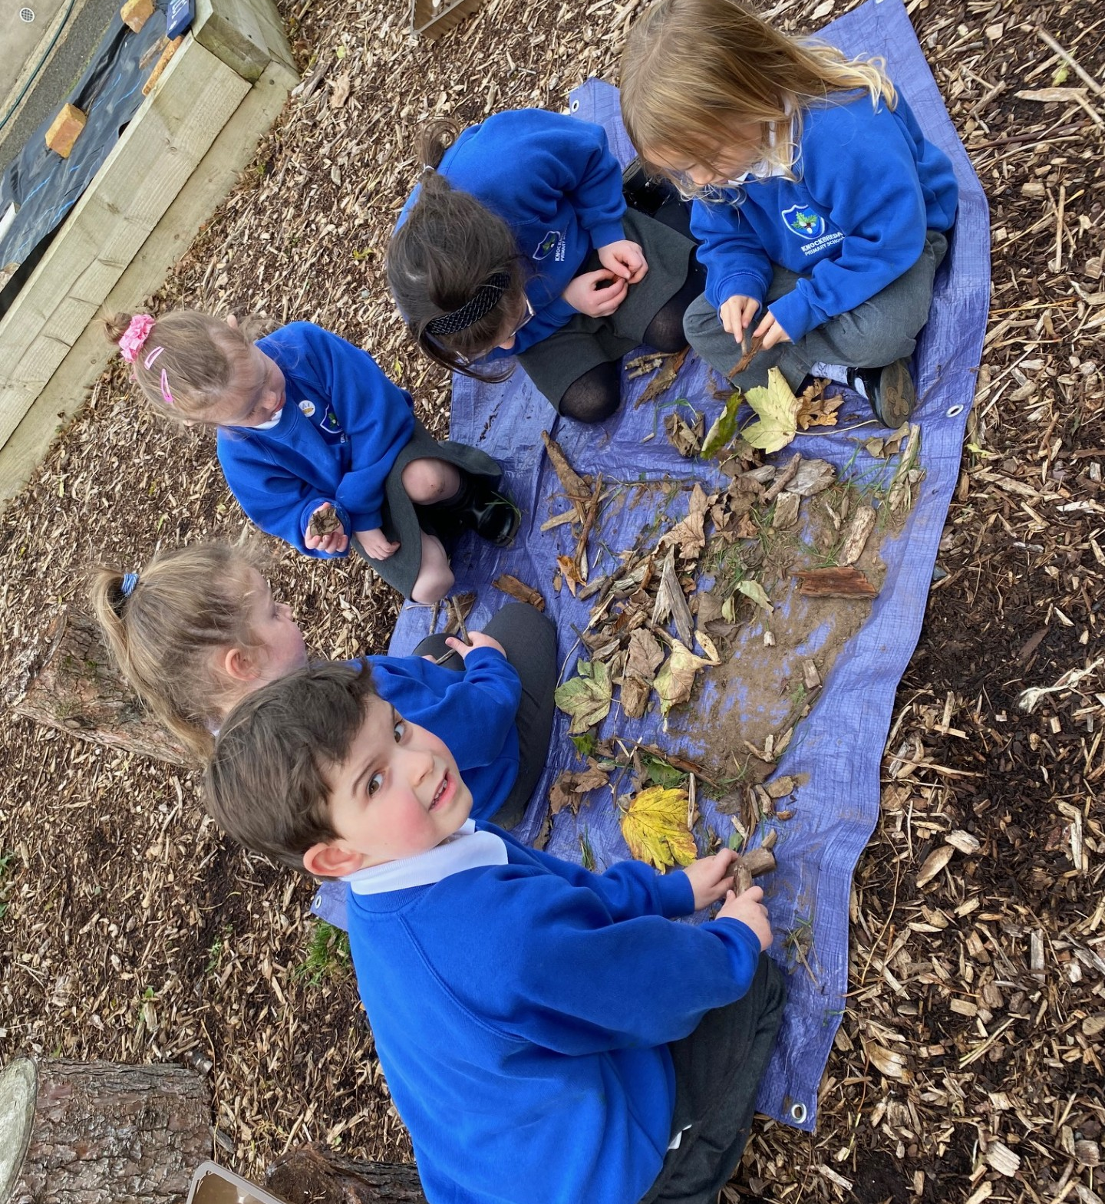
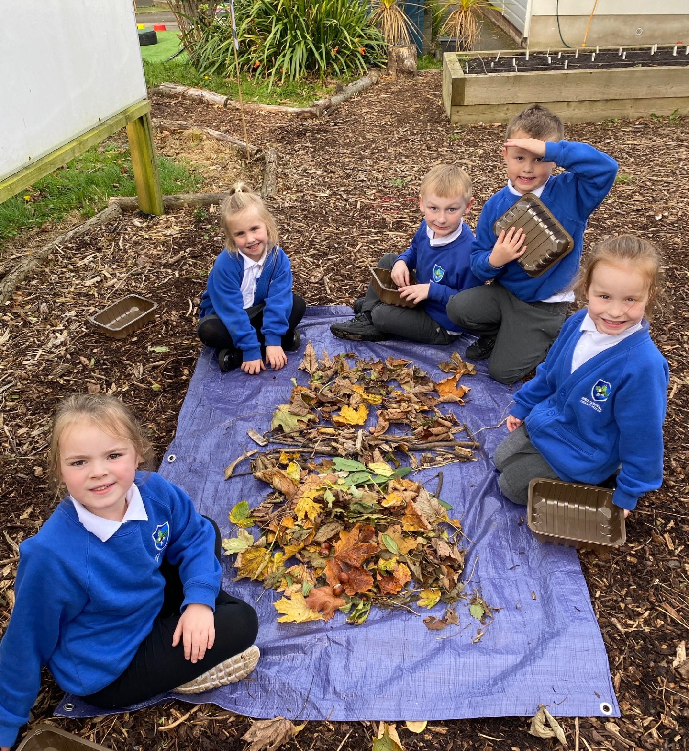
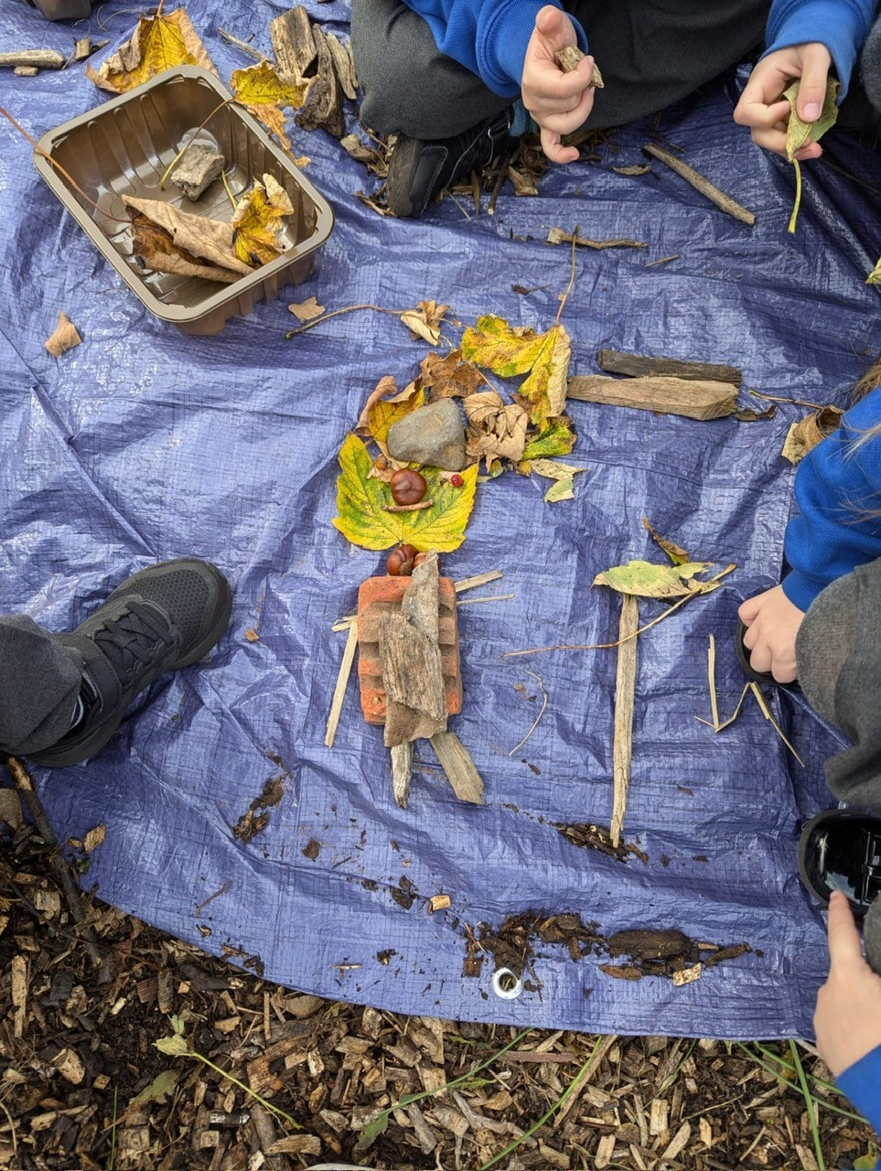
Using the natural resources to create pictures.

Slide 5
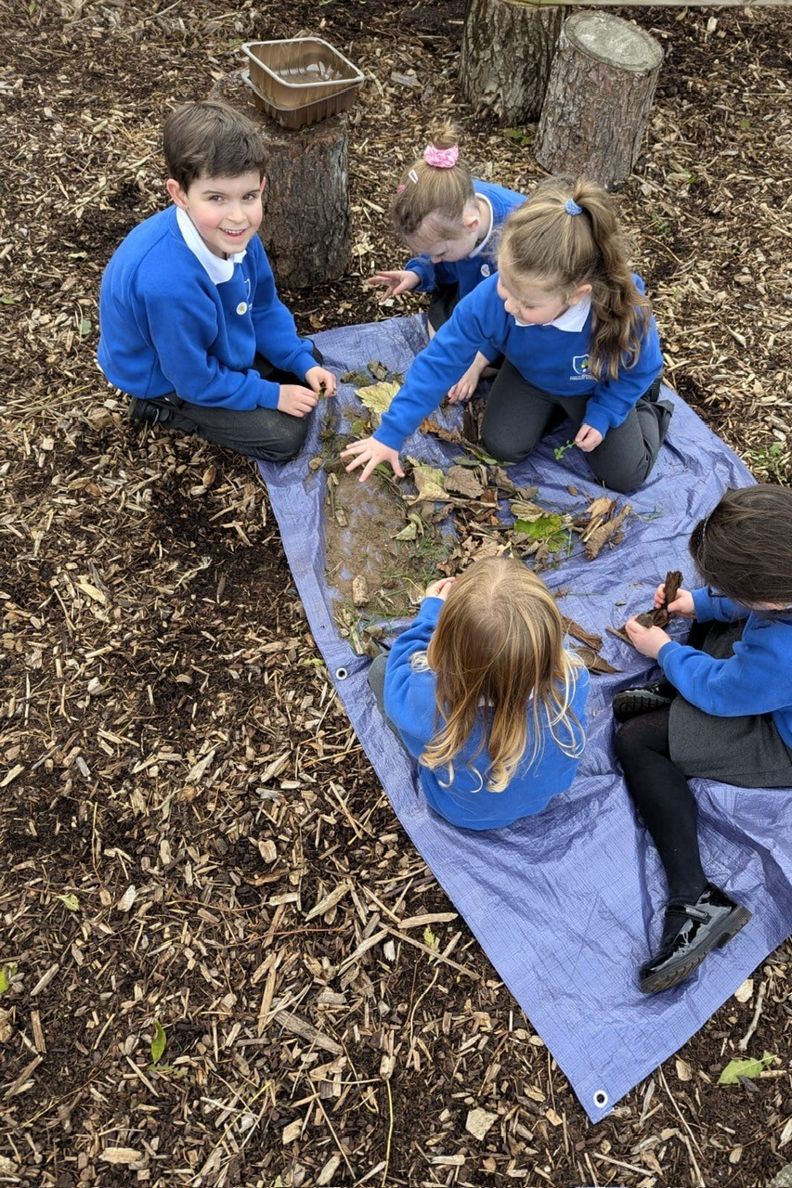
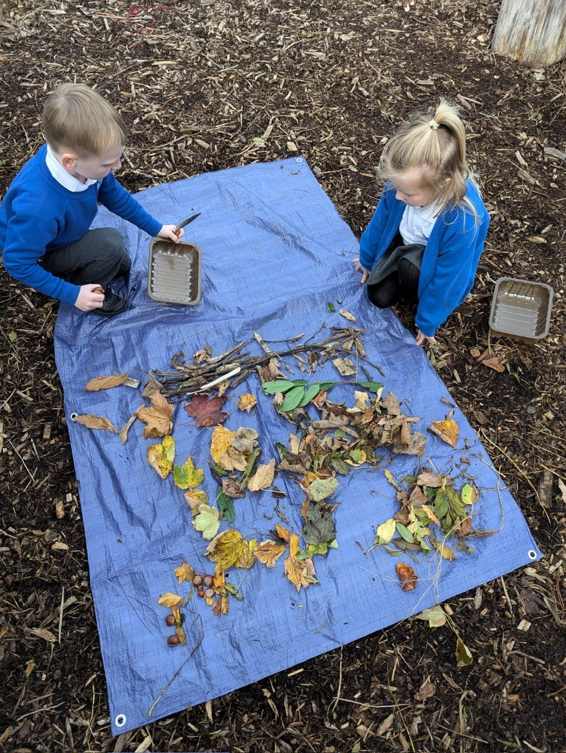
Everybody working hard.

Slide 6
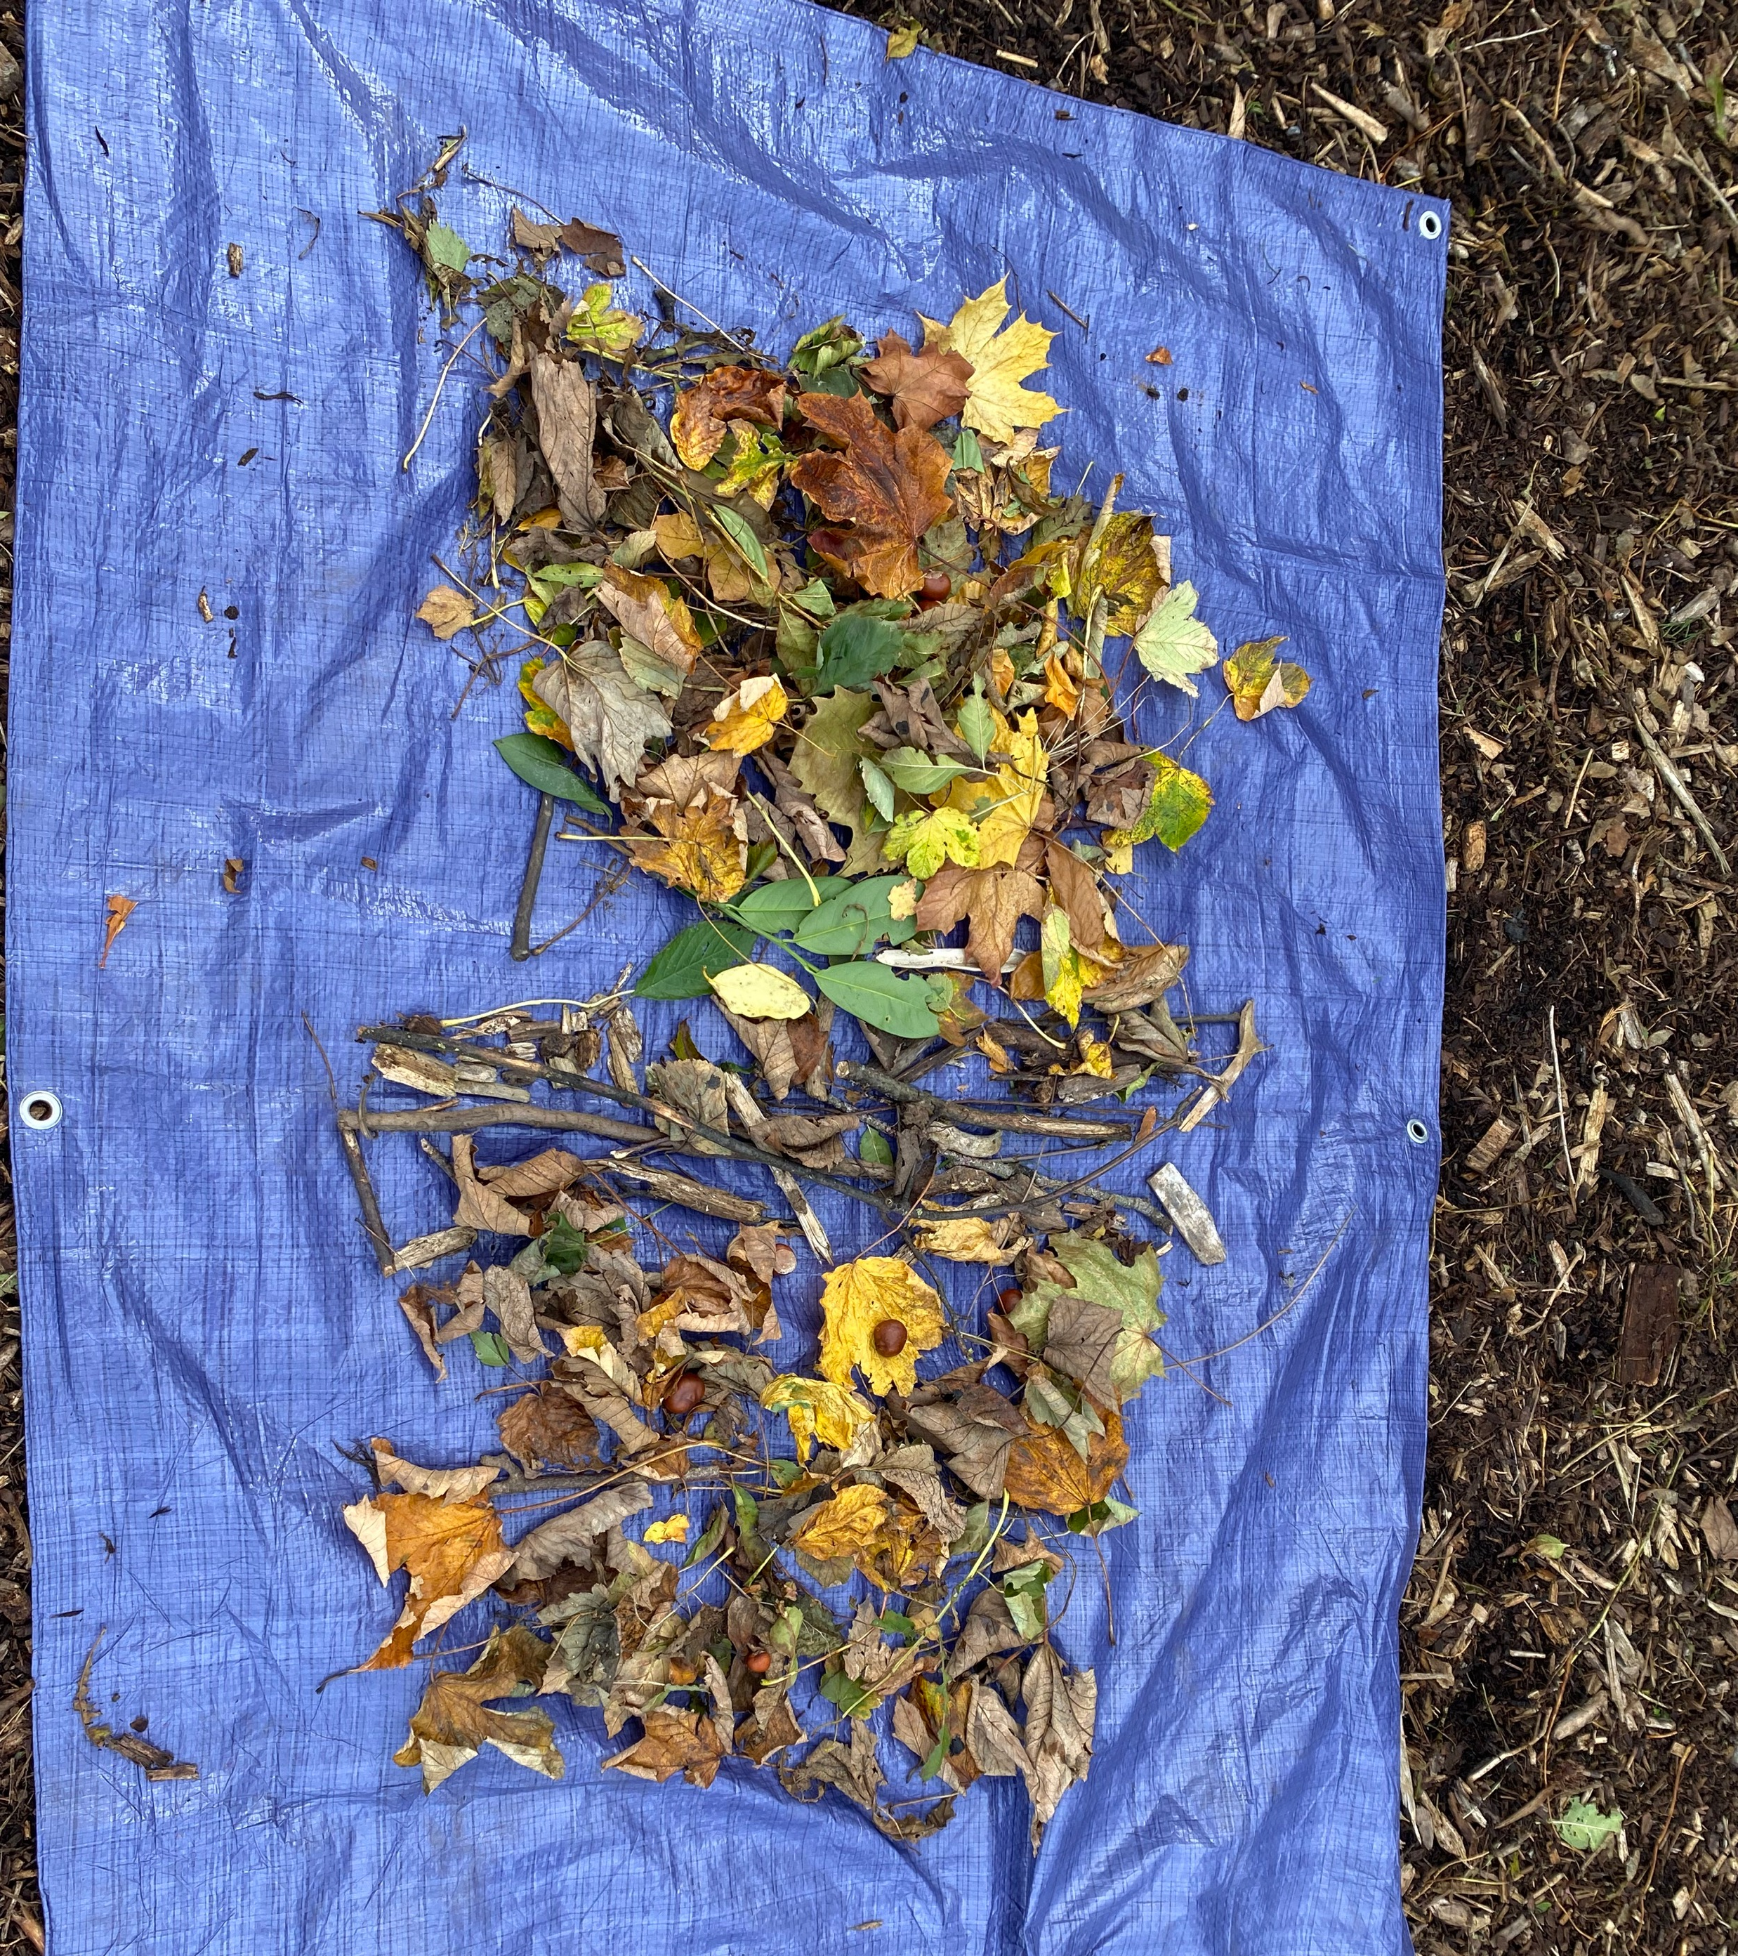
lots of amazing artwork.

