Slide 1
Primary 2
Forest School Diary 2024/2025
Mrs Gamble

Slide 2
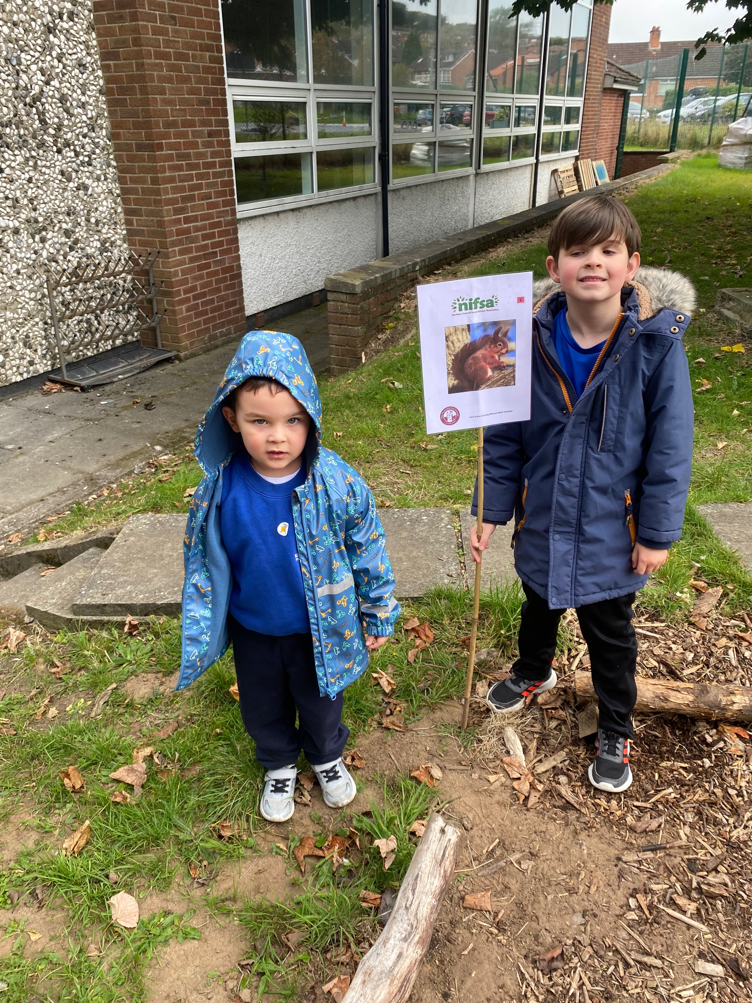
Lesson 1 – Wednesday 25th September 2024
We met in our circle, to talk about our activity and our forest school rules.
1 whistle – freeze
2 whistles – return
Agreed to have fun, learn and leave no trace
Volunteers set our boundaries with some adult help.

Slide 3
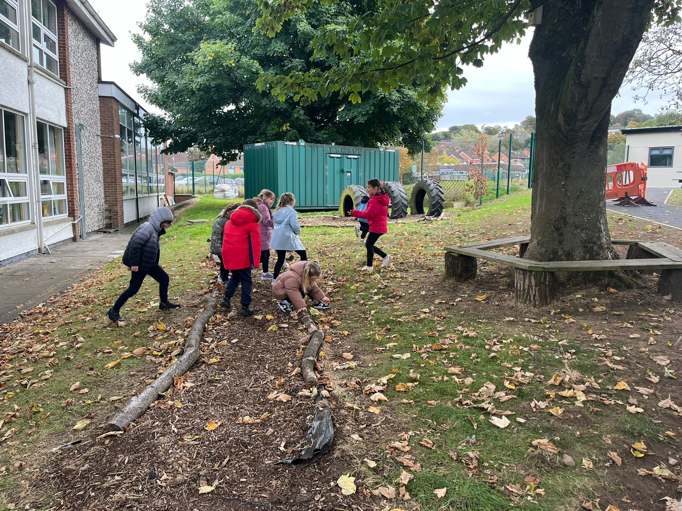
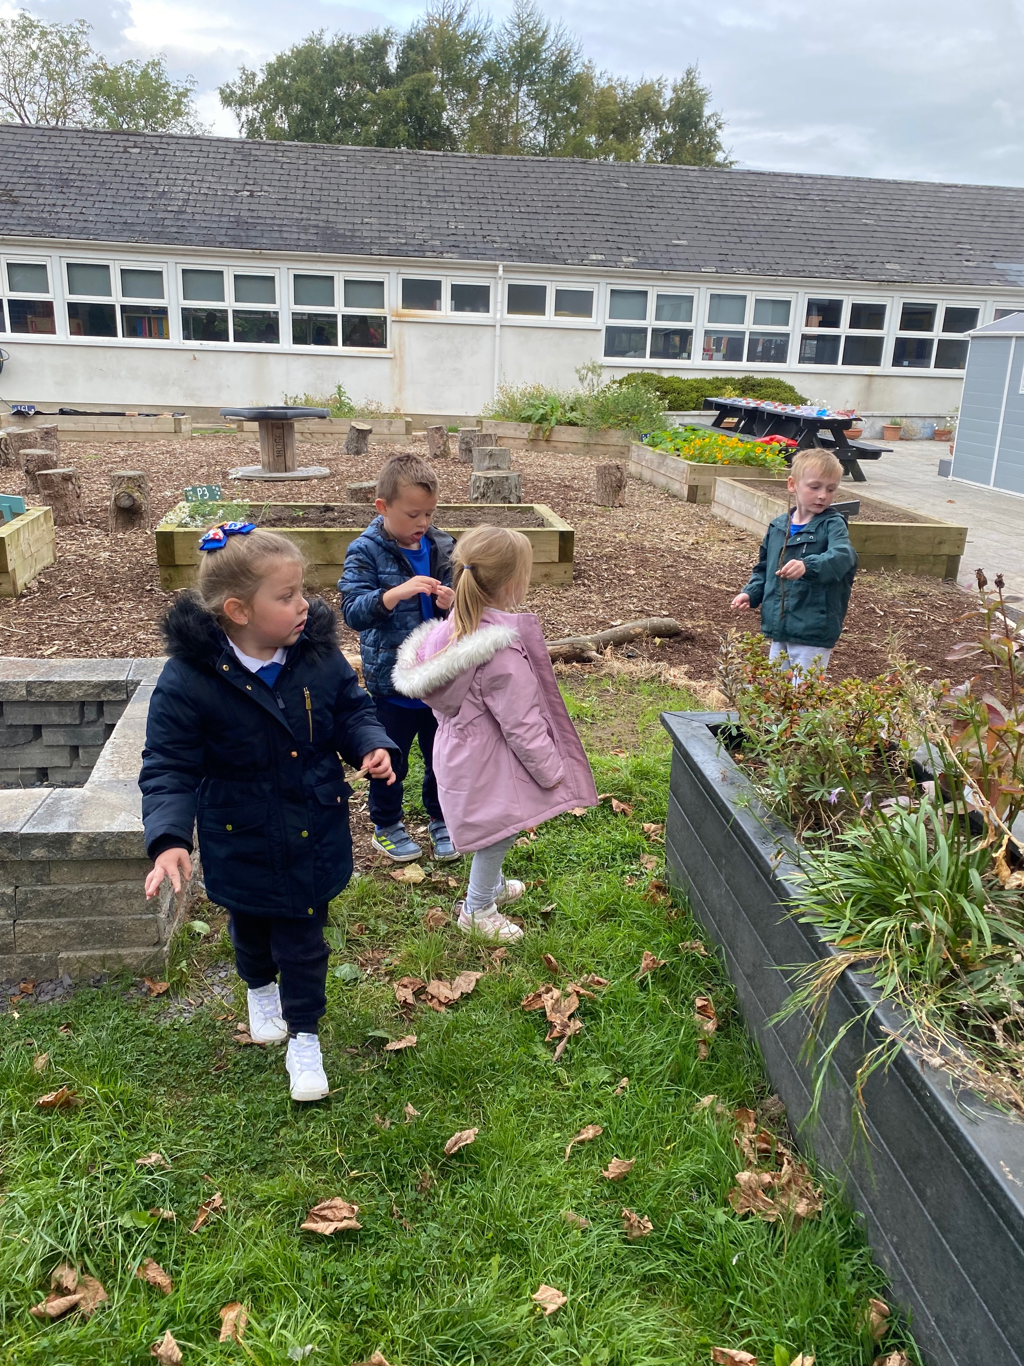
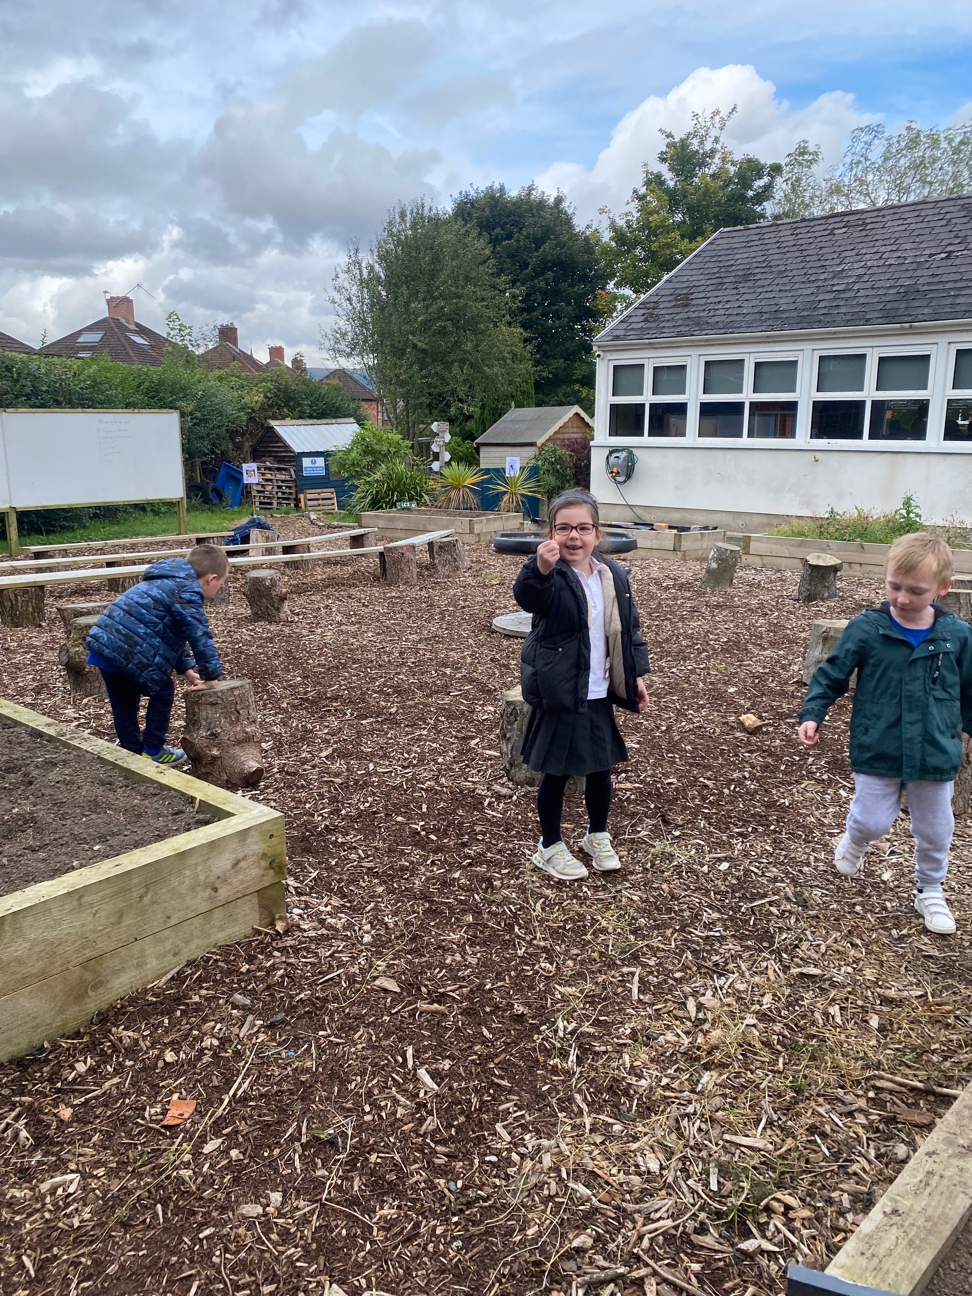
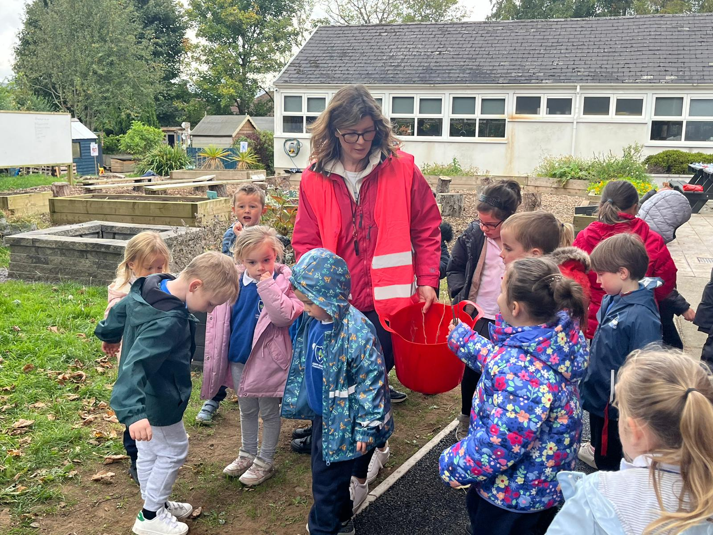
Gathering twigs to use for hedgehog spikes.

Slide 4
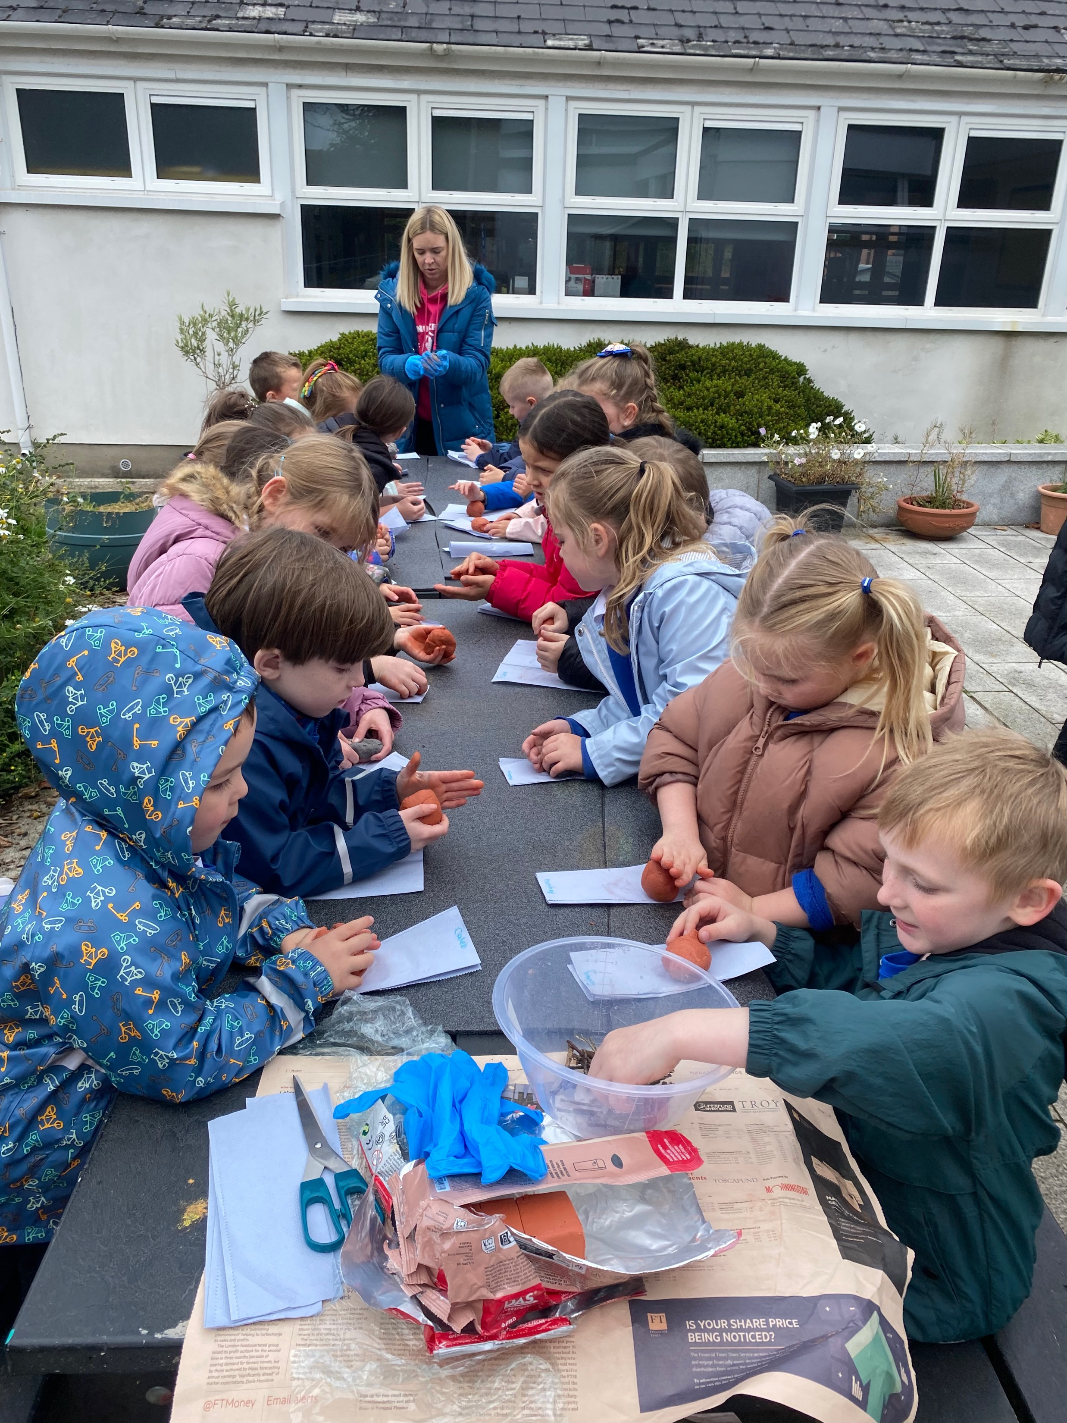
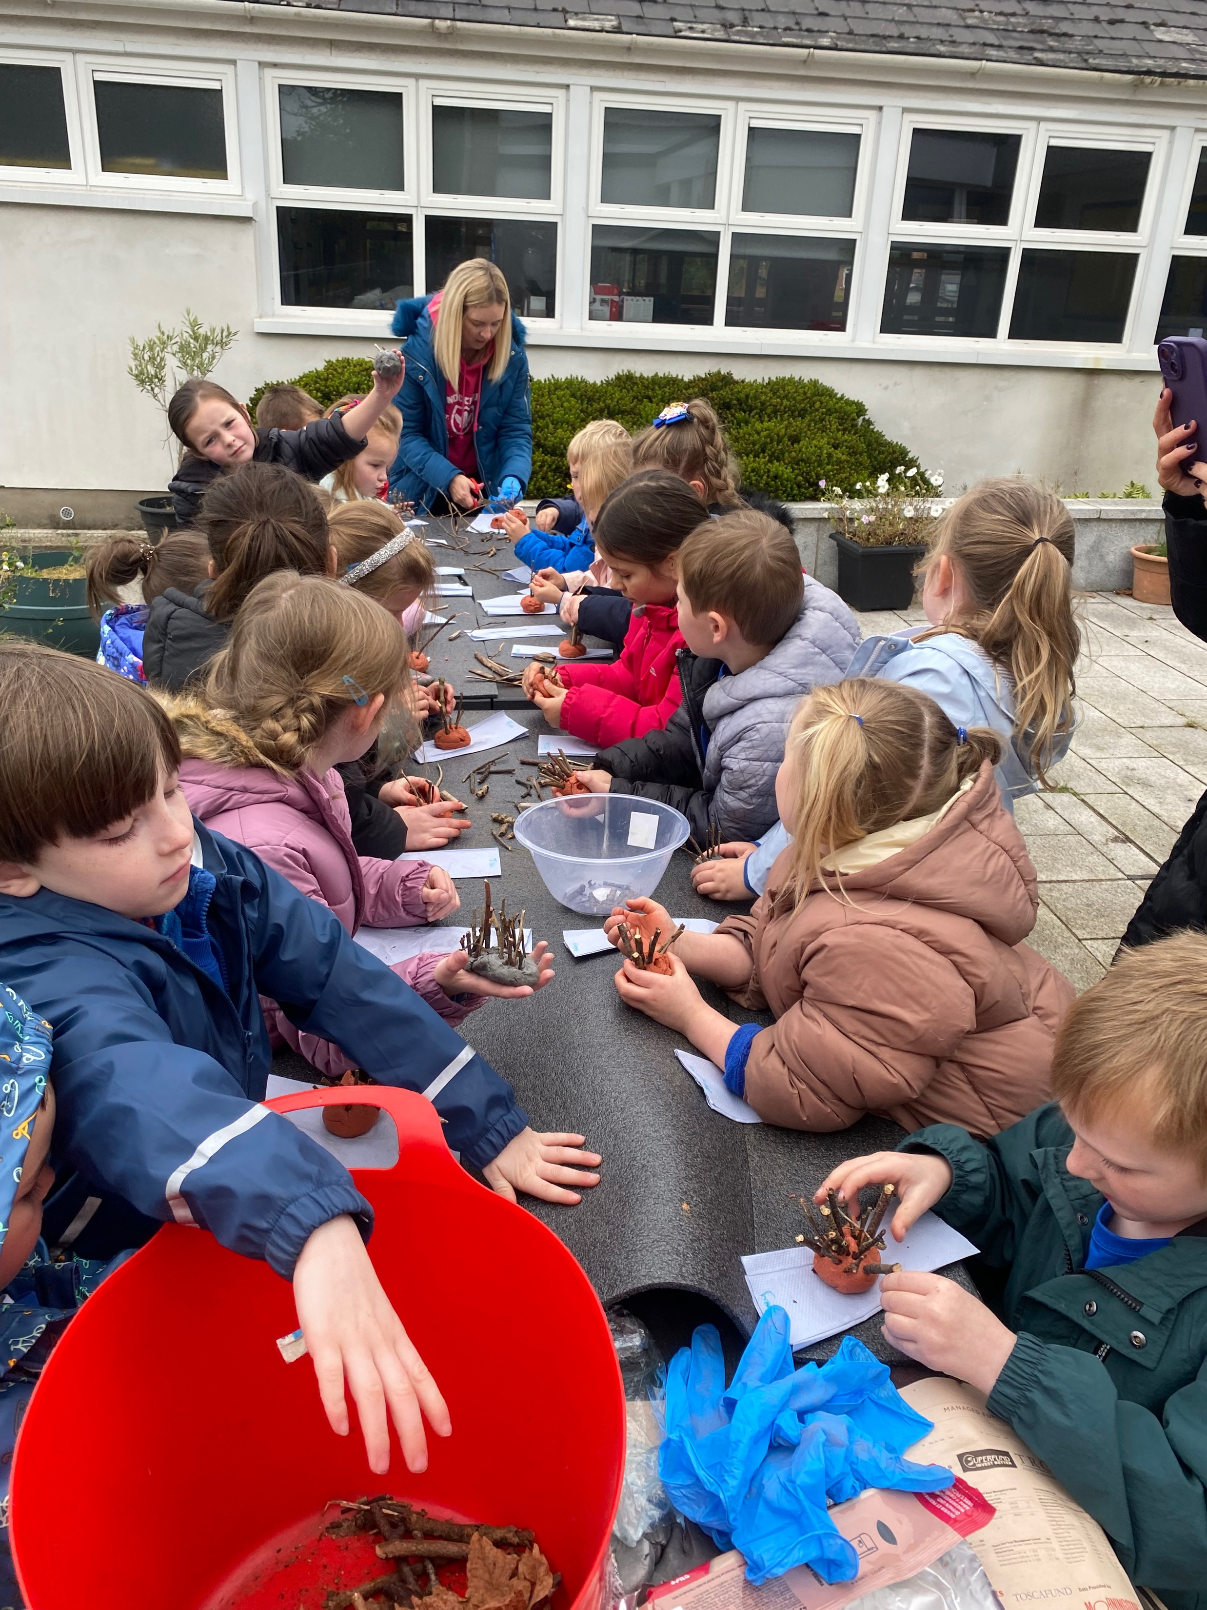
Moulding the clay to make shape of hedgehog body.

Slide 5
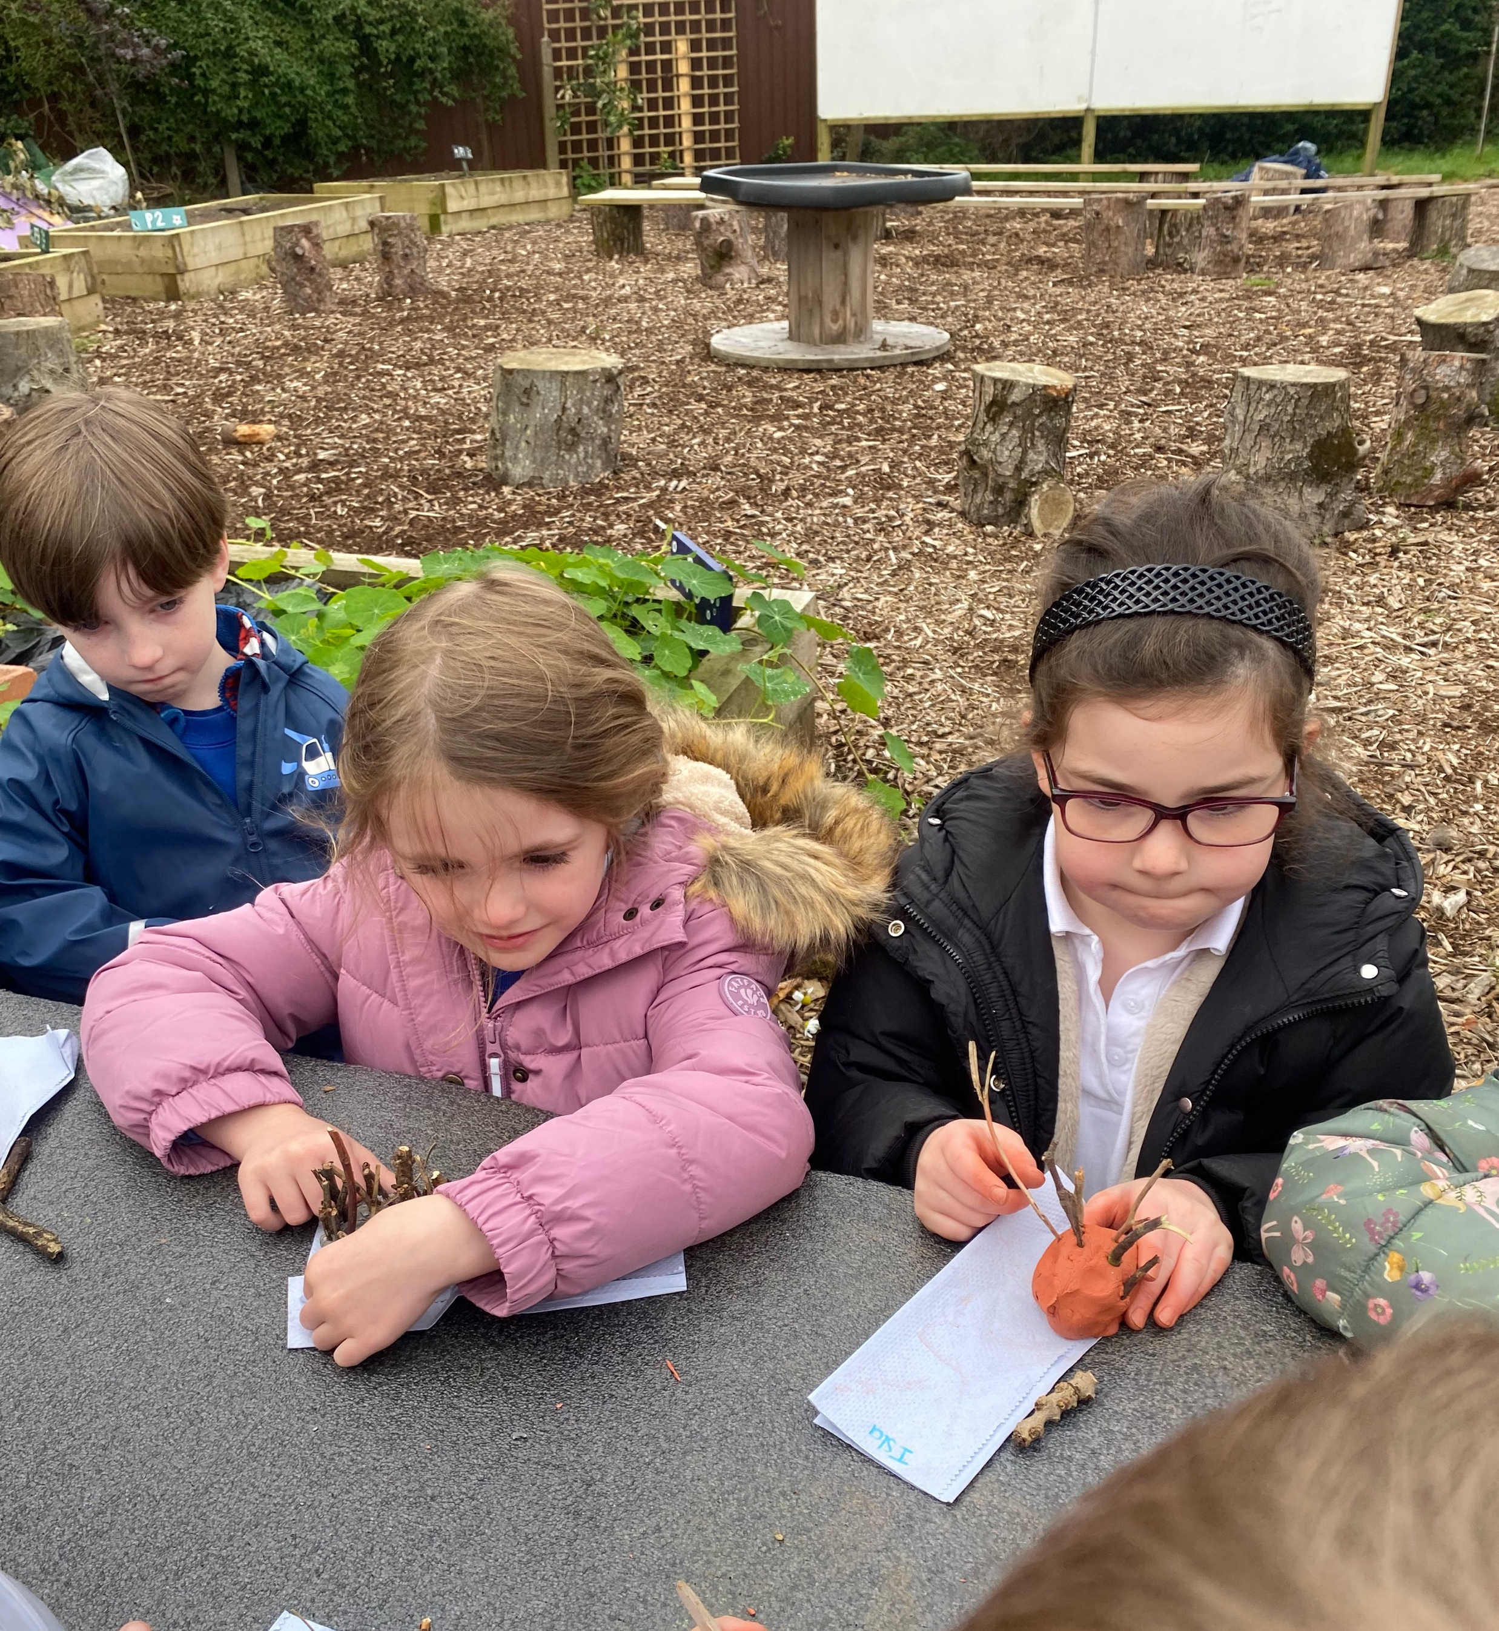
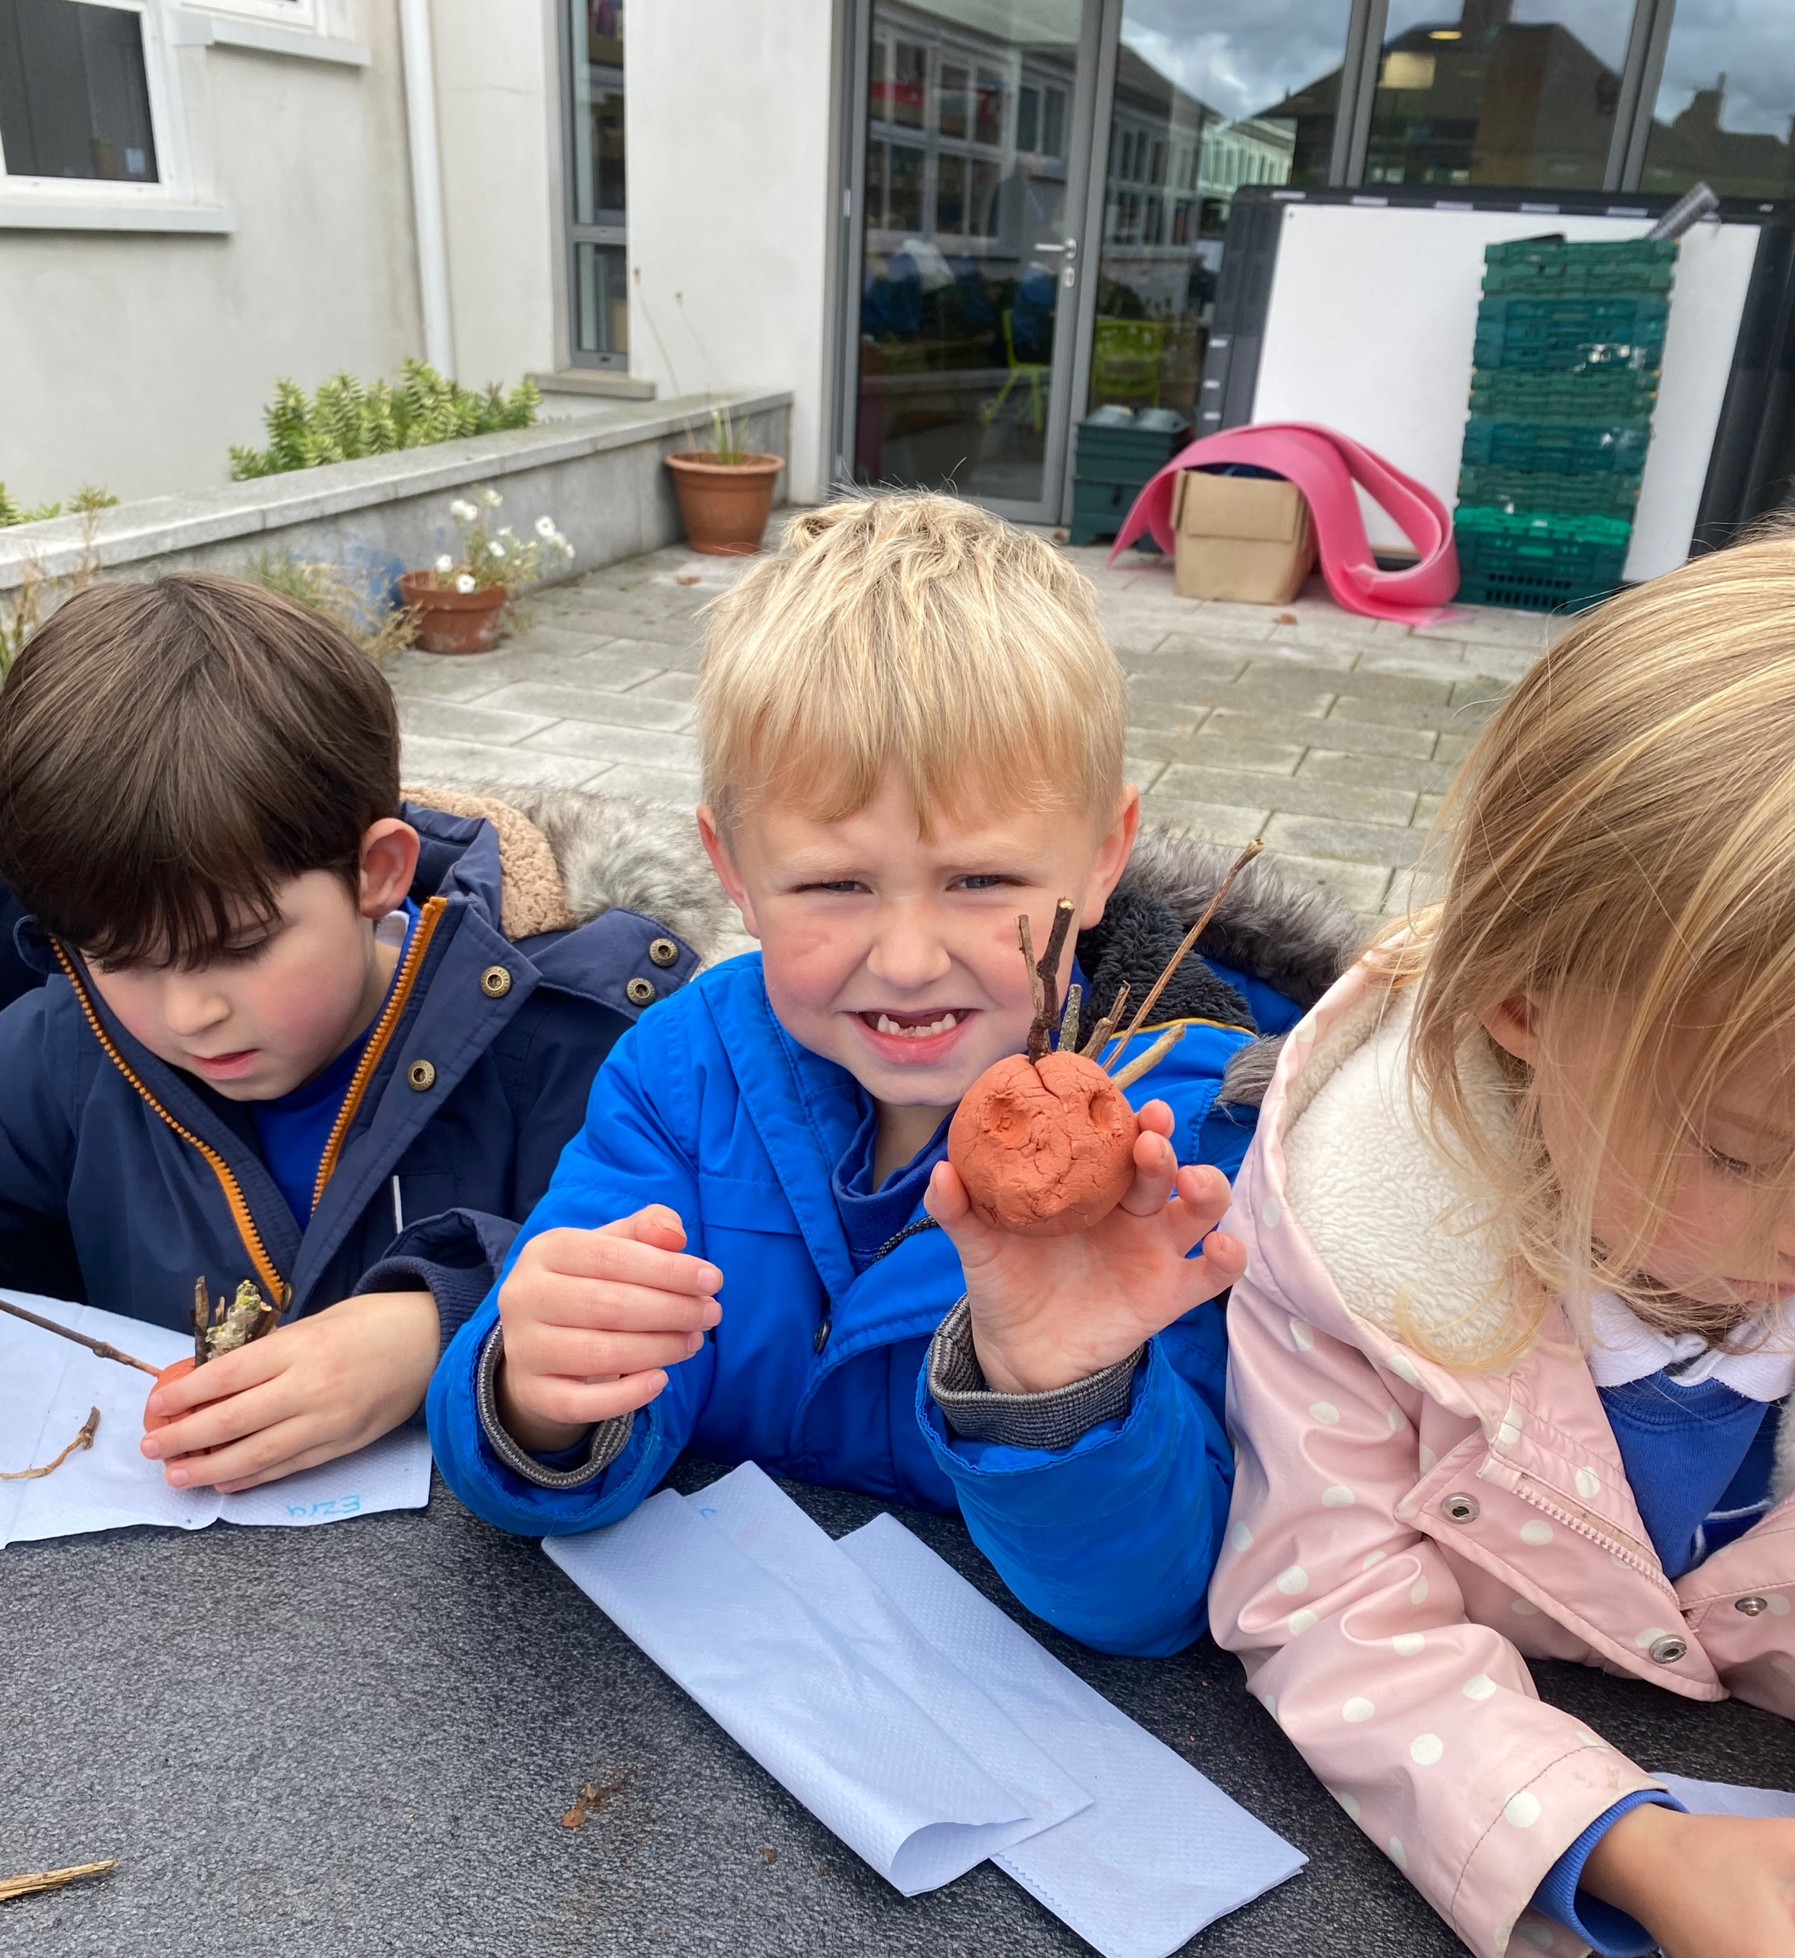
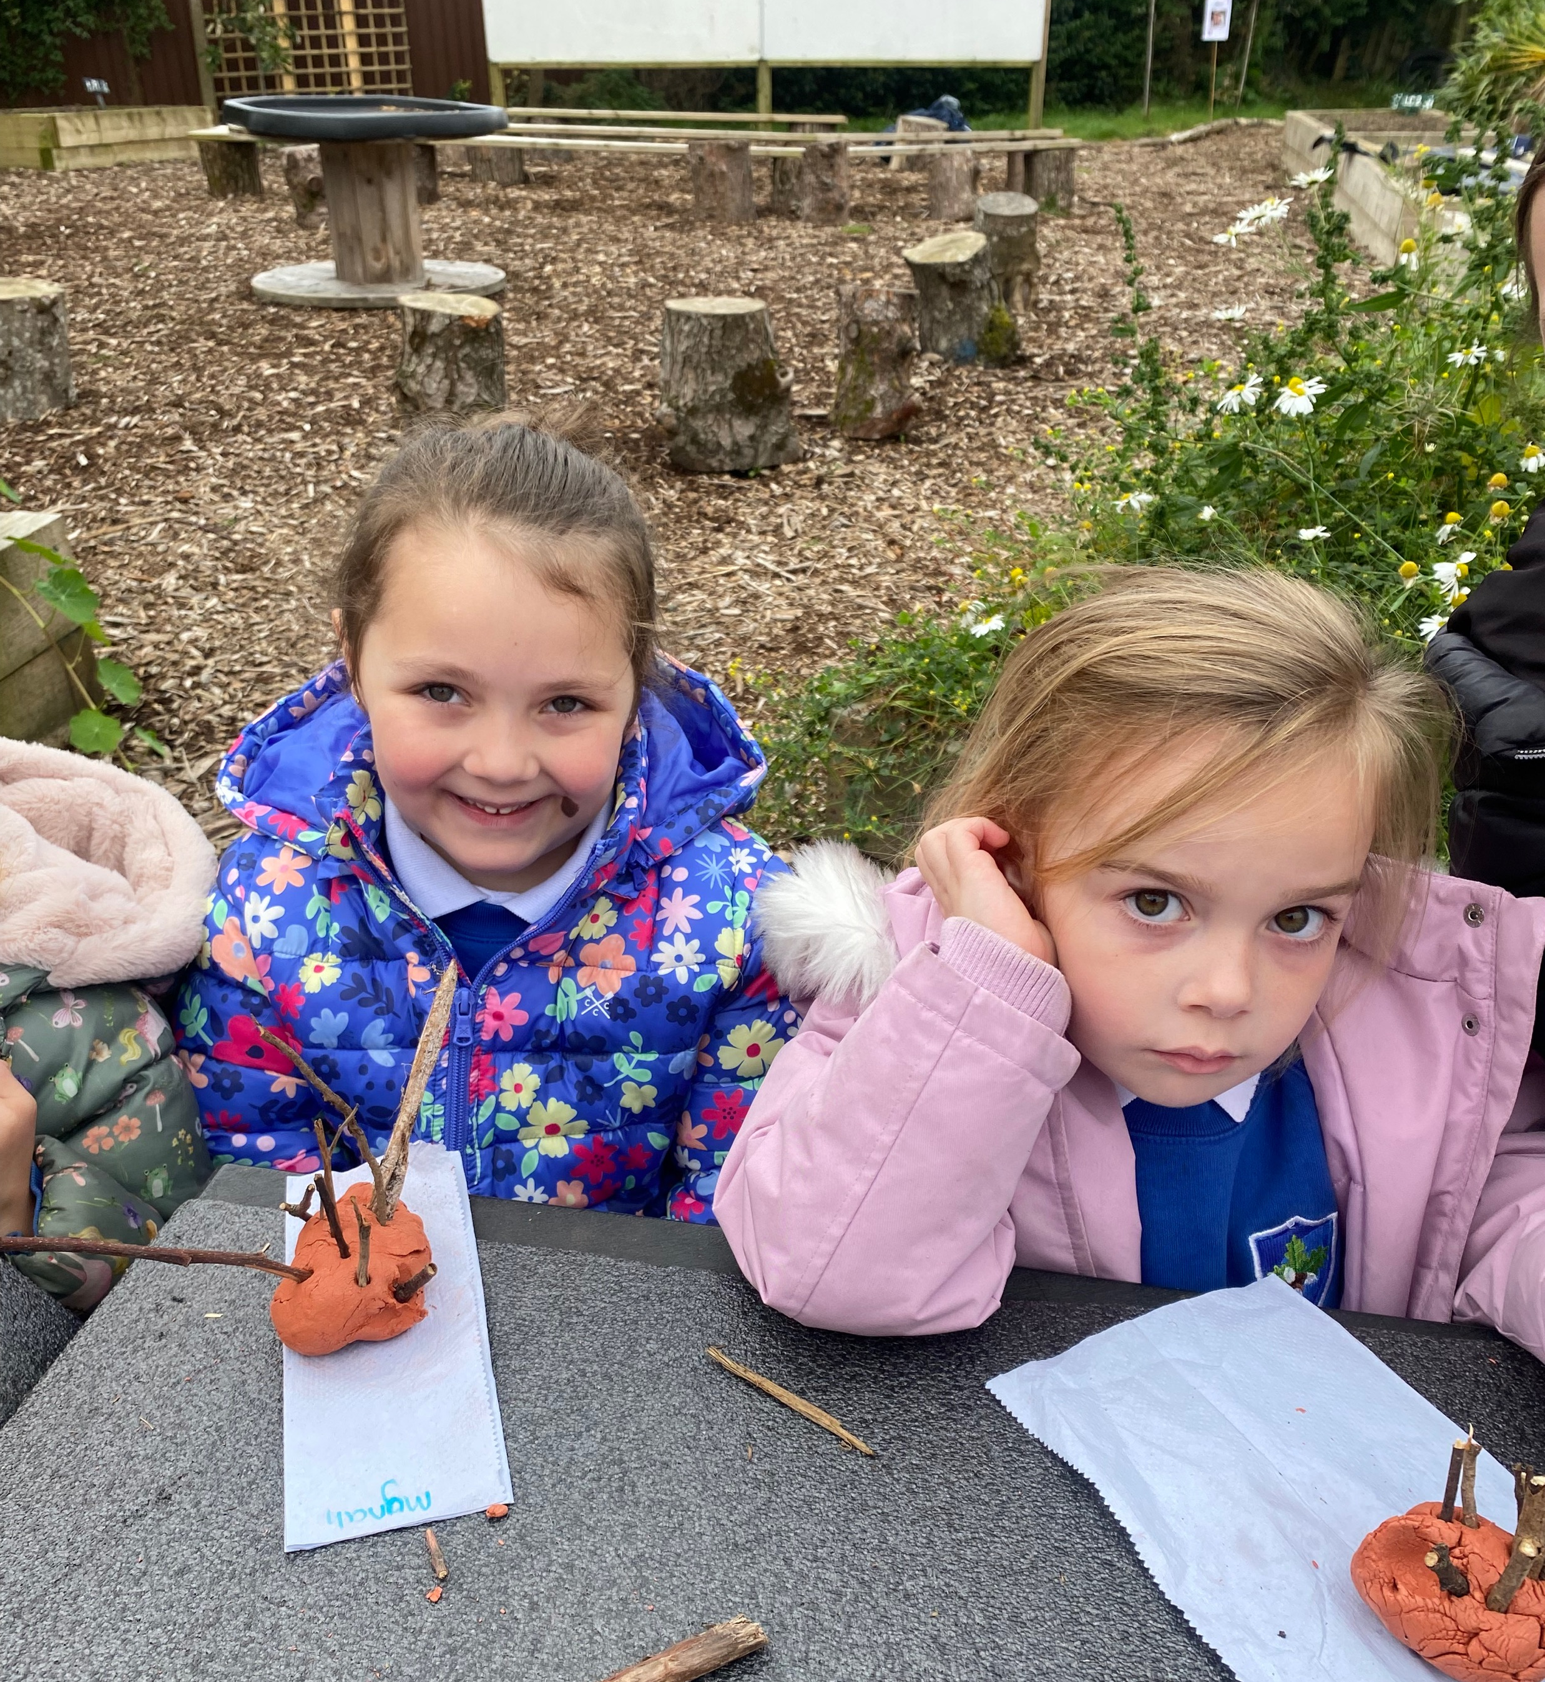
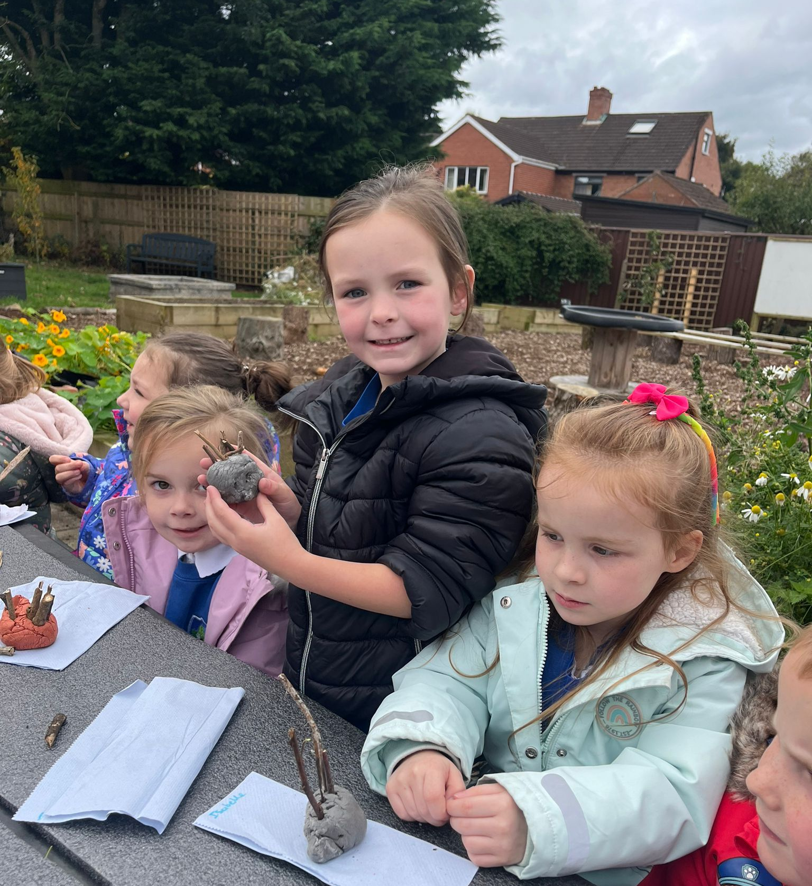
Adding twigs to make spikes for hedgehog.

Slide 6
Everybody working hard.

Slide 7
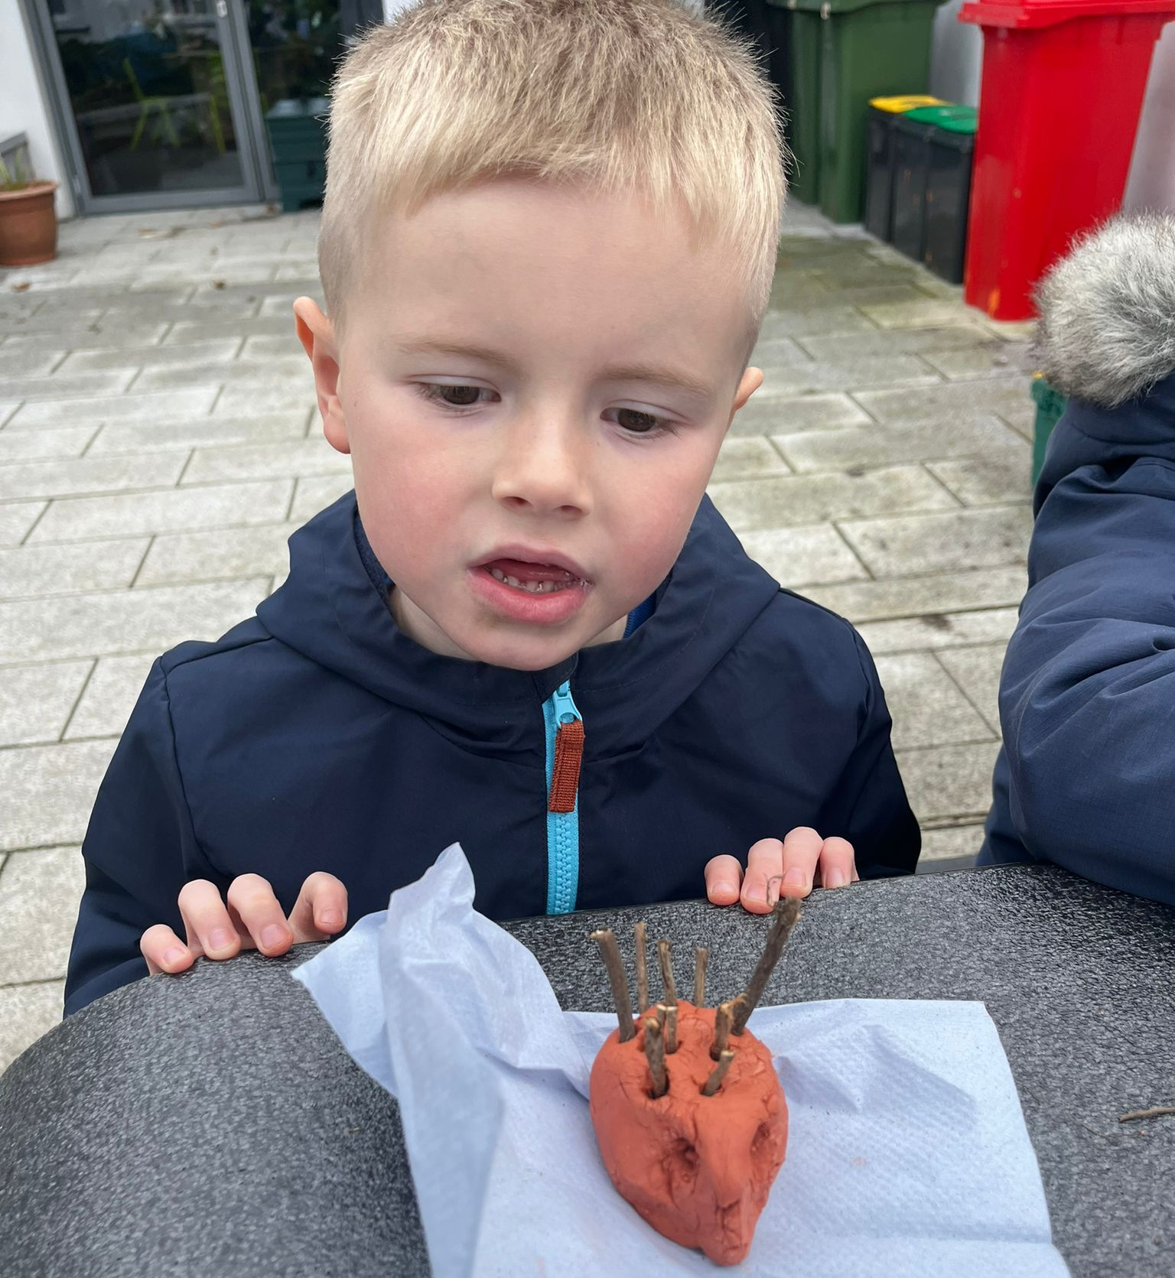
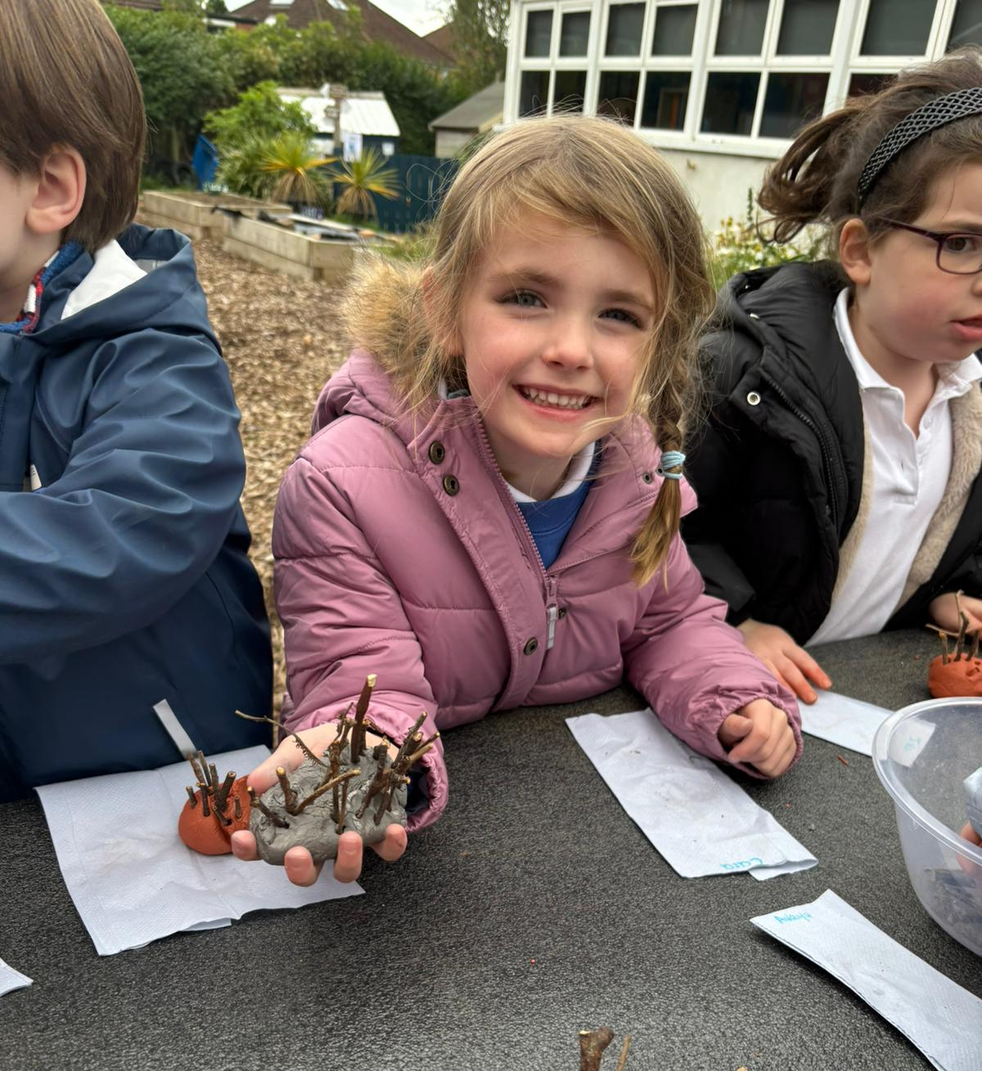
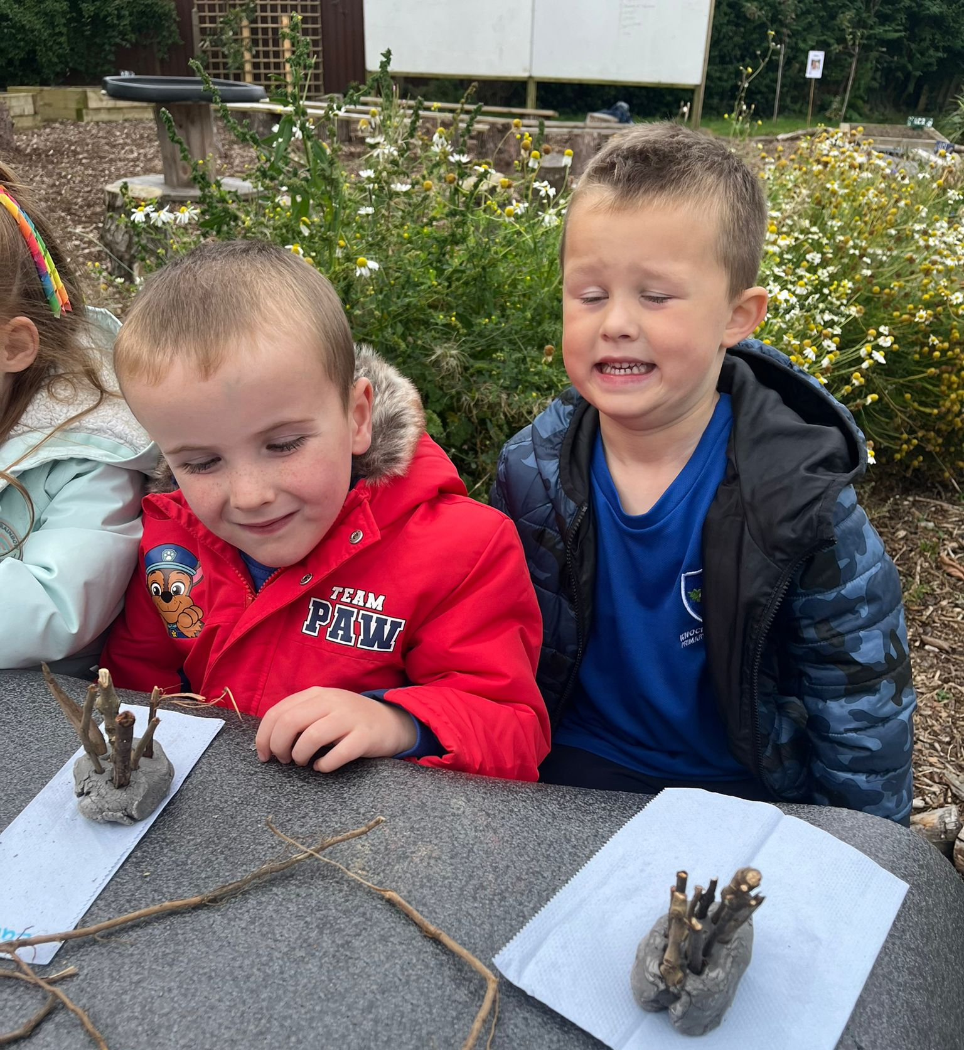
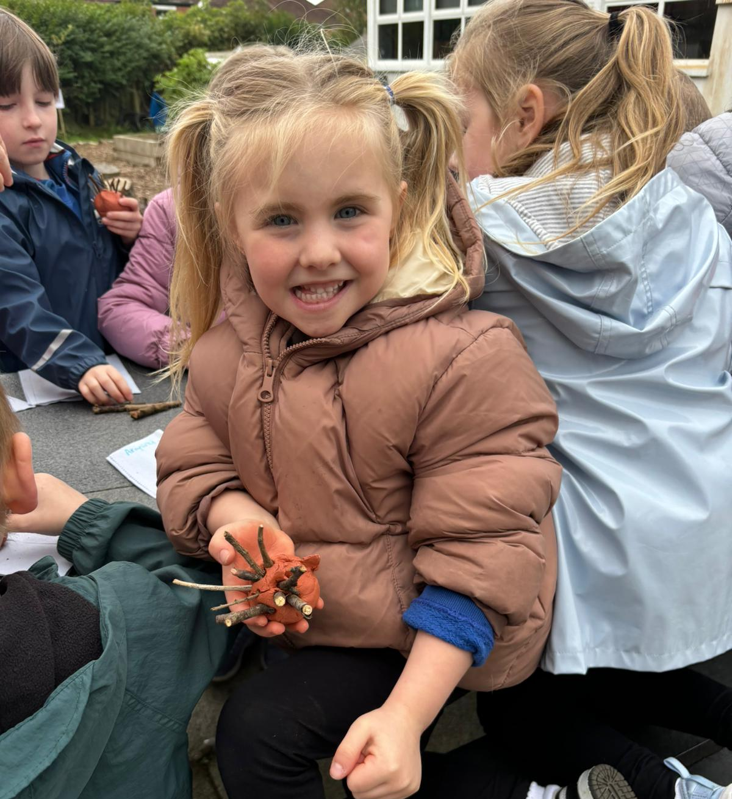
Some examples of our creations.

Slide 8
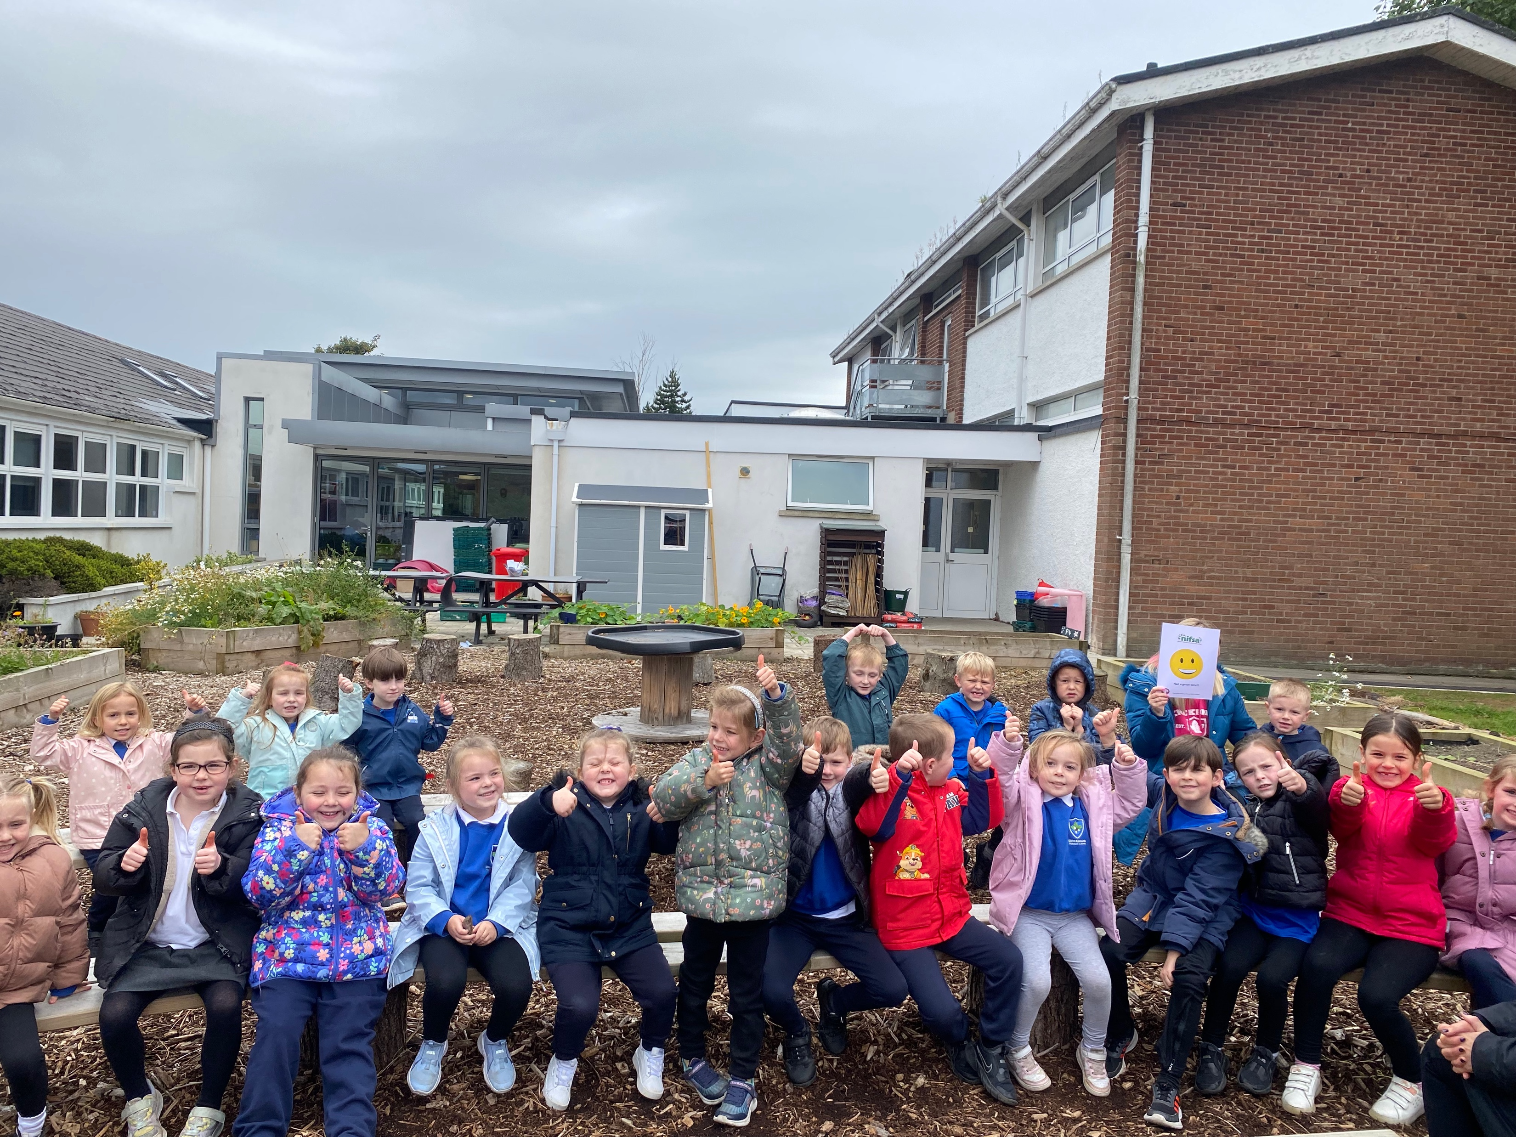
Lots of happy faces at the end….
we think it went very well ☺

