Slide 1


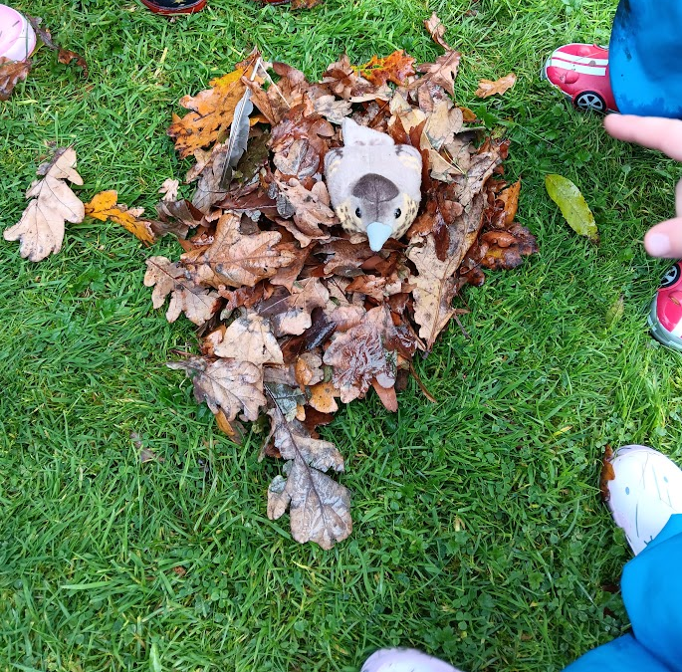

First Steps Laganvalley OUR FOREST SCHOOL DIARY 4TH November 2025

Slide 2
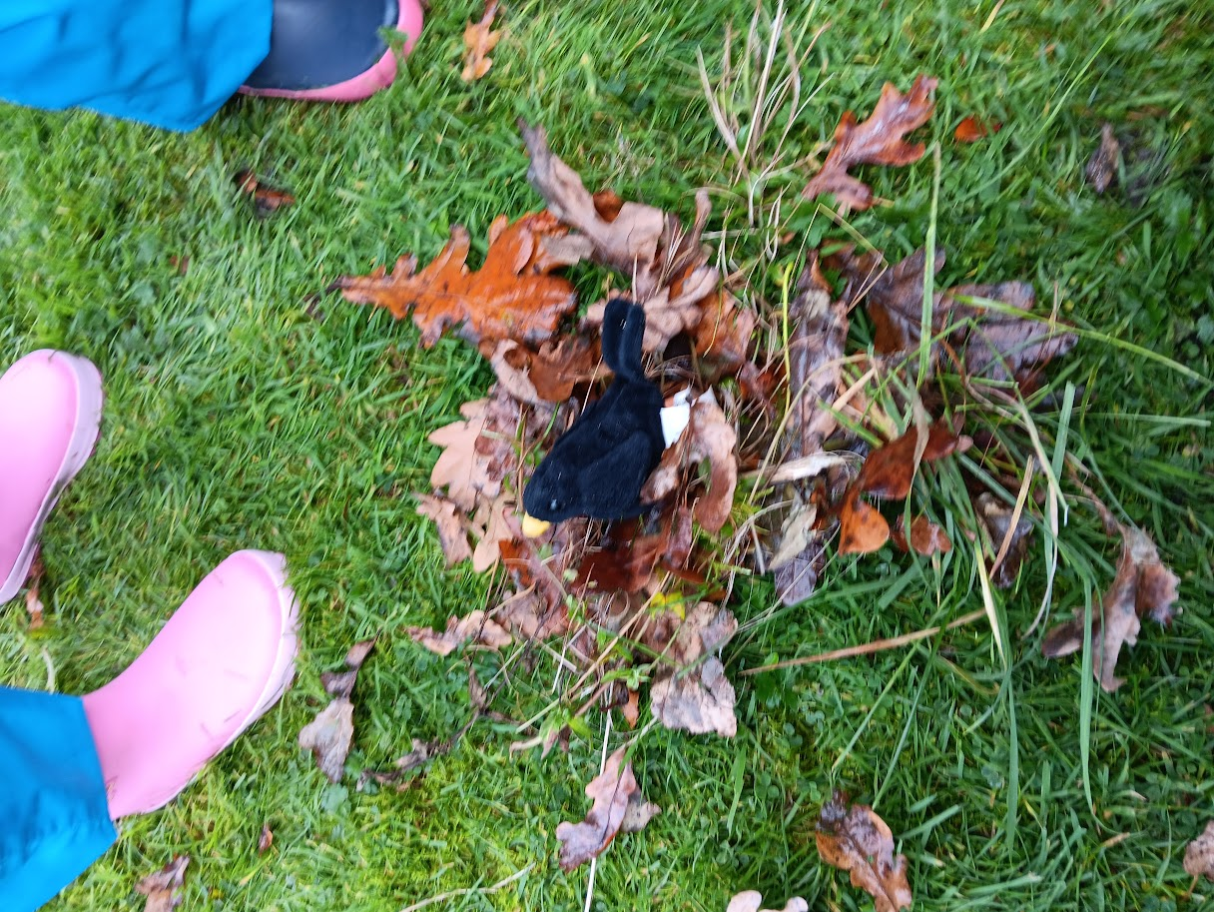
RULES
We put out the boundaries and go over our Forest School rules:
1 whistle: stop
2 whistles: back to base
3rd rule: have fun and learn

Slide 3
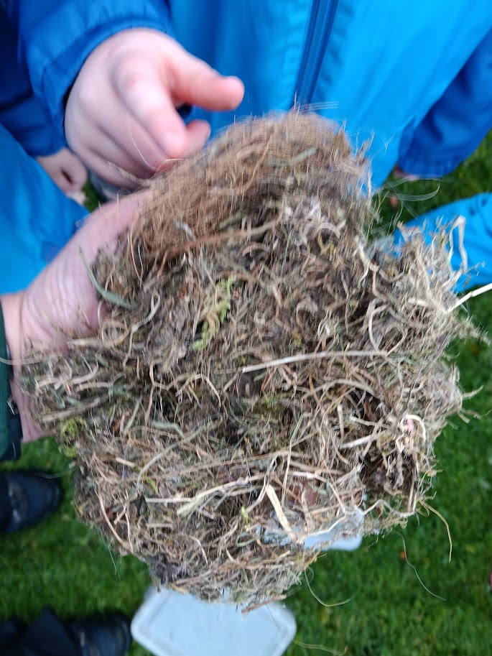
NESTS
We looked at a real birds nest and then got a bird to make a nest for.

Slide 4
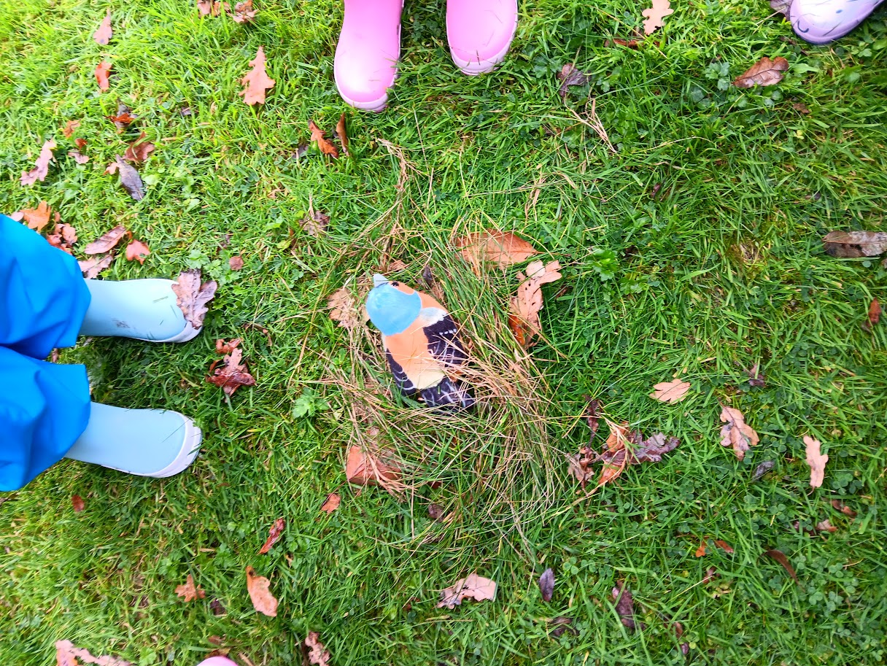
NESTS
We worked in small groups to make nests using natural materials.

Slide 5
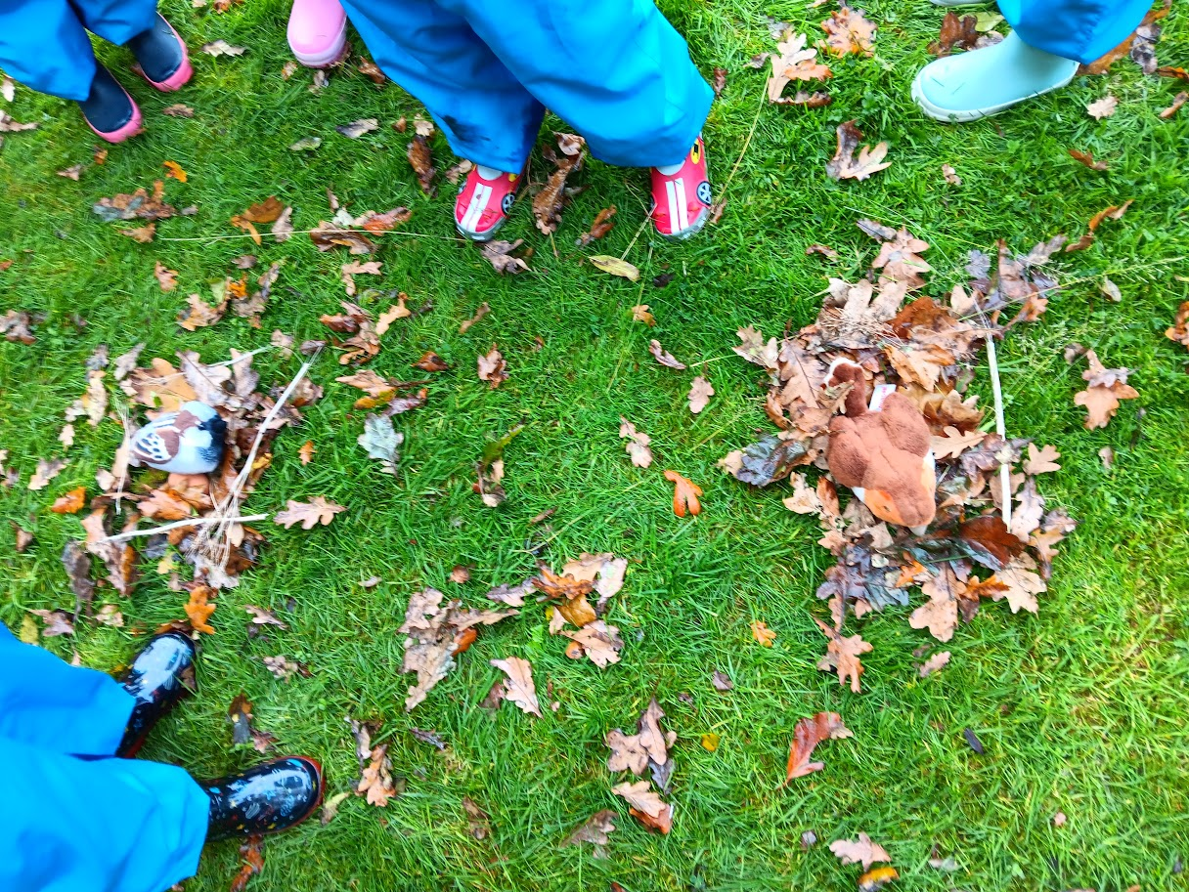
NESTS
Our nests were different shapes.

Slide 6
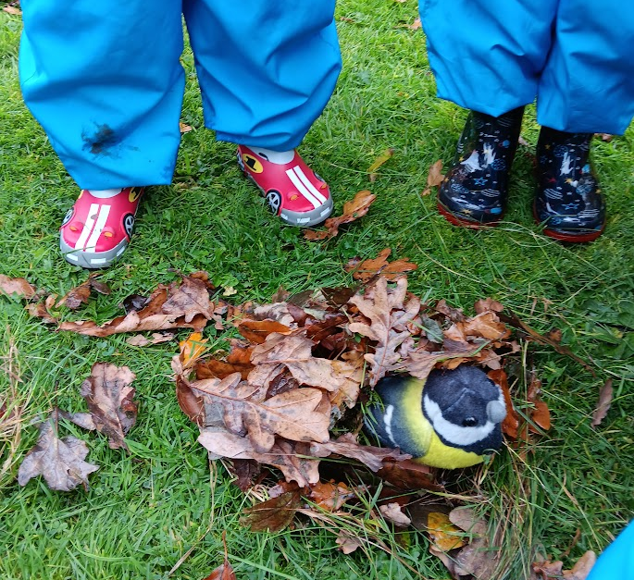
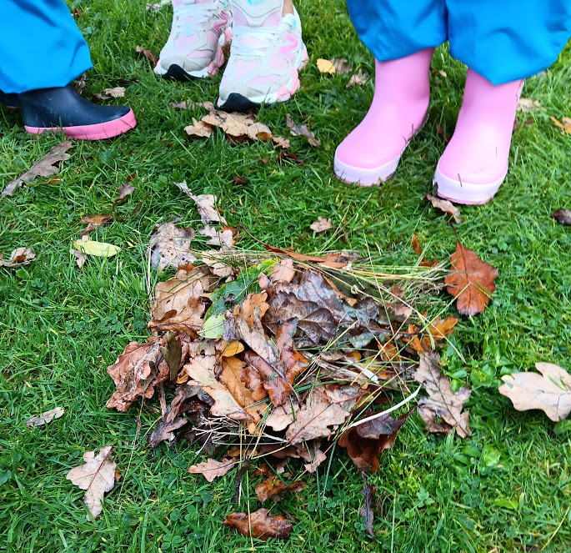
NESTS
There were so many leave that made the nests comfy and to make the birds blankets.

Slide 7
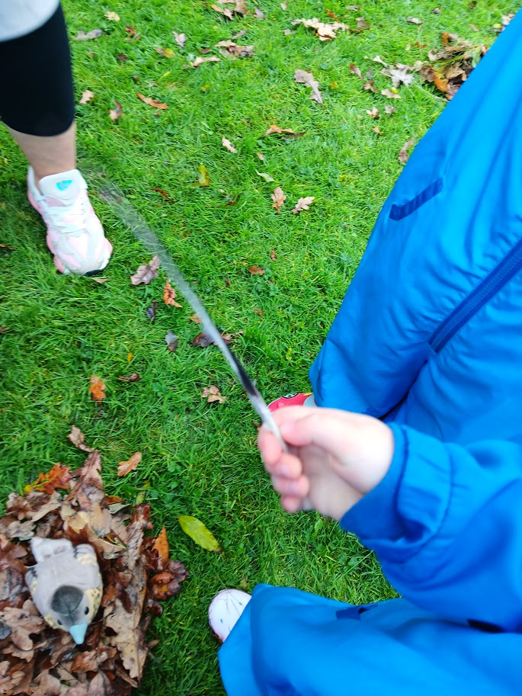
NESTS
We found a real feather from a bird.

Slide 8
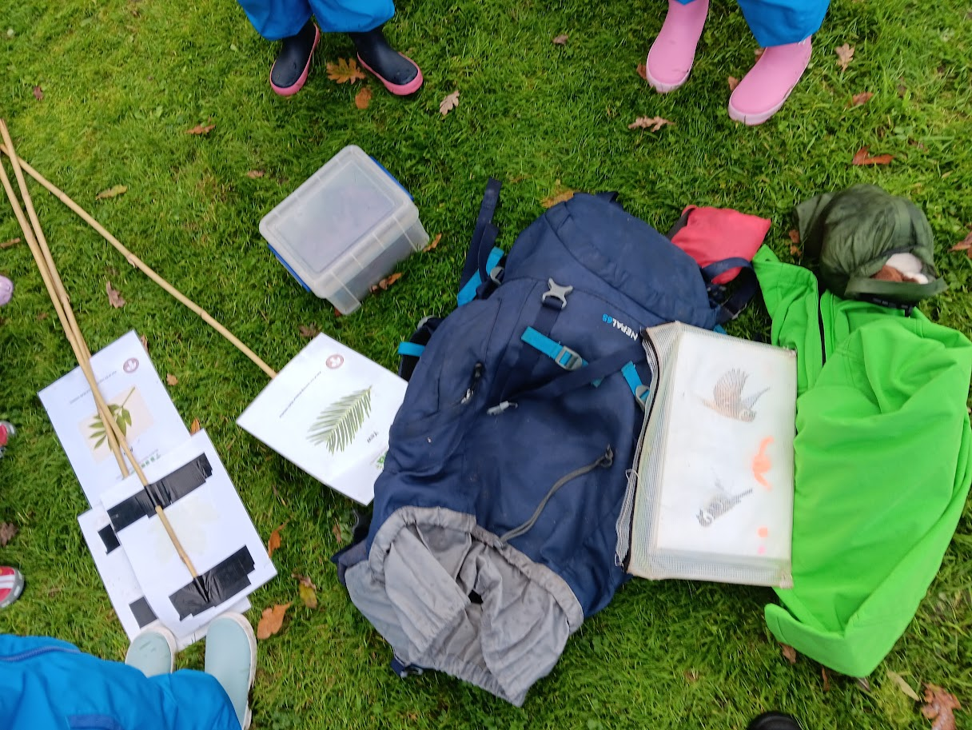
LEAVE NO TRACE
We put the birds away to leave the place safe for the wildlife and collected the boundaries.

Slide 9
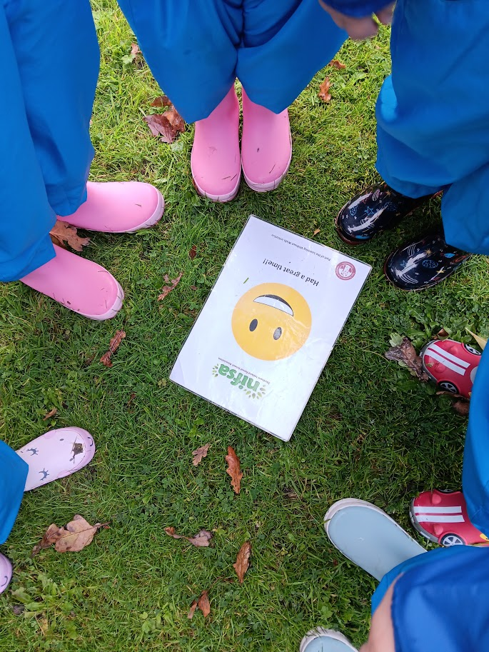
DID YOU ENJOY IT?
All smiley faces for being outside and making nests.

